Slide 1
Industrial Application of
Clone Change Management System
Yuki Yamanaka¹, Eunjong Choi¹,
Norihiro Yoshida², Katsuro Inoue¹, Tateki Sano³
1 Osaka University, Japan
2 Nara Institute of Science and Technology, Japan
3 NEC Corporation, Japan

Slide 2
Maintaining Code Clones
Consistent modification
  Modifying clone set † consistently
Refactoring
  Merging clone set into a single program Unit
modify
modify
merge
call
† Clone set: a set of code clones identical or similar to each other

Slide 3
Industrial Experience of
Clone Change Management
Related work
  Juergens et al. reported inconsistent clones in the industrial developments^{[1]}.
Our motivation
  Industrial experience of clone change management for refactoring support has NOT been reported.
  A development team in NEC needs the daily reporting system to notify developers clone change information.
[1] E. Juergens, F. Deissenboeck, B. Hummel and S. Wagner,“Do Code Clones Matter?,” Proc. International Conference on Software Engineering, pp.485-495, 2009.

Slide 4
Overview of Our Study
Investigate the usefulness of clone change management for refactoring support in NEC
  Develop a clone change management system according to the opinions of developers
  Apply the system to actual development process

Slide 5

Overview of Clone Change Management System
According to opinions of developer
Checkout
source code
Version Control System
Categorize clone sets
Commit
source code
Clone Change Management System
Report change information
E-mail notification
Web-based UI
Developer

Slide 6
Categorization of Clone Set
Step1: Detect code clones
Step2: Trace code clones
Step3: Categorize code clones
Step4: Categorize clone sets

Slide 7
Step1: Detect Code Clones
Apply CCFinder^{[2]} into two versions
Old Version
New Version
[2] T. Kamiya, S. Kusumoto, and K. Inoue, “CCFinder: A multilinguistic token-based code clone detection system for large scale source code”, IEEE Transactions on Software Engineering, 28(7):654-670, 2002.

Slide 8
Step2: Trace Code Clones
Trace code clones based on correspondence between start and end points of code fragments
Correspond
Correspond
Old Version
New Version

Slide 9
Step3: Categorize Code Clones
Categorize code clones based on evolution patterns of them
New Version
Old Version
New Version
Old Version
Old Version

Slide 10
Step3: Categorize Code Clones
Categorize code clones based on evolution patterns of them
Stable
Not modified
Stable
New Version
Old Version
New Version
Old Version
Old Version

Slide 11
Step3: Categorize Code Clones
Categorize code clones based on evolution patterns of them
Stable
Not modified
Stable
Added
Added
New Version
Old Version
New Version
Old Version
Old Version

Slide 12
Step3: Categorize Code Clones
Categorize code clones based on evolution patterns of them
Stable
Not modified
Stable
Added
Added
Modified
Modified
Modified
New Version
Old Version
New Version
Old Version
Old Version

Slide 13
Step3: Categorize Code Clones
Categorize code clones based on evolution patterns of them
Stable
Not modified
Stable
Added
Added
Modified
Modified
Modified
Deleted
Deleted
Old Version
New Version

Slide 14
Step4: Categorize Clone Set (1/2)
Stable Clone Set
  Share only stable clones between two versions
New Clone Set
  Share only added clones between two versions
Added
copy & paste
Added
14

Slide 15
Step4: Categorize Clone Set (2/2)
Deleted Clone Set
  Share only deleted clones between two versions
Changed Clone Set
  Share modified, added and deleted clones between two versions
Deleted
merge
Deleted
modify
Modified
Modified
Stable
Stable
15

Slide 16
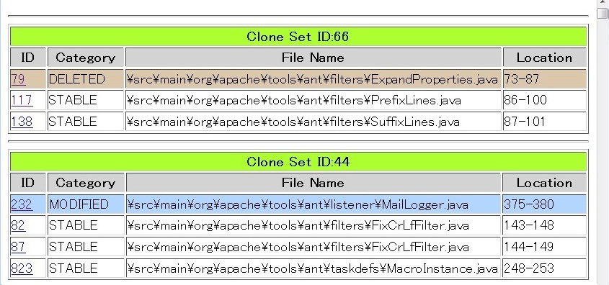
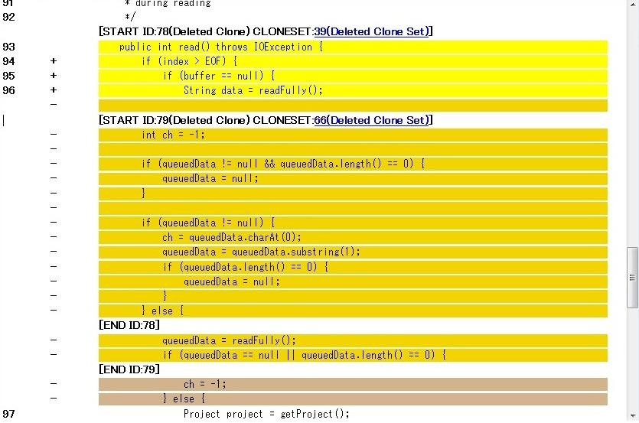
Example of Web-based UI
Clone Set List Page
Source File Page
Users can confirm change information of code clones

Slide 17
Industrial Case Study (1/2)
Apply to development process in NEC
Have the questionnaire and get feedback from a developer in NEC
Questionnaire
Daily Report
Feedback
Clone Change Management System
Developer
Authors

Slide 18
Industrial Case Study (2/2)
Term
  December 19, 2011 - January 31, 2012 ( 40days )
Project
  Java development
  6 programmers
  120KLOC, 350files
Target of questionnaire
  A project manager
  10 years of development experiences of Java

Slide 19

Questionnaire
Question1
Using the system, did developer notice any clone sets that need further maintenance?
Question2
How is developer going to maintain the clone sets?

Slide 20
Answer to Question1
Question1
Using the system, did developer notice any clone sets that need further maintenance?
Answer
  Yes, developer could notice 11 clone sets.

Slide 21
Answer to Question 2
Question2
How is developer going to maintain the clone sets?
 | Date | Category | Q.2
1 | Dec. 28, 2011 | New | Refactoring
2 | Dec. 28, 2011 | New | Refactoring
3 | Jan. 13, 2012 | New | Refactoring
4 | Jan. 13, 2012 | New | Comment
5 | Jan. 13, 2012 | New | Refactoring
6 | Jan. 13, 2012 | New | Refactoring
7 | Jan. 13, 2012 | New | Refactoring
8 | Jan. 16, 2012 | New | Refactoring
9 | Jan. 16, 2012 | New | Refactoring
10 | Jan. 18, 2012 | New | Refactoring
11 | Jan. 24, 2012 | New | Refactoring

Slide 22
Answer to Question 2
Question2
How is developer going to maintain the clone sets?
 | Date | Category | Q.2
1 | Dec. 28, 2011 | New | Refactoring
2 | Dec. 28, 2011 | New | Refactoring
3 | Jan. 13, 2012 | New | Refactoring
4 | Jan. 13, 2012 | New | Comment
5 | Jan. 13, 2012 | New | Refactoring
6 | Jan. 13, 2012 | New | Refactoring
7 | Jan. 13, 2012 | New | Refactoring
8 | Jan. 16, 2012 | New | Refactoring
9 | Jan. 16, 2012 | New | Refactoring
10 | Jan. 18, 2012 | New | Refactoring
11 | Jan. 24, 2012 | New | Refactoring
All targets are New clone sets!

Slide 23
Answer to Question 2
Question2
How is developer going to maintain the clone sets?
 | Date | Category | Q.2
1 | Dec. 28, 2011 | New | Refactoring
2 | Dec. 28, 2011 | New | Refactoring
3 | Jan. 13, 2012 | New | Refactoring
4 | Jan. 13, 2012 | New | Comment
5 | Jan. 13, 2012 | New | Refactoring
6 | Jan. 13, 2012 | New | Refactoring
7 | Jan. 13, 2012 | New | Refactoring
8 | Jan. 16, 2012 | New | Refactoring
9 | Jan. 16, 2012 | New | Refactoring
10 | Jan. 18, 2012 | New | Refactoring
11 | Jan. 24, 2012 | New | Refactoring
Almost of targets needed refactoring!

Slide 24
Answer to Question 2
Question2
How is developer going to maintain the clone sets?
 | Date | Category | Q.2
1 | Dec. 28, 2011 | New | Refactoring
2 | Dec. 28, 2011 | New | Refactoring
3 | Jan. 13, 2012 | New | Refactoring
4 | Jan. 13, 2012 | New | Comment
5 | Jan. 13, 2012 | New | Refactoring
6 | Jan. 13, 2012 | New | Refactoring
7 | Jan. 13, 2012 | New | Refactoring
8 | Jan. 16, 2012 | New | Refactoring
9 | Jan. 16, 2012 | New | Refactoring
10 | Jan. 18, 2012 | New | Refactoring
11 | Jan. 24, 2012 | New | Refactoring
Add comment on the location of code clones in source code

Slide 25

Result of Case Study
We confirmed the usefulness of clone change management system.
  This system is still used in NEC.
Clone change management is useful for developer to notice targets of refactoring in NEC.
  11 useful clone sets were found during 40 days.
    Need refactoring: 10 clone sets
    Need comment: 1 clone sets

Slide 26
Summary and Future work
Summary
  Developed a clone change management system based on opinions of industrial developers in NEC
  Confirmed the usefulness of clone change management system by applying to the development in NEC
Future work
  Get more feedbacks from the developers
  Improve the system based on the feedbacks

Slide 27
Thank you!

