Slide 1
Extraction of Product Evolution Tree from Source Code of Product Variants
Tetsuya Kanda, Takashi Ishio, Katsuro Inoue

Slide 2
Developing a new software product
Clone-and-own approach [1]
  Copying existing code/project
...
Copy and modify
Copy and modify
...
branched
Copy and modify
[1] Rubin et al. “Managing forked product variants” SPLC 2012.

Slide 3
As a result
Many products are created and stored
in a company.

Slide 4
From existing products to product line
A company already has a large number of products without applying SPLE.
The construction of a software product line from existing products is a major problem.
Compare source code to extract information
  Intersection: Common features
  Differences: Product specific features
Analyzing a large number of software products is a difficult task for developers.

Slide 5
Product selection
Choose representative software products as a starting point [2].
Pick up products with a principle
  Products in the same branch
  Products among branches
[2] Krueger “Easing the transition to software mass customization” PFE 2001

Slide 6
Relationships among products
Nonaka et al. “A preliminary analysis on corrective maintenance for an embedded software product family” IPSJ SIG Technical Report, 2009.

Slide 7
Relationships among products
Compare products in the same branch
to extract bug fixes and additional features
Nonaka et al. “A preliminary analysis on corrective maintenance for an embedded software product family” IPSJ SIG Technical Report, 2009.

Slide 8
Relationships among products
Compare products between branches
to extract core features and product specific features
Nonaka et al. “A preliminary analysis on corrective maintenance for an embedded software product family” IPSJ SIG Technical Report, 2009.

Slide 9
The evolution history
Evolution history of software products
shows the relationships among the products.
  Helps selection of the products
Is the history always available?

Slide 10
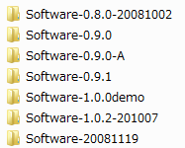
The history is not available
Products are not always version controlled.
  Or managed independently and relationships between branches are not recorded
In the worst case, developers only have access to source code of each product.
  No version numbers, no release dates
Lost

Slide 11
Proposal: Product Evolution Tree
We extract an approximation of the evolution history of software products.
  Analyze products using only the source code.
Source code
Product Evolution Tree

Slide 12
Key idea
Similar products has similar source files
Product B is more similar than Product C compared with Product A.
: similar source file pair
Product A
Product A
Product B
Product C

Slide 13
Construction of the
Product Evolution Tree
File similarity calculation
  Detect similar file pairs
Product similarity calculation
  Count the number of similar file pairs
Construction of
the minimum spanning tree
Evolution direction calculation

Slide 14

File similarity calculation
Calculate the similarity for all pairs of files across different products
class
A
{
int
a
=
0
;
public
int
getA
(
)
{
return
a
;
}
}
class
B
{
int
a
=
0
;
public
void
incA
(
)
{
a
++
;
}
}
LCS
$$sim\left(a,b\right)=$$
class A {
int a = 0;
public int getA(){
return a;
}
}
class B {
int a = 0;
public void incA(){
a++;
}
}
LCS
+
A
specific
+
B
specific
= 15 / 23 = 0.65…

Slide 15
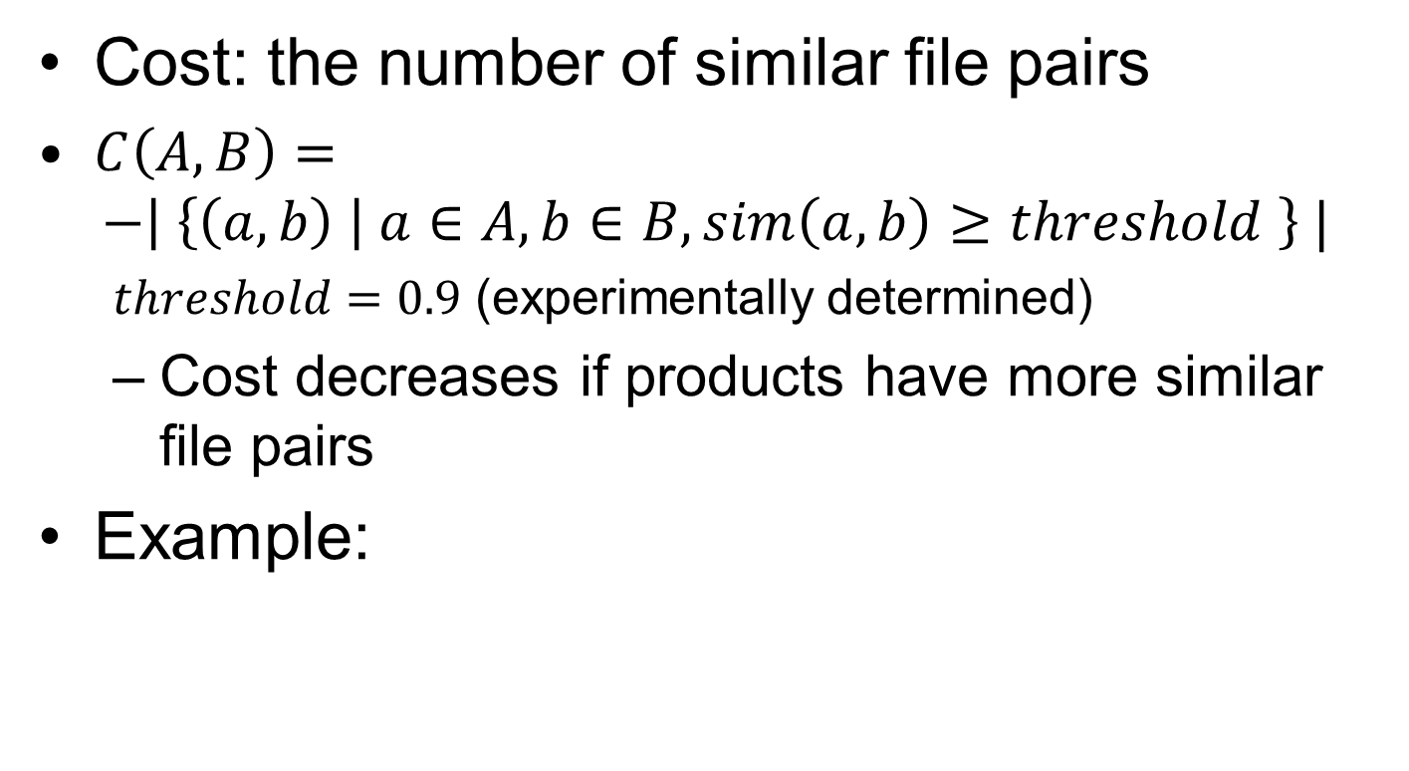

Product similarity calculation
Cost: the number of similar file pairs
$C\left(A, B\right)=$
$−\left| \left\{\left(a, b\right) \right| a∈A, b∈B,sim\left(a,b\right)≥threshold \right\} |$
  $threshold=0.9$ (experimentally determined)
  Cost decreases if products have more similar file pairs
Example:
Product A
$$C\left(A,B\right)=−4$$
Product B
: similar source file pair

Slide 16
Construction of the minimum spanning tree
Vertex: Software product
Edge: connects products
Minimum spanning tree
  A tree which has the smallest total cost
Prim's algorithm
-8
-5
-8
-6
-3
-4
-6
-6
-5
-6
Total cost: -27
-5
-4
-7
-7

Slide 17
Evolution direction calculation
Hypothesis: Source code is likely added.
  The new version of the software should have additional features.
Count the total number
of modified tokens
between projects
old
ADDED CODE
new
deleted code
-8
-6
-6
-7

Slide 18
Case study
6 datasets from OSS (written in C)
  4 datasets from PostgreSQL
    Single project
  1 dataset from FFmpeg and Libav
    Libav is forked from FFmpeg and is developed by a group of FFmpeg developers.
  1 dataset from 4.4BSD-lite, FreeBSD, NetBSD, OpenBSD
    4.4BSD-Lite and its derived OSs.

Slide 19
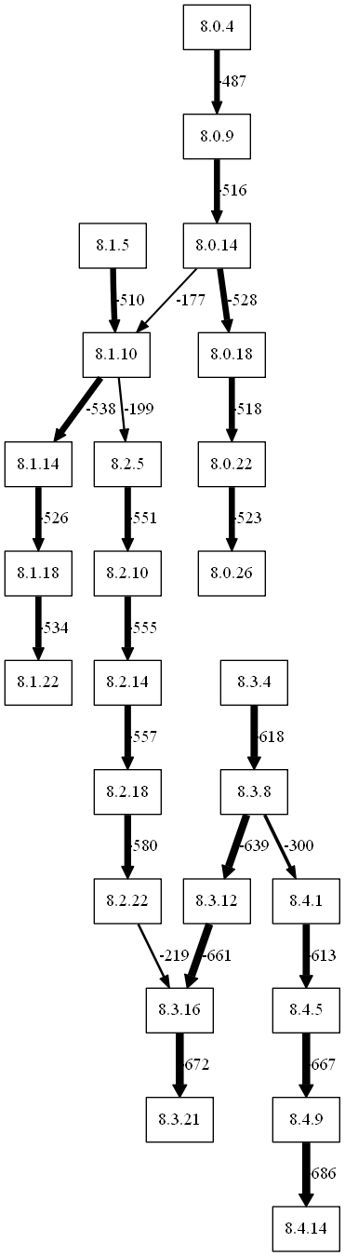
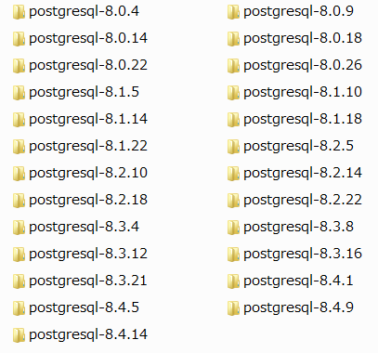
Input and Output
Input: source files
Each directory contains source files of one product
Output:
Producrt Evolution Tree

Slide 20
Recall
Dataset | Edges in the actual history | Matched Edges without direction |  | Matched Edges with direction
1 | 12 | 12 | 100% | 11 | 91.7%
2 | 143 | 136 | 95.1% | 128 | 89.5%
3 | 37 | 30 | 81.1% | 30 | 81.1%
4 | 24 | 20 | 83.3% | 20 | 83.3%
5 | 15 | 13 | 86.7% | 11 | 73.3%
6 | 17 | 12 | 70.6% | 9 | 52.9%

Slide 21
Dataset 4 (1/2)
Picked up PostgreSQL 8.X series
released in every Septembers

Slide 22
Dataset 4 (2/2)
83.3% recall
Using the cost value,
we can identify
branches.
All edges inside the branches are correct.
  We can identify initial and latest versions of each branch.
8.0.9→8.0.14
Cost: -516
8.0.14→8.1.10
Cost: -177

Slide 23
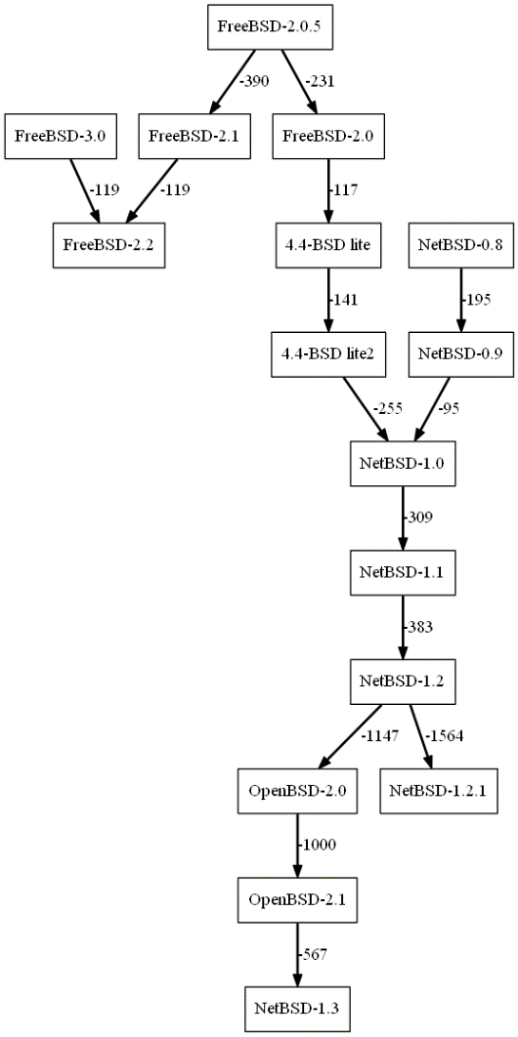
Dataset 6 (1/3)
  4.4BSD-lite, FreeBSD, NetBSD, OpenBSD
One product branched into three products

Slide 24
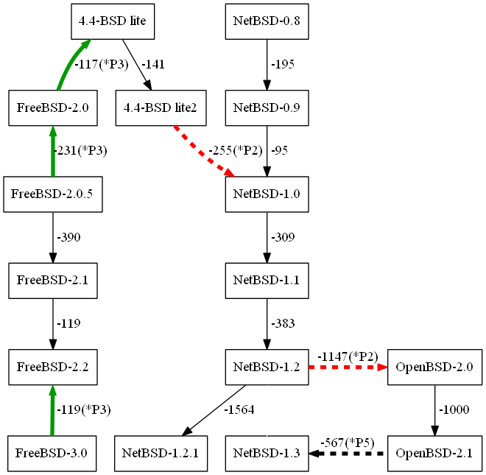
Dataset 6 (2/3)
The family-tree
Product Evolution Tree
Based on “bsd-family-tree” in the FreeBSD project
2 of 4 latest versions of the family-tree are detected by Product Evolution Tree

Slide 25
Dataset 6 (3/3)
52.9% recall
Misdetection increased for the products with the complex history
  Some edges shows reversed direction (green)
  connecting between branches are mismatched (red)

Slide 26
Misdetection Patterns
 | Dataset
 | 1 | 2 | 3 | 4 | 5 | 6
Version Skip |  | 1 |  |  | 1
Misalignment of Branch |  | 4 | 5 | 4 | 1 | 2
Misdirection | 1 | 8 |  |  | 2 | 3
Missing merge |  |  |  |  |  | 2
Out of Place |  | 2 | 2 |  |  | 1
Connects exact products but direction is wrong.
This pattern can be recovered with the release date.
Without considering this misdetection pattern, recall is about 80%

Slide 27
Concluding remarks
Our tool and datasets are available online.
  http://sel.ist.osaka-u.ac.jp/pret/
Product Evolution Tree visualizes relationships among software products from their source code.
  Branches and latest versions can be identified.
Future work
  Improve the cost function
  Extend datasets to other programming languages
  Case study with industrial developers

