Slide 1
Supporting Clone Analysis with Tag Cloud Visualization
Manamu Sano†, Eunjong Choi†, Norihiro Yoshida‡, Yuki Yamanaka†, Katsuro Inoue†
† Osaka University, Japan
‡ Nagoya University, Japan

Slide 2
Code Clone
A code fragment that has identical or similar ones to it in source code.
It is widely believed that code clones make software maintenance more difficult.
If there is a bug
there may be
the same bugs
code clone
clone set

Slide 3
Needs of Tool Support for Clone Analysis
Large software system involves a lot of code clones.
Checking code clones is necessary for refactoring and identifying license violations.
  It is unrealistic to check all code clones in software maintenance.^{[1]}
Tool support is necessary for clone analysis.
[1] M. Rieger et al., Insights into system-wide code duplication, Proc. of WCRE, 2004.

Slide 4

Scatterplot
A visualization technique for efficient grasp of parts involving a number of code clones.
Developers readily know in which files or
directories code clones exist by scatterplots.
Axes
files or directories
of systems
Points
the presence or
absence of
a clone relation
Example of scatterplots
in Gemini ^{[2]}.
[2] Ueda et al., Gemini: maintenance support environment based on code clone analysis, Proc. of 8th IEEE Symp. on Software Metrics, 2002.

Slide 5
Motivation
Scatterplot provides only the location information of code clones.
  Developers cannot understand why code clones are concentrated in parts of a system.
Lexical information provides a hint for understanding why those fragments are code clones.
  Existing tool using scatterplots do not use lexical information of code clones directly.
lexical information: variable, function, type names in code clone

Slide 6
Tag Cloud
It depicts keyword metadata for efficient understanding and information retrieval of given data.
Advantages
More keywords can be shown in a smaller area.
Support instinctive understanding of important keywords.
Example of tag cloud in natural language text.
generated by Wordle (http://www.wordle.net/).

Slide 7

Proposed Tool
CloneCloud
  A code clone analysis tool using scatterplot and tag cloud.
  Helps to :
    understand location of code clones.
    get a clue to the reason why code clones exist.
input
CCFinder^{[3]}
3 kinds of
views
source files of Java system
detecting code clones
[3] Kamiya, et al., CCFinder: a multilinguistic token-based code clone detection system for large scale source code, IEEE Trans. Sofw. Eng., 2002.

Slide 8
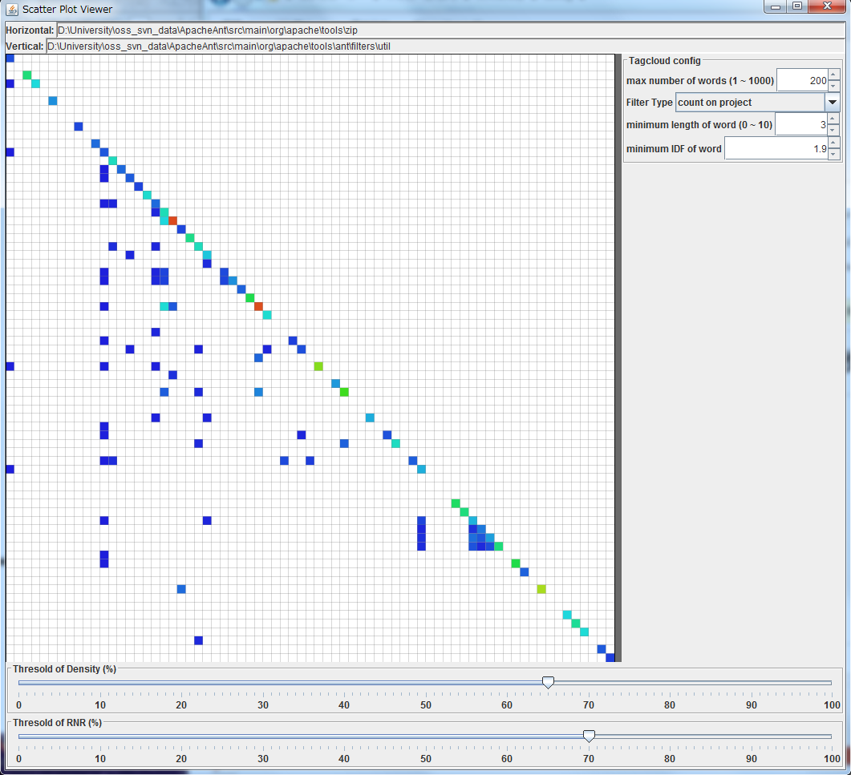
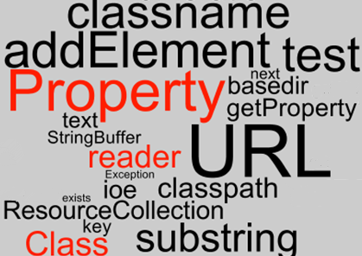
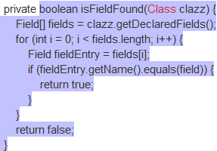
Views of CloneCloud
Scatterplot View
Tag Cloud View
Source Code View
scatterplot view
tag cloud view
source code view
Example from Apache Ant (http://ant.apache.org/) rev. 1486439.

Slide 9

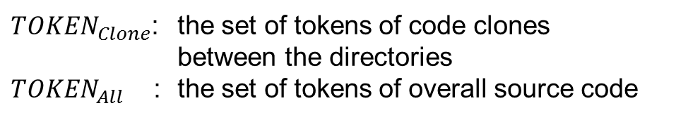
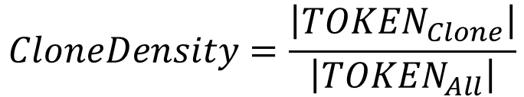
Scatterplot View（1/2）
Provides scatterplot of the input source files using Live Scatterplots^{[4]}.
vertical and horizontal axes
directories of the input system
color
Clone Density between vertical and horizontal directories
$$CloneDensity=\frac{\left|{TOKEN}_{Clone}\right|}{\left|{TOKEN}_{All}\right|}$$
${TOKEN}_{Clone}$: the set of tokens of code clones
between the directories
${TOKEN}_{All}$ : the set of tokens of overall source code
Low
High
[4] J. R. Cordy, Live Scatterplots, Proc. of IWSC 2011, 2011.

Slide 10
Scatterplot View（2/2）
Users can find directories where code clones are concentrated for clone refactoring.
For example, focusing on the directories of red cells
Tag Cloud View is popped up by selecting any cells.
Low
High

Slide 11
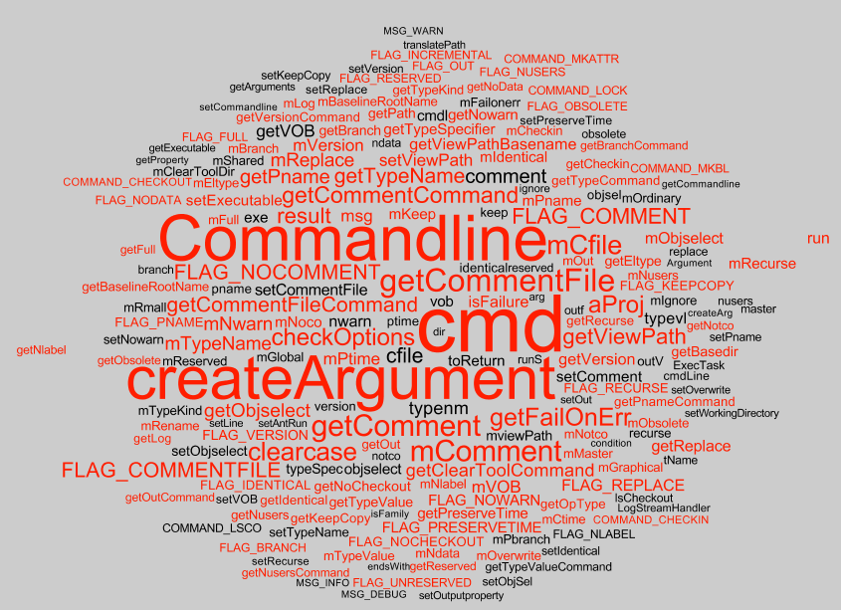
Tag Cloud View（1/2）
Shows identifier names in the selected directories in Scatterplot View.
Red
included in code clones of the directories
Black
contained only in the source code of the directories

Slide 12
Tag Cloud View（2/2）
Users can instinctively understand the role of the directories and get a clue for understanding code clones.
It implements the functionality of ClearCase command.
Example of the directory "optional/clearcase" in Apache Ant.
Code clones are concentrated in the source code for argument creation of a command line.
Red identifier names provide hyperlink to the Source Code View.

Slide 13

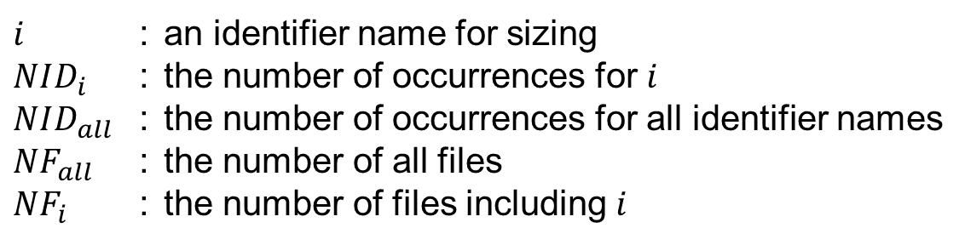


How to Generate Tag Cloud
Decide identifier names shown by tag cloud.
  Customize option :
    minimum sequence length
    minimum IDF values
Decide tag size based on TF-IDF^{[5]} and coloring.
Term Frequency
Inverse Document Frequency
$$TF_{i}=\frac{NID_{i}}{NID_{all}}$$
$$IDF_{i}=\log{\frac{NF_{all}}{NF_{i}}}$$
$$TF‐IDF_{i}=TF_{i}×IDF_{i}$$
$i$ : an identifier name for sizing
$NID_{i}$ : the number of occurrences for $i$
$NID_{all}$ : the number of occurrences for all identifier names
$NF_{all}$ : the number of all files
$NF_{i}$ : the number of files including $i$
[5] R. A. Baeza-Yates et al., Modern information retrieval - the concepts and technology behind search, Second edition, Pearson Education Ltd., 2011.

Slide 14
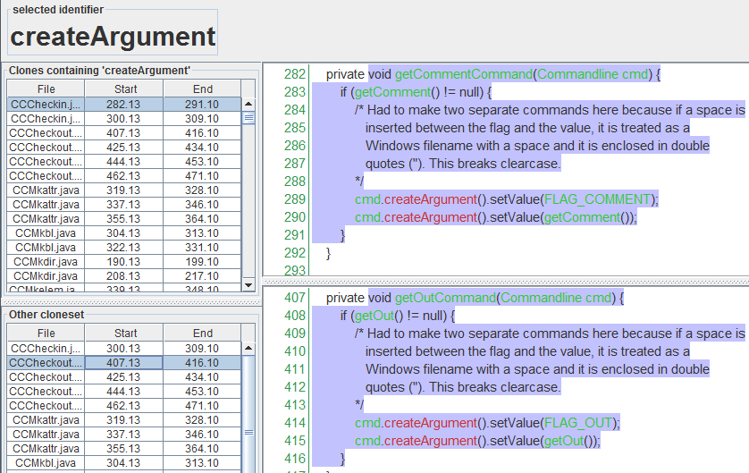
Source Code View（1/2）
Shows the source code of the code clones that include the selected identifier names in the Tag Cloud View.
selected identifier name
code clones containing
"createArgument"
source code of the selected clone
on the left pane, respectively
code clones belonging to
the same clone set

Slide 15
Source Code View（2/2）
Red
Users can confirm the source code including selected identifier names.
selected identifier name
They can take a clue for understanding code clones that they are interested in.
Green
shown in Tag Cloud View

Slide 16
Summary
Developed CloneCloud to support understanding code clones using tag cloud.
  Three kinds of views can provide a clue for understanding code clones.
Future Work :
  Evaluating the usability of CloneCloud
  Comparing with existing clone visualization tools
  Applying to actual development of industry

