Slide 1


Large-scale Analysis of Software Reuse for Code and License Changes
Yuhao WU
Advisor: Prof. Katsuro Inoue
Software Engineering Laboratory (井上研),
Department of Computer Science,
Graduate School of Information Science & Technology,
Osaka University
Notes:
https://www.google.co.jp/search?q=osaka+university+logo&num=20&source=lnms&tbm=isch&sa=X&ved=0ahUKEwigqYvtsOrdAhWbZt4KHQ5JAvUQ_AUIDigB&biw=1920&bih=938

Slide 2
Table of Contents
Introduction
Potential Risks in Code Reuse: the License Aspect
- Chapter 2 of the dissertation
Potential Challenges in Code Reuse: the Code Aspect
- Chapter 3 of the dissertation
Conclusion

Slide 3
Table of Contents
Introduction
Potential Risks in Code Reuse: the License Aspect
Potential Challenges in Code Reuse: the Code Aspect
Conclusion

Slide 4







“Software is Eating the World” ^{[1]} - Marc Andreessen
Applications
Medical Devices
Spacecrafts
Software Error
Software Error
Software Error
Application Crashes
Therac-25 [2]
3 human lives
Ariane 5 Explosion [2]
$500 million
[1] https://www.wsj.com/articles/SB10001424053111903480904576512250915629460
[2] http://www.cse.psu.edu/~gxt29/bug/softwarebug.html
Notes:
https://www.flaticon.com/free-icon/responsive_1055687#term=cellphone&page=1&position=14
https://www.flaticon.com/free-icon/project_1055646#term=rocket&page=1&position=5
https://www.flaticon.com/free-icon/money_902837#term=money%20loss&page=1&position=21
https://www.emergobyul.com/resources/videos-ce-marking
https://www.flaticon.com/free-icon/rip_1301675#term=death&page=1&position=28
https://www.flaticon.com/free-icon/warning_1086632#term=software%20error&page=1&position=11

Slide 5





Code Ruse: an Efficient and Effective Way to Improve Software Quality ^{[1]}
Open Source Projects
1. Fewer bugs:
Previous projects are generally well-tested [2]
Potential Risks and Challenges
Reuse
2. Less development time:
No need to write source code from scratch [3]
Your Projects
[1] Krueger, C. W. (1992). Software reuse. ACM Computing Surveys (CSUR), 24(2), 131–183.
[2] Basili, V. R., Briand, L. C., and Melo, W. L. (1996). How reuse influences productivity in object-oriented systems. Communications of the ACM , 39(10), 104–116.
[3] Boehm, B. W. (1987). Improving software productivity. Computer , 20(9), 43–57.

Slide 6
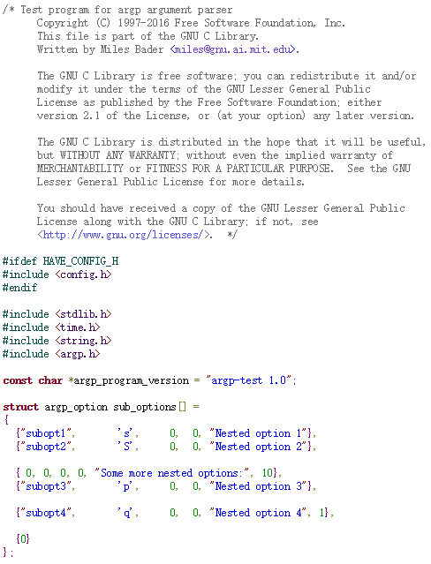

Potential Risks in Code Reuse: the License Aspect
Source file
License terms not satisfied
License
Statement
License violation
Law suit & penalty
[1]
$8.8 B
[1] https://www.wikiwand.com/en/Oracle_America,_Inc._v._Google,_Inc.

Slide 7
Potential Challenges in Code Reuse: the Code Aspect
Source file
① Comprehension efforts [1]
Source
Code
② Modification efforts [2]
[1] Ko, A. J., Myers, B. A., Coblenz, M. J., & Aung, H. H. (2006). An exploratory study of how developers seek, relate, and collect relevant information during software maintenance tasks. IEEE Transactions on software engineering, 32(12), 971-987.
[2] Bettenburg, N., Shang, W., Ibrahim, W. M., Adams, B., Zou, Y., & Hassan, A. E. (2012). An empirical study on inconsistent changes to code clones at the release level. Science of Computer Programming, 77(6), 760-776.

Slide 8
Table of Contents
Introduction
Potential Risks in Code Reuse: the License Aspect
Potential Challenges in Code Reuse: the Code Aspect
Conclusion

Slide 9
Overview of Chapter 2
Open Source Software (OSS) License
What is an OSS license
License Inconsistency
What is license inconsistency
How to detect
How do they evolve

Slide 10
Open Source Software
Open Source Software (OSS)
Becoming more and more popular
Reuse with no cost
High quality
Reduce the development time
An OSS license is necessary to reuse them
Violating the license may lead the developers into license infringement, resulting a large amount of penalty

Slide 11
OSS License
OSS License
A legal instrument governing the use or redistribution of software, usually put in the header of a source file
GPL-3.0+
Generally not allowed to be modified, removed or changed without copyright owner’s permission
MIT
This program is free software: you can redistribute it and/or modify
it under the terms of the GNU General Public License as published by
the Free Software Foundation, either version 3 of the License, or
(at your option) any later version.
…
…
The above copyright notice and this permission notice shall be included in all copies or substantial portions of the Software.

Slide 12
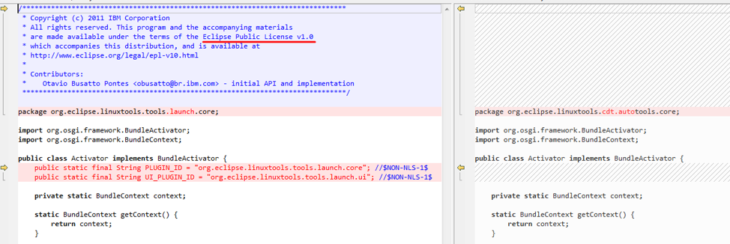
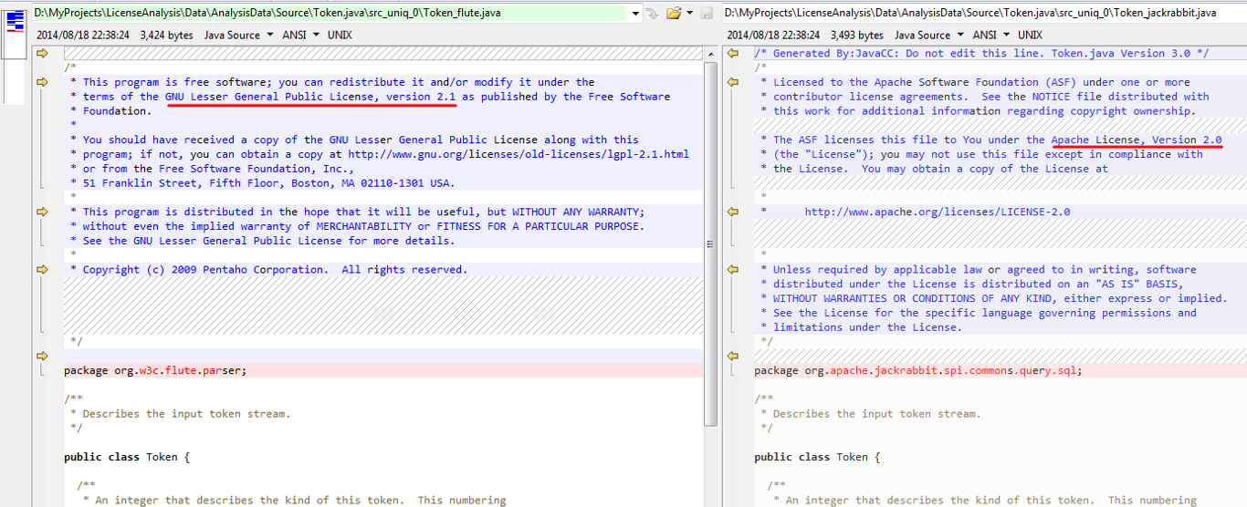
License Inconsistency
Files with same contents under different licenses
License A <==> License B
License C <==> No license
Definition of License Inconsistency
Two source files that have the same source code but contain different licenses
EPL-1.0
None
LGPL-2.1
Apache-2.0
License inconsistency indicates potential license violation problems

Slide 13
Method Overview^{[1]}
Source code available at:
https://github.com/wyhfrank/LIFinder
Collection of projects
Project_1
…
Project_2
Project_3
j Group files by their normalized tokens using CCFinderX^{[2]}
Group_1
Group_2
…
k Detect the license of each file in each group using Ninka
Group | #Licenses | #None | #Unknown
1 | 2 | 5 | 0
2 | 2 | 2 | 0
…
l Calculate metrics for the groups that contain license inconsistencies
[1] Yuhao Wu, Yuki Manabe, Tetsuya Kanda, Daniel M. German, Katsuro Inoue: "A Method to Detect License Inconsistencies in Large-Scale Open Source Projects", Proceedings of the 12th Working Conference on Mining Software Repositories (MSR 2015), pp.324-333, Florence, Itary, May 2015.
[2] T. Kamiya, S. Kusumoto, and K. Inoue, “CCFinder: A multilinguistic token-based code clone detection system for large scale source code,” IEEE Transactions on Software Engineering, vol. 28, no. 7, pp. 654–670, 2002.

Slide 14
Evolution of License Inconsistencies
Goal
Understand how developers are addressing the license inconsistency problem
Method
Apply the license inconsistency detection method to different versions of Debian
Compare the results to see why license inconsistency groups disappeared and why new ones appear.

Slide 15
Results - Overview
Number of license inconsistency groups detected in two versions.
Number of groups | Debian 7.5 | Debian 8.2
Total | 6763 | 7009
Intersection* | 4062 | 4062
Relative complement** | 2701 | 2947
Why these groups disappeared in the new version?
License changed (becomes consistent)
Relevant files were removed
Code evolved
Why new groups appear?
License changed
Newly created files
* Groups reported in both versions.
** Groups reported in one version but not the other.
7.5
8.2

Slide 16
Results - Example
GPL-2.0
GPL-3.0
Packages
kbuild
2011.8.17
2013.7.26
…
r2543
r2695
…
Reuse
License upgraded here.
make
2006.4.1
2010.7.28
2013.10.9
…
3.81
3.82
4.0
…
remake
2009.1.10
2015.4.6
…
3.81
3.82
…
2014.04.26
2015.09.05
Debian 7.5 uses a very old version of make.
Debian 7.5
Debian 8.2

Slide 17
Results - Summary
What is the life cycle of license inconsistencies and the underlying reasons?
Distribution latency → Temporary
Internal → Permanent
Copy and own
Out of sync → Permanent
In sync → Temporary
License inconsistencies exist for a longer or shorter period of time based on the reason that caused them.

Slide 18
Summary of Chapter 2
License inconsistencies
Proposed a method to detect them
Conducted an evolution analysis
Licenses are fairly used in OSS projects
Future direction
Analyze more projects
Provenance analysis

Slide 19
Table of Contents
Introduction
Potential Risks in Code Reuse: the License Aspect
Potential Challenges in Code Reuse: the Code Aspect
Conclusion

Slide 20


Stack Overflow (S.O.) is a question and answer (Q&A) platform for developers
Ask
Ideas
What are the barriers for code reuse and how can we improve?
Answer
Code snippets
Notes:
https://streamdata.io/blog/streaming-stack-exchange-api/
https://www.flaticon.com/free-icon/programmer_560216

Slide 21
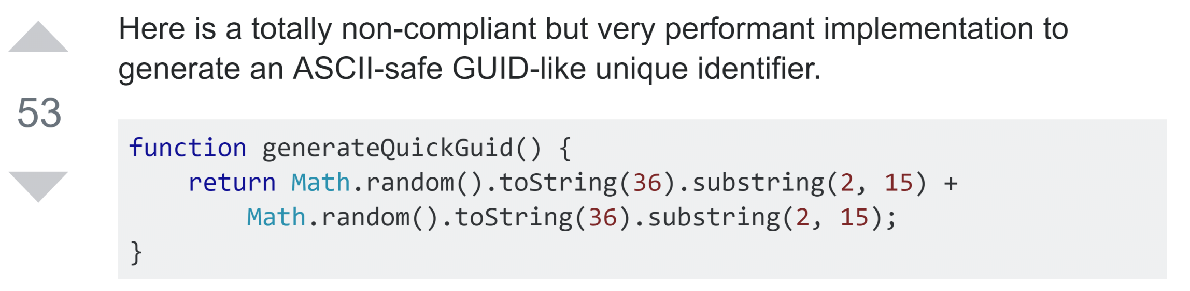
Developers reuse source code from S.O. posts
An answer on Stack Overflow
function generateID() {
return "avalon" +
Math.random().toString(36).substring(2, 15) +
Math.random().toString(36).substring(2, 15)
}
Source code in a GitHub project
Notes:
https://stackoverflow.com/questions/105034/create-guid-uuid-in-javascript/13403498#13403498
https://github.com/yinuoba/avalon/blob/master/avalon.js#L343

Slide 22

Structure of this study
Part I: Exploratory Study
How do developers reuse source code?
Part II: Survey
How do you think S.O. can be improved?
Responses
Notes:
https://www.supportdriven.com/github-logo/

Slide 23

Part I: Exploratory study
searchcode.com
4,878 source files
“stack overflow”
Filter
RQ1: modification frequency and reason
289 files
Analyze code reuse
RQ2: origin of code reuse
Notes:
https://www.flaticon.com/free-icon/search_722080#term=search%20icon&page=1&position=45

Slide 24
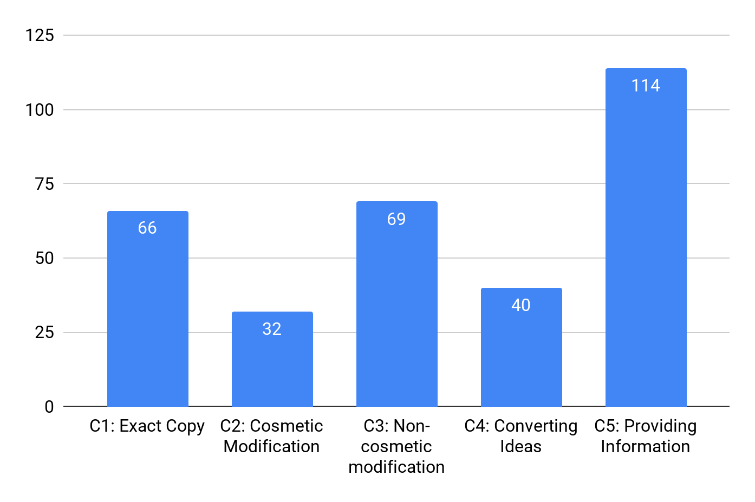
53% of the files that contain a reference to S.O. reuse source code from S.O.
32% of the reused source code snippets requires additional modification (C2+C3)
35%
22%
A summary of each answer might be helpful
21%
13%
10%

Slide 25
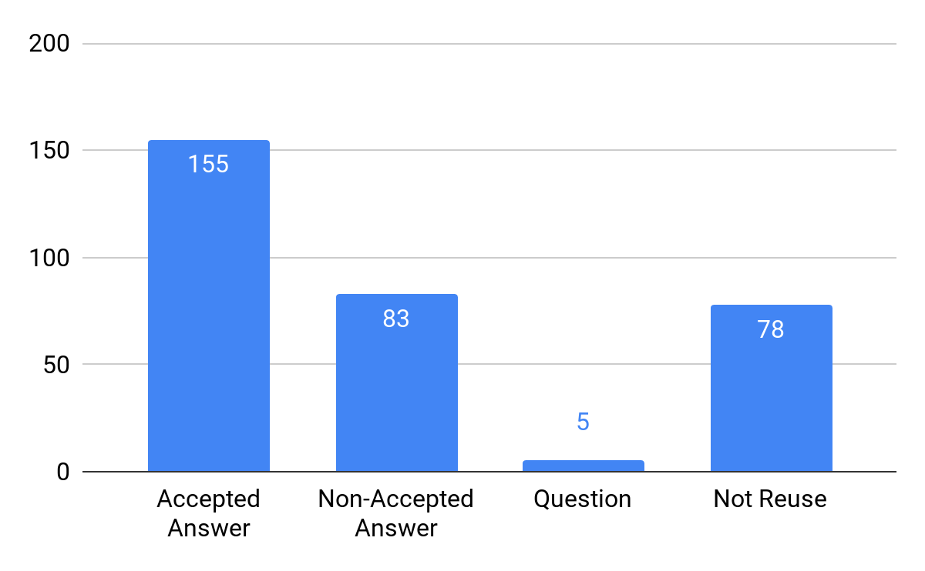
26% of the source code was reused from non-accepted answers
43%
Developers adopt answers based on different needs: simplicity, correctness, efficiency, etc.
An advanced tagging system might be helpful
26%
30%
1%

Slide 26
Part II: Large-scale survey on 400+ participants
Survey Questions
Experience
Type of project participated
...
Demography (7)
Difficulties in reusing source code
Opinions on OSS licenses
...
Barriers (10)
Suggestions (2)
Usefulness of proposed advanced tagging system
Any other suggestions
...

Slide 27



Three people open coded the responses ^{[1]}
Discussion
Me
Draft schema A
Answers
Unified schema
Draft schema B
Collaborator 1
Review
Collaborator 2
Final schema
[1] Stol, K. J., Ralph, P., & Fitzgerald, B. (2016, May). Grounded theory in software engineering research: a critical review and guidelines. In Software Engineering (ICSE), 2016 IEEE/ACM 38th International Conference on (pp. 120-131). IEEE.
Notes:
https://www.flaticon.com/packs/kids-avatars
https://www.flaticon.com/free-icon/boy_163837
https://www.flaticon.com/free-icon/boy_163801
https://www.flaticon.com/free-icon/student_167750

Slide 28
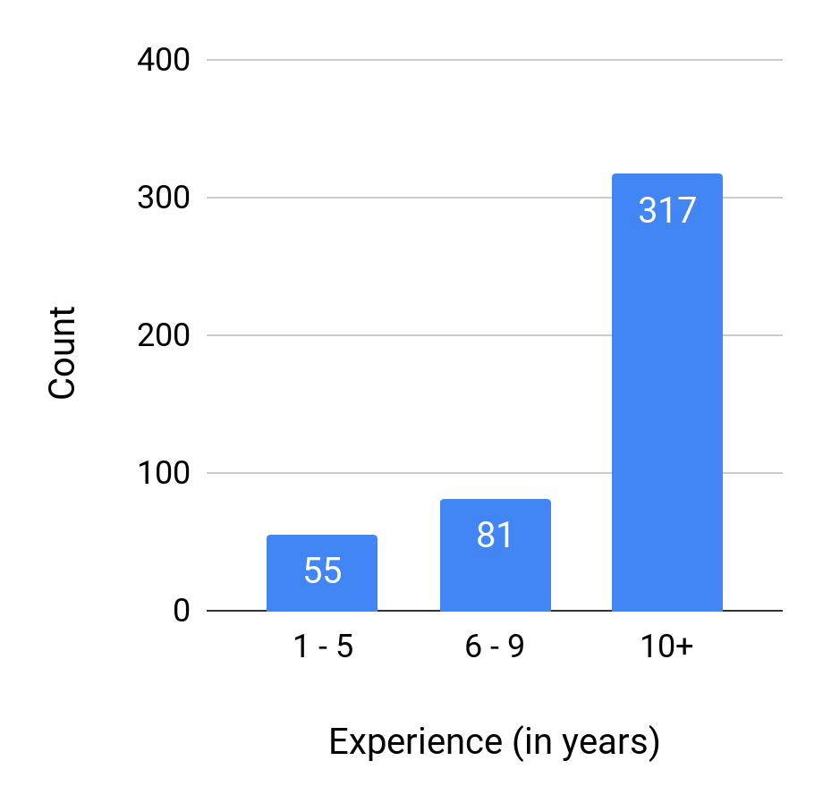
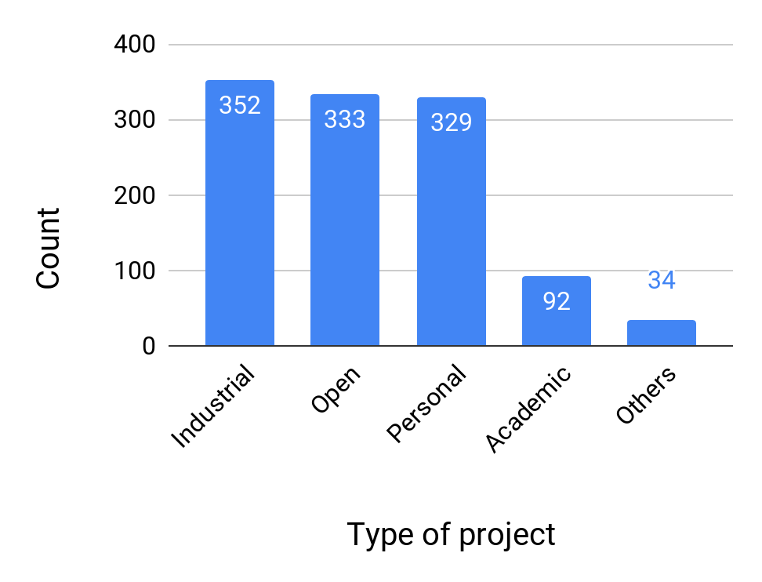
Most participants of our study are experienced developers
78%
74%
73%
70%
20%
8%
18%
12%
Distribution of programming experience
Distribution of type of projects the participants worked on

Slide 29
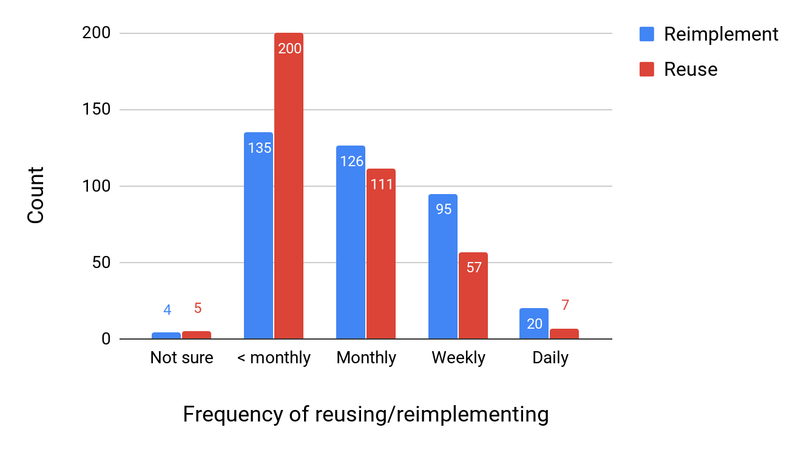
Developers reuse source code slightly more frequently than reimplement source code
53%
35%
33%
29%
25%
15%
1%
1%
5%
2%

Slide 30
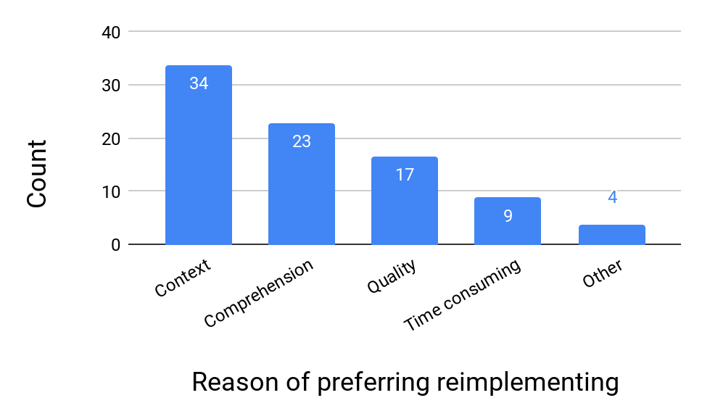
Improving code comprehension and code quality may have positive effects on code reuse
65%
44%
32%
17%
7%

Slide 31
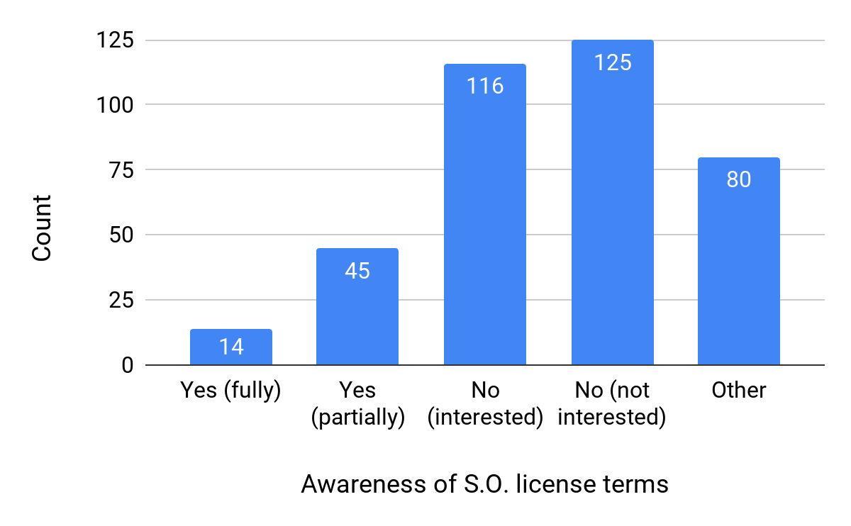
75% of the participants do not have a good understanding of license terms of the Q&A platform
33%
31%
21%
12%
4%
* S.O. adopts CC BY-SA 3.0 license, which is viral and requires attribution

Slide 32
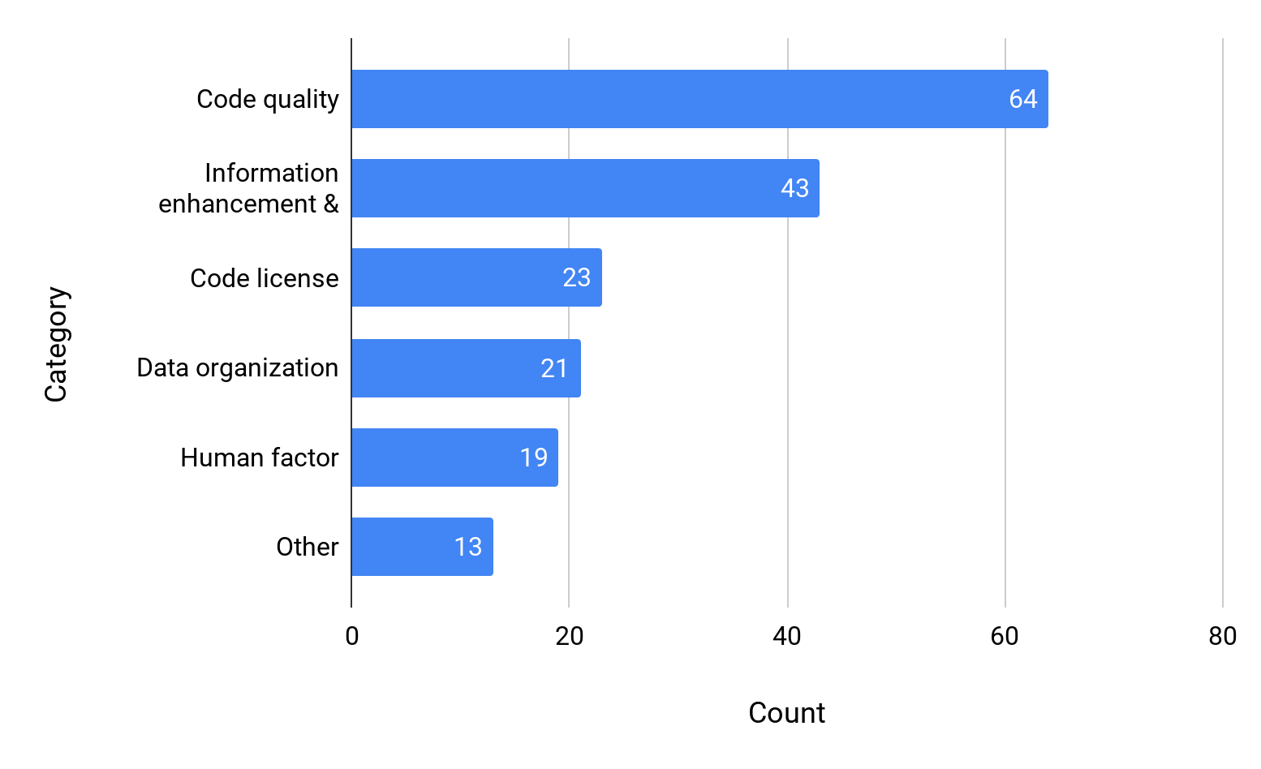
Most suggestions are on code quality
35%
24%
13%
12%
10%
7%

Slide 33
Suggestions: improving code quality
(35% of all categories)
Integrated validator
(42.2%)
Outdated code
(29.7%)
Answer quality
(17.2%)
Code review
(10.9%)
“Make date important in marking outdated code, and deprecate those snippets via the community”
“Better support for answers that are good, but out of date.”
“An inbuilt REPL environment for as many languages/ environments as possible.”
“In-browser code review and commenting similar to that provided by commercial code review tools.”

Slide 34
Suggestions: information enhancement & management
(24%)
Answer tagging
(37.2%)
Code evolution
(14.0%)
Resource linking
(11.6%)
Answer writing
(9.3%)
“Provide/require tagging of the version number(s) of the language [...]”
“Books suggestions based on questions.”
“where does the code come from and copied to, and also the revisions inside the platform”
“[...] it would be nice if it would be easier to ask
a good question [...]”

Slide 35
Summary of Chapter 3
Contributions
Generalized how developers modify source code during code reuse
Varying from variable renaming to complete re-writing
Generalized barriers that prevent developers reusing source code from Q&A platforms
Too much modification needed
In comprehensive code
Low code quality
Summarized suggestions for next-generation Q&A platforms
Practitioners: as a guideline to build a next-generation Q&A platforms
Researchers: as a guideline for future directions to focus more on developers’ needs

Slide 36
Table of Contents
Introduction
Potential Risks in Code Reuse: the License Aspect
Potential Challenges in Code Reuse: the Code Aspect
Conclusion

Slide 37
Conclusion and Future Directions
In the context of code reuse
License aspect
Studied the evolution characteristics of license inconsistency
Code aspect
Generalized different types of code reuse
Summarized suggestions for next-generation Q&A platforms
Future directions
Code provenance
Code quality

Slide 38
Thank you!

Slide 40
Publications
Journal
Yuhao Wu, Shaowei Wang, Cor-Paul Bezemer, Katsuro Inoue. “How Do Developers Utilize Source Code from Stack Overflow?”, Empirical Software Engineering (ESE), 2018 (to appear).
Yuhao Wu, Yuki Manabe, Tetsuya Kanda, Daniel M. German, Katsuro Inoue. “Analysis of License Inconsistency in Large Collections of Open Source Projects”, Empirical Software Engineering (ESE), Vol.22, No.3, pp.1194-1222, 2017.
Conference
Yuhao Wu, Shaowei Wang, Cor-Paul Bezemer, Katsuro Inoue. “How Do Developers Utilize Source Code from Stack Overflow?”, The 26th ACM Joint Meeting on European Software Engineering Conference and Symposium on the Foundations of Software Engineering (ESEC/FSE 2018), Journal-First, Lake Buena Vista, Florida, November 2018.
Yuhao Wu, Yuki Manabe, Daniel M. German, Katsuro Inoue. “How Are Developers Treating License Inconsistency Issues? A Case Study on License Inconsistency Evolution in FOSS Projects”, The 13th International Conference on Open Source Systems (OSS 2017), pp. 69-79, Buenos Aires, Argentina, May 2017.
Yuhao Wu, Yuki Manabe, Tetsuya Kanda, Daniel M. German, Katsuro Inoue. “A Method to Detect License Inconsistencies in Large-scale Open Source Projects”, in Proceedings of the 12th Working Conference on Mining Software Repositories (MSR 2015), pp.324-333, Florence, Italy, May 2015.
Related Publications
Anfernee Goon, Yuhao Wu, Makoto Matsushita, Katsuro Inoue. “Evolution of Code Clone Ratios throughout Development History of Open Source C and C++ ”, 11th International Workshop on Software Clones (IWSC 2017), pp. 47-53, Klagenfurt, Austria, February 2017.
Anfernee Goon, Yuhao Wu, Makoto Matsushita, Katsuro Inoue. “Analysis of Code Clone Ratios over Version Evolution in Open-Source Projects Written in C and C++”, Software Engineer Symposium (2016), pp. 255-256, 2016.
Buford Edwards III, Yuhao Wu, Makoto Matsushita, Katsuro Inoue. “Estimating Code Size After a Complete Code-Clone Merge”, Software Engineering Research Report (SE), 2016(3), pp. 1-8.

Slide 41

License Identification (1/2) - Manually
Copyright (C) <year> <name of author>
This program is free software: you can redistribute it and/or modify
it under the terms of the GNU General Public License as published by
the Free Software Foundation, either version 3 of the License, or
(at your option) any later version.
This program is distributed in the hope that it will be useful,
[…]
GPL-3.0+
LGPL-2.1
GPL-2.0
BSD-2
GPL-3.0+
BSD-3
MIT
Apache-2.0
BSD-2
Copyright (c) <YEAR>, <OWNER> All rights reserved.
Redistribution and use in source and binary forms, with or without modification, are permitted provided that the following conditions are met:
Redistributions of source code must retain the above copyright notice, this list of conditions and the following disclaimer.
Redistributions in binary form must reproduce the above copyright notice, this list of conditions and the following disclaimer in the documentation and/or other materials provided with the distribution.
THIS SOFTWARE IS PROVIDED BY THE COPYRIGHT HOLDERS AND
[…]

Slide 42
License Identification (2/2) - Automatically
Source file
Ninka^{[1]}
State-of-the-art tool
82.3% recall
96.6% precision
License
statement
Ninka
GPL-2.0
[1] D. M. German, Y. Manabe, and K. Inoue, “A sentence-matching method for automatic license identification of source code files,” in Proceedings of the 25th International Conference on Automated Software Engineering (ASE2010), 2010, pp. 437–446.

Slide 43
Problem
No research has been done to address these questions:
RQ1: How many types of license inconsistencies are there?
RQ2: Do they exist in large open source products?
RQ3: What is the proportion of each type of license inconsistency?
RQ4: What caused these license inconsistencies? Are they legal?

Slide 44
Empirical Study (1/3) - Setup
Goal
To reveal the characteristics of license inconsistency in a large open source software
Target:
Debian 7.5 and Java Projects
Categorization
LAR: License Addition or Removal
LUD: License Upgrade or Downgrade
LC: License Change
Type | Debian 7.5 | Java Projects
Projects | 17,160 | 10,514
Total files | 6,136,637 | 3,374,164
.c files | 472,861 | 15,627
.cpp files | 224,267 | 21,176
.java files | 365,213 | 3,337,361
Category | Debian 7.5 |  | Java Projects
LC | 5,272 | 98.4% | 12,653 | 90.9%
LUD | 2,350 | 43.9% | 1,316 | 9.5%
LAR | 1,500 | 28.0% | 6,179 | 44.4%

Slide 45
Empirical Study (2/3) - Result (example)
TagLibraryInfo.java
Apachev1.1
tomcat6
Apachev2
Tools that maintain the licenses made some mistakes.
Discussed with Apache people and changed to combined licenses
Validating the license by file basis is complicated and expensive
tomcat 5.5.x
CDDL
Multiple: CDDL, GPLv2
or Apachev2
glassfish
Debian7.5

Slide 46
Empirical Study (3/3) - Result (summary)
What caused these license inconsistencies?
i) Original author modified/upgraded the license;
ii) The file was originally multi-licensed and reusers chose either one;
iii) Reuser added one or more licenses;
iv) Reuser replaced the original license with another one, and changed the copyright owner.
Among them, the last two types of license modification are unsafe.

Slide 47
Suggestions: clearer and more permissive license
(13%)
Clearer license
(69.6%)
Permissive license
(30.4%)
“By far the most important requirement is clear licensing. Much of the code provided on such platforms is not currently usable because the license is unclear.”
“Let the user choose a more re-user-friendly license (e.g. copy without reference).”

Slide 48
Suggestions: better data organization
(12%)
Code searching/indexing
(47.6%)
Duplicate posts
(38.2%)
Comments
(14.3%)
“Source Code indexing for easier retrieval. It could also give the possibility to find example of usage functions.”
“Auto-suggest similar questions, particularly for questions that don't have answers.”
“Code in *comments* must be expressed better, than on Stack Overflow.”

Slide 49
Suggestions: human factor
(10%)
Better curator
(63.2%)
Gamication related
(36.8%)
“Base reputation on number of answers up-voted by others, not on personal activity.”
“Definitely curators for specific languages to rate answers in specific areas.”

Slide 50
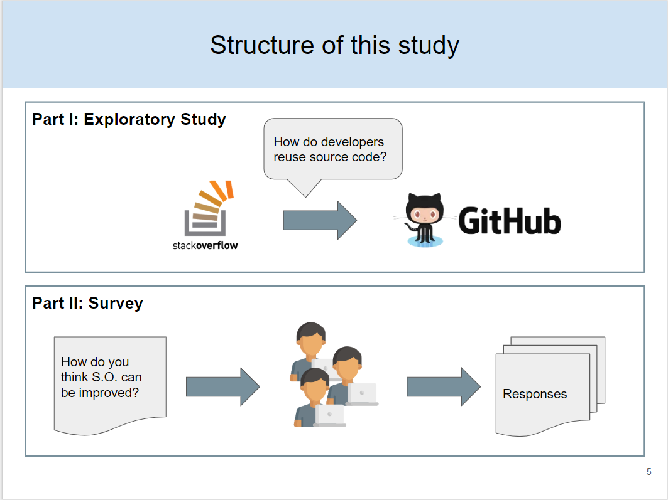
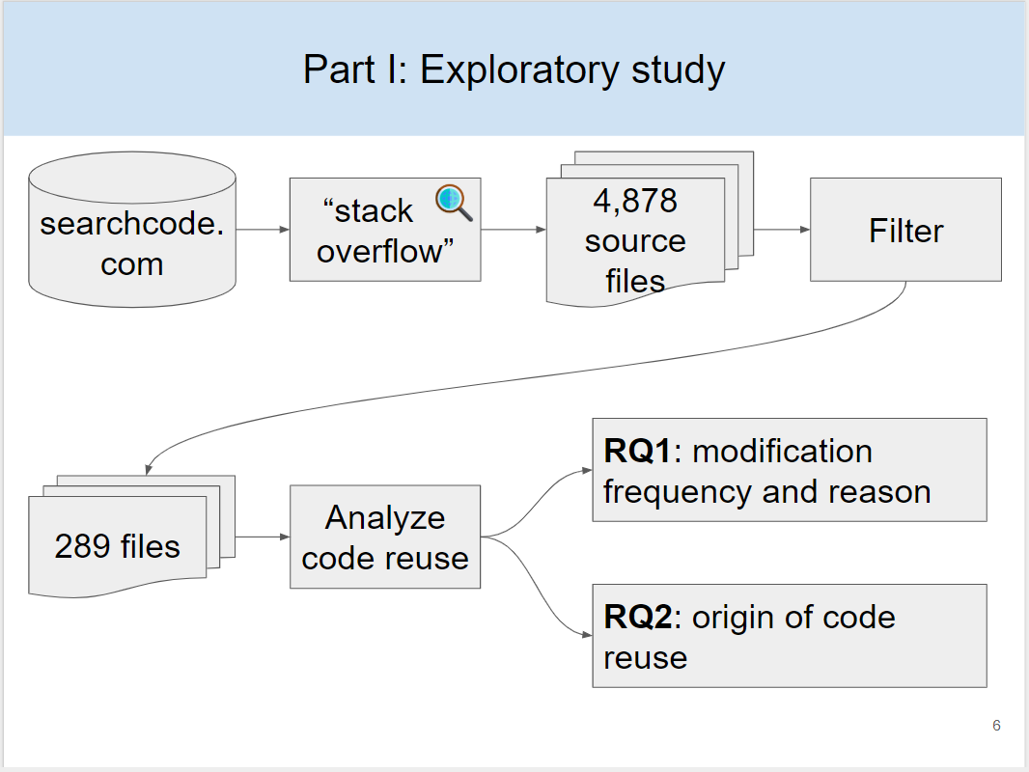
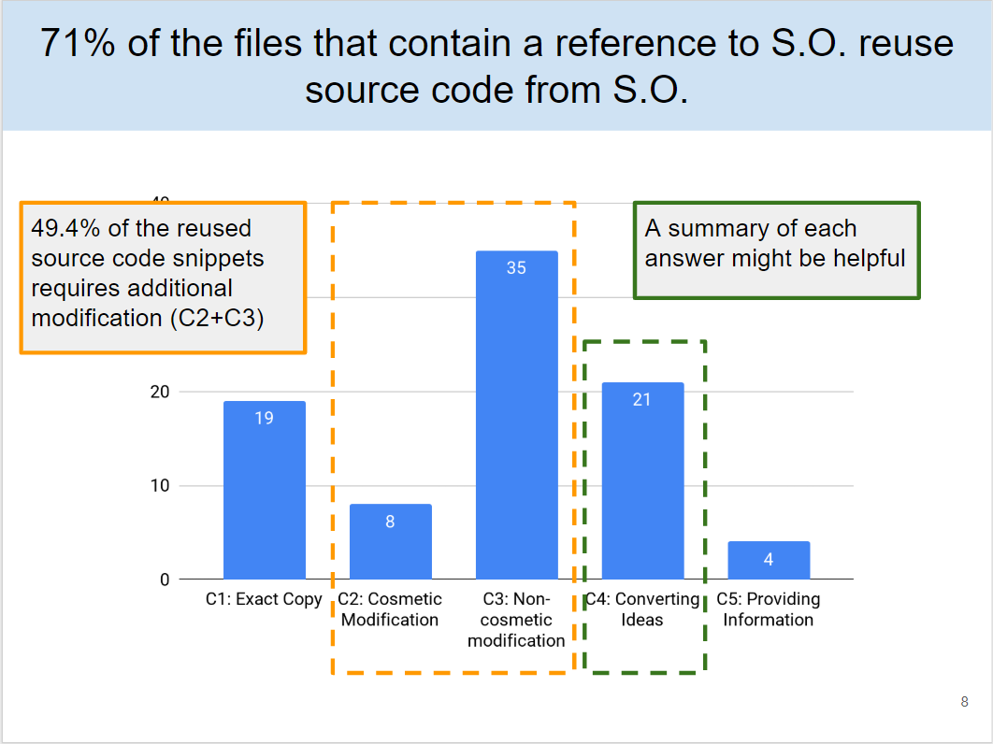
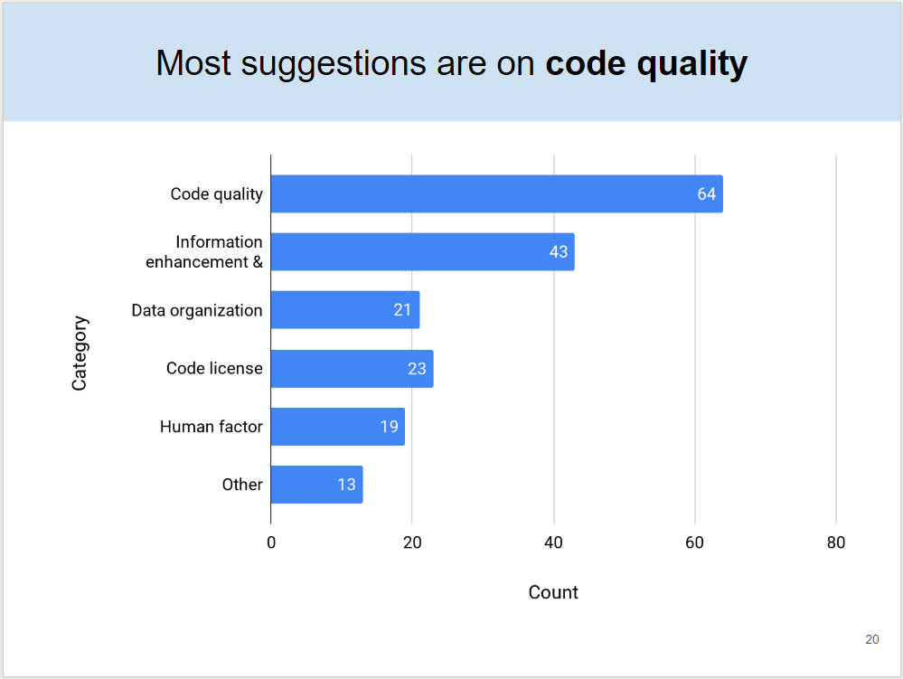

Slide 51
RQ1: How often and to what extent do developers need to modify source code from Stack Overflow in order to make it work in their own projects?

Slide 52
RQ2: From which part of the Stack Overflow post does the reused source code come?

Slide 53
RQ3: What are the preferences of developers when it comes to reusing code?

Slide 54
RQ4: What is the influence of the code license of Stack Overflow?

Slide 55
RQ5: How can code reuse be improved in next-generation Q&A platforms?

Slide 56
Research questions
Part I: Exploratory Study
RQ1: How often do developers modify source code from S.O.?
RQ2: From which part of the Stack Overflow post does the reused source code come?
Part II: Survey
RQ3: What are the preferences of developers when it comes to reusing code?
RQ4: What is the influence of the code license of Stack Overflow?
RQ5: How can code reuse be improved in next-generation Q&A platforms?

Slide 57
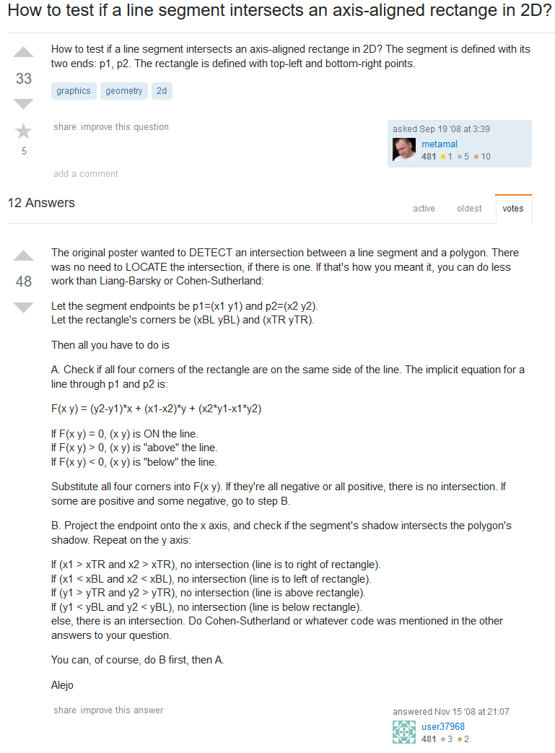
Developers reuse source code from S.O. posts
function linePosition(point) { var x = point[0]; var y = point[1]; return (y2 - y1) * x + (x1 - x2) * y + (x2 * y1 - x1 * y2); }
[...] relPoses.forEach(function(relPos) { if (relPos > 0) { noPositive = false; } else if (relPos < 0) { noNegative = false; } else if (relPos === 0) { noZero = false; } }, this);
[...] return !((x1 > this.right && x2 > this.right) || (x1 < this.left && x2 < this.left) || (y1 < this.top && y2 < this.top) || (y1 > this.bottom && y2 > this.bottom) );
Rect.prototype.collideLine = function(p1, p2) { var x1 = p1[0]; var y1 = p1[1];
var x2 = p2[0]; var y2 = p2[1]; function linePosition(point) { var x = point[0]; var y = point[1]; return (y2 - y1) * x + (x1 - x2) * y + (x2 * y1 - x1 * y2); } [...]
var noNegative = true; var noPositive = true; var noZero = true; relPoses.forEach(function(relPos) { if (relPos > 0) { noPositive = false; } else if (relPos < 0) { noNegative = false; } else if (relPos === 0) { noZero = false; } }, this); if ( (noNegative || noPositive) && noZero) { return false; } return !((x1 > this.right && x2 > this.right) || (x1 < this.left && x2 < this.left) || (y1 < this.top && y2 < this.top) || (y1 > this.bottom && y2 > this.bottom) ); };
How to test if a line segment intersects an axis-aligned rectangle in 2D?
Stack Overflow
Source code in a GitHub project
Notes:
https://stackoverflow.com/questions/99353/how-to-test-if-a-line-segment-intersects-an-axis-aligned-rectange-in-2d/293052#293052
https://github.com/wd5/1-gamejs/blob/94220592f4d16bfd8ee269050bc352e66d4e8593/lib/gamejs.js#L469

Slide 58
Motivating example
How to test if a line segment intersects an axis-aligned rectangle in 2D?
Let the segment endpoints be p1=(x1 y1) and p2=(x2 y2). Let the rectangle's corners be (xBL yBL) and (xTR yTR). Then all you have to do is A. Check if all four corners of the rectangle are on the same side of the line. The implicit equation for a line through p1 and p2 is: F(x y) = (y2-y1)*x + (x1-x2)*y + (x2*y1-x1*y2) If F(x y) = 0, (x y) is ON the line. If F(x y) > 0, (x y) is "above" the line. If F(x y) < 0, (x y) is "below" the line. Substitute all four corners into F(x y). If they're all negative or all positive, there is no intersection. If some are positive and some negative, go to step B. B. Project the endpoint onto the x axis, and check if the segment's shadow intersects the polygon's shadow. Repeat on the y axis: If (x1 > xTR and x2 > xTR), no intersection (line is to right of rectangle). If (x1 < xBL and x2 < xBL), no intersection (line is to left of rectangle). If (y1 > yTR and y2 > yTR), no intersection (line is above rectangle). If (y1 < yBL and y2 < yBL), no intersection (line is below rectangle). else, there is an intersection. Do Cohen-Sutherland or whatever code was mentioned in the other answers to your question.
Rect.prototype.collideLine = function(p1, p2) { var x1 = p1[0]; var y1 = p1[1];
var x2 = p2[0]; var y2 = p2[1]; function linePosition(point) { var x = point[0]; var y = point[1]; return (y2 - y1) * x + (x1 - x2) * y + (x2 * y1 - x1 * y2); } [...]
var noNegative = true; var noPositive = true; var noZero = true; relPoses.forEach(function(relPos) { if (relPos > 0) { noPositive = false; } else if (relPos < 0) { noNegative = false; } else if (relPos === 0) { noZero = false; } }, this); if ( (noNegative || noPositive) && noZero) { return false; } return !((x1 > this.right && x2 > this.right) || (x1 < this.left && x2 < this.left) || (y1 < this.top && y2 < this.top) || (y1 > this.bottom && y2 > this.bottom) ); };
Stack Overflow answer
Source code in a GitHub project
Notes:
https://stackoverflow.com/questions/99353/how-to-test-if-a-line-segment-intersects-an-axis-aligned-rectange-in-2d/293052#293052
https://github.com/wd5/1-gamejs/blob/94220592f4d16bfd8ee269050bc352e66d4e8593/lib/gamejs.js#L469

Slide 59
Part II: Survey
RQs
RQ3: preference of reusing or reimplementing source code
RQ4: influence of OSS license
RQ5: how can Q&A platforms be improved
Survey questions
Demography
Experience
Type of project participated
Barriers
Difficulties in reusing source code
Opinions on OSS licenses
Suggestions
Usefulness of proposed advanced tagging system
Any other suggestions

Slide 60
How do developers utilize S.O. posts
ID | Name | Count | Perc.
C1 | Exact Copy | 19 | 21.8%
C2 | Cosmetic Modification | 8 | 9.2%
C3 | Non-cosmetic modification | 35 | 40.2%
C4 | Converting Ideas | 21 | 24.2%
C5 | Providing Information | 4 | 4.6%

Slide 61
Conclusion
Part I: Exploratory Study
RQ1: 78% of the reused source code is modified (e.g. refactoring, complete rewriting)
RQ2: 26% of the developers reuse source code from non-accepted answers.
Part II: Survey
RQ3: More developers prefer reimplementing than reusing source code.
RQ4: Developers do not understand code license enough, which cause potential license issues.
RQ5: Q&A platforms should pay attention to: 1) code quality 2) information management 3) data organization 4) license 5) human factor.

