Slide 1
Investigating Clone Metrics of Merged Code Clones in Java Programs
Inoue Laboratory
Eunjong Choi

Slide 2
Background: Problem of Code Clone
Existence of code clones makes software maintenance difficult
  if a defect is contained in one code fragment of code clone, the others should be inspected for same defect.
should be inspected
A defect is contained
Source File1
Source File2

Slide 3
Background: Clone Refactoring
Code clones can be merged into single method by performing refactoring
  Code clones are replaced by call statements
  and single method.
call
Refactoring
Before
After

Slide 4
Refactoring Patterns
Extract Class
Extract Method
Extract Superclass
Form Template Method
Parameterize Method
Pull Up Method
Replace Method with Method Object

Slide 5
Refactoring Patterns
Extract Class
Extract Method
Extract Superclass
Form Template Method
Parameterize Method
Pull Up Method
Replace Method with Method Object

Slide 6
An Example of Extract Method
If code clones are exist in the same class, they can be merged into single method in it.
void printOwing(double amount){
printBanner();
System.out.println(“name:”+ _name);
System.out.println(“amount”+ amount);
}
void printAssets(double amount){
printResult();
System.out.println(“name:”+ _name);
System.out.println(“amount”+ amount);
}
void printOwing(double amount){
printBanner();
printDetails(amount);
}
void printAssets(double amount){
printResult();
printDetails(amount);
}
void printDetails(double amount){
System.out.println(“name:”+ _name);
System.out.println(“amount”+ amount);
}
Before
After

Slide 7
An Example of Replace Method with Method Object
If code clones that use local variables are existed, they can be merged into single method in a new class
Class Order...
double price(){
double PrimaryBasePrice;
double secondaryBasePrice;
double tertiaryBasePrice;
..........
}
double discount(){
double PrimaryBasePrice;
double secondaryBasePrice;
double tertiaryBasePrice;
..........
}
PriceCalculator
Order
primaryBasePrice
secondaryBasePrice
tertiaryBasePrice
price()
discount()
Compute()
return new PriceCalculator(this).compute()
Before
After

Slide 8

Motivation of Study (1/3)
What kind of code clones were performed refactoring in the past?
  Do not know what characteristics of code clones are appropriate for performing refactoring
What characteristics of code clones?
?
?
?
?
?
?

Slide 9
Motivation of Study (2/3)
How code clones were performed refactoring?
  Do not know which refactoring pattern is preferentially necessary for a tool support clone refactoring
Which refactoring pattern?
?

Slide 10

Motivation of Study (3/3)
The following information is necessary
  Characteristics of code clones that were performed refactoring
  Refactoring patterns that were applied to code clones
  Investigate history data of Java open
  source projects.
    To implementate a tool support clone refactoring

Slide 11
Study Step
Get history data of software projects from software repository
Identify code clones that were performed refactoring from extracted files
Investigate characteristics of code clones that were performed refactoring and their applied refactoring patterns
software repository
Get
extract
…
Revision : 220 221 280
(Record of the changed files)

Slide 12
Study Step
Get history data of software projects from software repository
Identify code clones that were performed refactoring from extracted files
Investigate characteristics of code clones that were
performed refactoring and their applied refactoring patterns
Identify Clone
Refactoring
refactoring ∩code clone
…
Revision : 220 221 280
(Record of the changed files)

Slide 13
Identify Clone Refactoring
Detect methods that were performed refactoring between two versions
Identify a pair of cloned fragments that were performed refactoring
refactoring
Previous Version Current Version

Slide 14
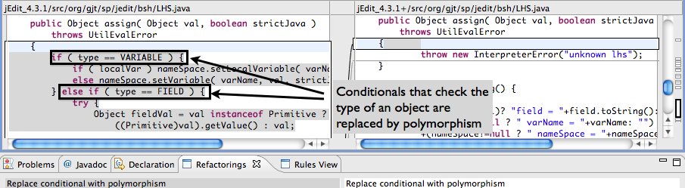
Refactoring Detection
Use REF-FINDER[Prete2010] to detect refactoring
  REF-FINDER : A tool that Identifies refactoring between two program versions
  High recall and precision
    Overall precision is 0.79 and recall is 0.95
[Prete2010] Template-based Reconstruction of Complex Refactorings, K. Prete, N. Rachatasumrit, N. Sudan, and M. Kim, Proceedings of the 26th IEEE International Conference on Software Maintenance, Pages 1-10

Slide 15
Identify Clone Refactoring
Detect methods that were performed refactoring between two versions
Identify a pair of cloned method that were performed refactoring
refactoring
Previous version Current version

Slide 16
Problem of Identify Clone Refactoring (1/2)
  Programmer often perform refactoring between code clones with low similarity
if (i > j) {
i = i/2;
i++;
}
if (i < j) {
i = i+ 1 ;
}
int compare(int i, int j){
if (i > j) {
i = i/2;
i++;
} else {
i = i+ 1 ;
}
return i
}
Previous version Current version

Slide 17
Problem of Identify Clone Refactoring (2/2)
To detect this code clone is difficult to use
token based clone detection tool(e.g.CCFinder)
  Due to modified and newly added code portion between code clones
if (i > j) {
i = i/2;
i++;
}
if (i < j) {
i = i+ 1 ;
}
int compare(int i, int j){
if (i > j) {
i = i/2;
i++;
} else {
i = i+ 1 ;
}
return i
}
Previous version Current version

Slide 18
Detecting Code Clone: usim [Mende2010] (1/3)
determine the similarity between two sequences.
  Using Levenshtein distance [Levenshtein1966]
    measuring the amount of difference between two sequences
      The minimal amount of changes necessary to transform one sequence of items into a second sequence of items
    Levenshtein distance between survey and surgery is 2 [Baeza-Yates]
+1
+1
survey → surgey → surgery
[Mende2010] an evaludation of code similarity identification for the grow-and-prune model, T. Mende, R. Koschke, and Felix Beckwermert, Journal of Software Maintenance 21(2): 143-169 (2009)
[Levenshtein1966] Levenshtein VI. Binary codes capable of correcting deletions, insertions, and reversals. Technical Report 8, Soviet Physics Doklady, 1966.
[Baeza-Yates] R. Baeza-Yates and B. Ribeiro-Neto.Modern Information Retrieval: The Concepts and Technology behind Search (2nd Edition). Addison Wesley, 2010.

Slide 19
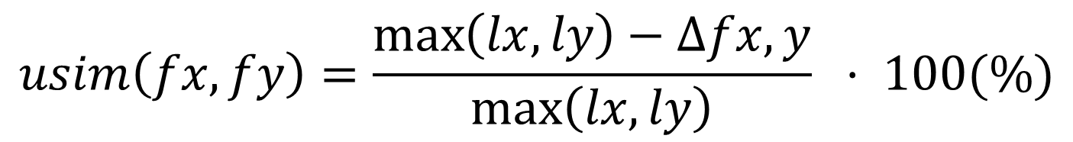



Detecting Code Clone: usim [Mende2010] (2/3)
$$usim\left(fx, fy\right)=\frac{\max\left(lx, ly\right)−∆fx,y}{\max\left(lx, ly\right)} · 100(\%)$$
$$sfx=norm(fx)$$
: a normalized sequence
$$lx=len(sfx)$$
: length of normalized sequence
$$∆fx,y=LD(sfx, sfy)$$
: number of items that have to
be changed to turn function fx into fy
Levenshtein distance between two sequences are normalized by the maximum size between them
[Mende2010] an evaludation of code similarity identification for the grow-and-prune model, T. Mende, R. Koschke, and Felix Beckwermert, Journal of Software Maintenance 21(2): 143-169 (2009)

Slide 20
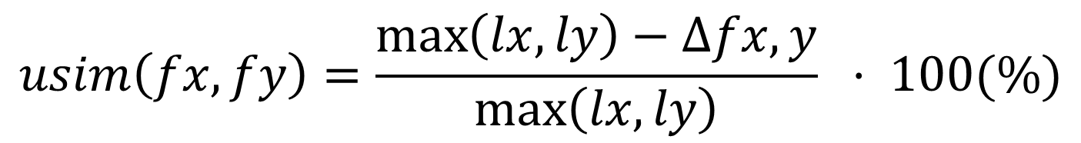
Detecting Code Clone: usim [Mende2010] (3/3)
$$usim\left(fx, fy\right)=\frac{\max\left(lx, ly\right)−∆fx,y}{\max\left(lx, ly\right)} · 100(\%)$$
If usim value is over 40% between two sequences, I define them as code clone[Mende2010]
[Mende2010] an evaludation of code similarity identification for the grow-and-prune model, T. Mende, R. Koschke, and Felix Beckwermert, Journal of Software Maintenance 21(2): 143-169 (2009)

Slide 21
Study Step
Get history data of software projects from software repository
Identify code clones that were refactored from extracted revisions of software projects
Investigate characteristics of code clones that were
performed refactoring and their applied refactoring patterns
…
Investigate Using
Clone Metrics
refactoring
Instances ∩code clone
…
Revision : 220 221 280
(Record of the changed files)

Slide 22
Clone Metrics
To investigate characteristics of code clones are appropriate for performing refactoring
  Features between a pair of cloned fragments that were performed refactoring
    Similarity difference between them
    The length difference between them
  Features of classes who contain code clone that were performed refactoring
    Class distance between classes who contain code clones

Slide 23
Subject Systems
10 revision pairs are selected from 3 Java open source systems[Prete2010]
  2 revision pairs(3.0-3.0.1, 3.0.2-3.1) from jEdit
  2 revision pairs(302-352, 352-449) from CAROL
  6 revision pairs(62-63, 389-421, 421-422, 429-430, 430-480, 480-481) from Columba
[Pete2010] Template-based Reconstruction of Complex Refactorings, K. Prete, N. Rachatasumrit, N. Sudan, and M. Kim, Proceedings of the 26th IEEE International Conference on Software Maintenance, Pages 1-10

Slide 24
The Number of Refactored Code Clones
Identify 31 pairs of cloned fragments that were performed refactoring from overall projects
Replace Method with Method Object is the most frequently applied refactoring pattern

Slide 25
The usim Value of Each Patterns (1/2)
Frequency
(%)
Low similarity : Extract Method , Replace Method with Method

Slide 26
The usim Value of Each Patterns (2/2)
Frequency
(%)
High similarity : Extract Superclass, Form Template Method

Slide 27
The Length Difference between Clone Pair of Each Patterns (1/2)
Frequency
Little length difference : Extract Method, Extract SuperClass, and Form Template Method

Slide 28
The Length Difference between Clone Pair of Each Patterns (2/2)
Frequency
Various length difference : Replace Method with Method Object

Slide 29
The Class Distance of Replace Method with Method Object
Frequency
Replace method with Method Object are the most frequently applied to code clones in the same package

Slide 30
Conclusion
Investigate characteristics of code clones that were performed refactoring
  From 3 Java open source software.
  Use REF-FINDER to detect refactoring
  Use usim to identify code clones
The most frequently applied refactoring pattern is Replace Method with Method Object
  They are applied to a pair of cloned fragment with little similarity
  They are applied to various length difference in the same package

Slide 31
Study Plan (1/3)
The first year : investigate a predictor for future code clone refactoring
Can predict future refactoring activity?
Cloned code
Cloned code
Cloned code
Cloned code
Cloned code
Cloned code
Current
Future

Slide 32

Study Plan (2/3)
The second year : suggest metrics to measure clone refactoring
Can metric measure clone refactoring?
refactoring

Slide 33
Study Plan (3/3)
The third year : develop a tool support clone refactoring
Can a tool support clone refactoring?
refactoring

Slide 34
Thank you for paying attention

