Slide 1
Investigating Impact to Compilability of Python Code Snippets on Stack Overflow due to Python Version Upgrades
Shiyu Yang
Inoue Lab
2022/02/09

Slide 2
Introduction
Stack Overflow
One of the most popular Q&A websites for programmers that have accumulated a wealth of code snippets
Programmers are used to looking for answers on Stack Overflow and reusing code snippets posted on Stack Overflow
Python 3 is not backward compatible with Python 2
[1]
[1] B. A. Malloy and J. F. Power, "Quantifying the Transition from Python 2 to 3: An Empirical Study of Python Applications," 2017 ACM/IEEE International Symposium on Empirical Software Engineering and Measurement (ESEM), Nov. 2017, pp. 314-323.

Slide 3
Problems
The lack of backward compatibility for Python 3 can cause problems for users who want to reuse Stack Overflow code snippets
Code snippets written in Python2 may be uncompilable for Python3
User's project
Python version: 2.x
Reuse
code snippet
Python 2 features
User's project
Python version: 3.x
Reuse

Slide 4
Research Questions
Research Questions
RQ1: What are the available Python version ranges for Python code snippets on Stack Overflow?
RQ2: How Stack Overflow users respond to each Python release, and what are the differences between Python 2 and Python 3?
RQ3: How are Python 2-only compilable Python code snippets and Python 3-only compilable Python code snippets distributed on Stack Overflow?

Slide 5
PyComply[1]
PyComply
Python Compliance Analyzer, testing applications for Python 2 and Python 3 compliance with Python syntax and feature identification
Dataflow
Input: Python code snippets
Output: The compliance results of the code snippets
compliance results
code snippets
Scanner x.x
Parser x.x
PyComply x.x

Slide 6
Study Approach(1/2)
2.Handling formatting issues
PyComply2.0
Python code snippets
Formatted Python code snippets
PyComply2.2
...
PyComply3.6
1.Extracting Python code snippets
Data source:
SOTorrent, an open dataset based on the official Stack Overflow data dump
version: SOTorrent20_03
Criteria for code snippets:
Code snippets from posts containing the tag "Python"
Posting data is up to date
Number of code snippets:
2,475,559
3.Build the PyComply for each Python version
4.PyComply parsing

Slide 7
Study Approach(2/2)
Failed for all versions
Passed for all versions
Failed for all versions:
Code snippets that are not compilable for all Python versions
Number: 1,173,905(47%)
Passed for all versions:
Code snippets that are compilable for all Python versions
Number: 993,866(40%)
Only passed for specific versions:
Code snippets that are only compilable for certain versions
Number: 307,788(12%)
Only passed for specific versions
Python code snippets

Slide 8
RQ1: Definition
RQ1: What are the available Python version ranges for Python code snippets on Stack Overflow?
Version range for Python 2 or Python 3:
Get the available Python version ranges of code snippets within Python 2 and Python 3, respectively
Version range combination :
Combine the obtained available version ranges in Python 2 and Python 3 in pairs, and extract the duplicates

Slide 9
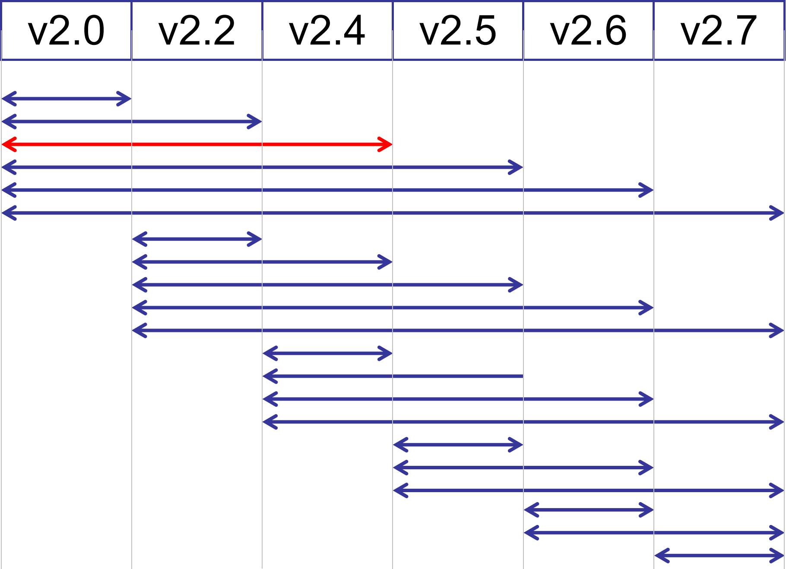
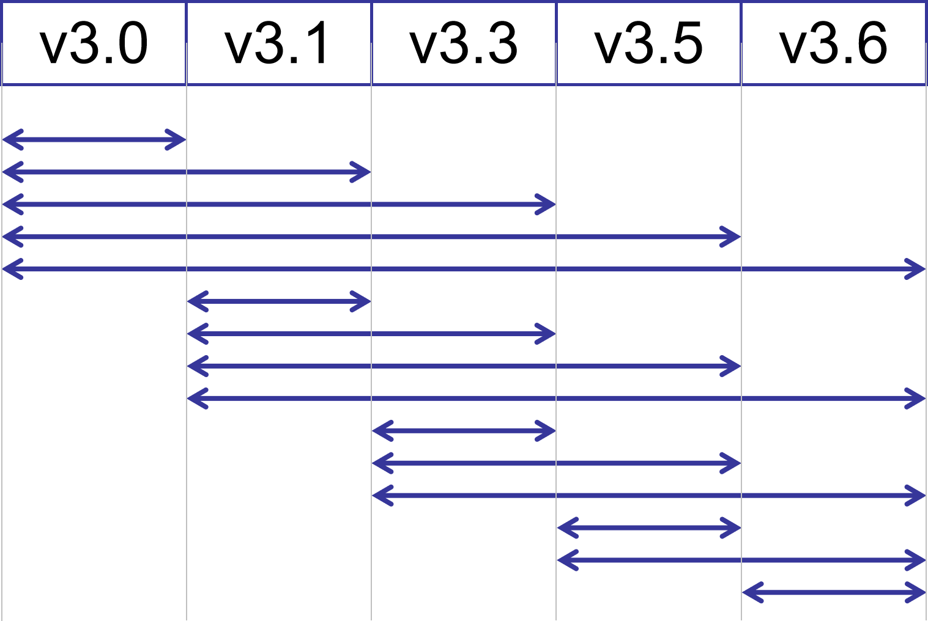
RQ1: Version range for Python 2 or Python 3
Criteria for available Python version ranges
From the oldest python version to the latest python version that the code snippet can pass PyComply parsing
There can be breaks between available python version ranges
An Example
2.0-2.4
code snippets are compilable for Python 2.0 and Python 2.4
code snippets can exist that are not compilable for Python 2.2

Slide 10
RQ1: Version range combination
The combination of available version ranges in Python 2 and Python 3 can be divided into three categories:
Ranges span Python 2 and Python 3：contains both the range of Python 2 and Python 3, such as [2.0,3.0-3.3]
Only in Python 2：Contains only the range of Python 2, not the range of Python 3, like [2.0, ∅]
Only in Python 3：Contains only the range of Python 3, not the range of Python 2, like [∅, 3.6]
∅: no Python 2 version available or no Python 3 version available
Version Range
2.0
2.0-2.4
2.0-2.5
2.0-2.7
2.2-2.4
2.2-2.7
2.4
2.4-2.5
2.4-2.7
2.5
2.5-2.7
2.6-2.7
2.7
∅
Version Range
3.0-3.3
3.0-3.6
3.1-3.3
3.1-3.6
3.3
3.3-3.5
3.3-3.6
3.5-3.6
3.6
∅
[Range in Python 2 , Range in Python 3]

Slide 11
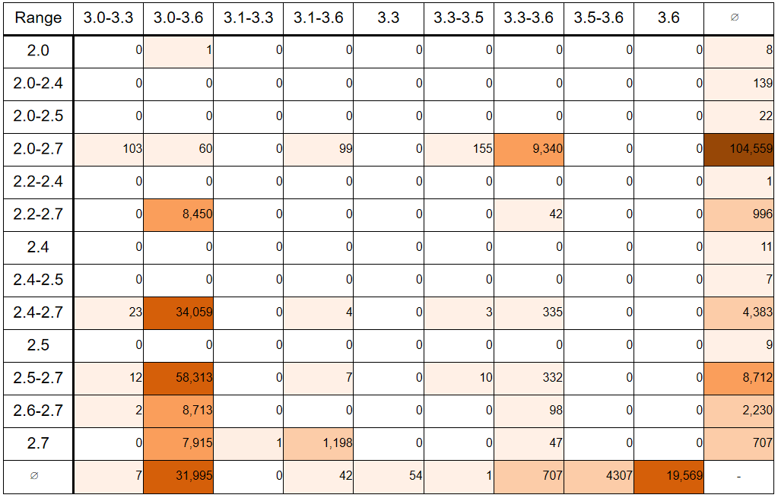
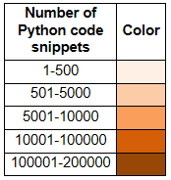
RQ1:Result
46 available Python version ranges
Ranges span Python 2 and Python 3： 42%
Only in Python 2： 40%
Only in Python 3： 18%
Code snippets are relatively concentrated in the range of versions containing 2.7 and/or 3.6

Slide 12
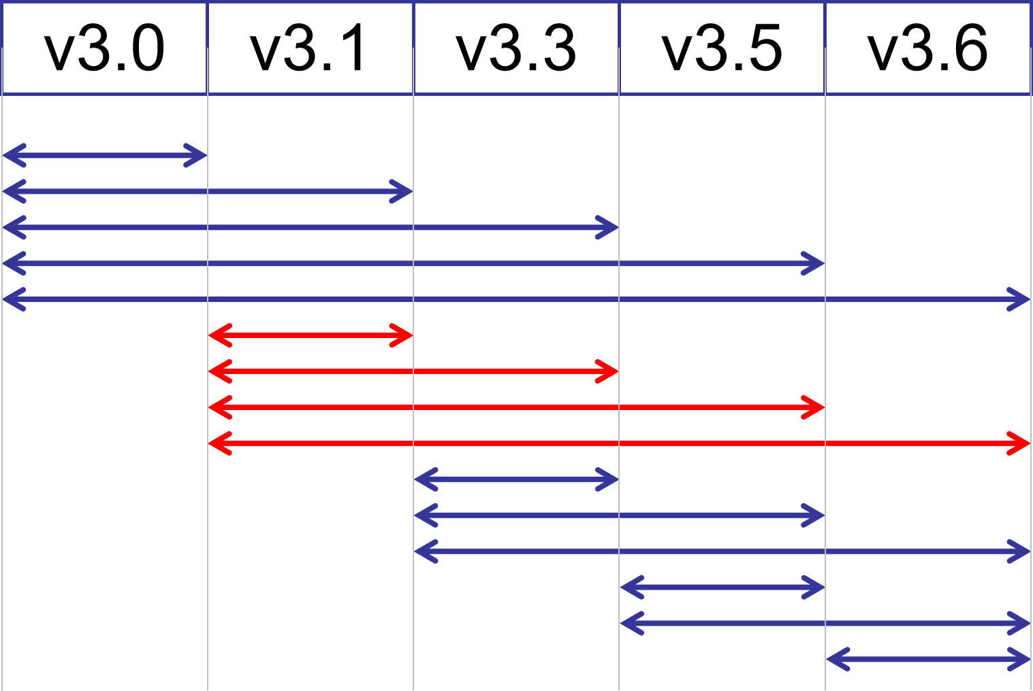
RQ2: Definition
RQ2: How Stack Overflow users respond to each Python release, and what are the differences between Python 2 and Python 3?
We refer to the Python code snippets that are compilable for a certain Python version after it is released as the code snippets responding to that version
Code snippets responding to a certain Python version need to be compilable for that version, and uncompilable for the Python versions before that version
Code snippets responding to Python 3.1

Slide 13
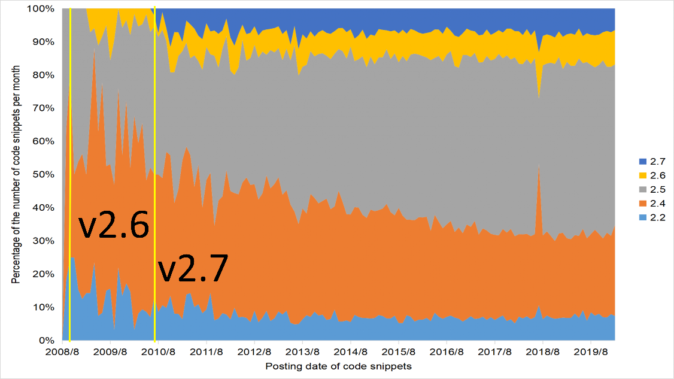
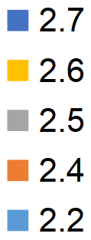
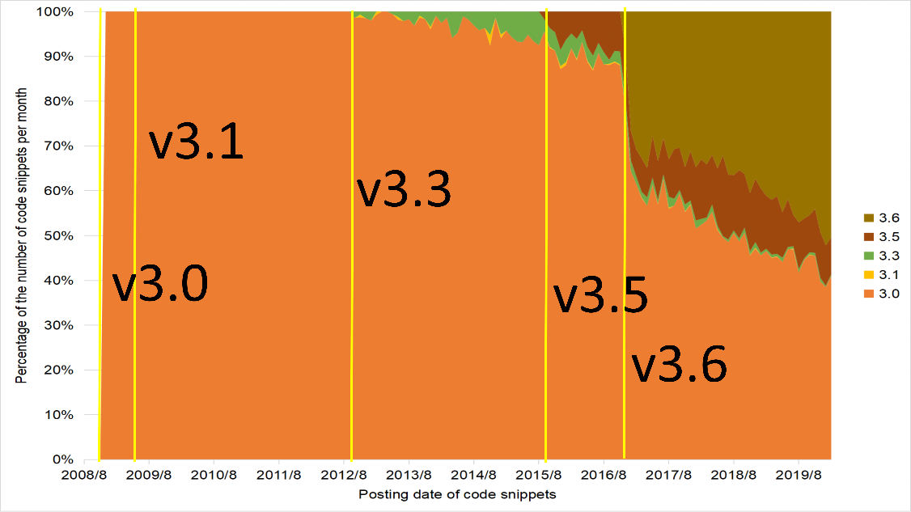
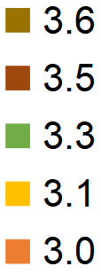
RQ2: Result
Except for 3.1, new versions are released and get a response shortly afterward
The release of the new version inhibits the development of the old versions
Unable to compare response differences between Python 2 and Python 3 releases
Notably:
3.6 developed rapidly after getting the response
100%
0%
2008/08
Posting date of code snippets
2019/08
100%
…
0%
2008/08
Posting date of code snippets
2019/08

Slide 14
RQ3: Definition
RQ3: How are Python 2-only compilable Python code snippets and Python 3-only compilable Python code snippets distributed on Stack Overflow?
While developers can upgrade to Python 3, code snippets written in Python 2 on Stack Overflow may not be modified by their authors to make them compilable for Python 3
We need to find out if Python 2-only compilable Python code snippets on Stack Overflow. If so, compare it to the Python 3-only compilable code snippets and analyze the differences

Slide 15
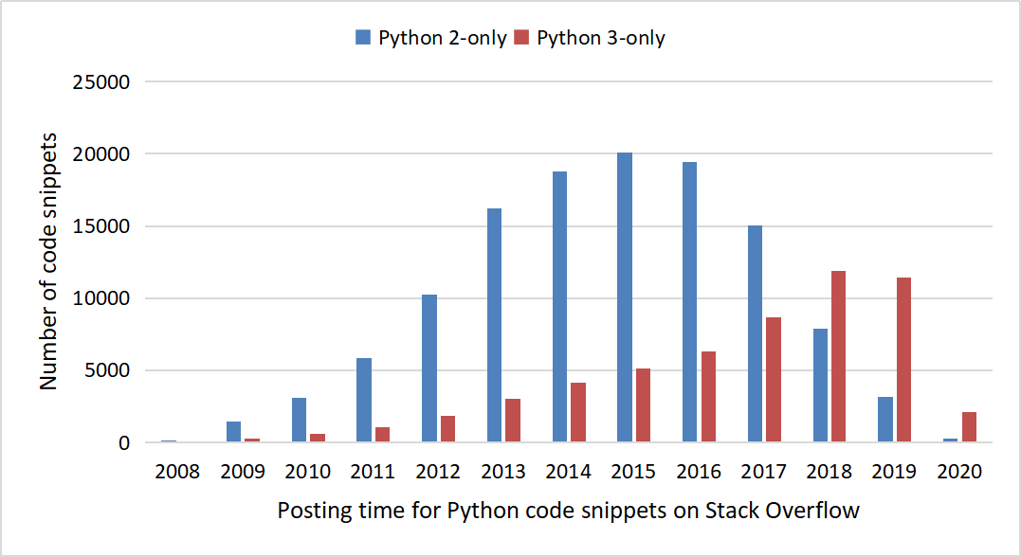
RQ3: Result
The number of Python 2-only compilable Python code snippets increased year by year starting in 2008, peaked in 2015, and began to decline year by year after that
There is an overall upward trend in Python 3-only compilable Python code snippets
Among the code snippets investigated by RQ3, the Python 2-only compilable Python code snippets are about twice as large as the Python 3-only compilable Python code snippets

Slide 16
Conclusion
We want to investigate the impact of Python version upgrades on the compilability of Python code snippets on Stack Overflow
By analyzing the compilability of Python code snippets on Stack Overflow for different Python versions, we found that Python version upgrades had an impact on the compilability of Python code snippets on Stack Overflow, as follows：
About 40% of the code snippets investigated in this study were uncompilable for Python 2
The release of new Python version inhibits Stack Overflow users’ response to older versions
The trend of code snippets responding to newer versions increases over time

Slide 17
Future Work
Investigate the reasons for the failure of the code snippets removed in this study that are uncompilable for all Python versions
Investigate factors that affect the compilability of code snippets on Stack Overflow due to Python version upgrades

Slide 18
Q&A

Slide 19
Q&A
Python versions
We removed the results for the versions whose parsing results were identical to the previous version
2.1, 2.3, 3.2, 3.4 were elided
Version
v2.0
v2.2
v2.4
v2.5
v2.6
v2.7
v3.0
v3.1
v3.3
v3.5
v3.6

Slide 20
Q&A
Version | Release Date
v2.0 | 2000.10.16
v2.2 | 2001.12.21
v2.4 | 2004.11.30
v2.5 | 2006.09.19
v2.6 | 2008.10.1
v2.7 | 2010.7.3
v3.0 | 2008.12.3
v3.1 | 2009.6.27
v3.3 | 2012.9.29
v3.5 | 2015.9.13
v3.6 | 2016.12.23
https://www.python.org/

Slide 21
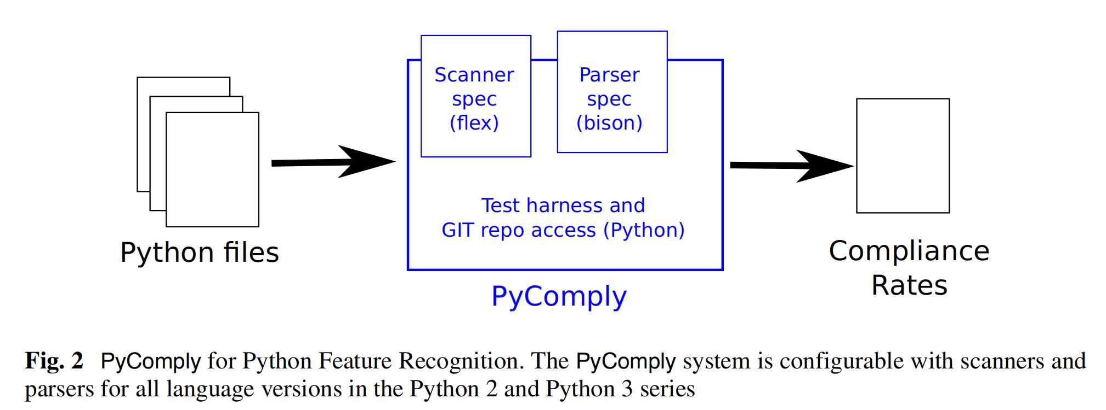
Q&A
PyComply
Python Compliance Analyzer, testing applications for Python 2 and Python 3 compliance with Python syntax and feature recognition
Dataflow
Input to PyComply is the Python grammar for the version under study together with a Python program or test case
output from the tool includes the statistical information that we gather for this study or the number of Python 3 features that were recognised by PyComply
[1]

Slide 22
Q&A
Code snippets on Stack Overflow are short and lack specific Python version features
[1]

