Slide 1
The Effect of Python Version Upgrades on the Compilability of Code Snippets Posted on Stack Overflow
Shiyu Yang¹, Tetsuya Kanda¹, Katsuro Inoue²
¹Osaka University
²Nanzan University

Slide 2
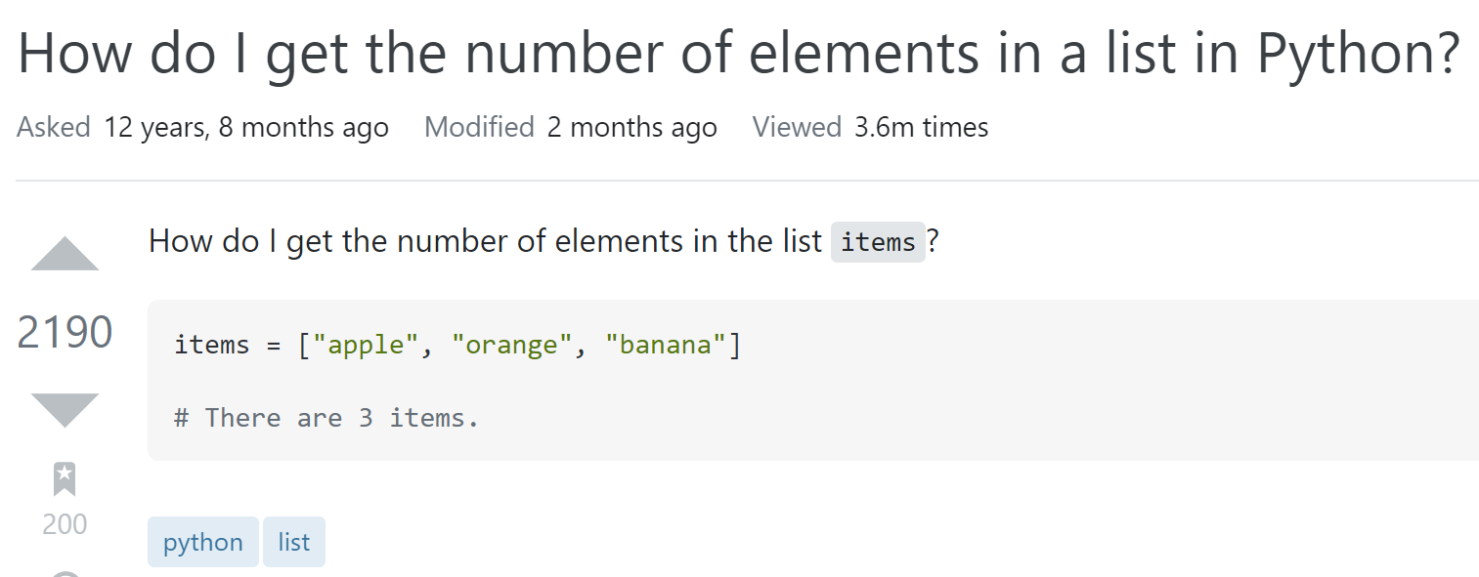
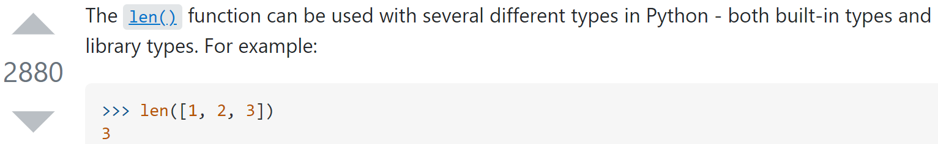
Stack Overflow
Developers are used to reusing code snippets from Stack Overflow
Question
Code snippet
tags
Answer
Code snippet

Slide 3
Problem
Some code snippets on Stack Overflow may have issues
  obsolete[1]
  low-quality[2]
  ...
These code snippets may mislead answer seekers, cause unexpected problems and create barriers to code reuse
There are many reasons why code snippets can be problematic, one of which is the use of outdated programming language features, which can cause code snippets to become obsolete
[1] H. Zhang, S. Wang, T. -H. Chen, Y. Zou and A. E. Hassan, "An Empirical Study of Obsolete Answers on Stack Overflow," in IEEE Transactions on Software Engineering, vol. 47, no. 4, pp. 850-862, 1 April 2021, doi: 10.1109/TSE.2019.2906315.
[2] Wu, Y., Wang, S., Bezemer, CP. et al. How do developers utilize source code from stack overflow?. Empir Software Eng 24, 637–673 (2019). https://doi.org/10.1007/s10664-018-9634-5.

Slide 4
Python Language Evolution and Backward Compatibility(1/2)
Programming languages need to evolve in response to external and internal factors continually
Many popular programming languages have maintained backward compatibility during their evolution
Backward Compatibility:
Software developed in an earlier version of the language can be compiled with a later version and express the same behavior as the previous version

Slide 5



Python Language Evolution and Backward Compatibility(2/2)
Python 3 is not backward compatible with Python 2
The lack of backward compatibility for Python 3 can cause problems for users
Reuse
User's project
Python version: 2.x
code snippet
Python 2 features
User's project
Python version: 3.x
Reuse

Slide 6
Research Purposes
Investigating the effect of Python version upgrades on the compilability of code snippets posted on Stack Overflow
  available versions of existing code snippets: the range of Python versions for which the code snippets can be compiled
  user attitudes toward Python version upgrades
Research Questions
  RQ1: What are the available Python version ranges for Python code snippets on Stack Overflow?
  RQ2: How Stack Overflow users respond to each Python release, and what are the differences between Python 2 and Python 3?
  RQ3: How are Python 2-only compilable Python code snippets and Python 3-only compilable Python code snippets distributed on Stack Overflow?

Slide 7
PyComply[3]
Definition
Python Compliance Analyzer, testing applications for compliance with Python 2 and Python 3 through Python feature recognition
Dataflow
Input: Python code snippets
Output: The compliance results of the code snippets, i.e. whether the code snippets are compilable for a certain Python version
code snippets
Scanner x.x
Parser x.x
compliance results
PyComply x.x
[3] B. A. Malloy and J. F. Power, "Quantifying the Transition from Python 2 to 3: An Empirical Study of Python Applications," 2017 ACM/IEEE International Symposium on Empirical Software Engineering and Measurement (ESEM), Nov. 2017, pp. 314-323.

Slide 8
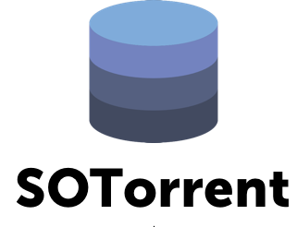
Study Approach(1/2)
2.Handling formatting issues
3.Build the PyComply for each Python version
Python code snippets
Formatted Python code snippets
1.Extracting Python code snippets
Data source:
SOTorrent, an open dataset based on the official Stack Overflow data dump
Version: SOTorrent20_03
Criteria for code snippets:
Code snippets from posts containing the tag "Python"
Posting data is up to date
Number of code snippets:
2,475,559
PyComply2.0
PyComply2.2
...
4.PyComply parsing
PyComply3.6
compliance results

Slide 9
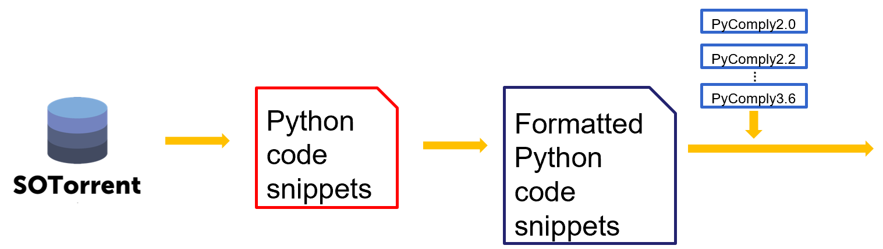


Study Approach(2/2)
compliance results
Failed for all versions
Passed for all versions
Failed for all versions:
Code snippets that are not compilable for all
Python versions
Number: 1,173,905(47%)
Passed for all versions:
Code snippets that are compilable for all Python versions
Number: 993,866(40%)
Only passed for certain versions:
Code snippets that are only compilable for certain versions
Number: 307,788(12%)
Only passed for certain versions

Slide 10
Research Questions
RQ1: What are the available Python version ranges for Python code snippets on Stack Overflow?
RQ2: How Stack Overflow users respond to each Python release, and what are the differences between Python 2 and Python 3?
RQ3: How are Python 2-only compilable Python code snippets and Python 3-only compilable Python code snippets distributed on Stack Overflow?

Slide 11
RQ1: Definition
Version range for Python 2 or Python 3:
  Get the available Python version ranges of code snippets within Python 2 and Python 3, respectively
Version range combination :
  Combine the obtained available version ranges in Python 2 and Python 3 in pairs, and extract the duplicates

Slide 12
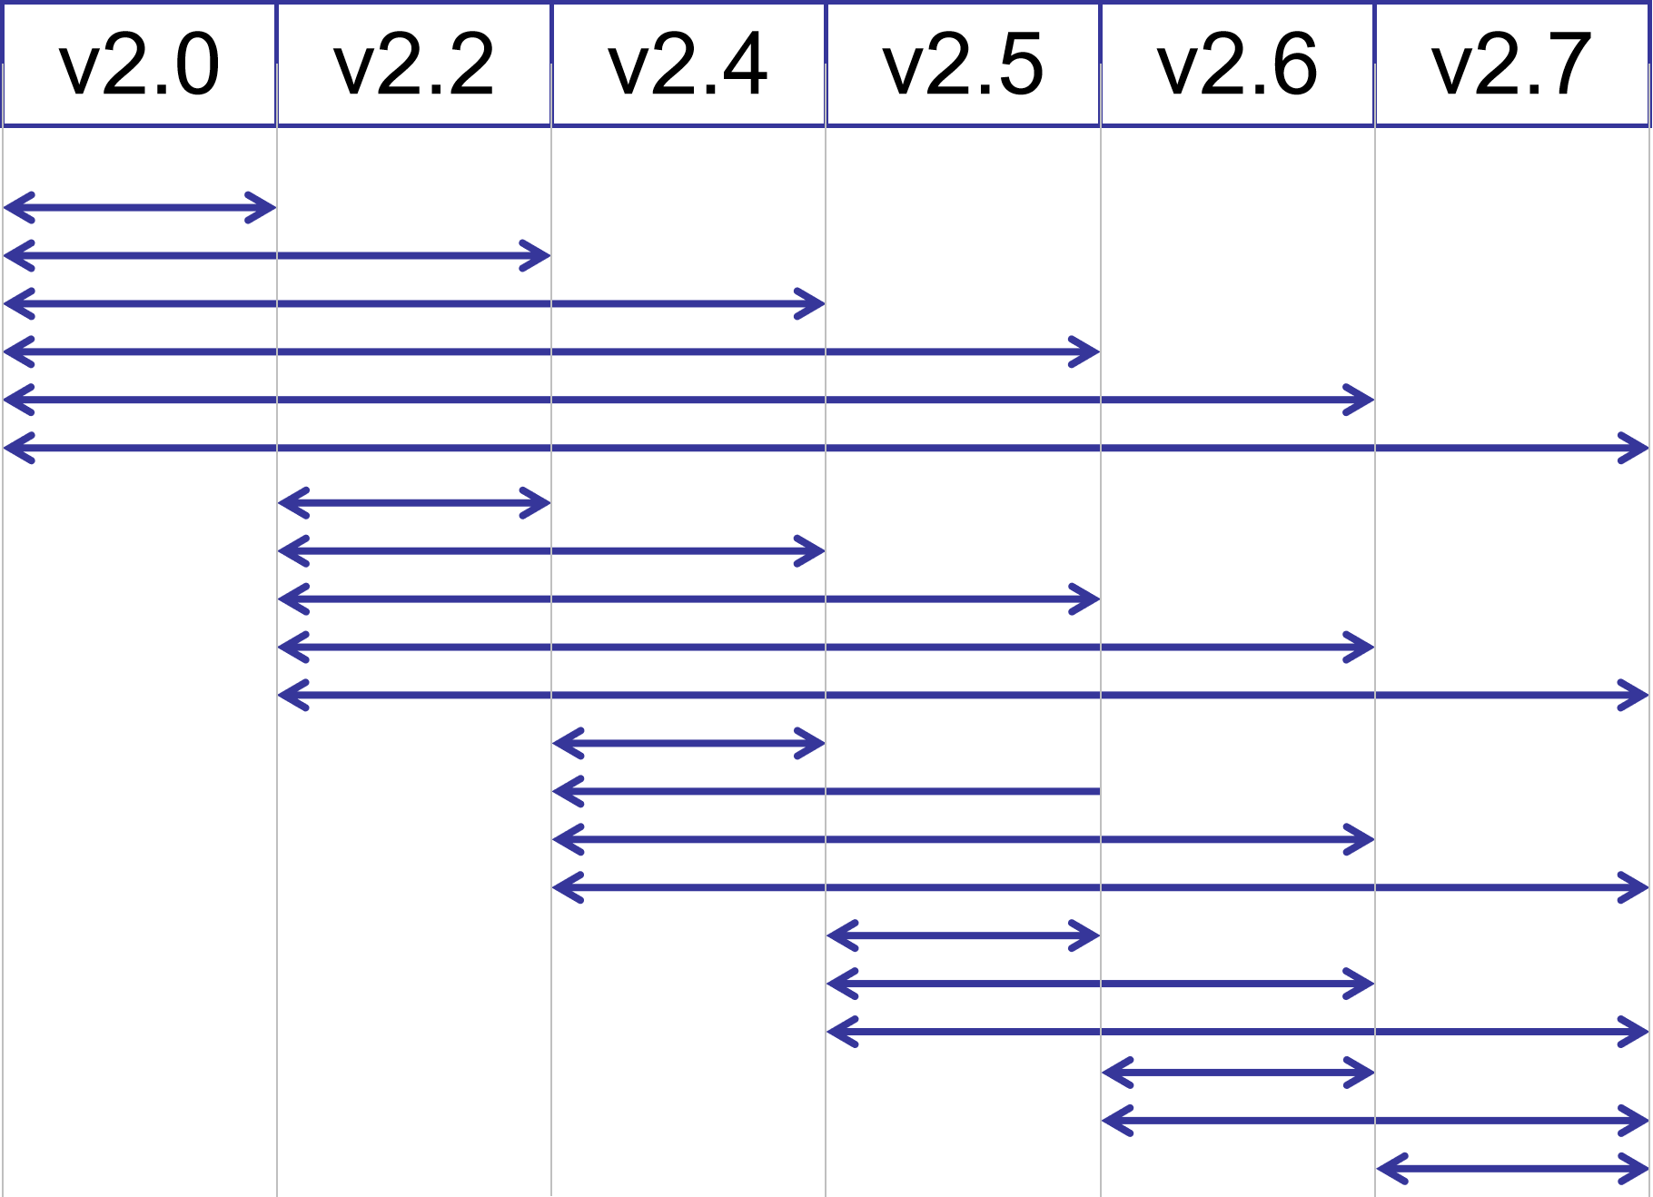
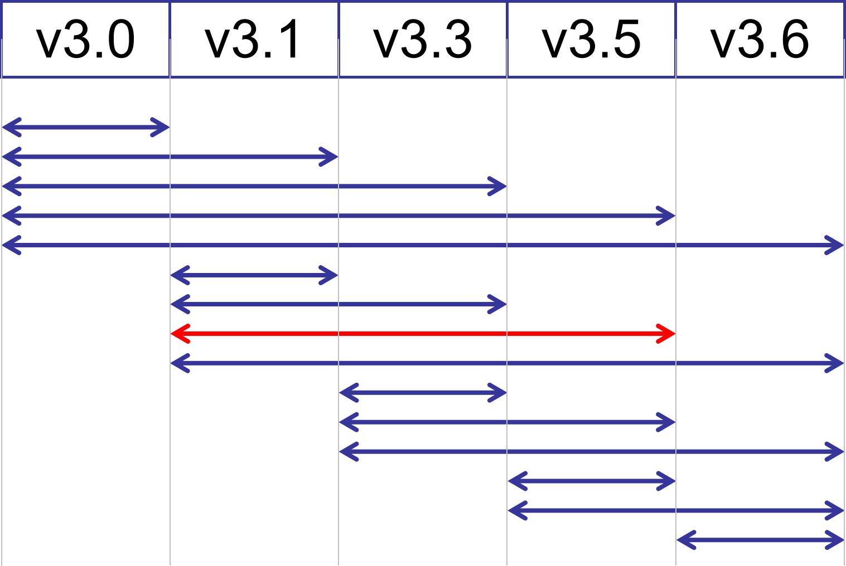
RQ1: Version range for Python 2 or Python 3
Criteria for available version ranges
  From the oldest Python version to the latest Python version that the code snippet can pass PyComply parsing
  There can be breaks between available Python version ranges
Range:3.1-3.5

Slide 13
RQ1: Version range combination
Categories of available version range combinations:
  Ranges span Python 2 and Python 3
    e.g. [2.0,3.0-3.3]
  Only in Python 2
    e.g. [2.0, ∅]
  Only in Python 3
    e.g. [∅, 3.6]
∅: no Python 2 version available or no Python 3 version available
Version Range
2.0
2.0-2.4
2.0-2.5
2.0-2.7
2.2-2.4
2.2-2.7
2.4
2.4-2.5
2.4-2.7
2.5
2.5-2.7
2.6-2.7
2.7
∅
Version Range
3.0-3.3
3.0-3.6
3.1-3.3
3.1-3.6
3.3
3.3-3.5
3.3-3.6
3.5-3.6
3.6
∅
[Range in Python 2 , Range in Python 3]

Slide 14
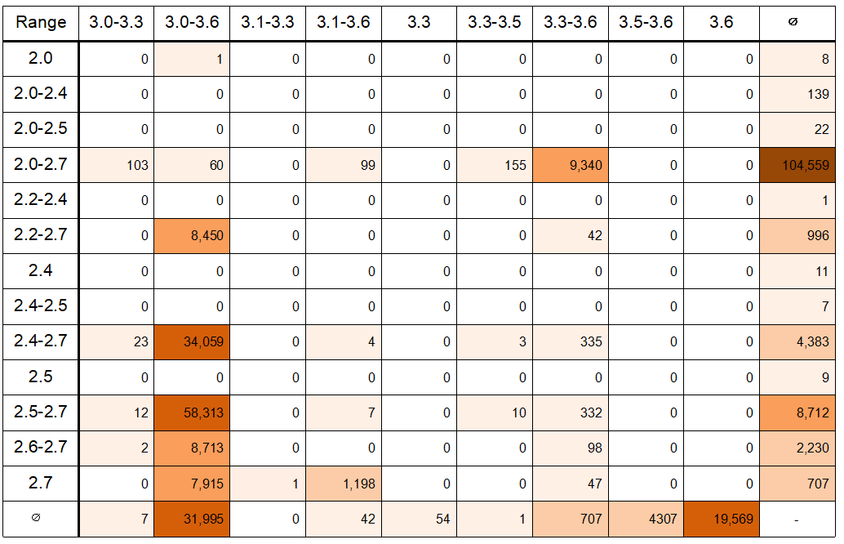
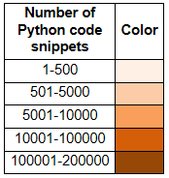
RQ1:Result
46 available Python version ranges
Ranges span Python 2 and Python 3： 42%
Only in Python 2： 40%
Only in Python 3： 18%
Code snippets are relatively concentrated in the range of versions containing 2.7 and/or 3.6

Slide 15
Research Questions
RQ1: What are the available Python version ranges for Python code snippets on Stack Overflow?
RQ2: How Stack Overflow users respond to each Python release, and what are the differences between Python 2 and Python 3?
RQ3: How are Python 2-only compilable Python code snippets and Python 3-only compilable Python code snippets distributed on Stack Overflow?

Slide 16
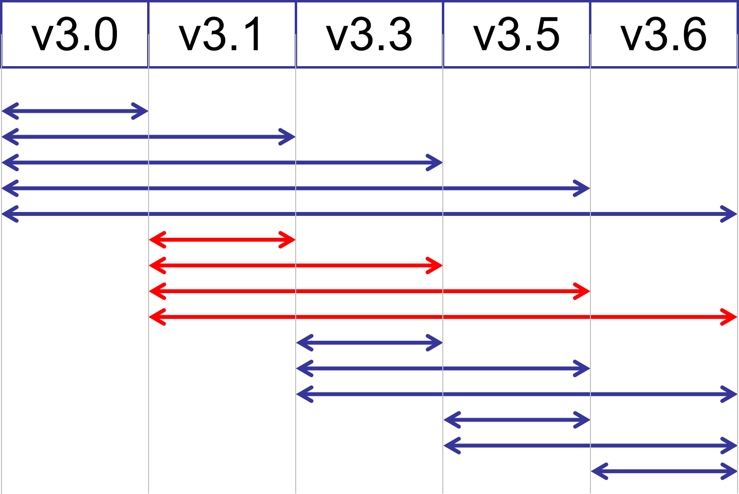
RQ2: Definition
Stack Overflow users respond to each Python release
  The evolution of Python code snippets in response to each Python version since the release of each version
Python code snippets responding to a certain version
  need to be compilable for that version, and uncompilable for the Python versions before that version
Code snippets responding to Python 3.1

Slide 17
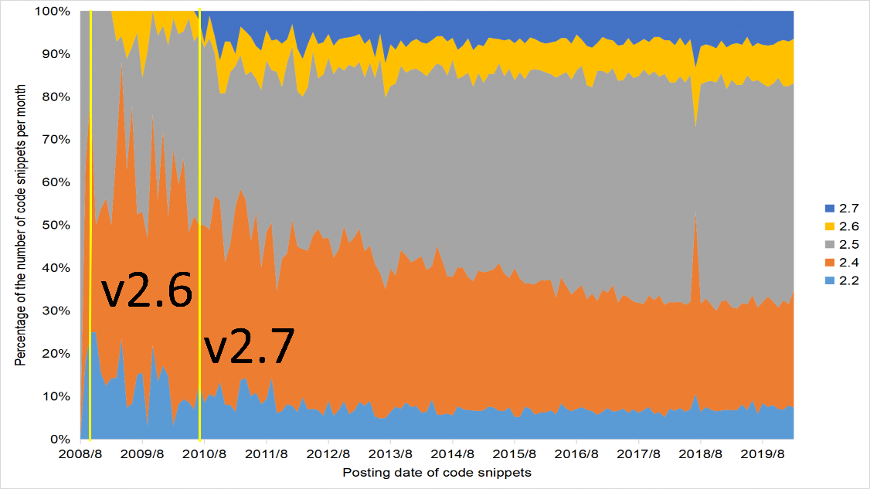
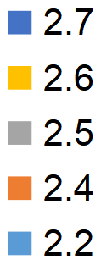
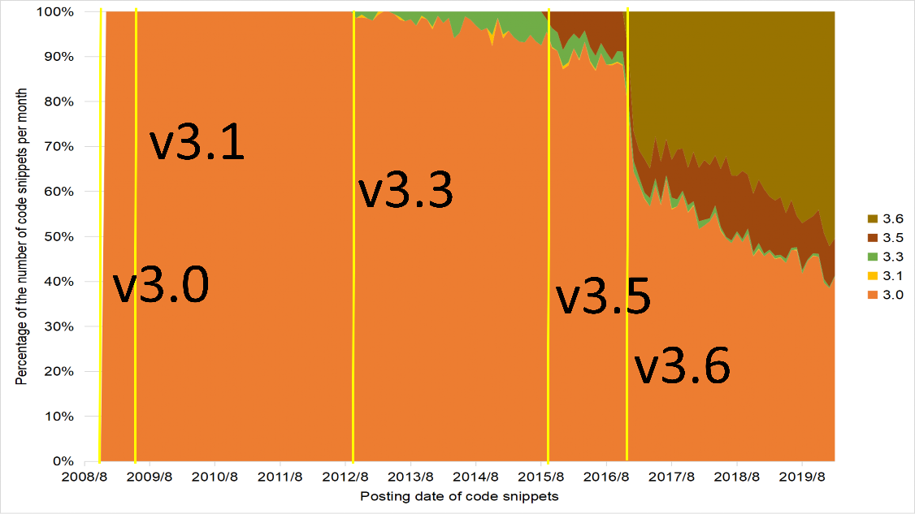
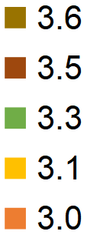
RQ2: Result(1/2)
horizontal axis:
  posting date of code snippets
vertical axis:
  percentage of the number of code snippets per month
yellow line:
  release date of each Python version
100%
0%
2008/08
Posting date of code snippets
2019/08
100%
0%
2008/08
Posting date of code snippets
2019/08

Slide 18
RQ2: Result(2/2)
Stack Overflow users are not averse to trying new Python versions
Python 2 and Python 3 have similar trends
100%
0%
2008/08
Posting date of code snippets
2019/08
100%
0%
2008/08
Posting date of code snippets
2019/08

Slide 19
Research Questions
RQ1: What are the available Python version ranges for Python code snippets on Stack Overflow?
RQ2: How Stack Overflow users respond to each Python release, and what are the differences between Python 2 and Python 3?
RQ3: How are Python 2-only compilable Python code snippets and Python 3-only compilable Python code snippets distributed on Stack Overflow?

Slide 20
RQ3
While developers can upgrade to Python 3, code snippets written in Python 2 on Stack Overflow may not be modified by their authors to make them compilable for Python 3
We need to find out if Python 2-only compilable Python code snippets on Stack Overflow
If so, compare it to the Python 3-only compilable code snippets and analyze the differences.

Slide 21
RQ3: Result
The Python 2-only compilable code snippets increased year by year, peaked in 2015, and began to decline year by year after that
There is an overall upward trend in Python 3-only compilable Python code snippets
The Python 2-only compilable code snippets are about twice as large as the Python 3-only compilable Python code snippets

Slide 22
Discussion： Implications
Suggestions for Stack Overflow:
  Build an automated tool
    To identify the Python language version of existing code snippets on Stack Overflow
    To help users identify the Python version used in the posted code snippet in real-time as they create their questions or answers
Suggestions for Stack Overflow users:
  Provide Python version information for code snippets

Slide 23
Conclusion&Future Work
Conclusion
Investigated the effect of Python version upgrades on the compilability of Python code snippets on Stack Overflow
Discussed the findings of our study and their implications
Future Work
Investigate the reasons for the failure of the code snippets removed in this study that are uncompilable for all Python versions
Investigate factors that affect the compilability of code snippets on Stack Overflow due to Python version upgrades

