Slide 1
Osmy: A Tool for Periodic Software Vulnerability Assessment and File Integrity Verification using SPDX Documents
Rio Kishimoto¹ Tetsuya Kanda¹ Yuki Manabe² Katsuro Inoue³ Yoshiki Higo¹
¹ Osaka University, Japan
² The University of Fukuchiyama, Japan
³ Nanzan University, Japan
Notes:
0:00-0:07
Today, We’d like to talk about “Osmy”, a tool for software management using SPDX documents.

Slide 2
SBOM & SPDX
Software management using SBOM is recommended ^{[1]}
Accelerate response to vulnerabilities of dependent libraries
SBOM (Software Bill of Materials)
List of components that make up software, including information on
dependent libraries (name, version, dependency etc.)
SPDX (Software Package Data Exchange)
One of the major formats of SBOM
Developed by Linux Foundation, Standardized as ISO/IEC 5962:2021
[1] NSA “Recommendations for Software Bill of Materials (SBOM) Management” (2023)
Notes:
0:07-0:50
Recently, software management using SBOM is recommended to accelerate response to vulnerabilities of dependent libraries.
Software Bill of Materials (SBOM) is a document that list up components that make up software.
It contains information of libraries such as name, version and dependency.
Software Package Data Exchange (SPDX) is one of the major formats of SBOM.
It is developed by Linux Foundation and has been standardized as an international standard.

Slide 3
Need for software management tool using SBOM
Regular tasks that take time and effort:
Continuously check for
new vulnerabilities
Detect file tampering/corruption
as soon as possible
Tools for software
end-users are needed
Tools that support SBOM is lacking ^{[2]}
[2] Xia et al. “An Empirical Study on Software Bill of Materials: Where We Stand and the Road Ahead” (ICSE2023)
Notes:
0:50-1:30
Software management requires tasks that take time and effort to be performed on regular basis,
to continuously check for new vulnerabilities and detect file tampering/corruption as soon as possible.
However, despite the recommendation of using SBOM, tools that support software management with SBOM is lacking.
For these reasons, such tools for software end users are needed.

Slide 4
Overview of Osmy
Osmy makes software management using SPDX documents easier and more labor-saving
Osmy
SPDX document
Vulnerability
Assessment
1.
Result
File Integrity
Verification
User
2.
Notification
Notes:
1:30-2:30
In this study, we create a tool called “Osmy” which performs vulnerability assessment and file integrity verification using SPDX documents.
Osmy makes software management using SPDX documents easier and labor-saving.
▼ The user prepare an SPDX document of software to manage with Osmy.
▼ Osmy automatically and periodically performs vulnerability assessment and file integrity verification of the software based on the information in the document.
▼ The user can check the result of the assessment and the verification. Osmy also notifies the user by e-mail if it finds any issues.

Slide 5
Overview of Osmy
Osmy makes software management using SPDX documents easier and more labor-saving
Osmy
SPDX document
Vulnerability
Assessment
1.
Result
File Integrity
Verification
User
2.
Notification
Notes:
1:30-2:30
In this study, we create a tool called “Osmy” which performs vulnerability assessment and file integrity verification using SPDX documents.
Osmy makes software management using SPDX documents easier and labor-saving.
▼ The user prepare an SPDX document of software to manage with Osmy.
▼ Osmy automatically and periodically performs vulnerability assessment and file integrity verification of the software based on the information in the document.
▼ The user can check the result of the assessment and the verification. Osmy also notifies the user by e-mail if it finds any issues.

Slide 6
Overview of Osmy
Osmy makes software management using SPDX documents easier and more labor-saving
Osmy
SPDX document
Vulnerability
Assessment
1.
Result
File Integrity
Verification
User
2.
Notification
Notes:
1:30-2:30
In this study, we create a tool called “Osmy” which performs vulnerability assessment and file integrity verification using SPDX documents.
Osmy makes software management using SPDX documents easier and labor-saving.
▼ The user prepare an SPDX document of software to manage with Osmy.
▼ Osmy automatically and periodically performs vulnerability assessment and file integrity verification of the software based on the information in the document.
▼ The user can check the result of the assessment and the verification. Osmy also notifies the user by e-mail if it finds any issues.

Slide 7
Overview of Osmy
Osmy makes software management using SPDX documents easier and more labor-saving
Osmy
SPDX document
Vulnerability
Assessment
1.
Result
File Integrity
Verification
User
2.
Notification
Notes:
1:30-2:30
In this study, we create a tool called “Osmy” which performs vulnerability assessment and file integrity verification using SPDX documents.
Osmy makes software management using SPDX documents easier and labor-saving.
▼ The user prepare an SPDX document of software to manage with Osmy.
▼ Osmy automatically and periodically performs vulnerability assessment and file integrity verification of the software based on the information in the document.
▼ The user can check the result of the assessment and the verification. Osmy also notifies the user by e-mail if it finds any issues.

Slide 8
Usage Example
Software management scenario using Osmy:
Vulnerability Assessment
File integrity verification
Target software:
ILSpy
Jellyfin
ScreenToGif
ShareX
v2rayN
Notes:
2:30-2:40
In this example, we manage 5 pieces of software with Osmy.

Slide 9
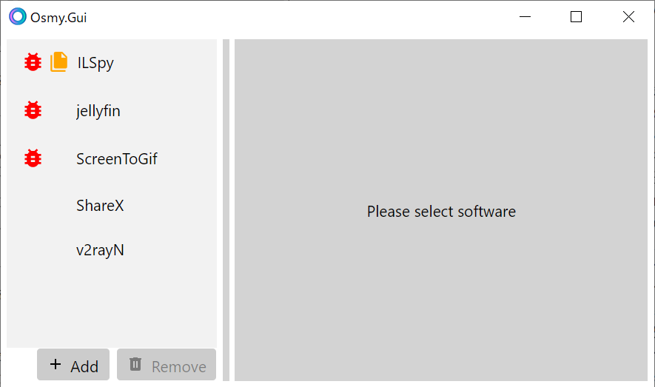
Overview of Osmy’s Main Window
1 piece of software has file integrity errors
3 pieces of software have vulnerabilities
Notes:
2:40-3:30
This is a screenshot of Osmy’s window just after startup.
Osmy shows the list of managed software in the left side of the window.
Each item in the list shows the software’s display name and icons with the latest result of vulnerability assessment and file integrity verification.
In this example, 1 piece of software has file integrity errors, and 3 pieces of software have vulnerabilities.
In the following slides, we will explain Osmy’s 2 main functionalities: Vulnerability Assessment and File Integrity Verification.

Slide 10
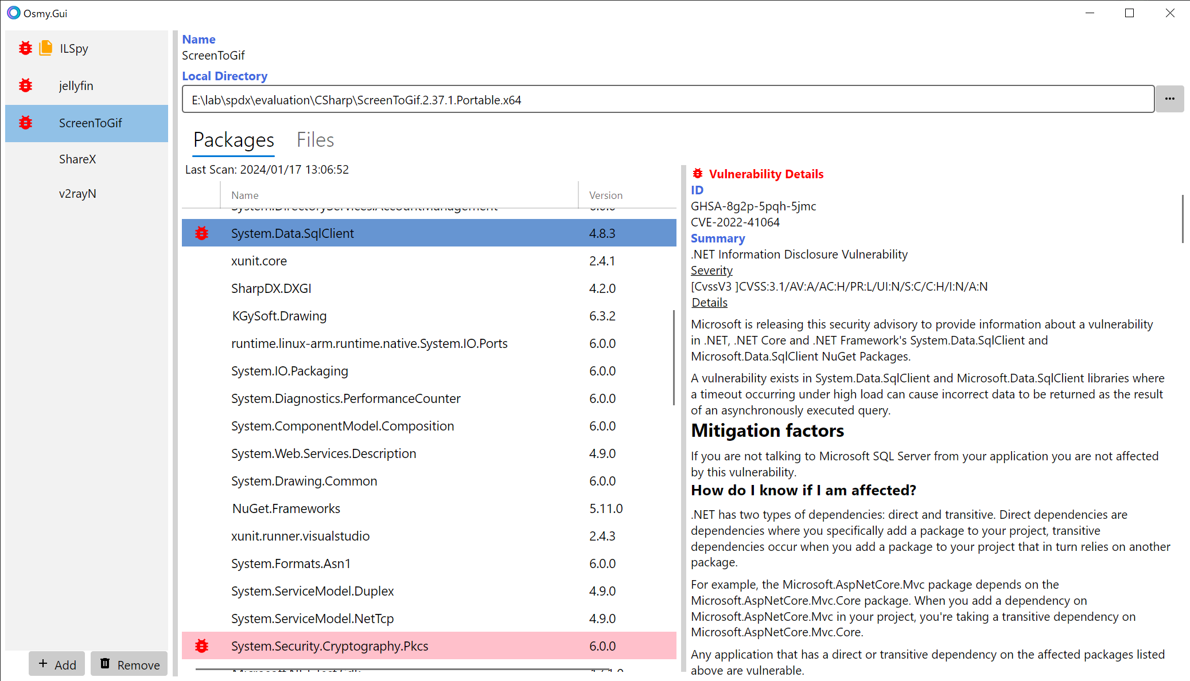
1. Vulnerability Assessment
1. Select software
2. Packages tab
3. Details of vulnerability
Notes:
3:30-4:15
First, we explain the functionality of vulnerability assessment.
In the left side of the window, we can select software and Osmy shows the detailed information of selected software in the right side.
Some areas of the right are tab-switchable. In the “Packages” tab, we can see the list of dependent packages of software.
Packages containing vulnerabilities are highlighted in red, and we can check the details of the vulnerability by selecting the highlighted package.

Slide 11
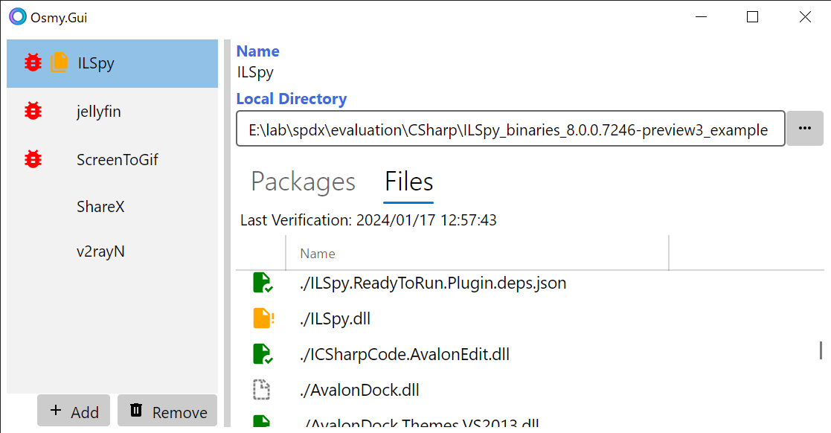
2. File Integrity Verification
File integrity verification result is displayed in the Files tab
Files tab
OK
Checksum mismatch
Missing file
Notes:
4:15-4:55
Next, we explain the functionality of file integrity verification.
In the “Files” tab, we can see the list of files consists of software.
Osmy indicates the latest result of file integrity verification by an icon next to the file name.
The green icon means that the file checksum matches the legitimate checksum written in the SPDX document.
The yellow icon means that the file checksum does not match it, and the dotted icon means that the file does not exist.

Slide 12
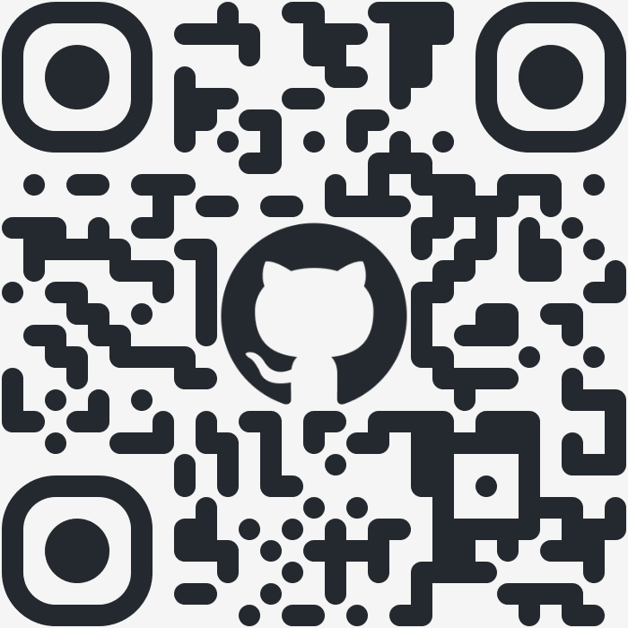
Conclusion
Present a tool called “Osmy”, which makes software management using SPDX documents easier and more labor-saving
https://github.com/higolab/Osmy
SPDX document
Osmy
Vulnerability
Assessment
1.
User
Result
File Integrity
Verification
2.
Notification
Notes:
4:55-5:00
(If you are interested, we want you to come to our tool demo.)
Thank you for your attention

Slide 13
Problems in software management
Third-party libraries are widely used in software development
Using libraries:
✔ shorten development time and reduce costs
✖ incorporate defects contained in libraries
Lack of management of third-party libraries results in:
✖ Delays in responding to vulnerabilities
✖ License violations
Notes:
First, We’d like to show a background.
In modern software development, third-party libraries are widely used.
Using libraries has the advantage of shortening development time and reducing costs, but it also has the disadvantage of incorporating defects contained in libraries into the software.
Therefore, it is important to manage the libraries you use.
However, the management is inadequate, resulting in delays in responding to vulnerabilities and license violations.
97% of software contains third-party (open source) code ^{[1]}
Research target of Synopsys: 17 areas of industries, codebases more than 2400

Slide 14
Vulnerable log4j is still in use
20%
https://www.sonatype.com/resources/log4j-vulnerability-resource-center
Notes:
A research has confirmed that vulnerable versions of libraries continue to be used.
This graph shows the percentage of vulnerable versions of the monthly downloads of Log4j, a Java logging library, over time.
In December 2021, a critical vulnerability called Log4Shell was found in Log4j.
More than two years later, in January 2024, vulnerable versions still account for more than 20% of downloads in many countries.
To deal with these problems in software management, the use of a software bill of materials is recommended.

Slide 15
Minimum elements of SBOM
NTIA shows the minimum elements of SBOM
Supplier of software component
Name of software component
Version of software component
Other unique identifiers
Dependency between software components
Creator of SBOM
Creation Date of SBOM
Notes:
アメリカ合衆国国家電気通信情報管理庁（NTIA）

Slide 16
Composition of SPDX document
SPDX v2.2.2 Document
Shall contain:
May contain:
SPDX Document
Creation Information
Creator
Creation Date etc.
Package Information
Relationships between
SPDX elements information
File Information
Annotations Information
Snippet Information
Review Information
Other Licensing
Information Detected
Notes:
SBOMs created in SPDX format is called “SPDX document”
SPDX document shall contain document creation information and may contain some other information.
In this study, we use package information, file information, and relationships between SPDX elements information.

Slide 17
Benefit of SBOM
without SBOM
with SBOM
libraries'
Name
Version
License etc.
libraries’
Name
Version
License etc.
Binary
Binary
Document
User
Document
SBOM
User
Collect information from many sources
Get information from SBOM
Source
Source
Developers create SBOM
Icons of binary, document and source CC BY 4.0 Microsoft and any contributors
https://github.com/microsoft/vscode-codicons/blob/main/LICENSE
Notes:
I will explain the benefits of using SBOM.
As shown in the left side of the slide, we need to collect information on dependent libraries from various sources.
On the other hand, when using SBOM, the information necessary for software management is compiled in SBOM by the software developers.
We can obtain necessary information from SBOM.
This will reduce the effort required by users to collect information and is expected to improve the accuracy of information.

Slide 18
Example of File Information
{
"fileName": "./log4net.dll",
"SPDXID": "SPDXRef-File-log4net.dll",
"checksums": [
{
"algorithm": "SHA256",
"checksumValue": "dde0278246298776f9d7fa731cef6463a4dbd5a53b7034e88aca30852e272b73"
},
{
"algorithm": "SHA1",
"checksumValue": "40fdba136f864c8a2f3e3f9c9e3949f7582a6077"
}
],
"licenseConcluded": "NOASSERTION",
"licenseInfoInFiles": [ "NOASSERTION" ],
"copyrightText": "NOASSERTION"
}
File Name
Checksums of a file
Notes:
This is an example of file information section of an SPDX document written in JSON format.
File Information contains file name, an identifier for the file within this document, checksum, license information, etc.
The file name is written in the green area, and file checksum is written in the blue area.
A checksum is a type of error detection code calculated from the contents of a file.
By using this, you can check whether the file has been tampered with or corrupted.

Slide 19
Example of Package Information and Relationship Information
Package Information
Relationship Information
{
"name": "log4net",
"SPDXID": "SPDXRef-Package-log4net",
"downloadLocation": "NOASSERTION",
"filesAnalyzed": false,
"licenseConcluded": "NOASSERTION",
"licenseInfoFromFiles": [ "NOASSERTION" ],
"licenseDeclared": "NOASSERTION",
"copyrightText": "NOASSERTION",
"versionInfo": "2.0.8",
"externalRefs": [ … ],
"supplier": "NOASSERTION"
}
{
"relationshipType": "DEPENDS_ON",
"relatedSpdxElement": "SPDXRef-Package-log4net",
"spdxElementId": "SPDXRef-RootPackage"
}
SPDXRef-RootPackage
DEPENDS_ON
SPDXRef-Package-log4net
Notes:
This is an example of package information section and relationship information section of an SPDX document written in JSON format.
In this example, information about version 2.0.8 of log4net is written.
The identifier for this package within this document is SPDXRef-Package-log4net.
On the right side, dependencies related to this package are described.
It is written that the package given the ID SPDXRef-RootPackage depends on log4net shown on the left.
By using this information, you can understand which packages the software depends on, and you can check whether any dependent packages contain vulnerabilities.

Slide 20
Future Works
Evaluate usability when managing a larger number of SPDX documents
Improve the user interface to help users prioritize vulnerabilities
Notes:
There are some future works to improve our tool.

Slide 21
Related Tools
spdx-to-osv
Developed by SPDX Workgroup
Fetch vulnerability information of dependent packages from OSV, and output it to a file
OSV-Scanner
Developed by Google
Fetch vulnerability information of dependent packages from OSV, and output it to a file
Package information must have specific type of identifier (Package URL)
Notes:
Software management tools for software developers

Slide 22
Details of Target Software
Software | #Packages | #Files
v2rayN | 36 | 60
ShareX | 11 | 557
jellyfin | 162 | 177
ScreenToGif | 75 | 1
ILSpy | 267 | 38
Total (Unique) | 551（525） | 833（833）

Slide 23
Performance
Target | Vulnerability Assessment
 | First time¹ | Second time²
525 packages | 14 sec | 6 sec
└ per 1 package | 28 msec | 12 msec
245 software / hour
software depends on an average of 525 open-source packages*
Fetch information on all detected vulnerabilities from OSV database
Fetch information only about vulnerabilities with updated information
Target | File Integrity Verification
833 files | 2.1 sec
└ per 1 file | 2.5 msec
205 software / hour
software installed on my laptop contains an average of 7000 files
* Synopsys. 2021 OPEN SOURCE SECURITY AND RISK ANALYSIS REPORT

Slide 24
CycloneDX
Developed by OWASP Foundation
Provides advanced supply chain capabilities for cyber risk reduction
Support multiple types of BOM including SBOM
Software Bill of Materials (SBOM)
Software-as-a-Service Bill of Materials (SaaSBOM)
Hardware Bill of Materials (HBOM)
Operations Bill of Materials (OBOM)
Vulnerability Disclosure Reports (VDR)
Vulnerability Exploitability eXchange (VEX)

Slide 25
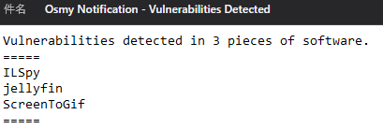
Example of Notification Message
List of software that have vulnerabilities
List of software that have file integrity errors
Notes:
This is examples of notification message.
Osmy notifies the list of software that have problems by e-mail.

Slide 26
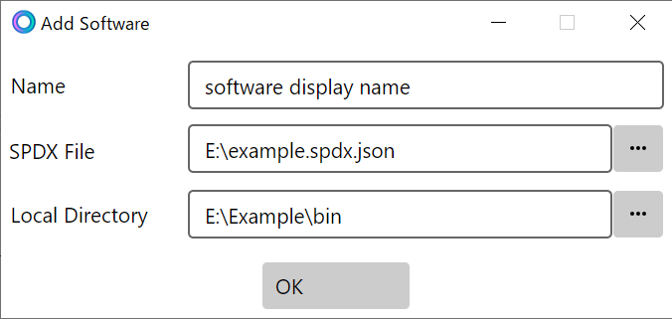
Add software to Osmy
Notes:
First, we add software to the list of managed software.
This slide shows a screenshot of Osmy’s window just after startup.
We push the button in the lower-left of the window, and then Osmy shows a dialog to add software.
In the dialog, we enter the display name of software, a path to an SPDX document, and a path to the directory where software located.
After filling in the dialog, we click the “OK” button to add software to the list.

Slide 27
Osmy: A Tool for Periodic Software Vulnerability Assessment and File Integrity Verification using SPDX Documents
Osmy makes software management using SPDX documents easier and more labor-saving
Osmy Client
Osmy Server
Software
Information
Automatic Periodic Execution
Add Software
SPDX
File Integrity
Verification
Software
List
Package Information
Vulnerability
Assessment
User
Check
Results
Result
Vulnerability Information
OSV
（Vuln DB）
Notification
(by e-mail)
Results
Notes:
In this study, we create a tool called “Osmy” which performs vulnerability assessment and file integrity verification using SPDX documents.
Osmy makes software management using SPDX documents easier and labor-saving.
Osmy mainly consists of two parts: Client and Server.
The user uses a client program for adding software to manage and checking the results of vulnerability assessment and file integrity verification.
The server program maintains information of software to manage and automatically and periodically performs vulnerability assessment and file integrity verification.
If Osmy finds any issues, it notifies the user by e-mail.
//Osmy performs vulnerability assessment by querying the OSV database for library names and versions described in SPDX documents.

