Slide 1
Mining Coding Patterns to Detect Crosscutting Concerns in Java Programs
Takashi Ishio,
Hironori Date, Tatsuya Miyake, Katsuro Inoue
Osaka University
Notes:
This work is an aspect-mining approach based on a pattern mining technique.

Slide 2
Overview
What is a Coding Pattern
  A frequent code fragment involved in programs
  “Not Modularized Code” == Crosscutting Concerns?
Sequential pattern mining for Java source code
  Apply PrefixSpan algorithm to normalized source code
  Coding patterns in 6 Java programs
  JHotDraw, jEdit, Tomcat, Azureus, ANTLR, SableCC
  “Consistent Behavior” crosscutting concern sort
Notes:
A coding pattern investigated in this work is a frequent code fragment involved in programs.
We have investigated coding patterns as candidates of crosscutting concerns because such code fragments are not modularized in programs.
We propose a sequential pattern mining approach for Java source code.
Our approach normalizes Java source code to a sequence database so that we extract sequential patterns from the database using PrefixSpan algorithm.
We implemented our pattern mining as a tool and extracted patterns from six open-source Java programs listed here.
The resultant patterns are code fragments implementing “consistent behavior” in the programs.

Slide 3
Coding Pattern
A coding pattern is a frequent code fragment to implement a particular kind of functionality.
copy-
and-
paste
while (iter.hasNext()) {
Item item = (Item)iter.next();
buf.append(item.toString());
}
while (iter.hasNext()) {
Item item = (Item)iter.next();
buf.append(item.toString());
}
while (iter.hasNext()) {
Item data = (Item)iter.next();
buf.add(process(data));
buf.add (data.getItem());
}
reuse
the loop
structure
Notes:
Developers often copy-and-paste a source code fragment, or an idiom, to implement a particular kind of functionality.
For example, this is a loop using Iterator.
Some developer copy-and-pastes the code to the different source code location.
Some other developer reuses only the structure of the loop but modified the contents.
In this case, a pattern comprises a while statement, hasNext method and next method as indicated by red color.

Slide 4
Another Example
In jEdit, methods that modify a text buffer must check the buffer is editable.
  If the buffer is not editable, the methods execute beep() instead of the original behavior.
JEditBuffer.java
public void undo(…) {
if (undoMgr == null)
return;
if (!isEditable()) {
Toolkit.getDefaultToolkit().beep();
return;
}
// undo an action
}
TextArea.java
public void insertEnterAndIndent() {
if (!isEditable()) {
getToolkit().beep();
} else {
try {
// insert “\n” and indent
} …
}
}
Notes:
The Iterator pattern is well-known and simple enough, therefore, it is not a problem.
This is another example of coding pattern in jEdit that is a text editor implemented in Java.
These methods are somehow editing a text buffer.
Before executing the actual action, isEditable method is called.
If the target text buffer is read-only, beep method is called instead of their original behavior.

Slide 5
Maintenance Problem
Coding patterns make maintenance difficult.
  Some patterns reflect implicit design in a program.
  Patterns are duplicated code.
    Developers have to consistently edit pattern instances.
Duplicated code is also known as code-clone.
  Efficient code-clone detection tools (e.g. CCFinder) are hard to detect small code fragments.
    Some of them might be modified after copy-and-pasted.
Notes:
Such nontrivial coding patterns make software maintenance difficult because they implicitly represent software design.
Developers have to understand undocumented design from source code.
Another problem of coding patterns is a sort of duplicated code.
When an instance of a pattern involves a defect, developers have to inspect all instances of the pattern because the other instances might contain the same defect. This problem is well-known in code-clone research, but the efficient code clone detection tools such as CCFinder are hard to detect code modified after copy-and-pasted.
Therefore, we need another approach to detect coding patterns.

Slide 6
Pattern Mining for Source Code
public B m1() {
…
}
public B m1() {
…
}
public B m1() {
…
}
public B m1() {
…
}
Each method is translated
into a sequence of method
calls and control elements.
public B m1() {
…
}
Normalization
public B m1() {
…
}
Java source code
(methods)
A.m1
IF
B.m2
LOOP
A.m2
END-LOOP
END-IF
A.m1
IF
B.m2
LOOP
A.m2
END-LOOP
END-IF
A.m1
IF
B.m2
LOOP
A.m2
END-LOOP
END-IF
A.m1
IF
B.m2
LOOP
A.m2
END-LOOP
END-IF
A.m1
IF
B.m2
LOOP
A.m2
END-LOOP
END-IF
Sequence Database
A.m1
IF
B.m2
LOOP
A.m2
END-LOOP
END-IF
Mining
We use PrefixSpan, an algorithm of sequential pattern mining.
Patterns
Classification
We classify similar patterns
into a group.
Pattern Groups
(an XML format)
Notes:
In this research, we propose a pattern mining approach to detecting coding patterns in source code.
Our pattern mining comprises three steps: Normalization, Mining and Classification.
The Normalization step takes as input a Java program and normalizes each method to a sequence of method call and control elements.
In the mining step, we apply PrefixSpan algorithm to the generated sequence database.
Finally, the resultant patterns are classified into pattern groups and some meaningless patterns are filtered out.
Next we talk the detail of these steps.

Slide 7
Normalization Rules for Java source code
Java Source Code
Normalized Sequence
while (iter.hasNext()) {
Item item = (Item)iter.next();
if (item.isActive()) item.foo();
}
hasNext(): boolean
LOOP
next(): Object
isActive(): boolean
IF
foo() : void
END-IF
hasNext(): boolean
END-LOOP
Method call elements,
  method signature without class name
LOOP/END-LOOP elements, and
IF/ELSE/END-IF elements.
  Maintaining statement-to-element mapping
Notes:
The first step is normalizing Java source code.
We have defined rules to translate each Java method into a sequence of three kind of elements representing method call, IF and LOOP statements.
Normalized source code simply represents the control-flow of its original source code.
In this example, method hasNext is called first, then, LOOP condition is evaluated.
In the loop body, next and isActive methods are called, the IF statement is executed, and hasNext method is called again.
A pair of LOOP and END-LOOP represents the while statement.
A pair of IF and END-IF represents the IF statement.

Slide 8
Pattern Mining with PrefixSpan [Pei, 2004]
Extract suffix sequences of “a”
Parameter:
min_support = 2
c d
a : 1
b : 2
c : 2
d : 1
a b
c
c : 1
b c
a
a c
a c d
a : 4
b : 3
c : 3
d : 1
a b
d
d : 1
a b c
Sequence
Database
b
c
a : 1
c : 1
c b a
The Result
a
Pattern
Support
a a b
c
a b
2
d
a : 1
b : 1
d : 1
a c
2
#instances
of length-1 patterns
b a
#instances
of length-2 patterns
Notes:
After a sequence database of a Java program is constructed, we use PrefixSpan algorithm to extract sequential patterns.
This algorithm takes as input a sequence database and the minimum support value that is the number of instances of a pattern to be extracted.
I show how PrefixSpan work on an example database comprising four sequences, [a, c, d], [a, b, c], [c, b, a] and [a, a, b] and the minimum support value equals two.
PrefixSpan first extracts frequent elements as the shortest pattern comprising only one element.
Element “a” is a length-1 pattern involved in all of four sequences.
Element “d” is not a pattern candidate because the only one sequence contains the element.
In the next step, PrefixSpan tries to extract length-two patterns based on one-element patterns.
For each length-1 pattern, a new sequence database is constructed.
Each sequence in the new database is a substring prefixed with a length-1 pattern.
For example, the database for pattern “a” includes sequence “c d”, that is a suffix of “a” in the sequence “a c d”.
“b c” comes from “a b c”, “a b” comes from “a a b”, respectively.
Frequent elements in the new database are the second elements of length-2 patterns.
PrefixSpan repeatedly tries to extract longer patterns and terminates all pattern candidates are investigated.

Slide 9
Filtering Patterns
A constraint for control statements:
  If a pattern includes a LOOP/IF element,
  the pattern must include its corresponding element
  generated from the same control statement.
Well-formed patterns
Malformed patterns
hasNext()
LOOP
next()
hasNext()
END-LOOP
hasNext()
LOOP
next()
hasNext()
hasNext()
next()
hasNext()
END-LOOP is missing!
Notes:
After patterns are extracted, we filter out meaningless patterns.
As I said in the normalization step, LOOP and IF elements are always generated with their corresponding END-LOOP and END-IF.
Therefore, if a pattern includes such an element, the pattern must include its corresponding element that is generated from the same control statement.
We accept left two patterns but we filter out the right pattern because it includes LOOP but does not include its corresponding END-LOOP.

Slide 10
Classifying Patterns into Groups
A pattern implies various sub-patterns.
  [A, B, C, D] implies [A, B, C], [A, C, D], …
We classify such sub-patterns into a single pattern group.
  If an instance of a pattern overlaps with an instance of another pattern,
  the patterns are classified into the same group.
Notes:
Finally, we classify the patterns into groups because a pattern implies various sub-patterns.
For example, if PrefixSpan detected a pattern of four elements [A, B, C, D], the algorithm also detected the shorter patterns [A, B, C], [A, C, D] and so on.
We classify such sub-patterns into a single pattern group using one simple rule: if an instance of a pattern overlaps with an instance of another pattern, the patterns are classified into the same group.

Slide 11
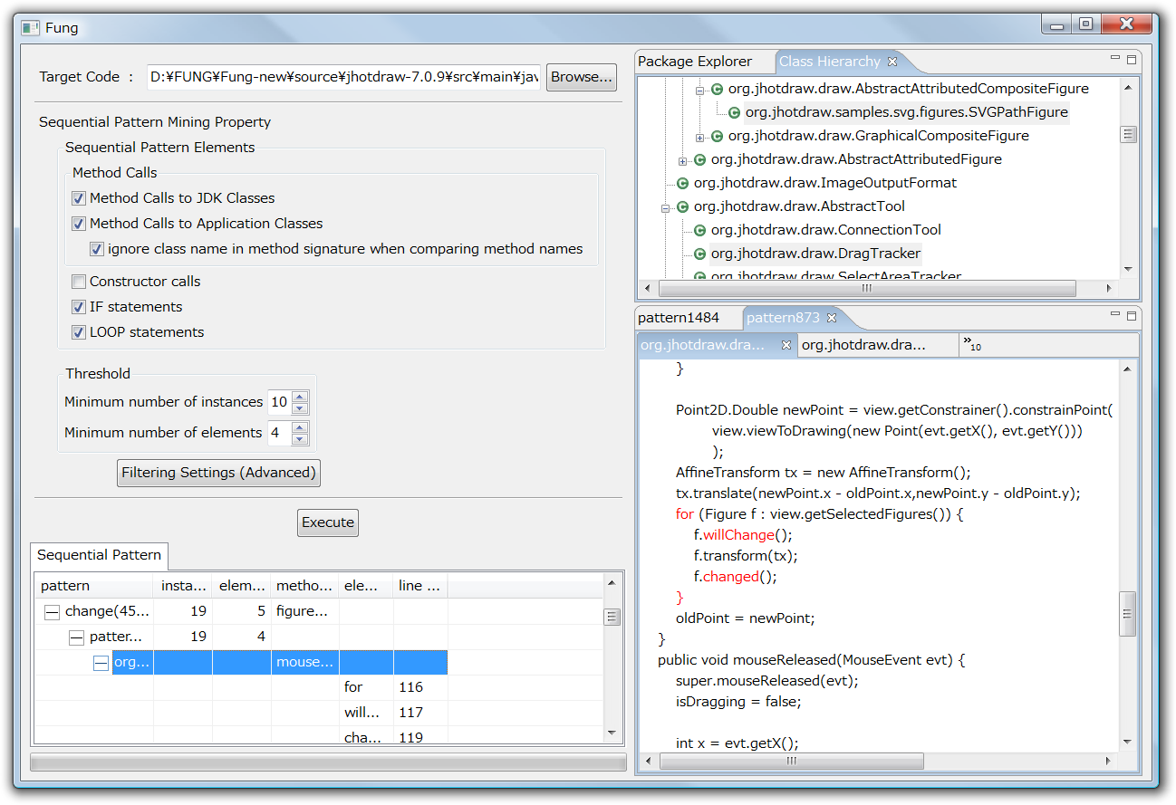
A screenshot of our tool
Class Hierarchy View
highlights classes involving a pattern.
Pattern Mining
Configuration
The resultant patterns
Source Code View
indicates elements of a pattern.
Notes:
We automated the pattern mining process as a tool.
This tool takes as input a source code directory and several parameters, and outputs a list of detected patterns with summary information, the number of instances and the number of elements in the pattern.
Selecting a pattern in the list highlights code fragments in the source code view and the class hierarchy view.

Slide 12
Case Study: 6 Java programs
Name | Version | Size(LOC) | #Pattern | #Group
JHotDraw | 7.0.9 | 90,166 | 747 | 37
jEdit | 4.3pre10 | 168,335 | 137 | 33
Azureus | 3.0.2.2 | 552,021 | 4682 | 128
Tomcat | 6.0.14 | 313,479 | 1415 | 85
ANTLR | 3.0.1 | 59,687 | 352 | 29
SableCC | 3.2 | 35,388 | 62 | 18
#instances ≧ 10, #elements ≧ 4
Notes:
Using the tool, we have investigated coding patterns in 6 Java programs as a case study.
We selected applications from different domains; two GUI tools JHotDraw and jEdit, two network systems Azureus and Tomcat, and two parser-generators ANTLR and SableCC.
We have extracted patterns that has at least 10 instances and each of patterns involves at least 4 elements.
The table shows version, size and the number of detected patterns in the programs.

Slide 13
Patterns in the programs
Manually analyzed 5 frequent pattern groups for each program.
  Excluded pattern groups comprising only JDK methods
    because most of them are well-known patterns for manipulating collections and strings.
17 groups (about 55%) are related to some functionality in applications
  Others are implementation-level patterns
    E.g. null-check if (getView() != null) getView().get…
Notes:
We have manually analyzed 5 frequent pattern groups for each program.
Before we choose 5 frequent patterns, we excluded patterns that comprises only JDK classes because most of them are well-known patterns for manipulating collections and strings.
We found that 17 pattern groups are related to some functionality in applications.
Others are implementation-level patterns such as null-check pattern that are not related to a particular function.

Slide 14
Pattern Categorization
17 pattern groups into five Categories
ID | Pattern Description | #pattern groups
1 | A boolean method to insert an additional action: <Boolean method>, <IF>, <action-method>, <END-IF> | 3
2 | A boolean method to change the behavior of multiple methods: <Boolean method>, <IF>, <action-method>, <END-IF> | 3
3 | A pair of set-up and clean-up: <set-up method>, <misc action>, … , <clean-up method> | 3
4 | Exception Handling: Every instance is included in a try-catch statement. | 3
5 | Other patterns | 5
Notes:
During the investigation, we recognized five categories of patterns.
Two categories are patterns related to a method call that returns a Boolean value followed by an IF statement using the value.
The third category is a pair of set-up and clean-up method calls.
The fourth category is exception handling; every instance of patterns is a part of a try-catch statement.
The final category is other patterns that are not covered by this categorization.
I show the example patterns for each category.

Slide 15
Category 1:
Boolean method inserting an action
Logging patterns in Tomcat and Azureus
[ isDebugEnabled(), IF, debug(String), END-IF ] (in Tomcat)
BasicAuthenticator.java
public boolean authenticate(…) … {
Principal principal = …
if (principal != null) {
if (log.isDebugEnabled())
log.debug("Already authenticated “ + …);
…
return (true);
}
…
}
304 instances in Tomcat
119 instances in Azureus
A well-known
crosscutting concern,
but
hard to modularize
various messages.
Notes:
The first category is a boolean method followed by an IF statement that executes an additional action.
A typical pattern in this category is this logging pattern in Tomcat.
The return value of isDebugEnabled method controls a debug method call.
Logging is a typical crosscutting concern, we found many instances of this type of patterns in Tomcat and Azureus.
Modularizing them into aspects is difficult because each instance uses a different debug message.

Slide 16
Category 2: Boolean method to switch the behavior of multiple methods
jEdit has 34 instances of the pattern
  Preventing a user from editing a read-only buffer
[ isEditable, IF, beep, END-IF ]
JEditBuffer.java
public void undo(…) {
if (undoMgr == null)
return;
if (!isEditable()) {
Toolkit.getDefaultToolkit().beep();
return;
}
// undo an action
}
Around advice in AspectJ
may replace the pattern.
Notes:
The second category is a boolean method followed by an IF statement that switch the behavior of methods.
While the category 1 inserts an additional action such as logging, this category completely replace the original behavior.
This is an example in jEdit that prevents a user from editing a read-only buffer.
This pattern first calls isEditable method.
If a buffer is not editable, beep method is called and the action is skipped.
Patterns in this category might be modularized using around advice in AspectJ.

Slide 17
Category 3: set-up and clean-up
Synchronization in Azureus
[ enter, LOOP, END-LOOP, exit ]
151 instances use
AEMonitor.enter and
AEMonitor.exit
DHTControlImpl.java
try {
activity_mon.enter();
listeners.addListener( l );
for (int i=0;i<activities.size();i++){
listeners.dispatch(…);
}
} finally {
activity_mon.exit();
}
Template-Method or
before/after advices
might be applicable.
Notes:
The third category is a pair of method calls for set-up and clean-up.
An example is synchronization method calls in Azureus.
This pattern comprises a pair of Enter and Exit method calls for a monitor object.
Each instance executes method calls between Enter and Exit.
These patterns may be replaced with template-method or a pair of before and after advices in AspectJ.

Slide 18
Category 4: Exception Handling
“Report Error” pattern in ANTLR parser
[ LT, match, reportError, recover ]
ANTLRParser.java
void rewrite_block() throws … {
try {
lp = LT(1);
…
match(LPAREN);
…
} catch (RecognitionException ex) {
reportError(ex);
recover(ex,_tokenSet_34);
}
returnAST = rewrite_block_AST;
}
38 instances
in parser classes
Notes:
The fourth category is exception handling; every instance of patterns in this category is a part of a try-catch statement.
For example, this pattern is found in ANTLR parser classes.
The pattern calls LT and match methods to process tokens according to a grammar.
If a RecognitionException is thrown, reportError and recover methods are called in catch block.
To extract this kind of patterns automatically, we need to extend our normalization rules for try-catch statements.

Slide 19
Other Patterns
Duplicated code in ANTLR’s test cases
[ setErrorListener, newTool,
setCodeGenerator, genRecognizer ]
TestAttributes.java
public void testArguments() … {
…
ErrorManager.setErrorListener(equeue);
Grammar g = new Grammar(…);
Tool antlr = newTool();
CodeGenerator generator = new …
g.setCodeGenerator(generator);
generator.genRecognizer();
… // extract a string from AST
assertEquals(expecting, found);
}
107 instances
in ANTLR test cases
The pattern configures
parser for each test case.
Notes:
Other patterns are duplicated code fragments that are not covered by other four categories.
One example is duplicated code in ANTLR’s test cases.
The pattern configures parsers for test cases using different grammar objects.

Slide 20
Discussion
Coding patterns are “Consistent Behavior” crosscutting concern sort [Marin, 2007].
Maintenance support using coding patterns
  Refactoring the patterns (AO-Refactoring)
  Consistently edit the instances (Fluid AOP)
  Documenting the patterns (SoQueT)
Only frequent patterns are investigated.
Notes:
The coding patterns we have investigated are to implement “consistent behavior” that is a crosscutting concern sort.
The coding pattern information can be combined with several approaches to support software maintenance.
One approach is refactoring the patterns using AspectJ or other techniques.
If refactoring is hard to perform, coding pattern information is still effective to consistently maintain the pattern instances and to write documentation for crosscutting concerns.
Our case study has one limitation; we have investigated only frequent patterns.
Less frequent patterns are not investigated yet. Therefore, we need further investigation on coding patterns.

Slide 21
Conclusion
Sequential pattern mining
to detect Coding Patterns in Java programs.
  Applied PrefixSpan algorithm to normalized source code.
  Frequent coding patterns implements “Consistent Behavior” in programs.
Future Work
  Support try-catch and synchronized statements
  Analyze more patterns with software metrics
  Compare coding patterns with code clones
Notes:
In summary, we proposed a sequential pattern mining to detect coding patterns in Java programs.
We have applied PrefixSpan algorithm to normalized Java source code.
The resultant patterns we found in 6 Java programs include consistent behavior crosscutting concern sort.
In future work, we would like to support try-catch and synchronized statements in pattern mining process.
We are developing a new version of the tool to investigate more coding patterns with software metrics.
We are also interested in comparison between coding patterns and code clones because both approaches extract duplicated code fragments.
Thank you for your attention.

Slide 23
Normalization for method calls
Rule: Extract only a method signature
without its class name.
Item item = (Item)iter.next();
next(): Object
Rule: Two or more method calls are sorted by
their control-flow and location in source code.
int p = max(getX(), getY());
getX(): int
getY(): int
max(int, int): int
Notes:
A method call in the source code is translated into a method call element, that is a method signature without its class name. We ignore class names to handle dynamic binding.
If two or more method calls are involved in an expression, the corresponding method call elements are sorted by control-flow. If undefined, we use source code location.
For example, “max” is called after these two methods, therefore the corresponding element is the end of the normalized code. The order of two method calls getX and getY is not defined, so we simply place them in the textual order.

Slide 24
Normalization for if statements
Rule:
if (COND) T; else F;
1. int x = getX();
if (a == x) …
COND
IF
T
ELSE
F
END-IF
2. if (a == getX()) …
getX(): int
IF
…
END-IF
Notes:
An If statement is translated into these elements.
According to the control-flow, method call elements in a conditional predicate are inserted before the IF element.
This rule translates these two fragments into the same sequence of elements.

Slide 25
Normalization for loop statements
Rule:
for (INIT; COND; INC) BODY;
INIT
COND
LOOP
BODY
INC
COND
END-LOOP
for (Iterator it = list.iterator();
it.hasNext(); ) {
Item item = (Item)it.next();
item.doSomething();
}
iterator(): Iterator
hasNext(): boolean
LOOP
next(): Object
doSomething(): void
hasNext()
END-LOOP
Rule:
while (COND) BODY;
COND
LOOP
BODY
COND
END-LOOP
Iterator it = list.iterator();
while (it.hasNext()) {
Item item = (Item)it.next();
item.doSomething();
}
Notes:
Similarly, we defined rules for loop statements such as “for” and “while”.
These rules simply extract the control-flow of loop statements.
If a developer rewrites this “for” loop to this “while” loop, both loops are translated into this same sequence.

Slide 26
The List of “App” Patterns | Sup
jEdit: Open and close “scope” before and after visiting a node, respectively | 55
jEdit: Alert if a read-only buffer is to be edited. | 34
Azureus: Enter and exit a monitor before and after a loop, respectively | 151
Azureus: Logging if enabled | 119
Tomcat: Logging if debugging mode | 304
Tomcat: Execute a function in privileged mode if a protection mode is enabled | 46
ANTLR: Create code generators for unit testing | 107
ANTLR: Parse AST and report an error if necessary | 38
ANTLR: Visit tree nodes to output a text | 29
Notes:
This is a list of application-specific patterns.
According to the limited time, we show the underlined four patterns.
Two of them are Logging concerns and the other two patterns involve similar elements to Logging patterns.

Slide 27
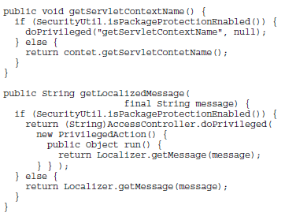
“Execute an action in privileged mode” pattern
Tomcat has 46 instances of the pattern.
[ isPackageProtectionEnabled, IF, doPrivileged, ELSE, END-IF ]
Notes:
This is a pattern in Tomcat that switches the behavior if the package-protection is enabled.
If isPackageProtectionEnabled method returns true, these methods use doPrivileged method instead of regular method calls.
Developers might refactor this pattern using an interface and polymorphic method calls; one class implements the protected mode and the other implements the regular mode.

Slide 28
Summarization of the pattern groups
Select the top three frequent tokens in a pattern group to summarize the pattern.
Undo Pattern in JHotDraw 5.2b1
Tokens in the pattern
setUndoActivity()
createUndoActivity()
getUndoActivity()
setAffectedFigures()
activity: 3
undo: 3
set: 2
affected: 1
create: 1
figures: 1
get: 1
set Undo Activity
Notes:
To make the analysis process efficient, we extract a summary information for each pattern group.
We extract the frequent tokens in the method call elements in the pattern.
For example, this pattern includes four elements: setUndoActivity, createUndoActivity, getUndoActivity, and setAffectedFigures.
We decompose all method names into tokens, and select frequent tokens “activity”, “undo” and “set” as the representative of the pattern.

