Slide 1

Towards Program Understanding Supported by Data-flow Visualization
Takashi Ishio
Osaka
University

Slide 2
Research Background
Modularization techniques decompose a single feature into modules.
To understand the feature, developers have to read multiple modules.
Can we reduce #modules that
developers have to read?

Slide 3
Example: When a dialog is not closed?
public void actionPerformed(ActionEvent evt) {
if (evt.getSource() == ok) {
if (editor.getAbbrev()==null || editor.getAbbrev().length()==0) {
getToolkit().beep();
return;
}
// process the input ...
if (!checkForExistingAbbrev()) return;
…
// close the dialog
dispose();
}
A return value of JTextField.getText()
The argument of setText(String)
The argument of
AbbrevEditor.setAbbrev(String)
“Add” Button Clicked
AbbrevsOptionPane.
actionPerformed is called.
(omitted)

Slide 4
Program slicing is promising, but …
A slicing tool based on Soot framework takes 20 minutes to construct SDG for JEdit (160KLOC).
Most is spent for pointer analysis.
Few seconds to compute a program slice
It is impractical for daily work.
A typical day: [Parnin, Software Quality Journal, 2011]
a 2-hour programming session
+ several 30 minute sessions

Slide 5
Our Approach: Simplified Data-flow Analysis for Java
Imprecise, but efficient
Control-flow insensitive
Object insensitive
Inter-procedural

Slide 6
Variable Data-flow Graph
A directed graph
Node: variable, statement
Edge: apporximated control- and data-flow
We directly extract a data-flow graph from AST.
without a control-flow graph

Slide 7
Data-flow Extraction
lhs = rhs; is regarded as
a dataflow rhs ➔ lhs.
A statement “a = b + c;” is translated to:
<<Variable>>
b
data
<<Statement>>
a = b + c;
data
<<Variable>>a
data
<<Variable>>
c

Slide 8
Control-flow Insensitivity
The same graph may be extracted from different code.
(a) X = Y; (b) Y = Z;
(b) Y = Z; (a) X = Y;
No Data
Dependence
Data
Dependence
<<Variable>>
Z
(b)
<<Statement>>
Y = Z;
(b)
<<Variable>>
Y
(a)
<<Statement>>
X = Y;
(a)
<<Variable>>
X
The transitive path Z ➔ X is infeasible for the left code.

Slide 9
Approximated Control-Dependence
A conditional predicate of if/for/while controls the enclosed statements.
“if (X) { Y = Z; }” is translated to:
<<Variable>>
X
control
<<Variable>>
Z
data
<<Statement>>
Y = Z;
data
<<Variable>>
Y

Slide 10
A method graph
dataflow
from callsites
x
y
x > y
static int max ( int x, int y ) {
int result = y ;
if ( x > y )
result = x ;
return result ;
}
result = x
result = y
result
return result;
<<return>>
to callsites

Slide 11
Inter-procedural Edges
Method Call
Dynamic binding is
resolved by CHA
Field Access
A field is also a variable vertex.
Object-insensitive
<<invoke>>
max(x, y)
x
y
return
<<Method>>
max(x, y)
x
y
<<return>>
<<Field Write>>
<<Field>>
size
obj
size
<<Field Read>>
obj
return

Slide 12
Graph Traversal
max(…)
C.p
class C {
void m() {
int size = max(p, q);
y.setSize(size);
}
}
<<invoke>>
max(int,int)
arg1
arg2
ret
C.q
size
C.y
<<invoke>>
setSize()
obj
arg
class D {
void setSize (int s) {
this.size = s;
}
….
}
(this)
s
<<Field Write>>
obj
arg
D.size

Slide 13
Heuristic edges
Library classes are ignored.
Heuristic edges between set/get methods
Example: Actual-parameter of setText(String)
➔ a return value of getText()

Slide 14
Fractal Value Filter
Fractal Value [Koike, 1995]
A value of a node is
divided to fan-in nodes.
A node whose fractal value
is less than 0.1 is filtered out.
0.5
0.125
0.125
0.125
0.125
0.5
0.5
0.5
1.0

Slide 15
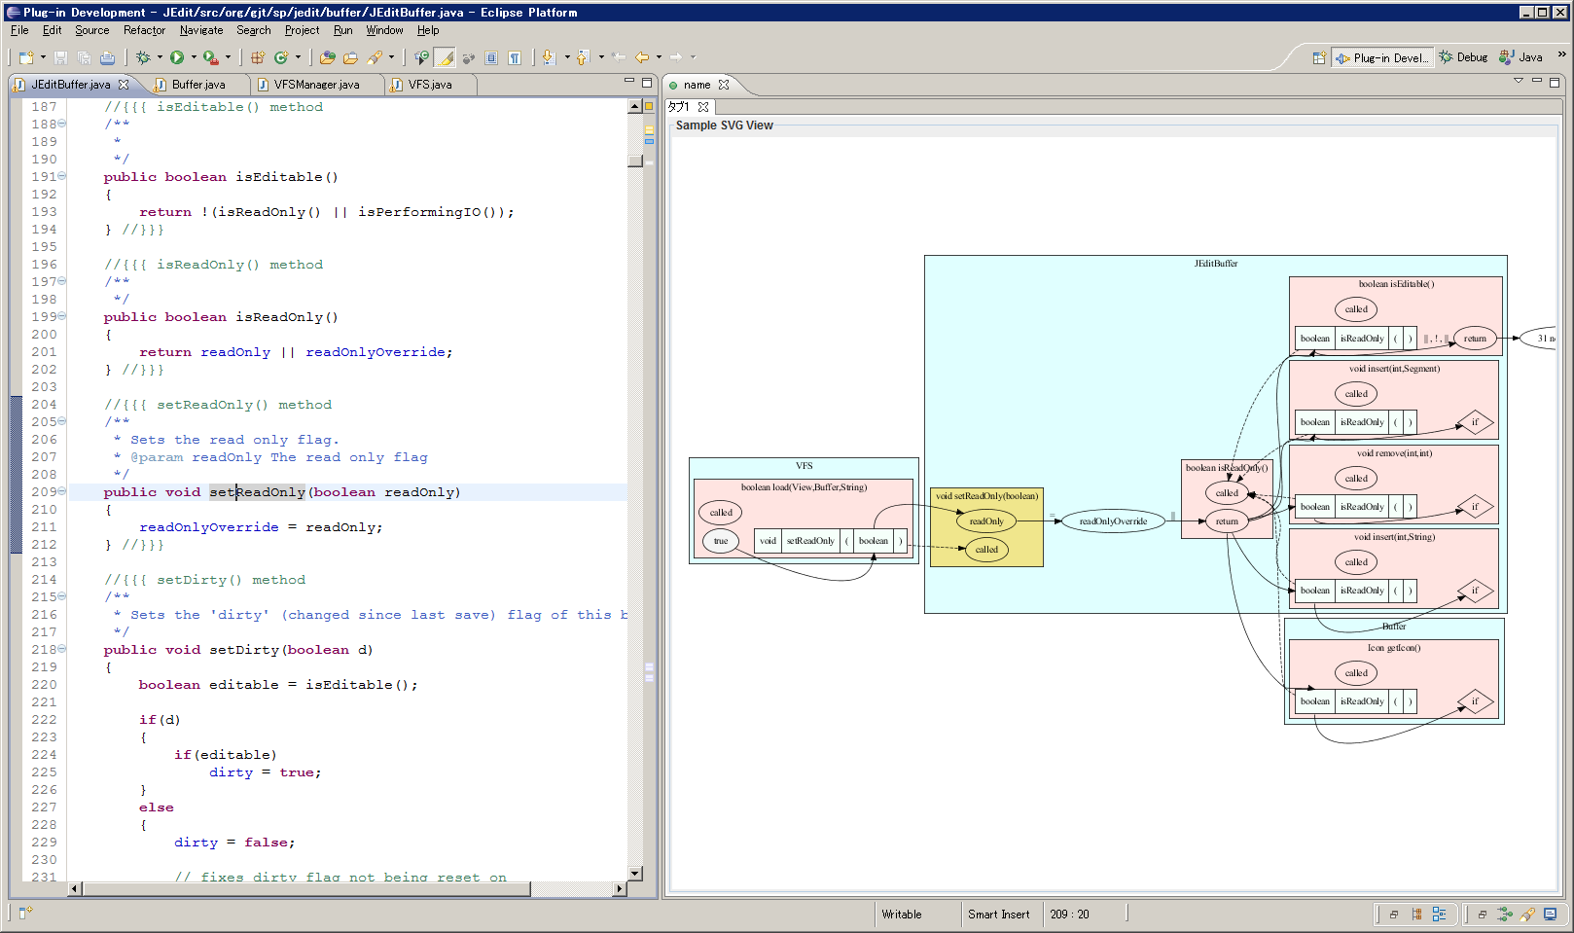
Implementation (1/2)
Graph Construction: a batch system
Viewer: an Eclipse plug-in
Data-flow edges are automatically traversed from a method where the caret is located.

Slide 16
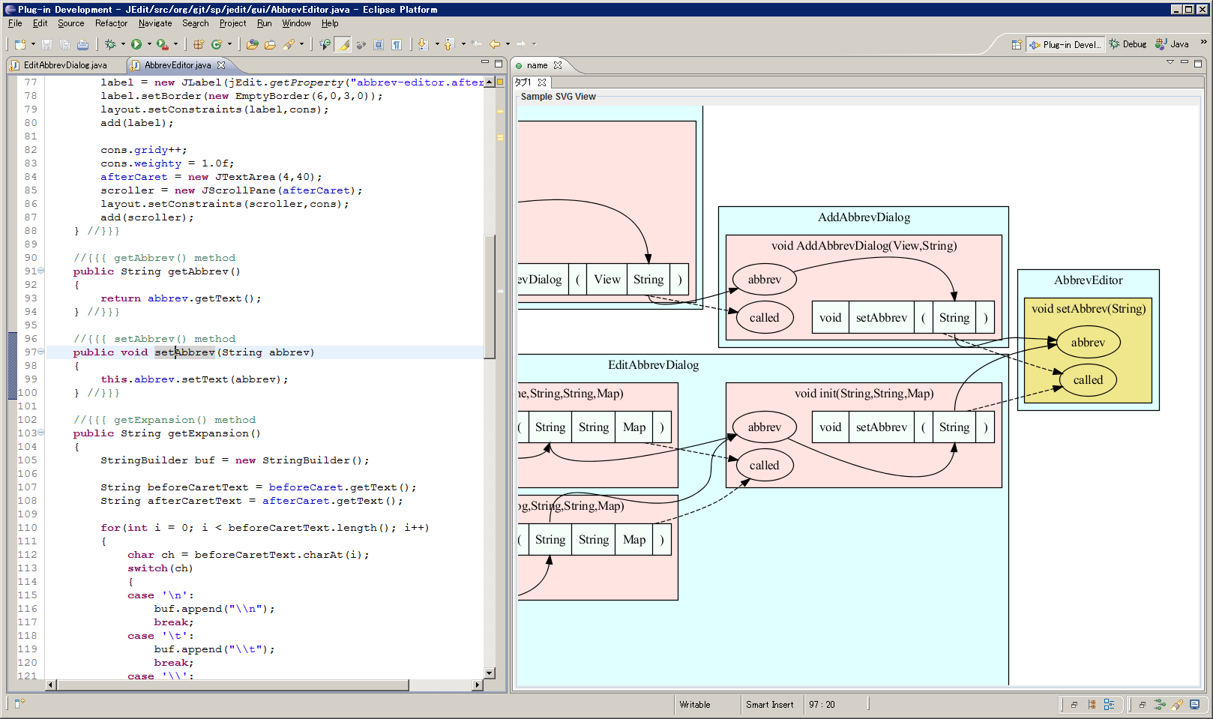
Implementation (2/2)
Only method calls, parameters and fields are visible.

Slide 17
Tradeoff
Simplified analysis
AST and symbol table
Class Hierarchy Analysis
No control-flow graph, no def-use analysis
Infeasible paths, unrealizable paths
Because of control-flow insensitivity

Slide 18
Experiment
Is it efficient?
Analyzed several Java programs
Is it effective for program understanding?
Assigned program understanding tasks to 16 developers.

Slide 19
Performance Measurement
Software | Size (LOC) | Time to construct AST and symbol table (sec.) | Time to analyze dataflow (sec.) | Total Time (sec.)
ANTLR 3.0.1 | 71,845 | 39 | 11 | 50
JEdit 4.3pre11 | 168,872 | 108 | 17 | 125
Apache Batik 1.6 | 297,320 | 155 | 33 | 188
Apache Cocoon 2.1.11 | 505,715 | 490 | 71 | 561
Azureus 3.0.3.4 | 552,295 | 353 | 115 | 468
Jboss 4.2.3GA | 696,761 | 703 | 348 | 1,051
JDK 1.5 | 885,887 | 1,054 | 1,001 | 2,055
on Windows Vista SP2, Intel® Core2 Duo 1.80 GHz, 2GB RAM

Slide 20
Program Understanding Tasks
Identify how an invalid user’s action is prevented in JEdit.
EditAbbervDialog.java, Line 153 (Task A)
JEditBuffer.java, Line 2038 (Task B)
30 minutes for each task (excluding graph construction)
16 participants (4 industrial + 12 graduate)
Group 1 | Group 2 | Group 3 | Group 4
Task A with Tool | Task A w/o Tool | Task B with Tool | Task B w/o Tool
Task B w/o Tool | Task B with Tool | Task A w/o Tool | Task A with Tool
“w/o Tool” means a regular Eclipse SDK without our plug-in.

Slide 21
Answer as a data-flow graph
The conditions are explained by a user’s action on GUI or the external environment.
Task A: the dialog is not closed.
“add” button is pushed.
IF statement: A string is null or “”.
AbbrevsOptionPane.
actionPerformed is called.
The string is a return value of
AbbrevEditor.getAbbrev().
The second argument of
new EditAbbrevDialog
The value is a return value of JTextField.getText()
The first argument of
EditAbbrevDialog.init
The value is the argument of JTextField.setText(String)
The argument of
AbbrevEditor.setAbbrev(String)

Slide 22
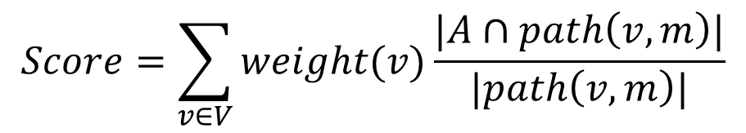
Correctness of answer
$$Score=\sum_{v∈V}{weight(v)\frac{|A∩path\left(v,m\right)|}{|path\left(v, m\right)|}}$$
v1
v2
0.5
0.5
[Example]
Correct Answer: V = {v1, v2}
A participant identified two red edges.
Score =
path(v1, m): 0.5 * (1 edge / 2 edges) +
path(v2, m): 0.5 * (2 edge / 2 edges) = 0.75
m

Slide 23
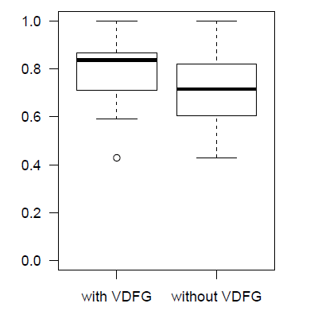
Result
Average Score:
with tool: 0.79
w/o tool: 0.71
t-test (a=0.05)
shows the difference
is significant.

Slide 24
Observation
No problem caused by infeasible data-flow edges.
Participants quickly confirmed source code and went back to the graph view.
A data-flow graph allowed developers to know the progress of investigation tasks.
A detailed graph was never used.
Participants combined data dependence among parameters with source code.
An “abstract” data-flow graph is enough for developers.

Slide 25
Related Work
Execution-After Relation [Beszédes, ICSM2007]
Control-flow based approximation of SDG
GrouMiner [Nguyen, FSE2009]
API Usage Mining based on Graph Mining
Each method is translated to a “groum” that approximates control- and data-flow.
Intra-procedural analysis

Slide 26
Conclusion
Simple data-flow analysis
Faster than regular dependence analysis
The analysis may generate infeasible paths, but it is still effective.
Future Work
Experiment on other systems
Summarization of a long data-flow path for visualization
Evaluate how infeasible data-flow paths affect automated analysis

