Slide 1
Development of a code clone search tool for open source repositories
Pei Xia†, Yuki Manabe†,
Norihiro Yoshida††, Katsuro Inoue†
† Graduate School of Information Science and Technology, Osaka University
†† Graduate School of Information Science, Nara Institute of Science and Technology

Slide 2
Jacobsen v. Katzer^{[1]}
A lawsuit between two open source software JMRI and KAMIND, in the U.S. federal court, 2008.
KAMIND reused some source code from JMRI, but deleted the copyright notice.
Settlement:
Katzer paid Jacobsen $100,000 for infringement
ceased using the JMRI code
etc.
[1] Arne, P.H. 2008. “Jacobsen v. Katzer - Open Source License Validation: How Far Does It Go?”,
The Computer & Internet Lawyer (25:11), pp 27-31.
Notes:
I want to start with a short story

Slide 3
Open Source Repositories
……
……..

Slide 4
Code Reuse
Developers reuse code from existing open source projects [2]
…
[2]C. Ebert (ed.), “Open Source Software in Industry”, IEEE Software, Vol. 25, No. 3, pp. 52-53, May/June 2008.

Slide 5
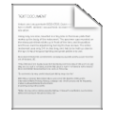
Code Clones Among OSS
There are many code clones exist among open source software [3].
code
clones
[3] S. Livieri, Y. Higo, M. Matsushita, K. Inoue, “Very-Large Scale Code Clone Analysis and Visualization of Open Source Programs Using Distributed CCFinder: D-CCFinder”, Proc. of 29th International Conference on Software Engineering (ICSE 2007), pp.106-115, Minneapolis, MN, May 2007.

Slide 6
Code Clones Among OSS
There are many code clones exist among open source software [3].
Code clone: Identical or similar source code fragments in a program or among different programs.
code
clones
[3] S. Livieri, Y. Higo, M. Matsushita, K. Inoue, “Very-Large Scale Code Clone Analysis and Visualization of Open Source Programs Using Distributed CCFinder: D-CCFinder”, Proc. of 29th International Conference on Software Engineering (ICSE 2007), pp.106-115, Minneapolis, MN, May 2007.

Slide 7
Questions
When we find a useful source code file, can we reuse it safely?
Are our own open source projects illegally reused by other people?
It is necessary to detect code clones
in open source repositories.

Slide 8
Existing technology
Code clone detection
CCFinder, DECKARD, etc.
Code search engine
Google code search, SPARS, etc.
Can only detect clones of the code in local machine
Do not provide enough code clone information

Slide 9
Solution
Using Code clone detection and code search technology to build up a mash-up tool.
Be able to detect code clones in open source repositories
Be able to provide related information about the files which contain code clones.

Slide 10
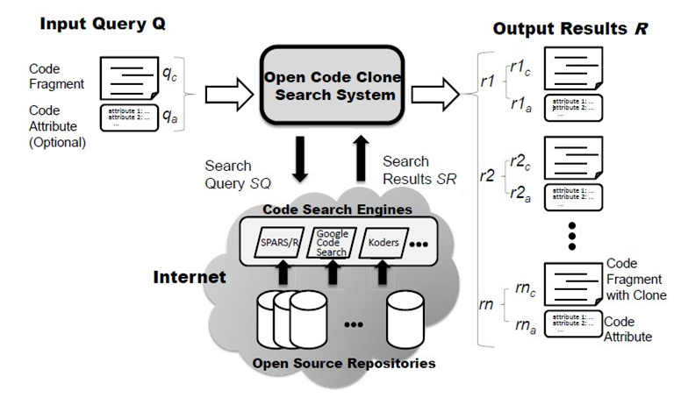
Overview of the Proposed method

Slide 11
Overview of the Proposed method
URL | where the file can be accessed on the Internet
File path | the path in the file’s own project
LOC | line of code
License | the software license of the file
Copyright | the copyright of the file
Last modified time | the latest committed time of the file in its repository
Cover ratio | the percentage of the queried code that reused by the file
Code clone detail | What part of the file has been detected as code clone

Slide 12
Search Process of Open CCFinder
Token1
Token2
Token3
Token4
Token5
Token6
…….
Filename
Keyword 6
Keyword 4
Keyword 1
Keyword 3
Keyword 2
Keyword 5
…….
③
Input Q
①
②
External code search engines
④
⑤
Code Clone information
⑦
Code Clone Detector
File1
File2
File3
….
⑥
Related information
…
⑧
Output R
Open source repositories
① Word Extraction ② Keyword Ranking ③ Generating request ④ searching for Candidate files
⑤ Merging candidates ⑥ crawling information ⑦ clone analysis ⑧ Result forming

Slide 13
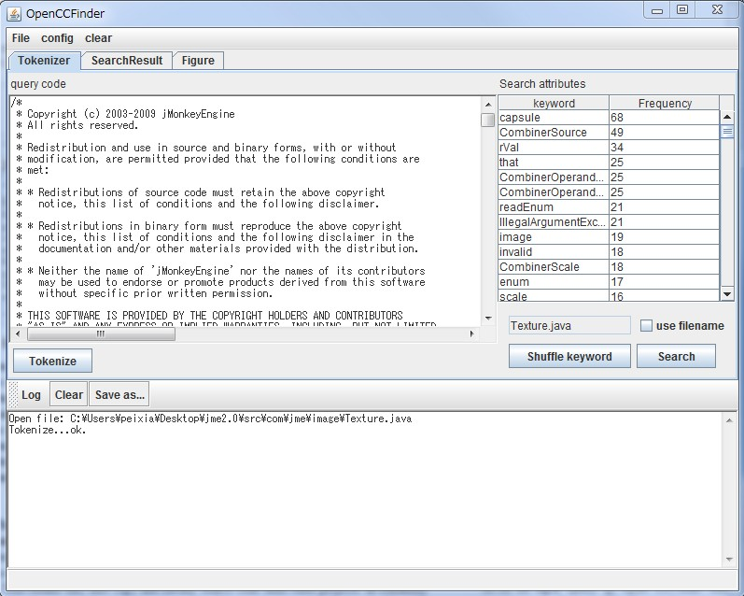
Demo – Tokenize View
①query input area
②keywords list
③log area
④Tokenize button
⑤Search button
⑥Shuffle button
Query input area
Keyword list
Log

Slide 14
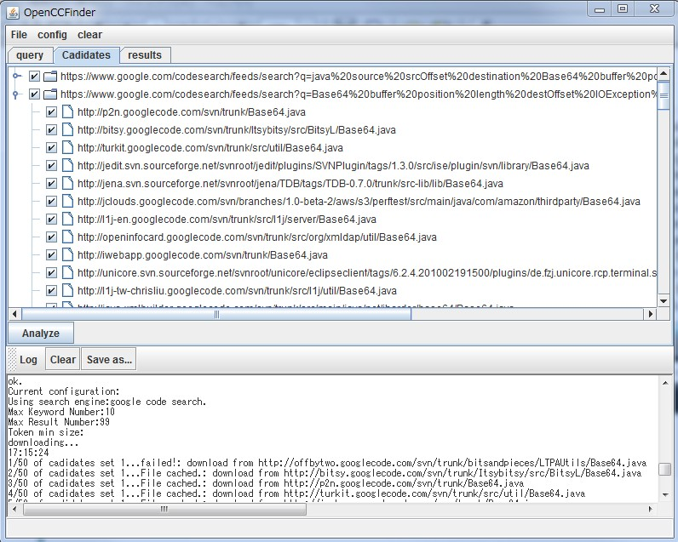
Demo – Candidates View
Candidates file list
Log

Slide 15
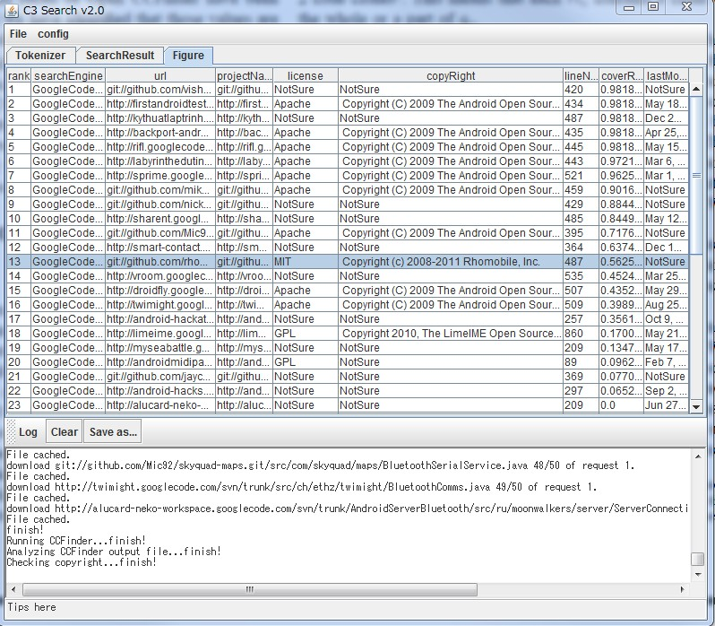
Demo – Results View
Results view
①results detail
②log area
Code attributes
Log

Slide 16
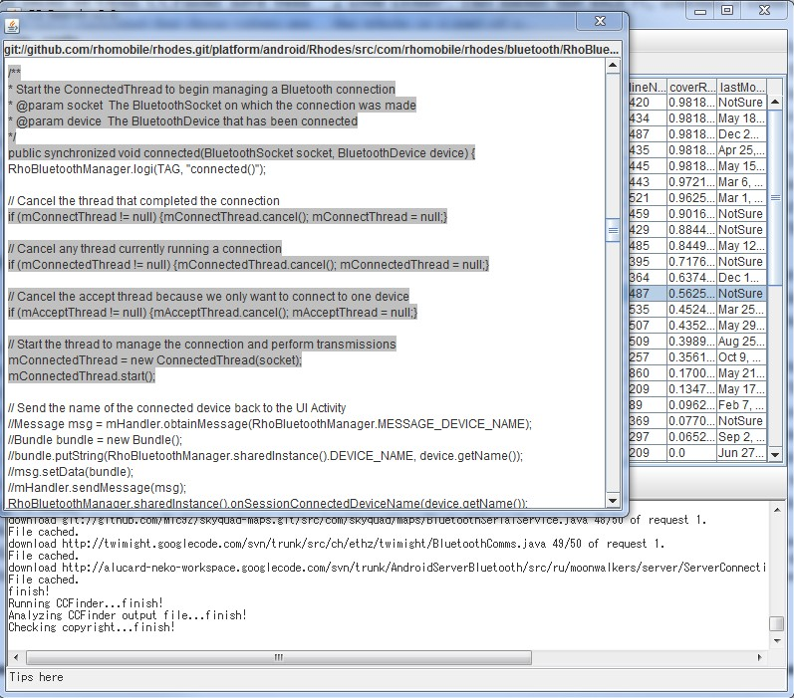
Demo – Results View
Results view
①results detail
②log area
③code clone detail
Code clone detail

Slide 17
Case Study 1
Question: When we find a useful source
code file, can we reuse it safely?
Subjects: base64.java
Purpose: To find the files from open source
repositories that we should check
while reusing this file.

Slide 18
Case Study 1 – Subjects
base64.java
Apache ObJectRelationBridge (Apache OJB) open source project
Apache license

Slide 19
Case Study 1 – Result
Files that contain code clones with base64.java
Query
Files that contain code clones with base64.java found by Open CCFinder (57 results)

Slide 20
Case Study 1 – Result
Files that contain code clones with base64.java
Query
With these information, developers would know what files they should check while reusing the query code.
Files that contain code clones with base64.java found by Open CCFinder (57 results)

Slide 21
Case Study 2
Question: Are our own open source projects
illegally reused by other people?
Subjects: SSHTools project
Purpose: To find similar files in open source
repositories, especially the
different licensed similar files.

Slide 22
Case Study 2 – Subjects
SSHTools
A java open source projects
A SSH application providing Java SSH API, terminal and so on.
Under GPL license

Slide 23
Case Study 2 – Result (1/3)
#Similar files* found
339 files have been checked
The histogram of #input files in terms of #similar files found by Open CCFinder
* Similar files: files that contain code clones with query code

Slide 24
Case Study 2 – Result (2/3)
#Different licensed similar files found
339 files have been checked
305 files have similar files found from open source repositories.
285 files in SSHTools have similar files with 1 different license
10 files in SSHTools have similar files with 2 different licenses
1 file in SSHTools have similar files with 3 different licenses.

Slide 25
Case Study 2 – Result (3/3)
Result example
/sshtools/common/util/BrowserLauncher.java
file path | Project name | Cover ratio | license | Last modified
/j2ssh-fork/src/com/sshtools/common/util/BrowserLauncher.java | j2ssh-fork | 0.91 | GPL | 2008/6/17
/de.fzj.unicore.rcp.terminal.ssh.gsissh/.../sshtools/common/util/BrowserLauncher.java | unicore | 0.89 | LGPL | 2010/2/3
/openfire/launcher/BrowserLauncher.java | openfire-tomcat | 0.88 | Apache | 2010/4/19
/dg/hipster/BrowserLauncher.java | hipster | 0.84 | BSD | 2006/10/12
… | … | … | … | …
Part of the similar files returned by Open CCFinder with 3 other different licenses

Slide 26
Case Study 2 – Result (3/3)
Result example
/sshtools/common/util/BrowserLauncher.java
file path | Project name | Cover ratio | license | Last modified
/j2ssh-fork/src/com/sshtools/common/util/BrowserLauncher.java | j2ssh-fork | 0.91 | GPL | 2008/6/17
/de.fzj.unicore.rcp.terminal.ssh.gsissh/.../sshtools/common/util/BrowserLauncher.java | unicore | 0.89 | LGPL | 2010/2/3
/openfire/launcher/BrowserLauncher.java | openfire-tomcat | 0.88 | Apache | 2010/4/19
/dg/hipster/BrowserLauncher.java | hipster | 0.84 | BSD | 2006/10/12
… | … | … | … | …
With these information, code owners can get suspicious candidates about illegally reused source code.
Part of the similar files returned by Open CCFinder with 3 other different licenses

Slide 27
Discussion
Usability
Open CCFinder is helpful to solve the raised problems
It cannot find all the code clones in the world
Time limit, space limit, external search engines, etc.
It could only provides clues to get evidence, but could not make the judgment.
Performance
It takes1-2 minutes for analyzing one file
Case study 1: About 2 minute for 1 file
Case study 2: About 7 hours for 339 files

Slide 28
Summary & Future Work
Summary
We proposed a tool that detect code clones and collect related information from open source repositories
We launched two case studies to show the usability of our tool.
Future work
Implement better keyword ranking algorithm
Import other external search engines

Slide 29
Thank you!

