Slide 1
Applying Clone Change Notification System into an Industrial Development Process
Yuki Yamanaka¹, Eunjong Choi¹,
Norihiro Yoshida², Katsuro Inoue¹, Tateki Sano³
1 Osaka University, Japan 2 Nara Institute of Science and Technology, Japan
3 NEC Corporation, Japan

Slide 2
Contents
Background
Clone Notifier
Industrial Application
Summary and Future Work

Slide 3
What is Code Clone ?
A code fragment that has similar or identical part in source code
Code Clone
Clone Set †
† Clone Set: a set of code clones identical or similar to each other

Slide 4
Maintaining Code Clones (1/2)
Consistent modification
Modifying code clones in a single clone set consistently
Consistent
Modification
Remove
Bugs
Include Bugs
Old Version
New Version

Slide 5
Maintaining Code Clones (2/2)
Refactoring
Merging clone set into a single program unit
Remove
Code Clones
Merging
call
Old Version
New Version

Slide 6
Clone Detection Tool : CCFinder^{[1]}
A token-based clone detection tool
Transform source code into sequence of tokens
Detect identical parts of the sequence as code clones
High speed and accuracy
Input
Output
Source Files
CCFinder
Location Information of Code Clone
[1] T. Kamiya, S. Kusumoto, and K. Inoue, “CCFinder: A multilinguistic token-based code clone detection system for large scale source code”, IEEE Transactions on Software Engineering, 28(7):654-670, 2002.

Slide 7
Clone Change Management
Besides CCFinder, various clone detection tools have been proposed.
Developers have to find targets of refactoring or consistent modification manually.
It is necessary to perform
clone change management.

Slide 8
Examples of Clone Change Management (1/2)
Newly-appeared code clones are candidates for refactoring.
copy
Old Version
New Version

Slide 9
Examples of Clone Change Management (2/2)
Inconsistent modified clone sets may introduce bugs into source code.
Include
bugs
modify
Old Version
New Version

Slide 10

Industrial Motivation
Touching source code after large-scale test may increase risk of defect.
Automatic clone change management is highly motivated for reducing cost of maintaining code clones.
We need the daily clone change notification system.

Slide 11
Overview of Our Study
Develop clone change notification system Clone Notifier.
Investigate the usefulness of Clone Notifier for industrial development process in NEC.

Slide 12
Contents
Background
Clone Notifier
Industrial Application
Summary and Future Work

Slide 13

Overview of Clone Notifier
According to opinions of developer
Checkout
source code
Version Control System
Categorize clone sets
Commit
source code
Clone Notifier
Report change information
E-mail notification
Web-based UI
Developer

Slide 14
Process of Clone Notifier
Step1: Checkout source code
Step2: Detect code clones
Step3: Trace clone evolution
Step4: Categorize code clones
Step5: Categorize clone sets

Slide 15
Step1: Checkout Source Code
Gain source code from version control system
Old Version
New Version

Slide 16
Step2: Detect Code Clones
Apply CCFinder into two versions
Old Version
New Version

Slide 17
Step3: Trace Clone Evolution
Trace code clones based on correspondence between start and end points of code fragments
Correspond
Correspond
Old Version
New Version

Slide 18
Step4: Categorize Code Clones
Categorize code clones based on evolution patterns of them
New Version
Old Version
New Version
Old Version
Old Version

Slide 19
Step4: Categorize Code Clones
Categorize code clones based on evolution patterns of them
Stable
Not modified
Stable
New Version
Old Version
New Version
Old Version
Old Version
Notes:
.

Slide 20
Step4: Categorize Code Clones
Categorize code clones based on evolution patterns of them
Stable
Not modified
Stable
Added
Added
New Version
Old Version
New Version
Old Version
Old Version

Slide 21
Step4: Categorize Code Clones
Categorize code clones based on evolution patterns of them
Stable
Not modified
Stable
Added
Added
Modified
Modified
Modified
New Version
Old Version
New Version
Old Version
Old Version

Slide 22
Step4: Categorize Code Clones
Categorize code clones based on evolution patterns of them
Stable
Not modified
Stable
Added
Added
Modified
Modified
Modified
Deleted
Deleted
Old Version
New Version

Slide 23
Step5: Categorize Clone Set
Stable Clone Set
Share only stable clones between two versions
Changed Clone Set
Share modified, added and deleted clones between two versions
New Clone Set
Share only added clones between two versions
Deleted Clone Set
Share only deleted clones between two versions

Slide 24
Example of Stable Clone Set
By ignoring this clone set, the cost of finding candidates for maintenance can be reduced.
Stable
Stable
Stable
Stable
Stable
Stable
Clone Set A
Clone Set A
Old Version
New Version

Slide 25
Example of Changed Clone Set
According to the report on this clone set, developers can notice forgotten modifications.
Modified
Modify
Modified
Stable
Stable
Stable
Stable
Clone Set A
Clone Set A
Old Version
New Version

Slide 26
Example of New Clone Set
This clone set may be candidate for refactoring
Added
copy
Added
Added
Clone Set A
Old Version
New Version

Slide 27
Example of Deleted Clone Set
According to the report on this clone set. developers can confirm to perform refactoring.
Deleted
Refactoring
Stable
Deleted
Deleted
Stable
Clone Set A
Old Version
New Version

Slide 28
Notification UIs
E-mail notification
Send an initial report of change information of code clones
Web-based UI
Help developers to understand the detail of change information of code clones

Slide 29
Example of E-mail Notification
*************************************************************
@1
*************************************************************
@1.0:MODIFIED \src\main\org\apache\tools\ant\listener\MailLogger.java 375.9-380.34
@1.1:STABLE \src\main\org\apache\tools\ant\filters\FixCrLfFilter.java 143.13-148.34
@1.2:STABLE \src\main\org\apache\tools\ant\filters\FixCrLfFilter.java 144.13-149.43
@1.3:STABLE \src\main\org\apache\tools\ant\taskdefs\MacroInstance.java 248.9-253.25
----------------------------------------------
### @1.0
### \src\main\org\apache\tools\ant\listener\MailLogger.java
372 }
373 // convert the replyTo string into a vector of emailaddresses
374 Vector replyToList = vectorizeEmailAddresses(values.replytoList());
<START MODIFIEDCLONE>
375 mailer.setHost(values.mailhost());
376 mailer.setPort(values.port());
377 mailer.setUser(values.user());
378 mailer.setPassword(values.password());
379 mailer.setSSL(values.ssl());
380 + mailer.setEnableStartTLS(values.starttls());
<END MODIFIEDCLONE>
- mailer.setEnableStartTLS(values.ssl());
381 Message mymessage =
382 new Message(values.body().length() > 0 ? values.body() : message);
383 mymessage.setProject(project);
----------------------------------------------
Clone Set ID
Code Clone List
Code Clone ID
Category
Source File
Location Information
Code Fragment

Slide 30
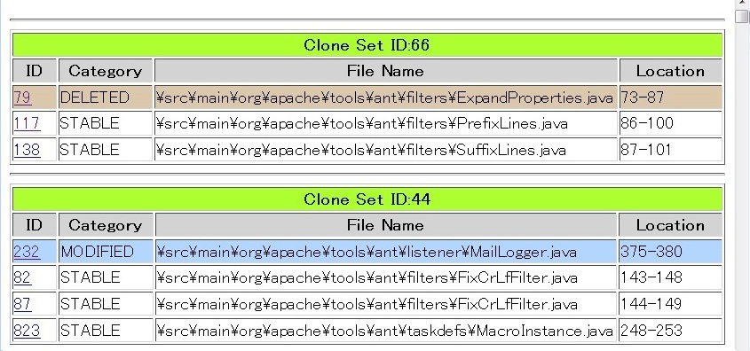
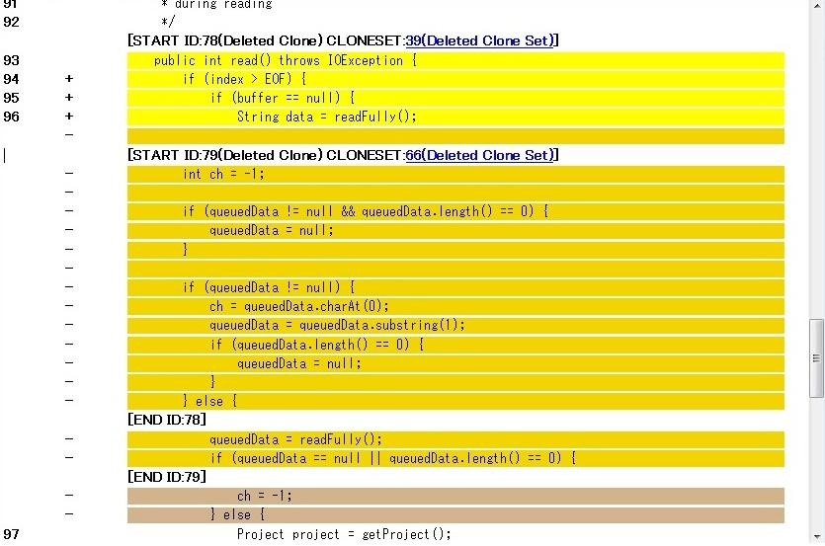
Screenshots of Web-based UI
Clone Set List Page
Source File Page
Users can confirm detail of change information of code clones

Slide 31
Contents
Background
Clone Notifier
Industrial Application
Summary and Future Work

Slide 32
Industrial Application (1/2)
Apply Clone Notifier to development process in NEC
Do the questionnaire and get feedback from a industrial developer in NEC
Questionnaire
Daily Report
Feedback
Clone Notifier
Developer
Authors

Slide 33
Industrial Application (2/2)
Term
December 19, 2011 - January 31, 2012 ( 40days )
Project
Web application system
6 programmers
120 KLOC, 350 files, written in Java
Target of questionnaire
A project manager
10 years of development experiences of Java

Slide 34
Candidates for Maintenance
 | Date | Category | Method of Maintenance
1 | Dec. 28, 2011 | New | Refactoring
2 | Dec. 28, 2011 | New | Refactoring
3 | Jan. 13, 2012 | New | Refactoring
4 | Jan. 13, 2012 | New | Comment
5 | Jan. 13, 2012 | New | Refactoring
6 | Jan. 13, 2012 | New | Refactoring
7 | Jan. 13, 2012 | New | Refactoring
8 | Jan. 16, 2012 | New | Refactoring
9 | Jan. 16, 2012 | New | Refactoring
10 | Jan. 18, 2012 | New | Refactoring
11 | Jan. 24, 2012 | New | Refactoring

Slide 35
Candidates for Maintenance
 | Date | Category | Method of Maintenance
1 | Dec. 28, 2011 | New | Refactoring
2 | Dec. 28, 2011 | New | Refactoring
3 | Jan. 13, 2012 | New | Refactoring
4 | Jan. 13, 2012 | New | Comment
5 | Jan. 13, 2012 | New | Refactoring
6 | Jan. 13, 2012 | New | Refactoring
7 | Jan. 13, 2012 | New | Refactoring
8 | Jan. 16, 2012 | New | Refactoring
9 | Jan. 16, 2012 | New | Refactoring
10 | Jan. 18, 2012 | New | Refactoring
11 | Jan. 24, 2012 | New | Refactoring
All candidates are
newly-appeared clone sets.

Slide 36
Candidates for Maintenance
 | Date | Category | Method of Maintenance
1 | Dec. 28, 2011 | New | Refactoring
2 | Dec. 28, 2011 | New | Refactoring
3 | Jan. 13, 2012 | New | Refactoring
4 | Jan. 13, 2012 | New | Comment
5 | Jan. 13, 2012 | New | Refactoring
6 | Jan. 13, 2012 | New | Refactoring
7 | Jan. 13, 2012 | New | Refactoring
8 | Jan. 16, 2012 | New | Refactoring
9 | Jan. 16, 2012 | New | Refactoring
10 | Jan. 18, 2012 | New | Refactoring
11 | Jan. 24, 2012 | New | Refactoring
Almost of candidates needed refactoring!

Slide 37
Candidates for Maintenance
 | Date | Category | Method of Maintenance
1 | Dec. 28, 2011 | New | Refactoring
2 | Dec. 28, 2011 | New | Refactoring
3 | Jan. 13, 2012 | New | Refactoring
4 | Jan. 13, 2012 | New | Comment
5 | Jan. 13, 2012 | New | Refactoring
6 | Jan. 13, 2012 | New | Refactoring
7 | Jan. 13, 2012 | New | Refactoring
8 | Jan. 16, 2012 | New | Refactoring
9 | Jan. 16, 2012 | New | Refactoring
10 | Jan. 18, 2012 | New | Refactoring
11 | Jan. 24, 2012 | New | Refactoring
Add comment on the location of code clones in source code

Slide 38
Analysis of Application Result
We observed the characteristics of refactoring candidate.
Collect data for the techniques of recommend refactoring candidates
Help developers to reduce the cost of finding refactoring candidates

Slide 39
Findings (1/2)
All refactoring candidates are newly-appeared by adding new code.
We reduced candidates that are newly-appeared by only code replacement and deletion.
13% of clone sets were reduced.

Slide 40
Findings (2/2)
All refactoring candidates include whole parts of loop or branch statements.
We reduced candidates by eliminating syntactically incomplete clone sets.
10% of clone sets were reduced.

Slide 41
Contents
Background
Clone Notifier
Industrial Application
Summary and Future Work

Slide 42
Summary
Developed a Clone Notifier based on opinions of industrial developers in NEC
Confirmed the usefulness of it by applying to the industrial development process
Clone Notifier has been used in NEC.
Investigated the characteristics of clone sets recognized as refactoring

Slide 43

Future Work
Integrate the filtering techniques with Clone Notifier based on findings of investigation
Conduct longer-term case study

Slide 44
Thank you!

