Slide 1


Towards modeling for Large Software Repositories
Raula Gaikovina Kula
Research Assistant Professor
Software Engineering Laboratory
Osaka University

Slide 2

Structure of the Talk
My Background
SARF Project
Current Work
Current Unpublished Idea and Work
Two Published Work

Slide 3
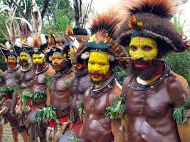
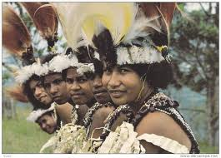

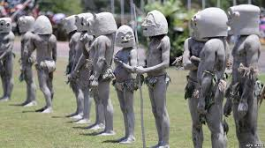
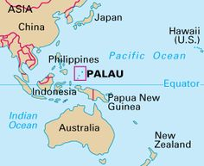
My Background – Land of the Unexpected
Papua New Guinea is largest Pacific Nation with over 800 languages and most diverse cultures…
National Language
Tok Pisin
Motu
English
732.1 million people
10% in Urban areas

Slide 4





My Background
Papua New Guinea is largest Pacific Nation with over 800 languages and most diverse cultures…
2000 -2003
2004 -2005
2005 -2007
2007 ~ present

Slide 5

Research in Japan
MEXT scholar
Masters of Engineering - 2010
Research Project Assistant Professor
(Kakenhi Project) - 2013
PhD in Engineering – 2013
Software Design
Software Process
Repository Mining
Micro Process Analysis
Software Engineering
Software Reuse
Code Clones
Software Licenses

Slide 6
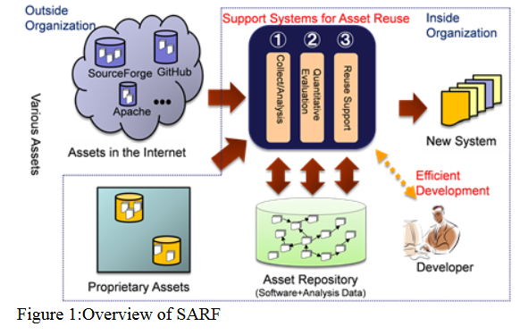
SARF Project (Osaka University)
‘Collecting, Analyzing, and Evaluating Software Assets for Effective Reuse’
Japan Society for the Promotion of Science, Grant-in-Aid for Scientific Research (No.25220003) – Katsuro Inoue

Slide 7



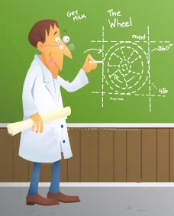


Software Library Reuse
Developer
Next System Release
Adopt 3rd party libraries
from
Previous System Version
Why adopt libraries?
needed features
inherited quality
time/effort cost efficient
avoid reinvent wheel

Slide 8
Software Systems and Library Dependency Co-Evolution
System
library
As the system evolves, more libraries are added.

Slide 9
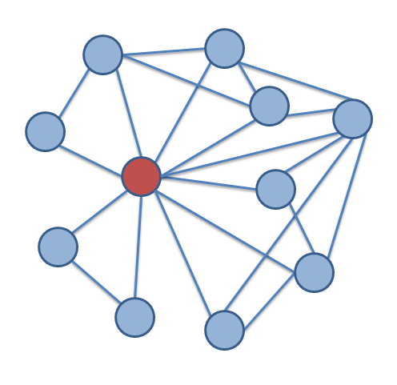
Library Maintenance
But any changes may disrupt dependencies, causing
library breakages
At the same time…
As libraries evolve, Library Updates to fix bugs and new features
As the system evolves, dependencies can become complex
System Maintainer needs to decide `if’, `when’ and `what to update?’

Slide 10


Library Maintenance
But any changes may disrupt dependencies, causing
library breakages
At the same time…
As libraries evolve, Library Updates to fix bugs and new features
As the system evolves, dependencies can become complex
System Maintainer needs to decide `if’, `when’ and `what to update?’

Slide 11





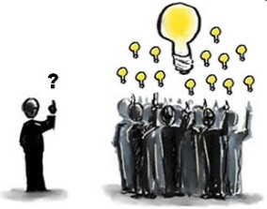



Popular Library Dependence
We can mine data from similar systems to find `wisdom of the crowd’
Similar OSS
systems

Slide 12


Slide 13






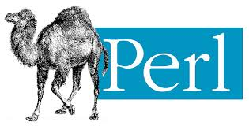
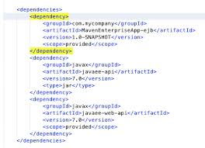


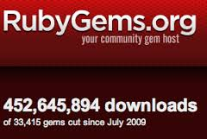



Universe of Super Repositories
Consumer System Repositories
Maven 2
CRAN
Library Repositories

Slide 14
Abstract Model of Use and Update Relations SUG (Software Universe Graph)
Library L
$$L_{1}$$
$$L_{2}$$
Depends(S,L)
$$S_{1}$$
$$S_{2}$$
$$S_{3}$$
$$S_{4}$$
System S
TIME

Slide 15
Software Universe Graph (SUG)
Meta-model
Repository
Universe
1
1..*
composed
Super
Repository
maps
P-SUG
SUG
1..*
1
1
hosts
dep
composed
1..*
0..1
1
Project
Repository
maps
P-Node
1..*
1..*
merged
composed
has
merged
1
dep
maps
dep
1..*
0..1
0..1
1
Code Release
Node
update
maps
update
1..*
0..*
0..*
1
1
maps

Slide 16
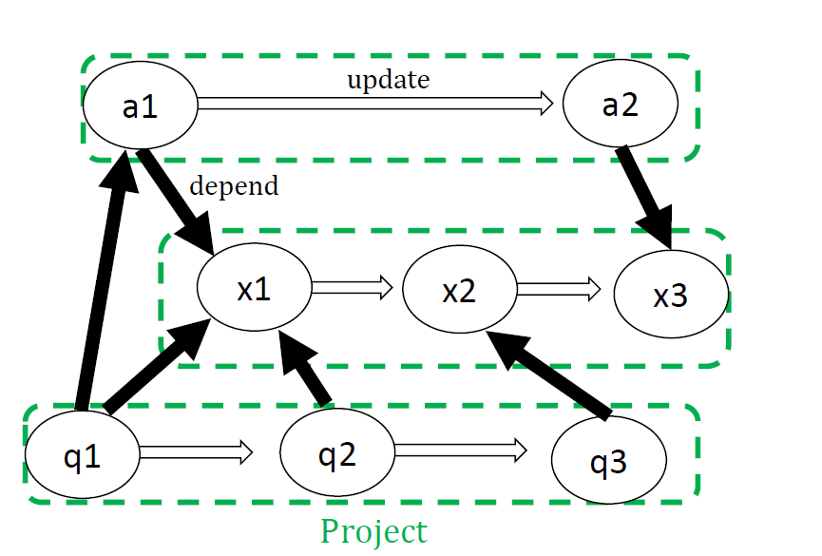
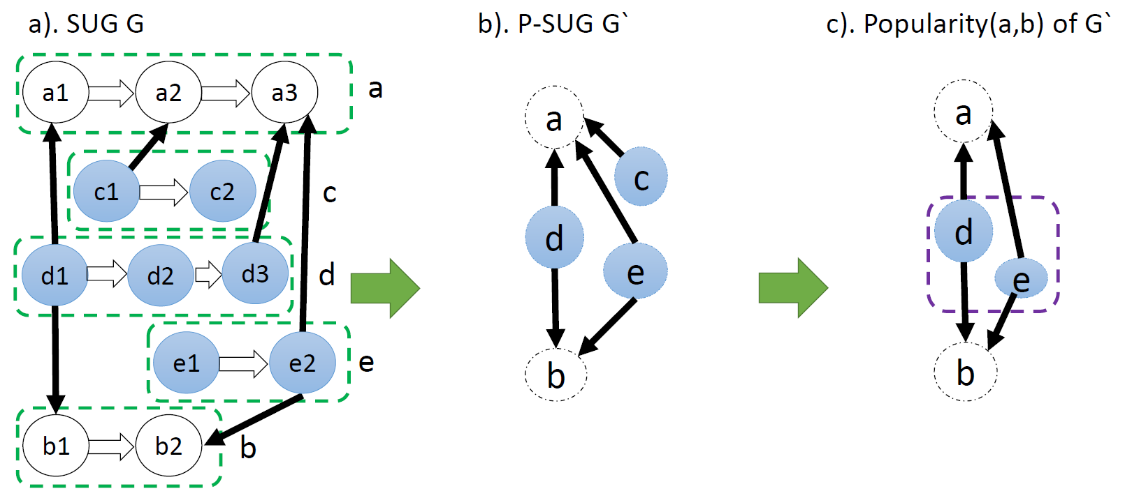
Software Universe Graph
SUG
P-SUG

Slide 17
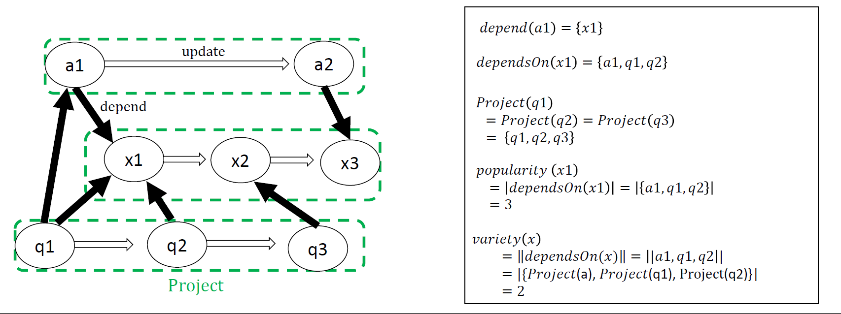

Slide 18
SUG Query related to Popular Library Dependence and Adoption
Adoption-Diffusion Popularity (when is the best time to adopt /abandon versions): Historic dependency and update trends.
Variety Popularity: Grouped by the same product
Co-Dependency (sets of libraries commonly used together):
Combinations of co-dependence sets of libraries (SUG and P-SUG)
Co-dependency value ranking.

Slide 19
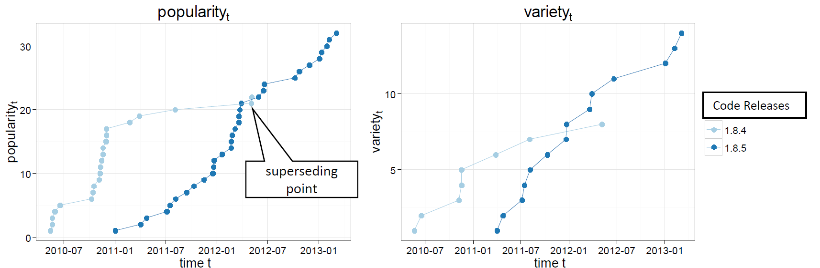
Diffusion Plots (DP)
Which popular library version to use?

Slide 20
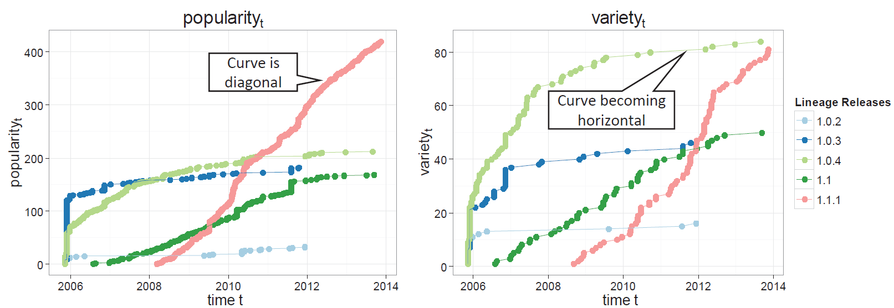
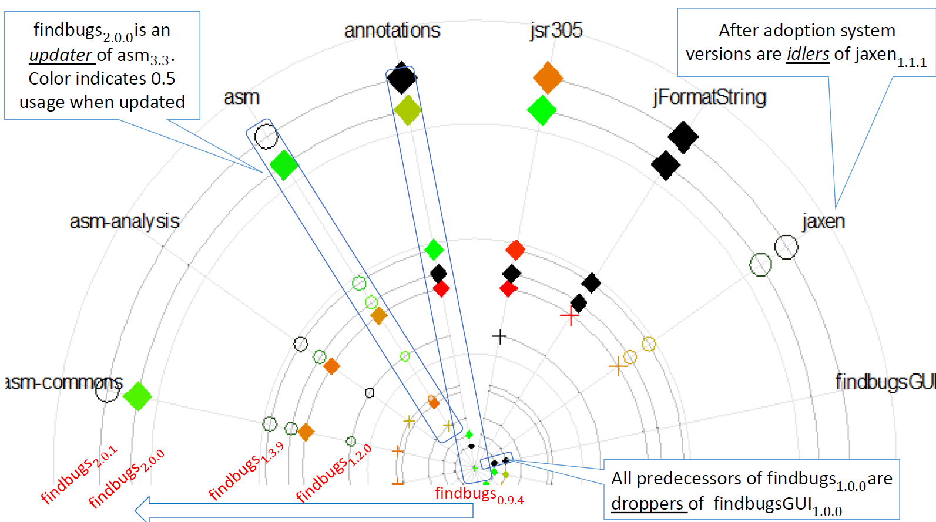
VISSOFT2014

Slide 21
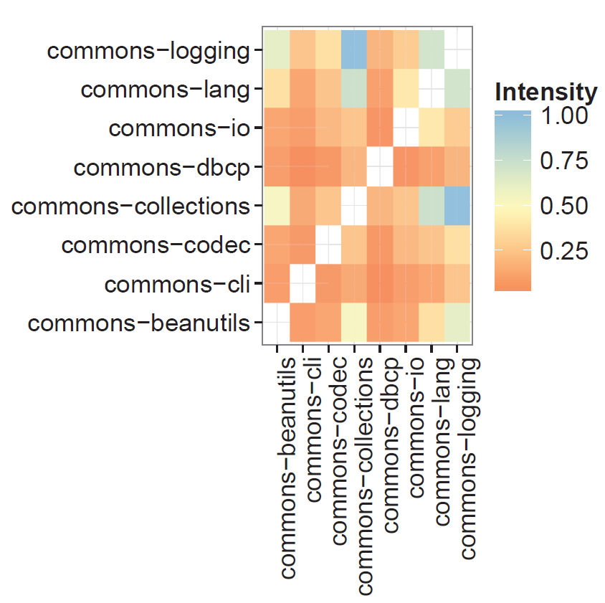
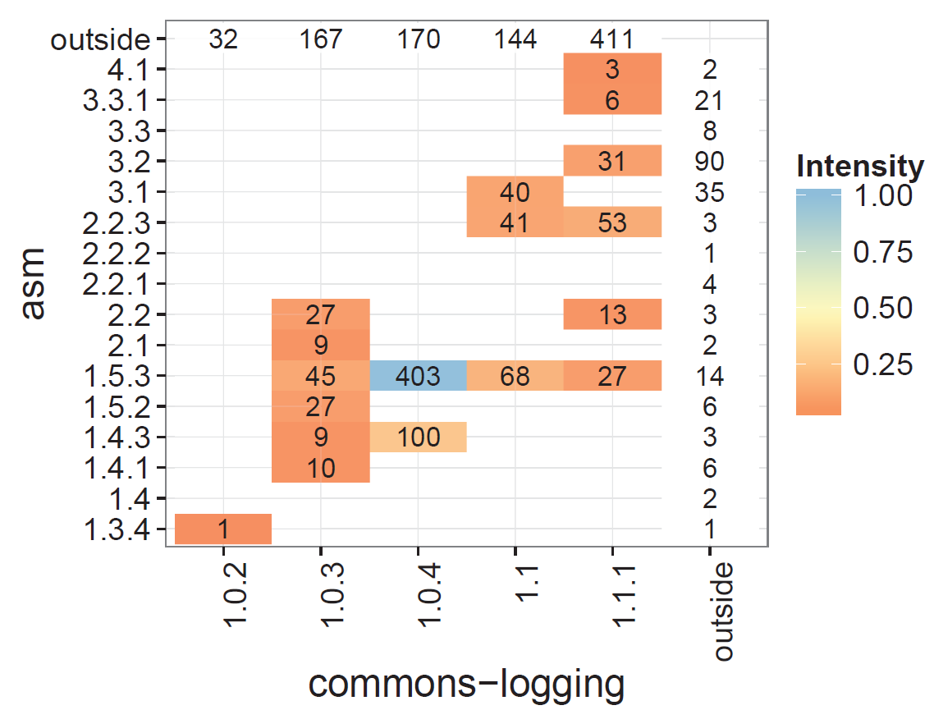
Co-Dependency Plots
Library Comparison
Library Version Level
Unpublished, under review

Slide 22

Two Related Published Works
Different Combinations of Libraries
Trust and Latency to adopt the latest release

Slide 23

Trust of a Library: A Study of the Latency to Adopt the Latest Maven Release
Raula Gaikovina Kula, Daniel German, Takashi Ishio, Katsuro Inoue
Osaka University, Japan
SANER2015-ERA Track

Slide 24



System Maintainers are wary beings…
But any changes may disrupt dependencies: aka breaking changes
System Maintainer needs to decide `if’, `when’ and `what to update?’
Dependency
Hell
Previous work suggests breaking changes and systems still using older versions

Slide 25
Notion of Trust as a metric …
Trusted Adoption: When the latest adoption is adopted
Latent Adoption: When previous releases are adopted

Slide 26
4 types of trust
‘Do exactly what it says’ –
Functional and non-functional specification
Major: Minor: Patch
API Documentation
‘Play with others’ –
Volatile to current system environment
Incompatibilities with other library transitive and non-transitive dependencies

Slide 27
4 types of trust
3. ‘Prior Engagements’ –
Loyalty to a release version based on previous experiences.
Wary of other new libraries and rather stick to familiar libraries
4. ‘Tried and tested’ –
Common belief that the latest release may contain untested bugs.
Prefer to adopt release versions 1 or 2 releases behind the latest.

Slide 28


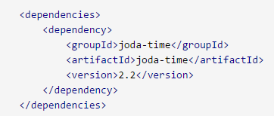

Empirical Study
pom.xml
 | Maven Dataset
Time Period | 2005-11-03 ~ 2013-11-24
# of Dependency Relations | 188,951
# of Systems | 6,374
# of libraries | 5,146

Slide 29
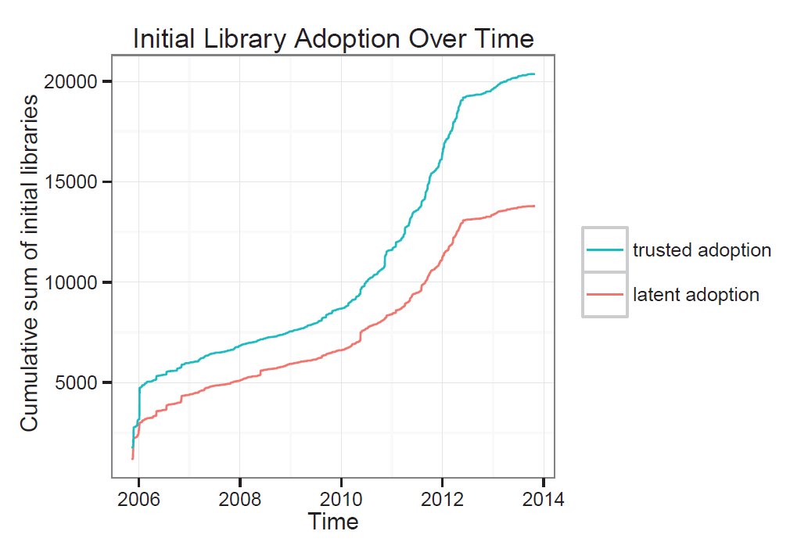
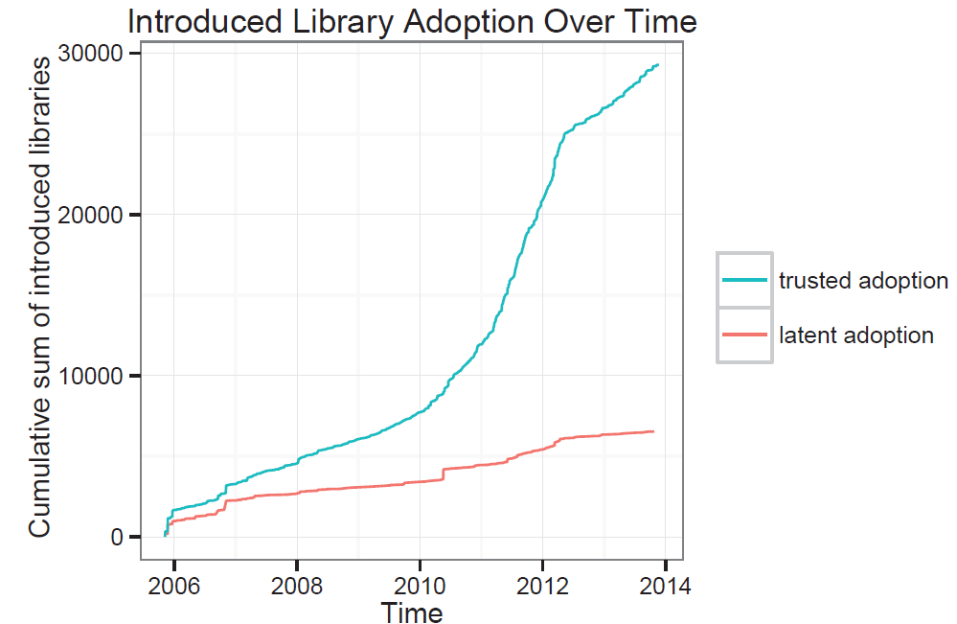
Adoption Trends over time

Slide 30
Study RQs
How much ‘latent adoption’ exists?
It is common, almost 40% at initial conception as compared to introduced.
What is the current trend of maintainers trust?
Over time, maintainers are more inclined to adopt the latest release (trusted dependency adoptions).

Slide 31
VerXCombo
Yuki Yano, Raula Gaikovina Kula, Takashi Ishio, Katsuro Inoue
ICPC2015 (to be presented next week)
Osaka University, Japan

Slide 32
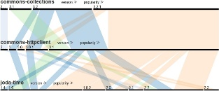

Popular Library Usage Combinations
We can mine data from similar systems to find `wisdom of the crowd’
Maven 2
VerXCombo
Similar systems
VerXCombo allows users to interact with the data to find the best-fit combination of libraries

Slide 33
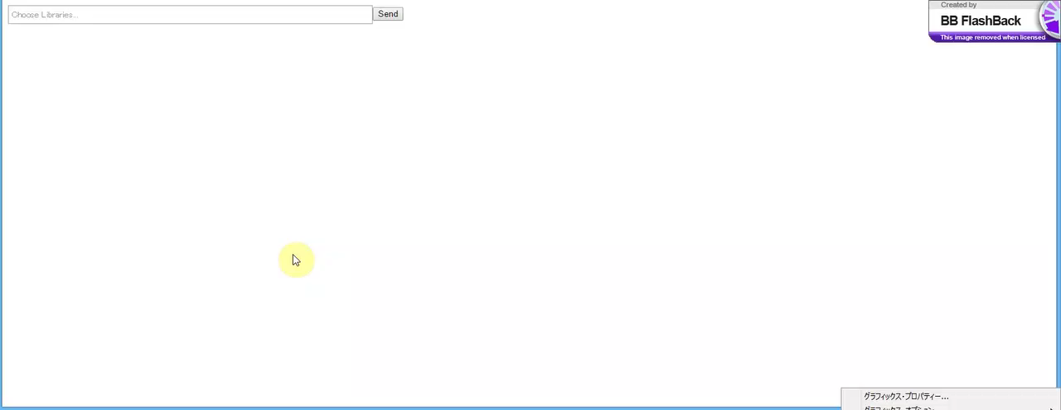
Interaction Features
Library Selection
Autofill lookup interested libraries
Interactive Manipulation
Mouse over highlighting
a combination link.
Vertical Rearrangement
Reorder Libraries for direct comparison
Horizontal Rearrangement
Reorder Library Version to isolate interested combinations
Sorting by Popular Usage
Thickness indicates popular versions. Most popular on left hand side
Sorting by Version
Latest Release will appear on most right hand side
VerXCombo

Slide 34
Challenges and Research Ideas
Validation of the Visualizations and Modelling
Library Compatibility and Latency to Version Adoption
Library Combinations.
Library code level analysis.

Slide 35
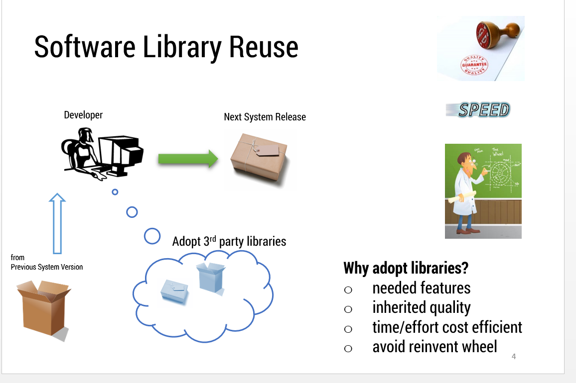
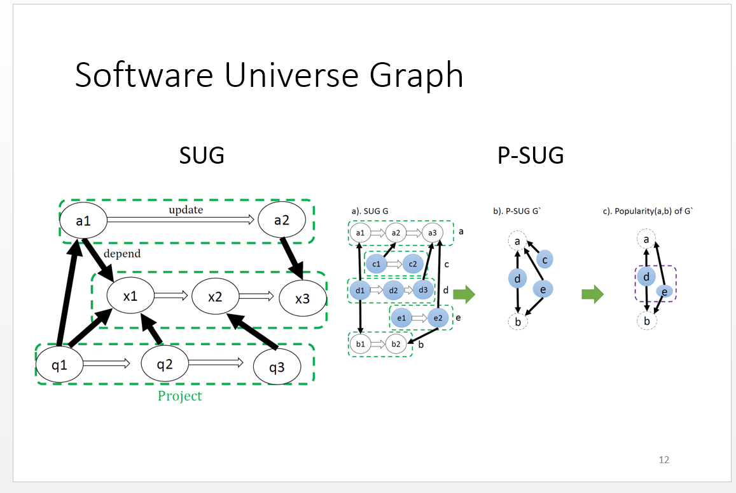
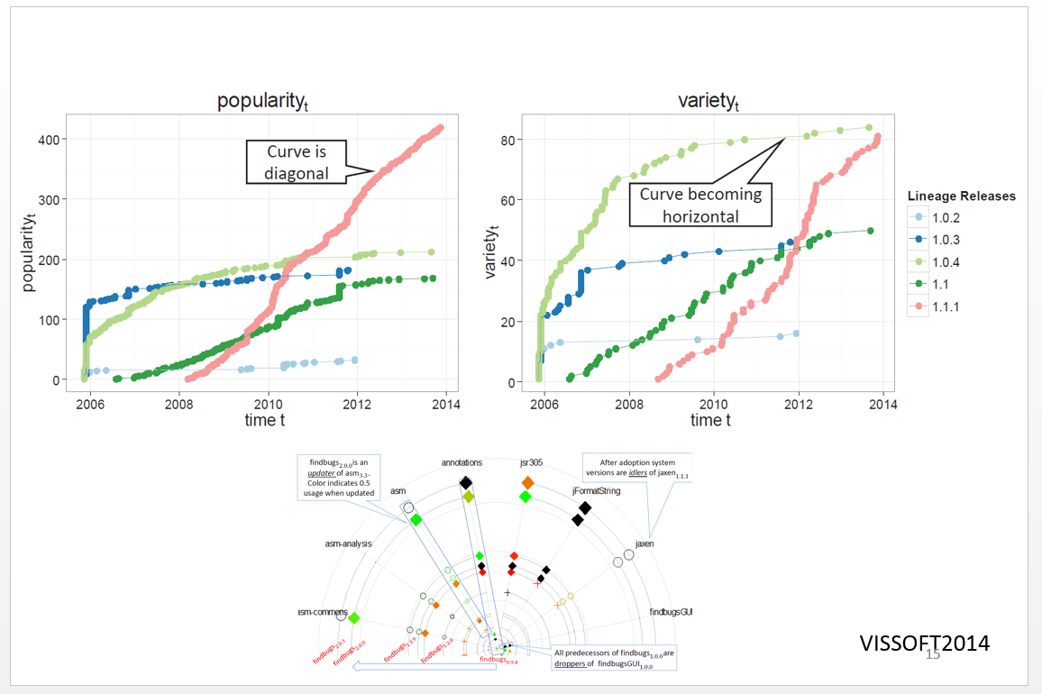
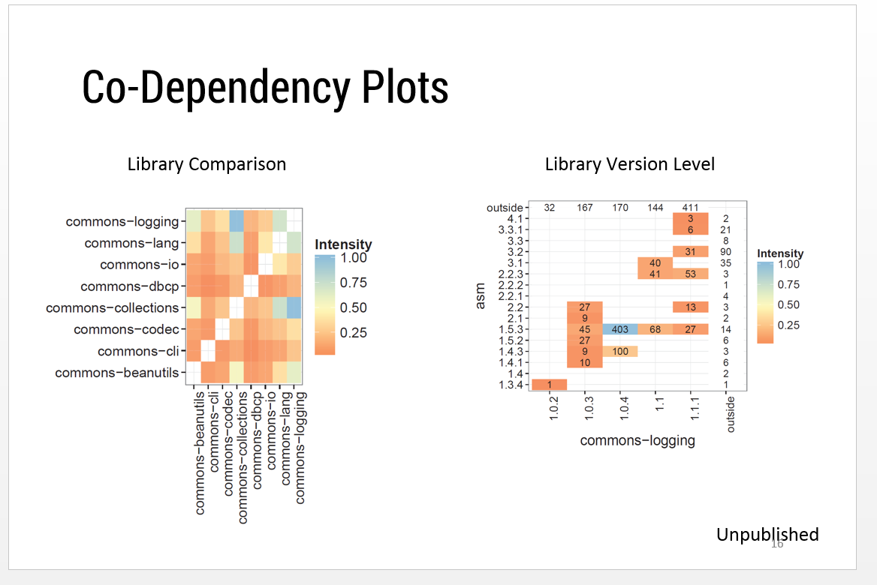
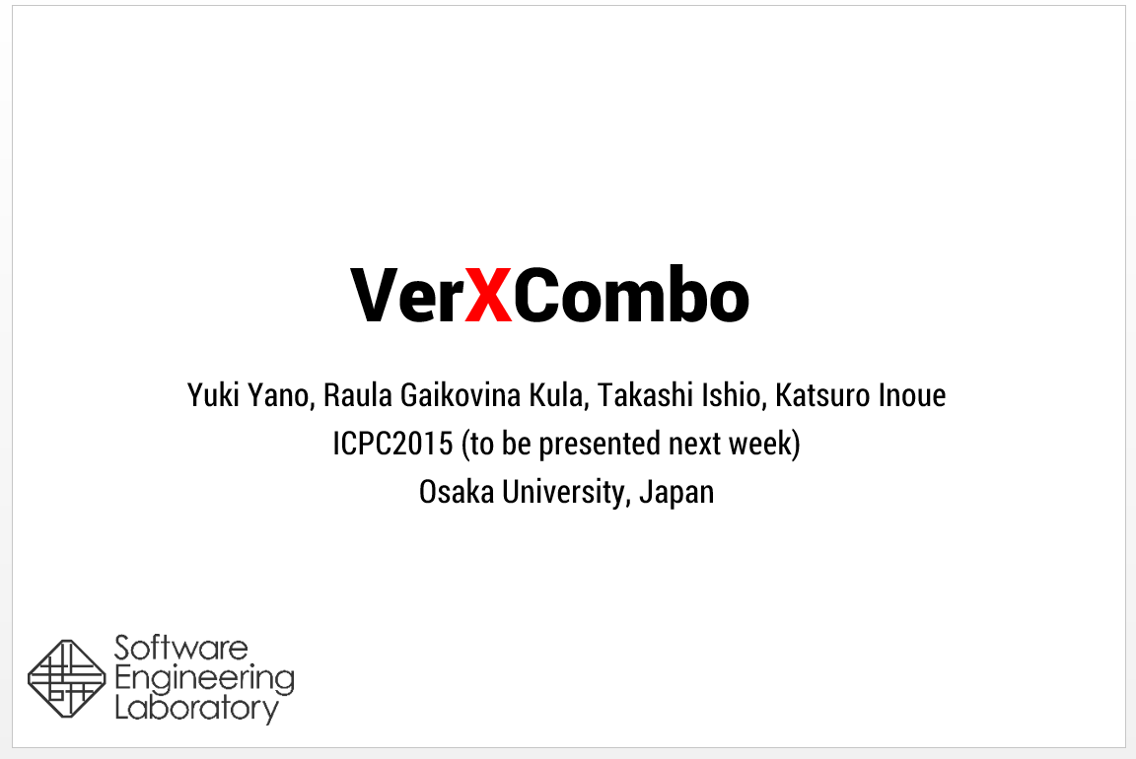
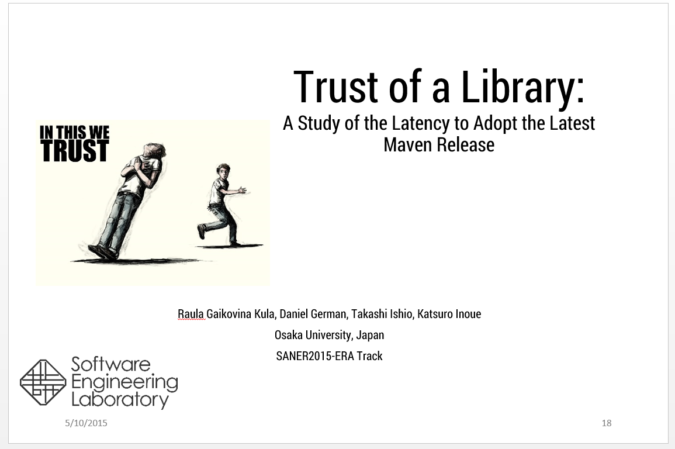
Summary and Conclusions

