Slide 1
An Empirical Study of Out-dated Third-party Code in Open Source Software
Pei Xia
Inoue Lab
2013/02/12

Slide 2
Third-party Code in OSS
Developers reuse 3rd-party code from existing open source projects^{[1]}
libpng
libxml2
zlib
……
libjpeg
openssl
reuse
User project
User project
User project
User project
[1] S.Haefliger, G.Krogh, S.Spaeth, 2008. “Code Reuse in Open Source Software”,
Management Science, Vol.54 No.1 Jan.2008

Slide 3
Out-dated Third-Party Code
Third-party code of older versions containing known defects such as software vulnerabilities that should be fixed by upgrading them to a newer version
No Existing Research
bug
bug
bug
3rd-party project
v1.0
v1.1
v1.2
v2.0
v2.1
Timeline
reuse
User project
User project
User project
User project

Slide 4
Research Questions
What is the proportion of out-dated 3rd-party code reused in the open source software?
What are the potential defects caused by such reuse?
How do user projects manage those out-dated 3rd-party code?
Be helpful in understanding OSS reuse activities, evaluating the quality of OSS and predicting some of the potential defects

Slide 5
Study Approach Overview
1.Defects Information Collection
rep
bug
bug
bug
3rd-party project
v1.0
v1.1
v1.2
v2.0
v2.1
Timeline
2.Projects Searching
3.Version Identifying
4.Management Information Collection

Slide 6
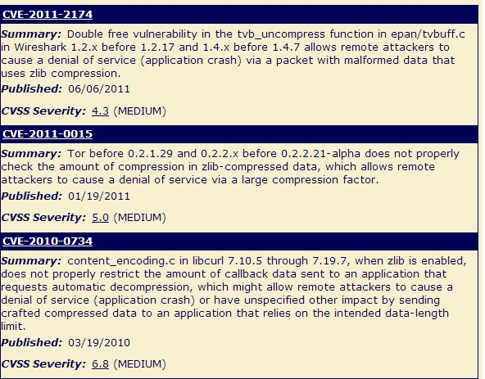
Step 1 : Defects Information Collection
Home page announcement
National Vulnerability Database^{[2]}
The U.S. Government repository of standards based vulnerability management data
[2] National Vulnerability Database,http://nvd.nist.gov/

Slide 7
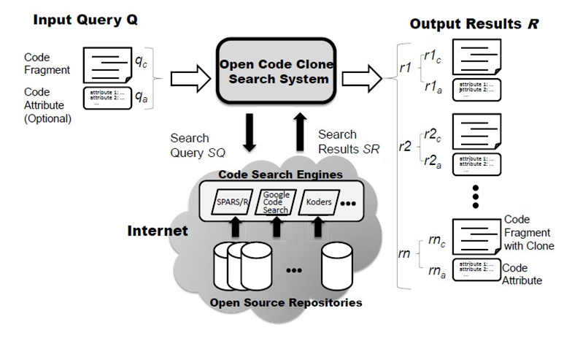
Step 2 : Projects Searching
Using OpenCCFinder^{[3]} to Search
[3] P. Xia, Y. Manabe, N. Yoshida, and K. Inoue. Development of a code clone search tool for open source repositories. Technical report, IPSJ SIG Technical Reports, Vol.2011-SE-174, No2 ,pp.1-8, 2011.

Slide 8
Step 3 : Version Identifying
// some comment
public static void main(){
int a=0;
a=a+1;
}
rep
Third-party project
v1.0
v1.1
v1.2
v2.0
v2.1
Timeline
V2.1
Tokenization
Tokenized file hash
publicstaticvoid$(){int$=$;$=$+$;}
197770261
197770261
197770261
598032372
598032372
Hashing
1786259145
1786259145
1786259145
1786259145
1191396480
917292968
917292968
527652421
197770261
706253673
527652421
527652421
849110879
706253673
706253673
706253673
match
197770261
1786259145
v1.1
rep
917292968
706253673
User project 1
Latest ver.
598032372
rep
1786259145
v2.0
527652421
706253673
User project 2
Latest ver.

Slide 9
Step 4 : Management Information Collection
Questions on reused 3rd-party code
Modified or Copy&Paste?
Keep updating?
Well managed?
Manual investigation
Directory structure and file name
Repository commit history
readme.txt
changelog.txt

Slide 10
Case study
Subject
Project Name | Domain | Project History
zlib | Data compression | 1995-current
libcurl | File transfer | 1999-current
libpng | Graphics | 1995-current

Slide 11
Case Study Result (1/5)
What is the proportion of out-dated 3rd-party code reused in the open source software?
# Projects using 3rd-party code
libpng (50)
Vulnerabilities reported
Warning from hompage
No defects reported
Reused Versions of 3rd-party code
11

Slide 12
Case Study Result (2/5)
What is the proportion of out-dated 3rd-party code reused in the open source software?
 | # investigated projects | # projects contain out-dated 3rd-party code | Out-date code Percentage
zlib | 45 | 14 | 31.11%
libcurl | 28 | 24 | 85.71%
libpng | 50 | 46 | 92.00%
total | 123 | 84 | 68.30%

Slide 13
Case Study Result (3/5)
What are the potential defects caused by such reuse?
zlib version | Reported defects
v1.1.3 | CVE-2002-0059 VU#368819 CA-2002-07
v1.1.4 | CVE-2003-0107 VU#142121
v1.2.1 v1.2.2 | CVE-2004-0797 VU#238687
v1.2.1 v1.2.2 | CVE-2005-2096 VU#680620
v1.2.2 | CVE-2005-1849
v1.2.4 | Bug Fixed. Update suggestion from project homepage
Example
CVE-2005-1849: inftrees.h in zlib 1.2.2 allows remote attackers to cause a denial of service (application crash) via an invalid file that causes a large dynamic tree to be produced.

Slide 14
Case Study Result (4/5)
How do user projects manage those out-dated 3rd-party code?

Slide 15
Case Study Result (5/5)
How do user projects manage those out-dated 3rd-party code?
96 (78.0%) of user projects reused the third-party code with copy and paste
6 (4.9%) of user projects changed directory names or mix the third-party code with other code

Slide 16
Conclusion
In this study, 68.3% of open source software are reusing out-dated third-party code which contain critical defects.
More than half of the open source projects did not manage the third-party code very well.

Slide 17
Future work
Develop a 3rd-party code manage system
Version identifying
Defects prediction
Automatically Updating

Slide 18
Q&A

