Slide 1
Extracting a Unified Directory Tree to Compare Similar Software Products
Yusuke Sakaguchi, Takashi Ishio,
Tetsuya Kanda, Katsuro Inoue
Notes:
My name is Yusuke Sakaguchi.
I’m a graduate master student at Osaka University, Japan.
Today, I’m talking about
Extracting a Unified Directory Tree to Compare Similar Software Products.

Slide 2
Background: Similar software products
Clone-and-own approach
Copying and modifying an existing product
Importing libraries
A
Ver.1.0
Fix a bug
A
Ver.1.1
Clone-and-own
B
Ver.1.0
B
Ver.1.1
Clone-and-own
C
Ver.1.0
Must fix the bug
t
Notes:
When developing a new software product,
clone-and-own is one of popular approaches.
In this figure, each circle represents an individual product.
The original product A is copied and modified
to the new product B with new features,
copied and modified again to the other product C.
Although clone-and-own is easy to develop many products,
it is difficult to manage source code of all the products.

Slide 3
Software Product Line Engineering
Promising for managing derived software products
To apply the approach to existing products, developers need to understand the commonalities and variabilities of them.
Duszynski et al. [1] proposed to compare source code in corresponding directories among similar products.
Developers must know corresponding directories among products (which directories should be compared).
[1] S. Duszynski, J. Knodel, and M. Becker
“Analyzing the source code of multiple software variants for reuse potential,” Reverse Engineering, 2011
Notes:
Software product line engineering is
a well-known approach for managing such derived software products.
To migrate existing products to a product line,
developers need to understand the commonalities and variabilities of them.
An existing work proposed to compare source code in corresponding directories among similar products.
But, to use the method, developers must know the correspondence of directories.
In other words, developers must know which directories should be compared.

Slide 4
The correspondence of directories
Some existing techniques [2], [3] can extract corresponding directories between two similar products.
Cannot analyze more than two products at a time.
[2] K. Yoshimura, D. Ganesan, and D. Muthig
“Assessing merge potential of existing engine control systems into a product line” Software Engineering for Automotive Systems, 2006
[3] D. Holten and J. J. van Wijk
“Visual comparison of hierarchically organized data”
Joint Eurographics / IEEE - VGTC Conference on Visualization, 2008
Notes:
There are some existing techniques that extract corresponding directories between two products.
However, they cannot analyze more than two products at a time.

Slide 5
The proposed method
Automatically extract a unified directory tree representing corresponding directories among multiple products
Key idea
Corresponding directories have similar source files
Notes:
So we propose a method to automatically extract and visualize a unified directory tree
that represents corresponding directories among multiple products.
The key idea is that corresponding directories have similar source files.

Slide 6
Our prototype
Input
Source code of some products
Output
a unified directory tree
S1
S2
S3
3
src
src
src
2
3
2
c
c
a
a
a
1
b
b
b
Directory graph
S1
S2
S3
S1
S2
S3
src
src
src
a
c
a
b
src
src
src
a
b
c
b
c
c
a
a
a
Directory trees
Spanning tree
b
b
b
Notes:
We implement a visualization tool
that takes as input source code of target products.
The visualization comprises two steps;
The first step translates given directory trees into a directory graph.
The second step extracts a spanning tree from the graph.

Slide 7
Node of directory graph
A node is a set of directories that contain similar source files
Two directories $d_{1} and d_{2}$ are represented by a single node
if $sim(d_{1}, d_{2})≥th$
sim(d₁, d₂) : a content similarity metric for two directories in different products
th : a predetermined threshold
Notes:
A node of a directory graph represents a set of directories that contain similar source files.
If a similarity between directories is equal to or greater than a predetermined threshold,
the directories are represented by a single node.

Slide 8
Similarity
the Jaccard similarity coefficient $sim\left(d_{1},d_{2}\right)=\frac{\left|L\left(d_{1}\right)∩L\left(d_{2}\right)\right|}{\left|L\left(d_{1}\right)∪L\left(d_{2}\right)\right|}$
$L(d)$
a set of lines extracted from all non-binary files directly contained in a directory d
Notes:
The similarity is defined by the Jaccard similarity coefficient.
We compare all the lines of source files in directories under comparison.
For efficiency, we use a directory-level comparison instead of a file-level.

Slide 9
Example
S1
S2
S3
src
src
src
a
c
a
b
a
b
c
b
The same color nodes are similar.
White nodes have no files.
Notes:
This slide shows a concrete example.
Suppose the same color nodes have similar contents.
White nodes have no files.
In this case, the same color nodes are represented by a single node.

Slide 10
Example
b
b
b
a
a
a
c
c

Slide 11
Special Treatment
Directories without files
A single node represents such directories if their subdirectories are represented by the same node
Root directories
A root node represents all the root directories of products, irrespective of product similarity.
Notes:
We have two special cases.
The first one is directories without files. The similarity is undefined for them.
We use a single node for such directories if their subdirectories correspond to the same node.
The second one is the root directories of target products.
All of them are represented by a root node, irrespective of products similarity.

Slide 12
Example
S1
S2
S3
src
src
src
a
c
a
b
a
b
c
b
Notes:
In the case of example products,
the subdirectories of the each source directories correspond to the same node.
Hence, the source directories are represented by a single node.
The root directories are represented by a root node.

Slide 13
Example
S1
S2
S3
src
src
src
c
c
a
a
a
b
b
b
Notes:
As a result, five nodes are created to represent the example directory trees.

Slide 14
Connecting nodes
Weighted arcs
The number of parent-subdirectory relationship among two nodes.
S1
S2
S1
S2
S3
S3
3
parent-subdirectory relationship
src
src
src
src
src
src
3
2
2
c
c
c
a
c
a
a
a
a
a
1
b
b
b
b
b
b
Notes:
We connect the created nodes by weighted arcs.
An arc between two nodes indicates the number of parent-subdirectory relationship.
For example,
the arc from the root node to source directory node
indicates three pairs of directories.
(Similarly, the arc from source to directory C indicates two pairs of directories.)

Slide 15
Greedy tree extraction
Initialize a spanning tree $V=\left\{root\right\}, E=∅$
$V$ represents a set of vertices
$E$ represents a set of selected arcs
Select the arc $\left(t, n\right)$having the maximum weight $w(t, n)$ among $t∈V, n∉V$
If the weights are identical, select that which is closest to $root.$
Update $V←V∪\left\{n\right\}, E←E∪\left\{(t, n)\right\}$
Repeat Steps 2 and 3 until $V$ includes all nodes.
Notes:
To obtain a directory tree, we extract a spanning tree from the graph.
Extraction method is a greedy algorithm.
It starts from the root node
and
repeatedly selects an arc having the maximum weight.

Slide 16
Greedy loop
$V=\left\{r\right\}$ $E= ∅$
$V=\left\{r, nsrc, na, nb, nc\right\}$ $E=\{ \left(r,nsrc\right),$
$\left(nsrc, na\right),$
$\left(nsrc, nb\right),$
$\left(nsrc, nc\right) \}$
$V=\left\{r, nsrc\right\}$ $E=\{ \left(r,nsrc\right) \}$
$V=\left\{r, nsrc, na, nb\right\}$ $E=\{ \left(r,nsrc\right),$
$\left(nsrc, na\right),$
$\left(nsrc, nb\right) \}$
$V=\left\{r, nsrc, na\right\}$ $E=\{ \left(r,nsrc\right),$
$\left(nsrc, na\right) \}$
S1
S2
S3
3
src
src
src
3
2
2
c
c
a
a
a
1
b
b
b
Notes:
In the case of the example graph,
the algorithm starts with the root node.
Then we select the arc from the root node.
We continue selecting arcs having the maximum weight.
When the spanning tree includes all the nodes,
the algorithm is terminated.
The resultant spanning tree is regarded as a unified directory tree.

Slide 17
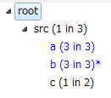
Directory Viewer
Different code
included
Tree View
shows the unified directory tree.
If a node contains multiple directories having different source code, the node is colored in blue.
Notes:
Our tool enables developers to access source code using the tree.
This slide shows a screenshot of our directory viewer.
This area is tree view.
The view shows the unified directory tree.
If a node contains directories having different source code,
the node is colored in blue.
Blue nodes are important to understand differences among products.

Slide 18
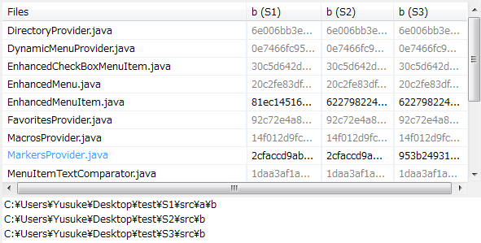
Directory Viewer
Different
contents
File List View
shows a table of file names and their MD5 hash values contained in a selected node.
A black hash value indicates that the file content is different from another product.
Notes:
Selecting a node in the Tree View displays File List View in this area.
File List View shows a table of file names and their MD5 hash values.
When the file content is different from another product, the hash value is black, otherwise gray.
Users can quickly focus on different files.

Slide 19
Directory Viewer
File Matrix View
shows the similarity of files having the same file name selected in a file list view.
A darker (yellow/red) color indicates a lower similarity.
Notes:
The detail of a selected file is visible in File Matrix View in this area.
File Matrix View shows the similarity of the files.
The columns and rows represent products.
Yellow and Red cell indicate a lower similarity values between files.
In this matrix, the third product has another version file.

Slide 20
Case study
Input products
Android OS : 4.2
CPU : Qualcomm MSM8974
Product | Vendor | Mobile Network Operator | Release | #Dirs
FJL22 | Fujitsu | au | 2013/11 | 7,683
301F | Fujitsu | SoftBank | 2013/12 | 7,708
F-01F | Fujitsu | NTT DOCOMO | 2013/10 | 7,582
SO-01F | Sony | NTT DOCOMO | 2013/10 | 5,840
Notes:
We conducted a case study using four Android products.
Input products are listed in the table.
Three products are designed by Fujitsu and one by Sony.

Slide 21
Output
A predetermined similarity threshold th = 0.8
Execution time ： 42 minutes
Two Intel Xeon (2.27Ghz, 4cores)
24GB RAM
The resultant unified directory tree comprises 9,037 nodes.
673 nodes contain different contents from other products.
Notes:
A predetermined similarity threshold is 0.8
Execution time is about 42 minutes.
The resultant unified directory tree comprises about nine-thousands nodes.
673 of them contain different contents from other products.

Slide 22
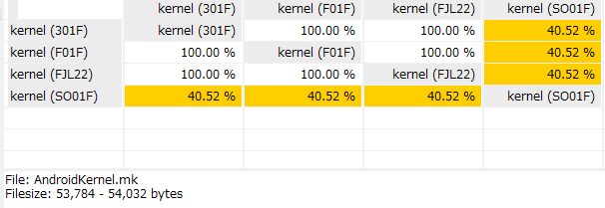
Example: kernel node
--------------Fujitsu-------------- --Sony--
AndroidKernel.mk
Makefile
Developer-specific options for the kernel build is mainly written in this file.
Notes:
This is an example difference
between products.
The unified directory tree includes a node representing the kernel directory in the products.
Some files in Sony are different from files in Fujitsu products.
The similarity of AndroidKernel.mk file is about 40%.
We found that developer-specific options for the kernel build is mainly written in this file.

Slide 23
Example: Product-specific directory
(Fujitsu)
external
(Sony)
external
external
(Fujitsu)
chronium
(Fujitsu/Sony)
Common subdirectories
chronium
chronium
Different
(Sony)
chronium
(Sony)
Unique subdirectories
Common
Input
Output
Unique to Sony
Notes:
Another example is the Chronium directory.
The contents in the Fujitsu’s directories are much different from the Sony’s one.
On the other hand, their subdirectories are very similar.
In this case, our tool outputs two distinct Chromium nodes.
Common subdirectories are merged into Fujitsu’s chronium node.
Another subdirectory unique to Sony is shown as a subdirectory of the Sony’s chromium directory.

Slide 24
Conclusion and Future Work
Our tool visualizes a unified directory tree.
We conducted a case study using four Android products.
The tool enabled us to quickly focus on directories having different contents.
Future work: Controlled experiment to evaluate
The effectiveness for source code comparison tasks.
Notes:
In this work, we proposed a tool to visualize a unified directory tree for multiple products.
As a case study, we have applied our tool to four Android products.
The tool enables us to quickly focus on directories where differences exists among products.
In future work, we would like to conduct a controlled experiment to evaluate its effectiveness for source code comparison tasks.
That’s all. Thank you for your attention.

Slide 26
Creating node
$$d_{2}$$
0.9
0.85
$$d_{1}$$
$$d_{3}$$
0.9
0.7
$$th=0.8$$
Can analyze the differences among the directories
Notes:
スライドまとめ
・3つ以上のディレクトリの説明

Slide 27
Aligning the tree with a specific product
Focus on S1
root : { , , }
s1
s2
s3
$$∞$$
nsrc : { , , }
s1/src
s2/src
s3/src
$$∞$$
$$∞$$
na : { ,
,
}
2
s1/src/a
nc :
{ ,
}
s2/src/a
s1/src/c
s3/src/a
s2/src/c
nb : { ,
,
}
s1/src/a/b
$$∞$$
s2/src/b
s3/src/b

Slide 28
Directory Viewer
Scope Button
Notes:
出力例は，今まで例で説明してきたものと同様としている
スライドまとめ
・各Viewの概要説明

Slide 29
Tree View
Directory name${( y \text{in} x )}^{(∗)}$
x : the number of directories
y : the number of variants
* : marked if a directory in the node has a different name or a different file path than the tree node
S2 : b
S1 : c
S2 : c
S1 : b
S3 : b
Difference
Similar
Different file Path
Notes:
例を用いながら説明
スライドまとめ
・Tree Viewの説明

Slide 30
Example: kernel node
--------------Fujitsu-------------- --Sony--
MAINTAINERS
Lack some non-ASCII characters
Notes:
It seems that the characters are accidentally
replaced by a developmental environment

Slide 31
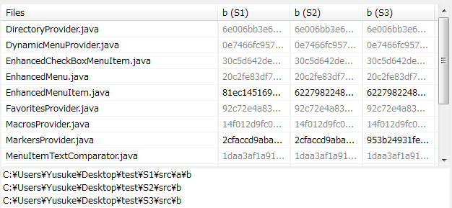
File List View
ディレクトリ b を選択
セルは、まとめられた各ディレクトリに対する 各ファイルのハッシュ値
ファイル内容が異なる場合黒く描画
フルパスをクリックするとファイル管理ツールでそのディレクトリが開く
Notes:
スライドまとめ
・File List Viewの説明

Slide 32
File Matrix View
After one of the cells is selected, an external diff tool (e.g.,WinMerge) is executed in order to compare two files.
Notes:
2つのテキストファイルの差分を可視化するツール
スライドまとめ
・File Matrix Viewの説明

