Slide 1
Estimating Code Size After a Complete Code-Clone Merge
Buford Edwards III, Yuhao Wu, Makoto Matsushita, Katsuro Inoue
Graduate School of Information Science and Technology, Osaka University

Slide 2
Outline
Review Code Clones
Prior Code Clone Research
Refactoring/Merging Code Clones
Complete Code-Clone Merge Explanation
Basic Case and Illustration
Expand to Difficult Case (Overlapping and Embedded Code Clones)
Prototype tool and its application
Conclusions

Slide 3

What are code clones?
Code clones – sections of code that are the same or very similar to each other
How similar they must be depends on what kind of clone and how one measures their similarity.
Image: http://learn.genetics.utah.edu/content/cloning/whyclone/images/clones.jpg
Notes:
Four types of code clones: 1 – identical, 2 – different identifier names and values, 3 – may have additions, deletions, altered statements, 4 – semantic, same function but different structure or syntax

Slide 4
Types of Code Clones
Type 1 – Identical
Type 2 – Different variable names/values
Type 3 – May have additions, deletions, altered statements due to editing
Type 4 – Semantic, has same function but different structure or syntax

Slide 5
Why do code clones matter?
Code clones increase maintenance costs
Inconsistent changes lead to bugs [1]
“Nearly every second unintentionally inconsistent change to a code clone leads to a fault” [2]
As project increases in size, more likely for unintentional code clones to appear [3]
[1] Chanchal K. Roy, James R. Cordy, Rainer Koschke, Comparison and evaluation of code clone detection techniques and tools: A qualitative approach, Sci. Comput. Program., Vol.74, No.7, pp.470-497 (2007).
[2] Elmar Juergens, Florian Deissenboeck, Benjamin Hummel, Stefan Wagner, Do code clones matter?, In Proceedings of the 31st Inter-national Conference on Software Engineering (ICSE ’09), pp.485-495 (2009).
[3] Michel Dagenais, Ettore Merlo, Bruno Lagu¨e, and Daniel Proulx. Clones occurrence in large object oriented software packages. In Pro-ceedings of the 8th IBM Centre for Advanced Studies Conference (CASCON ’98), pp. 192-200 (1998).

Slide 6
Should we get rid of clones?
Quantitative evaluation of code clones may help us decide
How much of the software system is made of code clones?
How much of the system size will be reduced if we merge all code clones?
Code clone detection tools exist to answer the first question.
Notes:
Do you wish to reduce the size of your system?

Slide 7
What is Merging?
Merging – we mean a kind of refactoring
Code refactoring – restructuring preexistent code without changing external behavior or final execution result [4]
Code clone refactor technique [5] –
Extract clones from the code
Create shared function that contains cloned portion
Create calls to that shared function
[4] Martin Fowler, Refactoring: Improving the Design of Existing Code, Addison-Wesley (1999).
[5] Yoshiki Higo, Toshihiro Kamiya, Shinji Kusumoto, Katsuro Inoue, Refactoring Support Based
on Code Clone Analysis, In Proceedings of 5th International Conference on Product Focused
Software Process Improvement, pp.220-233 (2004).

Slide 8
Complete Code-Clone Merge
How much of the system size will be reduced if we merge all code clones?
Complete Code-Clone Merge (CCM) is an algorithm designed to help answer that question

Slide 9
CCM Explained
We have a source file S of a certain line length |S|
Each code clone will have a unique ID.
Each unique code clone will be extracted to a shared function.

Slide 10
CCM Explained
Within S, each clone will be replaced with a call to their respective shared functions.
Merging all code clones creates S’ of a certain line length |S’|
We expect |S’| < |S|

Slide 11
Basic Case and Illustration
|S| = 100 lines
Recognize clones A and B.
A = 15 lines, B = 10 lines
POP of A = 2, POP of B = 2
POP (population) – number of times a clone appears
Merge clones into individual shared functions

Slide 12
Source Code: S
S’
|S| = 100 Lines
1
A: Function Call
- 1 Line
1
- 1 Line
A: Function Call
A: 15 Lines
B: Function Call
- 1 Line
A: 15 Lines
B: Function Call
- 1 Line
Clone Detection
Software
A: Initialization
- 1 Line
B: 10 Lines
A: 15 Lines
B: 10 Lines
A: Termination
- 1 Line
Clone Pair Data
- 1 Line
B: Initialization
B: 10 Lines
83
B: Termination
- 1 Line
100
CCM
|S’| = 83 Lines

Slide 13
Basic Case and Illustration
Result Summary
Initial Size |S| | 100 Lines
Total Clone Length | 50 Lines
Reduced Size |S’| | 83 Lines
Lines of Code Reduced | 17 Lines
Percent Reduction | 17%

Slide 14
Basic Case and Illustration
Result Summary
Initial Size |S| | 100 Lines
Total Clone Length | 50 Lines
Reduced Size |S’| | 83 Lines
Lines of Code Reduced | 17 Lines
Percent Reduction | 17%
Sum of all Unique Code Clone Lengths x POP
Clone ID | A | B
Lines | 15 | 10
POP | 2 | 2
Total Size | 30 | 20 | 50

Slide 15
Basic Case and Illustration
Result Summary
Initial Size |S| | 100 Lines
Total Clone Length | 50 Lines
Reduced Size |S’| | 83 Lines
Lines of Code Reduced | 17 Lines
Percent Reduction | 17%
(|S| - Total Clone Length) + Total Function Calls + Total Shared Function Size
50 Lines + 4 Lines + 29 Lines
Note: Initialization and
Termination may be
configured to be a value
other than the 1 Line
default value.
Function(Clone ID) | A | B
Core Lines | 15 | 10
Initialization Lines | 1 | 1
Termination Lines | 1 | 1
Total Size | 17 | 12 | 29

Slide 16
Basic Case and Illustration
Result Summary
Initial Size |S| | 100 Lines
Total Clone Length | 50 Lines
Reduced Size |S’| | 83 Lines
Lines of Code Reduced | 17 Lines
Percent Reduction | 17%
|S| - |S’| = Lines of Code Reduced
100 - 83 = 17

Slide 17
Basic Case and Illustration
Result Summary
Initial Size |S| | 100 Lines
Total Clone Length | 50 Lines
Reduced Size |S’| | 83 Lines
Lines of Code Reduced | 17 Lines
Percent Reduction | 17%
(Lines of Code Reduced / |S|) x 100 = Percent Reduction
(17 Lines / 100 Lines) x 100 = 17%

Slide 18
Overlapping and Embedded Code Clones
1
A: 15 Lines
Sections of code, identified as code clones that share a portion of their code with another unique code clone
Not uncommon, must be accounted for.
B: 15 Lines
A: 15 Lines
B: 15 Lines
100

Slide 19
Overlapping and Embedded Code Clones
1
A: 15 Lines
Can no longer simply create shared function for A and B
We decide to use the “Chunking Method”
B: 15 Lines
A: 15 Lines
B: 15 Lines
100

Slide 20
Overlapping and Embedded Code Clones
1
|S| = 100
1
A: 15 Lines
A’: 10 Lines
B: 15 Lines
C: 5 Lines
C: 5 Lines
B’: 10 Lines
A: 15 Lines
A’: 10 Lines
C: 5 Lines
C: 5 Lines
B: 15 Lines
C: 5 Lines
C: 5 Lines
B’: 10 Lines
100
100

Slide 21
Overlapping and Embedded Code Clones
1
A’: 10 Lines
After creating “chunks” can create a shared method for each
Create calls as normal
Overlaps increase the number of lines required in |S’|
C: 5 Lines
B’: 10 Lines
A’: 10 Lines
C: 5 Lines
C: 5 Lines
B’: 10 Lines
100

Slide 22
CCM Size Estimation Prototype Tool
Tool used to estimate system size after merging all code clones.
Tool uses CCFinderX as part of the required input [6]
Generates clone pair data used by the algorithm
Source code S is also required input.
Removal of whitespace/comments before running CCFinderX and tool.
[6] CCFinderX Official site, http://www.ccfinder.net/ .
Notes:
CCM size estimation prototype tool.

Slide 23
Application of the Tool
Three examples of source codes used as part of CCM Prototype application
Multilap.java
Java JDK [7]
Quake Engine [8]
Java JDK and Quake Engine chosen due to large size.
[7] Java SE j Oracle Technology Network j Oracle, http://www.oracle.com/technetwork/java/javase .
Java. SE Development Kit 8, Update 77 Release Notes, http://www.oracle.com/technetwork/java/javase/8u77-relnotes-2944725.html.
[8] GitHub - id-Software/Quake: Quake GPL Source Release, https://github.com/id-Software/Quake . © 1992

Slide 24
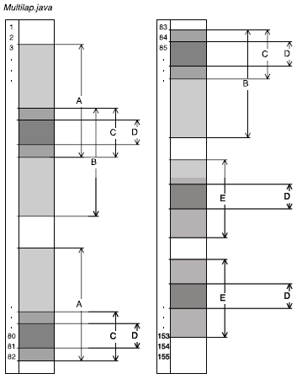
Multilap.java
Control to show multiple overlapping code clones.
Can follow the calculations for this step-by-step in paper.

Slide 25
Java JDK
Result Summary
Initial Size |S| | 813,546 Lines
Total Clone Length | 207,072 Lines
Code Clone Volume | 25.45%
Reduced Size |S’| | 708,139 Lines
Lines of Code Reduced | 105,407 Lines
Percent Reduction | 12.96%
Code clone volume:
Calculated via: (Total Clone Length/|S|) x 100
Java JDK 1.8.0_77-b03

Slide 26
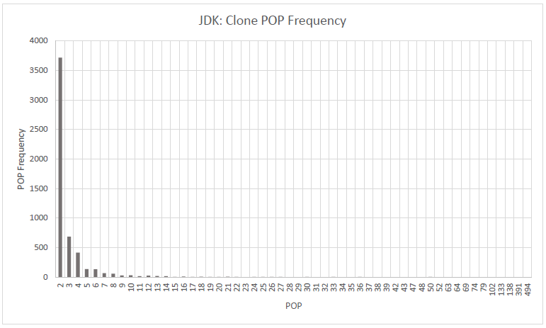
Java JDK
Code clone volume: Approx. 25%
Most common POP is 2
If we assume every clone has POP of 2, expected reduction percent would be about half of code clone volume. (12.73%)
Actual Reduction: 12.96%

Slide 27
Quake Engine
Result Summary
Initial Size |S| | 216,722 Lines
Total Clone Length | 49,098 Lines
Code Clone Volume | 22.66%
Reduced Size |S’| | 194,324 Lines
Lines of Code Reduced | 22,398 Lines
Percent Reduction | 10.33%

Slide 28
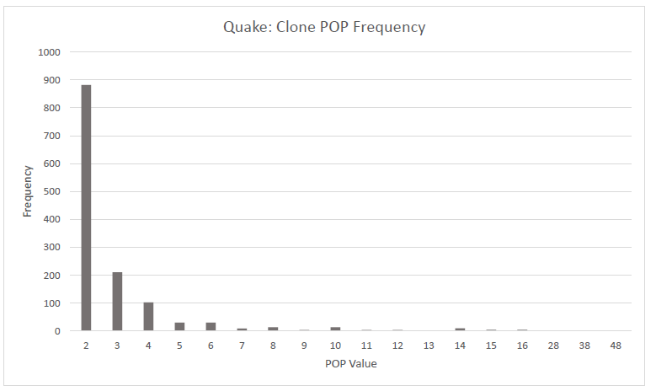
Quake Engine
Code clone volume: Approx. 22.66%
POP 2 is again most frequent, although to a lesser extent.
Expected reduction: 11.33%
Actual reduction: 10.33%

Slide 29
Conclusions
Quantitative evaluation:
What percentage of the source code could theoretically be reduced?
Application results seem reasonable
Analyzing the POP frequencies, reduction seems consistent with what is expected
Code clones with POP value of 2 most common in large sources analyzed by prototype

