Slide 1
Software Ingredients:
Detection of Third-party Component Reuse in Java Software Release
Takashi Ishio†,
Raula Gaikovina Kula†, Tetsuya Kanda†,
Daniel M. German‡, Katsuro Inoue†
†Osaka University, Japan
‡University of Victoria, Canada
MSR2016

Slide 2
Motivation: Software Reuse
In Java, many binary components are reused in a product binary.
Apache HttpClient
Apache Ant
Apache Commons Codec
Apache Commons Collections
Apache Xalan
HTMLUnit
All-in-one package
for WebApp development
Google Web Toolkit 2.7.0
is-made-of
…

Slide 3

Is it safe?
Product Documentation
All-in-one package
for WebApp development
Google Web Toolkit 2.7.0
A partial list of components
No version numbers
Relevant?
Security Advisories
#2014-002 Xalan-Java insufficient secure processing
arbitrary code can be executed if …
[Affected versions: before 2.7.2]
http://www.ocert.org/advisories/ocert-2014-002.html

Slide 4
Detection of Software Components
Our tool detects component names and their version numbers in a given jar file.
Google Web Toolkit 2.7.0
Apache
Ant 1.6.5
Apache Xalan 2.7.1
Apache Commons Collections 3.2.1
Apache HttpClient 4.3.1
HtmlUnit 2.13
Apache Commons Codec 1.8
is-made-of
Vulnerability Note VU#576313
Apache Commons Collections library insecurely deserializes data.
[Affected versions: 3.2.1, 4.0]
https://www.kb.cert.org/vuls/id/576313
#2014-002 Xalan-Java insufficient secure processing
arbitrary code can be executed if …
[Affected versions: before 2.7.2]
http://www.ocert.org/advisories/ocert-2014-002.html

Slide 5
Actions based on Detection Result
Upgrade the whole product
  if available
Upgrade vulnerable components
  if available
Use the product in a safe environment
  if upgrade is impossible
Accept a risk (Continue to use the product)
  if vulnerability conditions are unsatisfiable

Slide 6
How to Detect Components
A
Component Database
(e.g. Maven.org)
Input: a jar file
gwt-dev-2.7.0.jar
includes?
ant-1.6.4.jar
ant-1.6.5.jar
ant-1.7.0.jar
Output: jar files that are the most likely included in the input file
collections-3.2.0.jar
ant-1.6.5.jar
collections-3.2.1.jar
collections-3.2.1.jar
collections-3.2.2.jar

Slide 7
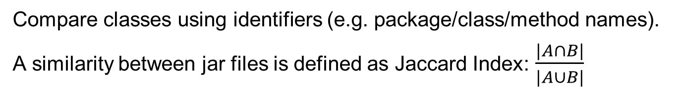
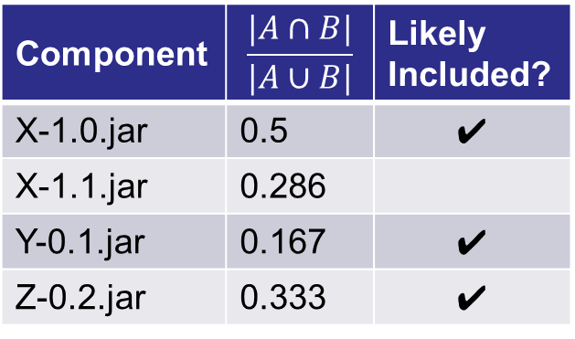
A previous work: Software Bertillonage
Compare classes using identifiers (e.g. package/class/method names).
A similarity between jar files is defined as Jaccard Index: $\frac{|A∩B|}{|A∪B|}$
Input:
Database
[target.jar]
Class Signature
A 7fabc...
B ff1dc...
C 07a21...
E 920b4...
F 6b9a3...
G a18e0...
[X-1.0.jar]
Class Signature
A 7fabc...
B ff1dc...
C 07a21...
[X-1.1.jar]
Class Signature
A 7fabc...
C 07a21...
D 35e23...
[Y-0.1.jar]
Class Signature
E 920b4...
[Z-0.2.jar]
Class Signature
E 920b4...
F 6b9a3...
Component | $$\frac{|A∩B|}{|A∪B|}$$ | Likely Included?
X-1.0.jar | 0.5 | ✔
X-1.1.jar | 0.286
Y-0.1.jar | 0.167 | ✔
Z-0.2.jar | 0.333 | ✔
A user has to manually identify original components using the information.

Slide 8
The key difference: Greedy search
  Strategy:
  Select the largest, entirely copied jar file
Input:
Database
[target.jar]
Class Signature
A 7fabc...
B ff1dc...
C 07a21...
E 920b4...
F 6b9a3...
G a18e0...
[X-1.0.jar]
Class Signature
A 7fabc...
B ff1dc...
C 07a21...
[X-1.1.jar]
Class Signature
A 7fabc...
C 07a21...
D 35e23...
[Y-0.1.jar]
Class Signature
E 920b4...
[Z-0.2.jar]
Class Signature
E 920b4...
F 6b9a3...

Slide 9
The key difference: Greedy search
  Strategy:
  Select the largest, entirely copied jar file
Greedy Search in this example:
Select X-1.0 because it provides 3 of 6 classes.
Input:
Database
[target.jar]
Class Signature
A 7fabc...
B ff1dc...
C 07a21...
E 920b4...
F 6b9a3...
G a18e0...
[X-1.0.jar]
Class Signature
A 7fabc...
B ff1dc...
C 07a21...
[X-1.1.jar]
Class Signature
A 7fabc...
C 07a21...
D 35e23...
[Y-0.1.jar]
Class Signature
E 920b4...
[Z-0.2.jar]
Class Signature
E 920b4...
F 6b9a3...
3 classes

Slide 10
The key difference: Greedy search
  Strategy:
  Select the largest, entirely copied jar file
Greedy Search in this example:
Select X-1.0 because it provides 3 of 6 classes.
Select Z-0.2 because it provides 2 of 3 remaining classes.
Input:
Database
[target.jar]
Class Signature
A 7fabc...
B ff1dc...
C 07a21...
E 920b4...
F 6b9a3...
G a18e0...
[X-1.0.jar]
Class Signature
A 7fabc...
B ff1dc...
C 07a21...
[X-1.1.jar]
Class Signature
A 7fabc...
C 07a21...
D 35e23...
[Y-0.1.jar]
Class Signature
E 920b4...
[Z-0.2.jar]
Class Signature
E 920b4...
F 6b9a3...
2 classes

Slide 11
The key difference: Greedy search
  Strategy:
  Select the largest, entirely copied jar file
Greedy Search in this example:
Select X-1.0 because it provides 3 of 6 classes.
Select Z-0.2 because it provides 2 of 3 remaining classes.
X-1.1 and Y-0.1 are not selected because they do not cover the remaining class G.
Input:
Database
[target.jar]
Class Signature
A 7fabc...
B ff1dc...
C 07a21...
E 920b4...
F 6b9a3...
G a18e0...
[X-1.0.jar]
Class Signature
A 7fabc...
B ff1dc...
C 07a21...
[X-1.1.jar]
Class Signature
A 7fabc...
C 07a21...
D 35e23...
[Y-0.1.jar]
Class Signature
E 920b4...
[Z-0.2.jar]
Class Signature
E 920b4...
F 6b9a3...

Slide 12
The key difference: Greedy search
  Strategy:
  Select the largest, entirely copied jar file
Greedy Search in this example:
Select X-1.0 because it provides 3 of 6 classes.
Select Z-0.2 because it provides 2 of 3 remaining classes.
X-1.1 and Y-0.1 are not selected because they do not cover the remaining class G.
Input:
Database
[target.jar]
Class Signature
A 7fabc...
B ff1dc...
C 07a21...
E 920b4...
F 6b9a3...
G a18e0...
[X-1.0.jar]
Class Signature
A 7fabc...
B ff1dc...
C 07a21...
[X-1.1.jar]
Class Signature
A 7fabc...
C 07a21...
D 35e23...
[Y-0.1.jar]
Class Signature
E 920b4...
[Z-0.2.jar]
Class Signature
E 920b4...
F 6b9a3...
is-made-of

Slide 13

Experiment to evaluate accuracy
Comparison with the previous work
  Component database: Sourcerer Dataset (172,232 jar files)
    A snapshot of Maven repository on August, 2012.
  1,000 artificial products: We randomly selected 10—1,000 components and repackaged them into a single jar file.
Randomly selected components
ant-1.6.5.jar
Copy classes
Our method and
the previous work
Reported components
ant-1.6.5.jar
commons-codec-1.8.jar
collections-3.2.1.jar
ant-1.6.5.jar
commons-codec-1.8.jar
collections-3.2.1.jar
commons- codec-1.8.jar
An artificially mixed jar file
collections-3.2.1.jar
Verify the result
(Compute precision and recall)

Slide 14
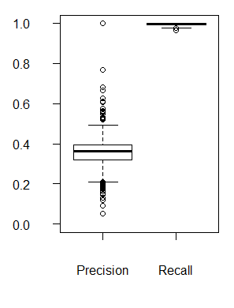
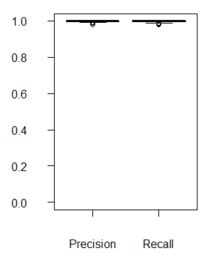
Result: Precision and Recall
The previous work
Our method
    Precision: 0.357 ➔ 0.998 Improved!
    Recall: 0.993 ➔ 0.997

Slide 15
Conclusion
Our method detects components in a Java binary file.
  Compare a binary with all the components in a database
  Introduced a greedy search to select reused components
    Precision: 0.357 ➔ 0.998
    Recall: 0.993 ➔ 0.997
  Our simple implementation (< 2.5KLOC) is available on GitHub
  http://www.github.com/takashi-ishio/JIngredients/
Future Work
  Component detection in source code
  Empirical studies on inter-project code reuse

Slide 17
Limitation
The experiment is performed on an ideal situation: The database included all the reused components.
  In reality, it is not so easy to keep all the components.
Our method and the previous work use identifiers (e.g. package names, class names) to compare classes.
  Our method is applicable to release engineering activities and open source projects.
  Our method is inapplicable to obfuscated code.
    We need a technique to identify similar classes in obfuscated code.

Slide 18
Q. Component dependencies are managed by a tool such as Maven -- Is it insufficient?
Insufficient. Because some components have an internal copy of their dependent components.
  For example, GWT re-packages all the dependent components to simplify dependencies.
  The dependent components, e.g. Ant and Xalan, do not appear in pom files of GWT users.

Slide 19
Q. Why don’t you use a MD5 file hash to compare classes?
A file hash (e.g. SHA-1, MD5) cannot compare classes, because different compilers generate different binary files.
  JDK version and debug information also affects binary files.
Davies et al. reported that 48% of jar files in Debian GNU/Linux have no class files that were identical to any classes in the Maven Central Repository.

