Slide 1



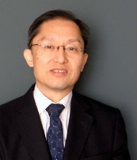

Search-Based Peer Reviewers Recommendation in Modern Code Review
Ali Ouni Raula Gaikovina Kula Katsuro Inoue
32nd IEEE International Conference on Software Maintenance and Evolution (ICSME) 2016
October 5-7, 2016, Raleigh, North Carolina, USA

Slide 2
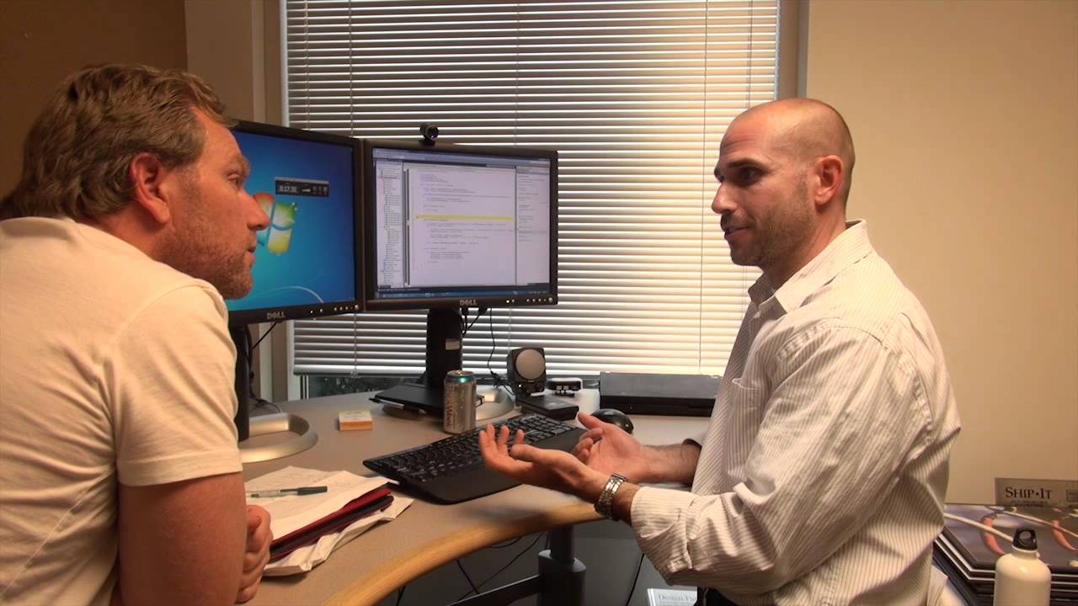
Code review is a key part of the software development process
Programmer
What does
that code do?
Code reviewer

Slide 3



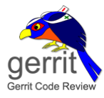




The “modern”, lightweight, tool-supported code review
gerrit
code review
Code change
Accepted code
developer
Code repository
reworked code
reviewers

Slide 4
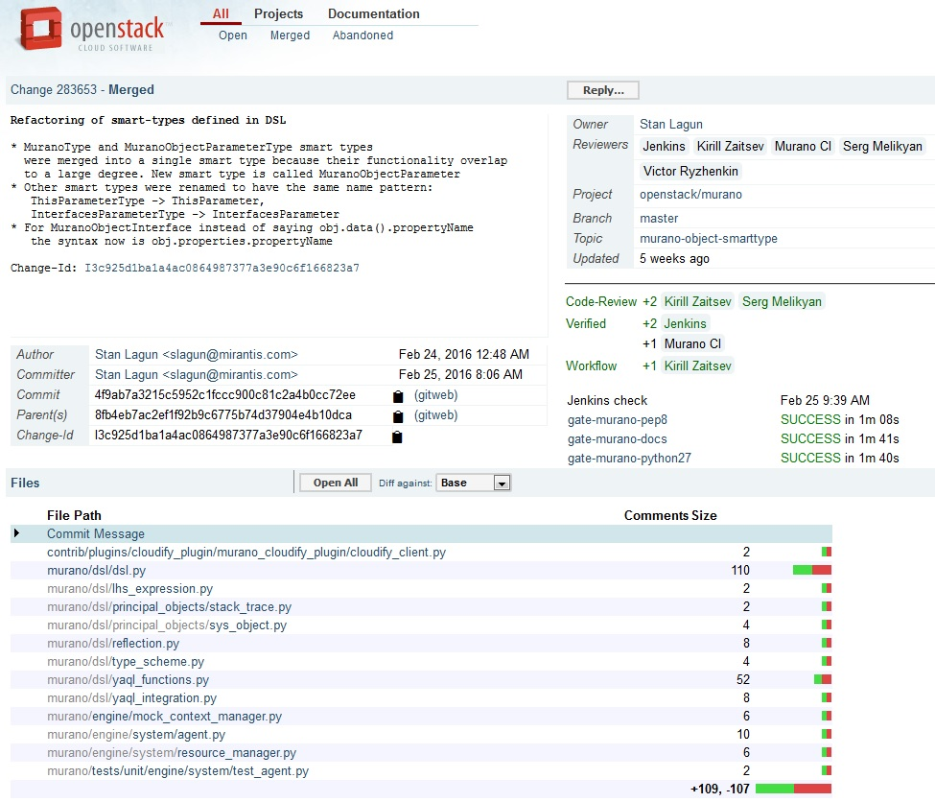
developer
reviewers
Code change description
changed files

Slide 5
Code reviewers assignment problem
“Who should review my code?”
Identifying appropriate reviewers is a hard task
  A code change involve multiple files
  A file is edited by multiple developers and reviewer my multiple reviewers
Reviewer assignment problem [Patanamon et al., SANER 2015]
  delays acceptance : 12 days
  sometimes patches are completely forgotten

Slide 6
State of the art
ReviewBot [Balachandran, ICSE 2013]
  based on the modification history of source code using static analysis tools to find experienced reviewers
RevFinder [Patanamon et al., SANER 2015]
  based on the past reviews of files with similar names and paths to build an expertise model
cHRev [Zanjani et al., TSE 2015]
  based on a reviewer expertise model
  combines a quantification of review comments and their time

Slide 7
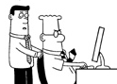
Problem Statement
THAT LINE OF CODE
GIVES ME GAS
Single/independent reviewers
  A change might require many reviewers
Focus only on reviewer expertise
  Expertise change over time (increase or decrease)
No consideration of the socio-technical aspect
  “Peer” code review
  human process = personal + social aspects
Combinatorial search problem while considering
both expertise and social aspects

Slide 8
Approach overview: RevRec
Review Request
Search-based Reviewers Recommendation
(Genetic Algorithm)
developer
Recommended
Reviewers
Reviewer
expertise
Reviewer
collaboration
Reviews history

Slide 9
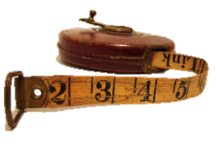
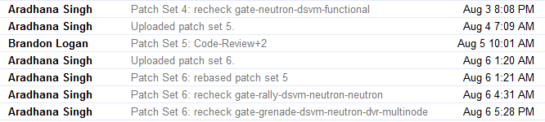

Reviewer Expertise (RE) model
For each modified file we consider
  Comments frequency
  Comments recency

Slide 10
Reviewer Collaboration (RC) model
Social network: each reviewer may have a review collaboration with
  developer
  other reviewers
Graph representation
  sub-graph connectivity
  weights count on the edges
  (comments count)
Stan
41
32
Kirill
46
Victor
59
126
18
26
45
Murano
Serg
59

Slide 11
Genetic algorithm (GA)
START
Population of solutions
Key elements
  Solution representation
  Change operators
  Fitness function
  Selection
  Creation of the initial population
Evaluation
Optimal or “good” solution found ?
Yes
No
END
Selection
Recommended
reviewers
Crossover
Mutation

Slide 12
GA adaptation
Solution representation
Dmitry | Kirill | Andrey | Murano | Serg | Giulio | Victor | Henar | Alexey | Jenkins
0 | 1 | 0 | 1 | 1 | 0 | 1 | 0 | 0 | 1

Slide 13
GA adaptation
Solution representation
Dmitry | Kirill | Andrey | Murano | Serg | Giulio | Victor | Henar | Alexey | Jenkins
0 | 1 | 0 | 1 | 1 | 0 | 1 | 0 | 0 | 1
Crossover operator
0 | 0 | 1
0 | 0 | 1 | 0
Child 1
Parent 1
0 | 0 | 1 | 0 | 0 | 1 | 0
Crossover
Point cut
k=3
0 | 1 | 0 | 0
Child 2
0 | 1 | 0 | 0 | 1 | 0 | 0
Parent 2
0 | 1 | 0
Mutation operator
Mutation
Parent
0 | 0 | 1 | 0 | 0 | 1 | 0
0 | 0 | 1 | 0 | 1 | 1 | 0
m=6

Slide 14

Fitness function
Maximize
Reviewer Expertise
RE
Reviewer Collaboration
RC
Stan
41
32
Kirill
46
Victor
59
126
18
26
45
Murano
Serg
59

Slide 15
Empirical Evaluation

Slide 16
Three research questions
RQ1. How accurate is RevRec in recommending peer reviewers for code changes?
RQ2. What are the effects of each of the reviewers expertise and collaboration on the accuracy of RevRec?
RQ3. How does GA compared to random search (RS) and other popular search algorithms, SA and PSO?

Slide 17



Studied systems
System | Period studied | #Reviews | #Reviewers | #Files
Android | 2008-10 ~ 2010-01 | 5,126 | 94 | 26,840
OpenStack | 2011-04 ~ 2012-05 | 6,586 | 82 | 16,953
Qt | 2011-05 ~ 2012-05 | 23,810 | 202 | 78,401
Dataset: http://kin-y.github.io/miningReviewRepo/

Slide 18


Analysis method
Accuracy
  Precision@k
  Recall@k
Ranking performance
  Mean Reciprocal Rank (MRR)
#1
Recommended
reviewer
#2
#3
#4
#5
Top-5 recommended
reviewers

Slide 19
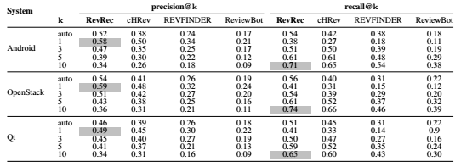

RQ1. Accuracy results
RevRec correctly recommends peer
code reviewers with an average of
55% of precision and 70% of recall

Slide 20
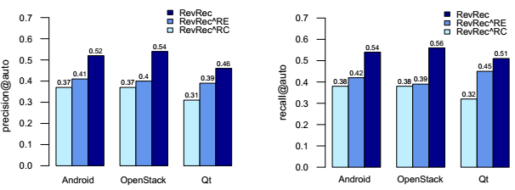
RQ2. Expertise vs. Collaboration
The social aspect plays an important role
in modern code review

Slide 21
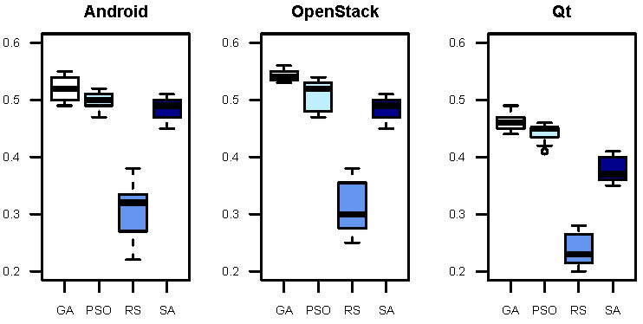
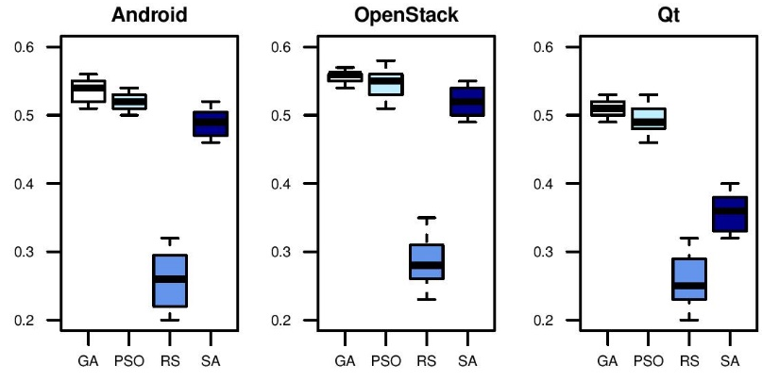
RQ3. Performance of Genetic Algorithm
Precision
Population-based search algorithms are more
suitable than local search for the reviewers
recommendation problem
Recall

Slide 22
Summary
We proposed an automated approach for peer reviewers recommendation
  Genetic algorithm
  Combine reviewers expertise and social aspect
Empirical evaluation on 3 open-source projects using Gerrit code review
  Promising accuracy results: 55% of precision and 70% of recall
  Social aspect plays an important role in modern code review
Future work
  Consider industrial and open source projects
  Integrate the commit history in the expertise model
  Other aspects to improve accuracy

Slide 23
Thank you for your attention!
Questions? Discussions? Suggestions?

