Slide 1
On the Effectiveness of Vector-based Approach for Supporting Simultaneous Editing of Software Clones
○ Seiya Numata ¹ Norihiro Yoshida ²
Eunjong Choi ³ Katsuro Inoue ¹
¹ Osaka University ² Nagoya University
³ Nara Institute of Science and Technology
Notes:
Thank you chair person. My name is Seiya Numata, first year master course student at Osaka University in Japan. I’m going to talk about “On the effectiveness of vector-based approach for supporting simultaneous editing of software clones.”

Slide 2
Code Clone
Code fragments that are identical or similar to each other
Considered to be an obstacle to software maintenance.
Clone pair
Code clone
Notes:
Code clone consists of code fragments that are identical or similar to each other. A clone pair is a pair of code clones. The presence of code clone has been generally considered to be an obstacle to software maintenance.
This figure shows an example of code clones. The red arrow represents a clone pair.

Slide 3
Types of Code Clone[1]
Category | Definition
Type 1 | Code fragments that are identical.
Type 2 | Code fragments that are structurally/syntactically identical.
Type 3 | Copied fragments that have undergone further modifications.
Type 4 | Code fragments that perform the similar computation, but are implemented through different syntactic variants.
[1] C. K. Roy, J. R. Cordy, R. Koschke., Comparison and Evaluation of Code Clone Detection Techniques and Tools: A Qualitative Approach, Science of Computer Programming, 2009
Notes:
There are four types of code clones.

Slide 4
Type 1 Code Clones
Category | Definition
Type 1 | Code fragments that are identical.
Type 2 | Code fragments that are structurally/syntactically identical.
Type 3 | Copied fragments that have undergone further modifications.
Type 4 | Code fragments that perform the similar computation, but are implemented through different syntactic variants.
int sum(int[] data){
int sum = 0;
for(int i=0; i<data.length; i++){
sum = sum + data[i];
}
return sum;
}
int sum(int[] data){
int sum = 0;
for(int i=0; i<data.length; i++){
sum = sum + data[i];
}
return sum;
}
Function A
Function B
Notes:
Type 1 code clones are code fragments that are identical, except for variations in whitespace ,possibly layout and comments.

Slide 5
Type 2 Code Clones
Category | Definition
Type 1 | Code fragments that are identical.
Type 2 | Code fragments that are structurally/syntactically identical.
Type 3 | Copied fragments that have undergone further modifications.
Type 4 | Code fragments that perform the similar computation, but are implemented through different syntactic variants.
int sum(int[] data){
int sum = 0;
for(int i=0; i<data.length; i++){
sum = sum + data[i];
}
return sum;
}
int sum(int[] data){
int sum = 0;
for(int j=0; j<data.length; j++){
sum = sum + data[j];
}
return sum;
}
Function A
Function B
Notes:
Type 2 code clones are code fragments that are structurally/syntactically identical, except for variations in identifiers, literals, types, layout and comments.

Slide 6
Type 3 Code Clones
Category | Definition
Type 1 | Code fragments that are identical.
Type 2 | Code fragments that are structurally/syntactically identical.
Type 3 | Copied fragments that have undergone further modifications.
Type 4 | Code fragments that perform the similar computation, but are implemented through different syntactic variants.
int sum(int[] data){
int sum = 0;
for(int i=0; i<data.length; i++){
sum = sum + data[i];
}
return sum;
}
int sum(int[] data){
int sum = 0;
for(int i=0; i<data.length; i++){
sum += data[i];
}
return sum;
}
Function A
Function B
Notes:
Type3 code clones are Copied fragments that have undergone further modifications. Statements may be changed, added or removed in addition to the variations in identifiers, literals, types, layout and comments.

Slide 7
Type 4 Code Clones
Category | Definition
Type 1 | Code fragments that are identical.
Type 2 | Code fragments that are structurally/syntactically identical.
Type 3 | Copied fragments that have undergone further modifications.
Type 4 | Code fragments that perform a similar computation, but are implemented through different syntactic variants.
int sum(int[] data){
int sum = 0;
for(int i=0; i<data.length; i++){
sum = sum + data[i];
}
return sum;
}
int sum(int[] data){
int sum = 0;
while(i<data.length){
sum += data[i];
i++;
}
return sum;
}
Function A
Function B
Notes:
Type 4 code clones are two or more code fragments that perform a similar computation, but are implemented through different syntactic variants.

Slide 8
CCFinder: A token-based Approach [2]
A token-based code clone detection tool
Detect Type1 and Type2 code clones at high speed.
Widely used in the many companies as well as universities [3], [4]
[2] T. Kamiya, S. Kusumoto, and K. Inoue. CCFinder: a multilinguistic token-based code clone detection system for large scale source code. IEEE Trans. Softw. Eng., Vol. 28, No. 7, pp. 654–670, 2002.
[3] L. Barbour, F. Khomh, Y. Zou, An empirical study of faults in late propagation clone genealogies, J. Softw. Evol. and Proc. vol. 25, no. 11, pp. 1139 - 1165
[4] Y. Yamanaka, E. Choi, N. Yoshida, K. Inoue, and Tateki Sano. 2012. Industrial application of clone change management system. In Proc. of IWSC '12.pp. 67-71 2012.
Notes:
Several tools have been proposed for detecting code clones from source code. One of the representative code clone detection tools is CCFinder, a token-based clone detection tool. It can detect type1 and type2 code clone at high speed. It is widely used in many companies as well as universities .

Slide 9
Vector-based Approach [5]
STEP1： Extract word from each functions in the source code.
STEP2: Generate a feature vector from each function, based on the weighted word.
STEP3: Cluster the feature vectors using the Locality-Sensitive-Hashing algorithm.
STEP4: Detect function clones based on the similarities between each pair of feature vectors.
STEP1
Function A
word | count
xxx | 3
yyy | 2
・・・ | ・・・
Function B
word | count
xxx | 3
zzz | 4
・・・ | ・・・
Source code
(Input)
List of words
[5] Yamanaka et al.:: A high speed function clone detection based on information retrieval technique. IPSJ Journal .2014
Notes:
Yamanaka et al developed the vector-based code clone detection tool which detects function-level code clones from Type1 to Type4.
This tool takes source code as an input and outputs a list of function-level code clones. In it, we can set similarity as a threshold.
The tool is comprised of four steps to detect code clones. First, it extracts word from each functions in the source code. During this process, if an identiﬁer consists of more than one word, it is divided into different words using a delimiters such as hyphens between words or a capital letter for each word using CamelCase.

Slide 10
Vector-based Approach [5]
STEP1： Extract word from each functions in the source code.
STEP2: Generate a feature vector from each function, based on the weighted word.
STEP3: Cluster the feature vectors using the Locality-Sensitive-Hashing algorithm.
STEP4: Detect function clones based on the similarities between each pair of feature vectors.
STEP1
Function A
STEP2
word | count
xxx | 3
yyy | 2
・・・ | ・・・
Function A
Function B
word | count
xxx | 3
zzz | 4
・・・ | ・・・
Source code
(Input)
Function B
List of words
Feature vectors
[5] Y.. Yamanaka, E. Choi, N. Yoshida, K. Inoue:: A high speed function clone detection based on information retrieval technique. IPSJ Journal 55(10), 2245–2255 (2014), in Japanese
Notes:
Next, it generates a feature vector from each function, based on the weighted word.

Slide 11
Vector-based Approach [5]
STEP1： Extract word from each functions in the source code.
STEP2: Generate a feature vector from each function, based on the weighted word.
STEP3: Cluster the feature vectors using the Locality-Sensitive-Hashing algorithm.
STEP4: Detect function clones based on the similarities between each pair of feature vectors.
STEP1
Function A
STEP2
STEP3
word | count
xxx | 3
yyy | 2
・・・ | ・・・
Function A
Function A
Function B
Function B
Function C
Function D
Function E
word | count
xxx | 3
zzz | 4
・・・ | ・・・
Source code
(Input)
Function B
Clusters of
functions
List of words
Feature vectors
[5] Y.. Yamanaka, E. Choi, N. Yoshida, K. Inoue:: A high speed function clone detection based on information retrieval technique. IPSJ Journal 55(10), 2245–2255 (2014), in Japanese
Notes:
Then, it clusters the feature vectors using the Locality-Sensitive Hashing algorithm.

Slide 12
Vector-based Approach [5]
STEP1： Extract word from each functions in the source code.
STEP2: Generate a feature vector from each function, based on the weighted word.
STEP3: Cluster the feature vectors using the Locality-Sensitive-Hashing algorithm.
STEP4: Detect function clones based on the similarities between each pair of feature vectors.
STEP1
Function A
STEP2
STEP3
STEP4
word | count
xxx | 3
yyy | 2
・・・ | ・・・
similarity | Function pair | clone
0.95 | Function A Function B | ✔
0.70 | Function C Function D
0.70 | Function C Function E
0.90 | Function D Function E | ✔
・・・ | ・・・
Function A
Function A
Function B
Function B
Function C
Function D
Function E
word | count
xxx | 3
zzz | 4
・・・ | ・・・
Source code
(Input)
Function B
Clusters of
functions
List of words
Feature vectors
Clone detection
[5] Y.. Yamanaka, E. Choi, N. Yoshida, K. Inoue:: A high speed function clone detection based on information retrieval technique. IPSJ Journal 55(10), 2245–2255 (2014), in Japanese
Notes:
Finally it detects function-level clones based on the similarities between each pair of feature vectors.

Slide 13
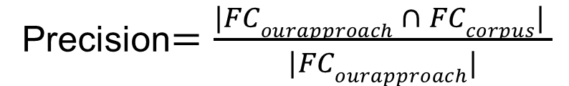
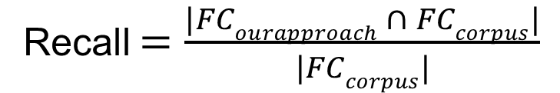
Evaluation Result from Previous Study[5]
measured the precision and recall based on the corpus proposed by Tempero et.al [6].
Precision$=\frac{|FCourapproach ∩ FCcorpus| }{|FCourapproach|}$
Recall $=\frac{|FCourapproach ∩ FCcorpus|}{|FCcorpus|}$
Project Name | # Clone Pairs | Precision | Recall
Apache Ant | 474 | 92% | 62%
Argo UML | 880 | 96% | 53%
[5] Y. Yamanaka, E. Choi, N. Yoshida, K. Inoue:: A high speed function clone detection based on information retrieval technique. IPSJ Journal 55(10), 2245–2255 (2014), in Japanese
[6] E. Tempero, C. Anslow, J. Dietrich, T, Han, J. Li, M. Lumpe, Hayden Melton, and James Noble. The qualitas corpus: a curated collection of java code for empirical studies. In Proc. of APSEC, pp. 336–345, 2010.
Notes:
To evaluate the accuracy of the vector-based approach, the authors measured the precision and recall of the vector-based approach based on the corpus proposed by Tempero et.al. For this experiment, they selected clone pairs from Java systems, namely, Apache Ant and ArgoUML in the corpus whose token were more than 50 and then measured the precision and recall as shown in these equations.
In these equations, FC_{ourapproach} is the set of clone pairs detected by the vector-based approach, and FC_{courpus} is the set of clone pairs included in the corpus (over 50 tokens).
The results of evaluation are shown in this table , and the vector-based approach detects clones accurately.

Slide 14


Motivation of this Study
Developers frequently perform a query-based search for similar code fragment.
query
Developer finds defect
Similar code
fragments
extract
Code clone detection tool
Subject
Source file
Inspect the
existence of a defect
Notes:
Based on our experiences, developers frequently perform a query-based search for similar code fragment using code clone detection tools.
For example, when a defect is found in the code fragment, the same defect is likely to be contained in its code clones.
So, developers extract a buggy code to use as a query,
and then do query-based search for the entire source file using code clone detection tool.
Finally, they investigate the existence of defects in the code clones from the results.

Slide 15

Motivation of this Study
We investigate the effectiveness of the vector-based approach.
in terms of query-based use for fixing of buggy clones
A collaborative IT company asked us to investigate it.
query
Similar code
fragments
extract
Vector-based approach
Source files
Notes:
Even though the vector-based approach is accurate, the effectiveness of query-based usage of the vector-based approach is still unknown. So, we investigated the effectiveness of query-based use of the vector-based approach for supporting simultaneous fixing of buggy clones in source code. This study is triggered from feedbacks from a Japanese IT company.

Slide 16

Dataset for Evaluation [7]
Each case has
(a) a buggy code fragment.
(b) buggy code clones of (a) including same defects.
(c) commit ID of Git.
Dataset has 58 cases from PostgreSQL, Git and Linux Kernel.
Clone pair
case
(b)
(a)
Clone pair
(b)
[7] J. Li and Michael D Ernst. CBCD: Cloned buggy code detector. In Proc. of ICSE , pp. 310–320, 2012.
Notes:
To Investigate the effectiveness of query-based use of the vector-based approach, we used a dataset that was collected by Li et al. This dataset contains cases of buggy code fragments, and buggy code clones of the same defects. Because the dataset contains commit ID of git, we can get snapshots of each case. They chose three open source software as a subject, Git, PostgreSQL and Linux Kernel. We removed cases with buggy code fragments and there code clones in the same function because the purpose of this study is the investigation of effectiveness of the query-based approach. There are 58 clone pair cases.

Slide 17
Investigation Method
Data set
Git
repository
STEP1
Snapshot
Notes:
Next, I’ll explain the investigation method of this study. At first, we checked out a snapshot of the commit of every cases of the dataset from the git repository.

Slide 18
Investigation Method
Clone detection tool
Data set
Buggy code
fragments (query)
Git
repository
STEP1
STEP2
Snapshot
Set the threshold of vector-based approach as 0.9 and 0.5 respectively.
Set 10 tokens as minimum length of a token sequence for CCFinder.
Notes:
Then, we detected code clones by a clone detection tool using a buggy code fragment as a query listed in the dataset. We set the vector-based clone detection tool’s threshold at 0.9 and 0.5 respectively to investigate the effective threshold for supporting simultaneous fixing of buggy clone.
To confirm the effectiveness of simultaneous fixing of buggy clones of the vector-based approach, we also adopted CCFinder because the IT company we collaborated with have used CCFinder for several years. For CCFinder, we set 10 tokens as minimum length of a token sequence because most clone-related defects in the dataset are 10 tokens or smaller in source code.

Slide 19
Effectiveness Criterion
Recall
Precision
F-measure
Notes:
We used precision/recall and F-measure as effectiveness criterion. I’ll explain each criteria in the following slides.

Slide 20
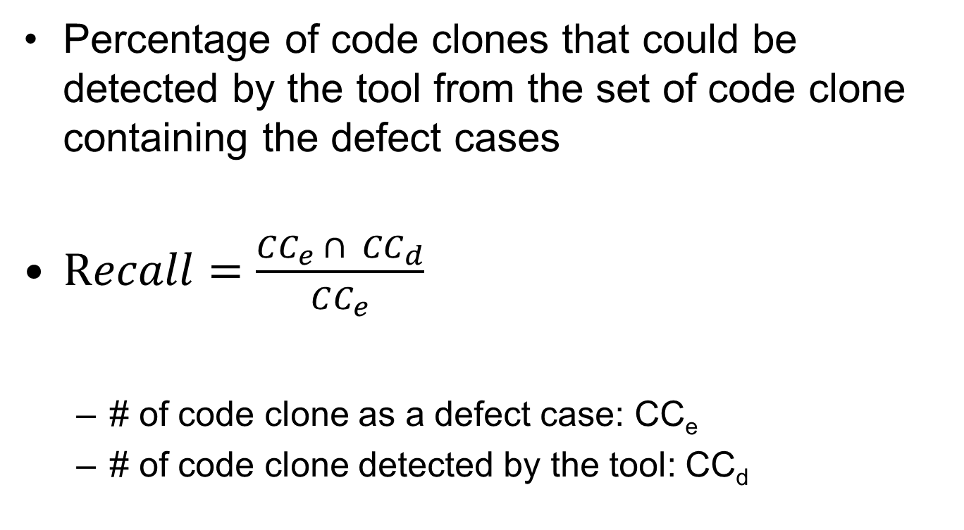
Recall
Percentage of code clones that could be detected by the tool from the set of code clone containing the defect cases
$Recall=\frac{CC_{e} ∩ CC_{d}}{CC_{e}}$
# of code clone as a defect case: CC_{e}
# of code clone detected by the tool: CC_{d}
Notes:
In this study, recall is the percentage of code clones that could be detected by the tool from the set of code clones containing the defect cases. It can be calculated by this formula. The symbol of CCe represents the number of code clones that are involved in a defect case in the dataset. The symbol of CCd represents the number of code clones that were actually detected by each tool.

Slide 21
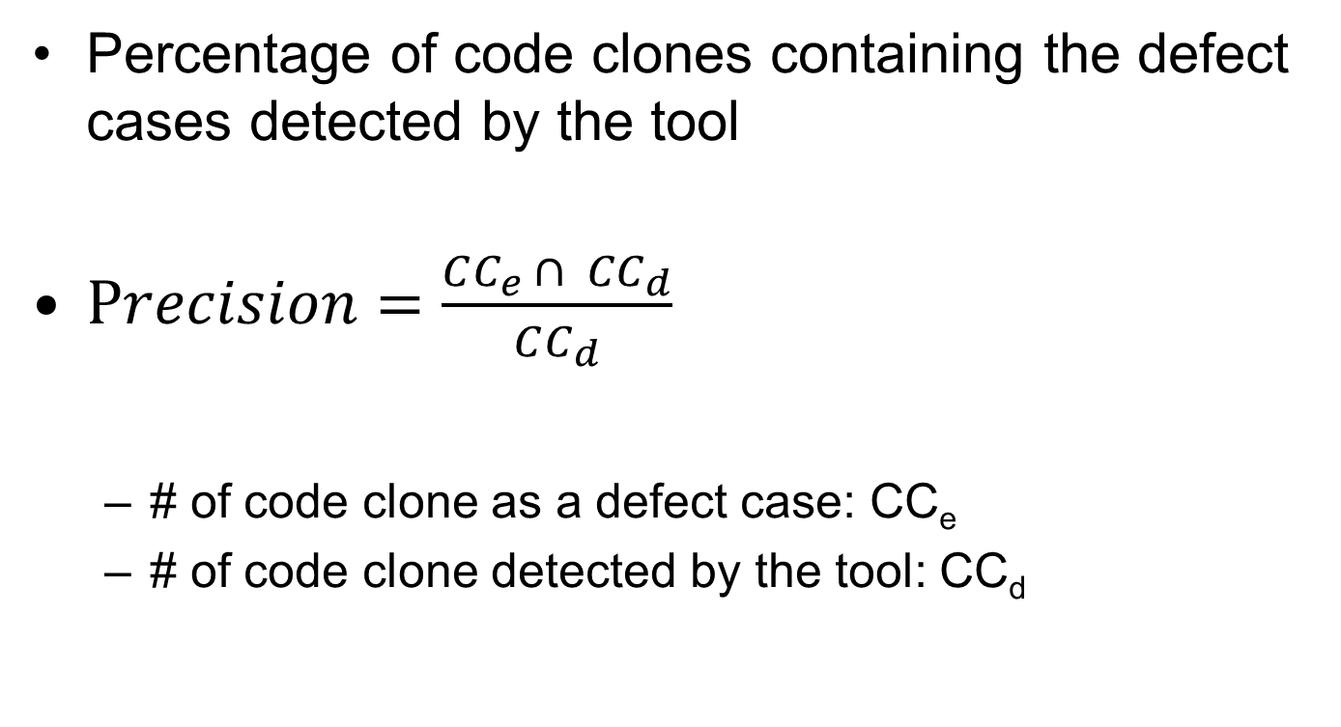
Precision
Percentage of code clones containing the defect cases detected by the tool
$Precision=\frac{CC_{e} ∩ CC_{d}}{CC_{d}}$
# of code clone as a defect case: CC_{e}
# of code clone detected by the tool: CC_{d}
Notes:
Precision is the percentage of code clones containing the defect cases detected by the tools. It represents accuracy of a tool, and can be calculated by this formula.

Slide 22

F-measure
Harmonic average of precision and recall
$F−measure=\frac{2 ∗Recall ∗Precision}{Recall +Precition}$
Notes:
F-measure is the harmonic average of precision and recall. It represents the efficiency of a tool, and can be calculated by this formula.

Slide 23
Result of Investigation
 | Vector-based approach |  | CCFinder
 | Threshold=0.9 | Threshold=0.5
Number of detections | 41 | 293 | 2274
Correct number of detections | 24 | 31 | 31
Recall | 0.41 | 0.53 | 0.53
Precision | 0.59 | 0.11 | 0.01
F-measure | 0.48 | 0.18 | 0.02
Notes:
The results of the investigation are shown in the table. As seen on the table, in terms of Precision and F-measure, the vector-based approach with threshold=0.9 is the highest score. In terms of Recall, the vector based approach with threshold=0.5 and CCFinder are the highest score, and the vector based approach with threshold=0.9 is lower a little. However, the vector based approach with threshold=0.5 and CCFinder are very low Precision.

Slide 24
Discussion
In terms of precision and F-measure
The vector-based approach with threshold=0.9 is the highest score.
In terms of recall
The vector-based approach with threshold=0.5 and CCFinder are the highest score.
However, the precision of CCFinder is extremely low.
most suitable approach when developers have
only a limited amount of time
more suitable for the development of a
highly-reliable software system
Notes:
From the results of the investigation, we can confirm that the vector-based approach with threshold=0.9 has the highest precision and F-measure. So, we can say that it is the most suitable approach when developers have only a limited amount of time.
In terms of recall, all of the scores are almost the same. The vector-based approach with threshold=0.5 and CCFinder are the highest between them. Since the precision of CCFinder is extremely low, we can say that the vector-based approach with threshold=0.5 is more suitable for the development of a highly reliable software system.

Slide 25
Summary and Future Work
Summary
We investigate the effectiveness of the vector-based approach.
in terms of query based use for fixing of buggy clones
The result shows high precision and F-measure with threshold=0.9.
Future work
Apply the vector-based approach into the process of an industrial software development.
Notes:
In summary, in this study, we investigated the effectiveness of query-based usage of the vector-based approach for supporting simultaneous fixing of buggy clones in the source code. The result shows high precision and F-measure with threshold=0.9.
In the future, we plan to apply the vector-based approach into the process of an industrial software development.

