Slide 1
c-JRefRec:
Change-Based Identification of
Move Method refactoring Opportunities
Naoya Ujihara¹, Ali Ouni²,
Takashi Ishio¹, Katsuro Inoue¹
¹Osaka University, Japan
²United Arab Emirates University, UAE

Slide 2
Background: Refactoring
Move method refactoring
class1
class2
class1
class2
method1
method2
method2
method1
It is easy to understand and change the methods

Slide 3

Existing refactoring recommendation tools
Existing refactoring tools recommend ‘global’ refactoring solutions
  Inspecting a resultant list is time-consuming and error-prone
  Candidates irrelevant to a change task are not useful

Slide 4


The proposed approach
c-JRefRec: change task based Java Refactoring Recommendation
An eclipse plug-in
analyzes source code changes
recommends refactoring for files related to changes
Modified Java Files

Slide 5
Static analysis
Source
code
: method
: field
We Extract method calls and field accesses from the source code and generate a dependency graph.

Slide 6
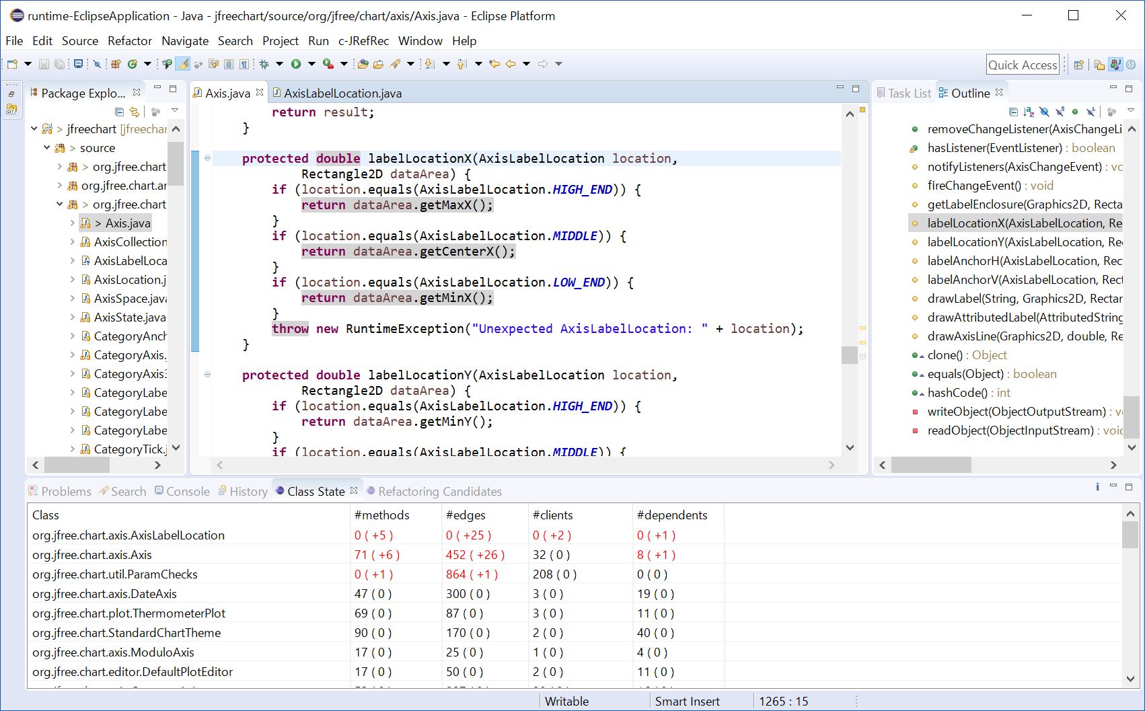
Class State View
Each line shows the numbers of methods, edges, client classes, and dependent classes.

Slide 7
Class State View
Class | #methods | #edges | #clients | #dependents
org.jfree.chart.axis.Axis | 71(+6) | 452(+26) | 32(0) | 8(+1)
The current task added
  6 methods
  26 edges
  1 dependent class
  to org.jfree.chart.axis.Axis class.
The number of client classes is not changed.

Slide 8
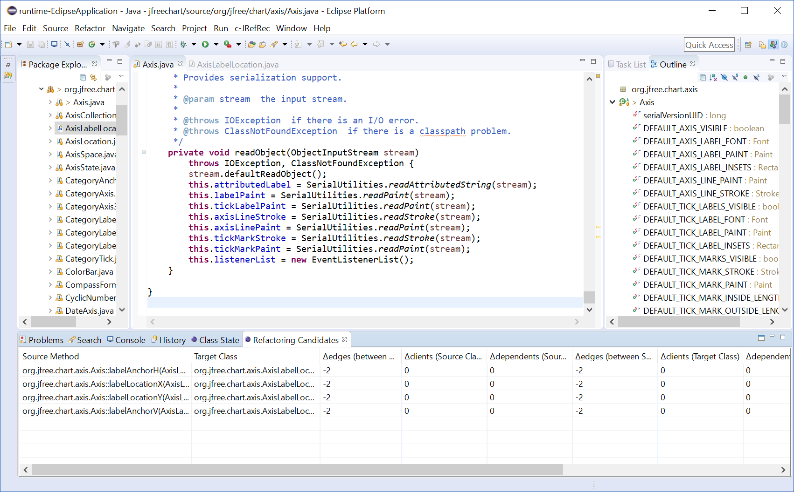
Move Method Refactoring Candidates View
Each line shows a refactoring candidate and its effect to modularity metrics.

Slide 9
Move Method Refactoring Candidates View
Source Method | Target Class | Δedges (source class) | Δclients (source class) | Δdependents (source class)
org.jfree.chart.axis.Axis#labelAnchorH() | org.jfree.chart.axis.AxisLabelLocation | -2 | +0 | +0
Δedges (target class) | Δclients (target class) | Δdependents (target class | Semantic Similarity (source class) | Semantic Similarity (target class)
-2 | 0 | 0 | 16.6% | 61.8%
This refactoring removes 2 edges from the source class and the target class.
The content of the method is similar to the target class.

Slide 10
Demo scenario
A change task for JFreeChart
  A class org.jfree.chart.axis.AxisLabelLocation is created.
    The new class has 5 fields and 5 methods.
  An existing class org.jfree.chart.axis.Axis is modified.
    1 field and 6 methods are added.
    2 methods are modified.

Slide 11
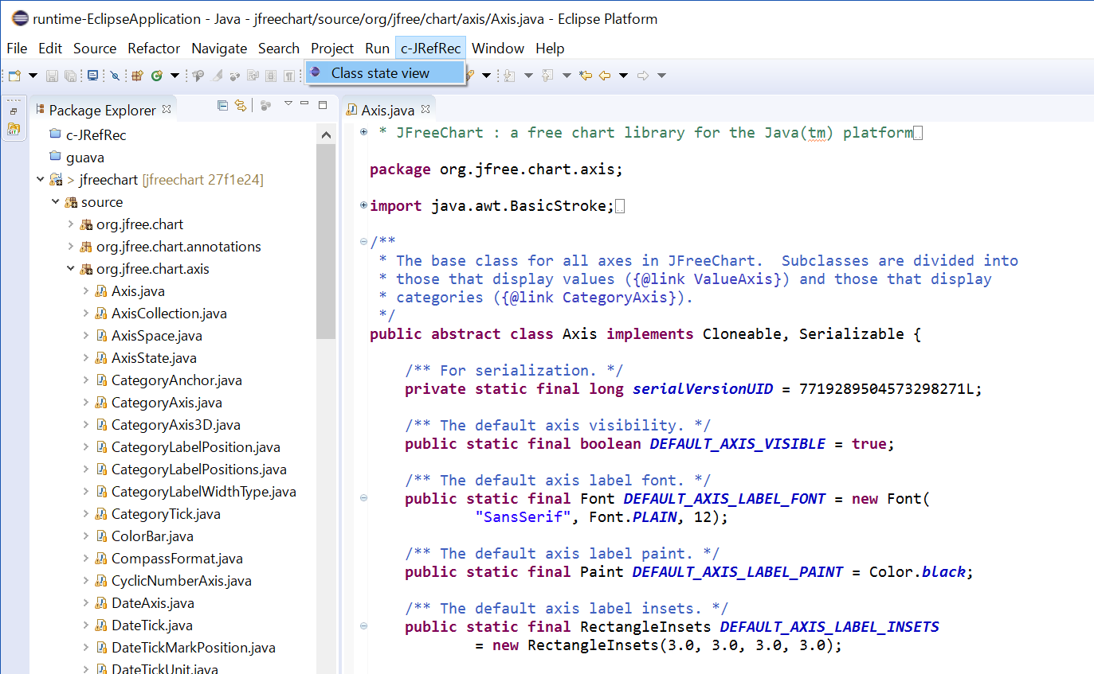
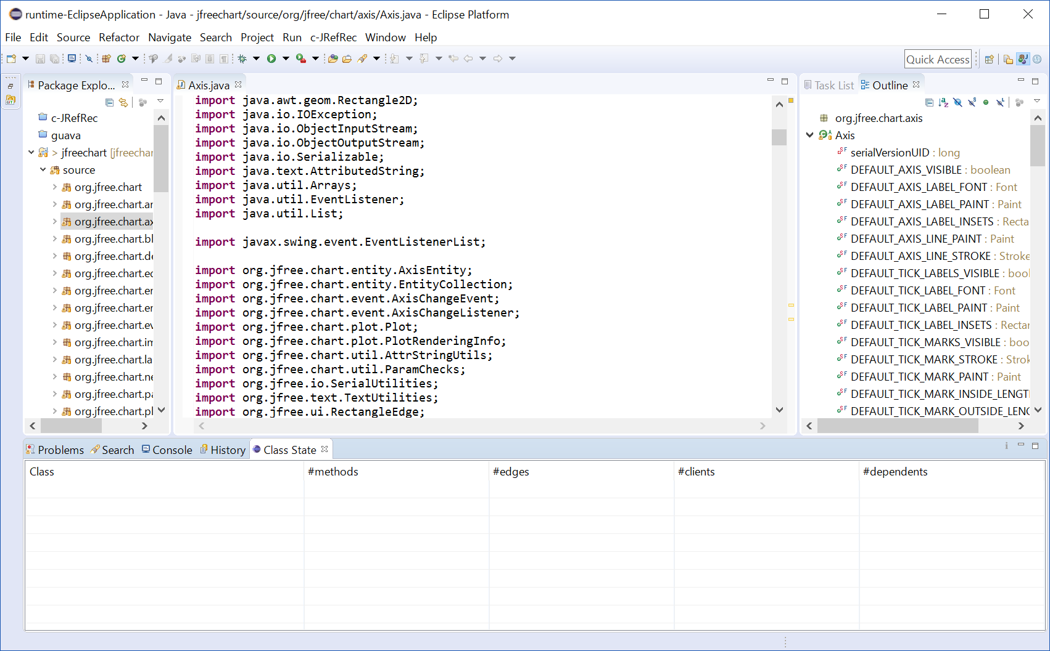
Demonstration

Slide 12
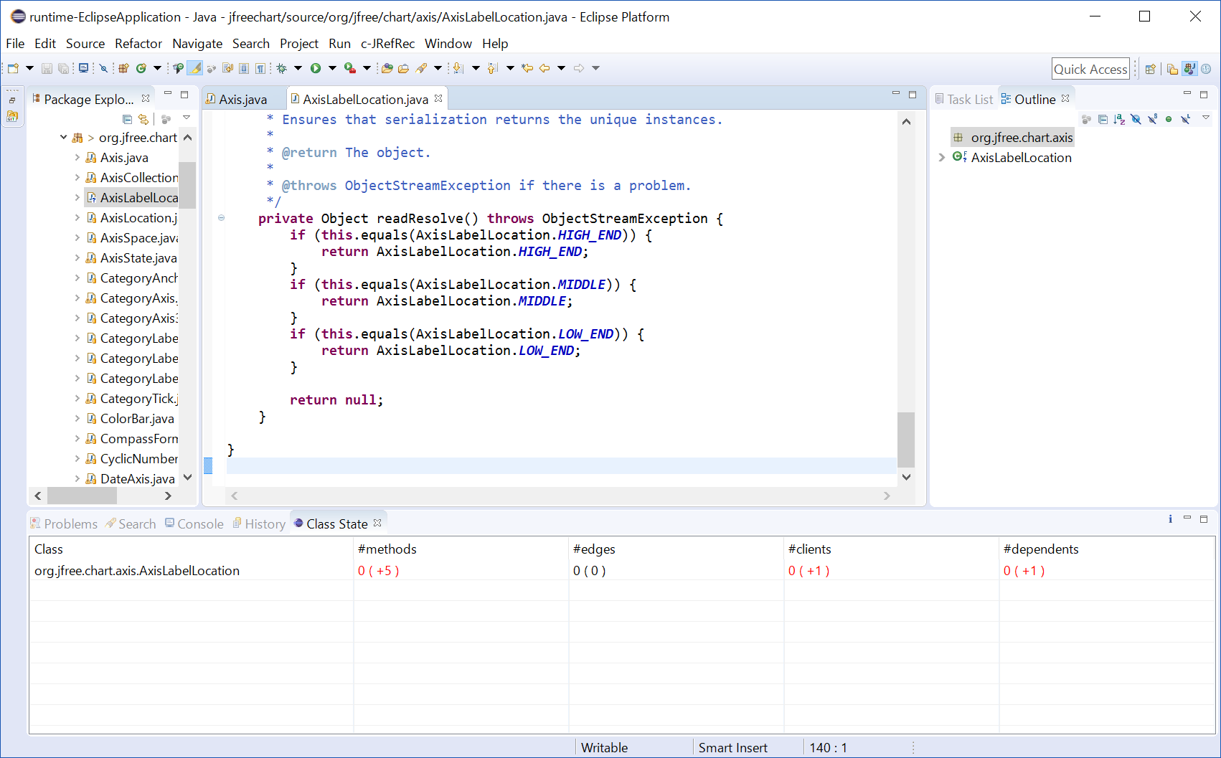
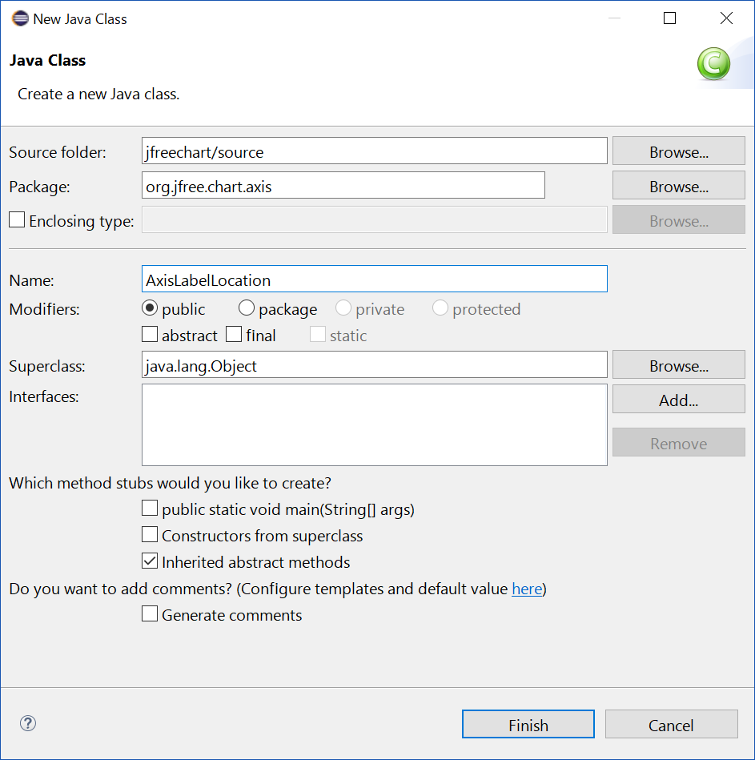
Demonstration

Slide 13
Demonstration

Slide 14
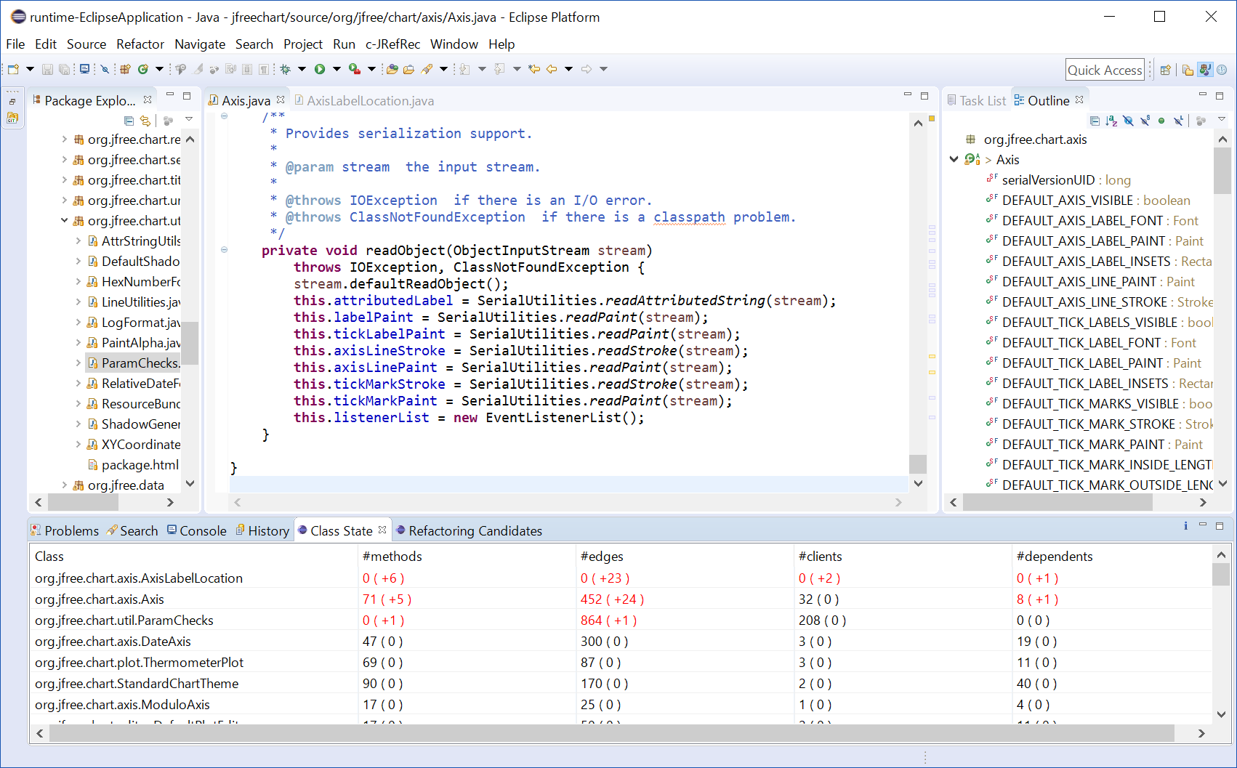
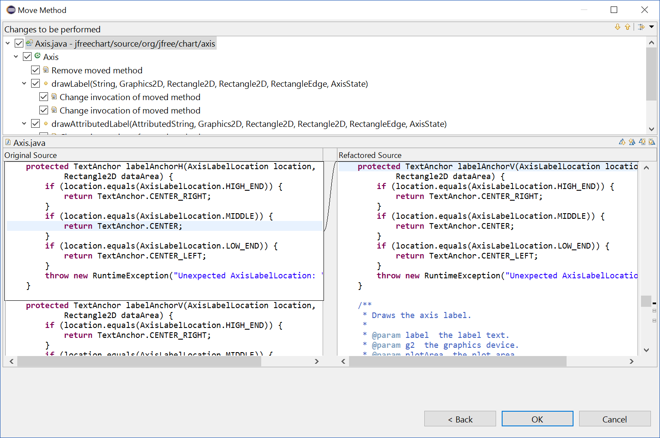
Demonstration

Slide 15
Experiment
Target systems: JUnit, JFreeChart and JMeter
We manually injected Feature Envy instances and used our tool and JDeodorant to remove them.
 | Precision | Recall
c-JRefRec | 0.48 | 0.73
JDeodorant | 0.38 | 0.25
Detect Feature Envy
 | Precision | Recall
c-JRefRec | 0.42 | 0.68
JDedotrant | 0.38 | 0.25
Identify move
method refactoring

Slide 16
Summary
We proposed a move method refactoring recommendation tool based on a change task.
  http://sel.ist.osaka-u.ac.jp/people/naoya-u/c-JRefRec/
Empirical evaluation on 3 open source projects
  Precision 0.42
  Recall 0.68
Future work
  Conduct an empirical study in real world scenarios and get more feedback
  Extend our tool to support more code smell and refactoring operations

Slide 17
Notes:
たくさんの候補

Slide 18
Why did our tool get better results than existing methods
In some case, JDeodorant recommended no move method refactoring candidates for the classes related to the change task.
(In many case, our tool recommended some move method refactoring candidates for the method.)
Notes:
I haven't researched it is good or bad for developers yet.

Slide 19
What is the difference with the existing method
Our tool supports refactoring activity during a software change task by showing structural metrics of classes related to the task and recommending only local move method refactoring candidates.

Slide 20
How much candidate is recommended
It depends on the number of files to be modified.
At each commit, 3 to 22 candidates were recommended in our experiment.

