Slide 1





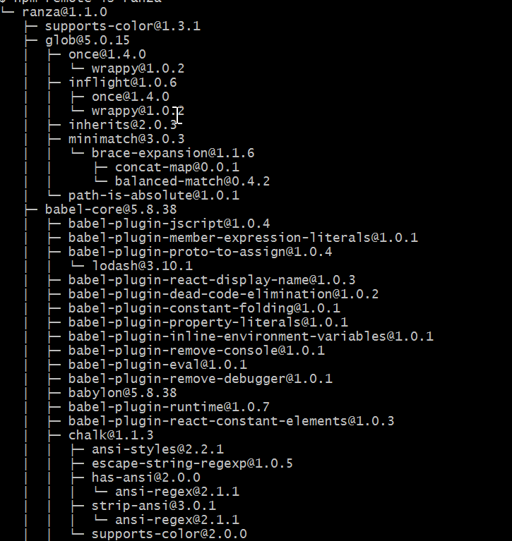

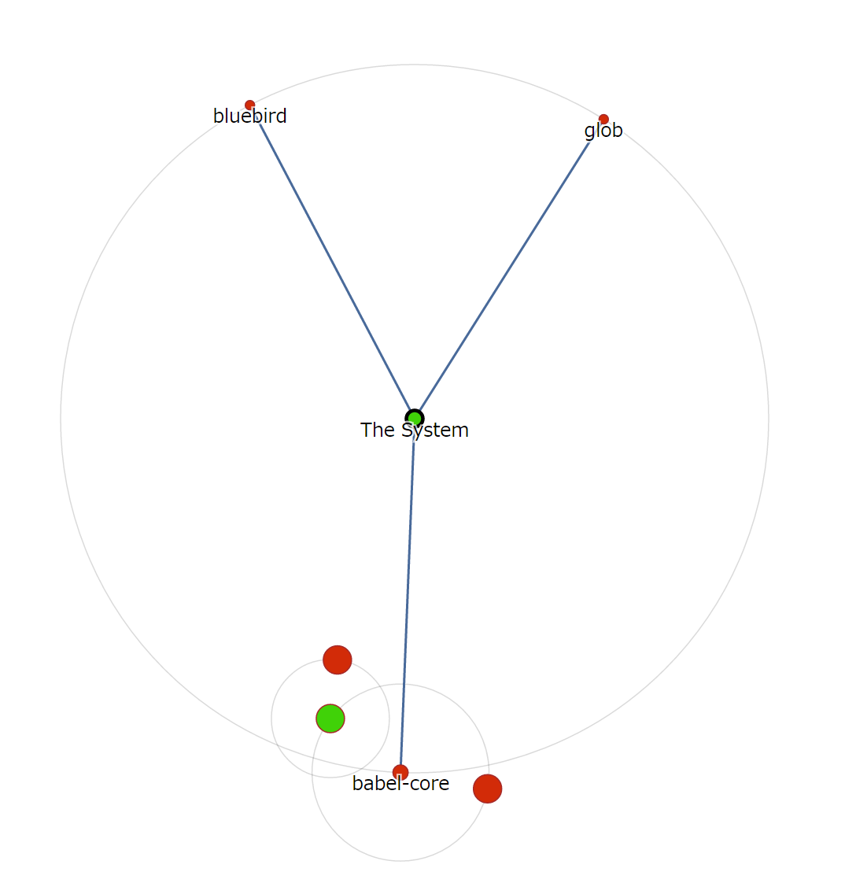
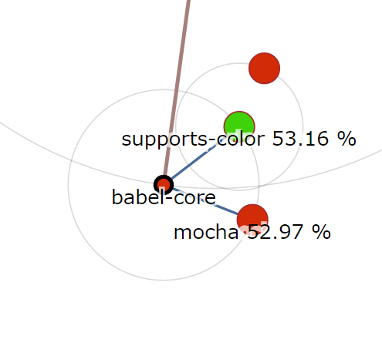
SOLIT Mantra: Visualizing Popular Library Combinations Based on Wisdom of the Crowd
Boris Todorov, Raula Gaikovina Kula, Takashi Ishio, Katsuro Inoue
Software Engineering Laboratory, Osaka University, Japan {boris-t, raula-k, ishio, inoue}@ist.osaka-u.ac.jp
Am I using the latest version of a library?
Problem Basis:
Third-party software adoption in software development (libraries)
Easily accessible in large cloud-based repositories (NPM, Maven, etc)
Libraries offer efficient and effective way for software reuse
Software Maintainer
Software System
Why update a library?
Quality improvements
Bug fixes
New features
Security improvements
If I update, what other libraries are affected?
Problems when updating:
Backward compatibility
Compatibility with other libraries
System integration issues
supports-color
babel-core
glob
bluebird
Online Package Manager
char-spinner
mocha
Library Dependencies for the Software System
Our Proposed Method to Measure Co-usage
Example: Ranza Library
Ranza Dependencies:
supports-color
glob
char-spinner
babel-core (A)
bluebird
mocha (B)
Wisdom of the Crowd
“We find how many other systems use the same libraries together” – library co-usage
Popular Library Combinations
B
A
53%
Ranza Dependency Tree
5673 users
2773 users
SOLIT Mantra - The Orbital Layout Visualization
Legend | Description
Planets | Libraries
Satellites | Co-used libraries
Color | Version notification
Size | Co-usage %
We succeeded in:
Showing outdated libraries, denoted by the red color flag.
By using co-usage, we display by using orbits, which libraries will be affected when updating.
Our visualization allows even for large scale systems to benefit, by adding additional “orbits”.
Raula Gaikovina Kula and Coen De Roover and Daniel M. German and Takashi Ishio and Katsuro Inoue (2014). Visualizing the Evolution of Systems and Their Library Dependencies. In Second IEEE Working Conference on Software Visualization, VISSOFT 2014, Victoria, BC, Canada, September 29-30, 2014, pp. 127–136.
Yuki Yano and Raula Gaikovina Kula and Takashi Ishio and Katsuro Inoue (2015). VerXCombo: An interactive data visualization of popular library version combinations. In 23rd IEEE International Conference on Program Comprehension, ICPC 2015, Firenze, Italy, May 18-19, 2015, pp. 291–294.
Raula Gaikovina Kula and Daniel M. German and Takashi Ishio and Katsuro Inoue (2015). Trusting a Library: A Study of the Latency to Adopt the Latest Maven Release. In 22nd IEEE International Conference on Software Analysis, Evolution, and Reengineering, SANER 2015, Montreal, Canada, March 2-6, 2015, pp. 520–524.

