Slide 1
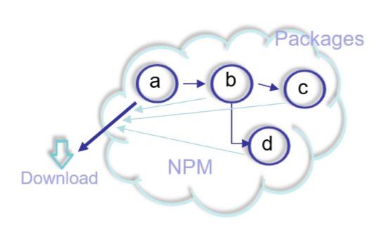

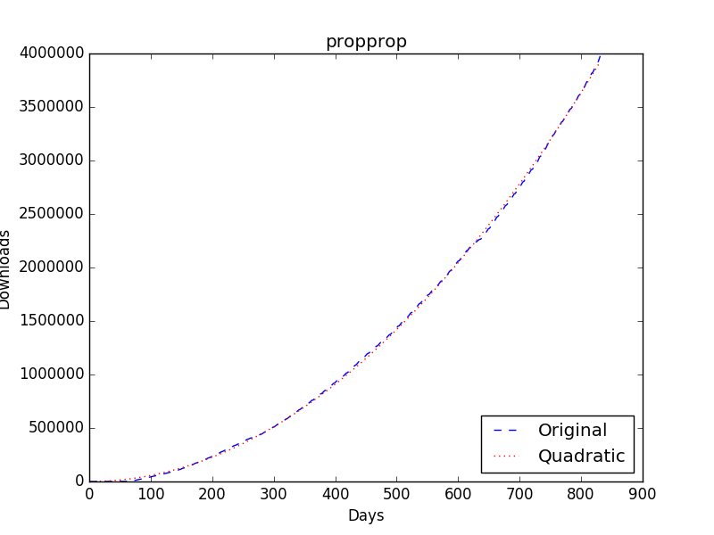
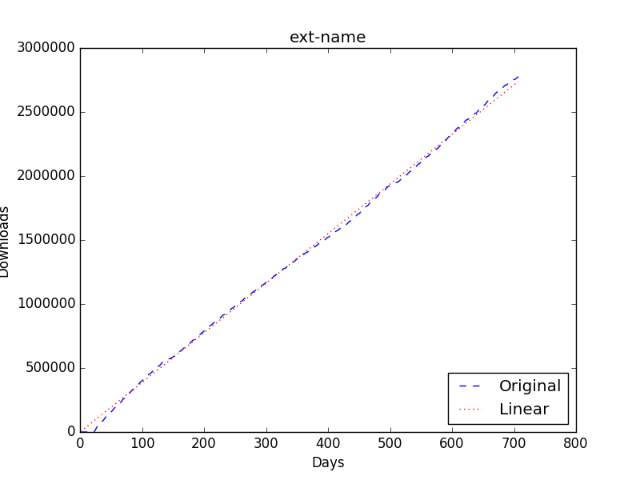
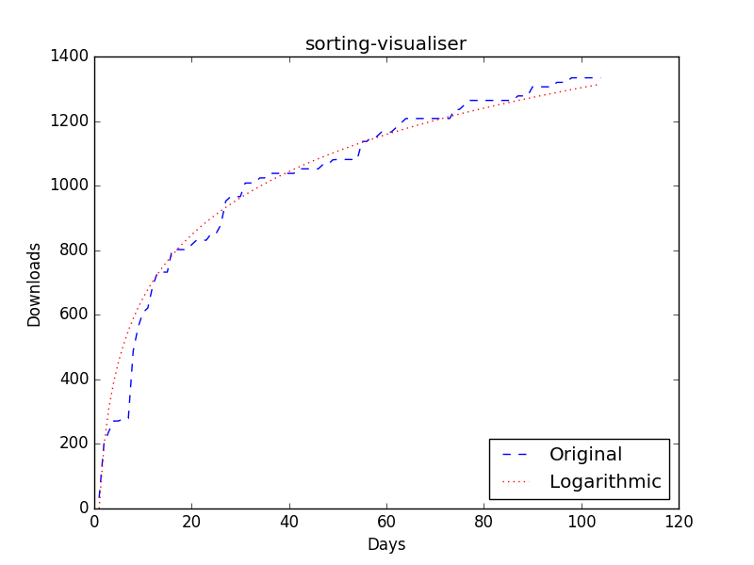
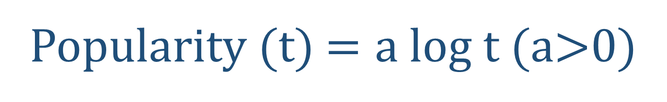
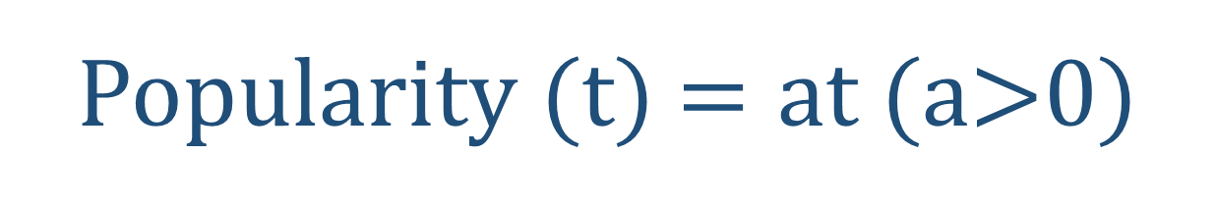
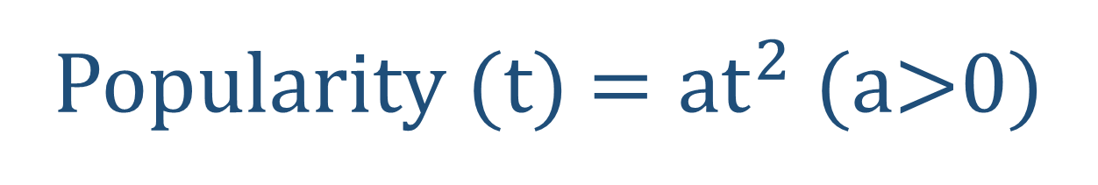
An Evolutionary Study on The Popularity of Packages in
NPM JavaScript Package Ecosystem
Shi Qiu, Raula Gaikovina Kula and Katsuro Inoue
Osaka University, Japan
{qiujitsu, raula-k, inoue}@ist.osaka-u.ac.jp
Motivation
The NPM registry hosts over 400,000 JavaScript packages of reusable code — the largest code registry in the world.
Our goal is to understand the emergence and growth of the package popularity in NPM [1].
Research Question
Do packages in NPM share common popularity growth characteristics?
If so, what kind of growth models best ﬁt them?
We propose three growth models to show the characteristics of popularity growth (i.e., Popularity (t)) over time (t) [2]. We then use the number of downloads as the metric to measure popularity and run experiments by which the popularity is ﬁtting against the three proposed growth models.
Result
Quadratic Model
Linear Model
Logarithmic Model
Popularity (t) $=at^{2}$ (a>0)
Popularity (t) $=at$ (a>0)
Popularity (t) $=a log t$ (a>0)
# Fitted
44,507
90,146
13,875
% of All
29.96%
60.67%
9.37%
Package popularity grows slowly at ﬁrst, but accelerates over time.
Package popularity grows steadily, with no signs of accelerating or slowing down.
Package popularity grows rapidly at ﬁrst, but gradually slows down.
Conclusion
Packages in NPM DO share common popularity growth characteristics. 90.63% of the 149,280 packages are best-ﬁtted by quadratic model and linear model, while only 9.37% are best ﬁtted by logarithmic model. Our result shows that reuse of packages in NPM is still ACTIVE, with more and more packages being installed from the NPM JavaScript package ecosystem.
[1] Wittern, E., Suter, P., Rajagopalan, S. A Look at the Dynamics of the JavaScript Package Ecosystem. In Proc. of the 13th International Conference on Mining Software Repositories (MSR)(2016).
[2] Kula, R. G., German, D. M., Ishio, T., Ouni, A., Inoue, K. An Exploratory Study on Library Aging by Monitoring Client Usage in a Software Ecosystem. In Proc. of the 24th International Conference on Software Analysis, Evolution, and Reengineering (SANER)(2017).
Department of Computer Science, Graduate School of Information Science and Technology, Osaka University

