Slide 1


Source File Set Search for Clone-and-Own Reuse Analysis
Takashi Ishio†‡, Yusuke Sakaguchi‡,
Kaoru Ito‡, Katsuro Inoue‡
† Nara Institute of Science and Technology, Japan
‡ Osaka University, Japan
NAIST
SE LAB
MSR2017

Slide 2

Motivation: Software Reuse
Developers often reuse existing libraries.
Firefox 45
Cloned Components
libjpeg
expat
libpng
zlib
libjar
stlport
libvpx
libogg
freetype2

Slide 3
Library Update Problem
Release note and security advisories often specify existing versions that should be updated.
Due to the bug fixes, any installations of 1.2.9 or 1.2.10 should be immediately replaced with 1.2.11.
zlib 1.2.11 release (http://www.zlib.net/)
A version number of a library copy is very important to answer:
zlib
“Should we update this library copy?”

Slide 4
Version number is often unavailable [Xia, 2013]
Some projects record version numbers in their repositories.
It may get lost over time.
Firefox-45:modules/zlib
Upgrade zlib to version 1.2.8
NSS-3.14:lib/zlib
reorganize NSS directory layout,
moving files, very large changeset!
(No version information)

Slide 5
Recovering Version Information from Source Files
Query: A set of files
Result: A list of components that are likely reused
Firefox-45.0
# | Package Name | Total Sim | Same | Similar
1 | zlib-1:1.2.8.dfsg-2 | 25.9714 | 22 | 4
2 | genometools-1.5.8-2 | 25.9670 | 22 | 4
3 | mongodb-1:3.2.8-1 | 19.9505 | 15 | 5
zlib/gzlib.c
zlib/inflate.c
zlib/mozzconf.h
zlib/zconf.h
zlib/zlib.h
zlib/zutil.c
… (27 files)
Debian GNU/Linux Package Database
(200,018 packages)

Slide 6
Process
Component Search
Compute similarity between query files and existing component files.
Component Ranking
Select components using aggregated file similarity.

Slide 7

Similarity Definition
Jaccard Index of trigrams: An approximation of edit distance
$sim\left(a, b\right)= \frac{|trigrams\left(a\right)∩trigrams\left(b\right)|}{|trigrams(a)∪trigrams(b)|}$
Example:
f1: while (( *dst++ = *src++) != '\0');
f2: while (*dst++ = *src++);
trigrams(f1)
trigrams(f2)
_, _, while
_, _, while
_, while, (
_, while, (
while, (, (
while, (, *
(, (, *
White space and comments are ignored.
Supported C/C++ and Java in this paper.
(, *, dst
(, *, dst
*, dst, ++
*, dst, ++
…
…

Slide 8

1. Component Search
Database
Find the most similar file in each component.
We ignore less similar files: $sim\left(a, b\right)≥th$.
zlib-1.2.8
gzlib.c
inflate.c
zconf.h
…
1.0
Query
Firefox-45.0
zlib/gzlib.c
zlib/inflate.c
zlib/mozzconf.h
zlib/zconf.h
zlib/zlib.h
zlib/zutil.c
…
0.9160
zlib-1.2.7
gzlib.c
inflate.c
zconf.h
…
mongodb-3.2.8
inflate.c
…

Slide 9
1. Component Search
Database
Find the most similar file in each component.
We ignore less similar files: $sim\left(a, b\right)≥th$.
zlib-1.2.8
gzlib.c
inflate.c
zconf.h
…
1.0
Query
0.9948
Firefox-45.0
0.9858
zlib/gzlib.c
zlib/inflate.c
zlib/mozzconf.h
zlib/zconf.h
zlib/zlib.h
zlib/zutil.c
…
0.9160
zlib-1.2.7
0.9568
gzlib.c
inflate.c
zconf.h
…
0.9384
0.991
mongodb-3.2.8
inflate.c
…
Components including similar files are likely reused.

Slide 10
Implementation Issue
A naïve file comparison takes time.
|Q| × |F|
#query files
#database files
27 files
in zlib directory
11,040,924 files
in Debian GNU/Linux
(C/C++ and Java)
➔ We employ b-bit minwise hashing technique.

Slide 11
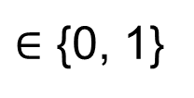
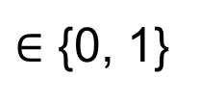
b-bit minwise hashing [Li, 2010]
1-bit Min-Hash: $b\left(f\right)=min \left\{ h\left(t\right) | t∈trigrams\left(f\right)\right\} mod 2$
trigrams(f1)
_, _, while
h(t₁)
_, while, (
h(t₂)
min
mod 2
while, (, (
h(t₃)
h(t_{i})
b(f1)
$∈$ {0, 1}
(, (, *
h(t₄)
(, *, dst
h(t₅)
*, dst, ++
h(t₆)
If f1 and f2 are more similar,
more likely b(f1) = b(f2).
…
…
trigrams(f2)
b(f2)
$∈$ {0, 1}

Slide 12

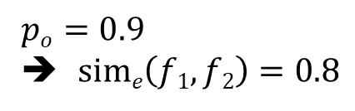
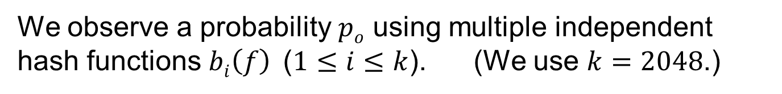

Similarity estimation
A hash function extracts the same hash value from two files on the probability $p:$
$p=sim\left(f1, f2\right)+\frac{1−sim\left(f1, f2\right)}{2}$
[Li, 2010]
Similarity represented by an observed probability $po$:
$sime\left(f1, f2\right)=\left(po−\frac{1}{2}\right)×2$
We observe a probability $po$ using multiple independent hash functions $bi\left(f\right)$ ($1≤i≤k$). (We use $k=2048$.)
 | b1 | b2 | b3 | b4 | b5 | b6 | b7 | b8 | b9 | b10
f1 | 1 | 1 | 0 | 1 | 1 | 0 | 0 | 0 | 1 | 1
f2 | 1 | 0 | 0 | 1 | 1 | 0 | 0 | 0 | 1 | 1
$$po=0.9$$
➔ $sime\left(f1, f2\right)=0.8$

Slide 13
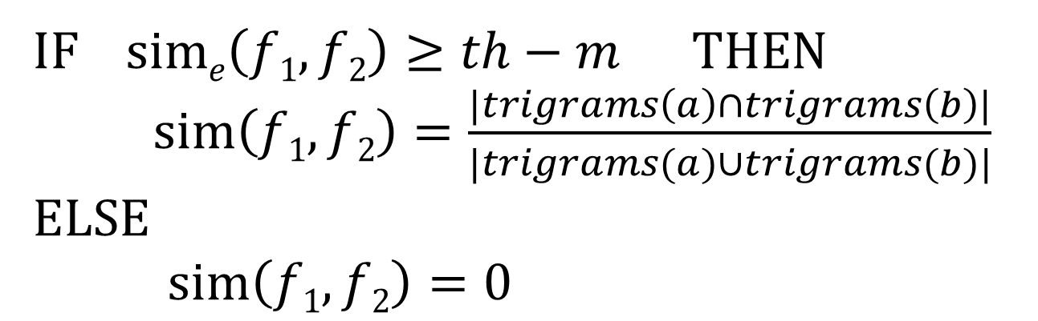
Fast similarity computation
Error margin
IF $sime\left(f1, f2\right)≥th−m \text{THEN}$
$sim\left(f1,f2\right)=\frac{|trigrams\left(a\right)∩trigrams\left(b\right)|}{|trigrams(a)∪trigrams(b)|}$
ELSE
$sim\left(f1,f2\right)=0$
An actual similarity is computed only if necessary.

Slide 14
2. Component Ranking
Database
Exclude uninteresting components.
zlib-1.2.8
gzlib.c
inflate.c
zconf.h
…
1.0
Query
0.9948
Sum=25.9714
Firefox-45.0
0.9858
zlib/gzlib.c
zlib/inflate.c
zlib/mozzconf.h
zlib/zconf.h
zlib/zlib.h
zlib/zutil.c
…
0.9160
zlib-1.2.7
0.9160
0.9568
gzlib.c
inflate.c
zconf.h
…
0.9568
0.9384
0.9384
0.991
mongodb-3.2.8
inflate.c
…
Sum=19.9505

Slide 15
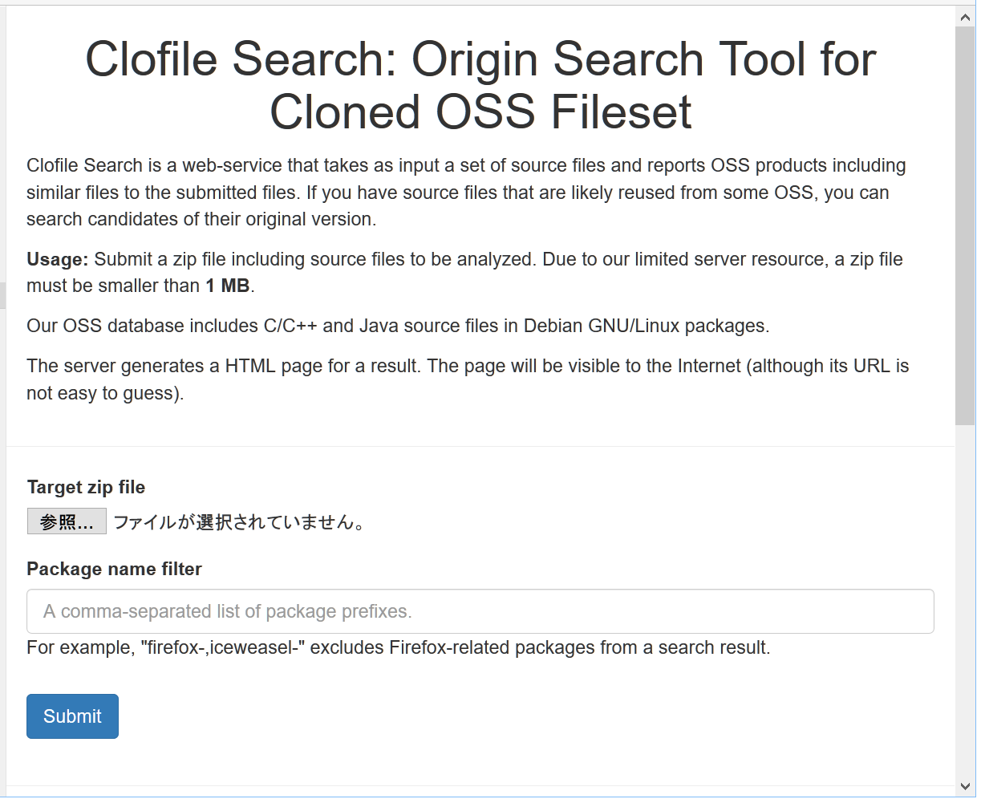
Our implementation: Clofile Search
http://sel.ist.osaka-u.ac.jp/clofile/
Submit a zip file including source files.
You will receive a web page for a result.

Slide 16
Evaluation
Does it report an original version of a component?
Dataset: 75 directories in Firefox and Android
Extracted version numbers from commit messages.
Analyzed a position of an original version in a result.
Accuracy measures:
Top-k Recall: How frequently an original component is included in the top-k of a result.
The sum of positions in the results: It approximates manual effort to identify all the original components.

Slide 17
Result
Method | Top-1 Recall | Top-5 Recall | Top-10 Recall | Top-∞ Recall | Sum of positions
Baseline (SHA-1) | 0.640 | 0.773 | 0.827 | 0.960 | 931
Baseline +Ranking | 0.707 | 0.840 | 0.867 | 0.960 | 719
th=1.0 | 0.733 | 0.867 | 0.893 | 0.987 | 785
th=0.9 | 0.733 | 0.907 | 0.920 | 1.000 | 551
th=0.8 | 0.733 | 0.893 | 0.920 | 1.000 | 627
th=0.7 | 0.680 | 0.880 | 0.907 | 1.000 | 692
th=0.6 | 0.667 | 0.880 | 0.907 | 1.000 | 689
Ranking is added
Ignoring white space and comments.
Identifying similar files.
Top-5: 0.773 ➔ 0.907
No false negatives!
Reduced manual effort
931 ➔ 551 (60%)

Slide 18
Performance
Time per Query [th=0.6]:
Median: 77.7 seconds
Max: 25 minutes
13,720 files are analyzed
in 3.5 hours.
(0.92 seconds per file)
Environment:
Intel Xeon E6-2690 v3 (2.6 GHz), 64 GB RAM
4 GB hash values and 20 GB file names on memory.
300 GB source files on HDD.

Slide 19
Conclusion
Our method reports existing components that are likely reused.
b-bit minwise hashing is employed to estimate a similarity from hash values in a practical time.
Clofile Search http://sel.ist.osaka-u.ac.jp/clofile/
We hope that the tool helps users to analyze their cloned components.
Please try it!

