Slide 1
SoL Mantra:
Using Library Coexistence Coefficient to
Visualize Update Opportunities
Boris Todorov¹, Raula Gaikovina Kula²,
Takashi Ishio², Katsuro Inoue¹
Osaka University¹ and NAIST²
Email: boris-t@ist.osaka-u.ac.jp

Slide 2
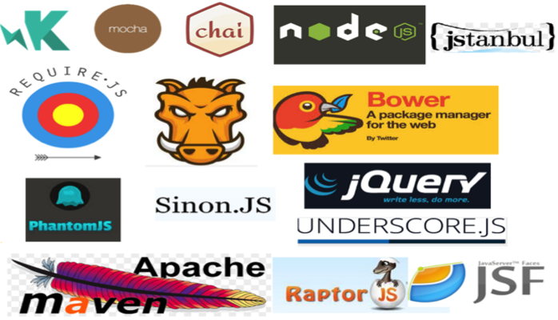


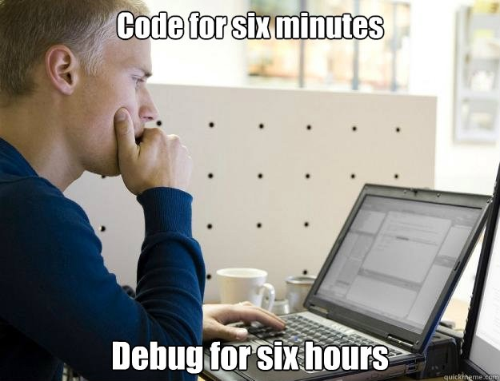
What is a Software Library?
Developing software with Libraries
(code reuse)
Developing Software from Scratch
2

Slide 3




Problem Background
Keeping Libraries up to Date
Am I using the latest version of a library?
Software System
Software Developer / Maintainer
If I update, what other libraries will be affected?
Library
repository
Dependencies /
Libraries

Slide 4
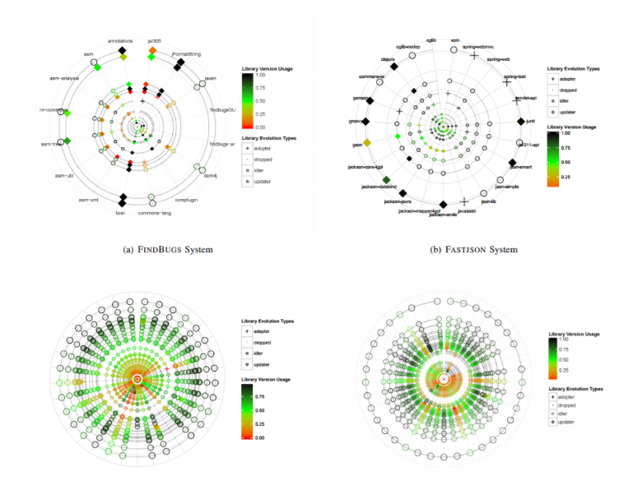
Previous Research (1/2)
Kula et al:
Visualized circularly a software’s dependencies with added historical data;
Raula Gaikovina Kula and Coen De Roover and Daniel M. German and Takashi Ishio and Katsuro Inoue (2014). Visualizing the Evolution of Systems and Their Library Dependencies. In Second IEEE Working Conference on Software Visualization, VISSOFT 2014, Victoria, BC, Canada, September 29-30, 2014, pp. 127–136.

Slide 5
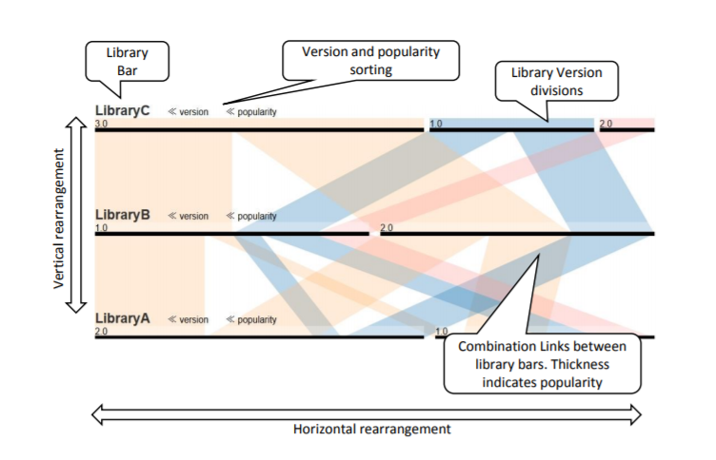
Previous Research (2/2)
Yano et al:
Visualized popular library version combinations to assist software maintenance;
Yuki Yano and Raula Gaikovina Kula and Takashi Ishio and Katsuro Inoue (2015). VerXCombo: An interactive data visualization of popular library version combinations. In 23rd IEEE International Conference on Program Comprehension, ICPC 2015, Firenze, Italy, May 18-19, 2015, pp. 291–294.

Slide 6
Basic Concepts
The Solar System Metaphor – we selected for our visualization the Orbital Layout powered by D3.Js as our main visualization technique, deriving that a software system is similar to the solar system.
Software – the program whose dependencies to other libraries are our concern for visualization;
Library – the programs used by the system or other libraries, forming library dependency directed graph;
Coexistence coefficient (cc) – a binary relation between two libraries (nodes) in an ecosystem, where those two libraries are used by at least one common library or common system.

Slide 7


Coexistence Coefficient (cc)
Library A – Q, D, J, F, E
Library B – J, F, E, Z
F
J
E
Q
A
B
$$CCA\left(B\right)=\frac{|Users A ∩Users B|}{|Users A|}$$
D
Z
$$\frac{6884 ∩3165}{6884}=\frac{3158}{6884}≈0.4587=45.87\%$$
Low cc score – safe to update
High cc score – high complexity

Slide 8
Visual Elements Representations
Core (sun) – in orange color and denotes the software system.
Planets – direct representations of the libraries used by the software.
Color – planets have 2 colors to identify the outdated flag and up-to-date flag – green and red.
Rotation – represents an easier depiction of the outdated libraries.
Moons – represent the coexisting libraries.

Slide 9
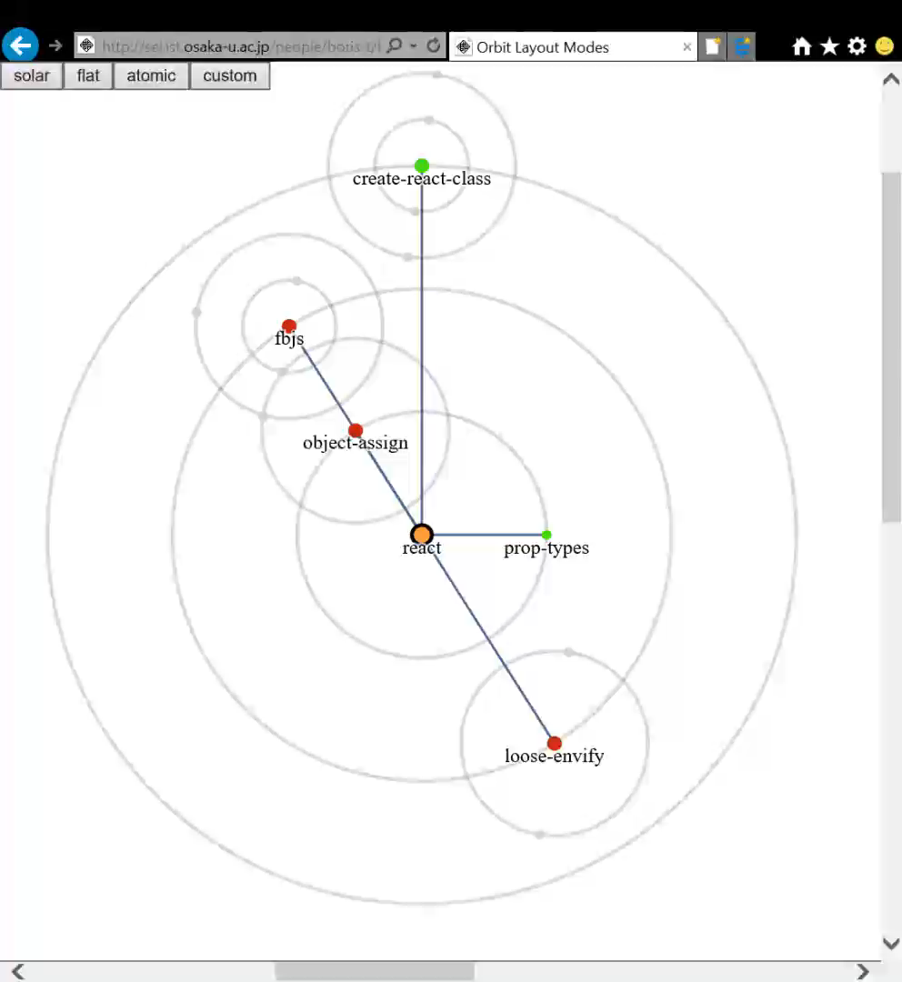
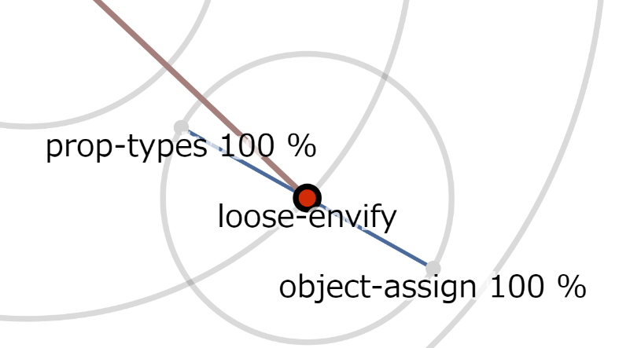
Demo Application Example
Am I using the latest version of a library?
If I update, what other libraries will be affected?

Slide 10
SoL Mantra General Comprehension Survey
Conducted a survey using google forms with 19 participants in total.
Survey Goals – test tool comprehension amongst inexperienced audience and how well users understand the coexistence logic.
Survey Q1 – Is the tool intuitive and easy to use?
Survey Q2 – Do the users understand coexistence?

Slide 11
Survey Results – General Information
General participants data collection:
Age: 25-30 (52.6%), 18-24(31.6%)
Affiliation: mostly students
Used coding language: Java and Python (31.6%)

Slide 12
Survey results – Basic Comprehension Questions
General comprehension tasks
3 simple questions regarding our visual cues:
What is the system represented – 100% answered correctly
How many libraries does the software system use – 94.7%
How many libraries are outdated (if any) – 94.7%

Slide 13
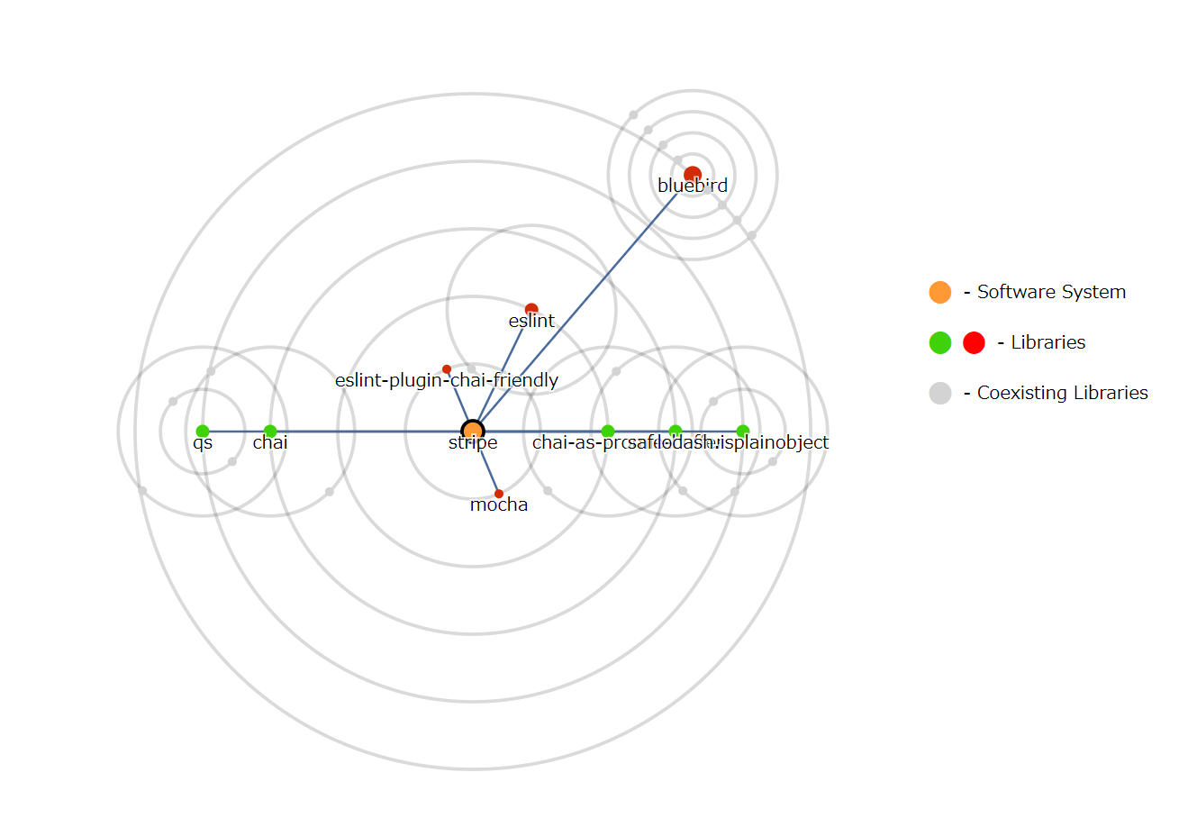
Survey SoL Mantra – “stripe”

Slide 14
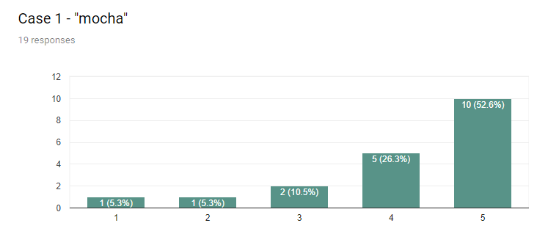
Coexistence Coefficient Comprehension Results – Case “mocha”
Further
Investigate
Safe to
update

Slide 15
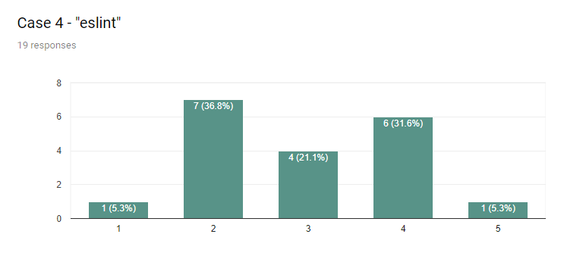
Coexistence Coefficient Comprehension Results – Case “eslint”
Further
Investigate
Safe to
update

Slide 16
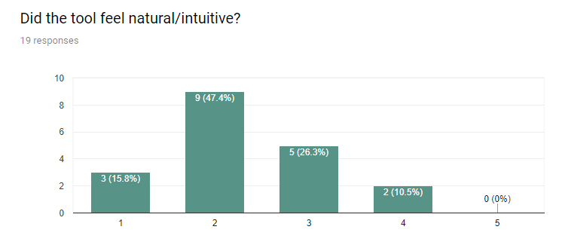
Post Task Survey Results – Is the tool intuitive or not?
Natural
Counter-intuitive

Slide 17
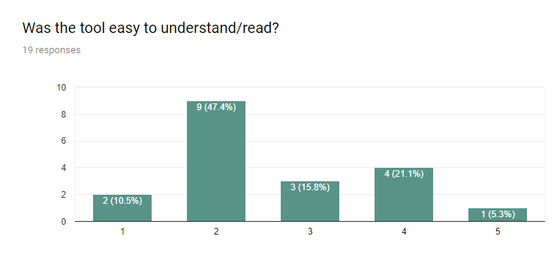
Post Task Survey Results – Was the tool easy to understand?
Difficult/
Confusing
Very easy

Slide 18
Threats to Validity
Collected data is based on established projects.
The tested projects could have specific reasoning for the version used that we are unaware.
Survey participants count (19).
Survey users are mostly students that don’t have experience in the field.

Slide 19
Summary
We created the SoL Mantra tool to visualize library update complexity.
We deployed an online survey to validate the usefulness and readability of our tool amongst inexperienced users.

Slide 20
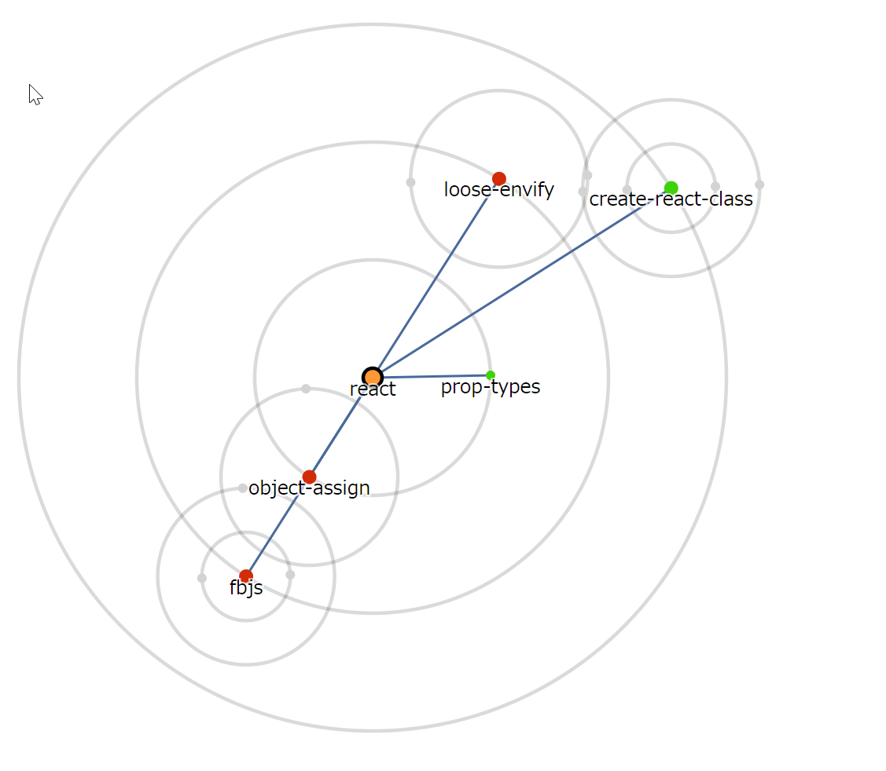
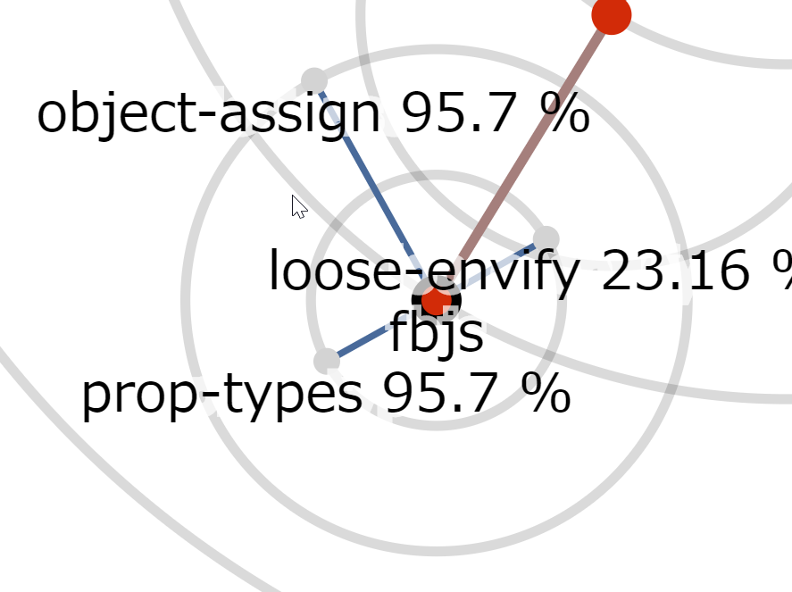
Empirical Evaluation Example

Slide 21

Problem Background
Keeping Libraries up to Date
Am I using the latest version of a library?
Software Developer
Software System
Bug
If I update, what other libraries will be affected?
New Features
Tracking library
evolution
Library
repository
supports-color
babel-core
NPM
glob
bluebird
Dependencies /
Libraries
char-spinner
mocha

