Slide 1
A Generalized Model for Visualizing Library Popularity, Adoption, and Diffusion within a Software Ecosystem
Raula Gaikovina Kula, Coen De Roover,
Daniel M German, Takashi Ishio, Katsuro Inoue
SANER’18 – March 22nd 2018, Campobasso, Italy

Slide 2
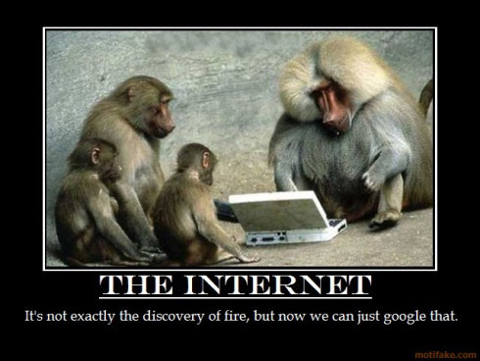
https://rantingcrow.wordpress.com/2016/02/08/monday-moaning-monkey-wisdom/

Slide 3
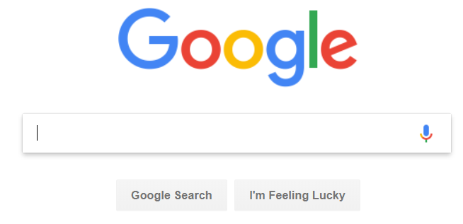
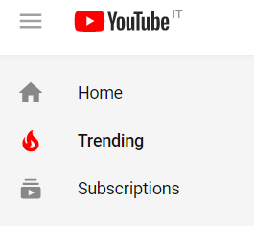
…‘Wisdom of the crowd’ is the new (or not so new) search
https://www.google.co.jp
https://www.amazon.com
And is run by algorithms…

Slide 4
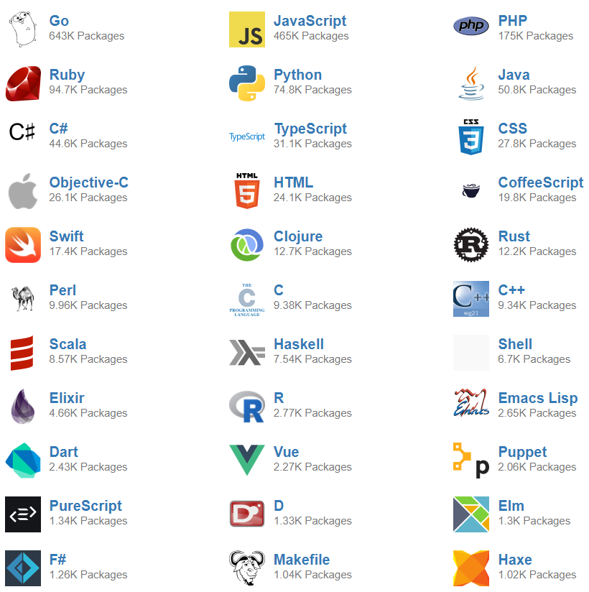
https://libraries.io/languages

Slide 5
Plethora of Empirical Studies at API and Library
Popularity Trends
Mileva et al., IWPSE09
De Roover, ICPC13
Evolution Studies (lags in updates)
Raemakers et al., ICSME12, MSR13
Robbles et al., FSE12
Bavota et al., ESE15
Dependency Networks (Transitive)
Decan et al., ESE18, SANER17
Abdalkareem et al., FSE17

Slide 6
Adhoc Mining of Libraries…
Third-party dependencies releases are inconsistent, making comparing difficult and time consuming:
Different semantic versioning, messy provenance tracking and release cycles, even within the same language
No standardized rules
(i.e., semantic versioning)

Slide 7
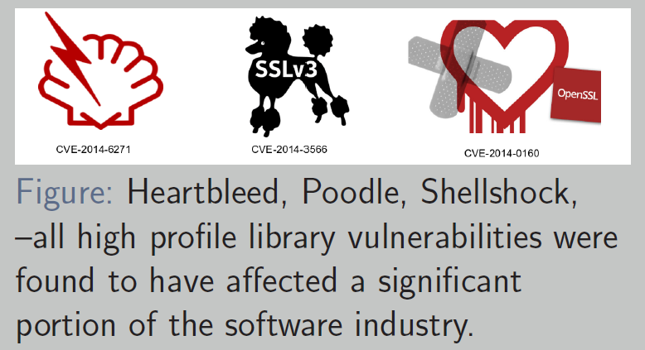
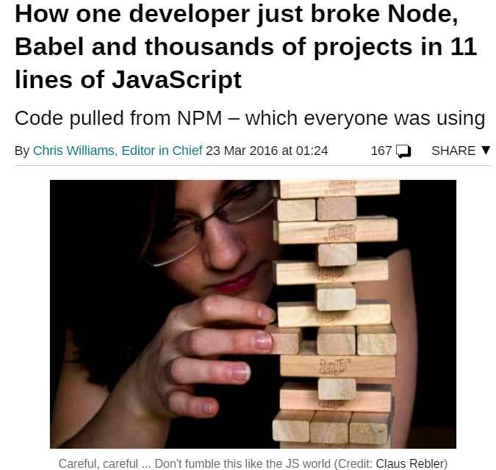
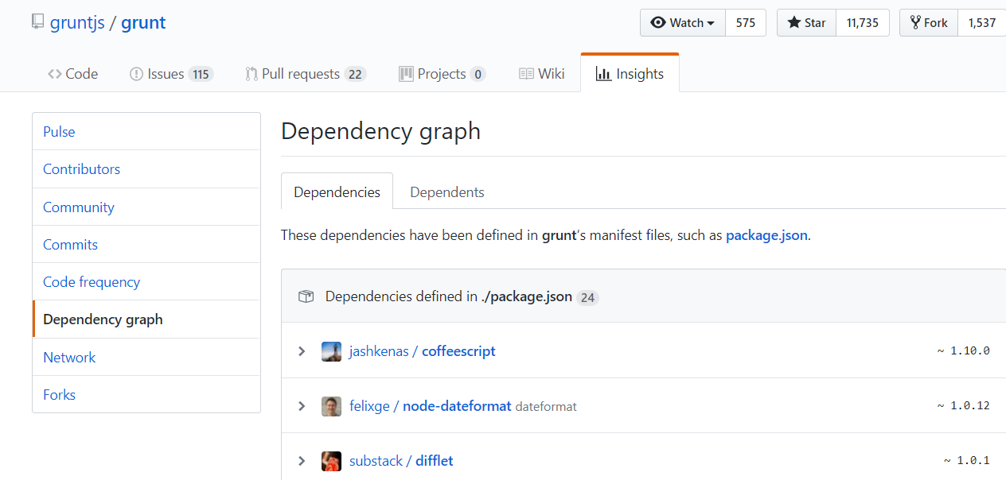
Why search libraries?
Third-party Vulnerabilities
Third-parties breaking Applications
Library Dependency Analysis
Awareness in key…
https://www.theregister.co.uk/2016/03/23/npm_left_pad_chaos/

Slide 8
Key Motivation:
Develop a systematic technology that spans any ecosystem of language platforms to understand:
Popularity refers to the usage of a library over time.
Adoption refers to systems introducing a new library dependency.
Diffusion, inspired by use-diffusion, is a measure of the spread of library versions over dependent systems.

Slide 9
Key Motivation:
Develop a systematic technology that spans any ecosystem of language platforms to understand:
Popularity refers to the usage of a library over time.
Adoption refers to systems introducing a new library dependency.
Diffusion, inspired by use-diffusion, is a measure of the spread of library versions over dependent systems.
Visualizations assist developers with the migration decision (not just use the latest).
… using wisdom of the crowd

Slide 10
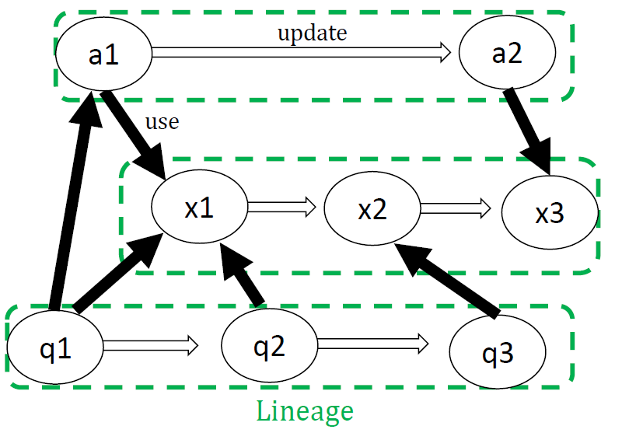
Software Universe Graph (SUG)
Node Properties
unique-name
version
timestamp

Slide 11
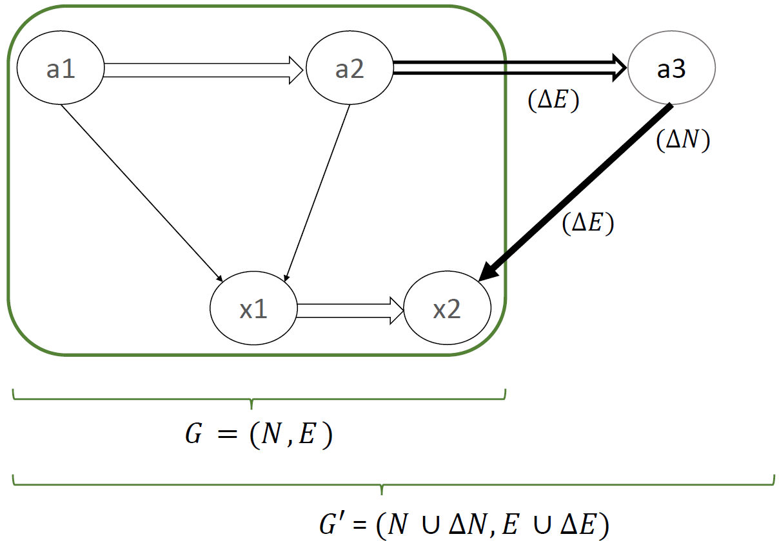
Software Universe Graph (SUG)

Slide 12
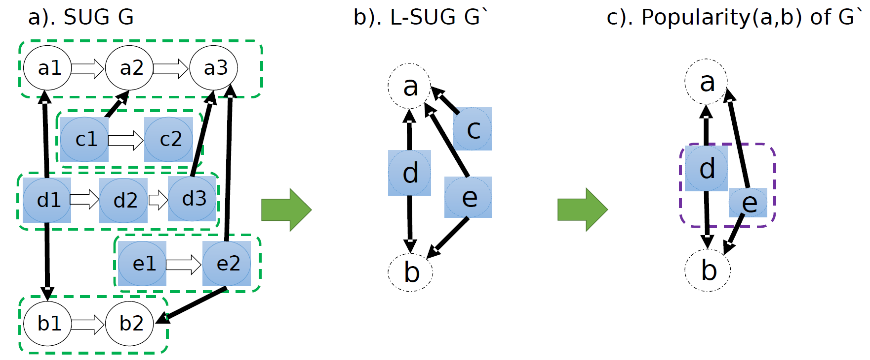
SUG Operations (1 of 2)

Slide 13
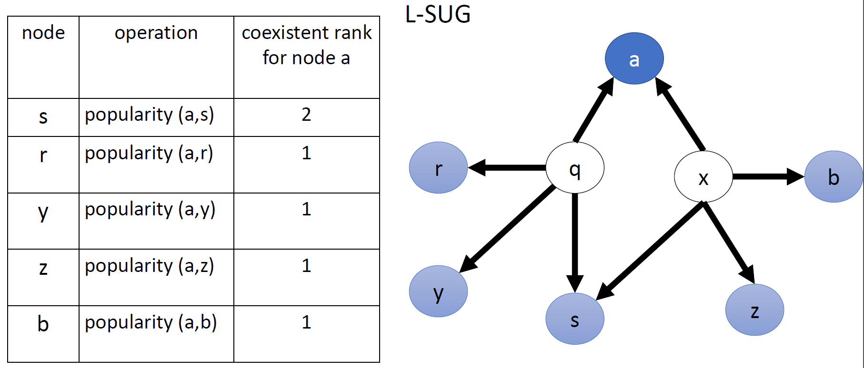
SUG Operations (2 of 2)

Slide 14
Empirical Study using the SUG
Our goal is to:
(1) construct real-world SUG models to show its practical
application and
(2) demonstrate visualization usefulness in library dependency
management through several case studies.

Slide 15
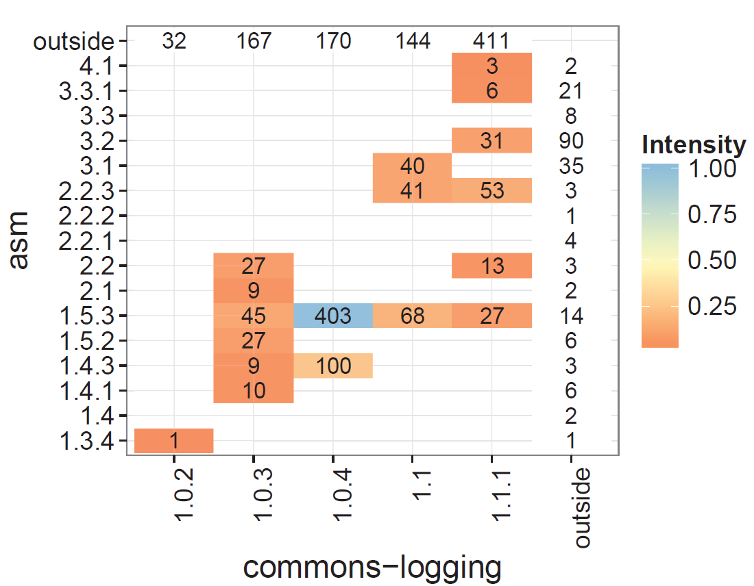
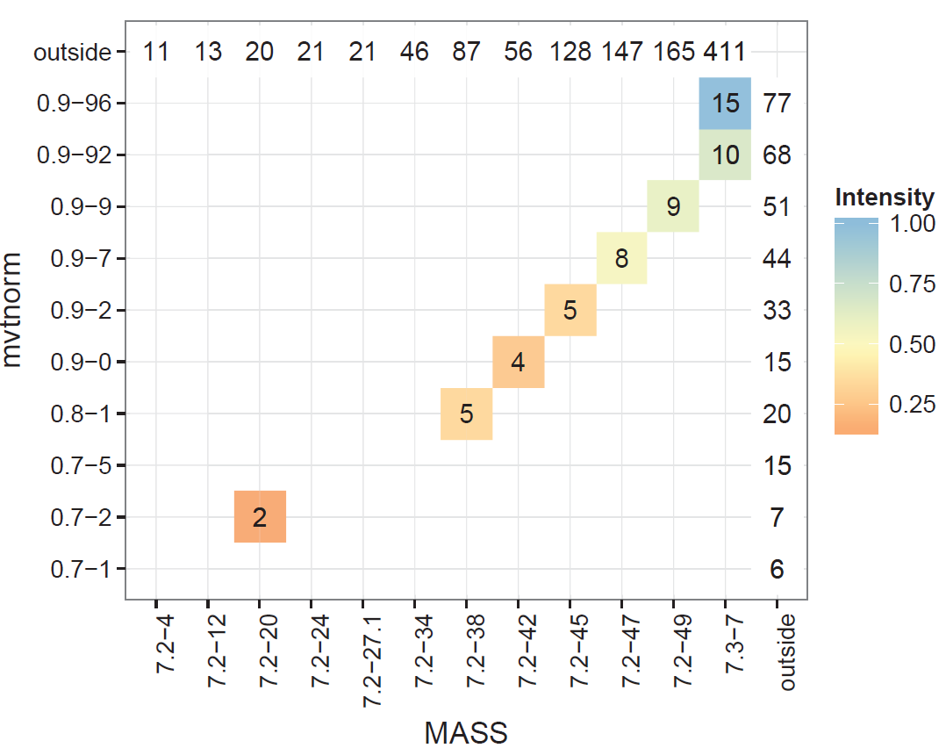
SUG Visualizations (1 of 2)
Other heatmaps of SUG operations (i.e., Lineage and coexistence rankings)

Slide 16
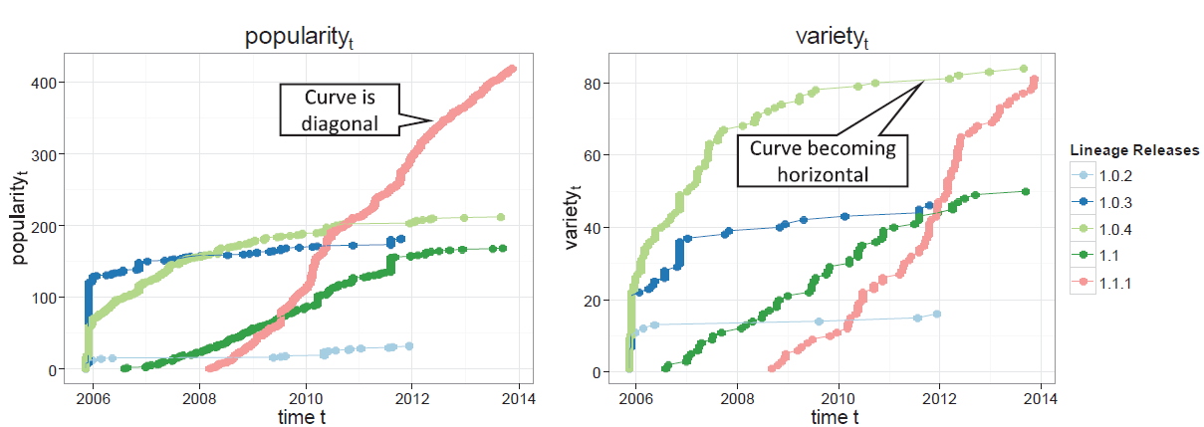
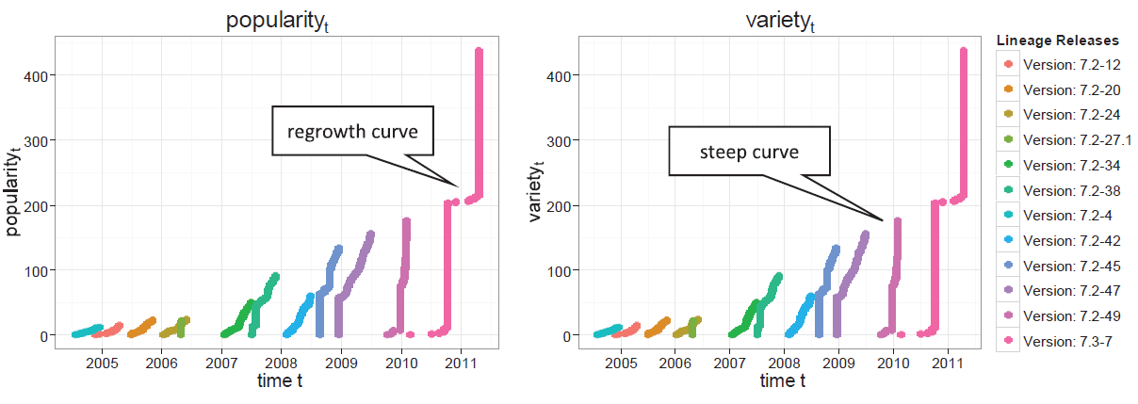
SUG Visualizations (2 of 2)
Popularity trends (i.e., popularity and diffusion)

Slide 18
Way Forward
algorithms from SUG operations: Explore more operations and
Interactive visualizations
Scalability: Empirical Studies (i.e., using libraries.io data)
User Studies: Real-time user visualization and navigation.
Combine with Code Analysis, Social and Technical Features at the API level.

Slide 19
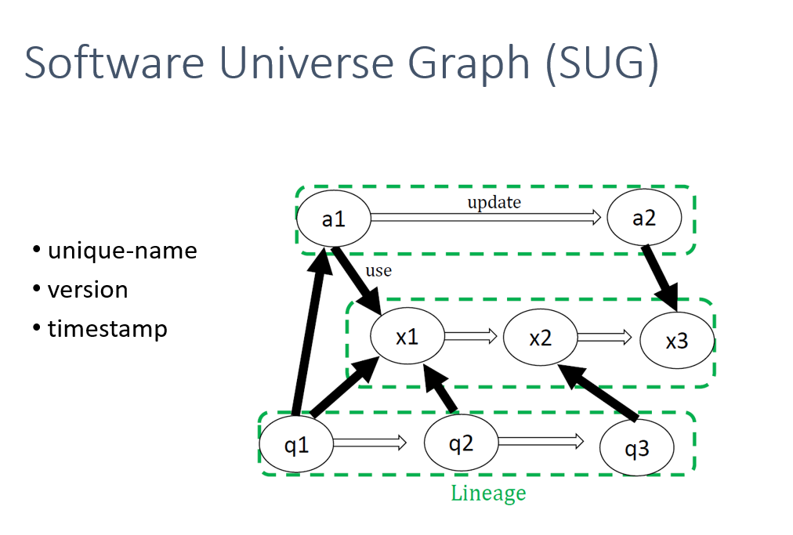
Contact me for more information: raula-k@is.naist.jp

