Slide 1
A Study of Practical Education Program on AI, Big Data, and Cloud Computing through Development of Automatic
Ordering System
Sachio Saiki, Naoki Fukuyasu,
Kohei Ichikawa, Tetsuya Kanda,
Masahide Nakamura, Shinsuke Matsumoto,
Shinichi Yoshida. Shinji Kusumoto

Slide 2


enPiT educational project
Educational project to develop the advanced IT engineer based on practical education in cooperation between industry and academia
promoted by MEXT
Security
Emb
BizSysD
AiBiC Eastern Japan
AiBiC Kansai
AiBiC Kyushu

Slide 3
enPiT educational project
Educational project to develop the advanced IT engineer based on practical education in cooperation between industry and academia
promoted by MEXT
PBL
Project Based Learning
Security
Emb
BizSysD
AiBiC Eastern Japan
AiBiC Kansai
AiBiC Kyushu

Slide 4
enPiT AiBiC & AiBiC Kansai
Social background
  Innovative engineer who can address a social challenge using big data processing, AI and cloud computing technologies with the generation of new business and value is required from industry.
enPiT AiBiC
  An education program aims to develop an innovative systems engineer through the Project Based Learning (PBL) practice targeted at undergraduate students
In this report
  How we designed a curriculum
  Analyze educational effectiveness of 2017
    Basic knowledge learning
    PBL exercises
AI
Big data
Cloud
In this report

Slide 5
PBL theme:
Automatic ordering system challenge
Development of the automatic ordering system for retail
store
  yogurt, cheese, natto, …
Stocks should be neither too much nor too little to minimize two kinds of losses
  Opportunity loss
    The loss of sales opportunities caused by out-of-stock
  Actual loss
    The loss due to discarding or discounting of unsold items
The system need determine an appropriate number of
orders to reduce these losses

Slide 6








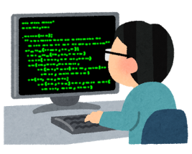
Problem Subject Overview
Dataset for learning
Day | weather | price | sales
Friday | Rainy | 148 | 68
Saturday | Sunny | 128 | 87
Sunday | Sunny | 98 | 157
Monday | Cloudy | 148 | 53
… | … | … | …
Microsoft
Azure Machine
Learning
Retail Store
(Simulator)
Machine
Learning
Demand Prediction Model
Web API
Web API
Big Data
Processing
Cloud Computing
Hadoop
Map Reduce
Big Scale
POS Data
Automatic Ordering Program

Slide 7
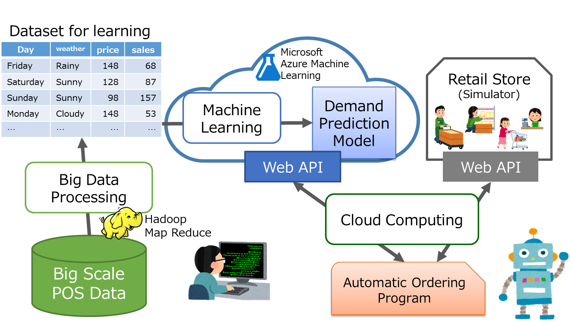
Tasks for Students
In this PBL, students mainly have to:
  (0. Read and understand processed big data )
  Create demand prediction model (on Azure ML)
  Implement automatic ordering program (in Python)

Slide 8
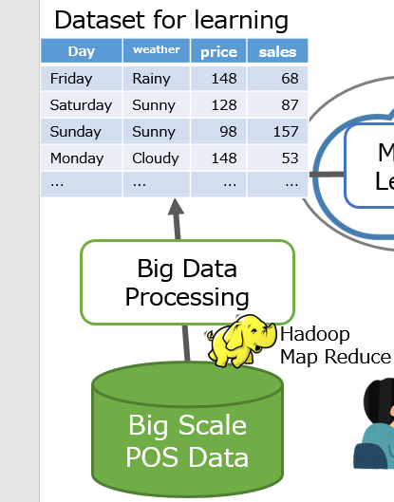
Datasets Provided to Students
POS dataset
  Sales records for 116 super market shops.
  2009-2013
Calendar dataset
  Day of week, holiday name, …
Weather dataset
  Weather, temperature, humidity,
  precipitation, … for each day

Slide 9
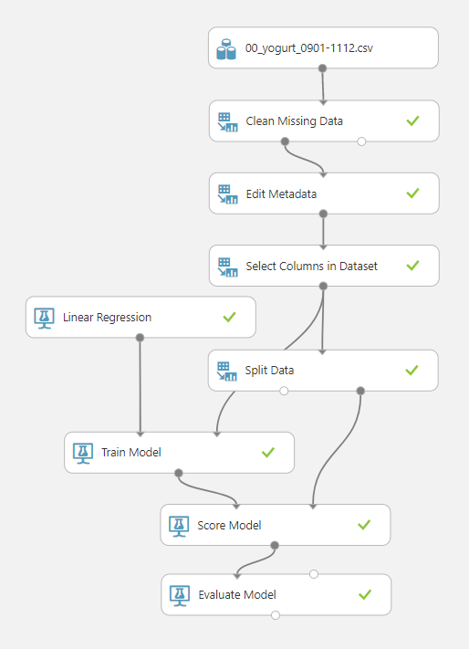
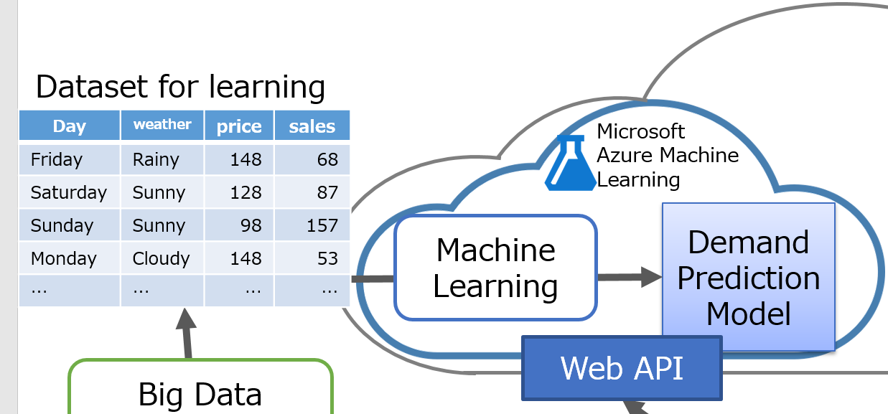
Demand Prediction Model
Machine Learning with given datasets
  Azure Machine Learning Studio (Azure ML)
Created demand prediction model is deployed as a Web service
  Automatic ordering program can access it via Web API
Input Data
Preprocessing
Data Definition
Model Definition
Training
Evaluate

Slide 10
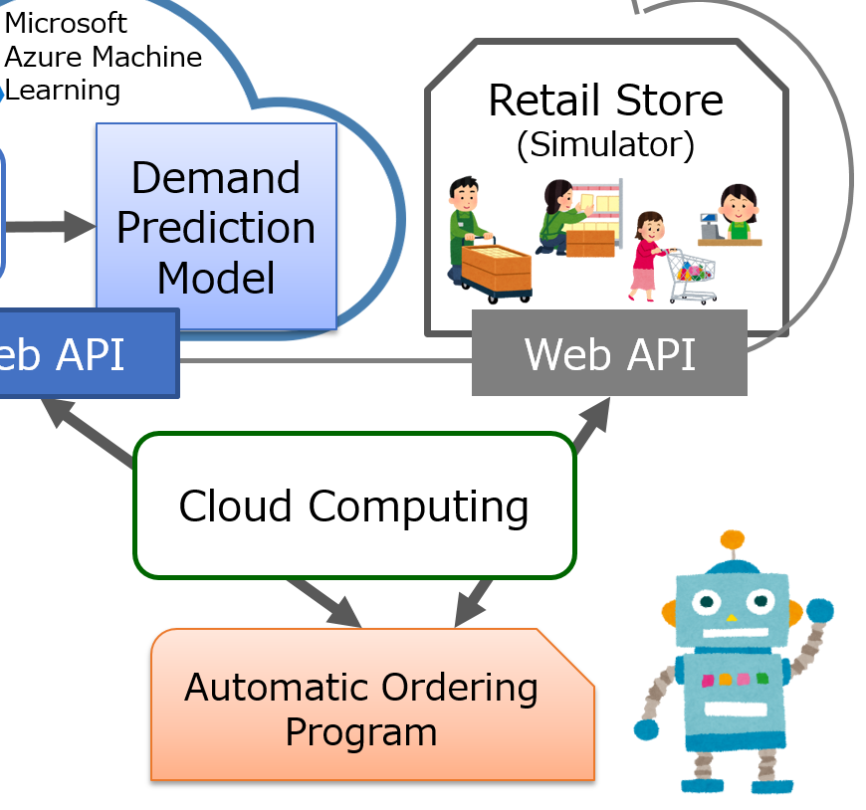
Automatic Ordering Program
Predicts the demand for tomorrow’s sales
Implemented in Python
  Template to access store simulator is provided.
Students have to add code for
  Generating input datasets to be given to the prediction model
  Calling the demand prediction model on Azure ML
  Heuristics that determine the actual number of orders
The number of orders is not always necessary to the number of differences between predicted demand and the current stocks.

Slide 11
Store simulator
Due to limitation of time and cost evaluations, we evaluate the students’ systems with a store simulator.
Functions are provided as REST APIs
  Placing orders with a specified number
  Retrieving information on the store of the specified date
    The number of sales, stocks and so on
  Weather and calendar data

Slide 12
Problem simplification
The store closes every day (not open 24 hours).
  The store places orders for the next day after closing the store.
  The ordered items will be delivered before the opening of the next day.
The cost of each item is fixed with a specific price in advance.
Each item has a specific expiration date, and the items passed the expiration date are discarded.
No discounting based on the expiration dates of the items
  The price of the item is decided based on the actual datasets.
Ordering
System
Order
NEXT DAY
Check Stock
Order
Shop open -close
(Wait for next order)
Simulator
Item deliver
Closing
(record sales)
Disposal

Slide 13

Practical report of 2017
52 students
  From 8 universities and 1 college of technology
  Work on PBL in 9 teams * 5-6 students
Classes are held at Osaka University Nakanoshima Center
Date | Class
May. 27 | Cloud computing
Jun. 10 | Big data analysis
Jul. 1 | AI
Aug. 5 | Integrated Study
Sep. 4 - 9 | Basic PBL
Oct.14 & Nov. 11 | Advanced PBL
Dec. 9 | Final presentation

Slide 14
Auxiliary fundamental knowledge learning
Including team activity
Cloud computing
  Lecture: The development of cloud computing with historical background
  Exercise: Construction of VM with AWS EC2
  Corporate seminar: NTT DATA Corporation and Rakuten, Inc.
Big data analysis
  Lecture: The definition and applications of big data
  Exercise: MapReduce analog game and Apache Hadoop
  Corporate seminar: FUJIFILM ICT Solutions Co., Ltd.

Slide 15
Auxiliary fundamental knowledge learning
Including team activity
AI
  Lecture: History from expert system to machine learning
  Exercise Prediction and classification on the real estate dataset
  Corporate seminar: IBM Japan, Ltd. and
  The Japan Research Institute, Limited.
Integrated study
  Pre-exercise for automatic ordering PBL
  How to use Azure ML and evaluate the prediction model

Slide 16
PBL: Automatic Ordering Competition
Competition among the student teams
  Profit of the store in a specified period
    Total sales – Total cost
Points to evaluate (other than profit)
  Selection of the machine learning algorithm
  Tuning of the parameter for the machine learning algorithm
  Selection of the explanatory values for the machine learning
  Implementation of the heuristics to tune the demand prediction
  Opportunity loss and actual loss
Final presentations
  Including a report of comparing and analyzing trials

Slide 17
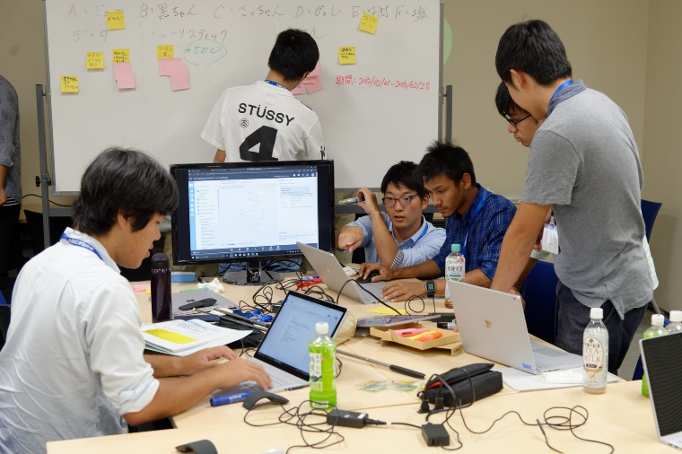
PBL: Step up
 | Basic PBL | Advanced PBL | Competition
Items | 1 (Yogurt) | 3 from 6 items | (same as Advanced PBL)
POS Dataset for ML | 1-3rd year | 1-3rd year | (use the Automatic ordering program developed in Advanced PBL)
POS Dataset for evaluating the performance | 4th year | 4th year | 5th year
Students can try their system with 5th year data / class to prevent overfitting.
(Detailed result is hidden and only the profit is notified to students)

Slide 18
PBL Results
Basic PBL
Advanced PBL
Basic PBL:
  decision forest regression
  sales ratio of 74.5%.
  Heuristics (2)
    If the next day is a closing day, the system does not place any order
    If the sales of today is big enough, the system places more orders for the next day

Slide 19
PBL Results
Basic PBL
Advanced PBL
Advanced PBL:
  boosted decision tree regression
  sales ratio of 93.8%.
  Heuristics (6)
    If the next day is a closing day, the system does not placed any order
    If the stock > 200, it reduces the number of the order by 100
    If the day with no opportunity loss lasts more than five days, it reduces the number of the order
    If today is a closing day and the next is opening day, it increases the number of the order
    If the item price of the next day is cheaper than that of today, it increases the number of the order
    If the item price of the next day is less than 150 JPY, it increases the number of the order 1.2 times

Slide 20
Questionnaire to students
It was a valuable experience that I could listen to the opinions of both the service vender side and the service user side at the same time.
Not only technical aspects but also how they worked normally, what kind of people are working, etc. commentary explained, so I was easy to image the company’s work.
Notes:
(Q1Q2)Almost all students were satisfied our PBL
One student indicated lack of basic lecture
Some of students expected to pursue technology deeply
Q3in the PBL exercise management, the lecturer’s skill was considered to be sufficient.
Q4. actively
Q5. 5 negative (network environment)
Web browser-based
Connection, speed
➔replaced some devices for network connection

Slide 21
Conclusion
We developed the education curriculum aims to develop system engineers who can exploit big data, AI and cloud computing technologies practically
  PBL theme: automatic ordering system development
Effectiveness of our PBL centered curriculum
  Most of students are satisfied with PBL exercise and its environment
Future works
  Improve curriculum more suitable for educational PBL contents

