Slide 1
Code-to-Code Search Based on Deep Neural Network and Code Mutation
Yuji
Fujiwara
Norihiro
Yoshida
Eunjong
Choi
Katsuro
Inoue

Slide 2
YOLO: Real-time Object Detection Using DNN (Deep Neural Network) [1]
https://de.wikipedia.org/wiki/Datei:Detected-with-YOLO--Schreibtisch-mit-Objekten.jpg
[1] Redmon et al.: You only look once: Unified, real-time object detection. CVPR 2016.

Slide 3
Tagging by object detection
https://de.wikipedia.org/wiki/Datei:Detected-with-YOLO--Schreibtisch-mit-Objekten.jpg

Slide 4
My first idea
Is it possible to apply
the idea of object detection
into
source code?

Slide 5
Is code tagging using DNN possible? (If so, is it useful?)
Reading a file
Parsing
https://commons.wikimedia.org/wiki/File:Source_code_in_Javascript.png

Slide 6
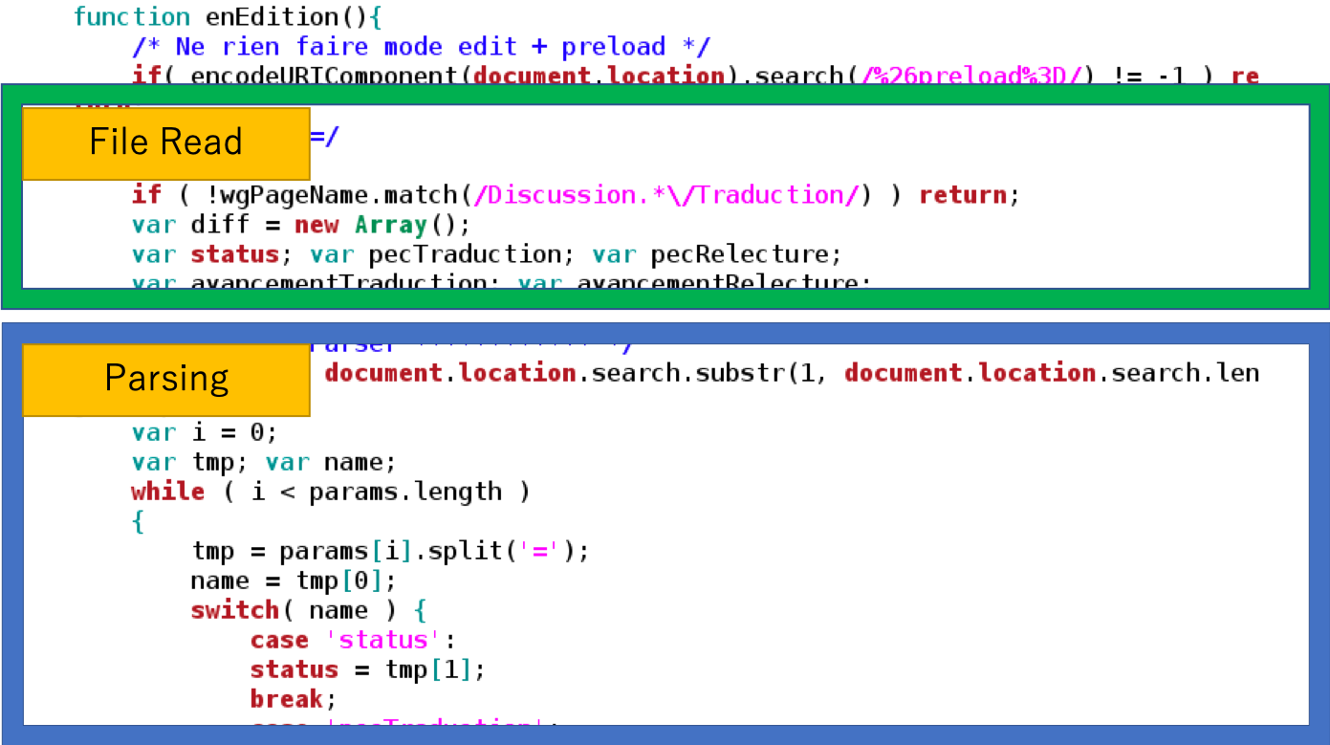
Code tagging in a collection of repositories
Supporting change propagation
Fix the same vulnerability
Catch-up API changes
Extracting libraries / Enhancing languages
If the same tag occurs many times

Slide 7
The road to code tagging is so hard!
Code search / clone detection techniques using DNN has to be established.
Many empirical studies of the techniques are needed.

Slide 8
Related Work: Code Search/Clone Detection Using DNN
Cloners meet DNN
White et al. @ASE2016
RtvNN
Wei and Li @IJCAI 2017
CDLH
Gu et al. @ICSE 2018
CODEnn
Zhao and Huang @FSE 2018
DeepSim
Saini et al. @FSE 2018
Oreo
https://pixabay.com/

Slide 9
DNN is useful for code search / clone detection?
Positive side
F-Score is extremely high
0.98 (DeepSim, BigCloneBench) [Zhao and Huang 2018]
Incremental detection can be performed efficiently
Once a DNN model is built.
Negative side
A DNN model is often unable to be useful for another dataset
It takes much time for learning phase

Slide 10
DNN is useful for code search / clone detection?
More research on
DNN-based code search /
clone detection are
needed to answer it.

Slide 11
Our study: Code-to-code search based on DNN
Code
block
query
result
FFNN
Similar
blocks
11
FFNN is a simple and high-speed DNN

Slide 12
Solving code-to-code search problem by DNN
Not found
label 0
label 1
Code
block
12
FFNN
as categorizer
label 2
label 3

Slide 13
Data generation for the learning phase
Negative data
Corresponds to
“No search result”
learning
Used code blocks
from the other projects
Positive data
FFNN
Corresponds to
each set of similar blocks
Used code blocks
from the target project
learning

Slide 14
Positive data generation for the learning
Finding similar code block pairs using line-based similarity
$$Similarity=\frac{2∗\left|t1∩t2\right|}{\left|t1\right|+|t2|}$$
t1, t2:
lines of code block
In the preliminary experiment, we gave thresholds

Slide 15
Deep learning needs much feed
Generating code blocks by mutating similar block pairs
Mutation operators [Roy and Cordy 2009]
Line insertion/deletion
Replacement of identifier names
Replacement of operators

Slide 16
Preliminary Experiment
RQ1: How does the performance changes when similarity threshold is changed?
Performance indicators: precision, recall, F-measure
RQ2: How does the performance changes between vectorizations?
BoW (Bag of Words)
Doc2Vec

Slide 17
Environment
CPU: Intel Xeon E5-1603 v4 @ 2.80GHz×2
Memory: 32.0GB
DNN framework: chainer 3.4.0
3 layers FFNN
an input layer
a hidden layer
an output layer (uses softmax)
200 Hidden nodes
https://chainer.org/

Slide 18
Target code blocks
We prepare 3 datasets
High Similarity Dataset:
0.9 <= Similarity <= 1.0
from Hbase
Middle Similarity Dataset:
0.7 <= Similarity <= 0.8
from OpenSSL
Low Similarity Dataset:
0.1 <= Similarity <= 0.2
Option analysis function using getopts in FreeBSD
20% is for learning, and 80% is for evaluation

Slide 19
Statistics of the datasets
Sim. | Source | For learning |  | For evaluation
 |  | Positive | Negative | Similar block | Non- Similar blocks
High | Hbase | 28,822 | 30,000 | 740 | 12,688
Middle | Open SSL | 36,772 | 30,000 | 281 | 99,719
Low | Free BSD | 27,852 | 30,000 | 747 | 8,177

Slide 20
Result
Sim. | BoW |  |  | Doc2Vec
 | prec. | rec. | f. | prec. | rec. | f.
High | 0.92 | 1.00 | 0.96 | 0.83 | 1.00 | 0.91
Mid. | 0.73 | 1.00 | 0.85 | 0.65 | 1.00 | 0.79
Low | 0.50 | 0.82 | 0.62 | 0.52 | 0.53 | 0.52
Answer to RQ1: Similarity-level fairly affects the performance.
Answer to RQ2: Surprisingly, BoW is better than doc2vec.

Slide 21
Summary and Future work
We propose a code-to-code search system using FFNN.
We also performed the preliminary experiment.
Similarity-level fairly affects the performance.
Surprisingly, BoW is better than Doc2Vec.
As near future work, we will compare the proposed approach with other DNN-based techniques.
We plan to develop code tagging system using DNN.

