Slide 1



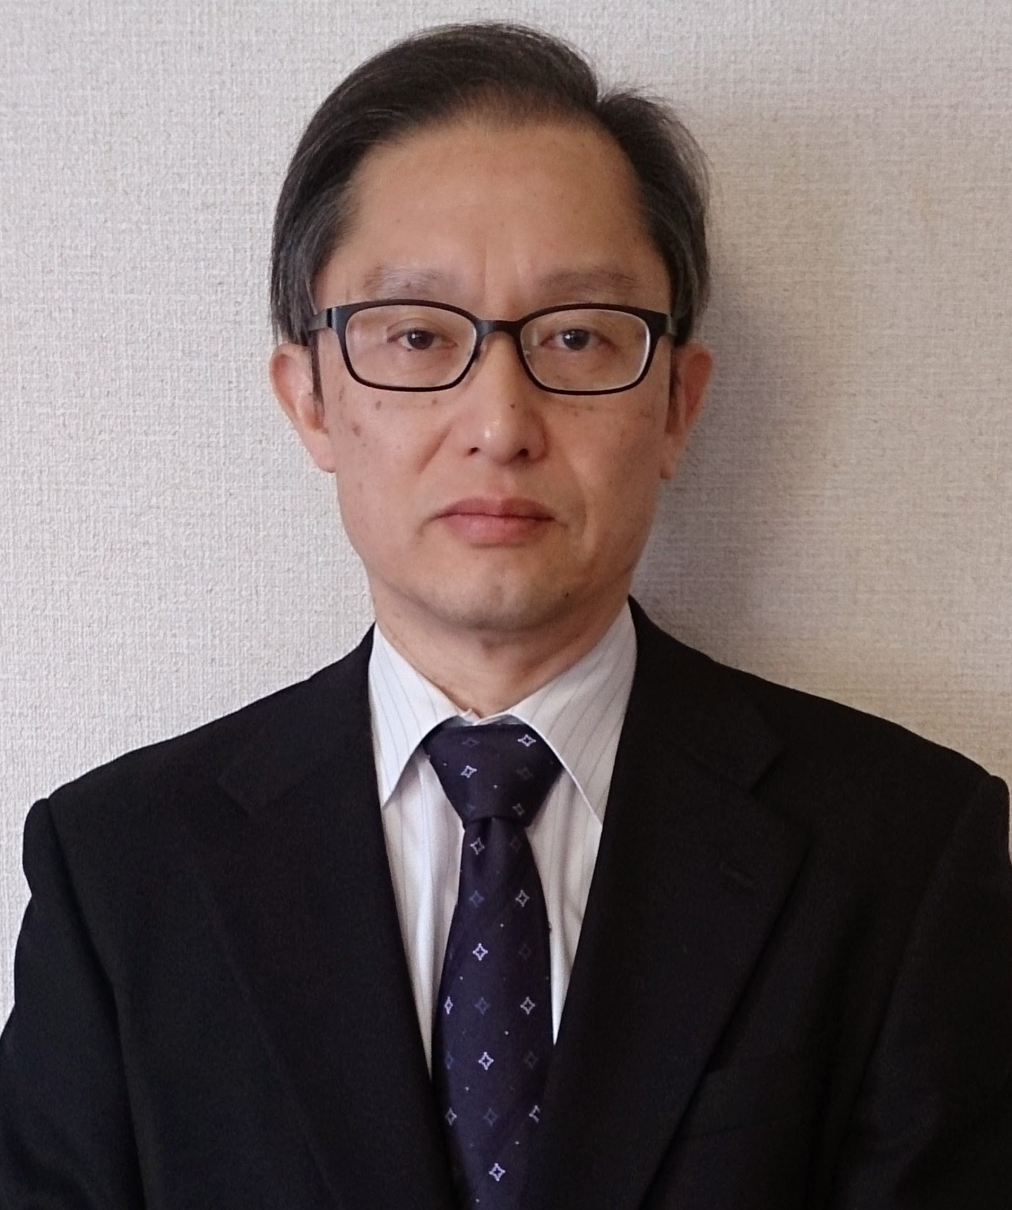



How Do Developers Utilize Source Code from Stack Overflow?
(Empirical Software Engineering)
JFP
Yuhao Wu
Shaowei Wang
Cor-Paul Bezemer
Katsuro Inoue
Notes:
https://www.google.co.jp/search?q=osaka+university+logo&num=20&source=lnms&tbm=isch&sa=X&ved=0ahUKEwigqYvtsOrdAhWbZt4KHQ5JAvUQ_AUIDigB&biw=1920&bih=938

Slide 2


Stack Overflow (S.O.) is a question and answer (Q&A) platform for developers
Ask
Ideas
What are the barriers for code reuse and how can we improve?
Answer
Code snippets
Notes:
https://streamdata.io/blog/streaming-stack-exchange-api/
https://www.flaticon.com/free-icon/programmer_560216

Slide 3
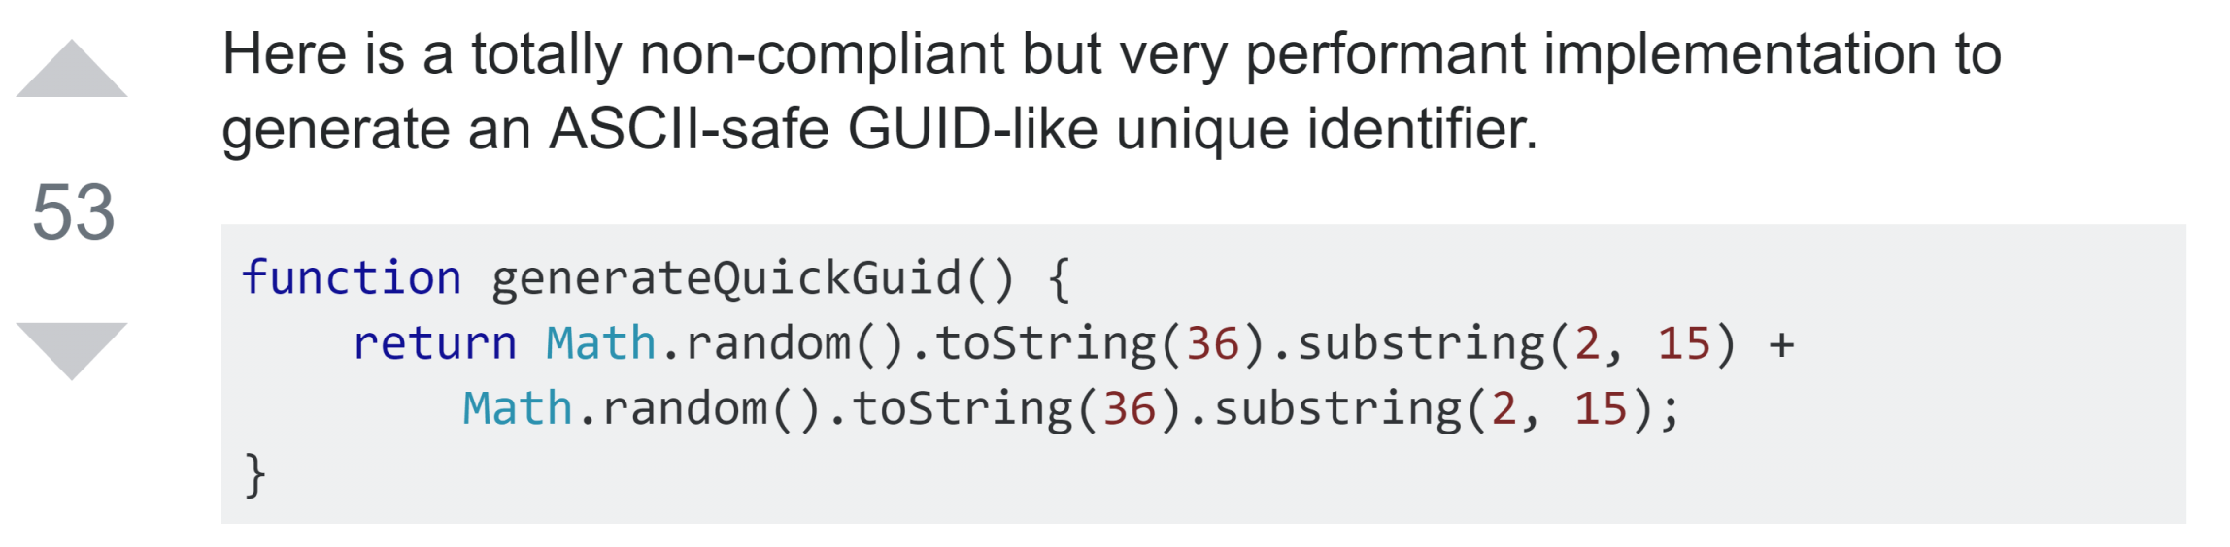
Developers reuse source code from S.O. posts
An answer on Stack Overflow
function generateID() {
return "avalon" +
Math.random().toString(36).substring(2, 15) +
Math.random().toString(36).substring(2, 15)
}
Source code in a GitHub project
Notes:
https://stackoverflow.com/questions/105034/create-guid-uuid-in-javascript/13403498#13403498
https://github.com/yinuoba/avalon/blob/master/avalon.js#L343

Slide 4

Structure of this study
Part I: Exploratory Study
How do developers reuse source code?
Part II: Survey
How do you think S.O. can be improved?
Responses
Notes:
https://www.supportdriven.com/github-logo/

Slide 5

Part I: Exploratory study
searchcode.com
4,878 source files
“stack overflow”
Filter
RQ1: modification frequency and reason
289 files
Analyze code reuse
RQ2: origin of code reuse
Notes:
https://www.flaticon.com/free-icon/search_722080#term=search%20icon&page=1&position=45

Slide 6
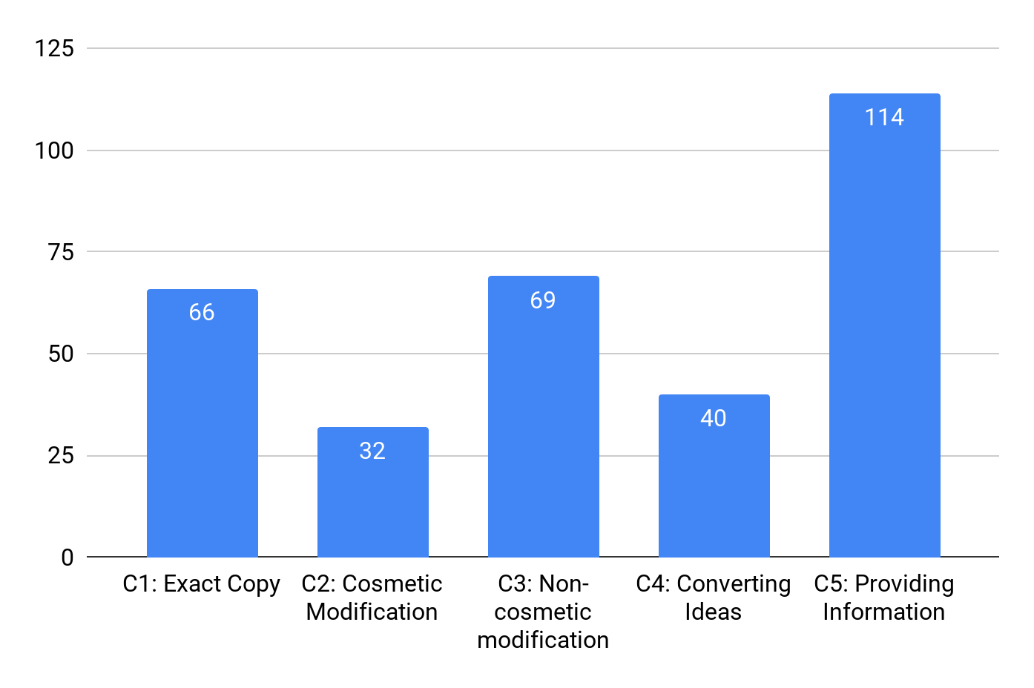
53% of the files that contain a reference to S.O. reuse source code from S.O.
32% of the reused source code snippets requires additional modification (C2+C3)
35%
22%
A summary of each answer might be helpful
21%
13%
10%

Slide 7
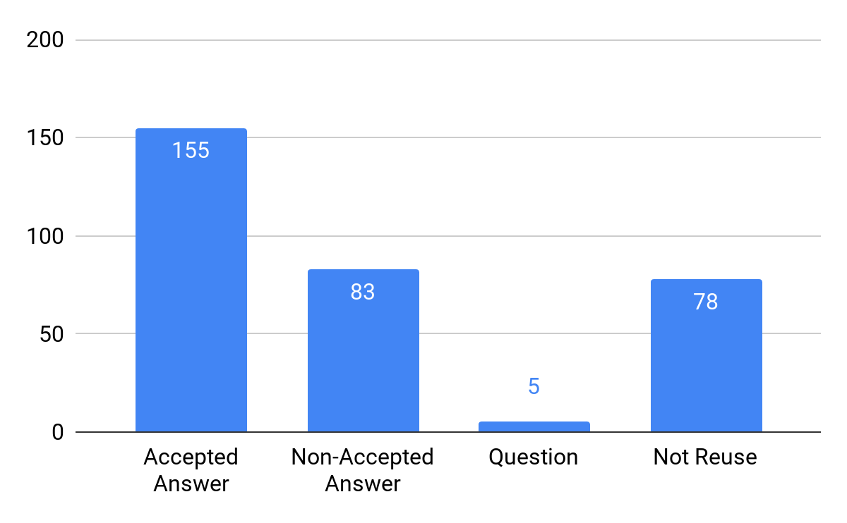
26% of the source code was reused from non-accepted answers
Developers adopt answers based on different needs: simplicity, correctness, efficiency, etc.
An advanced tagging system might be helpful
43%
26%
30%
1%

Slide 8
Part II: Large-scale survey on 400+ participants
Survey Questions
Experience
Type of project participated
...
Demography (7)
Difficulties in reusing source code
Opinions on OSS licenses
...
Barriers (10)
Suggestions (2)
Usefulness of proposed advanced tagging system
Any other suggestions
...

Slide 9



Three authors open coded the responses
Discussion
Draft schema A
Answers
Unified schema
Draft schema B
Review
Final schema
Notes:
https://www.flaticon.com/packs/kids-avatars
https://www.flaticon.com/free-icon/boy_163837
https://www.flaticon.com/free-icon/boy_163801
https://www.flaticon.com/free-icon/student_167750

Slide 10
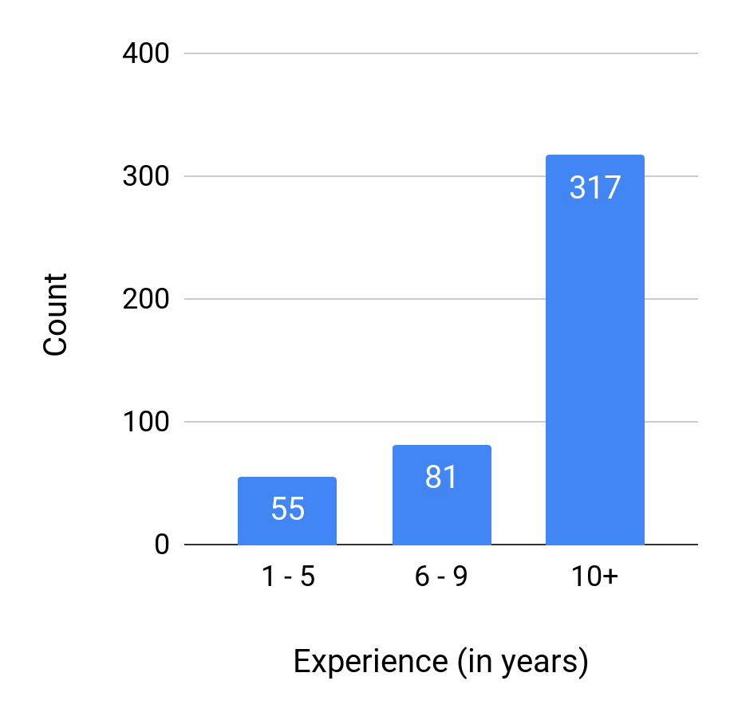
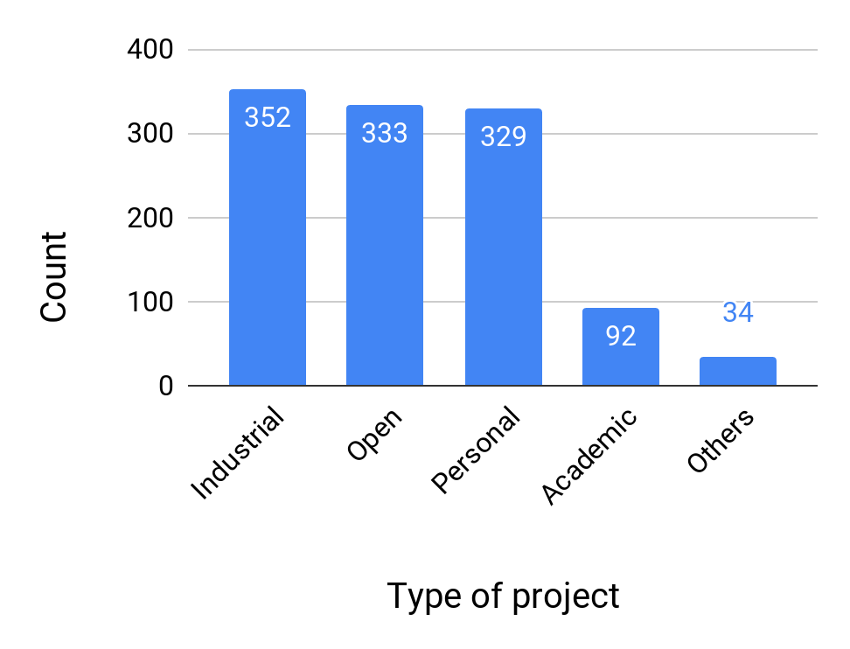
Most participants of our study are experienced developers
78%
74%
73%
70%
20%
8%
18%
12%
Distribution of programming experience
Distribution of type of projects the participants worked on

Slide 11
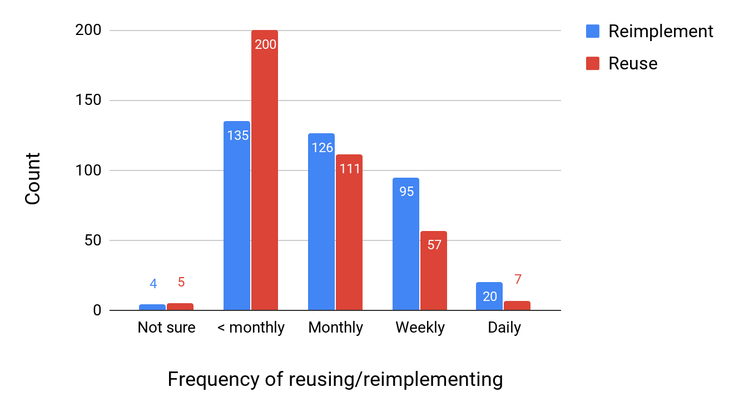
Developers reuse source code slightly more frequently than reimplement source code
53%
35%
33%
29%
25%
15%
1%
1%
5%
2%

Slide 12
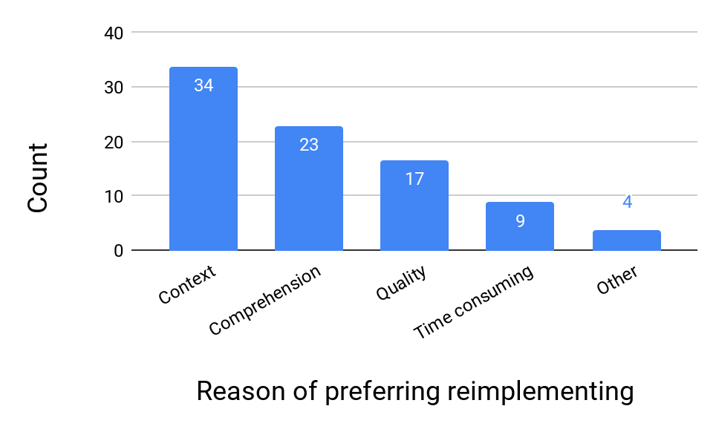
Improving code comprehension and code quality may have positive effects on code reuse
65%
44%
32%
17%
7%

Slide 13
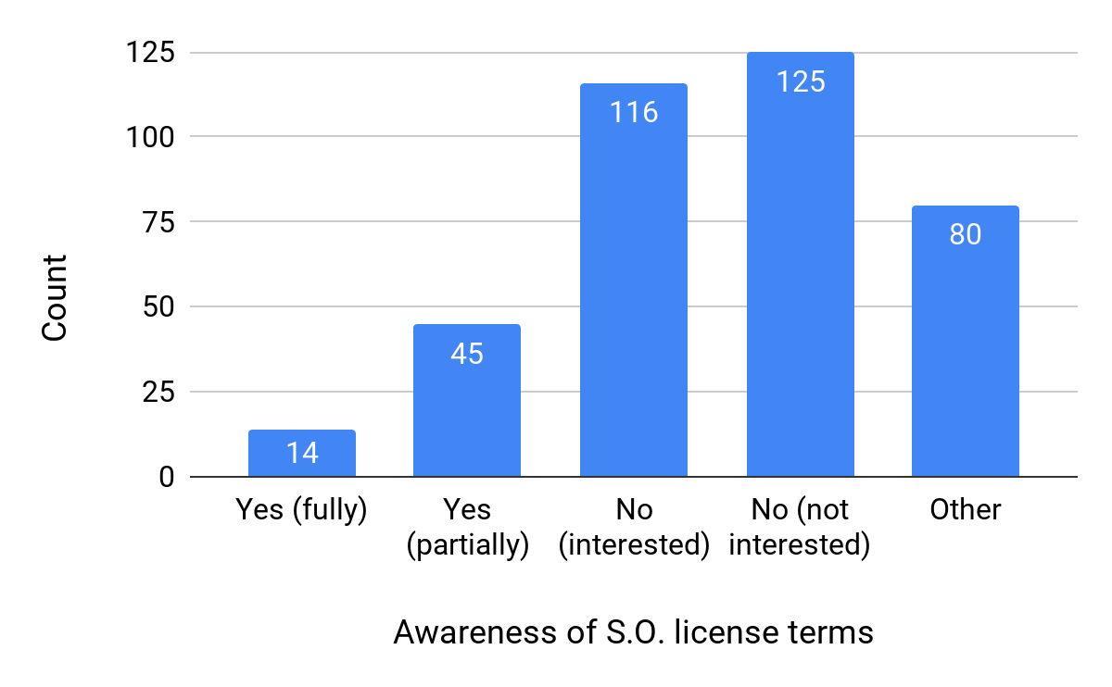
75% of the participants do not have a good understanding of license terms of the Q&A platform
33%
31%
21%
12%
4%
* S.O. adopts CC BY-SA 3.0 license, which is viral and requires attribution

Slide 14
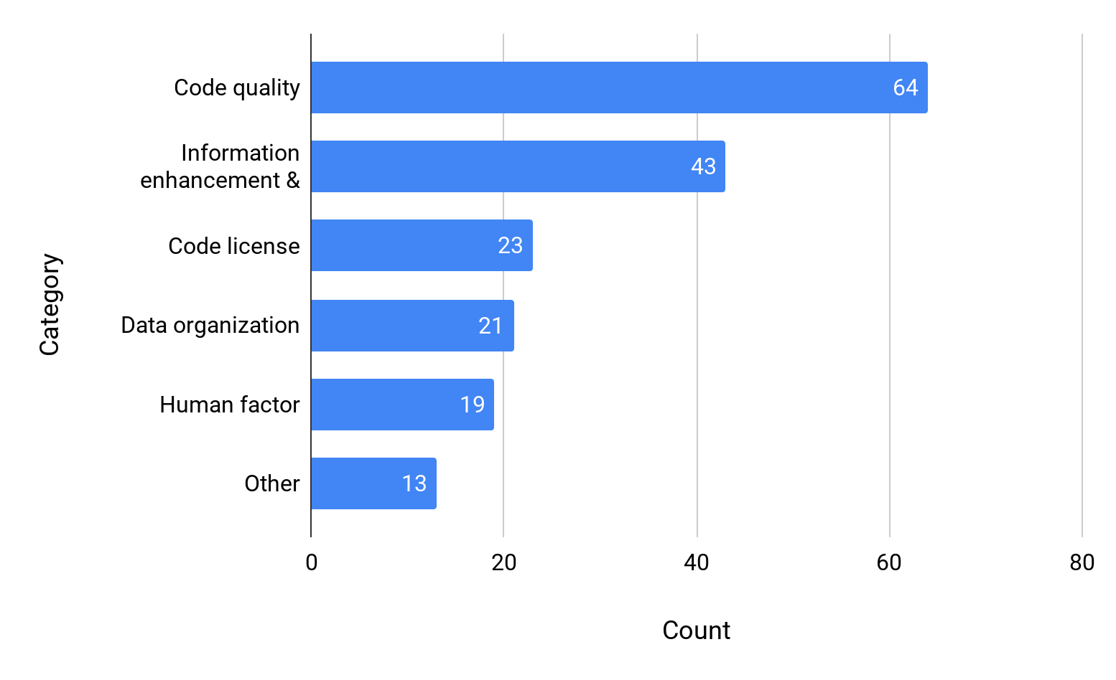
Most suggestions are on code quality
35%
24%
13%
12%
10%
7%

Slide 15
Suggestions: improving code quality
(35% of all categories)
Integrated validator
(42.2%)
Outdated code
(29.7%)
Answer quality
(17.2%)
Code review
(10.9%)
“Make date important in marking outdated code, and deprecate those snippets via the community”
“Better support for answers that are good, but out of date.”
“An inbuilt REPL environment for as many languages/ environments as possible.”
“In-browser code review and commenting similar to that provided by commercial code review tools.”

Slide 16
Suggestions: information enhancement & management
(24%)
Answer tagging
(37.2%)
Code evolution
(14.0%)
Resource linking
(11.6%)
Answer writing
(9.3%)
“Provide/require tagging of the version number(s) of the language [...]”
“Books suggestions based on questions.”
“where does the code come from and copied to, and also the revisions inside the platform”
“[...] it would be nice if it would be easier to ask
a good question [...]”

Slide 17
Suggestions: clearer and more permissive license
(13%)
Clearer license
(69.6%)
Permissive license
(30.4%)
“By far the most important requirement is clear licensing. Much of the code provided on such platforms is not currently usable because the license is unclear.”
“Let the user choose a more re-user-friendly license (e.g. copy without reference).”

Slide 18
Suggestions: better data organization
(12%)
Code searching/indexing
(47.6%)
Duplicate posts
(38.2%)
Comments
(14.3%)
“Source Code indexing for easier retrieval. It could also give the possibility to find example of usage functions.”
“Auto-suggest similar questions, particularly for questions that don't have answers.”
“Code in *comments* must be expressed better, than on Stack Overflow.”

Slide 19
Suggestions: human factor
(10%)
Better curator
(63.2%)
Gamication related
(36.8%)
“Base reputation on number of answers up-voted by others, not on personal activity.”
“Definitely curators for specific languages to rate answers in specific areas.”

Slide 20
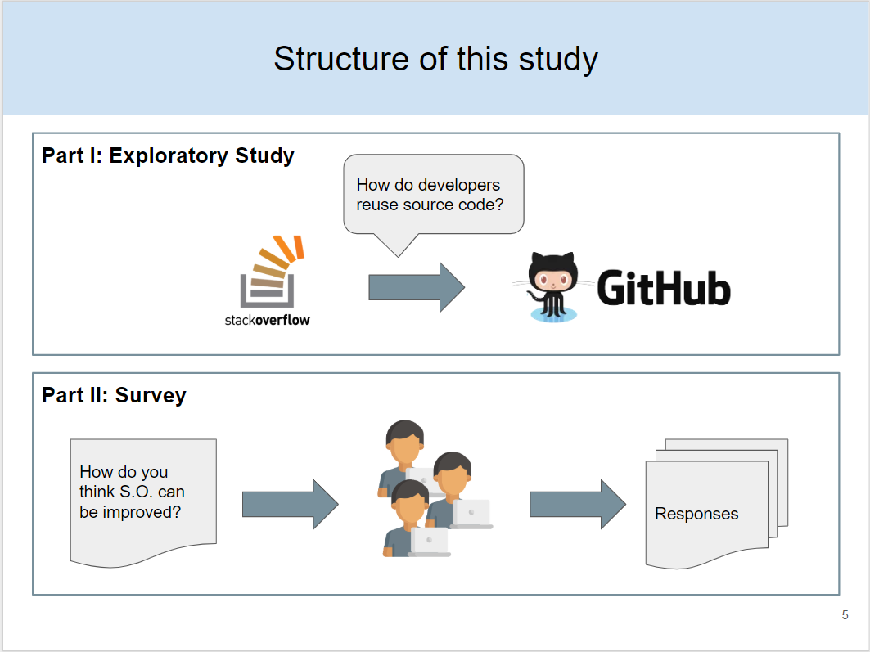
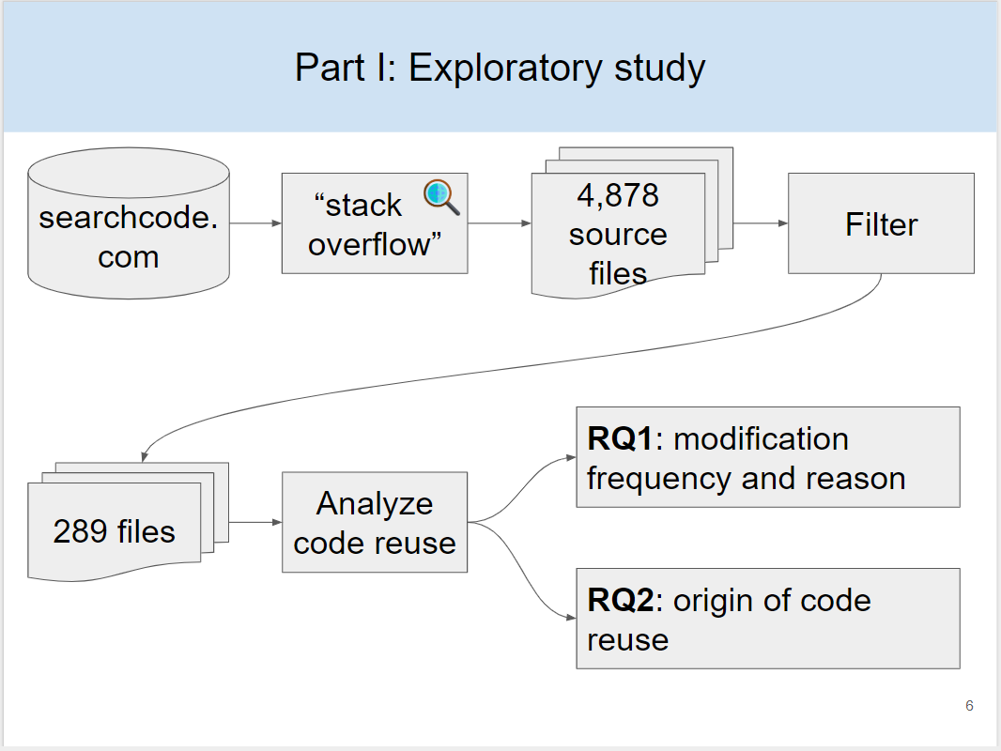
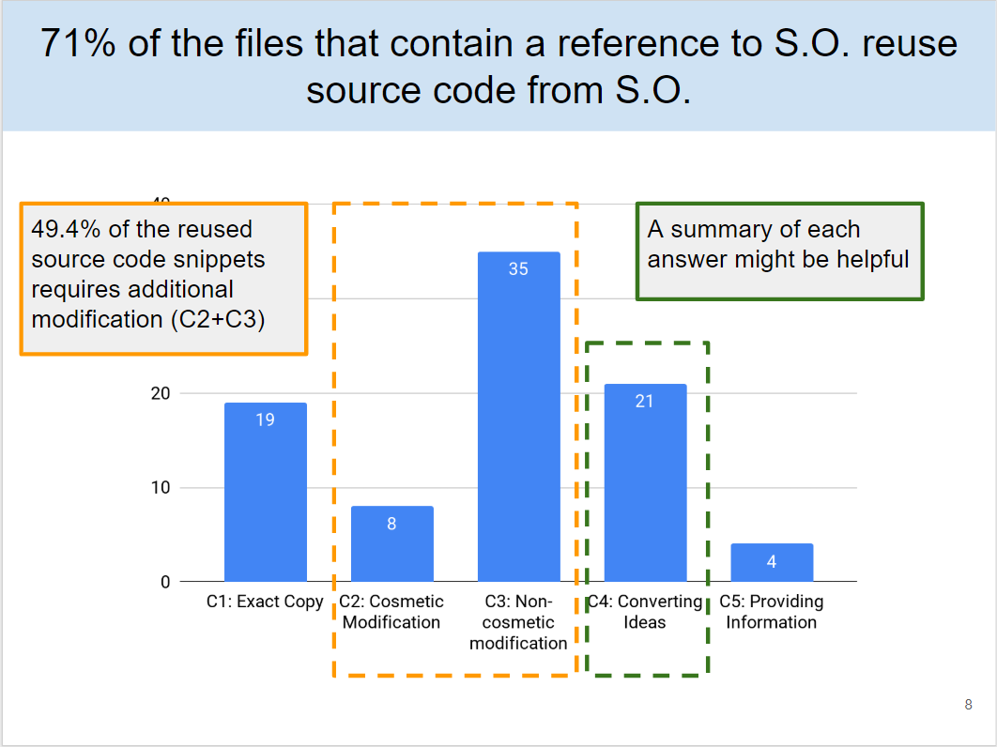
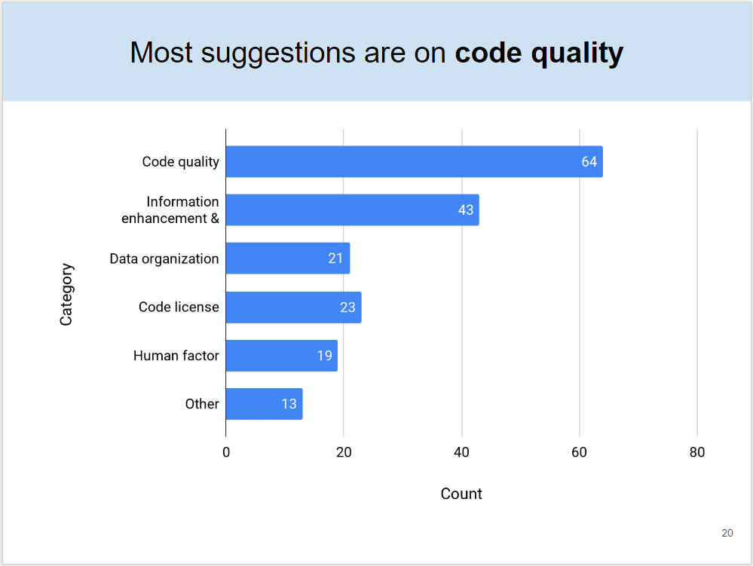

Slide 23
RQ1: How often and to what extent do developers need to modify source code from Stack Overflow in order to make it work in their own projects?

Slide 24
RQ2: From which part of the Stack Overflow post does the reused source code come?

Slide 25
RQ3: What are the preferences of developers when it comes to reusing code?

Slide 26
RQ4: What is the influence of the code license of Stack Overflow?

Slide 27
RQ5: How can code reuse be improved in next-generation Q&A platforms?

Slide 28
Research questions
Part I: Exploratory Study
RQ1: How often do developers modify source code from S.O.?
RQ2: From which part of the Stack Overflow post does the reused source code come?
Part II: Survey
RQ3: What are the preferences of developers when it comes to reusing code?
RQ4: What is the influence of the code license of Stack Overflow?
RQ5: How can code reuse be improved in next-generation Q&A platforms?

Slide 29
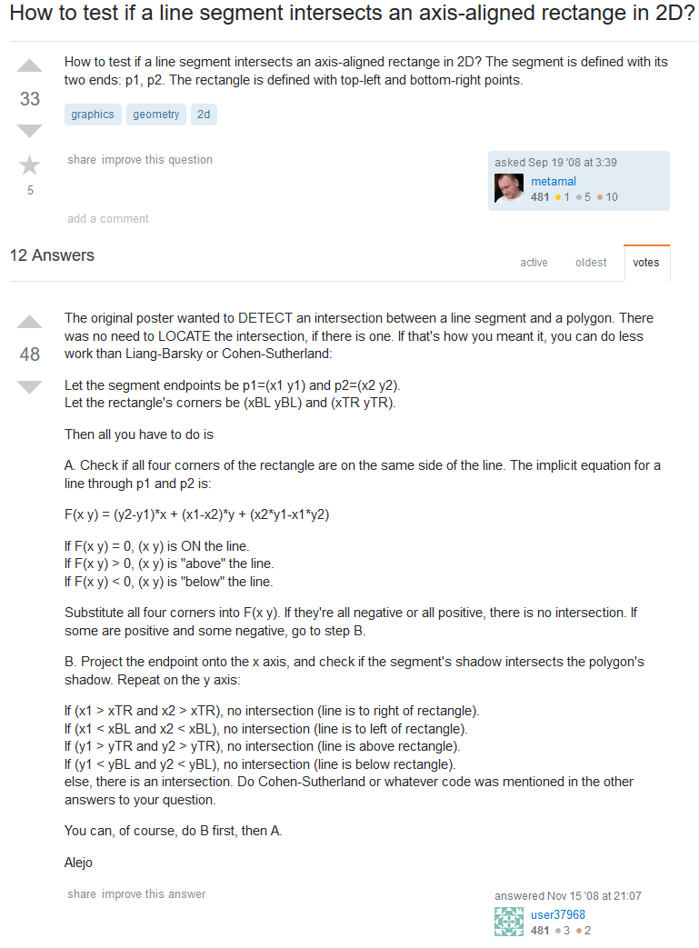
Developers reuse source code from S.O. posts
function linePosition(point) {
var x = point[0];
var y = point[1];
return (y2 - y1) * x + (x1 - x2) * y + (x2 * y1 - x1 * y2);
}
[...]
relPoses.forEach(function(relPos) {
if (relPos > 0) {
noPositive = false;
} else if (relPos < 0) {
noNegative = false;
} else if (relPos === 0) {
noZero = false;
}
}, this);
[...]
return !((x1 > this.right && x2 > this.right) ||
(x1 < this.left && x2 < this.left) ||
(y1 < this.top && y2 < this.top) ||
(y1 > this.bottom && y2 > this.bottom)
);
Rect.prototype.collideLine = function(p1, p2) {
var x1 = p1[0]; var y1 = p1[1];
var x2 = p2[0]; var y2 = p2[1];
function linePosition(point) {
var x = point[0];
var y = point[1];
return (y2 - y1) * x + (x1 - x2) * y + (x2 * y1 - x1 * y2);
}
[...]
var noNegative = true;
var noPositive = true;
var noZero = true;
relPoses.forEach(function(relPos) {
if (relPos > 0) {
noPositive = false;
} else if (relPos < 0) {
noNegative = false;
} else if (relPos === 0) {
noZero = false;
}
}, this);
if ( (noNegative || noPositive) && noZero) {
return false;
}
return !((x1 > this.right && x2 > this.right) ||
(x1 < this.left && x2 < this.left) ||
(y1 < this.top && y2 < this.top) ||
(y1 > this.bottom && y2 > this.bottom)
);
};
How to test if a line segment intersects an axis-aligned rectangle in 2D?
Stack Overflow
Source code in a GitHub project
Notes:
https://stackoverflow.com/questions/99353/how-to-test-if-a-line-segment-intersects-an-axis-aligned-rectange-in-2d/293052#293052
https://github.com/wd5/1-gamejs/blob/94220592f4d16bfd8ee269050bc352e66d4e8593/lib/gamejs.js#L469

Slide 30
Motivating example
How to test if a line segment intersects an axis-aligned rectangle in 2D?
Let the segment endpoints be p1=(x1 y1) and p2=(x2 y2).
Let the rectangle's corners be (xBL yBL) and (xTR yTR).
Then all you have to do is
A. Check if all four corners of the rectangle are on the same side of the line. The implicit equation for a line through p1 and p2 is:
F(x y) = (y2-y1)*x + (x1-x2)*y + (x2*y1-x1*y2)
If F(x y) = 0, (x y) is ON the line.
If F(x y) > 0, (x y) is "above" the line.
If F(x y) < 0, (x y) is "below" the line.
Substitute all four corners into F(x y). If they're all negative or all positive, there is no intersection. If some are positive and some negative, go to step B.
B. Project the endpoint onto the x axis, and check if the segment's shadow intersects the polygon's shadow. Repeat on the y axis:
If (x1 > xTR and x2 > xTR), no intersection (line is to right of rectangle).
If (x1 < xBL and x2 < xBL), no intersection (line is to left of rectangle).
If (y1 > yTR and y2 > yTR), no intersection (line is above rectangle).
If (y1 < yBL and y2 < yBL), no intersection (line is below rectangle).
else, there is an intersection. Do Cohen-Sutherland or whatever code was mentioned in the other answers to your question.
Rect.prototype.collideLine = function(p1, p2) {
var x1 = p1[0]; var y1 = p1[1];
var x2 = p2[0]; var y2 = p2[1];
function linePosition(point) {
var x = point[0];
var y = point[1];
return (y2 - y1) * x + (x1 - x2) * y + (x2 * y1 - x1 * y2);
}
[...]
var noNegative = true;
var noPositive = true;
var noZero = true;
relPoses.forEach(function(relPos) {
if (relPos > 0) {
noPositive = false;
} else if (relPos < 0) {
noNegative = false;
} else if (relPos === 0) {
noZero = false;
}
}, this);
if ( (noNegative || noPositive) && noZero) {
return false;
}
return !((x1 > this.right && x2 > this.right) ||
(x1 < this.left && x2 < this.left) ||
(y1 < this.top && y2 < this.top) ||
(y1 > this.bottom && y2 > this.bottom)
);
};
Stack Overflow answer
Source code in a GitHub project
Notes:
https://stackoverflow.com/questions/99353/how-to-test-if-a-line-segment-intersects-an-axis-aligned-rectange-in-2d/293052#293052
https://github.com/wd5/1-gamejs/blob/94220592f4d16bfd8ee269050bc352e66d4e8593/lib/gamejs.js#L469

Slide 31
Part II: Survey
RQs
  RQ3: preference of reusing or reimplementing source code
  RQ4: influence of OSS license
  RQ5: how can Q&A platforms be improved
Survey questions
  Demography
    Experience
    Type of project participated
  Barriers
    Difficulties in reusing source code
    Opinions on OSS licenses
  Suggestions
    Usefulness of proposed advanced tagging system
    Any other suggestions

Slide 32
How do developers utilize S.O. posts
ID | Name | Count | Perc.
C1 | Exact Copy | 19 | 21.8%
C2 | Cosmetic Modification | 8 | 9.2%
C3 | Non-cosmetic modification | 35 | 40.2%
C4 | Converting Ideas | 21 | 24.2%
C5 | Providing Information | 4 | 4.6%

Slide 33
Conclusion
Part I: Exploratory Study
RQ1: 78% of the reused source code is modified (e.g. refactoring, complete rewriting)
RQ2: 26% of the developers reuse source code from non-accepted answers.
Part II: Survey
RQ3: More developers prefer reimplementing than reusing source code.
RQ4: Developers do not understand code license enough, which cause potential license issues.
RQ5: Q&A platforms should pay attention to: 1) code quality 2) information management 3) data organization 4) license 5) human factor.

