Slide 1
PADLA: A Dynamic Log Level Adapter Using Online Phase Detection
Tsuyoshi Mizouchi
Osaka University
Kazumasa Shimari
Osaka University
Takashi Ishio
NAIST
Katsuro Inoue
Osaka University
Notes:
My name is Tsuyoshi Mizouchi.
I am a master course student at Osaka University, Japan.
I would like to talk about our tool, named PADLA.
It is a dynamic log level adapter.

Slide 2
Logging
Logging is a common practice …
Logging libraries can label each message
Notes:
Logging is a common practice to record run-time information.
You can use logging libraries to label each message and control which log should be output.

Slide 3
Logging Library
Logging libraries (Apache Log4j[1], etc) provide log levels
to control the amount of logs
fatal
error
warn
info
debug
trace
High Level
Low Level
Important
Small amount
Detailed
Huge amount
Choose the log threshold
Higher levels are still outputted
[1] Apache Software Foundation: Apache Logging Services -Log4j, http://logging.apache.org/log4j
Notes:
Logging libraries like apache log4j provide log levels to control the amount of logs
In general , a “high level” is labeled with important information like error messages.
A “low level” is labeled with detailed information like the value of variables.
The amount of log messages of “low level” is huge.
When using a logging library, you choose the log level threshold. Then, the specified level and higher ones are outputted.
For example, if you choose info level as the threshold, you can get info, warn, error, fatal level log messages.

Slide 4
Motivation
Developers have to choose a single log level threshold
for an execution
For debugging
Detailed information
But
Huge amount of logs
Our idea
Recording detailed logs
only while irregular behavior is happening
Notes:
Unfortunately, developers have to choose a single log level for an execution.
For debugging, you need detailed log messages of irregular behavior, so you need low level information.
But, the performance overhead and huge amount of log messages caused by low level should be avoided.
So, our idea is making a tool to record detailed log messages only while irregular behavior is happening.

Slide 5
PADLA: Phase-Aware Dynamic Log Level Adapter
PADLA dynamically adjusts the log level threshold
of a running system
Logging
Higher Level
(Not detailed)
Lower Level
(Detailed)
Higher Level
(Not detailed)
Phase
detection [2]
Regular behavior
Irregular behavior
Regular behavior
Threshold was changed by PADLA
[2] S. P. Reiss, “Dynamic detection and visualization of software phases,” in Proceedings of the Third International Workshop on Dynamic Analysis,2005, pp. 1–6.
Notes:
Our tool named PADLA dynamically adjusts the log level threshold of a running system.
PADLA represents Phase-Aware Dynamic Log Level Adapter.
It monitors behavior of the target system and recognizes whether an execution phase is regular or irregular using “Phase detection”.
In the regular behavior, PADLA records logs with a higher level which is not detailed.
In the irregular behavior, changes the log level threshold and records logs with a lower level which is detailed.
In the next slides, I am going to explain the “Phase detection”

Slide 6
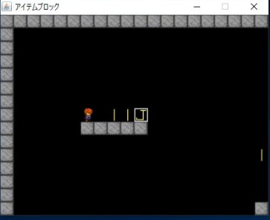
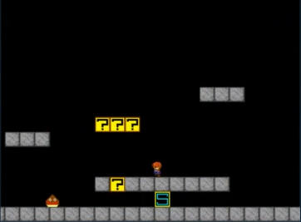
Phase Detection (1/2)
① Collect performance vectors of regular behavior
(length of each interval is 0.5s)
Known vectors
Start up (Interval 0)
Vector 0
Vector 1
…
[A, B, C] = [0.3, 0.1, 0.1]
Play (Interval 1)
Execution time
of each method
[A, B, C] = [0.1, 0.0, 0.4]
Notes:
Phase detection judges previously learned phase as regular behavior and unknown phase as irregular behavior.
At first, phase detection collects performance vector of regular behavior as known vectors.
In the current implementation, the performance vector is execution time of each method every 0.5s.
After this learning, PADLA does not change the log level threshold in the known phases

Slide 7
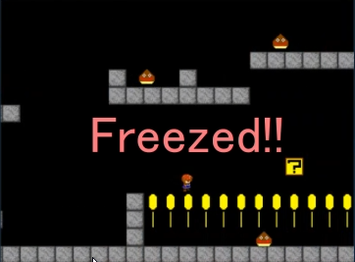
Phase Detection (2/2)
② Compare a new vector with known vectors by
cosine similarity
Interval N
Known vectors
Vector 0
Similarity = 0.3
Compare
Vector 1
Similarity = 0.0
…
[A, B, C] = [0.0, 0.5, 0.0]
Similarity < 0.95
This interval is an unknown phase
PADLA starts detailed logging
Notes:
Second, phase detection compares a vector of a new interval with known vectors using cosine similarity.
In this example, cosine similarity is 0.3 and 0 and the threshold is 0.95.
So, if the similarity is less than 0.95, this interval is judged as an unknown phase by the phase detection.
If the phase is unknown, PADLA starts detailed logging.

Slide 8
Summary
PADLA dynamically adjusts the log level threshold of a running system
It records detailed logs only while irregular behavior is happening
It employs “Phase detection” to detect irregular behavior automatically
Demo movie:
https://youtu.be/qoqilsbhD38
GitHub:
https://github.com/244-penguin/PADLA
Notes:
To summarize:
PADLA dynamically adjusts the log level threshold of a running system
It records detailed log messages only while irregular behavior is happening
It employs “Phase detection” to detect irregular behavior automatically
If you want to know more, please come to our poster

