Slide 1
Proactive Clone Recommendation System for Extract Method Refactoring
Norihiro
Yoshida
Seiya
Numata
Eunjong
Choi
Katsuro
Inoue

Slide 2
Code clone (duplicated code)
Developers tend to write clones unintentionally
even in the case that it is easily avoidable.
Code Clone
copy and paste
File A
copy and paste
File B

Slide 3
Clone Refactoring
It performs “Extract Method”
and then merges clones into a single method.
Refactoring
call
Before
After

Slide 4
Developers are motivated to refactor clones! [Alomar et al., IWoR 2019]

Slide 5
Related Works: Tool Support for Clone Refactoring
Tairas and Gray [IST ‘12]
extension of refactoring engines to handle variation of clones
Meng et al. [ICSE ‘15]
clone refactoring tool based on systematic edit
Mazinanian et al. [ICSE ‘16]
a part of the refactoring tool JDeodorant
refactorability analysis [TSE ‘15]

Slide 6
Strike while the iron is hot!
Only hot clones are refactored in industry
In industry, cost of clone refactoring cannot be ignored.
Regression test after refactoring takes much cost.
Industrial developers do not touch source code after a large-scale system test for releasing a major version.
Active support of clone refactoring is needed.

Slide 7
Proposed Plug-in
It detects ‘Extract Method’ on the fly
and then recommend the corresponding clones.
Phase1: Monitor & Detection
Phase2: Clone Recommendation
recommends
Extract
Method
clone
clone
clone
new m.
clone
new m.
Online analysis
clone
clone
Monitors code modification on the fly and detects ‘Extract Method’
Recommends developers to merge the other corresponding clones at same time
Notes:
そこで，その問題点を解決するために，Eclipseプラグインにより以下の環境を提案します．提案環境は大きく分けて2つの機能を有しており，1つ目の機能では，Eclipseを利用している開発者の作業内容をモニタリングし，その中からメソッド抽出リファクタリングの集約パターンを見つけます．そして，2つ目の機能では，そのメソッド抽出リファクタリングが行われたコード片のコードクローンを検出し，同時に集約するように推薦します．これにより，開発者はIDEと切り離した作業が必要なく，開発の際中に同時集約候補を知ることができ，見落としなく，少ないコストでメソッド抽出リファクタリングを行えると考えます．(3:00)

Slide 8
Architecture of the proposed plug-in
Diff
analysis
AST-level diff
Refactoring detection
developer
Clone detection
(CCFinderX)
Keystroke monitoring
Clone
detection
result
Refactoring
detection
result
Editor
Clones of
refactored code
Clone recommendation
Notes:
ここからそれぞれのステップについて説明します．まずはステップ１のキー入力追跡です．(5:04)

Slide 9
Keystroke and diff analyses
Identifies the insertion/deletion of one or greater lines.
Keeps AST-based diff once the insertion/deletion is identified
Deletion of
a code block
Insertion of
a method
declaration
…

Slide 10
Detection of “Extract Method” Refactoring
Insertion of method declaration
$$\left(Insert, MethodDeclaration\right)$$
$$∧$$
$$\left(Delete, code__block\right)$$
$$∧$$
$$\left(Insert, MethodInvocation\right)$$
$$where$$
$$position\left(code__block\right)=position\left(MethodInvocation\right)$$
$$∧name\left(MethodDeclaration\right)=name(MethodInvocation)$$
Block deletion
Insertion of method invocation
Block and the method invocation are at the same position.
Declared and invoked methods are the same names.
Notes:
Here is the formula of the conditions of Extract method refactoring used in this study. There are five conditions in this formula,
The first one is the insertion of method declaration. The second one is block deletion. The third one is the insertion of method invocation,
The forth one is the block and the method invocation are at same position. The declared and invoked method are same name.
When the all of 5 conditions are satisfied, the proposed plugin regards the code modification as ”Extract Method” refactoring.

Slide 11
Clone detection & recommendation
Clone Detection
Performs clone detection when a method declaration is inserted in Eclipse AST
Uses CCFinderX
High-speed token-based clone detection tool
Clone Recommendation
Recommend code clones of the code fragment which is extracted by ”Extract Method” refactoring
clone
clone
clone
clone
recommends
clone
new m.
clone

Slide 12
Start the monitoring of clone refactoring by selecting “monitoring refactoring” menu
A pair of code clones
List of recommend clones
Java editor of Eclipse
Notes:
Here is the screenshot of the proposed plugin. An user starts the monitoring of clone refactoring by selecting “by the monitoring refactoring menu.
The view on the right-hand side shows the list of recommend clones based on the analysis of code modification in the Java editor of Eclipse.
The Java editor on the left-hand side includes a pair clones.

Slide 13
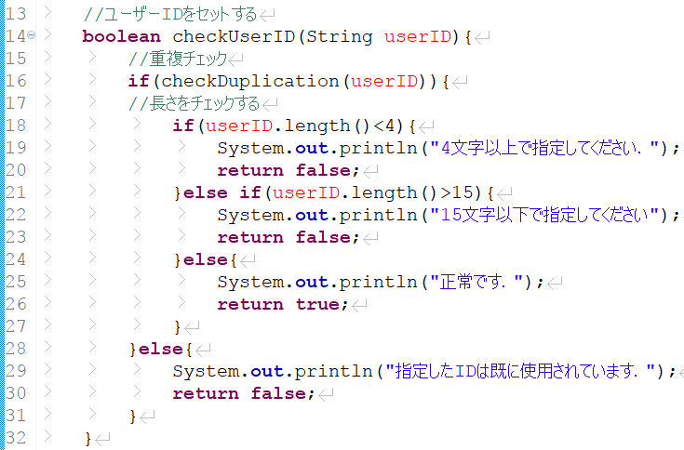
Extract Method
Detects clones of the code which is extracted by “Extract Method”
Notes:
Here we assume a user performs “Extract Method” refactoring as you can see in the left-hand side on the slide. Then, the proposed plug-in detects clones of the code fragment is extracted by “Extract Method”refactoring as you can see on the right-hand side of the slide.

Slide 14
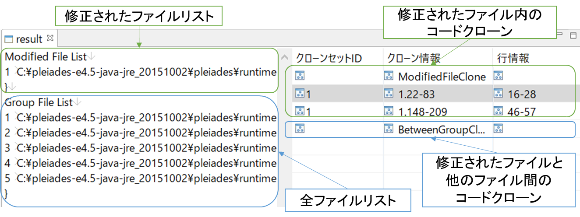
A list of modified files
A list of code clones in the modified file
Clone set ID
Clone set info.
Line numbers
A list of code clones in the other file
A list of all files
Notes:
At the same time, the list of recommend clones is shown in the right-hand side of the result view.
Once a user selects one of them …

Slide 15
Highlighted code clone
Notes:
The recommend clone is highlighted in the Java Editor of Eclipse.

Slide 16
Summary & Future work
We proposed a proactive clone recommendation system for extract method refactoring.
monitors code modification on the fly and detects ‘Extract Method’
recommends developers to merge the corresponding clone to the new method
We plan to apply other “Extract Method” detection technique and then perform a large-scale user study.

