Slide 1


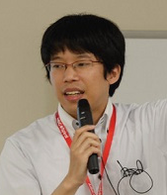
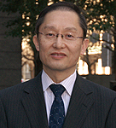

Near-Omniscient Debugging for Java
Using Size-Limited Execution Trace
Kazumasa Shimari
Osaka University
Takashi Ishio
NAIST
Tetsuya Kanda
Osaka University
Katsuro Inoue
Osaka University
Notes:
Thank you for coming.
My name is Kazumasa Shimari.
I am a Ph.D. student at Osaka University, Japan.
I would like to talk about our tool, Near-Omniscient Debugging.

Slide 2
Logging
Execution
Failure!
Insufficient information for debugging.
Log File
Notes:
First, I explain the background. Logging is a common practice for debugging.
Once the software starts the execution, it records log, log … so many logs.
But, a log file is not always perfect.
In this example, if the failure occurred at this point, the developer needs detailed behavior in this point, but there are no log messages.
So this log file is insufficient to debug this failure.

Slide 3
Omniscient Debugging
Execution
Record all instructions
Visualize the data flow
Replay the execution
Log File
Huge amount of logs (e.g.,10MB/s[1])
[1] Guillaume Pothier, Eric Tanter, and Jose Piquer. “Scalable omniscient debugging”. In Proc. of the 22nd ACM SIGPLAN Conference on Object-Oriented Programming Systems and Applications , pp. 535--552, 2007.
Notes:
To deal with this problem, omniscient debugging is proposed.
Its idea is very simple.
Omniscient debugging records all software instructions in the execution.
Using the log file, the developer can conduct detailed analysis such as visualizing the dataflow or replaying the execution.
So, when the failure occurred at any point, developers can debug the problem.
But this method is expensive because of log file size.
One implementation records logs at 10MB/s, so it requires a huge storage.

Slide 4
Log Reduction
A log file contains many repetitions
DaCapo Benchmarks[2]
Some instructions are executed 10+ million times
66% of instructions are executed at most 64 times
Remove the log data
for frequently executed instructions
[2] Blackburn et al. “The DaCapo Benchmarks: Java Benchmarking Development and Analysis”, : In Proc of the 21st annual ACM SIGPLAN conference on Object-Oriented Programing, Systems, Languages, and Applications, 2006
Notes:
So we would like to reduce the log file size.
A log file is huge because it contains many repetitions.
In case of DaCapo Benchmarks, some instructions are executed more than 10 million times.
On the other hand, 66% of instructions are executed at most 64 times.
From this observation, we remove the log data for repeated instructions.
It significantly reduces the log file size while keeping logs for most of the instructions.

Slide 5
Near-Omniscient Debugging
Proposed
Recording
Time Series
void methodA (int var) {
var = methodB(var);
while (var > 0)
var = methodC(var);
System.out.println(var);
}
1
1
2
2
3
5
7
9
11
13
15
17
17
4
6
8
10
12
14
16
16
18
18
19
19
Notes:
Based on the idea, we propose “Near”-Omniscient Debugging.
This is a small program. The left part is source code and right part is the execution order.
In the conventional omniscient debugging, we record all instruction. but the recording size is very huge.
So, in our near omniscient debugging, we record the latest information at each instruction.
Using this technique, we can record information at all instructions.
And our technique limits recording at repeated instructions.
If we want to record more information at each instruction, we can change the recording buffer size at each instruction like this.

Slide 6
Near-Omniscient Debugging
Proposed
Recording
Time Series
void methodA (int var) {
var = methodB(var);
while (var > 0)
var = methodC(var);
System.out.println(var);
}
1
1
2
2
3
5
7
9
11
13
15
17
15
17
4
6
8
10
12
14
16
14
16
18
18
19
19
maximum log file size : 12
6 instructions * size 2 buffers
Notes:
And, if we know the number of instructions in the execution, we can control the maximum log size.
In this example, there are six instructions, and each instruction has size two buffers.
So the maximum log file size is twelve.
That’s our near-omniscient debugging technique.

Slide 7
Near-Omniscient Debugging
DaCapo Benchmarks[2]
File size:
  43.5GB → 4.1MB (max 64 times / inst.)
Accuracy of data dependencies:
precision 0.9, recall 0.8
Notes:
We conducted an experiment with DaCapo Benchmarks and confirmed high reduction rate and high accuracy.
Comparing with conventional omniscient debugging, our technique reduced the log file size 40GB to 4MB.
The log file still keeps data dependencies with high accuracy. Precision is 0.9 and recall is 0.8.

Slide 8
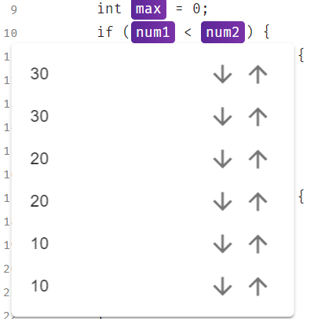

Trace Viewer
Show recorded variable values
Demo
Notes:
At last, I explain our trace viewer.
This viewer shows recorded variable values by hovering our mouse cursor on a highlighted variable.
In this figure, hovering mouse cursor on a variable num1, we can see values.
OK, I’ll show the actual viewer.
This is getmax method. It takes three parameters and returns the maximum value of the given parameters.
This method has been executed six times so hovering cursor shows the six values.
If we want to focus on the particular execution, we can filter the execution from here by clicking this arrow.
In this case, we focus on the last execution.
After the clicking, we can see the filtered execution.
Some highlightings disappeared because they are not executed in the filtered execution.
We can focus on any interval.

Slide 9
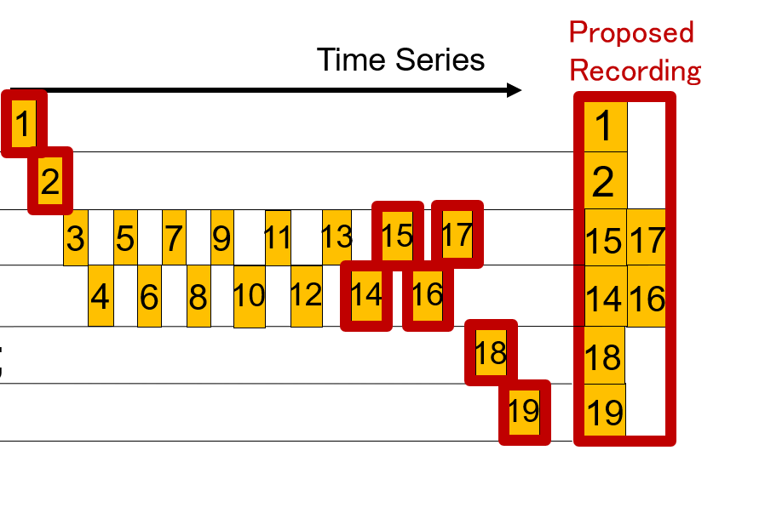
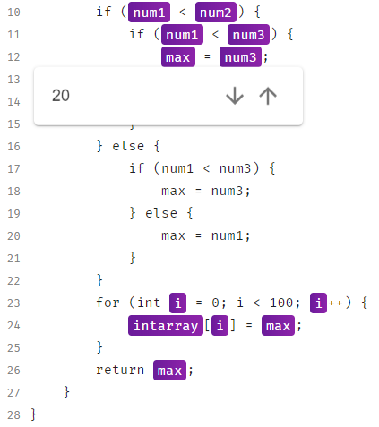
Summary
Near-Omniscient Debugging
Recording
Visualizing
Notes:
In summary, we propose near-omniscient debugging.

Slide 10

Our Demonstration Website
Online Demo and tools are available!
http://osku.jp/k0700
Notes:
Online demo is available on our website.
Thank you for listening.

