Slide 1

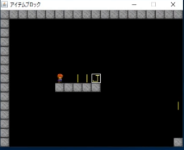
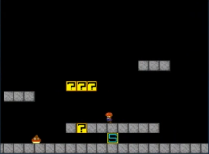
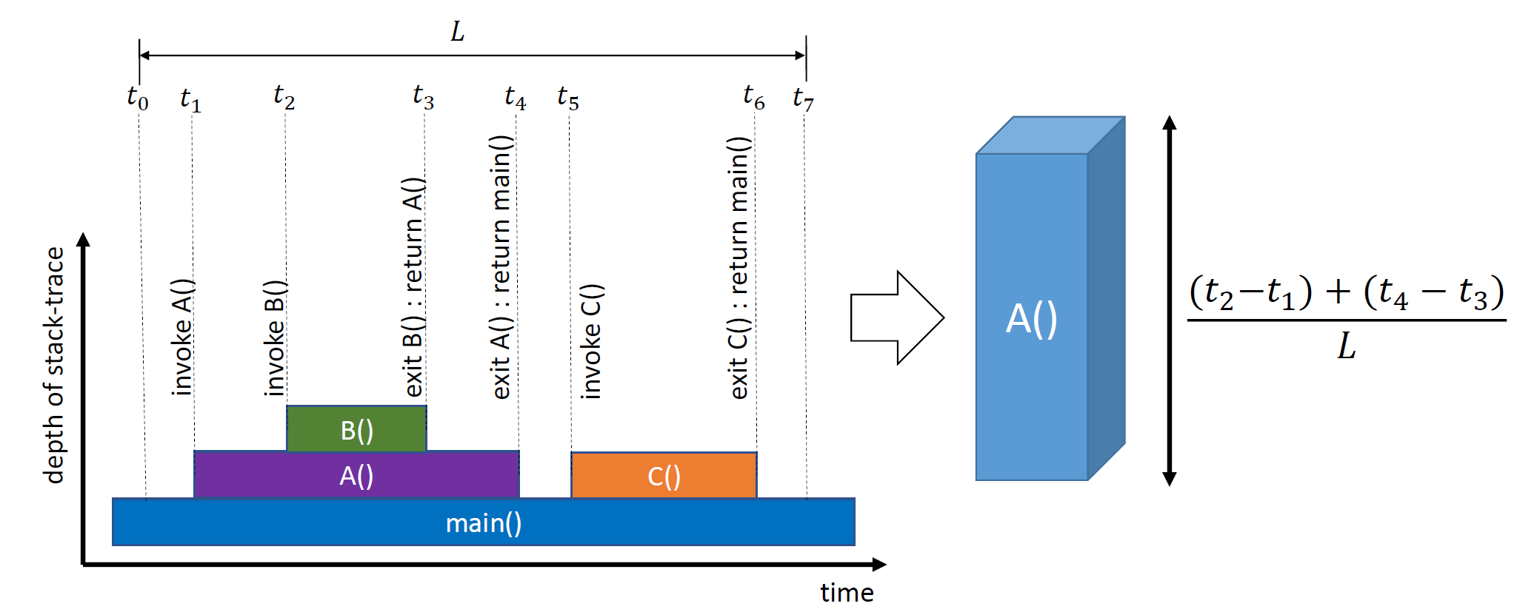
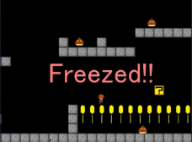
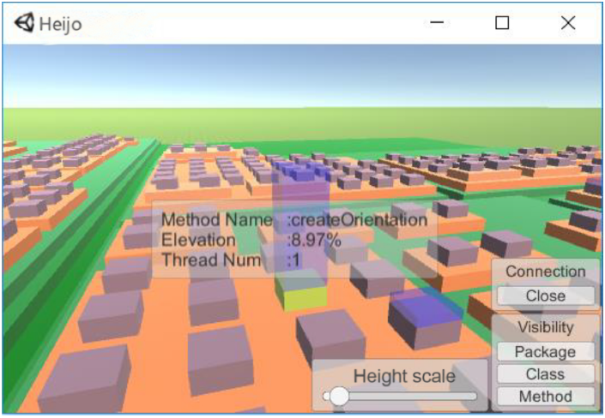
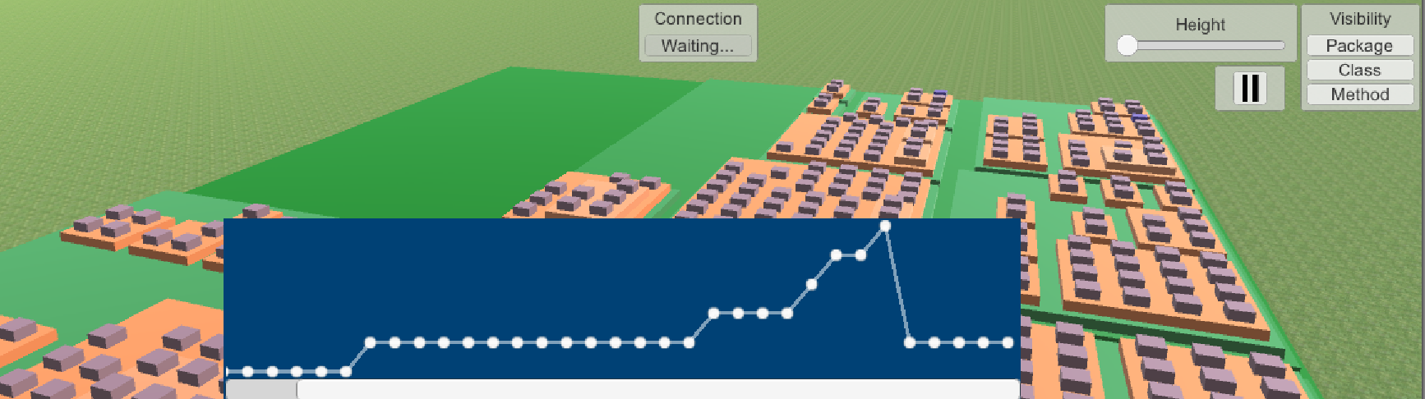
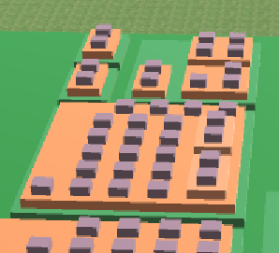
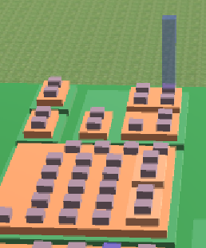
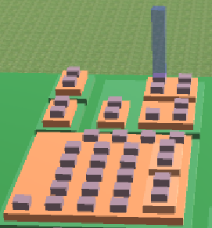
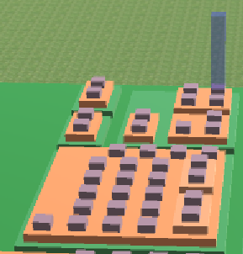
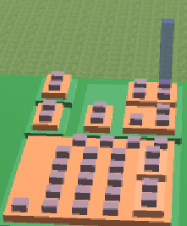
Visualizing Phase Transition for
Real-Time 3D Profiler
Jonathan Komala‡†, Tetsuya Kanda†, Tsuyoshi Mizouchi†, Katsuro Inoue†
†Osaka University, Japan ‡UC Irvine, CA, USA
Work done at Osaka University as a summer internship
Existing research 1: Heijo[1]
Existing research 2: PADLA[3]
A real-time 3D Java profiler with city view
Dynamic log-level adapter with phase detection[4]
Java Program
Agent
① Learning
② Detection
Start up
Known vectors
Play
Vector 0
(Start up)
✓
methodA: 0.3s
methodB: 0.1s
methodC: 0.1s
[0.3, 0.1, 0.1]
Vector 1
(Play)
[0.1, 0.0, 0.4]
Play
✗
Freeze
Figures from [2] ▴‣
Irregular
[0.1, 0.0, 0.4]
[0.0, 0.5, 0.0]
Change Log Level
Higher Level
(Not detailed)
Lower Level
(Detailed)
Proposed: Monitoring performance in real-time with city view
Problem: Hard to compare current status with past ones
Proposed: Recording detailed logs when irregular behavior is detected
Problem: No monitoring UI for phase detection
[1] K. Ogami et al., “Using High-Rising Cities to Visualize Performance in Real-Time,” VISSOFT2017, pp. 33-42.
[2] K. Ogami et al., “Heijo: A Real-time Profiler for Java and Android Applications with City-like Visualization of Dynamic Code Executions ,” Computer Software, 2019, vol.36, no.2, pp.93-105 (in Japanese)
[3] T. Mizouchi et al., “PADLA: A Dynamic Log Level Adapter Using Online Phase Detection,” ICPC2019, pp. 135-138.
[4] S. P. Reiss, “Dynamic detection and visualization of software phases,” WODA2005, pp. 1–6.
Integrate the phase detection result into Heijo
Allows users to see both phase changes and Heijo city
Graph View
Updating current phase in real-time
Easy to find phase transitions
Scrollbar to check past phases
New phase!
Returns to the second phase!
Roll Back
Clicking circle to reproduce the Heijo city status on specified phase
Easy to compare
This work was supported by JSPS KAKENHI Grant Numbers JP18H04094, JP19K20239

