Slide 1







Clone Notifier:
Developing and Improving the System to Notify Changes of Code Clones
Shogo
Tokui
Norihiro
Yoshida
Eunjong
Choi
Katsuro
Inoue
Notes:
I am Shogo Tokui, a Ph.D. student at Osaka University, Japan.
I would like to introduce about our tool, called Clone Notifier, the system to notify changes of code clones.
大阪大学の徳井です．
コードクローン変更管理システム，Clone Notifier について紹介します．

Slide 2
Inconsistent Change of
Code Clones
A code clone is a code fragment that is identical or similar to other code fragments in the source code.
Inconsistent change of clone set may cause defects.
defect
Code Clone A
Modify
Code Clone A’
Code Clone B
Stable
Code Clone B
Clone Set
Code Clone C
Stable
Code Clone C
defect?
Vi
Vi+1
Notes:
First, I will introduce an inconsistent change of code clones.
A code clone is a code fragment with an identical or similar code fragment in the source code.
(click)A set of code clones that are similar or identical to each others is defined as a clone set.
It often leads to a necessity to consistently modify code clones in the same clone set.
(click)For example, as you can see on this page, a code clone A is modified because a defect is found in this code clone.
(click)Similar defects might be contained in code clones B and C, which belong to the same clone set of clone A.
Inconsistently modified code clones might induce a new defect to the system.
Therefore, a developer needs to understand the information of changed code clones to prevent the occurrence of a new defect.
最初に，inconsistent change of code clones について説明します
コードクローンとは，互いに一致または類似した部分を持つコード片のことです．
コードクローンの集合はクローンセットと呼ばれます．
コードクローンは同時修正すべきです．
例えば，コードクローンＡに欠陥が見つかった場合，その欠陥を修正します．
しかし，同じような欠陥がコードクローンＢとＣに残っている可能性があります．
そのため，開発者は新しい欠陥を防ぐためにchanged code clone の変更情報を調べる必要があります

Slide 3
Motivation
Simultaneous modification is often needed in maintaining clone sets.
Example: When a code clone in a clone set is modified, developers have to decide whether to modify the other code clones in the same clone set.
Modified Code Clone
Stable Code Clone
int functionA (int a){
- if (a % 3 == 1){
+ if (a % 2 == 1){
return 1;
- } else if (a% 3 == 0){
+ } else if (a% 2 == 0){
return 0;
}
}
bool functionB (int a){
if (a % 3 == 1){
return true;
} else if (a % 3 == 0){
return false;
}
}
Notes:
Simultaneous modifications to the clone set should be done.
Because inconsistent change has the danger of leaving bugs.
However, it is difficult to manage and simultaneously modify code clones.
For example, when a code clone in a clone set is modified, developers have to decide whether to modify the other code clones in the same clone set.
Inconsistent change を防ぐために，メンテナンス時には同時修正をする必要があります．
例えば，1つのコードクローンが修正されるとき，他のコードクローンに同じ修正を行うかどうかを考える必要があります．
Todo: 図の変更
###
when one code clone is modified, making the same modification to another code clone requires complete knowledge of all its source code.
Inconsistent [ìnkənsístənt]
Consistent [kənsístənt]
Simultaneous [Sàiməltéiniəs]
defect
developer
whether

Slide 4

Overview of Clone Notifier
Clone Notifier reports change information of the code clones between two revisions of source code.
  Developers can check a summary of the results via e-mail.
  They can check the detailed results on the browser.
  It has been developed by our research group [1].
  It has still been developed and improved by our group.
Detect Clones
Track and Categorize Clone Sets
Notify Developers
Vi
Ci
Ci
Ci+1
developers
Detect Clones
tracked Clones
Generate Result Files
HTML
files
Vi+1
Ci+1
[1] Yamanaka, Yuki, et al. "Applying clone change notification system into an industrial development process." 2013 21st International Conference on Program Comprehension (ICPC). IEEE, 2013.
Notes:
Clone Notifier reports change information of the code clones between the two revisions of the source code.
It sends a summary of the results via e-mail and generates the HTML files.
It have been developed and improved by our group for several years.
Clone Notifier は２バージョン間のコードクローン変更情報を報告します．
Clone Notifierは，2リビジョンのソースコードを解析，トラッキング，分類します．
Clone Notifierは，分類されたコードクローンの変更情報を開発者にレポートし，そして，HTMLファイルに詳細な結果を出力しでブラウザ上で検出できるようにします．
私たちのグループによって Clone Notifier は開発され，まだ開発改善を続けています．

Slide 5
Improvement to Categorize Clone Sets
The previous version classifies clone sets into 4 categories: stable, changed, new, and deleted.
  Whether the clone set existed in either revision or not
  Whether the clone set had modified or not
The current version gives several labels for changed clone sets, including ‘inconsistent’ and ‘consistent’.
  ‘Inconsistent’ is attached.
Inconsistent
Consistent
Add
Subtract
modified
stable
modified
added
stable
deleted
Notes:
We have improved the way Clone Notifier classifies clone sets.
The previous version of Clone Notifier classifies clone sets into four categories based on whether they exist in both versions and whether they are modified.
In this study, we further classified changed clone sets.
The current version gives several labels for changed clone sets, including ‘inconsistent' and ‘consistent'.
私は，Clone Notifier のクローンセットの分類を改善しました．
従来の Clone Notifier は Stable, Changed, New, and Deleted の４つに分類しました．
2バージョン両方で検出されているかどうかと，修正有無です．
本研究では，’inconsistent change’ と ’consistent’ を含めたいくつかの修正ありの場合のコードクローンを分類しました．

Slide 6
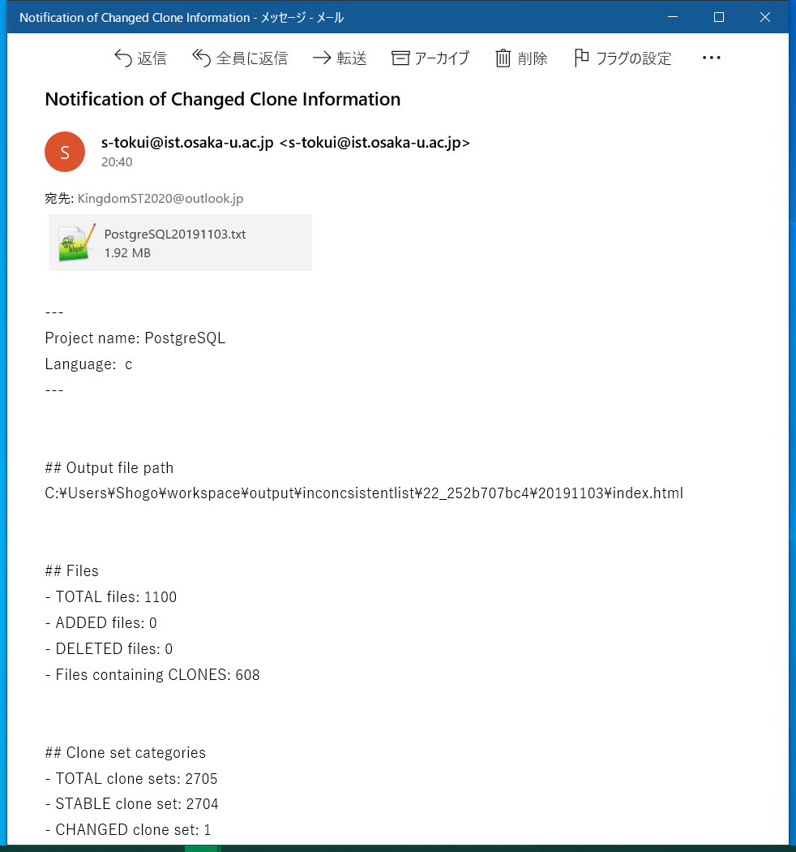
E-mail from Clone Notifier
Clone Notifier sends a summary of the results via e-mail after the execution.
## Clone set categories
- TOTAL clone sets: 2705
- STABLE clone set: 2704
- CHANGED clone set: 1
- Inconsistent clone set: 1
- NEW clone set: 0
- DELETED clone set: 0
Notes:
Next, I will introduce a usage example of Clone Notifier.
It sends a summary of the results via e-mail after the execution.
ここから，Clone Notifierの使い方について説明します
Clone Notifierの実行が終わると、Clone Notifier は結果の概要が書かれたメールを送ります．

Slide 7
E-mail from Clone Notifier
Clone Notifier sends a summary of the results via e-mail after the execution.
## Clone set categories
- TOTAL clone sets: 2705
- STABLE clone set: 2704
- CHANGED clone set: 1
- Inconsistent clone set: 1
- NEW clone set: 0
- DELETED clone set: 0
Access this result link on browser
Notes:
In this email, developers can see that one changed clone set has been identified by Clone Notifier.
They can check the detailed information of this clone set by clicking the URL in the email.
このメールによると、1つの inconsistent changed clone set が検出されています。
コードクローンに欠陥が残っていないかを調査するために、メールに書かれているURLにアクセスして結果を確認します。

Slide 8
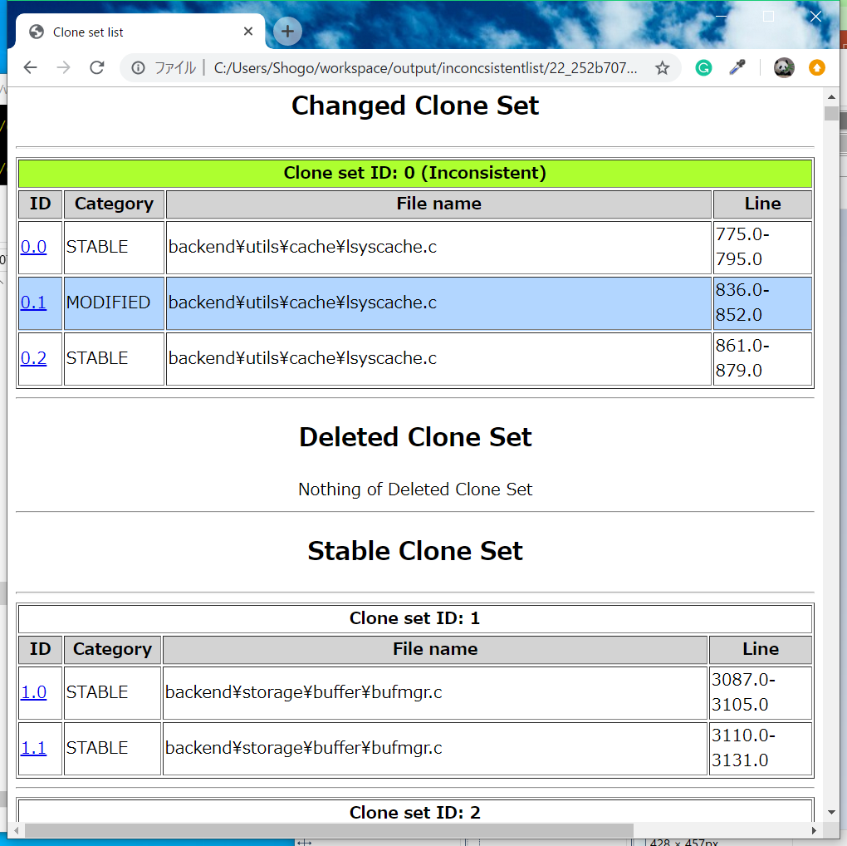
Web based UI: Clone set list page
It shows the code clone information
(modified/unmodified, location).
Label of the
changed clone set
Click clone ID
Code clone category
File name
Line
Notes:
The clone set list page will appear, developers can check the detailed information in clone sets with this page.
In other words, they can check some pieces of information on this page.
They can also check the detailed information of the changed clone set with a label.
On this page, the inconsistent label was assigned to clone set 0 because this clone set contains one modified code clone and two stable code clones.
Developers can confirm the modifications that were applied to the modified code clone by clicking on the code clone ID.
クローンセットページでは、クローンセットごとに、コードクローンの変更情報を見ることができます。
その情報とは、そのコードクローンが、変更されているか、どのファイルに含まれているか、ソースコード中の何行目にあるか、です。
さらに詳しく、どのような変更が行われたかを直に確認したい場合は、コードクローンIDをクリックします。
・ホームページからアクセスした先では、クローンセットの詳細を確認できる
・書くクローンセットのコードクローン情報（修正有無、場所）が書かれている
・コードクローンIDをクリックしたら、そのコードクローンのソースコードを確認できる

Slide 9
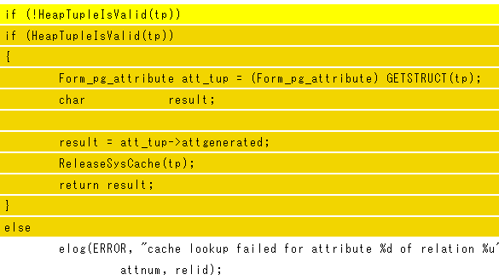
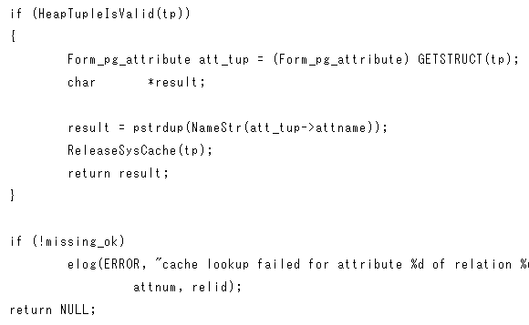
Web based UI: Source code page
Example of an inconsistent change of a clone set.
It was necessary to refactor the stable code clone to avoid the compiler warning in the source code of PostgreSQL.
Modified Code Clone
Stable Code Clone
File: src/backend/utils/cache/lsyscache.c
File: src/backend/utils/cache/lsyscache.c
Added lines
Deleted lines
Should be modified in the same way as Modified Code Clone
Notes:
After clicking on the code clone ID, the source code page will appear.
This page shows the source code that contains the code clone.
The changes between the two revisions are displayed in a diff format.
Before modifying stable code clones in the clone sets with inconsistent labels, it is highly recommended to compare the stable and the modified code clones because inconsistent modifications to these clone sets might be applied on purpose.
In the case of clone set 0, a conditional branch was deleted and the conditional statement was negatively changed to the modified code clone. Moreover, the conditional branch in the stable code clone is similar to the deleted parts in the modified code clone. Therefore, developers can confirm the same modification of the modified code clone.
ソースコードページでは、ソースコード中のコードクローンがある箇所を表示します。もし、変更が加えられていたら、変更部分に色がつきます。
stable code clone に修正を加える前に、stable code clone と、modified code clone を同時に表示して見比べることをお勧めします。その理由は、意図的に変更を加えていないかもしれないからです。この例では、 modified code clone は、条件分岐が削除され、条件文を否定形に変更されています。stable code clone の条件分岐は、 modified code clone で削除された部分とほとんど一致します。そのため、modified code clone と同じような修正を行う必要があります。
・同時修正されていなかった例を確認できる
・これは、片方のみリファクタリングされていて、一方がリファクタリングされていなかった
・後から混乱しないように？コードクローンもリファクタリングしたほうがいい

Slide 10

Thank you for your attention!
If you are interested,
I want you to come to my tool demo tomorrow.
https://github.com/s-tokui/CloneNotifier
Notes:
Thank you for your attention.
Todo: ブースに来てね．
質疑応答集
・2バージョンで足りるか？ -> CCEvovisがある（スライド11）
・9ページの色分け -> 削除された行は濃い黄色，追加行は薄い黄色，変更のない行は白
・クローン検出には何を用いているか -> CCFinder, SourcererCC, CCVolti(スライド12)
・How do you track clone set? -> (スライド13)

Slide 11
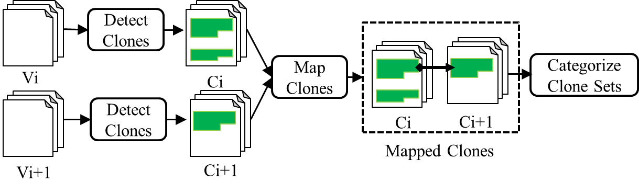
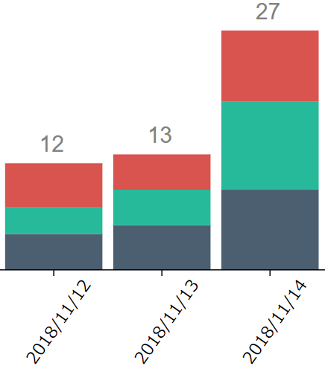
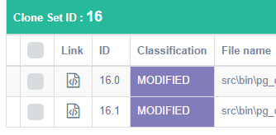
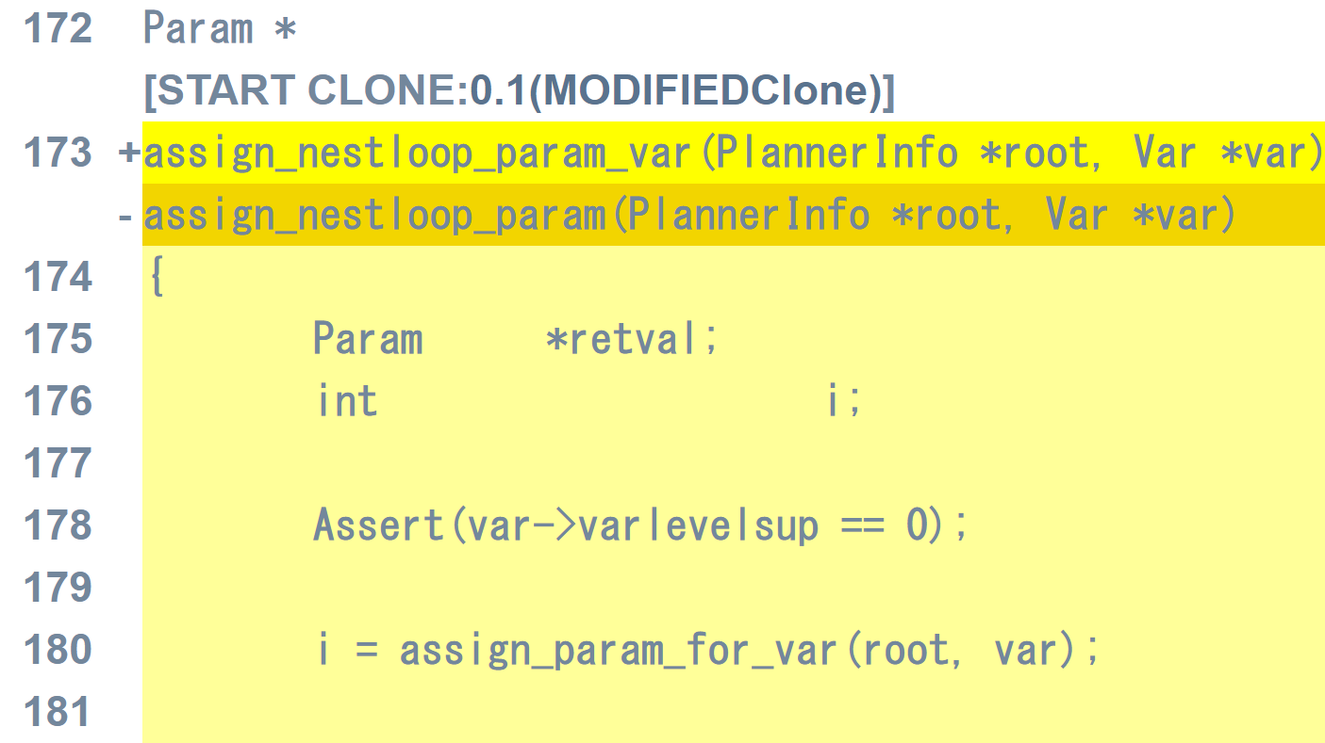
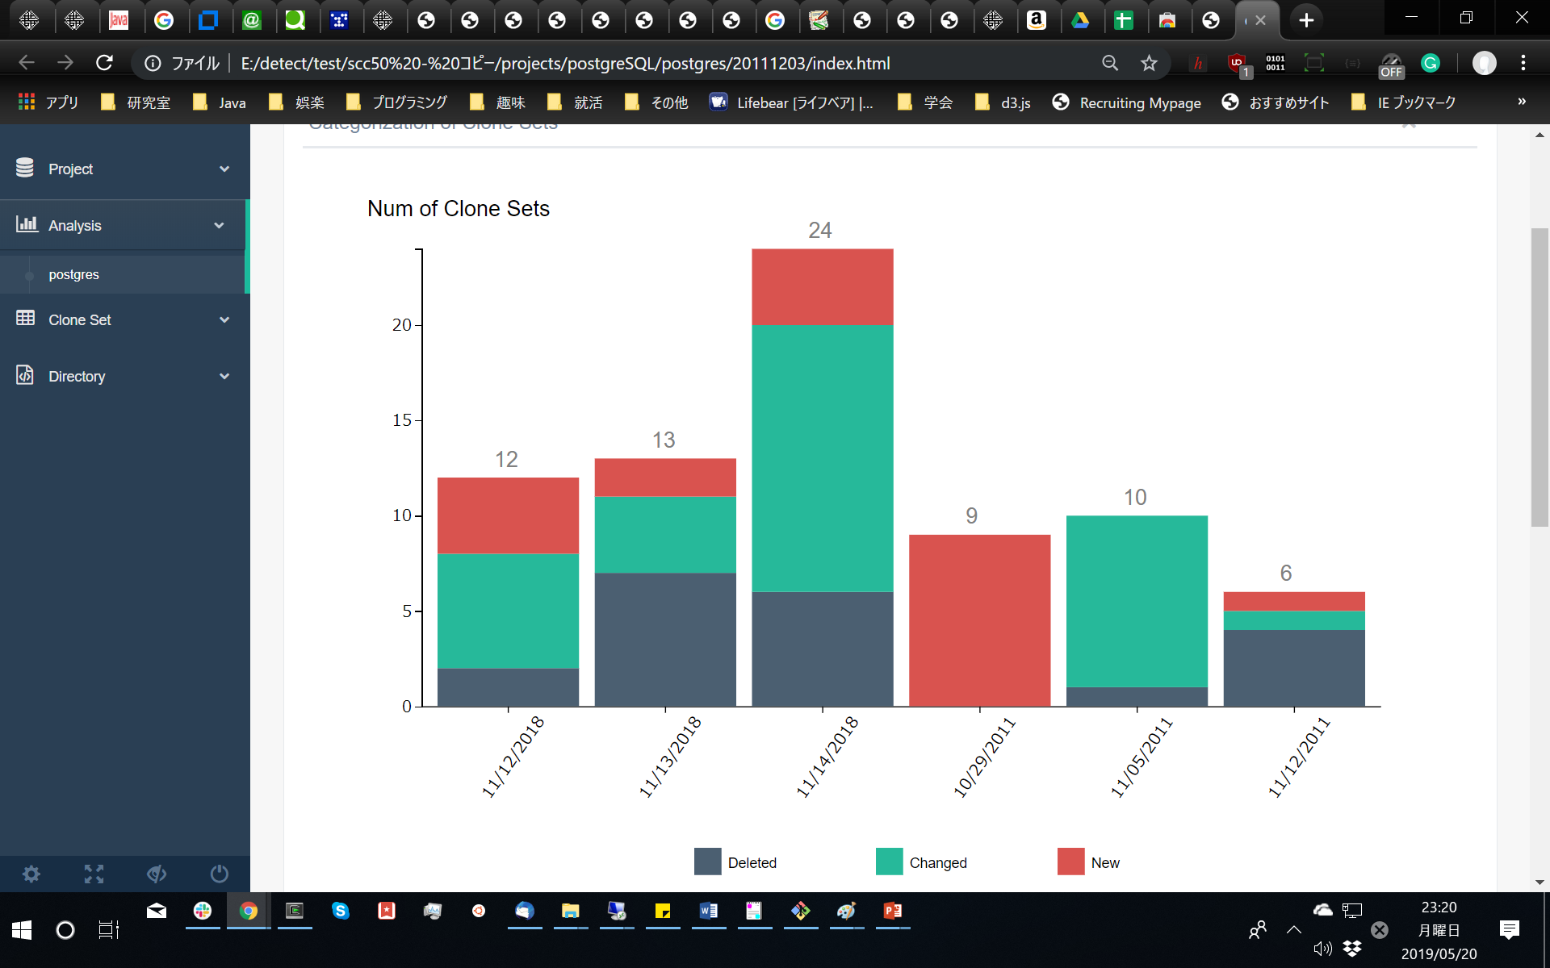
Related tool: CCEvovis [2]
CCEvovis
Clone Notifier
Visualize the Clone Evolution
Stacked Bar Graph
Clone Set List
Source Code
[2] H. Honda, S. Tokui, K. Yokoi, E. Choi, N. Yoshida, and K. Inoue, “CCEvovis: A Clone Evolution Visualization System for Software Maintenance,” in Proc. ICPC, 2019, pp. 122–125.
Notes:
Our research group presented about CCEvovis last year at ICSE’(twenty).
CCEvovis visualizes change information of code clone with stacked bar graph.
If developers use Clone Notifier several times, .
昨年のICSE’20でCCEvovisについて発表した．
CCEvovisはコードクローンの変更情報を変更履歴全体で可視化する．

Slide 12
Using clone detections
Clone Notifier user can choose a clone detector in several ones below.
CCFinderX [3]
SourcererCC [4]
CCVolti [5]
[3] T. Kamiya, S. Kusumoto, and K. Inoue, “CCFinder: a multilinguistic token-based code clone detection system for large scale source code,” IEEE Transactions on Software Engineering, vol. 18, no. 7, pp. 654–670, 2002.
[4] H. Sajnani, V. Saini, J. Svajlenko, C. K. Roy, and C. V. Lopes, “SourcererCC: Scaling code clone detection to big-code,” in Proc. ICSE, 2016, pp. 1157–1168.
[5] K. Yokoi, E. Choi, N. Yoshida, and K. Inoue, “Investigating vector-based detection of code clones using bigclonebench,” in Proc. APSEC, 2018, pp. 699–700.

