Slide 1
Comparison and Visualization of
Code Clone Detection Results
Kazuki Matsushima¹, Katsuro Inoue¹
¹Osaka University

Slide 2
Background:
Problems on code clone analysis
A code clone detection result changes drastically based on characteristics of code clone detectors or its detection parameters.
  The precision of a detection result by an optimized parameters was three times higher than the one by the default parameters, while the recall was fixed. [1]
  The lines reported as cloned by a clone detector were not reported as cloned by most other clone detectors. [2]
[1] S. Bellon, R. Koschke, G. Antoniol, J. Krinke, and E. Merlo, ”Comparison and evaluation of clone detection tools,” Transactions on Software Engineering, vol. 33, No. 9, pp. 577-591, 2007.
[2] T. Wang, M. Harman, Y. Jia, and J. Krinke, ”Searching for better configurations: a rigorous approach to clone evaluation,” in Proc. ESEC/FSE 2013, pp. 455-465, 2013.

Slide 3
Background:
Problems on code clone analysis
Developers may miss important code clones if they analyze only one code clone detection result.
To improve the accuracy of code clone analysis,
it is important to apply different clone detectors or different parameters and identifying the different or common parts of the detection results.

Slide 4
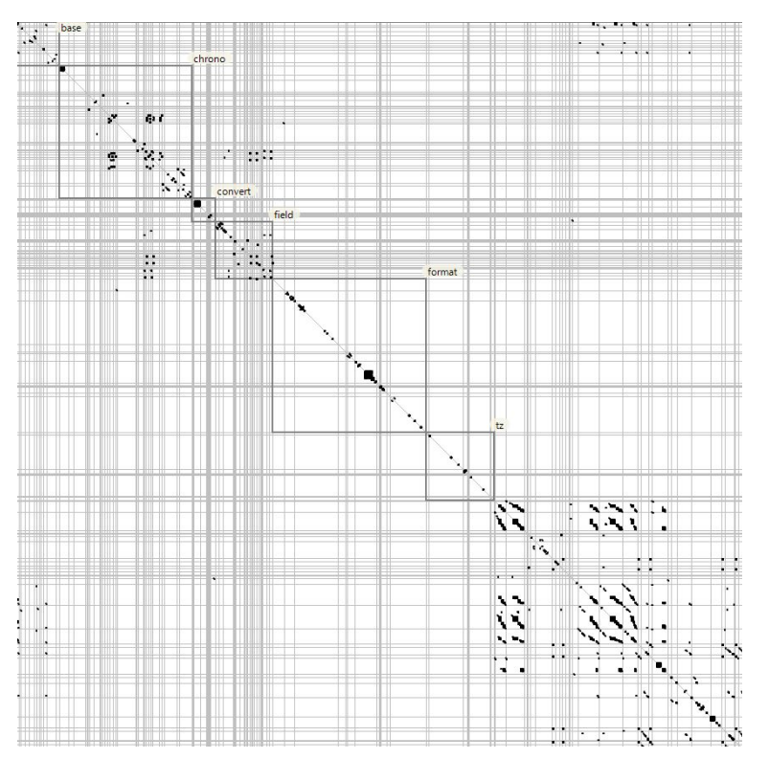
Background:
Visualization of detection results
Scatter plot (dot plot)[3]
  X and Y axes represent the sequence of tokens of source code.
  Dots are plotted if tokens on X and Y axes are the same.
  The location and the length of code clones are shown.
[3] Y. Ueda, Y. Higo, T. Kamiya, S. Kusumoto, and K. Inoue, ”Gemini: Code clone analysis tool,” in Proc. ISESE 2002, pp. 31-32, 2002.

Slide 5
Proposed method
Comparison method of code clone detection results focusing on the mapping of clone pairs.
Visualization of the difference of code clone detection results.
Detect
Code Clones
Map
Clone Pairs
Parameters
Clone Detector
Step A
Detection Result
Step B
0.5
0.0
Mapping Result
0.0
1.0
0.2
Target System
Step C
Step D
Detect
Code Clones
Step B
Calculate
Mismatch Rate
Visualize
the Difference
0.2
Parameters
Clone Detector
Step A
Map
Clone Pairs
Detection Result

Slide 6
Step A: Detect code clones
Detect code clones from a target system with multiple detectors or their detection parameters.
Detection results are normalized into a standard format for Step B.
Parameters
Clone Detector
Detection and normalization
Detection Result
Target System
Parameters
Clone Detector
Detection and normalization
Detection Result

Slide 7


Step B: Map clone pairs
Clone pairs are mapped between code clone detection results.
Metrics-based mapping for clone pairs [1]
  ok-value: An overlap degree of two clone pairs ($0≤ok≤1$)
  good-value: A containment degree of two clone pairs ($0≤good≤1$)
Map
Clone Pairs
Clone Pair A
Mapping Result
$$ok\left(A, B\right)=\frac{5}{6}$$
$$good\left(A,B\right)=\frac{5}{8}$$
Detection Result
Map
Clone Pairs
Detection Result
Clone Pair B
File1
File2
[1] S. Bellon, R. Koschke, G. Antoniol, J. Krinke, and E. Merlo, ”Comparison and evaluation of clone detection tools,” Transactions on Software Engineering, vol. 33, No. 9, pp. 577-591, 2007.

Slide 8



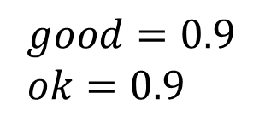

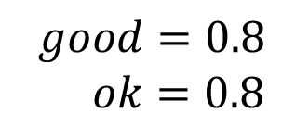

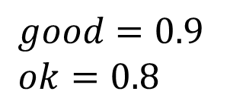

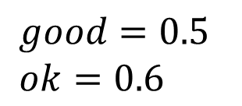
Step B: Algorithm
Calculate ok-value and good-value
between all possible combinations.
$$result_{1}$$
Remove combinations with ok-value or
good-value lower than the threshold t.
(We used 0.7 as t)
$$CP_{A}$$
$good=0.5$
$ok=0.6$
$$CP_{B}$$
$good=0.8$
$ok=0.8$
$good=0.9$
$ok=0.9$
Map similar clone pairs
  The combination with the highest good-value
  If there are some combinations with the same
  highest good-value, the combination with the
  highest ok-value is selected.
$$CP_{X}$$
$good=0.9$
$ok=0.8$
$$CP_{Y}$$
$$result_{2}$$

Slide 9
Step B: Algorithm
Calculate ok-value and good-value
between all possible combinations.
$$result_{1}$$
Remove combinations with ok-value or
good-value lower than the threshold t.
(We used 0.7 as t)
$$CP_{A}$$
$good=0.5$
$ok=0.6$
$$CP_{B}$$
$good=0.8$
$ok=0.8$
$good=0.9$
$ok=0.9$
Map similar clone pairs
  The combination with the highest good-value
  If there are some combinations with the same
  highest good-value, the combination with the
  highest ok-value is selected.
$$CP_{X}$$
$good=0.9$
$ok=0.8$
$$CP_{Y}$$
$$result_{2}$$

Slide 10
Step B: Algorithm
Calculate ok-value and good-value
between all possible combinations.
$$result_{1}$$
Remove combinations with ok-value or
good-value lower than the threshold t.
(We used 0.7 as t)
$$CP_{A}$$
$$CP_{B}$$
$good=0.8$
$ok=0.8$
$good=0.9$
$ok=0.9$
Map similar clone pairs
  The combination with the highest good-value
  If there are some combinations with the same
  highest good-value, the combination with the
  highest ok-value is selected.
$$CP_{X}$$
$good=0.9$
$ok=0.8$
$$CP_{Y}$$
$$result_{2}$$

Slide 11

Step C: Calculate mismatch rate
Mismatch rate
  $0≤MismatchRate≤1$
  The ratio of a proper mapping from one result to another
  Calculated on each combination of files
f0
f1
f2
f3
f0
0.5
0.0
Mapping Result
f1
0.0
1.0
0.2
0.5
f2
Mismatch rate calculation
f3
0.2
f1,f2,f3,f4: Files of a target system

Slide 12
Step D: Visualize the difference
Colorize each point of a scatter plot depending on its mismatch rate.
  No clone pair → white
  Mismatch rate is…
    Zero → Green
    Low → Yellow
    High → Red
f0
f1
f2
f3
f0
f1
f2
f3
f0
0.5
0.0
f0
f1
0.0
1.0
0.2
f1
f2
f2
Colorization
f3
0.2
f3
Green → All clone pairs are also reported by the other tool or set of parameters
Yellow → Few clone pairs are also reported by other tool or set of parameters
Red → All clone pair is not reported by other tool or set of parameters

Slide 13
Experiment
Compare two detection results of an OSS through our proposed method
Target system
  JEdit
    Language: Java
    Size: 113,826 LoC
Target clone detectors
  CCFinderX
  NiCad
Parameters
NiCad
JEdit
Parameters
CCFinderX

Slide 14
Parameters for detectors
We use the default parameters of each clone detector.
CCFinderX
  Minimum clone length: 50
  Minimum TKS: 12
NiCad
  granularity: blocks
  threshold: 0.3
  minsize: 10
  maxsize: 2,500
  rename: blind
  transform/filter/abstract/normalize: none

Slide 15
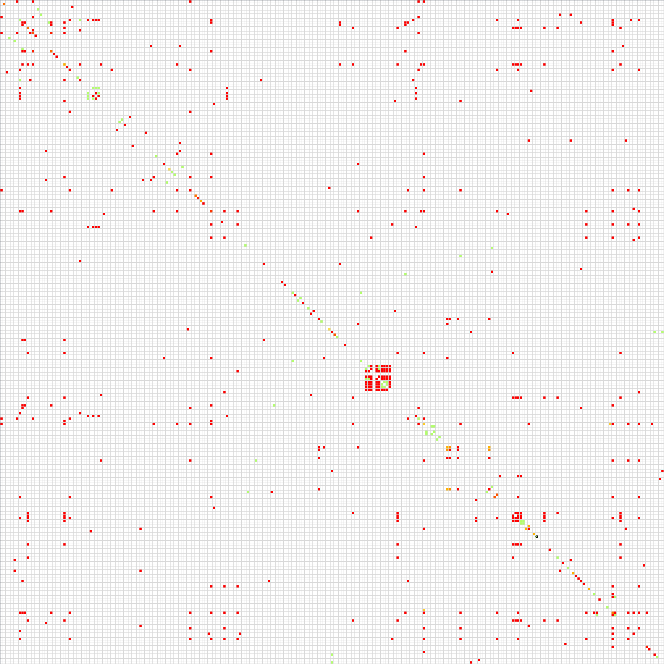
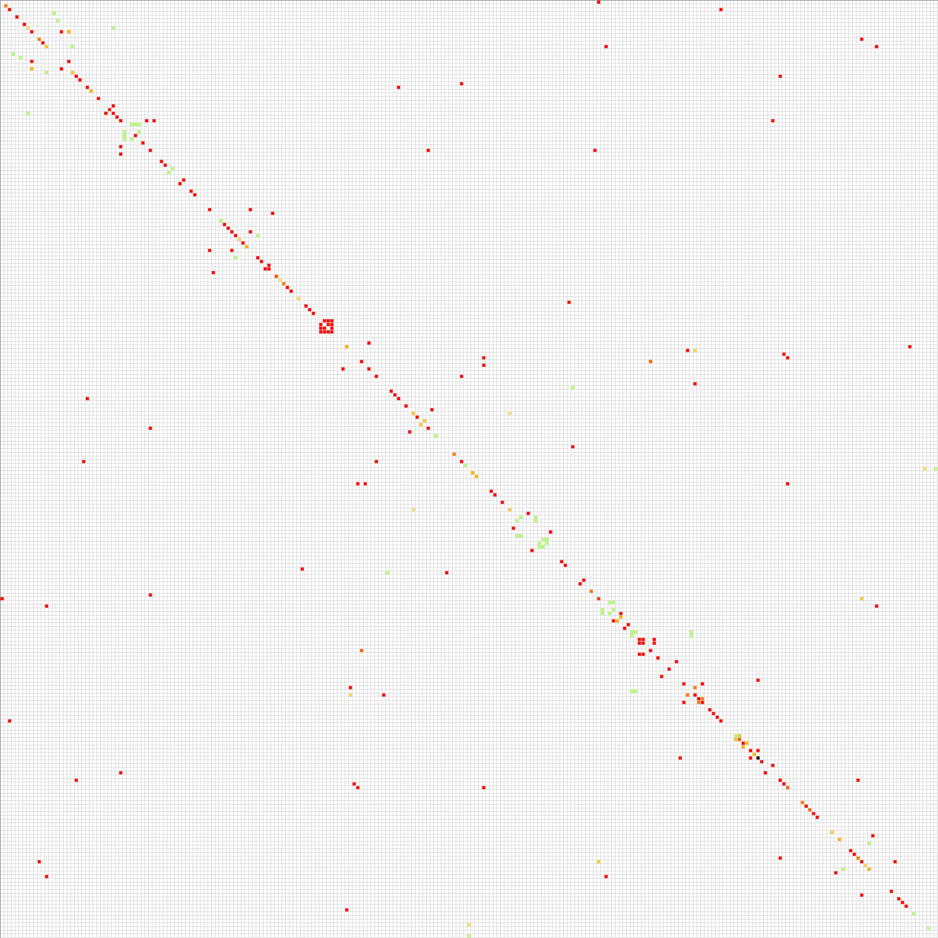
Overview of the comparison result
Comparison result base on NiCad’s detection result
Comparison result based on CCFinderX’s detection result
2,518 clone pairs
2,771 clone pairs
43% of them are not
reported by CCFinderX
63% of them are not
reported by NiCad

Slide 16
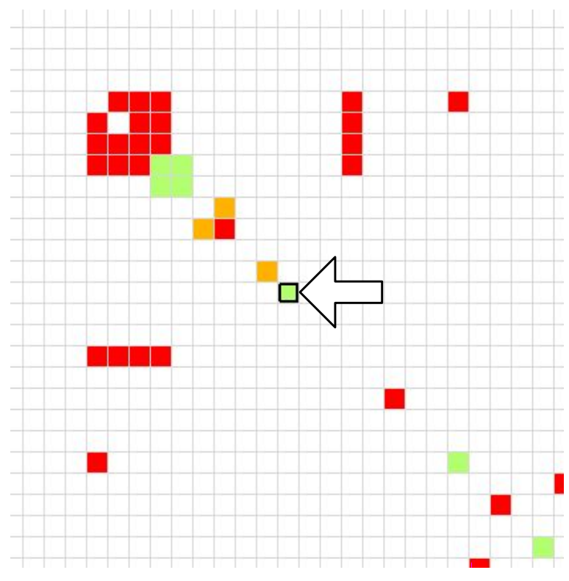
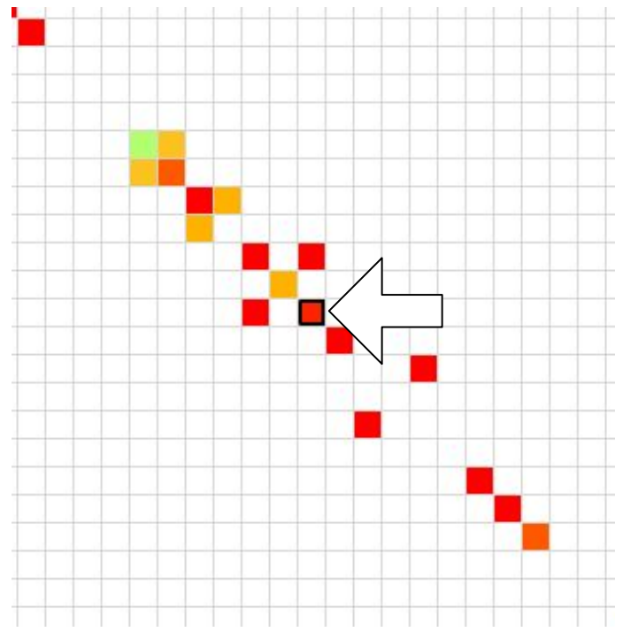
Details of the comparison result
Comparison result base on
NiCad’s detection result
Comparison result based on CCFinderX’s detection result
Green:
Mismatch rate equals zero.
Red:
Mismatch rate is high.
NiCad reported one clone pair and
it is also reported by CCFinderX
CCFinderX reported 20 clone pairs and
only one is also reported by NiCad

Slide 17
Details of the comparison result
Investigating the remaining 19 clone pairs reported by CCFinderX, we have found that one of them contained a buggy code fragment.
  These buggy clones were fixed simultaneously in JEdit’s commits history.

Slide 18
Buggy clone pair
String checkMarginsMessage = pageSetupPanel.recalculate();
if ( checkMarginsMessage != null )
{
JOptionPane.showMessageDialog( PrinterDialog.this, checkMarginsMessage, jEdit.getProperty( "print-error.title" ), JOptionPane.ERROR_MESSAGE );
return;
}
// gather all the attributes from the tabs
for ( int i = 0; i < tabs.getTabCount(); i++ )
{
PrinterPanel panel = ( PrinterPanel )tabs.getComponentAt( i );
AttributeSet panelAttributes = panel.getAttributes();
if (panelAttributes != null)
{
PrinterDialog.this.attributes.addAll( attributes );
}
}
// adjust the print range to filter based on odd/even pages
PageRanges pr = ( PageRanges )PrinterDialog.this.attributes.get( PageRanges.class );
try
{
pr = mergeRanges( pr );
PrinterDialog.this.attributes.add( pr );
}
catch ( PrintException e )
{
e.printStackTrace();
JOptionPane.showMessageDialog( PrinterDialog.this, jEdit.getProperty( "print-error.message", new String[] {e.getMessage()} ), jEdit.getProperty( "print-error.title" ), JOptionPane.ERROR_MESSAGE );
return;
}
String checkMarginsMessage = pageSetupPanel.recalculate();
if ( checkMarginsMessage != null )
{
JOptionPane.showMessageDialog( PrinterDialog.this, checkMarginsMessage, jEdit.getProperty( "print-error.title" ), JOptionPane.ERROR_MESSAGE );
return;
}
// gather all the attributes from the tabs
for ( int i = 0; i < tabs.getTabCount(); i++ )
{
PrinterPanel panel = ( PrinterPanel )tabs.getComponentAt( i );
AttributeSet panelAttributes = panel.getAttributes();
if (panelAttributes != null)
{
PrinterDialog.this.attributes.addAll( attributes );
}
}
// adjust the print range to filter based on odd/even pages
PageRanges pr = ( PageRanges )PrinterDialog.this.attributes.get( PageRanges.class );
try
{
pr = mergeRanges( pr );
PrinterDialog.this.attributes.add( pr );
}
catch ( PrintException e )
{
e.printStackTrace();
JOptionPane.showMessageDialog( PrinterDialog.this, jEdit.getProperty( "print-error.message", new String[] {e.getMessage()} ), jEdit.getProperty( "print-error.title" ), JOptionPane.ERROR_MESSAGE );
return;
}
Buggy
statements
Buggy
statements

Slide 19
Summary
Conclusion
  We proposed the method for comparison and visualization of different detection results focusing on the mapping of clone pairs.
  We presented an example of the important yet missed clones through the experiment.
Future work
  We will extend this method to allow more than two detection results.

