Slide 1
Blanker: A Refactor-Oriented Cloned Source Code Normalizer
Davide Pizzolotto, Katsuro Inoue
Osaka University, Japan

Slide 2
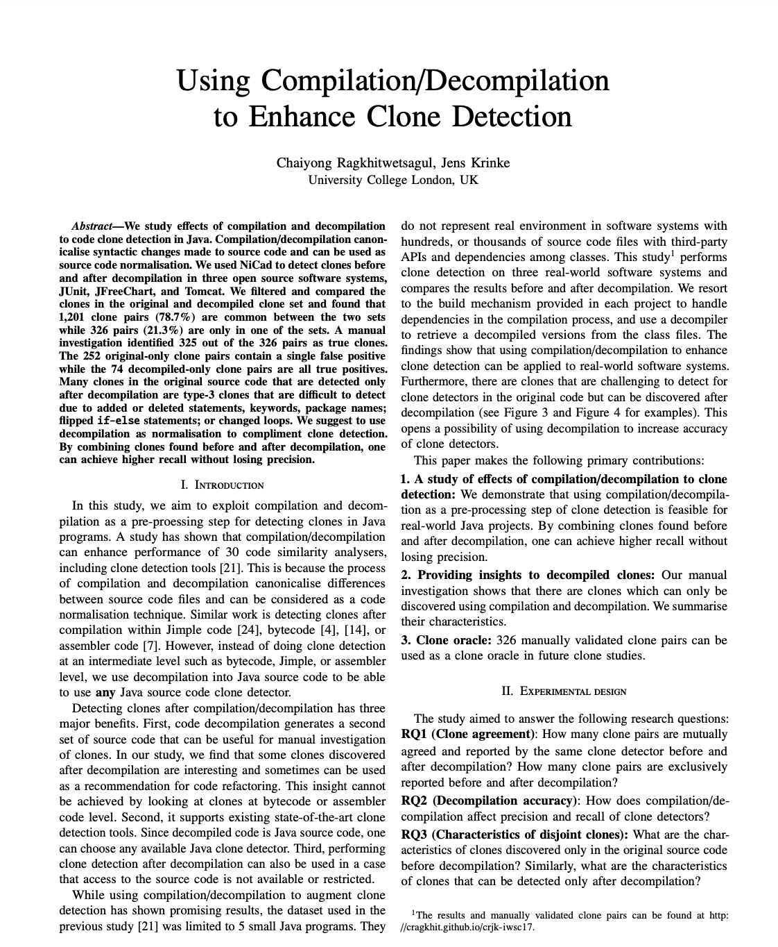
Based on the results of
Ragkhitwetsagul et al.

Slide 3
Previous work overview
Original Source
Compilation
Decompilation
Decompiled Source

Slide 4
Previous work overview
Original Source
Compilation
Code
Clone
Detector
Decompilation
Decompiled Source

Slide 5
Previous work overview
Original Source
Original Source
Clones
Compilation
Code
Clone
Detector
Decompilation
Decompiled Source
Clones
Decompiled Source

Slide 6
Previous work overview
Original Source
Original Source
Clones
Compilation
Code
Clone
Detector
Results
Decompilation
Decompiled Source
Clones
Decompiled Source

Slide 7
Limitations
Compilation/Decompilation not be available in every language
Decompilation may introduce errors and false positives

Slide 8
Our solution
A single source-to-source transformation
mimicking the entire compilation/decompilation step

Slide 9
Our solution overview
Original Source
Code
Clone
Detector
Transformation
Results
Transformed
Source
Transformed Source
Clones

Slide 10
Transformations overview
Based on the results of Ragkhitwetsagul et al., most transformation happens in the control-flow structures
We analyzed their results and implemented those transformation not requiring flow analysis

Slide 11
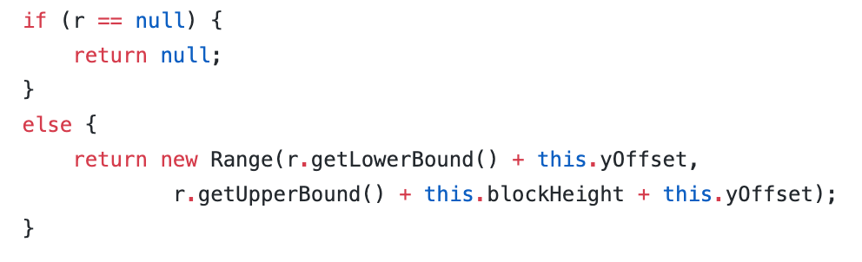
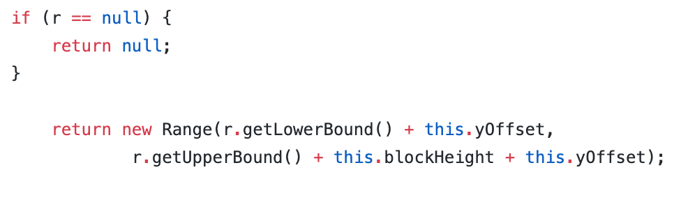
Transformations example

Slide 12
Transformation Approach
Source code parsing
Parsed structure analysis
Applying transformation

Slide 13
Source code parsing
Challenges:
  - Recognize needed structures
  - Avoid requiring a new grammar for every language

Slide 14
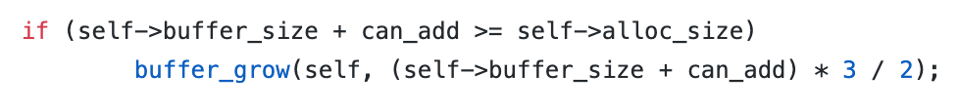
Source code parsing
Challenges:
  - Recognize needed structures
  - Avoid requiring a new grammar for every language
-> Unknown to Java

Slide 15

Source code parsing
Challenges:
  - Recognize needed structures
  - Avoid requiring a new grammar for every language
-> Unknown to Java
`new` Unknown to C

Slide 16
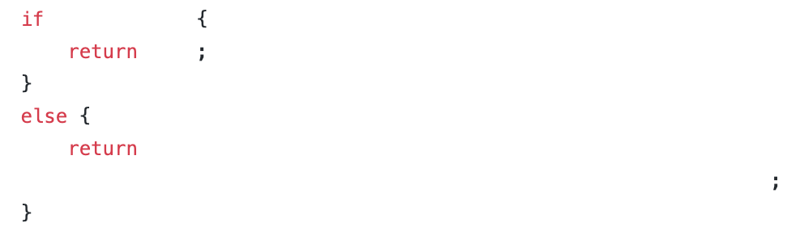
Source code parsing
We recorded only semicolon and important keywords

Slide 17
Transformation Approach
Source code parsing
Parsed structure analysis
Applying transformation

Slide 18
Transformation Approach
Source code parsing
Parsed structure analysis
Applying transformation

Slide 19
Applying transformation
User (developer) does not care about
transformed source code

Slide 20
Applying transformation
User (developer) does not care about
transformed source code
Run the clone detector on the transformed code, presents the results on the original code

Slide 21
Applying transformation
User (developer) does not care about
transformed source code
Run the clone detector on the transformed code, presents the results on the original code
May require code remapping

Slide 22
Evaluation
Same configuration of the original paper
System | Version | LoC
JUnit | 4.13 | 9,777
JFreeChart | 1.5.0 | 96,711
Apache Tomcat | 9.0 | 256,974

Slide 23
Evaluation
Same configuration of the original paper
Code Clone Detector | Type | Configuration
NiCad 5.2 | Type-1 | UPI=0.0; renaming = none
 | Type-2 | UPI=0.0; renaming = constistent
 | Type-3 | UPI=0.3; renaming = constistent

Slide 24
Evaluation
Type-2 clone detection
System | Original clones | Transformed clones | Delta
JUnit | 6 | 6 | 0%
JFreeChart | 373 | 397 | 6.43%
Apache Tomcat | 242 | 275 | 13.64%

Slide 25
Notable points
We detected a superset of clones with no false positives
Every detected clone can be refactored with an extract method procedure and little to no effort

Slide 26
Conclusion
This slide intentionally left blank

