Slide 1
A Practical Approach to the Year 2038 problem for 32bit Embedded Systems
Asia BSD CON 2020
Hideyuki Oe Osaka University
Makoto Matsushita, Katsuro Inoue Osaka University

Slide 2
Outline
Introduction
Method
Results
Conclusion
Discussions
Future Works

Slide 3
Introduction

Slide 4
Introduction
What is the year 2038 problem ?
This lead to the problem like the year 2000 problem.
Actual time (UTC)
System time (UTC)
January 19, 2038, 3 o’clock
14 minutes 7 seconds
January 19, 2038, 3 o’clock
14 minutes 8 seconds
January 19, 2038, 3 o’clock
14 minutes 7 seconds
January 1st, 1970, 0 o’clock
0 minutes 0 seconds*
* An example of invalid time value.

Slide 5
Introduction
How does this problem occur ?
Time value is handled by “time_t”
January 1st, 1970, 0 o’clock 0 minutes 0 seconds (Epoch)
time_t-type value
0x00000000
January 19, 2038, 3 o’clock 14 minutes 7 seconds
time_t-type value
0x7FFFFFFF
January 19, 2038, 3 o’clock 14 minutes 8 seconds
time_t-type value
0x80000000
A system might misunderstand the current time.
Digit overflow occurs in the year 2038, because of the type “time_t” is defined by “32bit signed int” type in the 32bit system.

Slide 6
Our Method

Slide 7
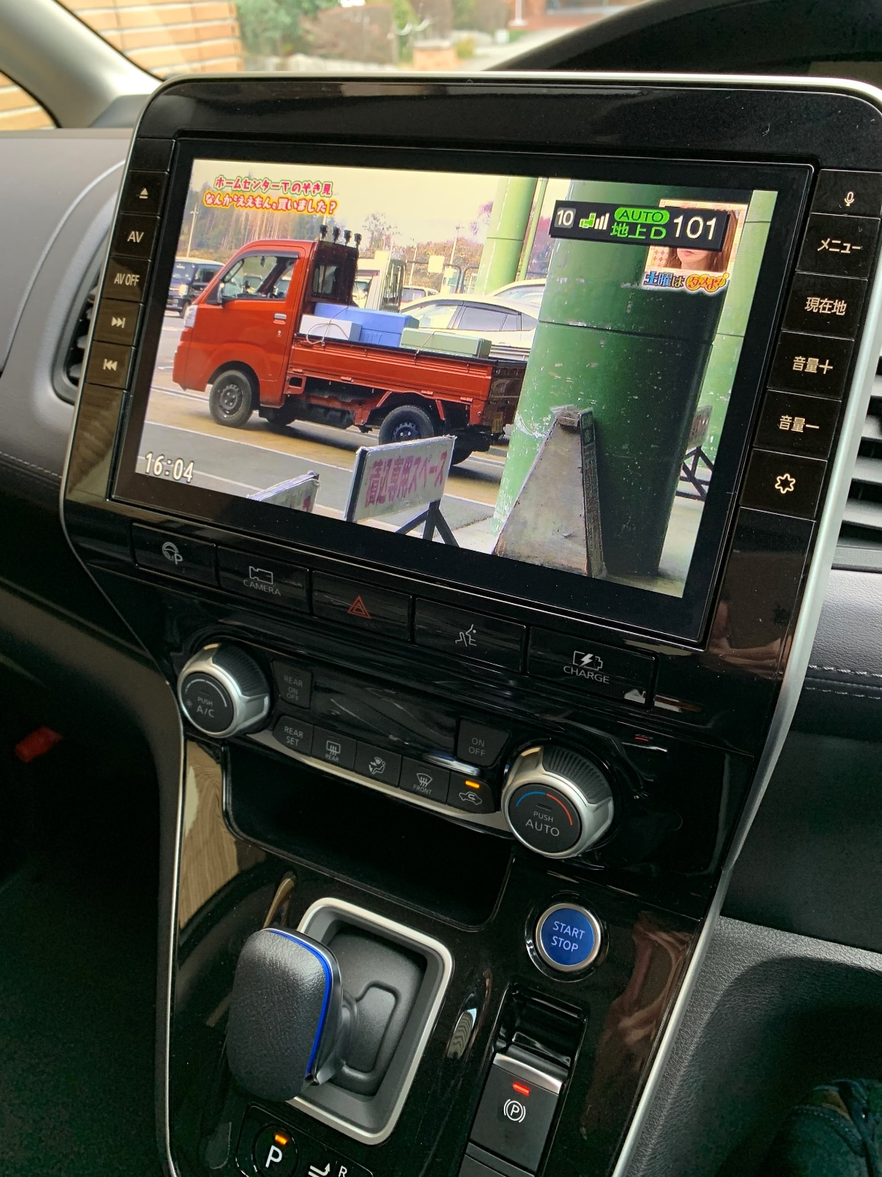
Method
An example of the target system
Time value from outside
(broad cast signal)
Display the drawing items.
TV Program, On Screen Display, …
This photograph is an image
If the system timer returns to 1970 …

Slide 8
Method
Our target system
Keep it up after 2038
Development target system
(operation)
Drawing material
(including time information)
Input device
Drawing material
(including time information)
Drawing command
(From other device)
Data for display
Drawing material
Drawing decision
Display device
20 years warranty
Append, delete
Current time
Control flow
System time
Data flow

Slide 9
Method
Our software architecture
Application layer
Reshape drawing
User I/F
Display control
1.3
Million lines
A
Library
Daemon
Communication
Data conversion
Data storage
Drawing engine
Function management
Kernel／Driver
UNIX base system (OS core)
UNiX
command
Boot
0.5
Million lines
B
Device driver
File system
init
Boot loader
A : In-house development part, B : OS part

Slide 10
Method
The number of changes in the program
Location | Number of changes
OS part (including device driver, OSS, standard library) | 2546
In-house development part | 945
We did not want to modify the OS part, because…
The modification volume is huge for the development period.
The maintenance cost of modification would be expensive.

Slide 11
Method
Possible Solutions
(a) 64-bit time_t or change to 64-bit OS
(b) Unsigned int time_t
32bit
About 68 years
About 136 years
32bit
・・・
bit31
bit0
・・・
64bit
Over 290 billion years
・・・
Use the sign bit for the time value
(c) Check the digit overflow and treat it
in the program.
(d) Change the “epoch”
About 68 years
Overflow?
n
1970
2038
y
time += 68years
1998
2066
About 68 years

Slide 12
Method
Our design decision
Approaches | Development volume | OS part modify | Impact range
(a) 64-bit time_t or change to 64-bit OS. | Huge | Needed | Huge
(b) Unsigned int time_t. | Huge | Needed | Huge
(c) Check the digit overflow and treat it in the program. | Huge | Needed | Huge
(d) Change the “epoch”. | Medium | Unnecessary | Medium

Slide 13
Method
Our design
How many years we have to shift from 1970(epoch) ?
How do we shift the epoch ?
Which kind of data do we have to check ?
Which kind of library functions do we have to check ?
We can get the design of the program.

Slide 14
Method
Change the epoch from 1970 to 1998
Date and time（UTC）
January 1, 1970
0:00:00
January 1, 1998
0:00:00
January 19, 2038
3:14:07
January 19, 2066
3:14:07
(time_t type variable value)
Epoch (1970)
0x0000 0000
0x34AA DC80
0x7FFF FFFF
0xB4AA DC7F
Epoch (1998)
－
0x0000 0000
0x4B55 237F
0x7FFF FFFF
28 years shift because
20 years warranty (need to shift over 20 years)
Multiples of 4 to account for leap years
No need to calculate the “day of week” until the year 2099

Slide 15
Method
Calendar every 28 years
28 years
28 years
March, 2020
March, 2048
March, 2076
Su | Mo | Tu | We | Th | Fr | Sa
1 | 2 | 3 | 4 | 5 | 6 | 7
8 | 9 | 10 | 11 | 12 | 13 | 14
15 | 16 | 17 | 18 | 19 | 20 | 21
22 | 23 | 24 | 25 | 26 | 27 | 28
29 | 30 | 31
Su | Mo | Tu | We | Th | Fr | Sa
1 | 2 | 3 | 4 | 5 | 6 | 7
8 | 9 | 10 | 11 | 12 | 13 | 14
15 | 16 | 17 | 18 | 19 | 20 | 21
22 | 23 | 24 | 25 | 26 | 27 | 28
29 | 30 | 31
Su | Mo | Tu | We | Th | Fr | Sa
1 | 2 | 3 | 4 | 5 | 6 | 7
8 | 9 | 10 | 11 | 12 | 13 | 14
15 | 16 | 17 | 18 | 19 | 20 | 21
22 | 23 | 24 | 25 | 26 | 27 | 28
29 | 30 | 31

Slide 16
Method
Change the epoch mechanism
Before modification
After modification
time value (except time_t type variable)
time_t type variable
(1998 Epoch)
time value (except time_t type variable)
time_t type variable
(1970 Epoch)
External time value
External time value
Data flow
A
A
Do not change this part.
Change epoch
between 1970 and 1998
(Do not change epoch)
Library
(1970 epoch)
B
Library
(1970 epoch)
(Change epoch)
B
A : In-house development part
time_t type variable
(1970 Epoch)
time_t type variable
(1998 Epoch)
B : OS part
Epoch interpretation change

Slide 17
Method
The data types which need to check
Number | Types | Abstraction
1 | time_t | Data type for storing system time. It is defined in the standard C library, and is defined as 32-bit signed integer in 32-bit FreeBSD.
2 | struct timeval | A structure that has a time_t-type variable (tv_sec) and a suseconds_t-type variable (tv_usec) as members. tv_sec stores seconds, and tv_usec stores microseconds.
3 | struct tm | A structure that stores time information for each element such as year, month, day, day of the week as members, and stores each member as an int.

Slide 18
Method
The library function examples
Number | Function name | Wrapper function creation
1 | clock_t clock(void) | ―
2 | char *ctime(const time_t *) | Required
3 | double difftime(time_t, time_t) | ―
4 | int gettimeofday(struct timeval *, struct timezone *) | Required
5 | struct tm *gmtime(const time_t *) | Required
6 | struct tm *localtime(const time_t *, struct tm *) | Required
7 | time_t mktime(struct tm *) | Required
8 | int settimeofday(const struct timeval *, const struct timezone *) | Required
9 | time_t timegm(struct tm *) | Required
・ | ・ | ・
・ | ・ | ・
60 | void tzsetwall(void) | ―

Slide 19
Method
The time value’s data flow and control flow
Control flow
Application
Original system
Data flow
Present time
settimeofday
CTIME functions
(localetime_r etc.）
getttimeofday
System time
Device driver
・・・
OS part
Epoch(1970) time

Slide 20
Method
How to change the epoch
Control flow
Application
Epoch(1998) time
Epoch(1970) time
Calculate time : before 28 years
Present time
wrapper_settimeofday
CTIME wrapper functions
(wrapper_localetime_r etc.）
wrapper_getttimeofday
Decrease 28 years
Increase 28 years
Do not change the year value
settimeofday
CTIME functions
(localetime_r etc.）
getttimeofday
System time
Device driver
・・・
OS part
Epoch(1998) time

Slide 21
Implementation

Slide 22
Implementation
Macro definition
#define DATE_OFFSET_YEAR 28 /* 28years */
#define LEAP_DAYS (DATE_OFFSET_YEAR >> 2)
#define DATE_OFFSET_SEC ((DATE_OFFSET_YEAR * 365 + LEAP_DAYS) * 60 * 60 * 24)
・・・

Slide 23
Implementation
Wrapper function (1)
int wrapper_settimeofday(const wrapper_timeval * tv , const struct timezone * tz)
{
struct timeval tv_tmp, *tvp;
int ret;
if (NULL == tv)
{
tvp = NULL;
}
else {
tv_tmp.tv_sec = (time_t)(tv->tv_sec - DATE_OFFSET_SEC);
tv_tmp.tv_usec = tv->tv_usec;
tvp = &tv_tmp;
}
ret = settimeofday(tvp, tz);
return ret;
}

Slide 24
Implementation
Wrapper function (2)
struct tm* wrapper_localtime_r (const time_t *clock, struct tm *result)
{
struct tm *tm_tmp;
if ((tm_tmp = localtime_r(clock, result)) != NULL)
{
result->tm_year += DATE_OFFSET_YEAR;
}
return tm_tmp;
}

Slide 25
Results

Slide 26
Result
The number of the test items and results
 | Test items | Number of defects
Unit test | 165 | 0
Integrated test | 103 | 1

Slide 27
Result
The modification volume
 | Library function name | Created lines of wrapper function | Number of call locations | Modification lines of calling part
1 | ctime | 11 | 0 | 0
2 | ctime_r | 11 | 0 | 0
3 | gettimeofday | 6 | 25 | 1262
4 | gmtime | 9 | 0 | 0
5 | gmtime_r | 9 | 1 | 21
6 | localtime | 9 | 2 | 12
7 | localtime_r | 9 | 30 | 1131
8 | mktime | 22 | 10 | 307
9 | settimeofday | 15 | 2 | 127
10 | strftime | 81 | 2 | 48
11 | timegm | 22 | 1 | 28
12 | timelocal | 22 | 0 | 0
13 | Common functions etc.* | 38 | - | -
Total |  | 264 | 73 | 2936
Modification lines |  | 264 + 2936 = 3200
* Includes functions shared by multiple wrapper functions and “include” and “define” statements.

Slide 28
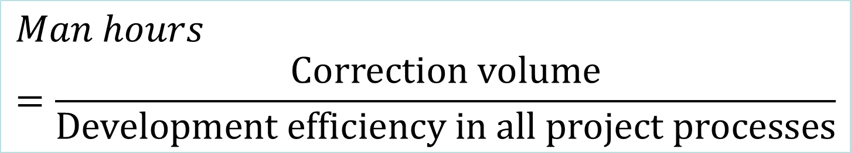
Result
Calculation of the “man-months”
$$Man hours=\frac{Correction volume}{Development efficiency in all project processes}$$
Development efficiency in all project processes = 3.45 steps / man-hours
Correction volume = 3200 steps
Development efficiency in the “year2038 problem” = 3200 / 3.45 = 927.54 man-hours
8 hours / day, 20 days / month
927.54 / (8 * 20) = 5.80 man-months

Slide 29
Discussions

Slide 30
Discussions
Evaluation of corrective work
Project
Development was completed as planned
There was nothing particularly difficult
Method
The new system cannot handle before 1998
Easy solution by changing epoch (from 1970 to 1998) by wrapper functions

Slide 31
Related Issues

Slide 32
Related Issues
Handling date and time in Software
 | Windows | NetBSD | macOS/iOS | FreeBSD | Raspbian
Time info | 64bit | 64bit | 64bit | 64bit/32bit | 32bit
Remarks | In versions of Visual C++ and Microsoft C/C++ before Visual Studio 2005, time_t was a long int (32 bits). | NetBSD has been modified to represent time_t in 64 bits on all supported architectures. | Time is expressed as the number of seconds since January 1st, 2001 UTC, and it is currently defined by regulations to allow only 64-bit applications. | The 32-bit OS can be used continuously, but the 2038 problem described in this paper will occur. | Raspbian Buster has released on 2020-02-13, but still 32-bit system.

Slide 33
Related Issues
The UNIX’s year 2004 issues
1970
2004
2038
0x0000 0000
0x4000 0000
0x7FFF FFFF
13:37:04, January 10th, 2004(UTC)
Digit overflow occurred because …
Two dates are added together
0.5sec unit timer

Slide 34
Related Issues
The year 2000 problem
1
9
9
9
2
0
0
0
Use only 2 digits for represent the year
(a) The time period calculation
Ex) From the year 1996 till 2000 is “00 – 96 = -96” ?
(b) Comparison which is newer
Ex) The year 1996 is newer than the year 2000 because “96 > 00” ?
(c) Newer data save logic
Ex) Save the year 1999 data and delete the year 2000 data because “99 > 00” ?
No major confusion occurred because prior approaches.

Slide 35
Conclusion and Future Works

Slide 36
Conclusion
We have solved the year 2038 problem without modify the OS part by
shifting the epoch from 1970 to 1998 with wrapper functions
- Development of the 20 years warranty products
- Considering the leap year
- No need to calculate the week of days
in 32-bit FreeBSD system.
The modification cost was 5.80 man-month for 1.3 million lines application.

Slide 37

Future Works
So many systems are working in the 32-bit system now.
For example “Raspbian” is a popular OS, for the inexpensive IoT systems.
Some IoT systems that include this problem may run beyond 2038 invisibly.
The impact may be greater than we think…
We’d like to solve the year 2038 problems more efficiently.

Slide 38
Acknowledgement
We deeply appreciate the developers of 2nd Engineering Department at Persol AVC Technology Co., Ltd. for providing data related to this project.
Thank you very much

Slide 39
References
Brown, E.: Embedded Linux Keeps Growing Amid IoT Disruption, Says Study, Linux.com News, 2015.
Apple: 64-bit Transition on macOS, Apple Developers News and Update, https://developer.apple.com/news /?id=0411018a, April 11, 2018.
FreeBSD: time(3), FreeBSD 11.1-RELEASE manual, 2003.
Holzmann, G.: Out of Bounds, IEEE Software, Vol32, No.6, pp24-26, 2015.
Takatomo Suzuki, Kensuke Nakamura : Troubles in “year 2038 problem”, Nikkei Computer (2004-4-1), http://tech.nikkeibp.co.jp/it/ members/NC/ITARTICLE/20040325/1/, 2004 (in Japanese).
Takao Yokota : Meaning of the year 2000 problem and countermeasures, Computer Software, Vol.13, No.5, pp.412-419, 1996 (in Japanese).
Cabinet Computer Year 2000 Problem Management Office, “Report on the year 2000 problem”, https://www.kantei.go.jp/jp/pc2000/ houkokusyo/honbun.html, 2000 (in Japanese).
Harshini, S. and Kavyasri, K. R.: Digital World Bug : Y2k38 an Integer Overflow Threat-Epoch, International Journal of Computer Sciences and Engineering, Vol.5(3), Mar 2017, E-ISSN : 2347-2693 , 2017.
Microsoft: Microsoft Docs: Time Management, https:// docs.microsoft.com/en-us/cpp/c-runtime-library/time-management
Apple: NSDate - Foundation | Apple Developer Documentation, https://developer.apple.com/documentation/foundation/nsdate
Apple: 64-bit Requirement for Mac Apps, https://developer.apple.com/ news/?id=06282017a
Apple: 64-bit Apps on iOS 11, https://developer.apple.com/ news/?id=06282017b
NetBSD Foundation: Announcing NetBSD 6.0, https:// www.netbsd.org/releases/formal-6/NetBSD-6.0.html

