Slide 1
On the Variations and Evolutions of API Usage Patterns: Case Study on Android Applications
Koki Ogasawara, Tetsuya Kanda, Katsuro Inoue

Slide 2
API Usage
API: Application Programming interface
A set of functions to communicate with libraries or platforms from client applications.
Used in combination and have typical patterns ➔ API usage patterns

Slide 3

Mining-based approach
How!
To!
Use!
APIs!

Slide 4

Mining-based approach
Learning resources
Documents sometimes do not describe how to combine APIs enough.
Mining real-world usages to find typical usage of APIs
Misuse detection
f.open()
f.read()
f.close()
f.open()
f.read()
f.close()
f.open()
f.read()
f.close()
f.open()
f.read()

Slide 5
Am I mining a good mine?
Can the API mining result be applied to other projects?
Is the minor API usage patterns are always misuse?
Can mining results of a few (years / releases) ago be applied in current development?
My mine is very different from your mine.

Slide 6
Extracting patterns
Methods
API usage patterns
public void abc() { SomeClass s = new SomeClass(); while (s.hasNext()) { s.goToNext(); } }
#use
Someclass.new()
hasNext()
goToNext()
:1
List.get()
hasNext()
goToNext()
:1
public void xyz(List<SomeClass> list) { SomeClass s = list.get(7); while (s.hasNext()) { s.goToNext(); }
s.goToNext(); }
(without instance)
hasNext()
goToNext()
:2

Slide 7
Extracting patterns
API usage patterns
#pattern: 2
#use
Someclass.new()
hasNext()
goToNext()
:1
List.get()
hasNext()
goToNext()
:1
#pattern: 1
(without instance)
hasNext()
goToNext()
:2

Slide 8
Case Study
21 Android applications from GitHub
Picked up 6 versions that released every six months
Targeting 3 Classes
android.content.Context
android.content.Intent
android.database.Cursor

Slide 9
Case Study
21 Android applications from GitHub
Picked up 6 versions that released every six months
Targeting 3 Classes
 | #pattern (w/o instance) |  | #use
android.content.Context | 44 | (18) | 218
android.content.Intent | 213 | (144) | 1233
android.database.Cursor | 206 | (136) | 380

Slide 10
RQs
RQ1: How many API usage patterns are contained in Android application projects and what is the difference between frequent API usage patterns and uncommon ones?
RQ2: What is the difference in API usage patterns among projects?
RQ3: How the new releases of applications affect API usage patterns and their #use?

Slide 11
RQ1: #pattern
How many API usage patterns are contained in Android application projects and what is the difference between frequent API usage patterns and uncommon ones?

Slide 12
Frequency Distribution

Slide 13
Frequent patterns
Top-5 patterns
Top-5: 65%
Top-5: 61%
Top-5: 13%

Slide 14
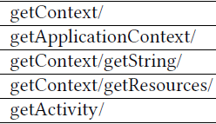
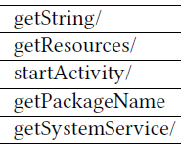
Frequent patterns
Top-5 patterns in Context: Contains a few API calls
Top-5
Top-5 w/o instance

Slide 15

Why so many variations?
Expanded patterns:
and sub patterns…
Frequent
Minor
method1/method2/method3
More Frequent
Frequent
Minor
Frequent
method1/method2/method3
method1/method2/method3

Slide 16
RQ1: Results
API usage patterns
Some of API usage patterns are frequently used.
There are also many uncommon API usage patterns.
Reason of variations
Frequent API usage pattern with additional API calls

Slide 17
RQ2: Difference among projects
What is the difference in API usage patterns among projects?

Slide 18
How many projects use each patterns?
Total: 21 projects
Context
Intent
Cursor

Slide 19
How many projects use each patterns?
Frequent patterns: widely used (but not all)
Context
Intent
Cursor

Slide 20
How many projects use each patterns?
Project-specific patterns
Context
Intent
Cursor

Slide 21
Project-specific patterns
API | Top-5 | Project-specific
Context | 142 (65%) | 47 (21%)
Intent | 754 (61%) | 241 (19%)
Cursor | 52 (13%) | 271 (71%)

Slide 22
Project-specific patterns
Frequent patterns are widely used
API | Top-5 | Project-specific
Context | 142 (65%) | 47 (21%)
Intent | 754 (61%) | 241 (19%)
Cursor | 52 (13%) | 271 (71%)

Slide 23
Project-specific patterns
Top-5 patterns are not major in most of projects
(only 6 out of 21 projects use these patterns)
API | Top-5 | Project-specific
Context | 142 (65%) | 47 (21%)
Intent | 754 (61%) | 241 (19%)
Cursor | 52 (13%) | 271 (71%)
Most of extracted patterns are project-specific patterns

Slide 24
RQ2: Results
Major patterns:
Widely used in various projects
But not for all projects
In the case of the API Intent, most of API usage patterns are project-specific.

Slide 25
RQ3: Historical analysis
How the new releases of applications affect API usage patterns and their #use?

Slide 26
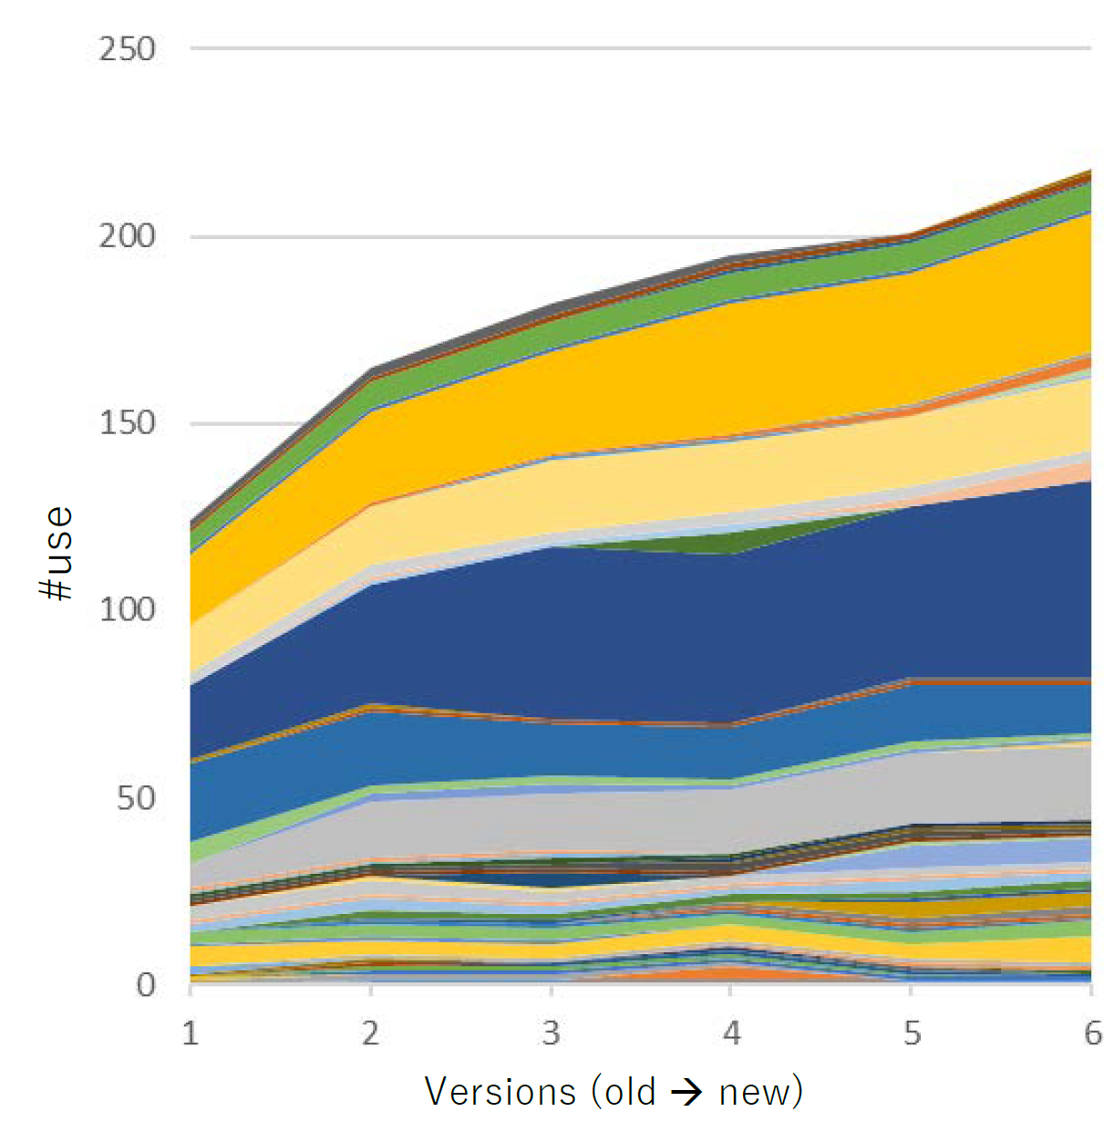
Patterns with Version History
API: Context
Frequent patterns: continuously growing
Uncommon patterns: still alive

Slide 27
Cause of new patterns
#pattern also increases in the new version …but no such a increase when we count w/o instance patterns
The hint is in the cause of new patterns
New!
Frequent
newWayToGetInstance / method1 / method2
71/137 new patterns

Slide 28
RQ3: Results
Frequent patterns: increase
Uncommon patterns: appeared and disappeared
And there are some long-lived minor patterns
Main cause of new patterns:
Applying new method call to get an instance to an existing pattern
This is also cause of new project-specific patterns

Slide 29
Conclusion
API usage pattern mining in both project-wide and historical approach
Some APIs have many project-specific patterns
Mining results will be strongly affected by the target
Most of the API usage patterns are consist of the frequent API usage pattern with additional API calls
Mining results can be grouped by such variants

