Slide 1


Identifying Compiler and Optimization Options from Binary Code using Deep Learning Approaches
D. Pizzolotto, K. Inoue
Osaka University

Slide 2
Problem Definition
Information about compiler is lost during compilation
The compiler name is written in the .comment section
String dump of section '.comment':
[ 0] Linker: LLD 10.0.0
[ 13] GCC: (GNU) 9.2.0
[ 25] clang version 10.0.0
Which one is the compiler?

Slide 3
Problem Definition
Information about compiler is lost during compilation
The compiler name is written in the .comment section
The compilation flags used are not recorded anywhere

Slide 4
Motivation
Classify an older build between release and debug
Recognize statically linked libraries original flags
Vulnerability detection

Slide 5
Dataset Creation
Building the dataset may use existing static libraries!
Find a system where the compilation flags for each library are known
Modify the build script of every software in the dataset to avoid static linking

Slide 6
Dataset Creation
Building the dataset may use existing static libraries!
Find a system where the compilation flags for each library are known
Modify the build script of every software in the dataset to avoid static linking
We decide to build a system for each configuration,
following the Linux From Scratch book

Slide 7

Dataset Creation
Host machine
Toolchain
Controlled
No information about used libraries
Minimal build system with the required flags
Full-fledged environment with the required flags
Icons made by Freepik from Flaticons

Slide 8
Dataset Creation
Host machine
Toolchain
Controlled
No information about used libraries
No information about used libraries
Minimal build system with the required flags
Full-fledged environment with the required flags
Used as Dataset
Icons made by Freepik from Flaticons

Slide 9
Dataset Creation
GCC-O0
GCC-O2
clang-O0
clang-O2
Host machine
Toolchain
Controlled
More than 7700 files in total
No information about used libraries
Minimal build system with the required flags
Full-fledged environment with the required flags
Used as Dataset
Icons made by Freepik from Flaticons

Slide 10
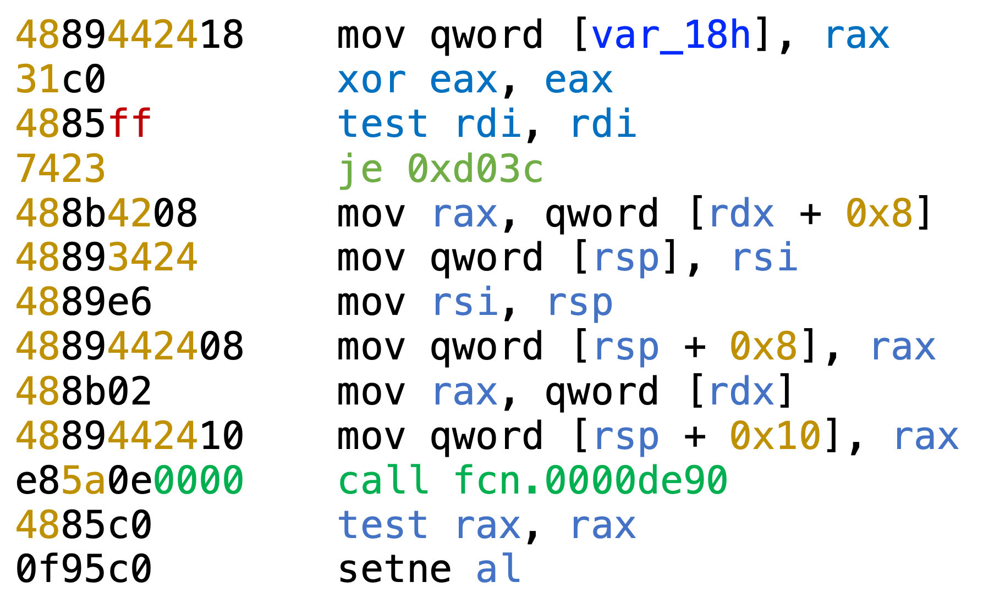
Encoding
Option 1: Vector of instructions
Requires disassembly
Additional effort to extract the architecture instructions
May require truncating a function
= instructions encoded in the vector

Slide 11
Encoding
Option 2: Raw Bytes
May cut instructions in half
May contain portions of data instead of instructions
Requires forced padding in order to tolerate variation in input length
= Chunk 1
= Chunk 2

Slide 12
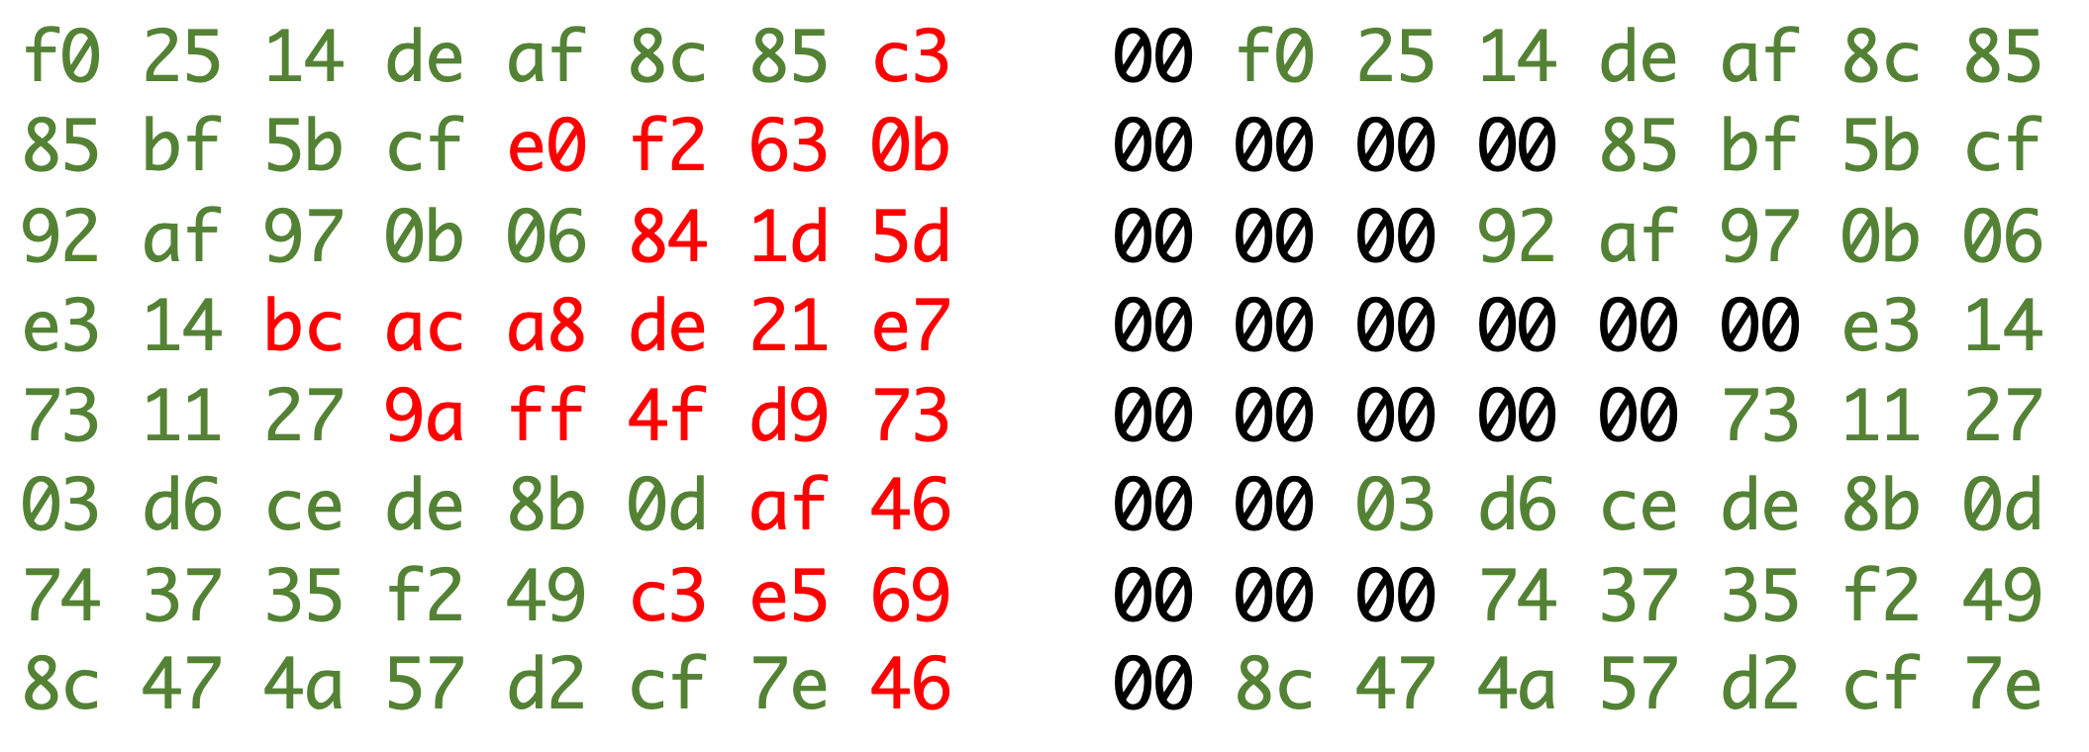
Encoding
Forced padding example
Option 2: Raw Bytes
May cut instructions in half
May contain portions of data instead of instructions
Requires forced padding in order to tolerate variation in input length

Slide 13
Encoding
Forced Padding example. Each line is one chunk
Red part of each chunk is removed (the amount is random)
Replaced with zeroes (pre-padded)

Slide 14
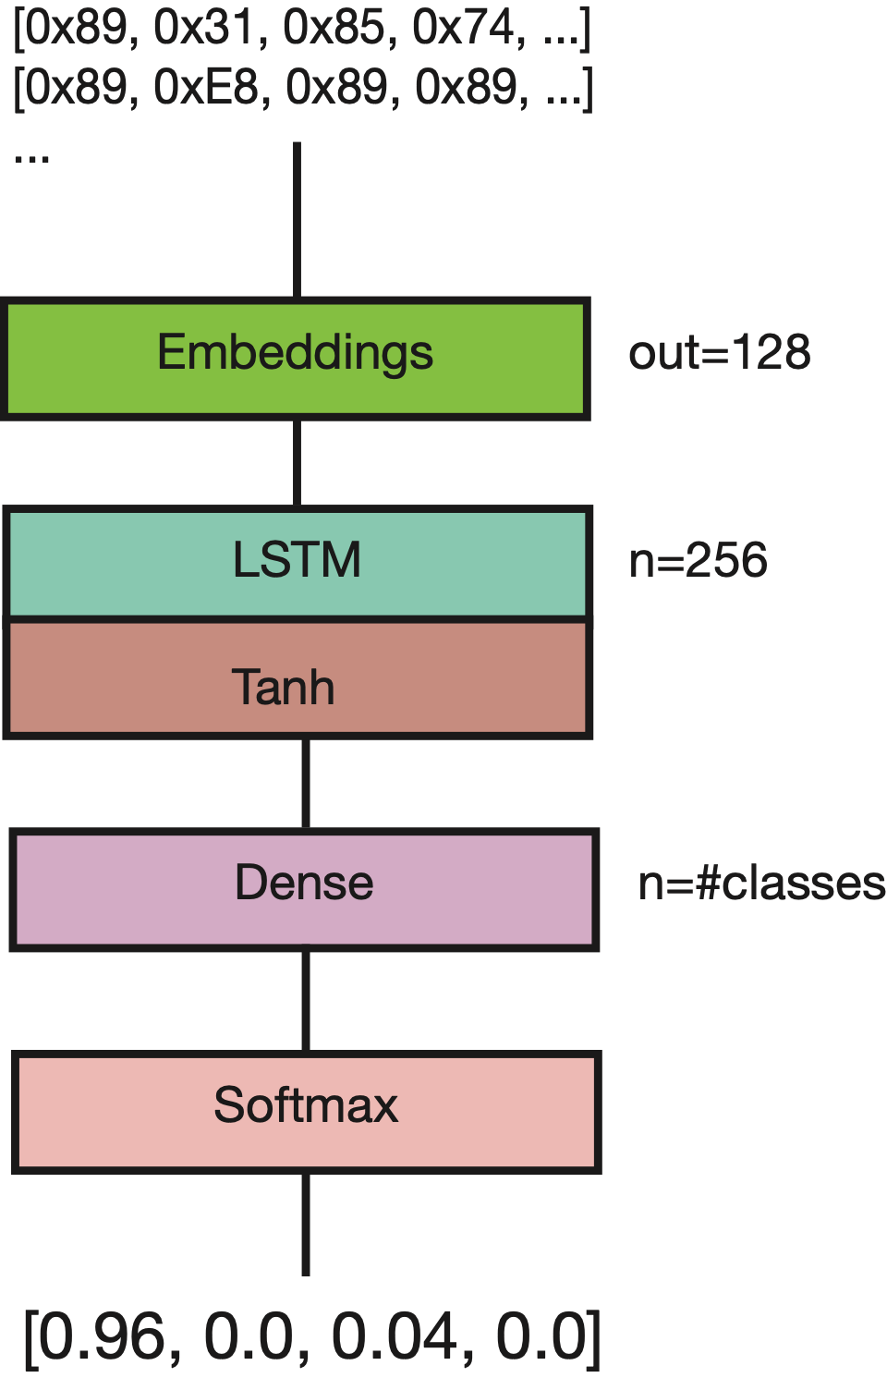
Networks

Slide 15
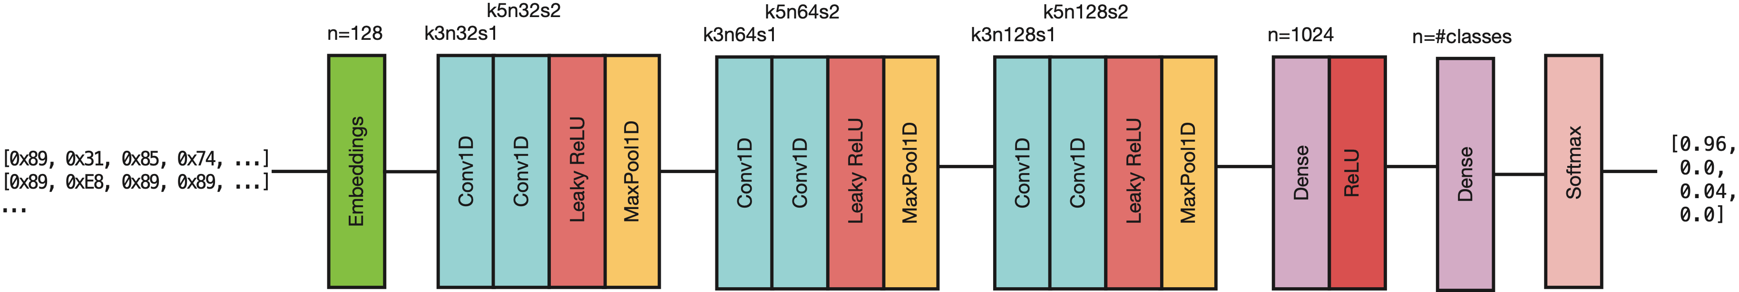
Networks

Slide 16
Evaluation
RQ1: Is it better to use the opcodes encoding or just feed raw bytes?
RQ2: How the various models perform while detecting the optimization level?
RQ3: How the various models perform while detecting the optimization level if multiple compilers are mixed?
RQ4: How the various models perform while detecting both the optimization level and the compiler used?
RQ5: Does padding during training improve the performance of the networks?

Slide 17
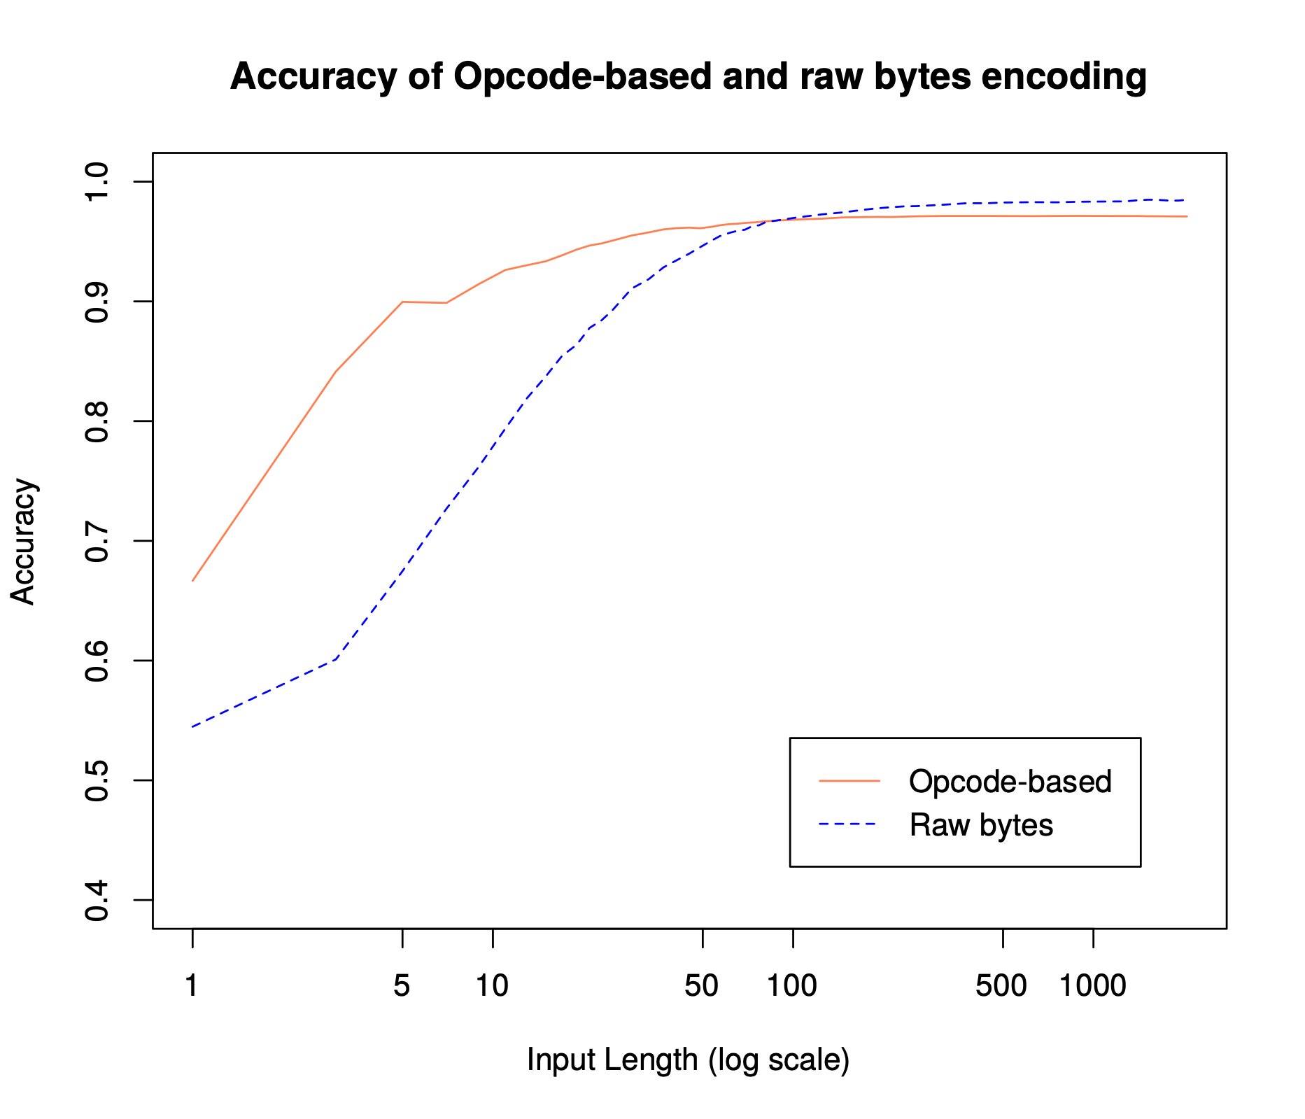
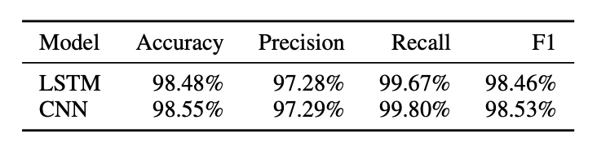
RQ1
Is it better to use the opcodes encoding or just feed raw bytes?
Metrics for Raw bytes encoding

Slide 18
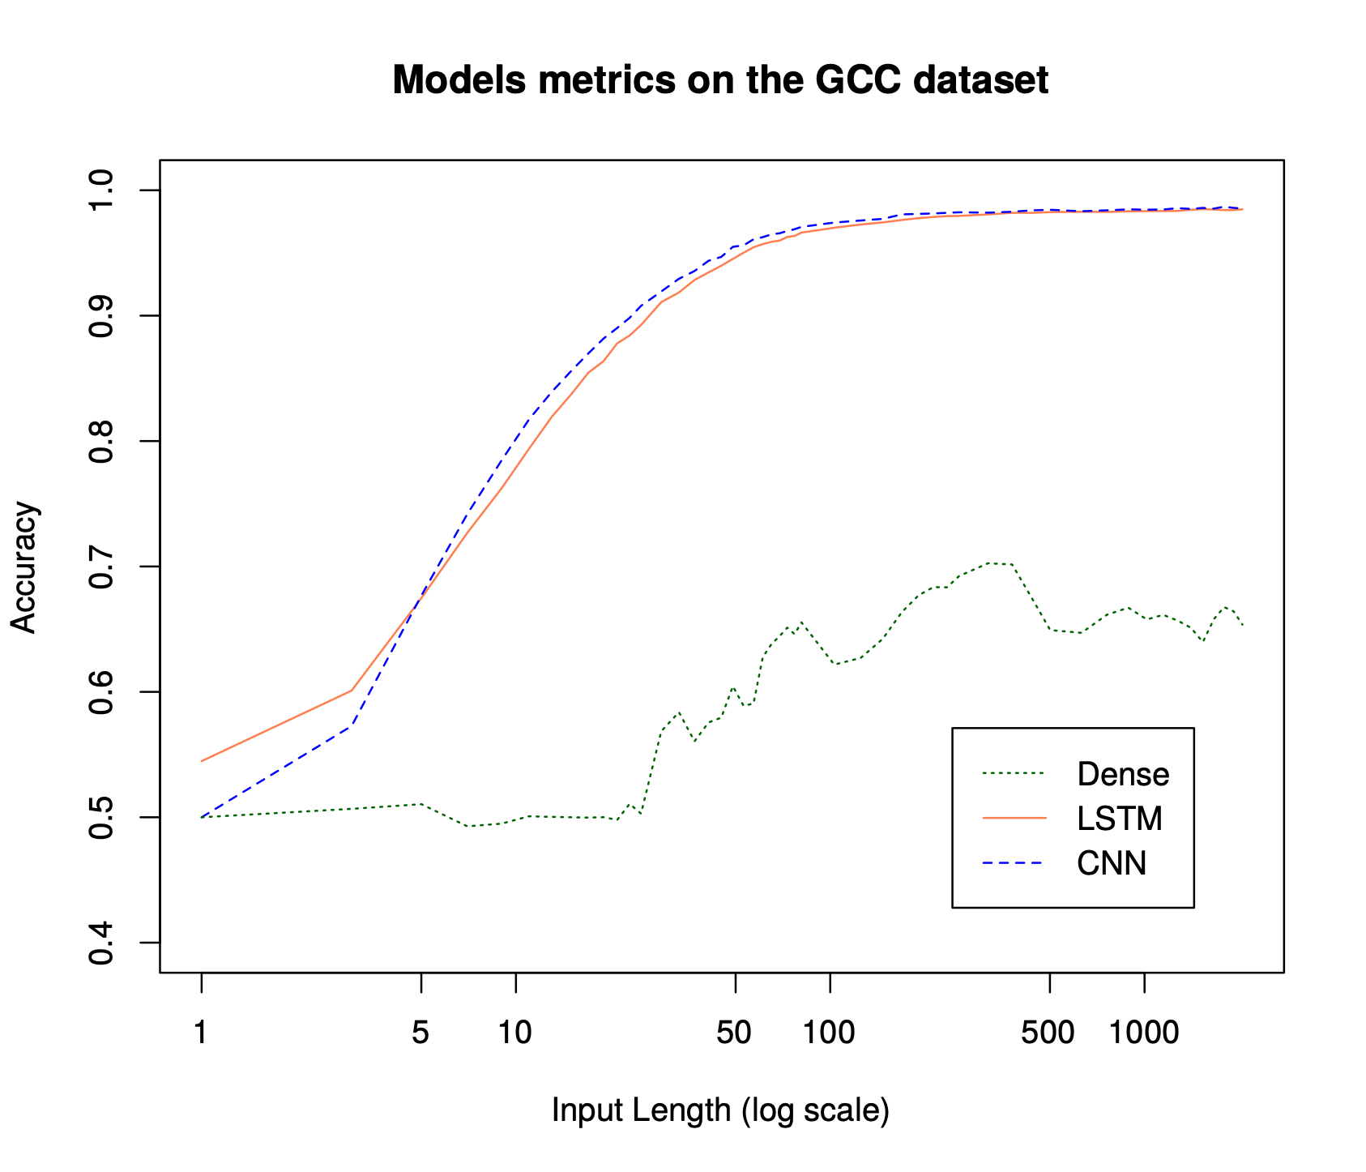
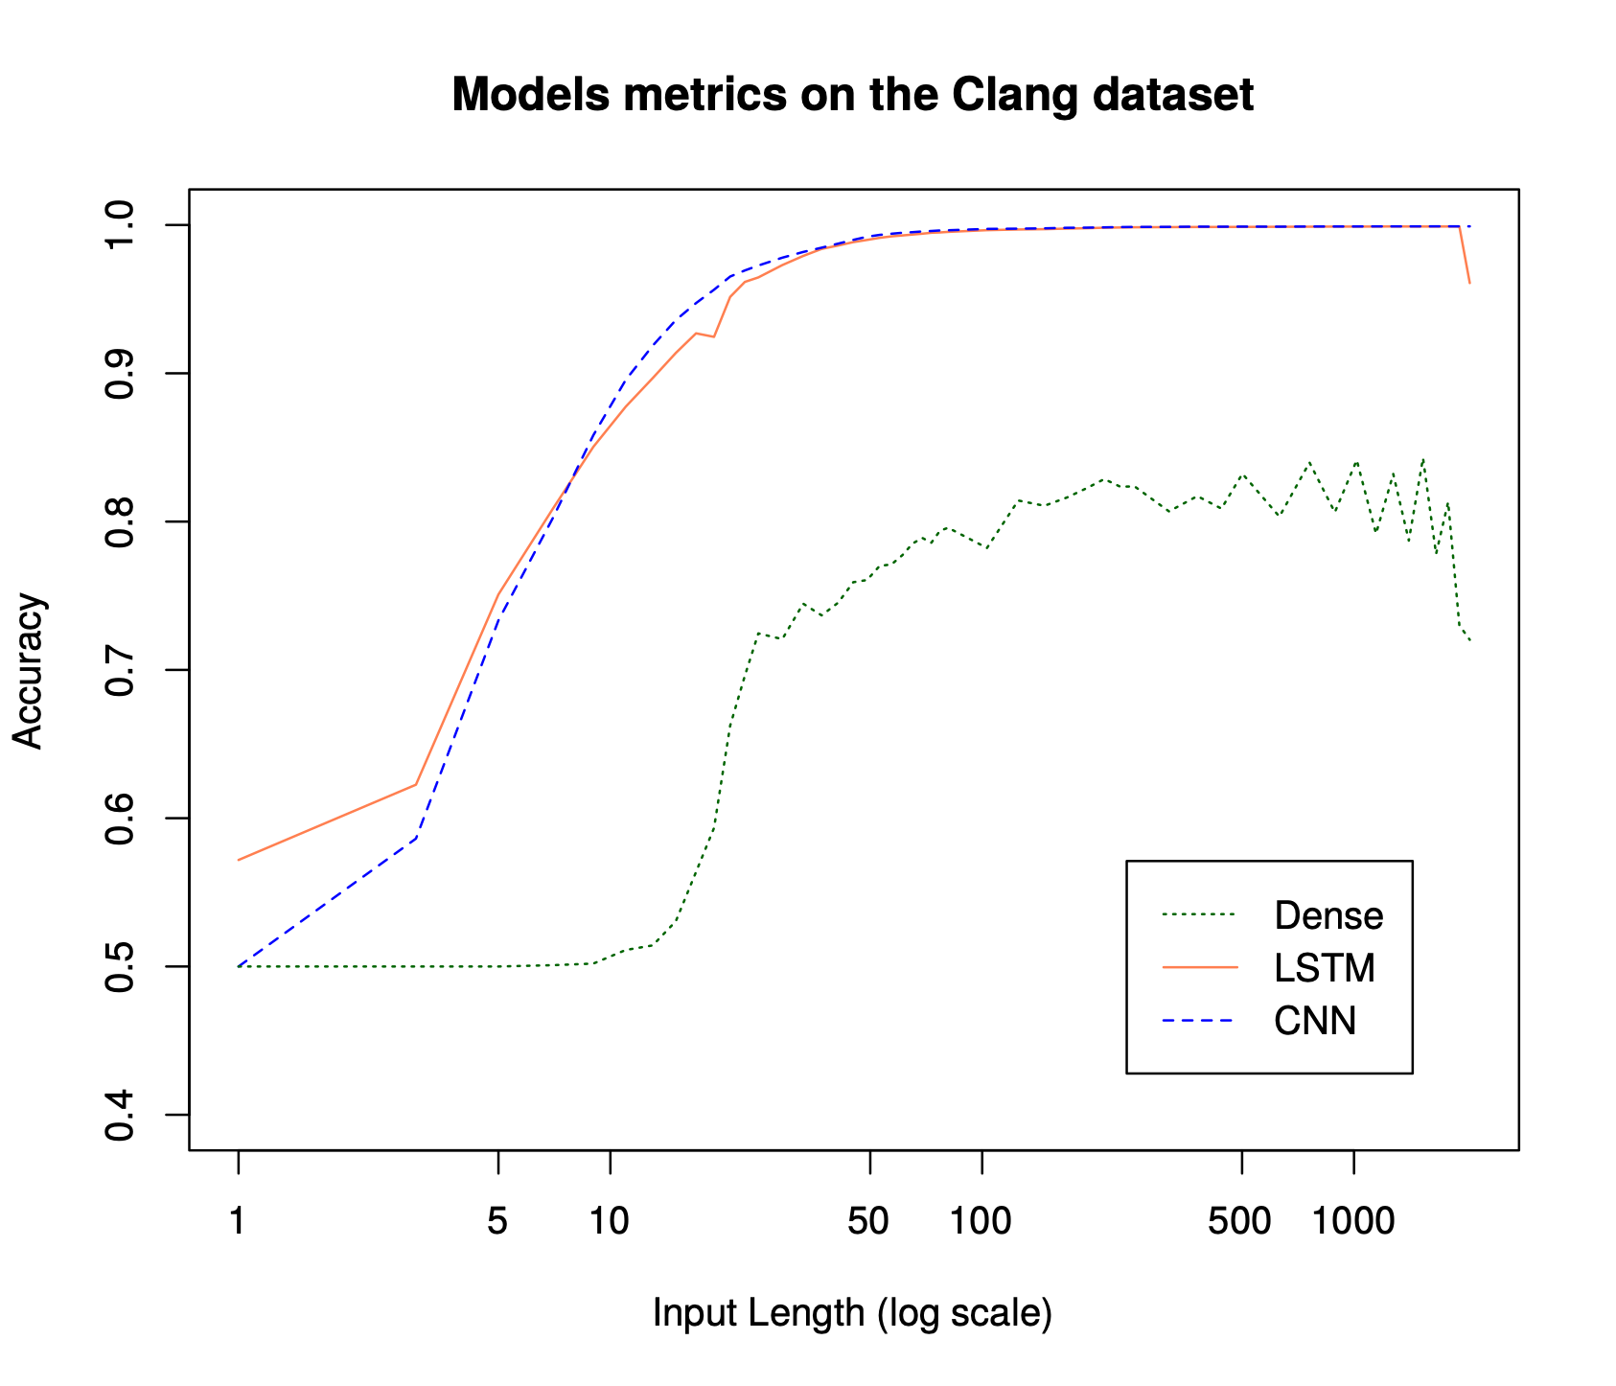
RQ2
How the various models perform while detecting the optimization level?
GCC-O0, GCC-O2
LSTM network and CNN network
Raw bytes
WEBCAM
GOES
HERE

Slide 19
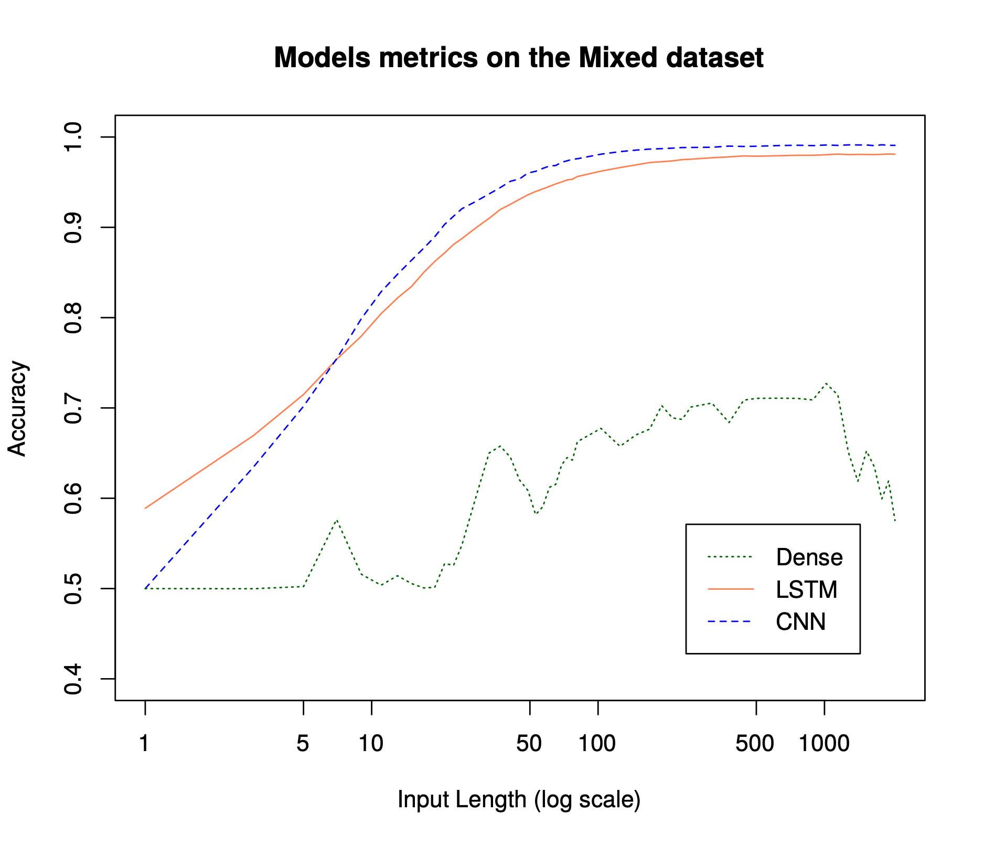
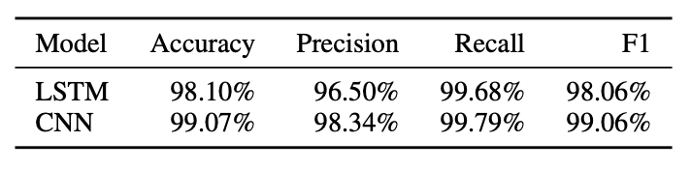
RQ3
How the various models perform while detecting the optimization level if multiple compilers are mixed?
Metrics for mixed compilers

Slide 20
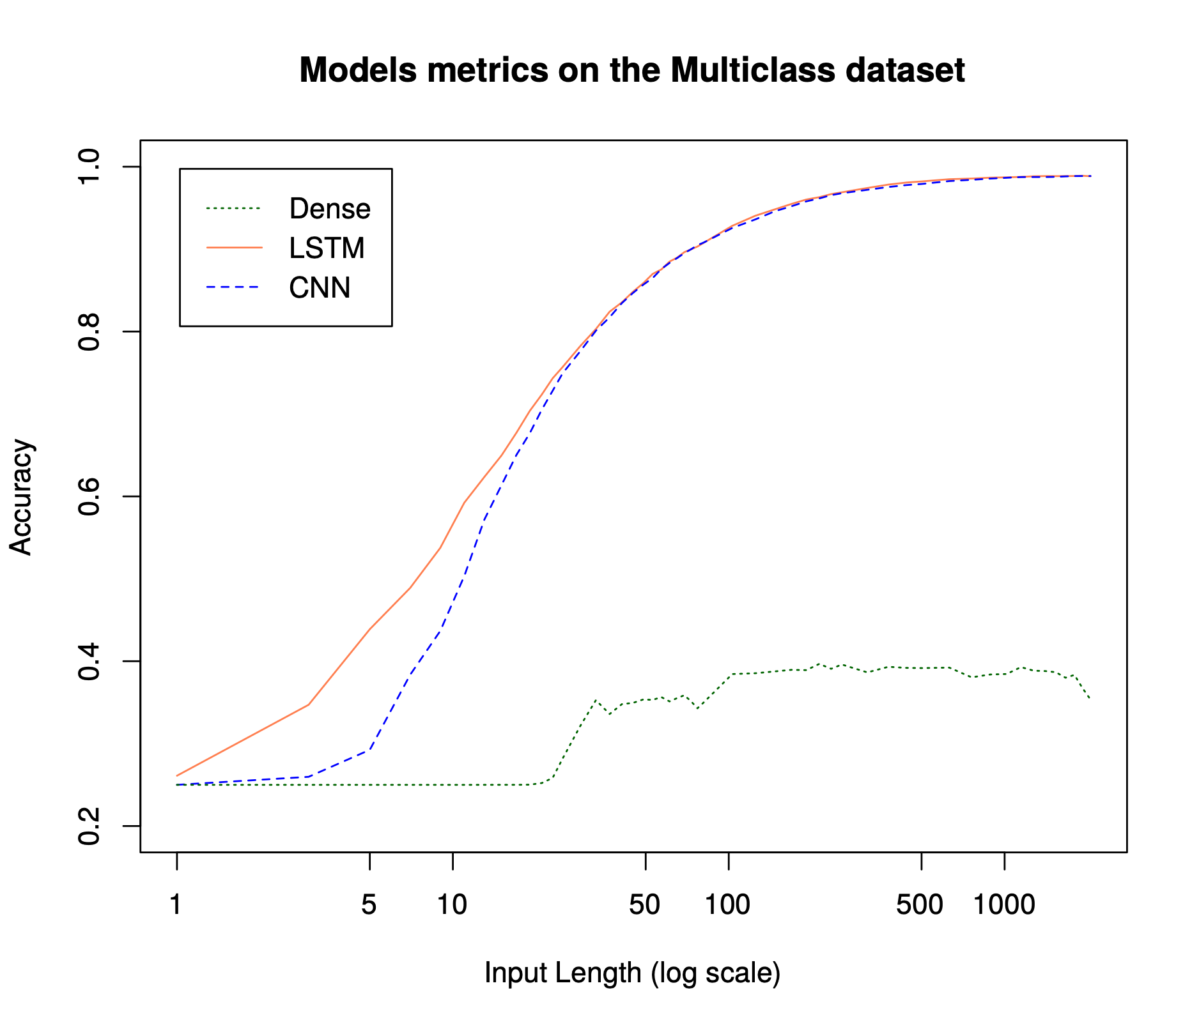
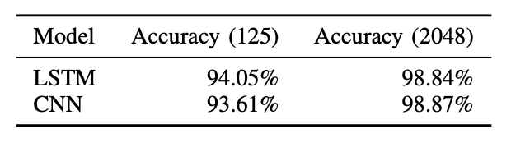
RQ4
How the various models perform while detecting both the optimization level and the compiler used?
Accuracy with 125 and 2048 bytes

Slide 21
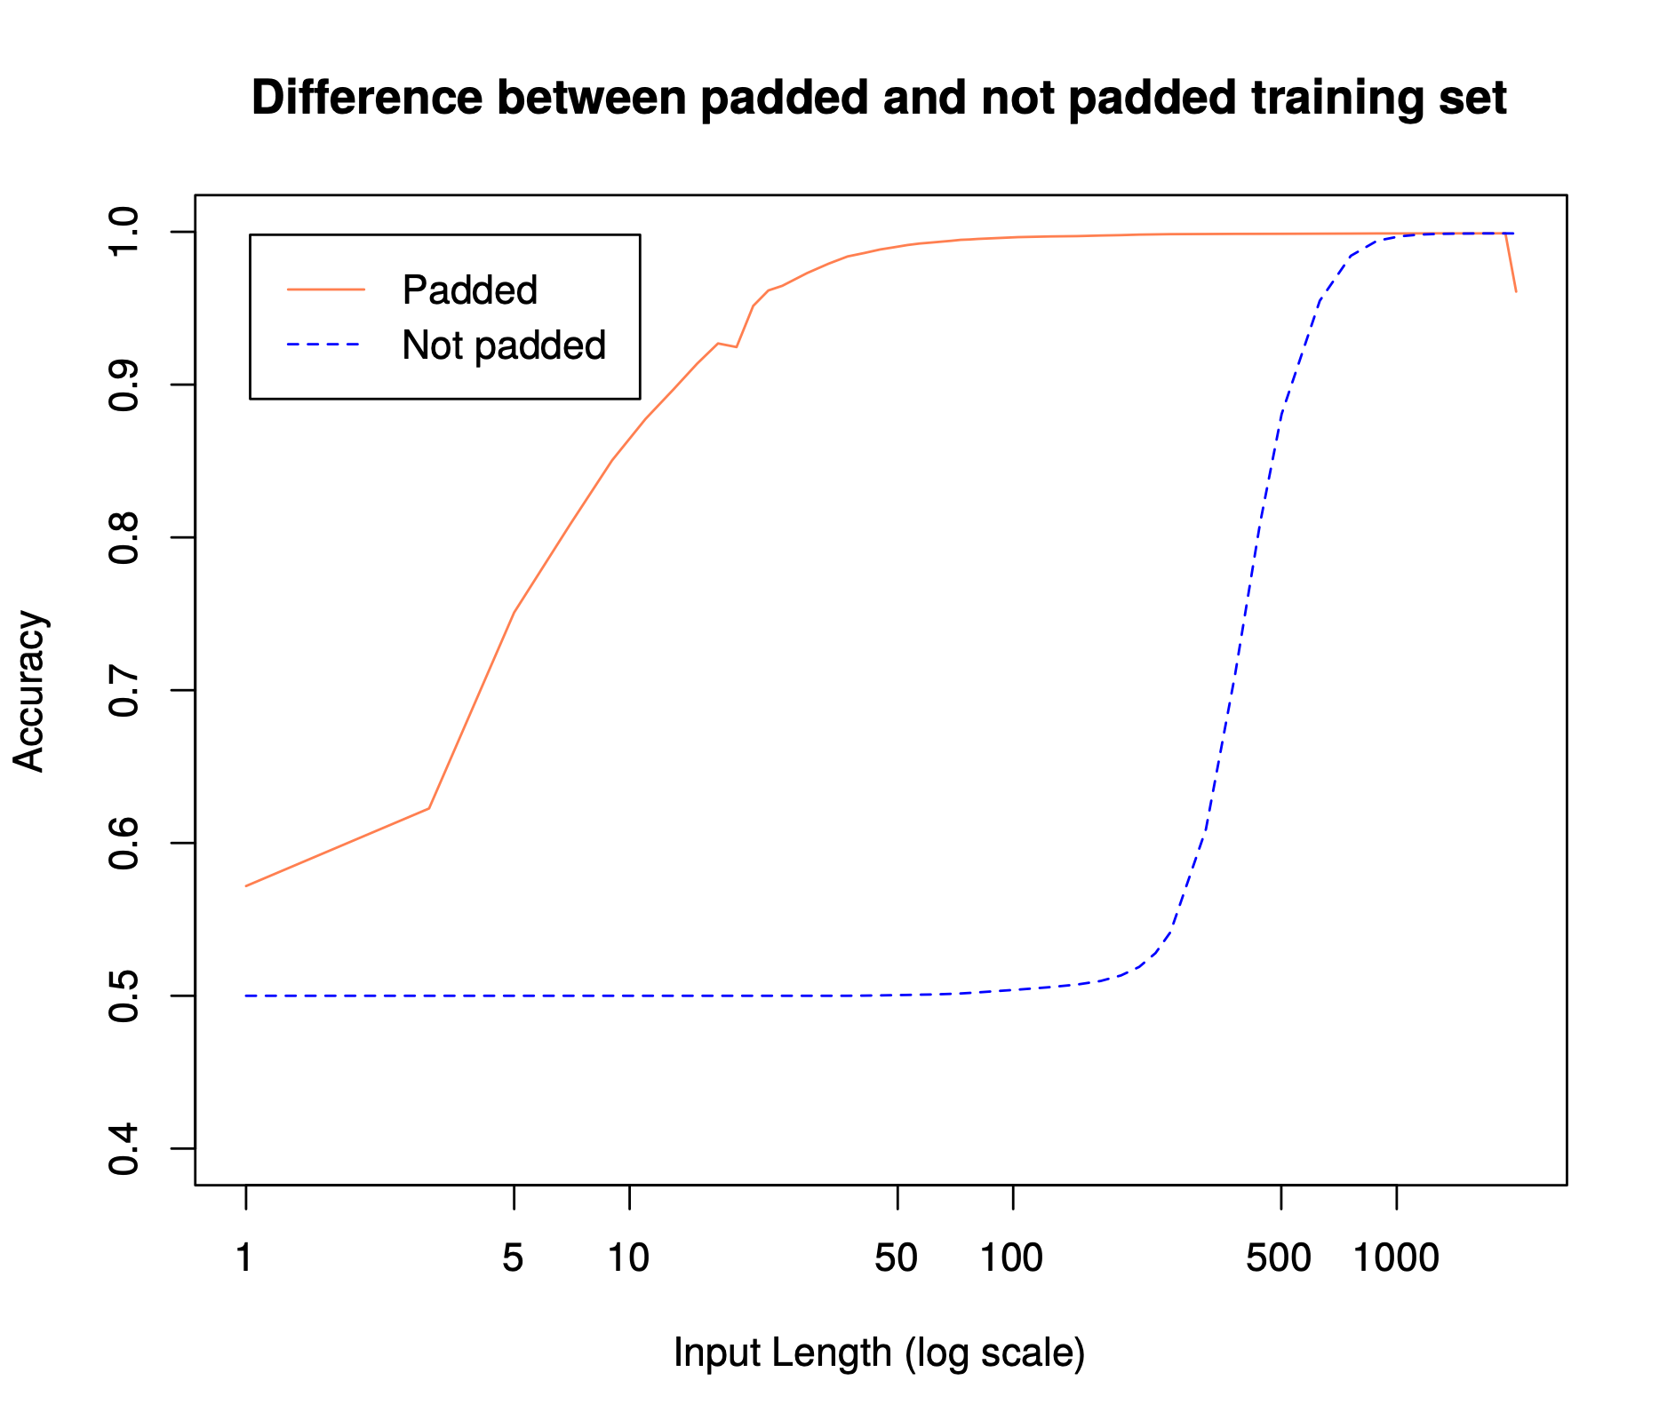
RQ5
Does padding during training improve the performance of the networks?

Slide 22

Conclusion

Slide 23
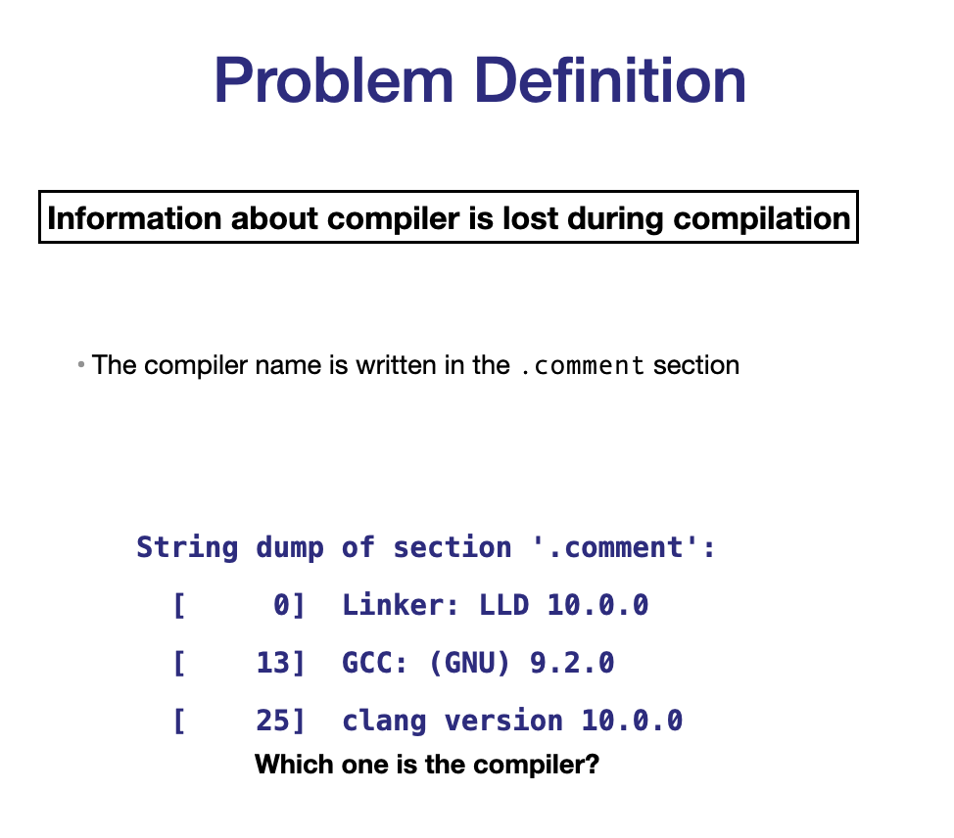
Conclusion

Slide 24
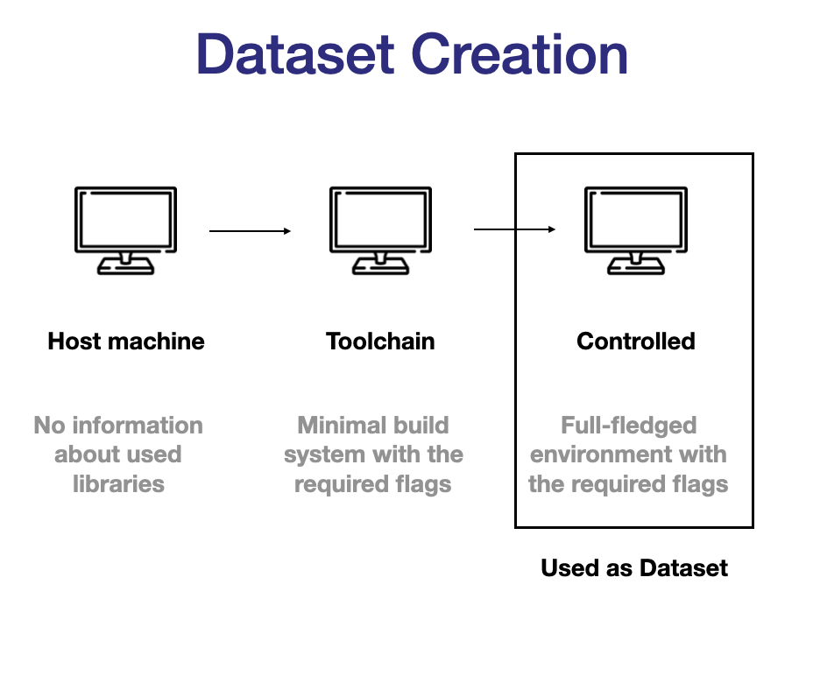
Conclusion

Slide 25
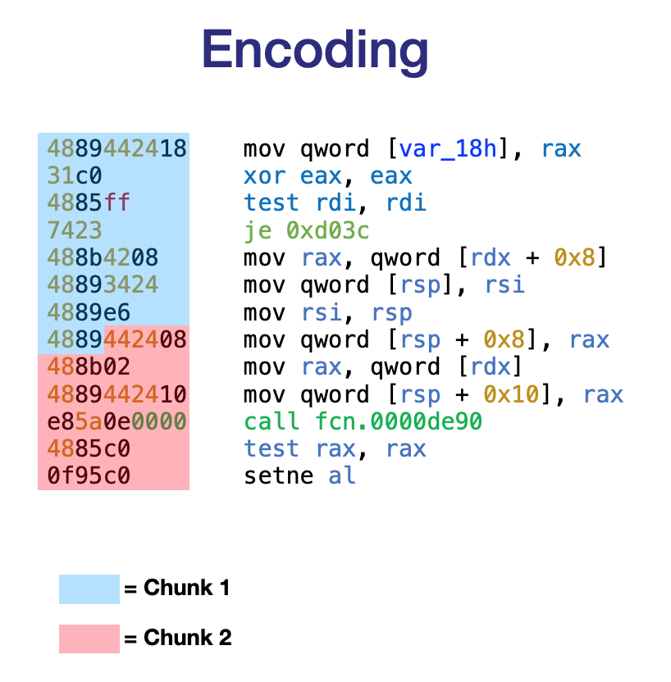
Conclusion

Slide 26
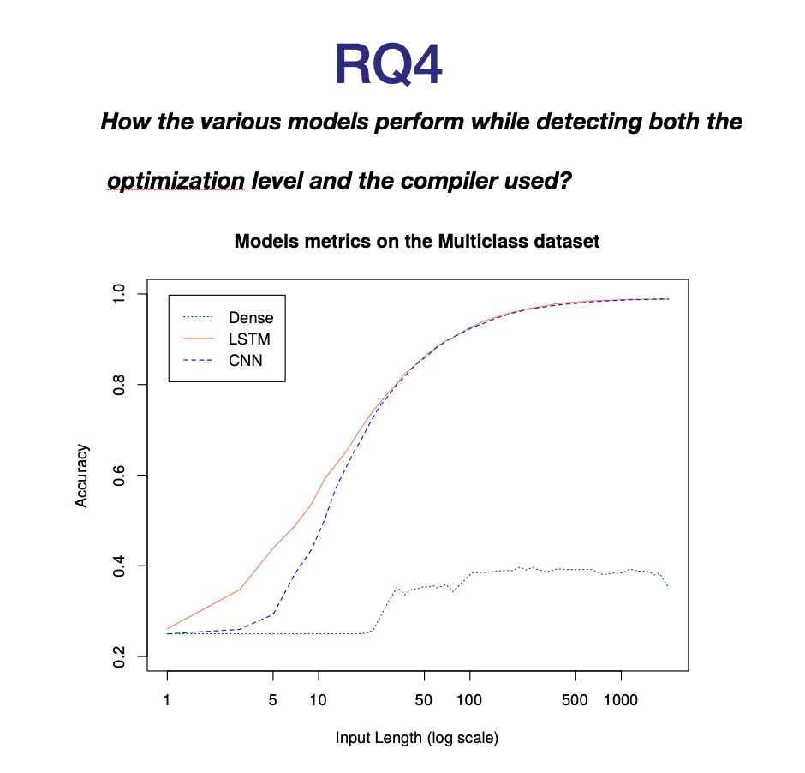
Conclusion

