Slide 1

Investigating the impact of source code metrics on merge conflict resolution judgement model
◯ Mohan Bian, Tetsuya Kanda,
Kazumasa Shimari, Katsuro Inoue

Slide 2
Background
In large-scale software development projects, it is common for multiple developers to work together.
For multi-person development, it is necessary to record information such as “when”, “who”, and “what changes were made” for trouble shooting afterwards. Therefore, a Version Control System(VCS) was frequently used.
However, there are problems when using VCS, merge conflict is one of them.

Slide 3
Merge Conflict
10 - int a;
10 + int a, b;
11 + a = 1;
12 + b = 2;
Merge Conflict
Ancestor
Commit P
Commit P1
10 int a;
++<<<<<
+ int a, b;
+ a = 1;
+ b = 2;
++======
+ int a = 1;
+ int b = 2;
++>>>>>
10 - int a;
10 + int a = 1;
11 + int b = 2;
Commit P2

Slide 4
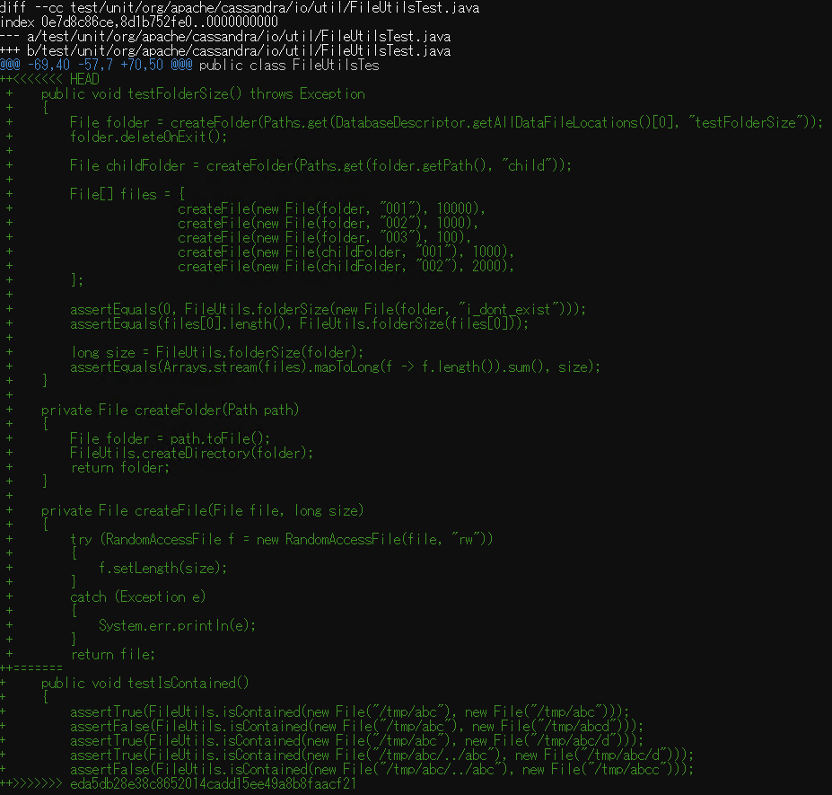
Merge Conflict
testFolderSize()
commit 1
Developer must consider
whether both tests are needed or not.
testIsContained()
commit 2
To resolve merge conflicts, it takes time and effort[1]
[1] Bakhtiar Khan Kasi and Anita Sarma. Cassandra: Proactive Conict Minimization through Optimized Task Scheduling. In Proceedings of ICSE 2013, San Francisco, CA, USA , pp. 732-741.

Slide 5
Support of resolving merge conflicts
For commit pairs where merge conflicts occur, it is often resolved by adopting one and deleting the other(98%).[2]
Shiraki[3] used machine learning to build a judging model.
propose to the developer how to resolve each commit
attempt to help resolve merge conflicts
++<<<<<
+ int a, b;
+ a = 1;
+ b = 2;
++======
+ int a = 1;
+ int b = 2;
++>>>>>
ADOPT
+ int a, b;
+ a = 1;
+ b = 2;
DELETE
An example of merge conflict resolution
[2] Yuzuki, R., Hata, H. and Matsumoto, K.: How we resolve conflict: an empirical study of method-level conflict resolution, 2015 IEEE 1st International Workshop on Software Analytics(2015)
[3] Shiraki, S., Kanda, T. and Inoue, K.: Judgment Model of Merge Conflict Resolution Pattern Using Machine Learning Meta-Information, IEICE Technical Report(2020)

Slide 6
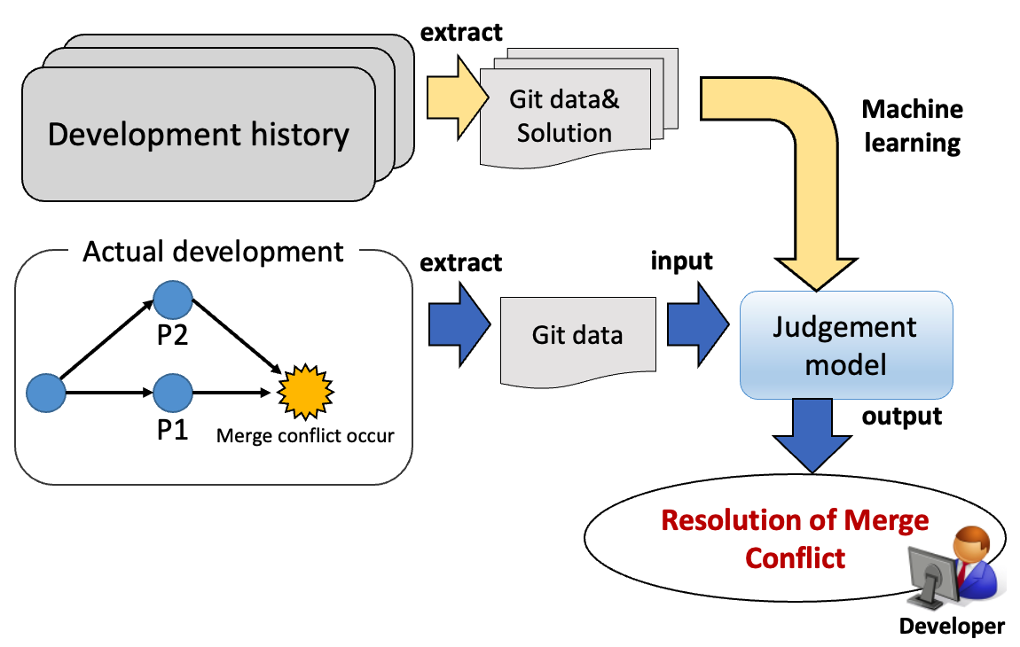
Previous Research[3]：Experimental Approach
[3] Shiraki, S., Kanda, T. and Inoue, K.: Judgment Model of Merge Conflict Resolution Pattern Using Machine Learning Meta-Information, IEICE Technical Report(2020)

Slide 7
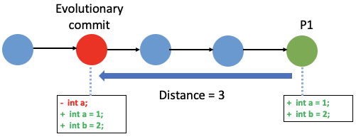
Evolutionary Commit and Distance
Latest commit may not be the cause of merge conflict.
Evolutionary Commits
  when merge conflict occur, there is a commit edited in the branch from the common ancestor to the latest commit that directly related to merge conflict.
Distance
  Defined as the distance between Evolutionary commit & latest one
the latest commit

Slide 8
Parameters used to build the model（previous research）
The following information is extracted from P1, P2 and the differences between P1, P2, and used as model parameters
line_num | (P1) | Number of lines where merge conflicts occur
 | (P2)
 | (Diff)
time | (P1) | Commit creation date and time
 | (P2)
 | (Diff)
distance | (P1) | Distance between commit and its Evolutionary Commit
 | (P2)
 | (Diff)
author_ratio | (P1) | Ratio of commit made by creator to total commit number
 | (P2)
 | (Diff)

Slide 9
Defined merge conflict resolution
++<<<<<
+ int a, b;
+ a = 1;
+ b = 2;
++======
+ int a = 1;
+ int b = 2;
++>>>>>
ADOPT
+ int a, b;
+ a = 1;
+ b = 2;
DELETE
Output : set of instructions for each commit(ADOPT, DELETE)
ADOPT | Adopt all edits
DELETE | Delete all edits
EDIT | Make edits
ZERO | 0 lines to edit
Defined merge conflict resolution instruction

Slide 10
Conclusion of previous research
20 Java projects from the OSS projects published by the Apache Software Foundation were used for the experiment
The accuracy is a result of cross-validation by dividing the merge conflict data into five for each project. Random forest algorithm was used.
  The accuracy of predicting the set of instructions(eg: [ADOPT, DELETE]) was 66.41% on average and 94.43% at maximum.

Slide 11
Discussion of previous research
In the previous research, data that could be got easily from Git was used as parameter of the judging model.
There might be more suitable parameters for building the model.

Slide 12
Our idea: Introducing source code metrics
Source code metrics are measurements of various aspects of software code.
  In Lanubile et al’s research[4], it has become clear that the complexity of the program calculated by the source code metrics is related to the defects of the program
  Ahmed et al’s studies[5] have also shown that bugs lead to merge conflicts
From the above, we realized it is possible that source code metrics are potential indicators of merge conflict.
[4] Lanubile, F., Ebert, C., Prikladnicki, R. and Vizca ıno, A Collaboration Tools for Global Software Engineering, IEEE Software, Vol. 27, No. 2, pp. 52–55 (2010).
[5] Ahmed, I., Brindescu, C., Mannan, U. A., Jensen, C. and Sarma, A.: An Empirical Examination of the Relationship Between Code Smells and Merge Conflicts, In International Symposium on Empirical Software Engineering and Measurement(ESEM), pp. 58–67 (2017).

Slide 13
Research goal
Investigate the influence of source code metrics to the judging model
To help resolve merge conflicts not only for Java but also for other language
Improve prediction accuracy by improving features in previous research

Slide 14
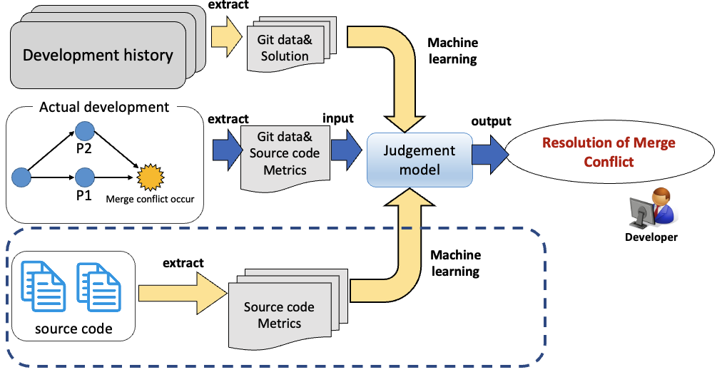
New judgement model by adding code metrics
Model Expansion

Slide 15
Newly added source code metrics
There are many source code metrics show the complexity of the program.
  For example, cyclomatic complexity, lines of code, number of operators, number of function calls, and so on.
Considering the cost of extracting the source code metrics, we decided to use source code metrics that can be easily got.
  Extracting source code metrics by a tool ➔ ANTLR
  Count the number of Name, Operators, Keywords

Slide 16
Parameter in the experiment
Name: number of variables and functions
Operators: + - * / = ! …
Keywords: if, else, continue…
parameter | Shiraki’s model | Expanded model
linenum | ✔️ | ✔️
Time | ✔️ | ✔️
author ratio | ✔️ | ✔️
distance | ✔️ | ✔️
Name_Num |  | ✔️
Operator_Num |  | ✔️
Keyword_Num |  | ✔️
Java : 34 kinds of operators
50 kinds of keywords
Python: 39 kinds of operators
35 kinds of keywords
Newly added
Code metrics

Slide 17
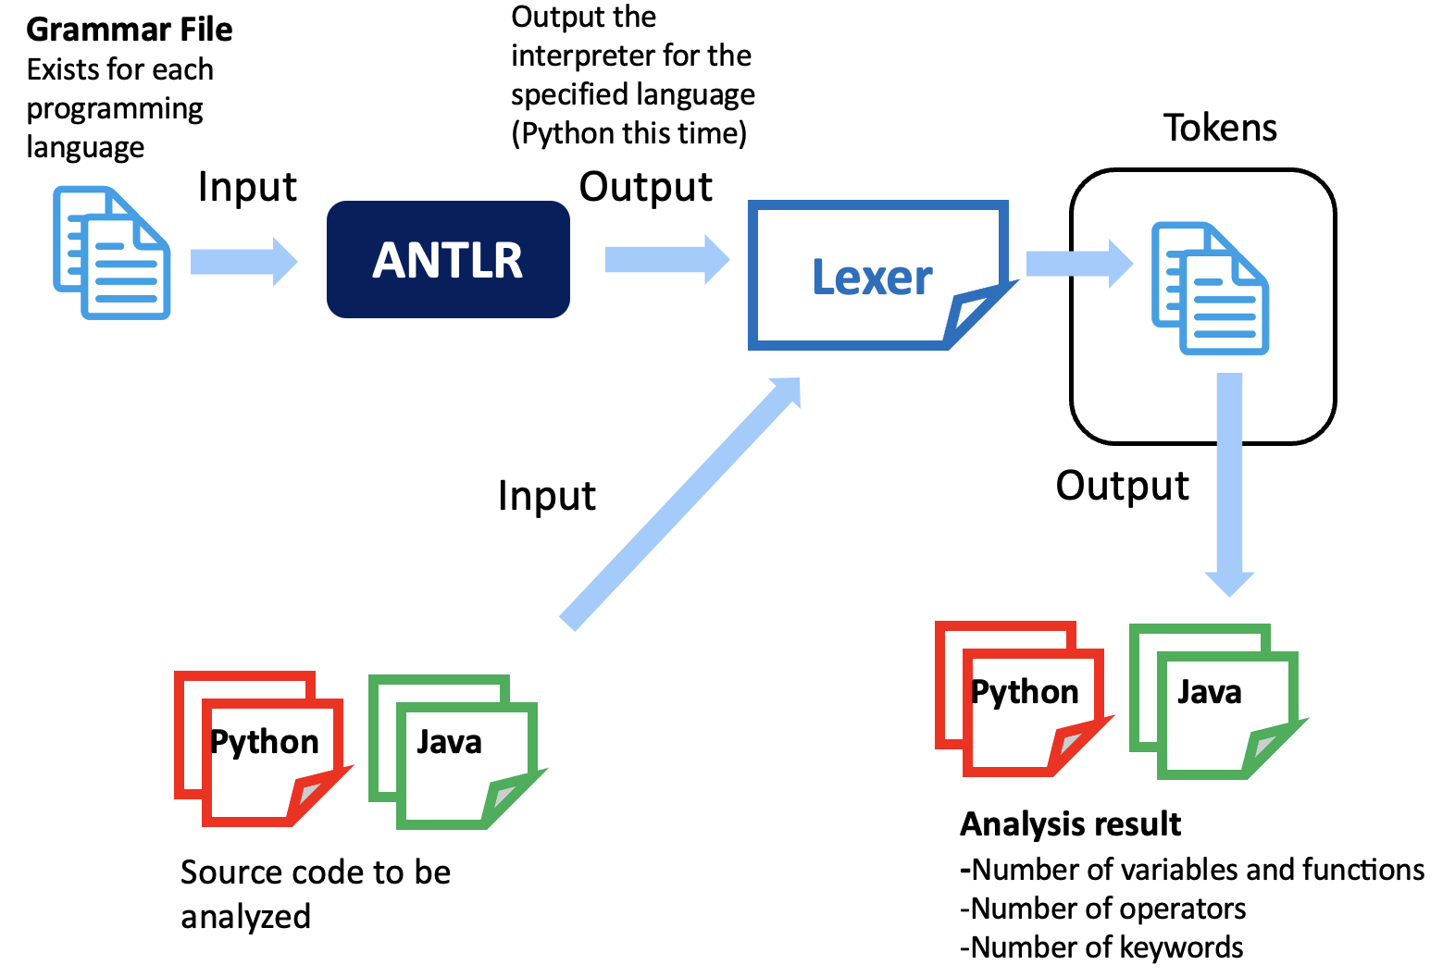
The method of extracting code metrics

Slide 18
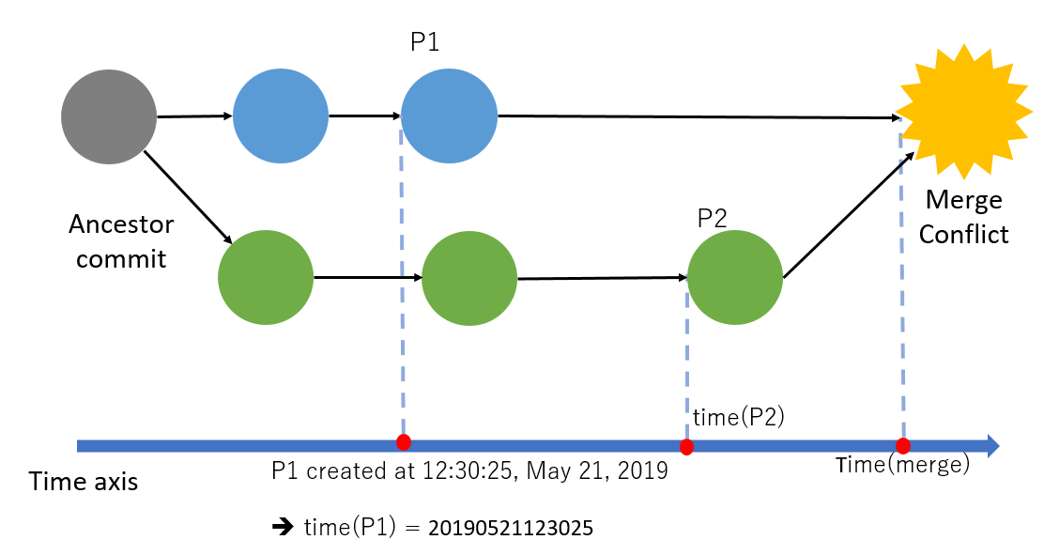
Parameter Improvement
The time feature time(P1), time(P2) used in previous research are absolute date and time, which are not suitable as parameters for the judging model.

Slide 19
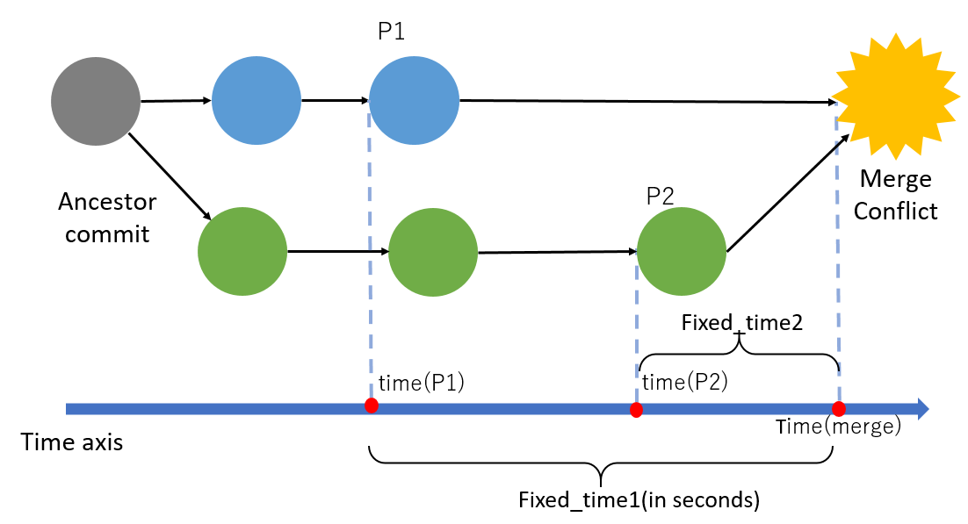
Parameter Improvement
The new time feature Fixed_time1, Fixed_time2 used in this research
absolute value ➔ relative value

Slide 20
Evaluation
Evaluate the expanded model from the following research questions
  RQ1:How does the accuracy of the model change if both developing history data and language-specific source code metrics are used in the model?
  RQ2: How is the developing history data that contributes to the judgment different between Java and Python language projects?

Slide 21
Projects used in the experiment
20 Java projects from the OSS projects published by the Apache Software Foundation.
To resolve merge conflict not only in Java, we also conduct our experiment on python projects.
  8 Python projects from the same place

Slide 22

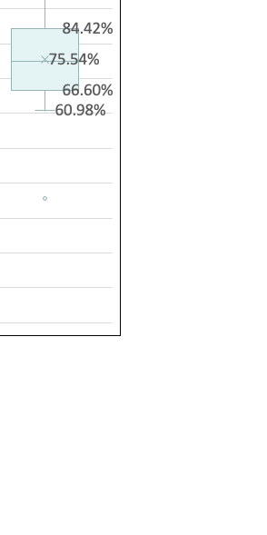
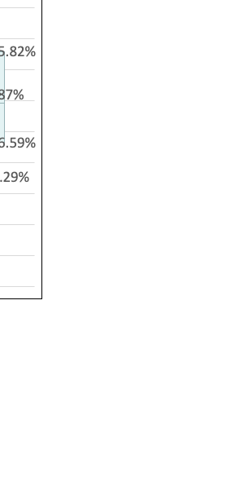
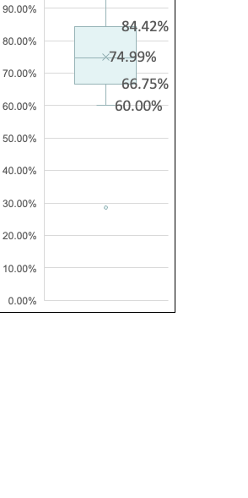
RQ1:How does the accuracy of the model change if both developing history data and language-specific source code metrics are used in the model?
Accuracy of each model
Java
Python

Slide 23
Feature importance
Blue: P1(mainstream parameter)
Red: P2(branch parameter)
Green: P1 - P2(difference)
Grey: Source code metrics
Code metrics
The importance of source code metrics is about 30%.
In all 9 source code metrics, the 3 difference source code metrics in each commit pair has bigger impact.
Code metrics

Slide 24
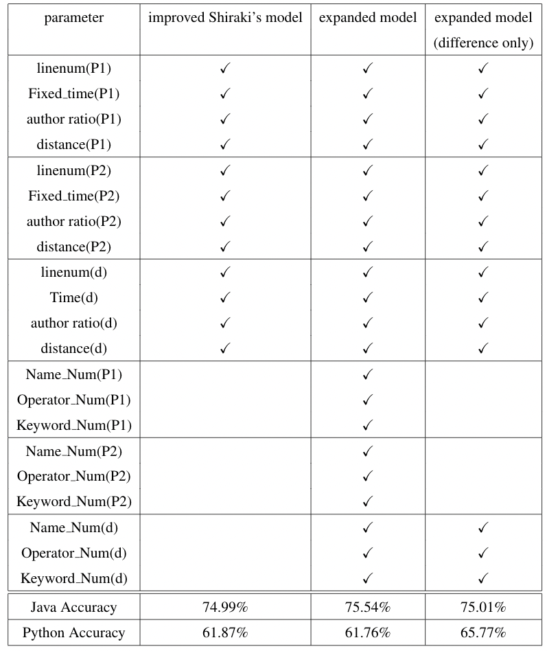
RQ1:How does the accuracy of the model change if both developing history data and language-specific source code metrics are used in the model?
By adding 9 source code metrics into the model, the accuracy didn’t change much in both Java and Python project.
With only the difference of metrics from each commit, it increased about 4% in Python.
Fixed_time(d)

Slide 25
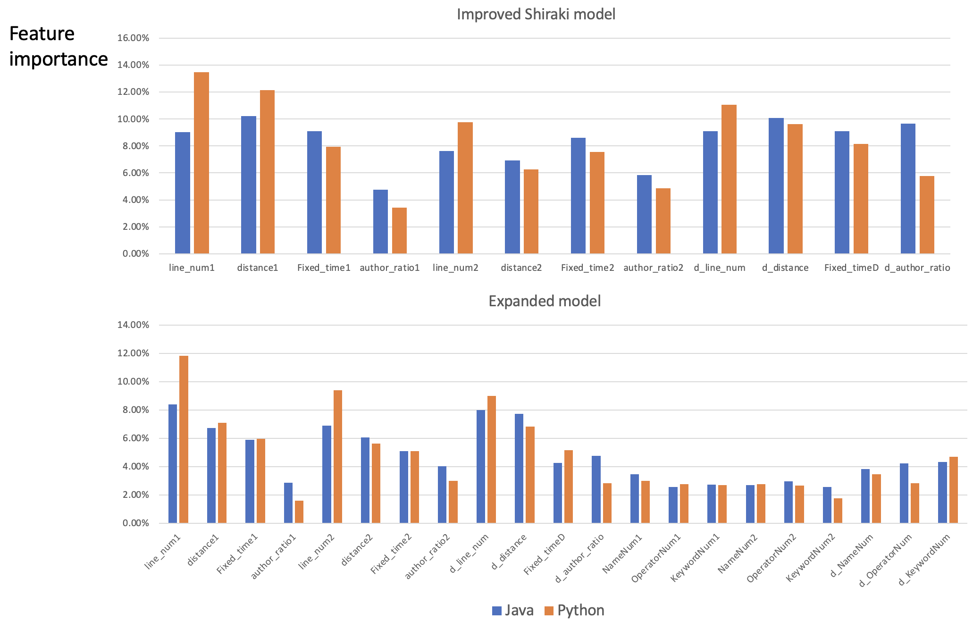
RQ2: How is the developing history data that contributes to the judgement different between Java and Python language projects?
Java project
Python project
Java project features that are of high importance tend to have high importance in Python as well.

Slide 26
RQ2: How is the developing history data that contributes to the judgement different between Java and Python language projects?
Java project features that are of high importance tend to have high importance in Python as well
It became clear that line num, distance, Fixed time, and the differences in the source code metrics of commit pair were of high importance.

Slide 27
Conclusion
We traced back to the file contents during the development phase, extracted the source code metrics, and added them to Shiraki’s model
For building the model, the importance of source code metrics is not high, but the difference of the metrics from each commit has a relative high importance
The features with high importance of the Java project tend to be of high importance also in Python

Slide 28
Future work
By extracting source code metrics from the part directly related to the conflict may contribute to the judging model more.
All the projects used in this study are OSS provided by Apache. It will be necessary to conduct research on various projects in various languages.

