Slide 1
didiffff A Viewer for Comparing Changes in both Code and Execution Traces
Tetsuya Kanda (Osaka University, Japan)
Kazumasa Shimari (NAIST, Japan)
Katsuro Inoue (Nanzan University, Japan)

Slide 2
Reviewing code changes
Changes in source code
- DELETE
+ ADD
diff
Developers are familiar with

Slide 3
Reviewing code changes
Changes in source code
Result of running changed program
- DELETE
+ ADD
diff
Only test result?
Test✘
Test✓
Why and how did the test results change?
?

Slide 4
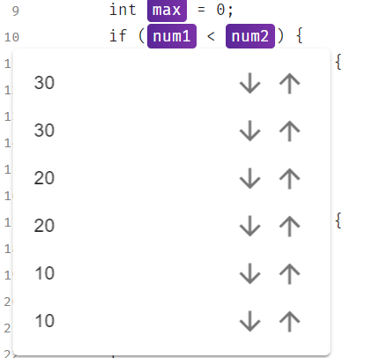
Execution Traces
(Software instruction in the execution)
Our existing tool: NOD4J
(Near-)Omniscient Debugging tool for Java
Recording execution trace and visualize variables values
Some existing tools deal with comparing multiple execution traces of the same code, different input
We would like to compare execution traces from before and after the code changes

Slide 5
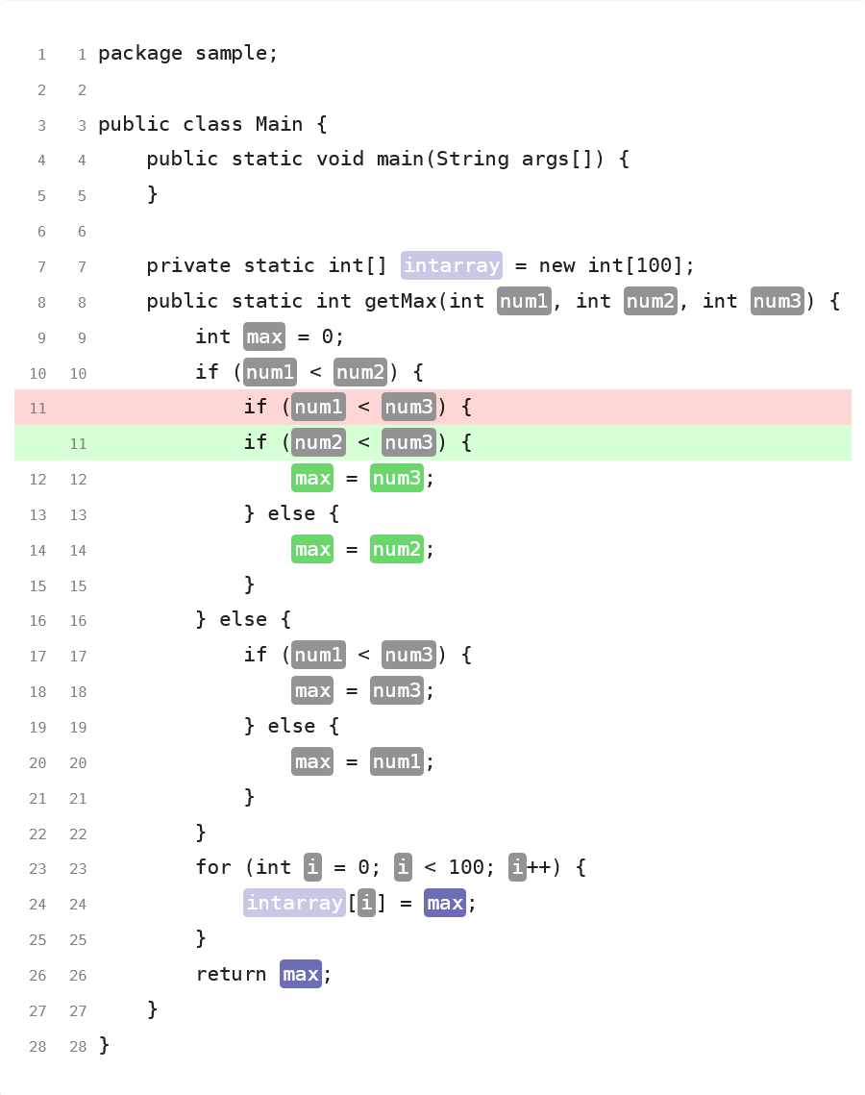
Proposed tool: didiffff
Visualizes both code changes and the difference of execution traces at a glance
Based on NOD4J
Map the difference of the execution traces on source code
Changes in code
Highlighted lines
Changes in execution traces
Highlighted variables

Slide 6
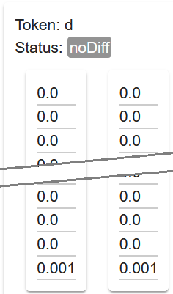
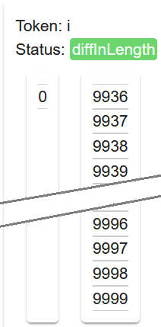
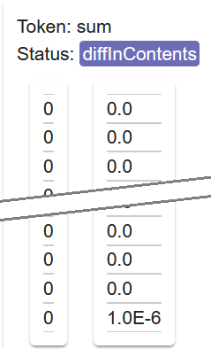
Highlighted variables & Value list view
having its execution traces
No difference or nothing to compare
Differences in trace length
(executed different times)
Same trace length, but differences in some value
Same trace length, and it is not a primitive type

Slide 7
Example Scenario
Reviewing the debug result of a bug Math57 from the Defects4J dataset
One line has been changed to fix this bug
We ran the test cases before and after the bug fix and obtained execution traces

Slide 8
VIDEO

Slide 9
didiffff A Viewer for Comparing Changes in both Code and Execution Traces
available on GitHub
https://github.com/tetsuyakanda/didiffff

