Slide 1



Selecting Test Cases based on Similarity of Runtime Information: A Case Study of an Industrial Simulator
Kazumasa Shimari, Masahiro Tanaka, Takashi Ishio, Makoto Matsushita, Katsuro Inoue, Satoru Takanezawa
Industry Track Short Paper
Notes:
OK. Let’s start my presentation.
My name is Kazumasa Shimari. I am an assistant professor from NAIST Japan.
Today, I would like to present our paper, entitled Selecting Test Cases based on Similarity of Runtime Information: A Case Study of an Industrial Simulator.
This paper is a short paper in Industry track.
And, this is a collaboration work with Japanese company, DAIKIN Industries. The company achieves top air conditioner share in the world.

Slide 2

Background: Industrial Simulator
DAIKIN Industries develops and maintains a simulator for air conditioner design
More than tens of millions of simulations have been performed in five years and recorded as test cases
Calculation conditions (Circuit name, Parameters)
Simulation output
(Thermal efficiency)
Simulator
User
Notes:
First, I will explain our case study target, Industrial Simulator.
Our collaborating company, DAIKIN Industries develops and maintains a simulator for air conditioner design.
This simulator is frequently used to simulate thermodynamic and fluid mechanic.
Users send calculation conditions to the simulator and receive the simulation’s output, which includes Thermal efficiency of the structure.

Slide 3
Background: Industrial Simulator
DAIKIN Industries develops and maintains a simulator for air conditioner design
More than tens of millions of simulations have been performed in five years and recorded as test cases
Calculation conditions (Circuit name, Parameters)
Record execution as test cases
Simulation output
(Thermal efficiency)
Simulator
Test cases
User
Notes:
Simulator users have performed more than tens of millions of simulations in five years.
Their simulation input and output are recorded as test cases. A large number of test cases are recorded.
~1:20

Slide 4

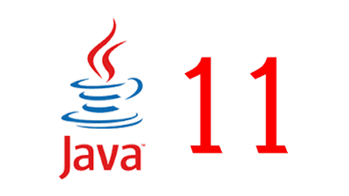

Motivating Example: Updating Dependency
Simulator
Regression Testing
Developer
Notes:
Next, I will explain our motivating example about the industrial simulator.
To maintain the simulator, developers have to update its dependencies. In this example, developers updated the JDK version from JDK 8 to JDK 11 and performed regression testing.

Slide 5
Motivating Example: Updating Dependency
Calculation conditions
User
Simulator
Insufficient Coverage
Regression Testing
Developer
Notes:
However, a few months after the regression testing, a simulator failure occurred
The cause of the failure was a behavior change of the Java standard library, which prevented several simulations from running properly.
In this regression testing, the test cases‘ coverage are insufficient, so the test cases did not cover a corner case. It leads to the failure.

Slide 6
Motivating Example: Updating Dependency
Calculation conditions
Test cases
User
Simulator
Insufficient Coverage
Selecting Test cases
Regression Testing
High Coverage
Diverse Execution Time
Execute within one night
Developer
Notes:
To deal with this problem, we would like to improve the coverage.
So, we decide to use a large number of recorded test cases.
In this presentation, we report our approach which selects a small number of effective test cases from a large number of test cases.
The requirements from the developers are like that. High coverage, diverse execution time, which includes both short simulations and long simulations, and overall execution time is within one night.
~2:30

Slide 7

Our Test Case Selection Method
STEP I：
Collect Runtime Information
STEP II：
Classify Similar Execution
Simulator with SELogger [1]
Selected Test Cases
Test Cases
[1] Kazumasa Shimari, Takashi Ishio, Tetsuya Kanda, Naoto Ishida, Katsuro Inoue, “NOD4J: Near-Omniscient Debugging Tool for Java Using Size-Limited Execution Trace,” Science of Computer Programming, vol.206, pp102630, June 2021
Notes:
We describe an overview of our approach.
First, we prepare the simulator with our logger and a large number of recorded test cases as inputs.
Then we collect runtime information for each test case, and classify test cases based on their execution similarity, and select their representative test cases.
~3:00

Slide 8
STEP I: Collect Runtime Information (1/2)
Simulator source code
Runtime information
Event Name | Location | Execution Count
Method Entry | Line 1 | 1
Method Parameter | Line 1 | 1
Local Variable Load | Line 2 | 1
Local Variable Load | Line 3 | 4
Local Variable Load | Line 4 | 3
Method Call | Line 4 | 3
Local Variable Store | Line 4 | 3
Local Variable Store | Line 6 | 0
Local Variable Load | Line 8 | 1
Method Normal Exit | Line 9 | 1
1: void methodA (int var) {
2: if (var > 0) {
3: while (var > 0)
4: var = methodB(var);
5: } else {
6: var = 0;
7: }
8: System.out.println(var);
9: }
Simulator with SELogger [1]
Test Cases
[1] Kazumasa Shimari, Takashi Ishio, Tetsuya Kanda, Naoto Ishida, Katsuro Inoue, “NOD4J: Near-Omniscient Debugging Tool for Java Using Size-Limited Execution Trace,” Science of Computer Programming, vol.206, pp102630, June 2021
Notes:
We describe the detail of each step.
In STEP I, we collect runtime information for each test case by using our logger which can record Java bytecode instructions.
This is an example of collected runtime information for the simulator source code.
The runtime information consists of runtime events name and their location, and their execution counts.
In this example, Method Entry event is executed and the while loop from line 3 to line 4 is executed three times, so some events are repeatedly executed. At last method exit event is executed. We record this execution.
3:40

Slide 9
STEP I: Collect Runtime Information (2/2)
Runtime information
Event Name | Location | Execution Count
Method Entry | Line 1 | 1
Method Parameter | Line 1 | 1
Local Variable Load | Line 2 | 1
Local Variable Load | Line 3 | 4
Local Variable Load | Line 4 | 3
Method Call | Line 4 | 3
Local Variable Store | Line 4 | 3
Local Variable Store | Line 6 | 0
Local Variable Load | Line 8 | 1
Method Normal Exit | Line 9 | 1
Instruction vector
Test ID | Vector
1 | [1,1,1,4,3,3,3,0,1,1,…]
… | …
Notes:
Then, our method translates these recorded information into a vector of integers with test ID.
The length of the vector in our method is the number of bytecode instructions in the program.
For each test case, we record these runtime information and translated to the instruction vectors.
4:00

Slide 10
STEP II: Classify Similar Execution
Clustered instruction vectors
K-means clustering method
Test ID | Vector
1 | [1,1,1,4,3,3,3,0,1,1,…]
3 | [1,1,1,3,2,2,2,0,1,1,…]
… | …
Instruction vectors
Selected oldest test cases
Test ID | Vector
1 | [1,1,1,4,3,3,3,0,1,1,…]
2 | [1,1,1,3,2,2,2,0,1,1,…]
3 | [1,1,1,3,2,2,2,0,1,1,…]
4 | [1,1,1,0,0,0,0,1,1,1,…]
5 | [1,1,1,50,49,49,49,0,1,1,…]
… | …
Selected ID
1
2
5
Test ID | Vector
2 | [1,1,1,0,0,0,0,1,1,1,…]
4 | [1,1,1,0,0,0,0,1,1,1,…]
… | …
Test ID | Vector
5 | [1,1,1,50,49,49,49,0,1,1,…]
… | …
Notes:
Then, we classify these vectors into groups using the k-means clustering method.
We adopt the k-means method because this method has less computational complexity than hierarchical clustering.
We use Euclidean distance when measuring the distance between vectors. The distance distinguishes a short simulation from a long simulation. After the clustering, we select the oldest test case from each cluster as the representative test cases because they are the first test cases that triggered new behaviors of the simulator.
~4:40

Slide 11
Case Study
Purpose: Understanding the usefulness of our method
Target: Industrial Simulator
Two perspectives:
Coverage
Execution Time Diversity
Simulator
Notes:
We have conducted case study. We apply our test selection method to the industrial simulator to understand the usefulness of our method.
we measure the code coverage and the execution time diversity of selected test cases.

Slide 12
Case Study - Settings
Target simulator:
61 classes, 509 methods, 21,527 lines
Select Test Cases:
Maximum 1,000 simulation * 10 days = 9,612 test cases -> 100 test cases (K=100)
Three Baselines:
Boolean-based selection: (a variant of our method using a 0-1 vector)
Random selection: (chronologically random)
Component-based selection: (14 simulation Component * 7 or 8 test cases)
Current method in the collaborating company
Notes:
This is the settings of our method.
The target simulator has sixty classes, five-hundred methods, and twenty-one thousands lines.
We collect ten days of test cases for the case study, with a maximum of one thousand test cases per day.
We decided to use k = 100 after a discussion with developers.
We use three baselines. These methods also select 100 test cases.:
The Boolean-based selection is a variant of our method using a 0-1 vector. It is introduced to evaluate the importance of execution counts.
In Random selection, we selected test cases chronologically random.
Component-based selection is the method used by software developers in collaborating company.
We selected 7 or 8 test cases for each fourteen simulation component.

Slide 13
Case Study - Coverage
Relative Coverage = Selection Method Coverage / All Test Cases Coverage
Test Case Selection Method | Relative Instruction Coverage
Our clustering-based selection | 99.76%
Boolean-based selection(Baseline1) | 99.88%
Random selection (Baseline2) | 65.72%
Component-based selection (Baseline3) | 97.73%
All Test Cases Coverage | 100.00%
We can select test cases that cover different execution using the runtime information.
Notes:
Then, I’ll show you the result.
This table shows the relative coverage of each method. This coverage is calculated by selection method coverage divided by all test cases coverage.
From this result, we confirm that our clustering-based method and the Boolean-based method outperform other baselines. We can select test cases that cover different execution using the runtime information.

Slide 14
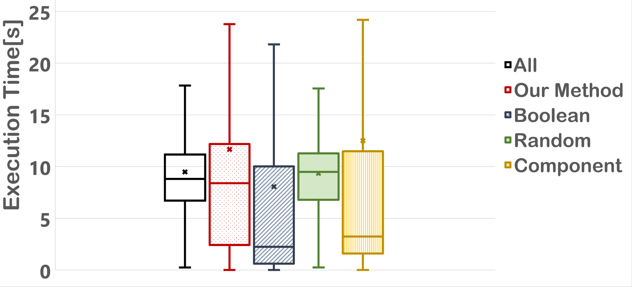
Case Study - Execution Time Diversity
Notes:
This is a result of the execution time diversity excluding outliers.

Slide 15
Case Study - Execution Time Diversity
Our method achieved the execution time diversity by
distinguishing complex executions from simple executions.
aaa
Notes:
Especially focusing on the median, our method and the Random selection resulted in similar distributions to the all distribution.
On the other hand, Boolean-based method and the Component-based method resulted in different distributions from the all distribution.
By using the information of instruction execution count, we could distinguish complex execution from simple execution. Thus we achieved the execution time diversity by considering the execution count.

Slide 16

Field Experiment
Regression Testing with
our selected test Cases
Developer
Simulator
Notes:
At last, we conduct a field experiment.
Based on the case study results, our collaborating company’s developers decided to use our method for their dependency update activity.
They decided to update their JDK from 11 to JDK 17 and tested their simulator using our selected test cases.

Slide 17
Field Experiment
Regression Testing with
our selected test Cases
working without failure for six months (until now)
Developer
Simulator
Comments
High Coverage
Diverse Execution Time
Execute within one night
Notes:
In this experiment, our selected test cases did not find any incompatibilities. However, the simulator is working without failure for six months until now.
Developers commented that the execution time was short enough that it did not affect the execution of the simulator. They considered that these selected test cases contained various coverage and execution times , which are better than those of their previous method.
From this comment, we conclude that our test case selection method is useful for selecting the representative test cases from a large number of test cases.

Slide 18
Conclusion
We report the current test case selection practice for industrial simulator.
Runtime-Information-based method allows selecting test cases with high coverage and diversity of execution time.
Software developers in the company used a small number of test cases to quickly check the impact of dependency updates.
For Future work, we would like to select test cases having various execution paths from all recorded test cases in a practical time.
Combine our method with the Component-based selection
Notes:
I summarize the presentation. We report the current test case selection practice for industrial simulator and show the usefulness of our runtime-information-based approach.
From this collaboration, we found that software developers in the company used a very small number of test cases to quickly check the impact of dependency updates, even though they had a sufficient number of test cases.
For Future work, we would like to select test cases having various execution paths from all recorded test cases in a practical time by combining our method with the Component-based selection.

Slide 19
Case Study – Execution Time Diversity
既存手法や回数情報を考慮しない場合と比較して， 回数情報を考慮した場合は多様な実行時間を示している

Slide 20
Lessons Learned
We report the current test case selection practice for industrial simulator.
Runtime-Information-based method allows selecting test cases with high coverage and diversity of execution time.
For Future work, we would like to select test cases having various execution paths from tens of millions of test cases in a practical time.
Combine our method with the Component-based selection

Slide 21
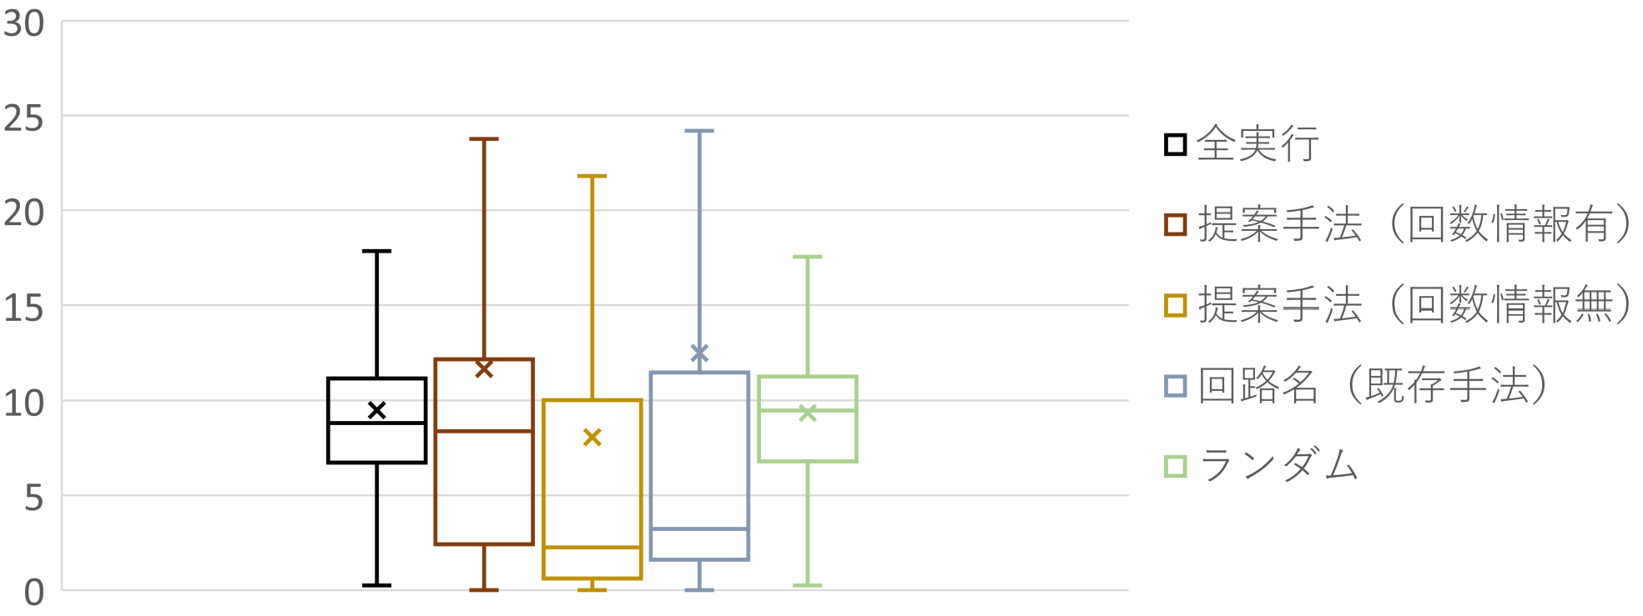
RQ2:実行時間の分布の多様さはどうか？
実行時間（秒）
既存手法や回数情報を考慮しない場合と比較して， 回数情報を考慮した場合は多様な実行時間を示している

Slide 22
STEP I: Collect Runtime Information (2/2)
Test ID | Vector
1 | [1,1,1,4,3,3,3,0,1,1,…]
… | …
Event Name | Location | Execution Count
Method Entry | Line 1 | 1
Method Parameter | Line 1 | 1
Local Variable Load | Line 2 | 1
Local Variable Load | Line 3 | 4
Local Variable Load | Line 4 | 3
Method Call | Line 4 | 3
Local Variable Store | Line 4 | 3
Local Variable Store | Line 6 | 0
Local Variable Load | Line 8 | 1
Method Normal Exit | Line 9 | 1
Notes:
In StepII, We classify vectors obtained from Step I into groups using the k-means clustering method. We adopt the k-means method simply because users can specify the number of test cases to be selected according to their time budget. In addition, the k-means method is less computational complexity than hierarchical clustering. We use Euclidean distance when measuring between vectors. The distance distinguishes a short simulation from a long simulation even if they use the same set of instructions. After clustering, we select the oldest test case from each cluster as the representative test cases because they are the first test cases that triggered new behaviors of the simulator.

Slide 23
STEP1: テストケースの実行時情報の収集(2/2)
実行時情報を2種類のベクトルに変換する
Event Name | Location | Execution Count
Method Entry | Line 1 | 1
Method Parameter | Line 1 | 1
Local Variable Load | Line 2 | 1
Local Variable Load | Line 3 | 4
Local Variable Load | Line 4 | 3
Method Call | Line 4 | 3
Local Variable Store | Line 4 | 3
Local Variable Store | Line 6 | 0
Local Variable Load | Line 8 | 1
Method Normal Exit | Line 9 | 1
テストID | ベクトル (回数情報有)
1 | [1,1,1,4,3,3,3,0,1,1]
… | …

Slide 24
ライブラリ更新事例への適用
システムのJDKのバージョンを11から17へと更新し， 提案手法（回数情報有）で選択したテストケースで テストを実施した
今回の更新におけるテストでは非互換性の問題は 生じなかった
提案手法は開発者からみても高いカバレッジと 多様な実行時間分布を示しており，既存の テスト手法よりも有用である

Slide 25
STEP1: テストケースの実行時情報の収集(2/2)
実行時情報を2種類のベクトルに変換する
イベント名 | 行番号 | 実行回数
Method Entry | Line 1 | 1
Method Param | Line 1 | 1
Local Variable Load | Line 2 | 1
Local Variable Load | Line 3 | 4
Local Variable Load | Line 4 | 3
Method Call | Line 4 | 3
Local Variable Store | Line 4 | 3
Local Variable Store | Line 6 | 0
Local Variable Load | Line 8 | 1
Method Normal Exit | Line 9 | 1
テストID | ベクトル (回数情報有)
1 | [1,1,1,4,3,3,3,0,1,1]
… | …
回数情報を削除
テストID | ベクトル (回数情報無)
1 | [1,1,1,1,1,1,1,0,1,1]
… | …

