Slide 1
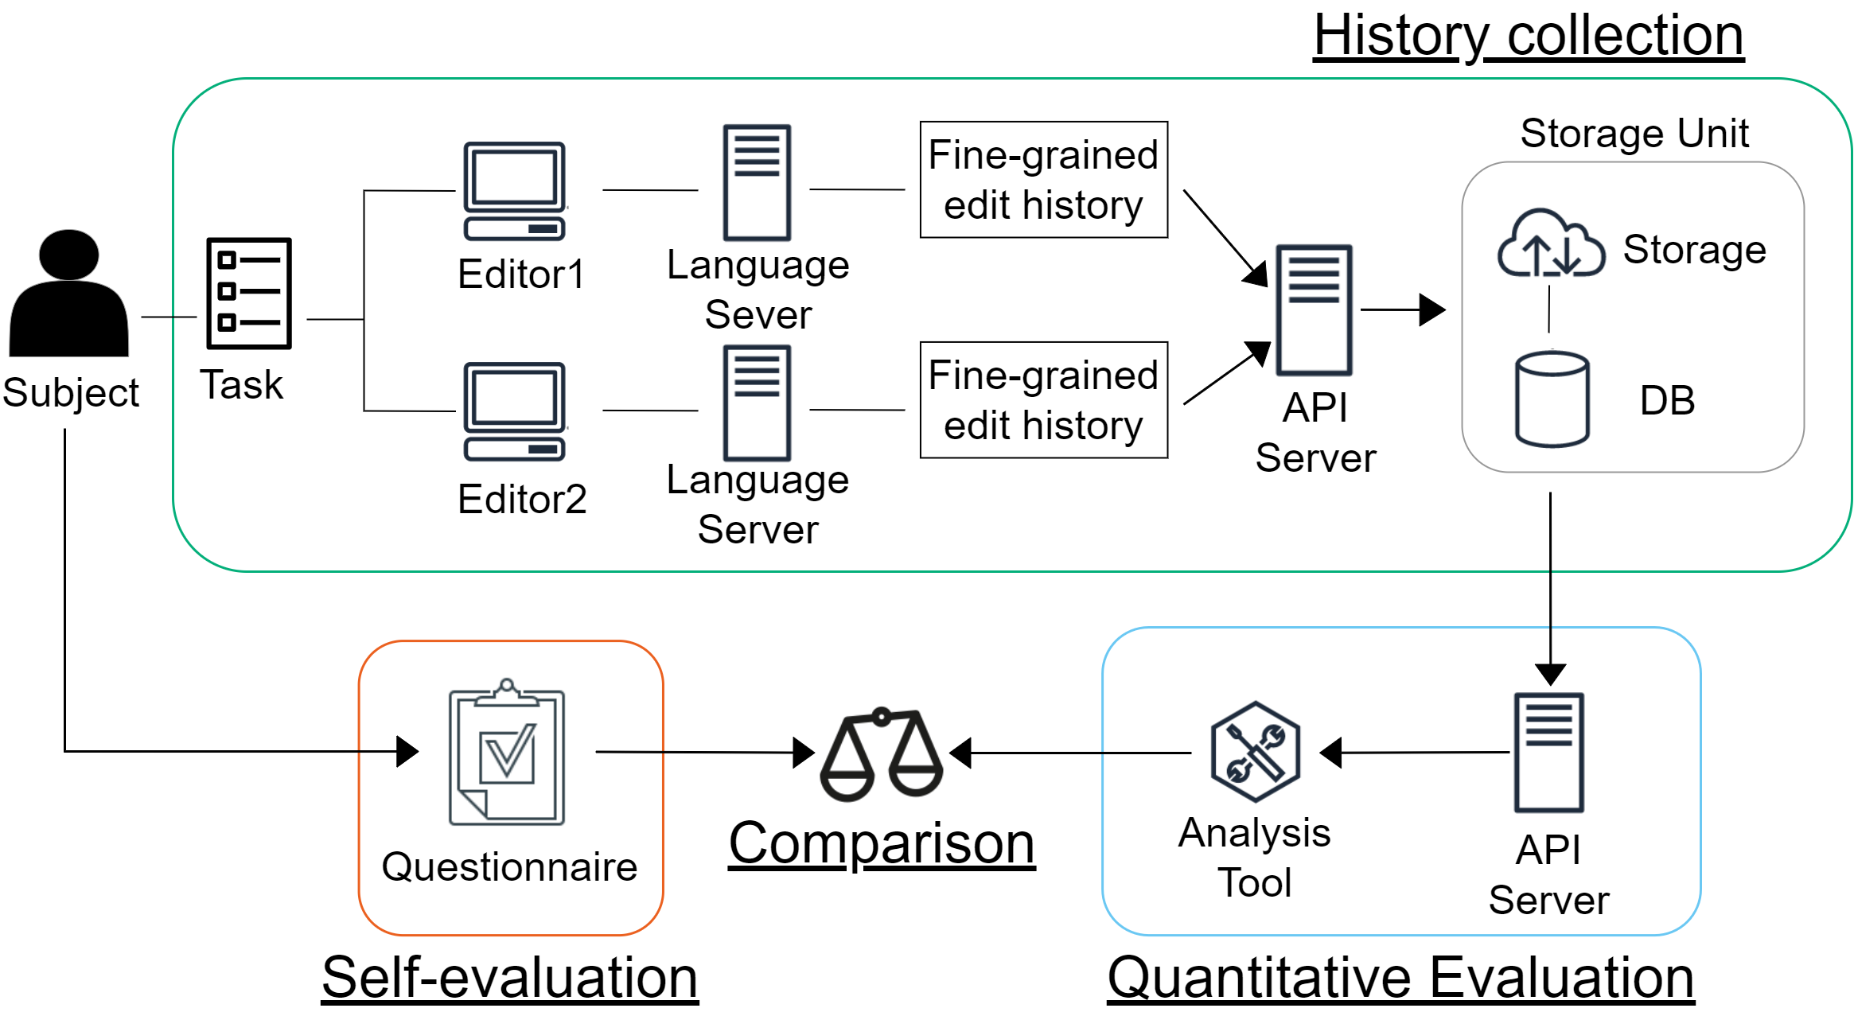





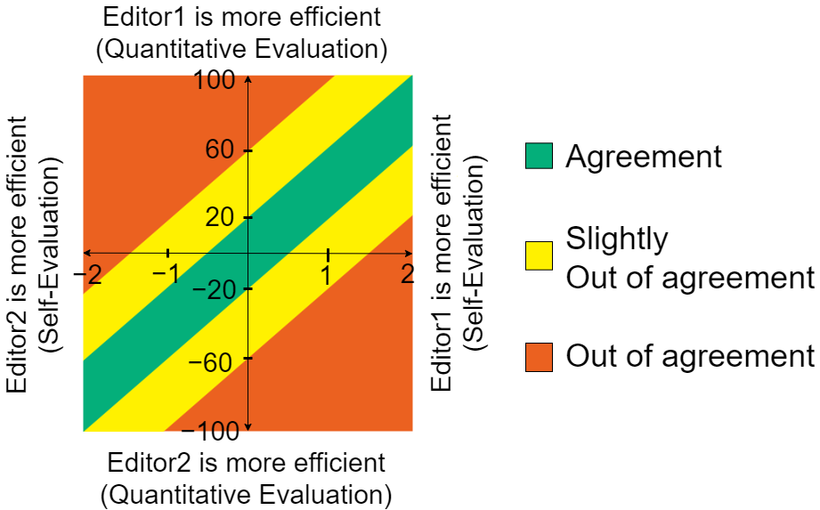
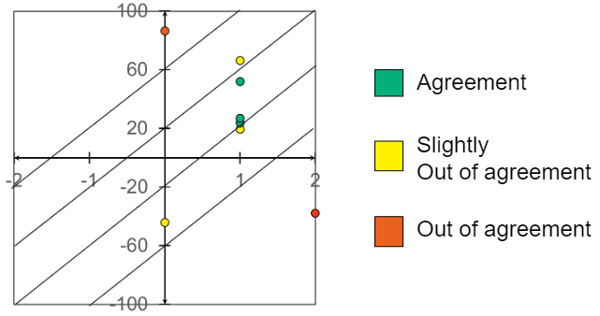
Comparison of Developer’s Work Efficiency
between Different Editors
〇Sentaro Onizuka¹ Tetsuya Kanda¹ Katsuro Inoue²
1 Osaka University 2 Nanzan University
1. Overview
2. Proposed Method
Analyzing the coding process has been limited
to a single editor
Editors are important in the efficiency of development
Collecting and comparing
“self-evaluations” and “quantitative evaluations”
of developer’s work efficiency for each editor
Propose a method
to compare developer’s work efficiency
between different editors
3. Collecting evaluation of work efficiency
4. Comparison based on scatter plot
Self-evaluation
Criteria to determine if in agreement or not
5-point Likert scale
“Which editor do you think is faster at coding?”
Correlation coefficient
Judge by area
Editor2
-2
-1
0
+1
+2
Editor1
Quantitative evaluations
Fine-grained edit history
Development progress graph
Time required for each task
- { (avg of editor1) - (avg of editor2) }× 100
Normalized data（0 ～ 1）
Editor2
-100
0
+100
Editor1
5. Method Example
6. Conclusion
Conducted a small experiment with the method
on Visual Studio Code and Eclipse
Proposed a method to realize the comparison of developer’s work efficiency between different editors
Showed an example output of the proposed method
with two editors
Correlation coefficient: - 0.27
Judge by area: 3 people 3 people 2 people
Fine-grained edit history collection platform
GitHub: https://github.com/inoueke-n/sairi-common
Plug-in for Visual Studio Code
GitHub: https://github.com/inoueke-n/sairi-plugin-for-vscode
Plug-in for Eclipse
GitHub: https://github.com/inoueke-n/sairi-plugin-for-eclipse
A scatter plot of comparing post-development self-evaluations and
quantitative evaluations of a source code transcription task
This work was supported by JSPS KAKENHI Grant Numbers JP19K20239 and JP18H04094

