Slide 1
An Empirical Study of Python Code Snippets with Version Compatibility Issues on Stack Overflow
Shiyu Yang¹, Tetsuya Kanda¹, Davide Pizzolotto¹, Daniel M. German², Yoshiki Higo¹
¹Osaka University
²University of Victoria
Notes:
Thank you for your introduction.
Good afternoon, everyone. I’m shiyu yang from Osaka University.
Today, I'd like to present my research: An Empirical Study of Python Code Snippets with Version Compatibility Issues on Stack Overflow

Slide 2
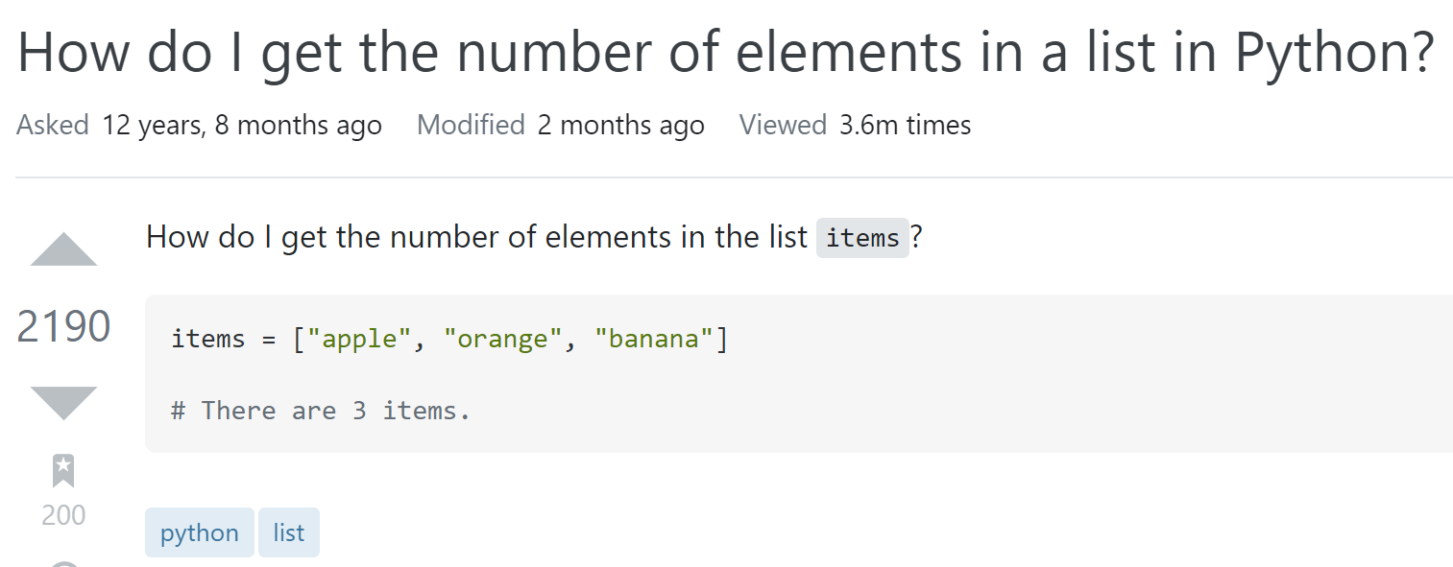
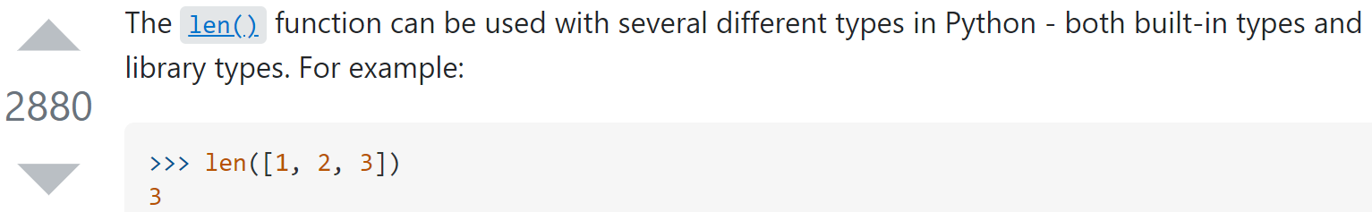
Stack Overflow
Developers are used to reusing code snippets from Stack Overflow
Question
Code snippet
tags
Answer
Code snippet
Notes:
Stack Overflow is one of the most popular Q&A sites for developers. Developers can post and answer questions on the site.
When posting a question on Stack Overflow, the original posters use tags to describe the topic of the question,
And they can attach code snippets to describe their question in detail
Each question can get multiple answers from different answerers. Answerers can also post answers with code snippets.
These questions and answers on Stack Overflow accumulate a large number of code snippets.
Nowadays, developers are used to looking for answers on Stack Overflow and reusing code snippets from Stack Overflow

Slide 3
Problem
Some code snippets on Stack Overflow may have issues
  obsolete[1]
  low-quality[2]
  ...
These code snippets may mislead answer seekers, cause unexpected problems and create barriers to code reuse
Outdated programming language features
  Cause code snippets to become obsolete
[1] H. Zhang, S. Wang, T. -H. Chen, Y. Zou and A. E. Hassan, "An Empirical Study of Obsolete Answers on Stack Overflow," in IEEE Transactions on Software Engineering, vol. 47, no. 4, pp. 850-862, 1 April 2021, doi: 10.1109/TSE.2019.2906315.
[2] Wu, Y., Wang, S., Bezemer, CP. et al. How do developers utilize source code from stack overflow?. Empir Software Eng 24, 637–673 (2019). https://doi.org/10.1007/s10664-018-9634-5.
Notes:
While searching for the required code snippets on Stack Overflow is convenient, recent studies have shown that some code snippets may have issues，such as being obsolete and low quality.
These code snippets may mislead answer seekers, cause unexpected problems and create barriers to code reuse
There are many reasons why code snippets can be problematic, one of which is the use of outdated programming language features, which can cause code snippets to become obsolete

Slide 4
Python Language Evolution and Backward Compatibility
Software developed in an earlier version of the language can be compiled with a later version and express the same behavior as the previous version
Python 3.0 significantly broke backward compatibility with Python 2
The lack of backward compatibility of Python code snippets may thus reduce their usability
Notes:
Existing programming languages ˈconstantly evolve to meet new needs
Many popular programming languages have maintained backward compatibility during their evolution
meaning that
software developed in an earlier version of the language can be compiled with a later version and express the same behavior as the previous version.
However, Python is known to break backward compatibility at almost every release.
Python 3.0 significantly broke backward compatibility with Python 2.
The lack of backward compatibility of Python code snippets may thus reduce their usability.
########
For example, a user found a code snippet that meets his/her needs and wants to reuse it in his/her project.
But, this code snippet is written in Python 2 and may not be compilable if used directly in the user's project written in Python 3.

Slide 5
Research Purposes
Investigating how common are Stack Overflow Python code snippets with version compatibility issues
Research Questions
  RQ1: How many Python code snippets have version compatibility issues in the accepted answers and top answers to Stack Overflow questions?
  RQ2: How many of the code snippets interpretable only by Python 2 or only by Python 3 are tagged with such Python version?
Notes:
So, In this study, we want to investigate how common are Stack Overflow Python code snippets with version compatibility issues
We organized our study by answering the following research questions:

Slide 6
Results
RQ1: How many Python code snippets have version compatibility issues in the accepted answers and top answers to Stack Overflow questions?
RQ2: How many of the code snippets interpretable only by Python 2 or only by Python 3 are tagged with such Python version?
Notes:
First， let’s talk about RQ1.

Slide 7
RQ1:
Top answers
Categories | #Code snippets | Percentage
Pass all versions | 672,190 | 53.3%
Fail for all versions | 365,822 | 29.0%
Fail for some Python 2 or some Python 3 | 102,825 | 8.2%
Fail for all Python 2, Pass Python 3 (all or some) | 50,284 | 4.0%
Fail for all Python 3, Pass Python 2 (all or some) | 69,321 | 5.5%
Results of the accepted answers shows almost the same trend
Answer to RQ1:
About 18% of code snippets have version compatibility issues in the accepted answers and top answers to questions
Notes:
The parsing results of the top answers and accepted answers show almost the same trend, and we describe and discuss the results of the top answers, as shown in the Table
The code snippets can be divided into the following five categories:
Pass all versions: The code snippet passes PyComply parsing for all Python 2 and all Python 3 versions
Fail for all versions: The code snippet fails for PyComply parsing for any Python 2 and any Python 3 versions
Fail for some Python 2 or some Python 3: The code snippet passes at least one PyComply parsing for Python 2 and at least one PyComply parsing for Python 3, but not all versions
Fail for all Python 2, Pass Python 3 (all or some): The code snippet fails for any Python 2 PyComply parsing, but passes all or some Python 3 PyComply parsing
Fail for all Python 3, Pass Python 2 (all or some): The code snippet fails for any Python 3 PyComply parsing, but passes all or some Python 2 PyComply parsing
From the table, we can see that: About 18% of code snippets have version compatibility issues in the accepted answers and top answers to questions.

Slide 8
Results
RQ1: How many Python code snippets have version compatibility issues in the accepted answers and top answers to Stack Overflow questions?
RQ2: How many of the code snippets interpretable only by Python 2 or only by Python 3 are tagged with such Python version?
Notes:
next，RQ2:

Slide 9
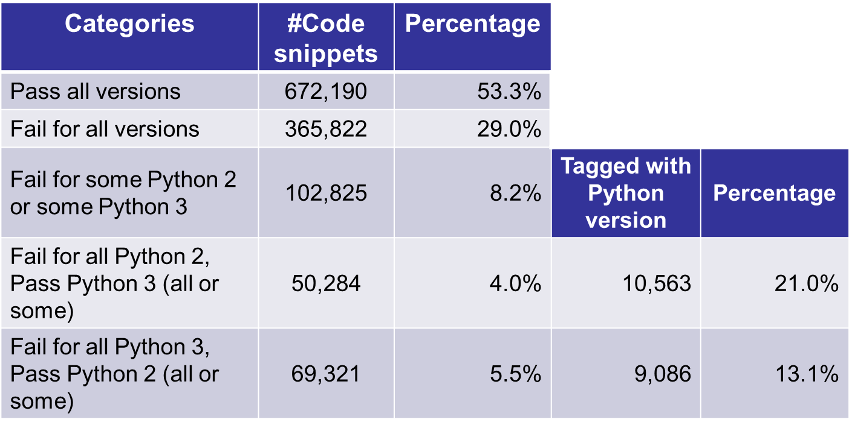
RQ2:
Top answers
“Python 2.x” or “Python 3.x”
Results of the accepted answers shows almost the same trend
Notes:
``Python 2.x'' and ``Python 3.x'' tags now exist on Stack Overflow for users to indicate the Python version.
If these tags are used correctly, users can avoid using outdated code snippets
######
For example, if the ``Python 3.x'' tags correctly identify a code snippet that cannot be used by Python 2, then users can avoid using that code snippet in Python 2.
We would like to know how many of the code snippets that are interpretable only by Python 2 or only by Python 3 are tagged with such Python version.
For this purpose, we further processed the parsing results of the code snippets.
As in RQ1, we describe and discuss the results for the top answers.
The results are shown in the Table. The fifth row of the table is the code snippets that can only be interpreted by Python 2. Its fourth column corresponds to the number of code snippets that have the tag ``Python 3.x'' in the question.
The last row of the table is for code snippets that can only be interpreted by Python 3. The fourth column corresponds to the number of code snippets with the ``Python 2.x'' tag in the question.
##############
From Table, we can see that only about 13% of the code snippets that are only interpretable by Python 3 have the ``Python 2.x'' tags added to the questions. This means the other 87% of code snippets do not give the user a Python version hint via the tags.

Slide 10
RQ2:
Answer to RQ2:
Less than 17% of code snippets interpretable only by Python 2 or only by Python 3 are tagged with the Python version
Insights:
Version compatibility issues of code snippets exist at Stack Overflow
Code snippets are not well tagged with the Python version
  May lead to misuse of the code snippet
Need to provide a tool for users to determine the Python version of Python code snippets on Stack Overflow
Notes:
From the table, we can see that: Less than 17% of code snippets interpretable only by Python 2 or only by Python 3 are tagged with the Python version.
It is clear that the version compatibility issues of code snippets exist at Stack Overflow and cannot be ignored.
However, since code snippets are not well tagged with the Python version, Stack Overflow users cannot simply determine the Python version of the code snippet by the tag, which may lead to misuse of the snippet.
Therefore, we need to provide a tool for users to determine the Python version of Python code snippets on Stack Overflow.

Slide 11
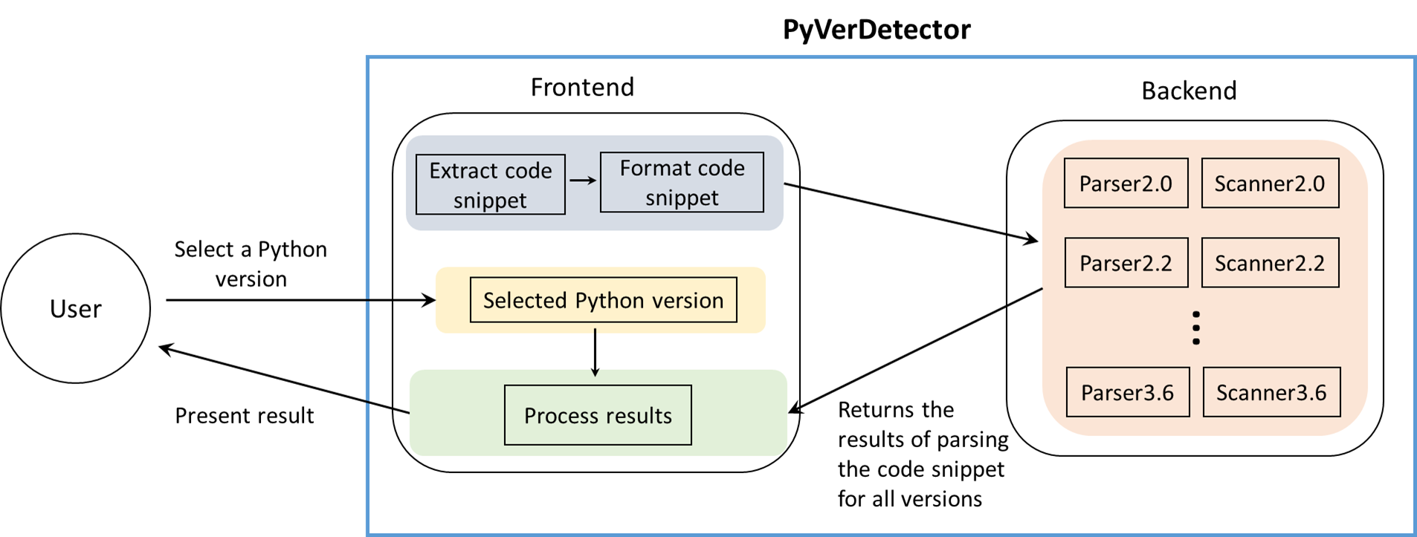
PyVerDetector
Chrome extension to help Stack Overflow users detect the Python version of code snippets
Notes:
We developed a Chrome extension, PyVerDetector to help Stack Overflow users detect the Python version of code snippets.
In order to detect the compliance of a code snippet with a particular grammar, PyVerDetector consists of two components:
a frontend part responsible for fetching the code snippet from Stack Overflow and displaying the results, and a backend part responsible for statically analyzing the given code snippet across multiple Python versions.
The overview of PyVerDetector is shown in Figure
#######
Upon loading a Stack Overflow page, for each Python snippet, the extension calls the backend and retrieves the response in JSON format containing all the supported Python versions for that snippet.
Then, based on the user preferences, the frontend alters the page to present the result to the user.

Slide 12
Conclusion&Future Work
Conclusion
Investigating how common are Stack Overflow Python code snippets with version compatibility issues
Future Work
Investigate the reasons for the failure of the code snippets in this study that are uncompilable for all Python versions
Investigate factors that affect the compilability of code snippets on Stack Overflow due to Python version upgrades
Notes:
In conclusion，
In this study, we investigated how common are Stack Overflow Python code snippets with version compatibility issues.
and There are two possible directions for future work.
That’s all I have to say. Thank you for your attention.

Slide 13



Python Language Evolution and Backward Compatibility
The lack of backward compatibility of Python snippets may thus reduce their usability
Reuse
User's project
Python version: 2.x
code snippet
Python 2 features
User's project
Python version: 3.x
Reuse
Notes:
For example, a user found a code snippet that meets his/her needs and wants to reuse it in his/her project.
But, this code snippet is written in Python 2 and may not be compilable if used directly in the user's project written in Python 3.

Slide 14
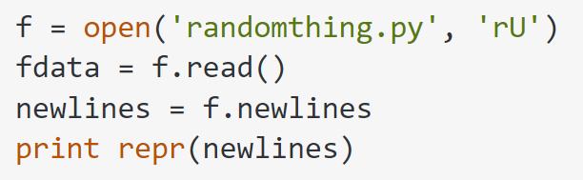
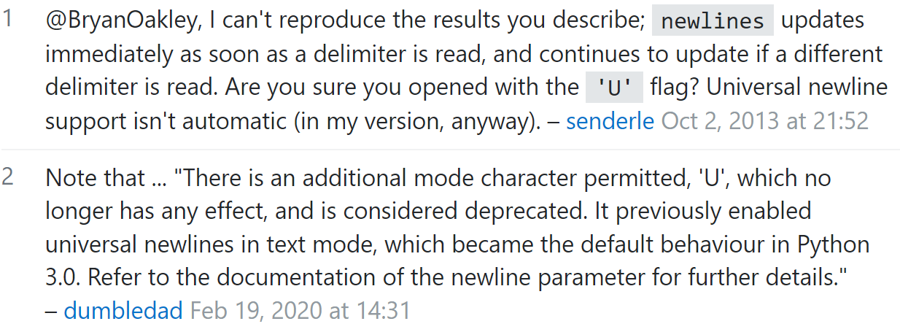
Python Language Evolution and Backward Compatibility
Python 3.0 significantly broke backward compatibility with Python 2
The lack of backward compatibility of Python snippets may thus reduce their usability
Notes:
For example, in a question on SO, the code snippet for the accepted answer to the question used a deprecated Python 2 feature, and pointed this out in the comments.
Such code snippets containing deprecated features may not be directly interpreted by newer Python versions without modifications. Moreover, Python 2 is currently deprecated and is being phased out by most distributions.

Slide 15
PyComply[3]
Definition
Python Compliance Analyzer, testing applications for compliance with Python 2 and Python 3 through Python feature recognition
Dataflow
Input: Python code snippets
Output: The compliance results of the code snippets, i.e. whether the code snippets are compilable for a certain Python version
code snippets
Scanner x.x
Parser x.x
compliance results
PyComply x.x
[3] B. A. Malloy and J. F. Power, "Quantifying the Transition from Python 2 to 3: An Empirical Study of Python Applications," 2017 ACM/IEEE International Symposium on Empirical Software Engineering and Measurement (ESEM), Nov. 2017, pp. 314-323.
Notes:
We use PyComply to investigate the compilability of Python code snippets
PyComply is a Python Compliance Analyzer that tests applications for compliance with Python 2 and Python 3 through Python feature recognition
In this study, input to PyComply is the Python code snippets;
the output of PyComply is the compliance results of code snippets, that is whether the code snippets are compilable for a certain Python version
Pycomply has a parser and a scanner.
To create a tool that can parse each version of Python, we need to generate parser and scanner for each Python version
########
The scanner reads the input program and processes it into a form that can be used by the parser.
A parser is a software component that takes a program as input and determines whether the program is syntactically correct with respect to the grammar used to construct the parser.

Slide 16
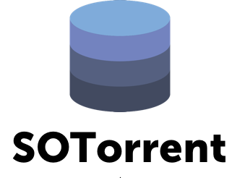
Study Approach(1/3)
Python code snippets
Formatted Python code snippets
Posts
①
Accepted answers
②
Accepted answers
③
Accepted answers
Top answers
Top answers
Top answers
Get the accepted answers and top answers
Extract Python code snippets
Handle formatting issues
Build the PyComply for each Python version
PyComply parsing
PyComply2.0
④
⑤
PyComply2.2
...
PyComply3.6
compliance results
Notes:
Now, I’d like to turn to the Study Approach
the Study Approach can be divided into five steps
First, We use SOTorrent to get Get the accepted answers and top answers posted on Stack Overflow.
Then extract Python code snippets from them
Next handle the formatting issues of the python code snippets
In addition, we need to build the PyComply for each Python version
And finally parse the python code snippet with PyComply

Slide 17
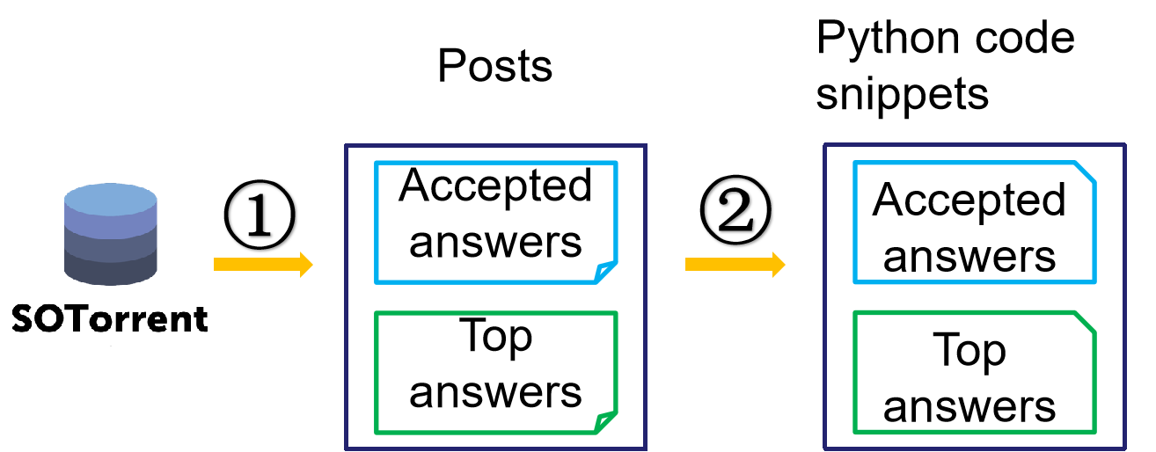
Study Approach(2/3)
Get the accepted answers and top answers
Data source:
SOTorrent, an open dataset based on the official Stack Overflow data dump
Version: SOTorrent20_03
Criteria for posts:
Accepted answers and top answers with at least one question tag containing the word "Python"
Posting data is the latest version
Extract Python code snippets
Number of code snippets:
Accepted answers: 1,023,782
Top answers: 1,260,442
Notes:
We then explain some of these steps in detail
First, We use SOTorrent to get the accepted answers and top answers posted on Stack Overflow.
SOTorrent is an open dataset based on the official Stack Overflow data dump.
In this study, the version we used was SOTorrent20underscore03.
The Accepted answers and top answers need to have at least one question tag containing the word "Python"
and Posting data was the latest version
Then we extract Python code snippets from the accepted answers and top answers
1,260,442 code snippets were extracted from the top answers, and 1,023,782 code snippets were extracted from the accepted answers.

Slide 18
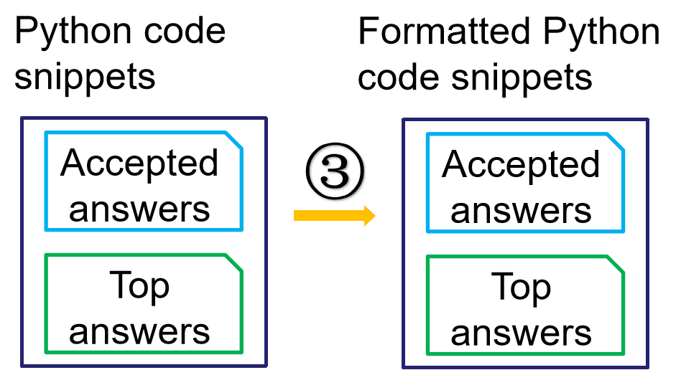
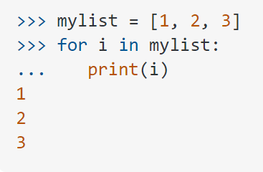
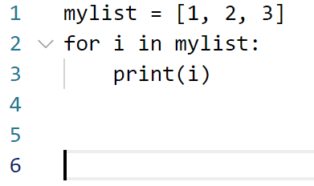
Study Approach(3/3)
Handle formatting issues
Remove extra indentation:
SOTorrent data contains an extra indentation at the beginning of each line so we removed it for parsing
Remove the output and prompt of the REPL mode:
If the code snippet starts with “>>>”, we consider it copied from the REPL mode, so we preserve the executed code by removing the output of the execution and the prompt mark (“>>>” and “···”) at the beginning of the line. Also keep its line number unchanged by filling empty lines
Notes:
third We need to Handle formatting issues that cause code snippets not to be parsed by PyComply
first we Remove extra indentation: SOTorrent data contains an extra indentation at the beginning of each line so we removed it for parsing
then we Remove the output and prompt of the REPL mode:
If the code snippet starts with “>>>”, we consider it copied from the REPL mode, so we preserve the executed code by removing the output of the execution and the prompt mark (“>>>” and “···”) at the beginning of the line. Also keep its line number unchanged by filling empty lines

Slide 19
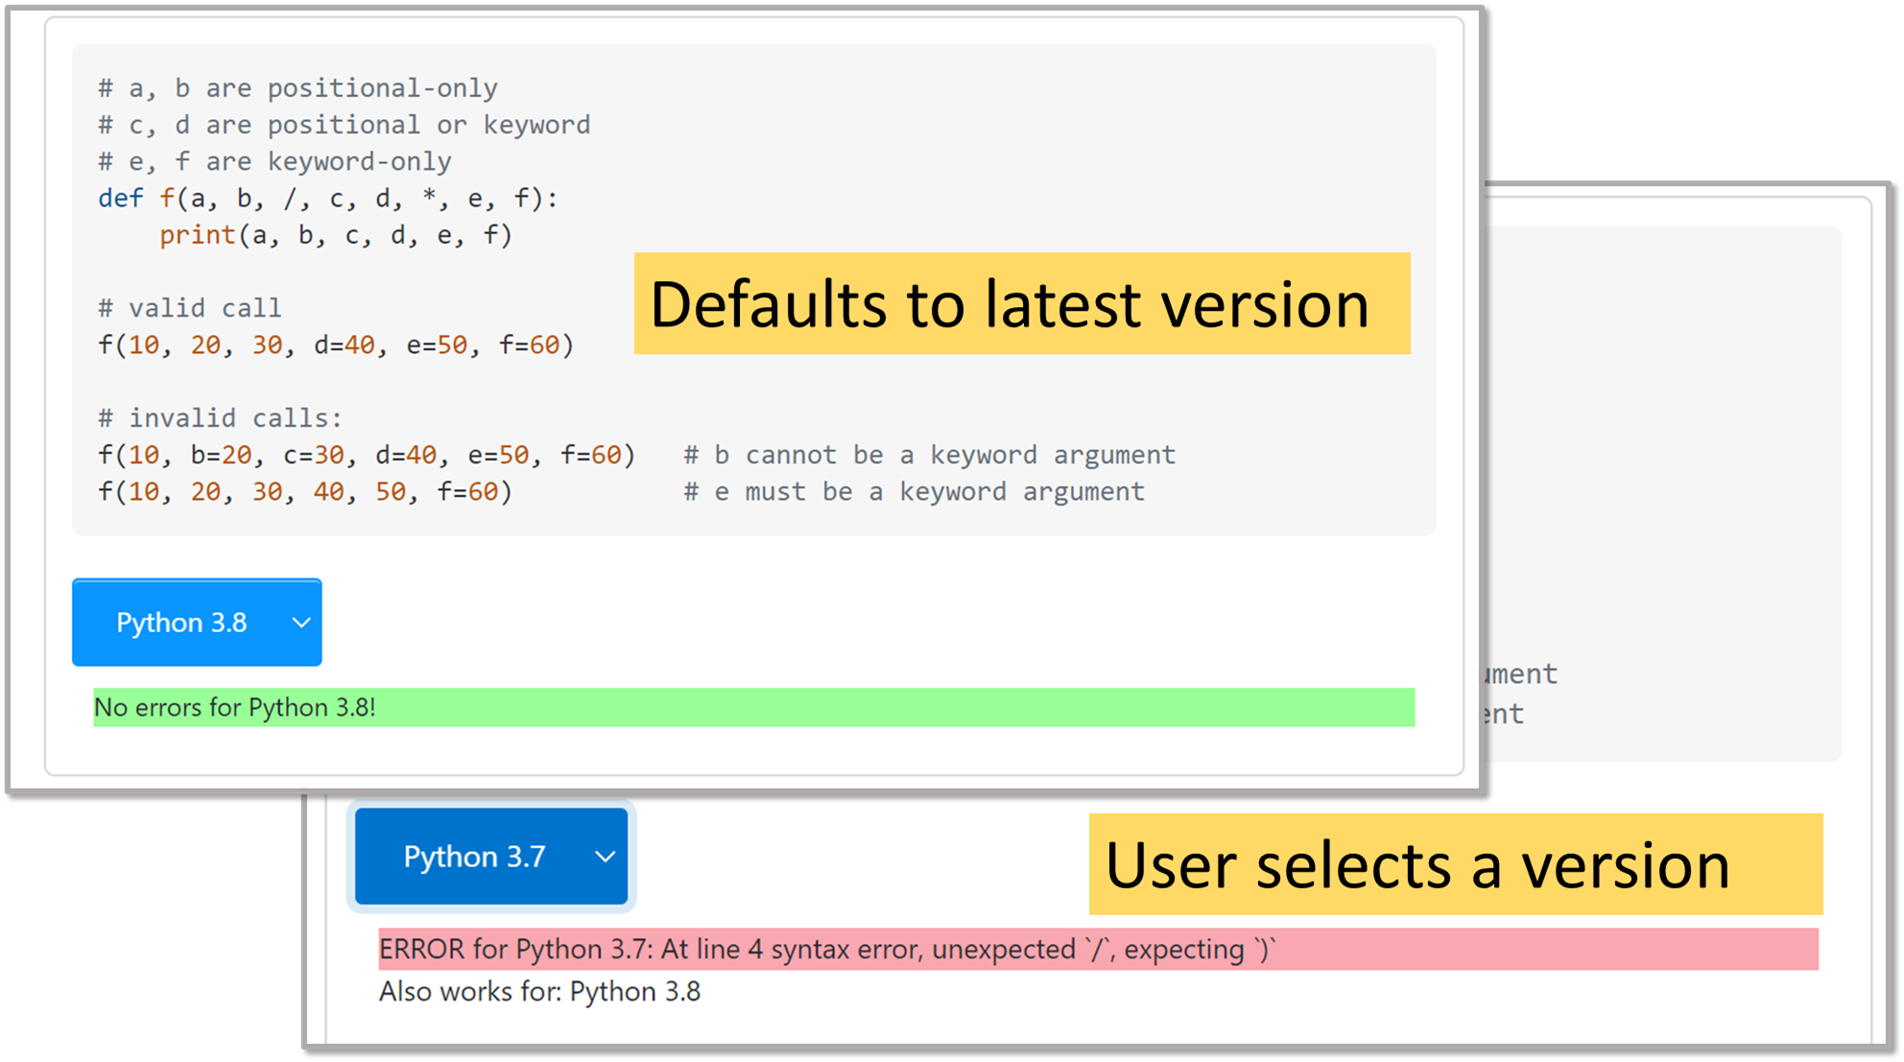
Chrome Extension for Stack Overflow:

Slide 20
RQ2:
Use the SO tag to indicate the Python version: " Python 2.x", "Python 3.x“
  If these tags are used correctly, users can avoid using outdated code
Notes:
Questions on SO require tags to be added to describe the question topic.
``Python 2.x'' and ``Python 3.x'' tags now exist on SO for users to tag questions for Python 2 or Python 3 only.
For example, if the ``Python 3.x'' tags correctly identify a code snippet that cannot be used by Python 2, then users can avoid using that code snippet in Python 2.
We would like to know how many of the code snippets that are interpretable only by Python 2 or interpretable only by Python 3 are tagged with such Python version.

