Slide 1


PyVerDetector
A Chrome Extension Detecting the Python Version of Stack Overflow Code Snippets
Shiyu Yang (Osaka University, Japan)
Tetsuya Kanda (Osaka University, Japan)
Davide Pizzolotto (Osaka University, Japan)
Daniel M. German (University of Victoria, Canada)
Yoshiki Higo (Osaka University, Japan)

Slide 2


Problem
Python 3 is not backward compatible with Python 2
Reuse
User's project
Python version: 2.x
code
Python 2 features
User's project
Python version: 3.x
Reuse

Slide 3
Problem
Python 3 is not backward compatible with Python 2
Reuse
User's project
Python version: 2.x
code
Python 2 features
User's project
Python version: 3.x
Reuse
May affect users of Q&A sites such as Stack Overflow (SO)

Slide 4
Empirical Study
Investigating how common are SO Python code snippets with version compatibility issues
  About 10% of snippets have version compatibility issues in the top answers to questions
  Only about 17% of snippets interpretable only by Python 2 or only by Python 3 are tagged with the Python version

Slide 5
Empirical Study
Investigating how common are SO Python code snippets with version compatibility issues
A tool needs to be provided for users to detect the Python version of the Python code snippets on SO

Slide 6
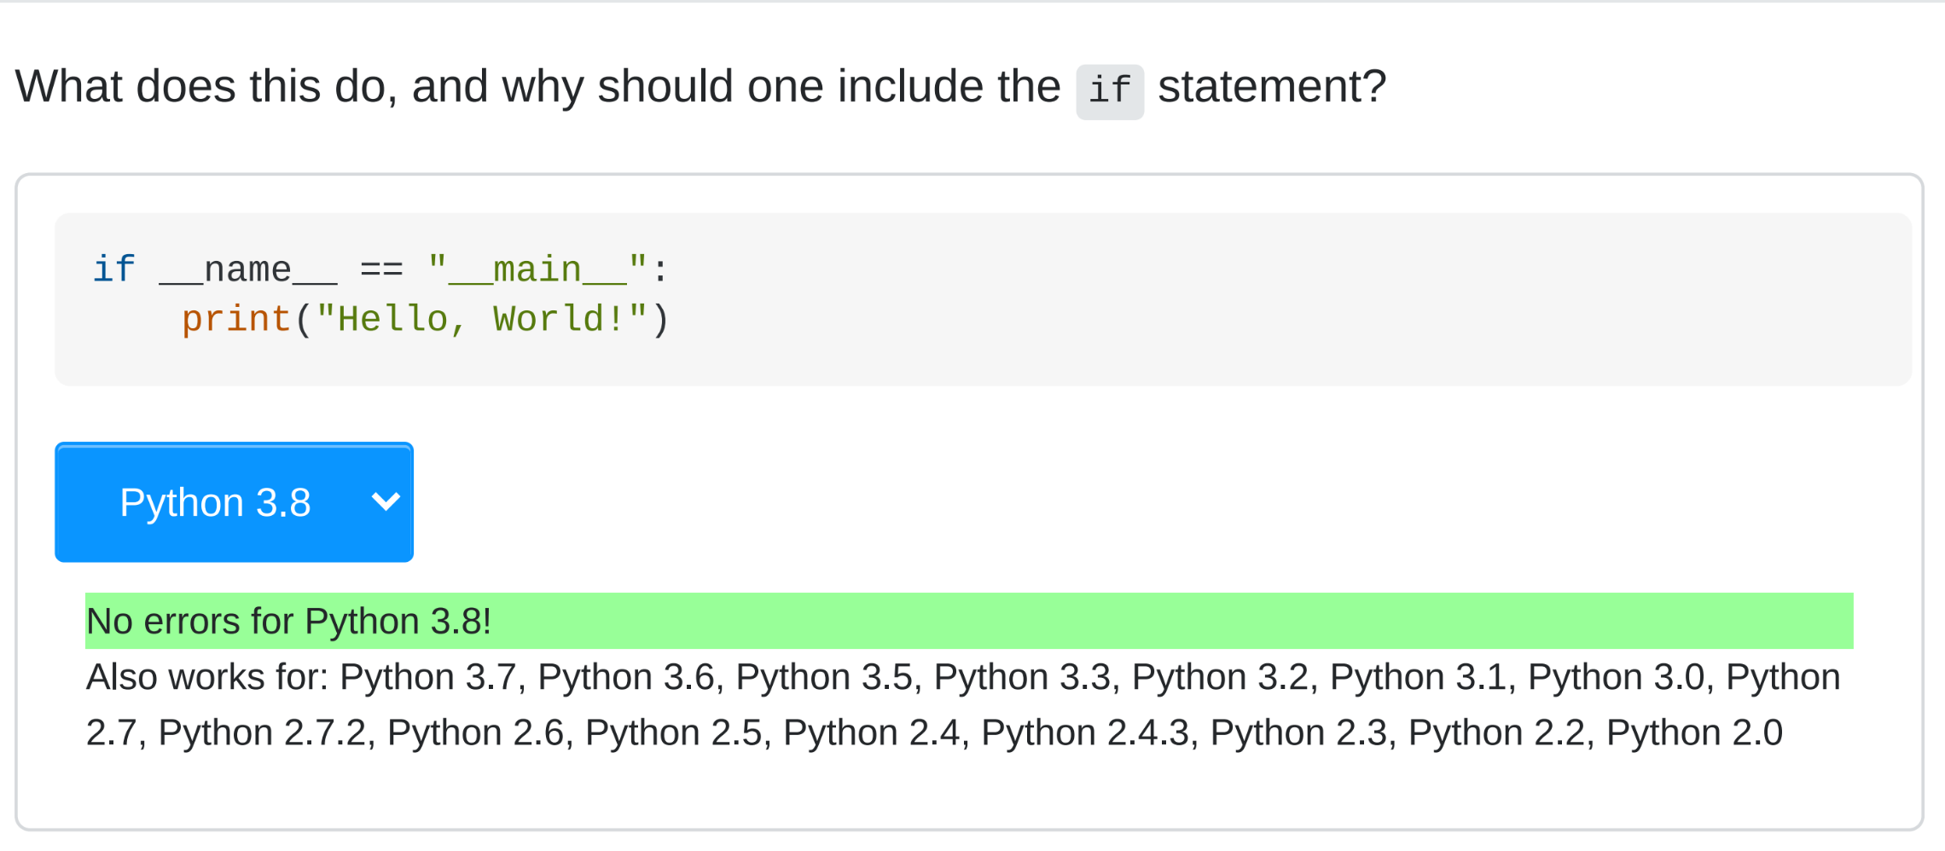
PyVerDetector
A Chrome extension that helps SO users address the version compatibility issue of Python code snippets
SO Page
Code Snippet
Drop-down menu
Select Python Version
Message Areas

Slide 7
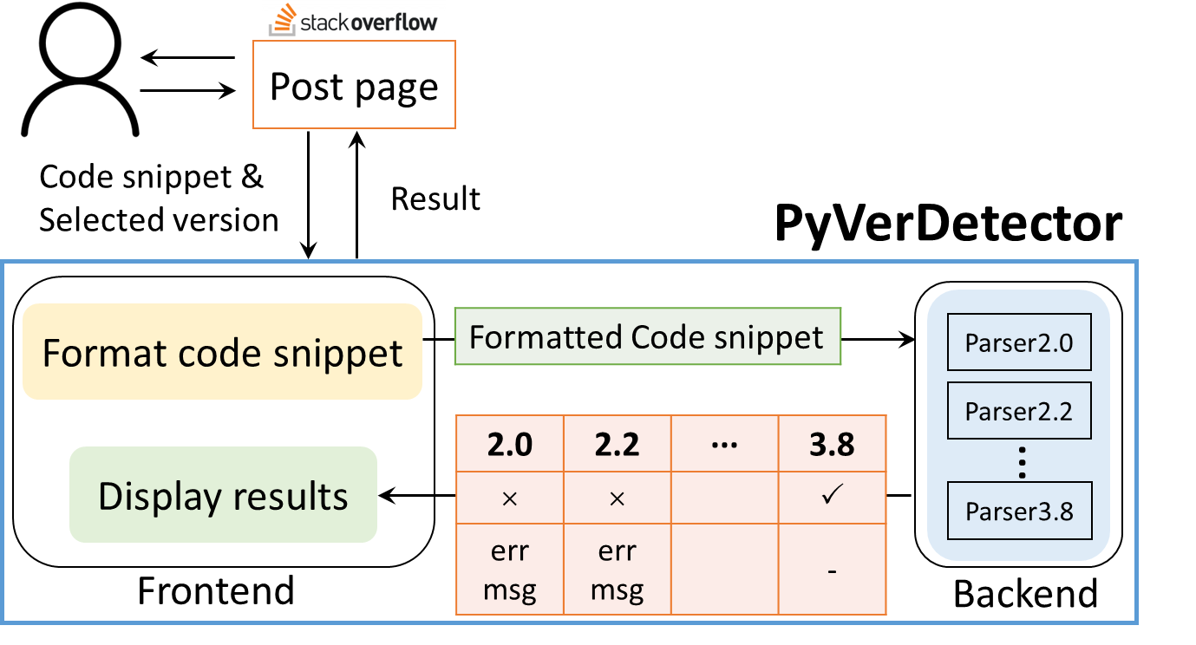
PyVerDetector
Fetching the code snippet from SO
Displaying the results
Frontend

Slide 8
PyVerDetector
Statically analyzing the given code snippet across multiple Python versions
Backend

Slide 9
PyVerDetector

Slide 10
Usage Scenarios
Displaying the latest version as default
Accurate display of results for selected versions

Slide 11
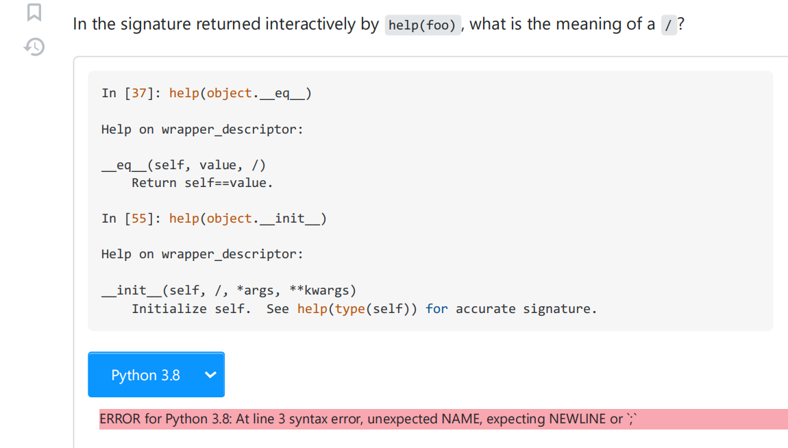
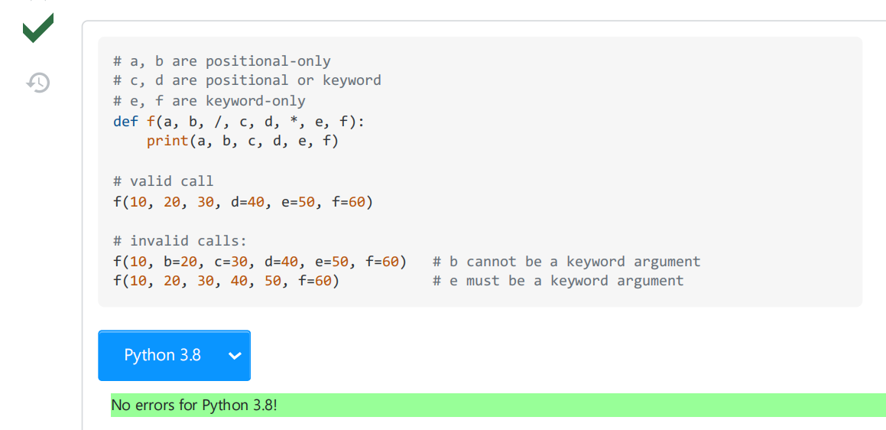
Usage Scenarios
Displaying the latest version as default
For all Python code snippets on the page

Slide 12
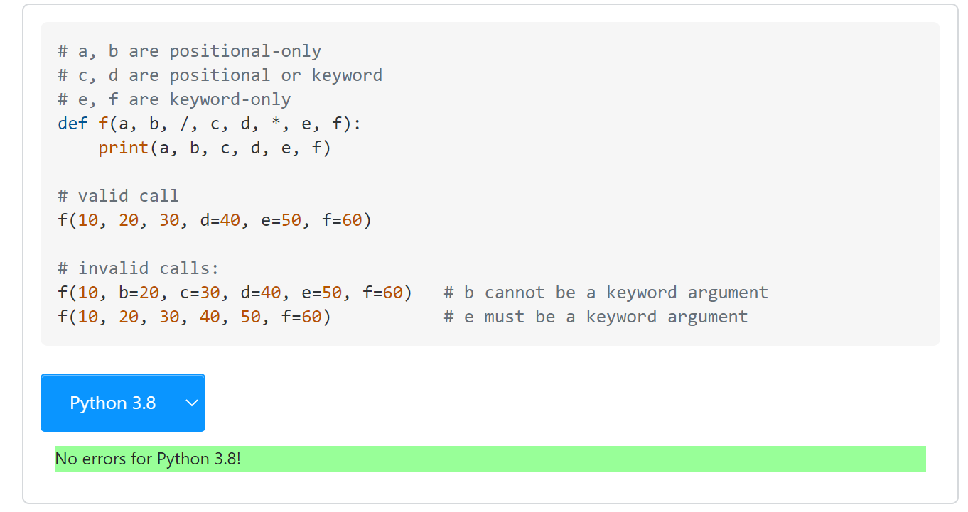
Usage Scenarios
Accurate display of results for selected versions
Before selecting a version

Slide 13
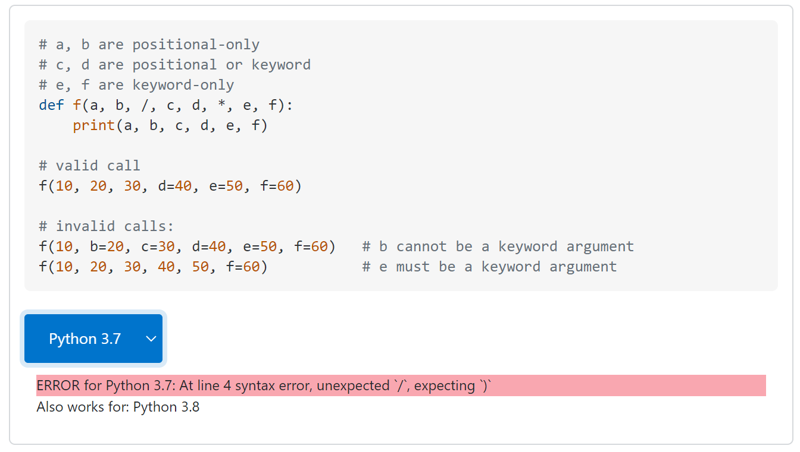
After selecting a version
Usage Scenarios
def f(a, b, /, c, d, *, e, f):
Accurate display of results for selected versions
Before selecting a version
Positional-only parameters
After selecting a version
At line 4 syntax error, unexpected ‘/’

Slide 14
After selecting a version
Usage Scenarios
def f(a, b, /, c, d, *, e, f):
Accurate display of results for selected versions
Before selecting a version
Positional-only parameters
After selecting a version
Other compatible Python versions

Slide 15

PyVerDetector
A Chrome Extension Detecting the Python Version of Stack Overflow Code Snippets
available on GitHub
https://github.com/ysy-dlg/PyVerDetector

