Slide 1
Mining Application-Specific Coding Patterns for Software Maintenance
Takashi Ishio, Hironori Date,
Tatsuya Miyake, Katsuro Inoue
Osaka University, Japan
Notes:
This work is an aspect-mining approach based on a pattern mining technique.

Slide 2
Overview
What is a Coding Pattern
A frequent code fragment involved in programs
Important for software maintenance
Sequential Pattern Mining for Java source code
PrefixSpan algorithm
We defined rules to normalize Java source code.
Crosscutting concerns as patterns in 6 programs
JHotDraw, jEdit, Tomcat, Azureus, ANTLR, SableCC
Notes:
A coding pattern is a pattern of frequent code fragments involved in programs.
Understanding patterns is important for software maintenance.
Therefore, we applied sequential pattern mining to Java programs.
We used PrefixSpan algorithm proposed in Data Engineering area, and we have defined rules to normalize Java source code for pattern mining.
I report crosscutting concerns we have detected as patterns in 6 open-source programs.

Slide 3
Coding Pattern
Developers copy-and-paste source code.
A coding pattern is a frequent code fragment to implement a particular kind of functionality.
copy-
and-
paste
while (iter.hasNext()) {
Item item = (Item)iter.next();
buf.append(item.toString());
}
while (iter.hasNext()) {
Item item = (Item)iter.next();
buf.append(item.toString());
}
while (iter.hasNext()) {
Data data = (Data)iter.next();
buf.add(process(data));
buf.add (data.getItem());
}
reuse
the idiom
Notes:
A developer often copy-and-pastes or reuses a code fragment in various source code locations.
A coding pattern is a frequent code fragment, or an idiom, to implement a particular kind of functionality.
This is an example pattern of a loop using an Iterator.
A developer may copy-and-paste the code to the different source code location.
Another developer may reuse only the structure of the loop and modify the method calls in the loop.

Slide 4
Maintenance Problem
A large number of instances are spread across several systems.
When an instance of a pattern involves a defect, developers have to inspect all instances of the pattern.
The other instances might contain the same defect.
This problem is well-known in code-clone research.
The efficient code clone detection tools (e.g. CCFinder) is hard to detect code fragments modified after copy-and-padsted.
Notes:
Such copy-and-pasted patterns make software maintenance difficult.
A large number of instances are spread across several systems.
When an instance of a pattern involves a defect, developers have to inspect all instances of the pattern because the other instances might contain the same defect. This problem is well-known in code-clone research, but the efficient code clone detection tools such as CCFinder is hard to detect code modified after copy-and-pasted.
#Therefore, we need another approach to detect coding patterns.
#Developers are required to keep the patterns consistent.

Slide 5
Pattern Mining for Source Code
public B m1() {
…
}
public B m1() {
…
}
public B m1() {
…
}
public B m1() {
…
}
Each method is translated
into a sequence of method
calls and control elements.
public B m1() {
…
}
Normalization
public B m1() {
…
}
Java source code
(methods)
A.m1
IF
B.m2
LOOP
A.m2
END-LOOP
END-IF
A.m1
IF
B.m2
LOOP
A.m2
END-LOOP
END-IF
A.m1
IF
B.m2
LOOP
A.m2
END-LOOP
END-IF
A.m1
IF
B.m2
LOOP
A.m2
END-LOOP
END-IF
A.m1
IF
B.m2
LOOP
A.m2
END-LOOP
END-IF
Sequence Database
A.m1
IF
B.m2
LOOP
A.m2
END-LOOP
END-IF
Mining
We use PrefixSpan, an algorithm of sequential pattern mining.
Patterns
Classification
We classify similar patterns
into a group after filtering
meaningless patterns out.
Pattern Groups
(an XML format)
Notes:
We propose a pattern mining approach to detecting coding patterns in source code.
Our pattern mining comprises three steps: Normalization, Mining and Classification.
The Normalization step takes as input a Java program and normalizes each method to a sequence of method call and control elements.
In the mining step, we apply PrefixSpan algorithm to the generated sequence database.
Finally, the resultant patterns are classified into pattern groups and some meaningless patterns are filtered out.
Next We talk the detail of the three steps.

Slide 6
Normalization for Java source code
We define rules to normalize a Java method to a sequence of the following elements:
method call elements
IF/ELSE/END-IF elements
LOOP/END-LOOP elements
hasNext()
LOOP
next()
toString()
append(String)
hasNext()
END-LOOP
while (iter.hasNext()) {
Item item = (Item)iter.next();
buf.append(item.toString());
}
Notes:
The first step is normalizing Java source code.
We have defined rules to normalize a Java method to a sequence of three kind of elements, method call, IF and LOOP elements.
In short, a normalized source code represents the control-flow of its original source code.
In this code, hasNext() is called first , then the loop condition is checked, next() method is called, and so on. Its normalized source code represents the control-flow.

Slide 7
Normalization for method calls
Rule: Extract only a method signature
without its class name.
Item item = (Item)iter.next();
next(): Object
Rule: Two or more method calls are sorted by
their control-flow and location in source code.
int p = max(getX(), getY());
getX(): int
getY(): int
max(int, int): int
Notes:
A method call in the source code is translated into a method call element, that is a method signature without its class name. We ignore class names to handle dynamic binding.
If two or more method calls are involved in an expression, the corresponding method call elements are sorted by control-flow. If undefined, we use source code location.
For example, “max” is called after these two methods, therefore the corresponding element is the end of the normalized code. The order of two method calls getX and getY is not defined, so we simply place them in the textual order.

Slide 8
Normalization for if statements
Rule:
if (COND) T; else F;
1. int x = getX();
if (a == x) …
COND
IF
T
ELSE
F
END-IF
2. if (a == getX()) …
getX(): int
IF
…
END-IF
Notes:
An If statement is translated into these elements.
According to the control-flow, method call elements in a conditional predicate are inserted before the IF element.
This rule translates these two fragments into the same sequence of elements.

Slide 9
Normalization for loop statements
Rule:
for (INIT; COND; INC) BODY;
INIT
COND
LOOP
BODY
INC
COND
END-LOOP
for (Iterator it = list.iterator();
it.hasNext(); ) {
Item item = (Item)it.next();
item.doSomething();
}
iterator(): Iterator
hasNext(): boolean
LOOP
next(): Object
doSomething(): void
hasNext()
END-LOOP
Rule:
while (COND) BODY;
COND
LOOP
BODY
COND
END-LOOP
Iterator it = list.iterator();
while (it.hasNext()) {
Item item = (Item)it.next();
item.doSomething();
}
Notes:
Similarly, we defined rules for loop statements such as “for” and “while”.
These rules simply extract the control-flow of loop statements.
If a developer rewrites this “for” loop to this “while” loop, both loops are translated into this same sequence.

Slide 10
Sequential Pattern Mining
Extract frequent subsequences from a sequence database.
Each sequence represents a Java method.
Sequence Database
(normalized source code)
Sequential Patterns
A
A
E
A
A B C
E B C
D F C
A E
B
E
D
D
…
C
B
F
B
D
C
B
F
Sup3
Sup2
Sup
2
Sup2
E
A
C
C
Len3
Len3
Len3
Len2
Notes:
After a normalization step, we apply sequential pattern mining to the sequence database of the normalized source code to extract frequent subsequences in the methods.
In this example database, three sequences involve the pattern “ABC” , two sequences involve the pattern “EBC”, different two sequences involve the pattern “DFC”, and so on.
For each pattern, we compute its support value, the number of instances and its length, the number of elements in the pattern.

Slide 11
PrefixSpan: an algorithm of Sequential Pattern Mining ^{[1]}
Extract the substrings after “a”
Parameters:
length = 2
support = 2
c d
a : 1
b : 2
c : 2
d : 1
a b
c
c : 1
b c
a
a c
a c d
a : 4
b : 3
c : 3
d : 1
a b
d
d : 1
a b c
b
c
a : 1
c : 1
Sequence
Database
c b a
a
The Result
c
Pattern
Support
a a b
d
a : 1
b : 1
d : 1
a b
2
The number of instances
b a
a c
2
[1] Jian Pei, Jiawei Han, Behzad Mortazavi-Asl, Jianyong Wang, Helen Pinto, Qiming Chen, Umeshwar Dayal, Mei-Chun Hsu, “Mining Sequential Patterns by Pattern-Growth: The PrefixSpan Approach”, IEEE Transactions on Knowledge and Data Engineering, Vol.16, No.11, pp.1424-1440，2004.
Notes:
We use PrefixSpan algorithm to obtain such sequential patterns.
This algorithm takes two parameters, the minimum length of a pattern and the minimum number of instances of a pattern.
We use this four sequences [a, c, d], [a, b, c], [c, b, a] and [a, a, b] for example.
PrefixSpan first constructs the shortest pattern candidates that contain only one element.
Then the algorithm calculates the number of sequences for each element.
The pattern candidate “d” is filtered out because the pattern is less frequent than the “support” threshold. Other three elements are one-element patterns.
Next, PrefixSpan tries to extract two-element patterns based on one-element patterns.
It extracts the substrings after “a” for each sequence, and calculates the number of sequences for each element placed after “a”, and calculates the number of sequences.
Here, “b” and “c” are included in two sequences, so we can say that the patterns “a, b” and “a, c” are detected.
PrefixSpan tries to three-element patterns based on these two-element patterns.
This algorithm stops all pattern candidates are investigated.

Slide 12
Filtering Patterns
A constraint for control elements:
If an IF/ELSE/END-IF/LOOP/END-LOOP element is included in a pattern, the pattern must include its corresponding element.
We verify this constraint using AST information.
hasNext()
LOOP
next()
hasNext()
END-LOOP
hasNext()
LOOP
next()
hasNext()
hasNext()
next()
hasNext()
Notes:
After patterns are extracted, we filter meaningless patterns out.
As I said, IF and LOOP are always represented as a pair of IF and END-IF and a pair of LOOP and END-LOOP, respectively.
Therefore, we use a constraint; if a pattern includes a control-element, the pattern must include its peer element.
We accept the two patterns but we reject this pattern because it includes LOOP but does not include its peer END-LOOP element. We verify the constraint using AST information.

Slide 13
Classifying Patterns into Groups
A pattern implies various sub-patterns.
[A, B, C, D] implies [A, B, C], [A, C, D], …
We classify such sub-patterns into a single pattern group.
Rule: If an instance of a pattern overlaps with an instance of another pattern,
the patterns are classified into the same group.
Notes:
After the filtering, we classify the patterns into groups because a pattern implies various sub-patterns.
For example, if PrefixSpan detected a pattern of four elements [A, B, C, D], the algorithm also detected the shorter patterns [A, B, C], [A, C, D] and so on.
We classify such sub-patterns into a single pattern group using this rule: if an instance of a pattern overlaps with an instance of another pattern, the patterns are classified into the same group.

Slide 14
Summarization of the pattern groups
Select the top three frequent tokens in a pattern group to summarize the pattern.
Undo Pattern in JHotDraw 5.2b1
Tokens in the pattern
setUndoActivity()
createUndoActivity()
getUndoActivity()
setAffectedFigures()
activity: 3
undo: 3
set: 2
affected: 1
create: 1
figures: 1
get: 1
set Undo Activity
Notes:
To make the analysis process efficient, we extract a summary information for each pattern group.
We extract the frequent tokens in the method call elements in the pattern.
For example, this pattern includes four elements: setUndoActivity, createUndoActivity, getUndoActivity, and setAffectedFigures.
We decompose all method names into tokens, and select frequent tokens “activity”, “undo” and “set” as the representative of the pattern.

Slide 15
Fung, our pattern mining tool
Implemented in JDK 1.5 with JavaCC and SWT
Input:
Java source code and pattern mining parameters
Output:
An XML file. GUI is also available.
Performance:
The current implementation can analyze <100KLOC programs.
We are planning to make the tool public.
We still have some work on the tool for error handling.
Notes:
We have implemented a pattern mining tool named Fung.
The tool is implemented in JDK 1.5.
Fung takes as input Java source code, and outputs the resultant patterns in an XML format.
Fung also has a GUI to show the patterns.
The performance is not so fast; the current implementation can analyze up-to 100KLOC.
We are trying to improve the performance problem.
We are planning to make the tool public after we finish some additional work.

Slide 16
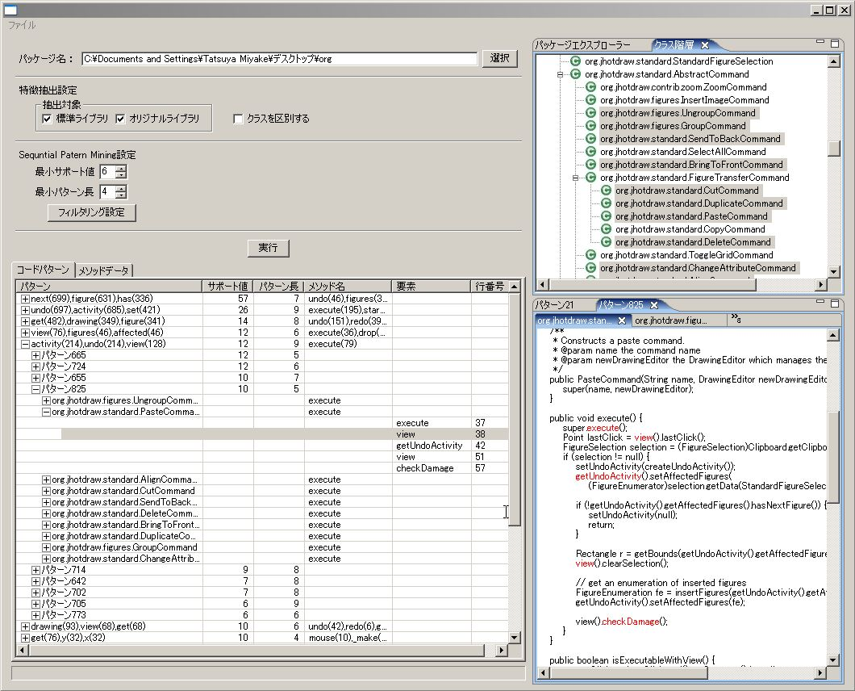
A screenshot of our tool
Class Hierarchy View
highlights classes involving a pattern.
Parameters
for Pattern Mining
The resultant patterns
Source Code View
indicates elements of a pattern.
Notes:
This is a screenshot of the GUI we used to analyze the patterns.
The detected patterns are listed here with summary information, the number of instances, the number of elements in the pattern.
Selecting a pattern in this list highlights code fragments in the source code view and the class hierarchy view.

Slide 17
Case Study: 6 Java programs
Name | Version | Size(LOC) | #Pattern | #Group
JHotDraw | 7.0.9 | 15104 | 747 | 37
jEdit | 4.3pre10 | 17024 | 137 | 33
Azureus | 3.0.2.2 | 85248 | 4682 | 128
Tomcat | 6.0.14 | 33568 | 1415 | 85
ANTLR | 3.0.1 | 3616 | 352 | 29
SableCC | 3.2 | 6336 | 62 | 18
Pattern Mining Parameters: Sup ≧ 4, Len ≧ 4
Notes:
We have applied our pattern mining tool to 6 Java programs.
We selected applications from different domains; two GUI tools JHotDraw and jEdit, two network systems Azureus and Tomcat, and two parser-generators ANTLR and SableCC.
We have detected patterns that has at least 4 instances and involve at least 4 elements.
The number of patterns before and after classification is listed these columns.

Slide 18
Patterns in the programs
We manually analyzed 30 pattern groups.
5 frequent pattern groups for each program
9 “App” groups and 21 “Impl” groups.
“Impl” indicates a pattern is an implementation idiom using only JDK classes.
Most of them are obvious patterns for manipulating collections and strings.
Notes:
We have manually analyzed 5 frequent pattern groups for each program, 30 patterns in total.
We manually classified them to 9 “application” groups and 21 “implementation” groups.
Implementation means that a pattern is an implementation idiom using only JDK classes.
Most of them are obvious patterns for manipulating collections and strings.

Slide 19
The List of “App” Patterns | Sup
jEdit: Open and close “scope” before and after visiting a node, respectively | 55
jEdit: Alert if a read-only buffer is to be edited. | 34
Azureus: Enter and exit a monitor before and after a loop, respectively | 151
Azureus: Logging if enabled | 119
Tomcat: Logging if debugging mode | 304
Tomcat: Execute a function in privileged mode if a protection mode is enabled | 46
ANTLR: Create code generators for unit testing | 107
ANTLR: Parse AST and report an error if necessary | 38
ANTLR: Visit tree nodes to output a text | 29
Notes:
This is a list of application-specific patterns.
According to the limited time, we show the underlined four patterns.
Two of them are Logging concerns and the other two patterns involve similar elements to Logging patterns.
---
jEdit and Azureus have the similar patterns to execute set-up and clean-up before and after an action.
According to the limited time, we show three examples of aspect-like patterns; jEdit alerts if a read-only buffer is to be edited, Tomcat executes a function in privileged mode and Logging of Tomcat and Azureus.

Slide 20
“Alert if a read-only buffer is to be edited” pattern
jEdit has 34 instances of the pattern
[ isEditable, IF, beep, END-IF ]
JEditBuffer.java
public void undo(…) {
if (undoMgr == null)
return;
if (!isEditable()) {
Toolkit.getDefaultToolkit().beep();
return;
}
: // undo an action
}
TextArea.java
public void insertEnterAndIndent() {
if (!isEditable()) {
getToolkit().beep();
} else {
try {
: // insert “\n” and indent
}
}
}
Notes:
First I show a pattern in jEdit that alerts if a read-only buffer is to be edited.
This pattern comprises four elements: isEditable method call, IF, beep method call and END-IF elements.
This pattern prohibits a modification of a read-only buffer; if a buffer is not editable, beep method is called and the action is skipped.
We might replace this pattern with an around advice in AspectJ.

Slide 21
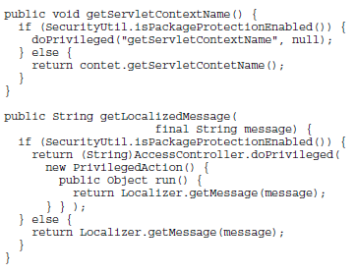
“Execute an action in privileged mode” pattern
Tomcat has 46 instances of the pattern.
[ isPackageProtectionEnabled, IF, doPrivileged, ELSE, END-IF ]
Notes:
This is a pattern in Tomcat that switches the behavior if the package-protection is enabled.
If isPackageProtectionEnabled method returns true, these methods use doPrivileged method instead of regular method calls.
Developers might refactor this pattern using an interface and polymorphic method calls; one class implements the protected mode and the other implements the regular mode.

Slide 22
Logging patterns
A typical crosscutting concern
Modularizing them is difficult!
Various messages are recorded.
Tomcat: 793 messages are used in 925 call sites.
“Process msg”, “Error creating class”, …
Azureus: 199 messages are used in 255 call sites.
“ping ok”, “ping failed”, “add store ok” …
We can replace method names and parameters in logging messages with attributes of join points.
[ isDebugEnabled(), IF, debug(String), END-IF ] (in Tomcat)
Notes:
We also shows two logging patterns in Tomcat and Azureus.
The elements of the pattern are similar to the previous patterns, and logging is a typical crosscutting concern, but modularizing them in aspects is difficult.
This is because these Logging patterns record various messages.
Tomcat uses 793 messages in 925 call sites. Azureus uses 199 messages in 255 call sites.
Here we listed several String literals in the programs.
They represent what a program is doing at a high-level, therefore, it is difficult to construct a mapping from join points to such String literals.

Slide 23
Discussion
We found crosscutting concerns as patterns.
Developers may create documents for patterns.
Difficulties to refactor the patterns to aspects
How Logging aspect generate appropriate messages indicating “what a program is doing” for each join point?
Only “frequent ” (short) patterns are investigated
We will evaluate properties of longer (less-frequent) patterns.
Notes:
Our approach detected crosscutting concerns as coding patterns.
Developers may create documents for the patterns.
We also found that refactoring some pattern to aspects is difficult.
In the Logging example, we have no good ideas to implement a logging aspect that generates appropriate messages indicating what a program is doing at a high-level for each join point.
In this study, we have investigated only frequent, short patterns.
We will evaluate properties of longer, less-frequent patterns in the future work.

Slide 24
Summary
Sequential Pattern Mining approach to detect coding patterns in Java programs.
We have defined rules to normalize source code.
Patterns in 6 programs include both crosscutting concerns and implementation idioms.
Future Work
Analyze all patterns with software metrics
Compare patterns with code clones
(Automatic) Documentation Using SoQueT
Notes:
In summary, we proposed a sequential pattern mining approach to detect coding patterns in Java programs.
We have defined rules to normalize source code.
The patterns we found in 6 Java programs include both crosscutting concerns and implementation idioms.
The case study is only limited to a small number of patterns, therefore, we are analyzing a large number of patterns using software metrics.
We are also planning to compare patterns with code clones, and automatically filter implementation patterns out.

Slide 26
The List of Application-Specific Patterns | Sup | Len
jEdit: Open and close “scope” before and after visiting a node, respectively (tokens: node, scope, close) | 55 | 13
jEdit: Beep if buffer is not editable. (tokens: beep, get, toolkit) | 34 | 6
Azureus: Enter and exit a monitor before and after a loop, respectively (tokens: next, iterator, enter) | 151 | 10
Azureus: Logging if enabled (tokens: log, is, enabled) | 119 | 13
Tomcat: Logging if debugging mode (tokens: debug, is, enabled) | 304 | 24
Tomcat: Execute a function in privileged mode if protection is enabled (tokens: protection, is, enabled) | 46 | 4
ANTLR: Create code generators for unit testing (tokens: set, tool, code) | 107 | 8
ANTLR: Parse AST and report an error if necessary (tokens: LT, match, report) | 38 | 11
Visit tree nodes for textual output (tokens: match, get, text) | 29 | 8

