Slide 1
A Criterion for Filtering
Code Clone Related Bugs
Yasuhiro Hayase†, Yii Yong Lee, Katsuro Inoue†
Osaka University
†{y-hayase,inoue}@ist.osaka-u.ac.jp

Slide 2
Background
Code Clone
  a code fragment occurring more than once in identical or similar form into a software system
  introduced in the source program because of various reasons such as reusing code by `copy-and-paste’
Clone Pair
  a pair of code fragment that are identical or similar each other

Slide 3
Clone-Related Bugs
Clone-Related Bug
  Clones are often modified after copy-and-paste
  Faults are possibly introduced through the modification.
CP-Miner (Zhenmen Li et al., 2007)
  Detecting clone-related bugs
    Find and present inconsistent renaming of identifier between clones
  Problem
    False-positives
    ➔ Propose a new criterion to filter out the false-positives

Slide 4
Brief Summary of CP-Miner
Map identifier appearances between a clone pair
Create renaming table between a clone pair
Compute UnchangedRatio (UR)
  Smaller UR except for 0 means that the renaming is suspicious.
Clone C1 | Clone C2
… = b; b++; for (p=0; p<10; p++) { x += p; } a(x); a(x); | … = c; c++; for (q=0; q<10; q++) { y += p; } a(x); a(z);
ID in C1 | ID in C2 | count | UR
a | a | 2 | 1
b | c | 2 | 0
p | p | 1 | 0.25
 | q | 3
x | x | 1 | 0.20
 | y | 2
 | z | 2
Leave unchanged

Slide 5
Our Approach: New Filtering Criterion
x seems intentionally renamed to different symbols
Criterion Conflict (CF)
  true if the identifier mapped into two or more other identifiers
  false otherwise
ID in C1 | ID in C2 | count | UR | CF
a | a | 2 | 1 | false
b | c | 2 | 0 | false
p | p | 1 | 0.25 | false
 | q | 3
x | x | 1 | 0.20 | true
 | y | 2
 | z | 2

Slide 6
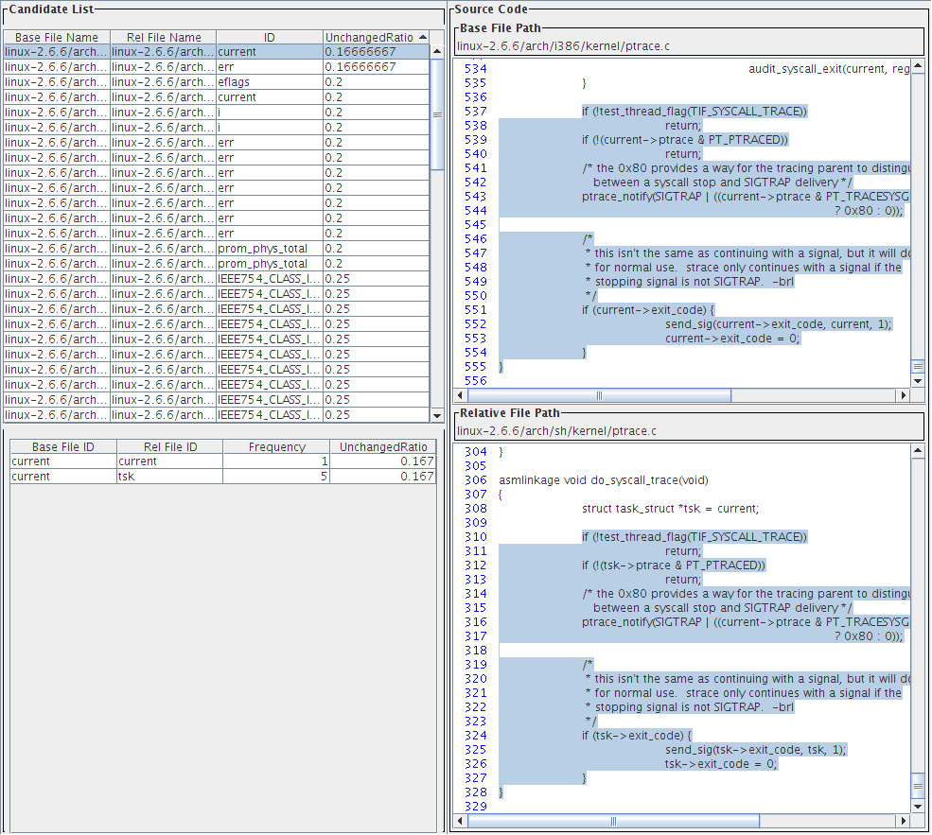
Implementation
The filter using Conflict is implemented into clone-related bug detection system.
  The system uses
  CCFinder

Slide 7
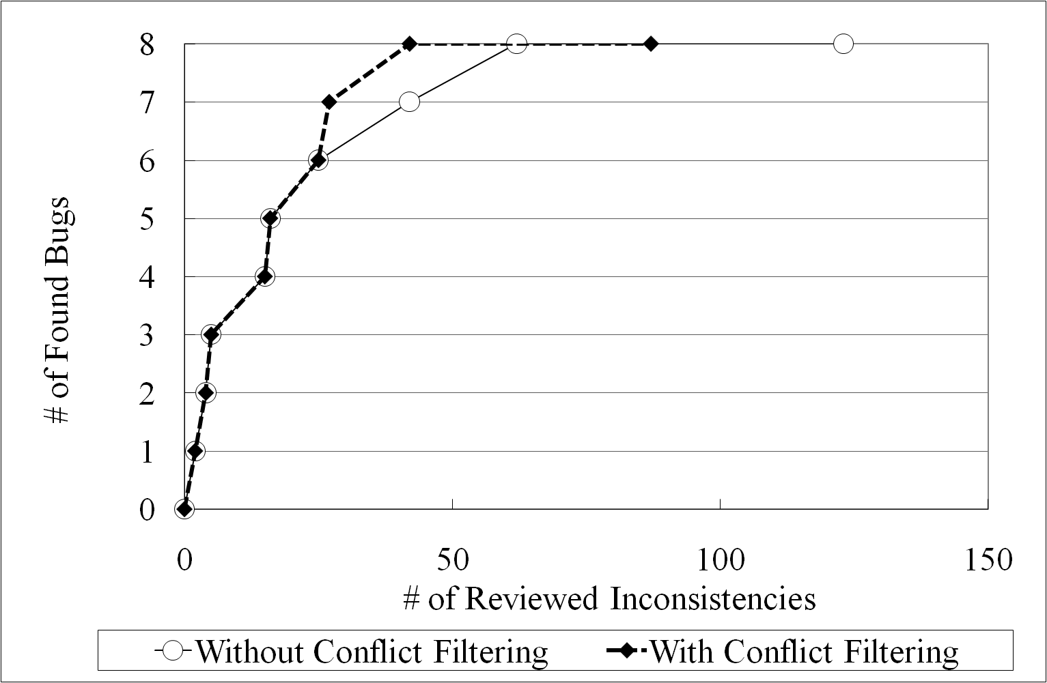
Evaluation
An experiment was performed for evaluation
  Target: arch module of Linux 2.6.6
  Inconsistencies whose UnchangedRatio≦0.4 are reviewed in ascent order of UnchangedRatio
Result
  Reduce 27% of
  inconsistencies
  Filter removes
  NO true-faults

Slide 8
Conclusion
We proposed a criterion for filtering false-candidates detected by CP-Miner
  The criterion recognizes the identifiers renamed to two or more names different from the original name
The filter using the criterion is implemented into a clone-related bug detection system
The filter reduces 27% of inconsistencies

