Slide 1
大規模パターンマイニングを用いた
高品質ソースコードの検索
石尾 隆,
伊達 浩典，市井 誠，井上 克郎

Slide 2
概要
再利用可能なソースコードの検索
  コードを書かずに済むほうが良い
  従来は，必要な機能に対応するコードを検索する
品質の高いコードを検索可能とする
  再利用の実績
    複数のプロジェクトに登場している
  動作実績
    長期間変更されていない
パターンマイニングによるコードの抽出
  複数のソフトウェア，複数のバージョン

Slide 3
再利用可能なソースコードの検索
ソースコードを書かず，再利用する
  欠陥の混入を避ける
  生産性の向上
検索方法
  再利用単位： クラス，メソッド，コード片
  検索クエリ： キーワード，形式仕様ほか
  利用形態： ブラウザによる検索，統合開発環境でのコード補完

Slide 4
「高品質なソースコード」の基準
求める機能に合致しているコード
  この部分は既存の検索技術でカバーされている
簡潔なコード
  適切な長さ，サイクロマチック数，変数の使用など
再利用しやすいコード
  再利用の実績があるものは安心
安定したソースコード
  システムに対する要求の変化に影響されにくい
  欠陥が既に取り除かれている
Notes:
安定している（変更されない）のは，変更が難しいから変更されていない可能性もある．
ただし，「変更の差し戻し」（一度コミットした内容をキャンセルするようなコミット）が起きる場合を除き，
バージョン管理ではそもそも「変更を破棄」してしまうので，変更自体が難しいことを判定するのは難しい．

Slide 5
高品質なソースコードを見つける方法
ソースコードに対するパターンマイニング
  複数のソフトウェア，複数のバージョンに適用
    計算の大規模化：分散計算を導入して対応中
  頻出するソースコード片を抽出
抽出されるコード片をメトリクスで選別
  再利用の実績： 複数のプロジェクトに登場している
  動作実績： 長期間変更されていない
対象は Java

Slide 6
コーディングパターンマイニング[Ishio, 2008]
頻出するメソッド呼び出し列と制御構造を抽出
  モジュール化されていないコードの抽出に適用
  特定のソフトウェア，特定のバージョンの解析
  ➔ 複数ソフトウェア，複数バージョンに拡張
JEditBuffer.java – jEdit
public void undo(…) {
if (undoMgr == null)
return;
if (!isEditable()) {
Toolkit.getDefaultToolkit().beep();
return;
}
// undo an action
}
TextArea.java – jEdit
public void insertEnterAndIndent() {
if (!isEditable()) {
getToolkit().beep();
} else {
try {
// insert “\n” and indent
} …
}
}
Notes:
パターンの出力は，コードの断片

Slide 7
良いコーディングパターンの選別基準
「ある程度の数のソフトウェアで，安定したコード」
パターンの一般性（Universality） [Ichii, 2008]
  多数のソフトウェアに出現するほど一般性は高い
  多数のクラスから使用されるメソッドを使うパターンほど一般性は高い
  JDK関連 ＞ ドメイン固有 ＞ アプリケーション固有
パターンの安定性（Stability）
  パターンに該当するコードに対する修正回数
  一定期間変更されない = 欠陥による修正もない

Slide 8
コーディングパターンの利用法
ソースコードのテンプレートとして利用する
  一般性が高く，かつ安定性も高いパターンを検索
クラスあるいはメソッドの利用法として提示する
  既存のソースコード検索システム用の付加情報
品質指標としてのパターンの利用
  パターンに合致するソースコードが多いクラス
  = 定型的なコードのみからなるクラス
    どのソフトウェアにも登場するようなコードである
    安定しており，あまり変更されていない
    独自のコードに比べると可読性が高い (?)

Slide 9
関連研究: コードクローン検出
抽出するコードの種類と目的の差異
  コードクローン検出:
    １つのソフトウェアに含まれた多数の類似したコード片
  ➔ 保守性を悪化させる可能性があるので検出する
  本研究:
    複数のソフトウェア，バージョンに頻出するコード片
  ➔ 実績のある再利用候補
検出方法の技術的な違い
  他のコードの挿入，削除に強い

Slide 10
まとめと今後の課題
パターンマイニングを用いた高品質なソースコード片の抽出
  再利用の実績 = 一般性 (Universality)
    複数のプロジェクトに登場している
  動作実績 = 安定性 (Stability)
    長期間変更されていない
再利用の方法
  テンプレートとして再利用
  パターンを多数含むソフトウェア部品を再利用
パターンに対するメトリクスの妥当性の評価
  従来の複雑度などとの相関を調査

Slide 12
補足資料
未使用スライド
WCRE2008, LATE2008 発表資料

Slide 13
パターンマイニングの拡張
複数ソフトウェア，複数バージョンの同時解析
  バージョン間はインクリメンタルな解析
    バージョン間で変更されてないコードの抽出は簡単
  ソフトウェア間で類似したコードは計算が必要
    同時刻に存在するソフトウェアのスナップショット比較
問題の大規模化への対応
  解析手法のスケーラビリティ ➔ 分散計算導入
  得られるパターンの選別 ➔ 分析用メトリクス定義

Slide 14
Pattern Mining for Source Code
public B m1() {
…
}
public B m1() {
…
}
public B m1() {
…
}
public B m1() {
…
}
Each method is translated
into a sequence of method
calls and control elements.
public B m1() {
…
}
Normalization
public B m1() {
…
}
Java source code
(methods)
A.m1
IF
B.m2
LOOP
A.m2
END-LOOP
END-IF
A.m1
IF
B.m2
LOOP
A.m2
END-LOOP
END-IF
A.m1
IF
B.m2
LOOP
A.m2
END-LOOP
END-IF
A.m1
IF
B.m2
LOOP
A.m2
END-LOOP
END-IF
A.m1
IF
B.m2
LOOP
A.m2
END-LOOP
END-IF
Sequence Database
A.m1
IF
B.m2
LOOP
A.m2
END-LOOP
END-IF
Mining
We use PrefixSpan, an algorithm of sequential pattern mining.
Patterns
Classification
We classify similar patterns
into a group.
Pattern Groups
(an XML format)
Notes:
In this research, we propose a pattern mining approach to detecting coding patterns in source code.
Our pattern mining comprises three steps: Normalization, Mining and Classification.
The Normalization step takes as input a Java program and normalizes each method to a sequence of method call and control elements.
In the mining step, we apply PrefixSpan algorithm to the generated sequence database.
Finally, the resultant patterns are classified into pattern groups and some meaningless patterns are filtered out.
Next we talk the detail of these steps.

Slide 15
Normalization Rules for Java source code
Java Source Code
Normalized Sequence
while (iter.hasNext()) {
Item item = (Item)iter.next();
if (item.isActive()) item.foo();
}
hasNext(): boolean
LOOP
next(): Object
isActive(): boolean
IF
foo() : void
END-IF
hasNext(): boolean
END-LOOP
Method call elements,
  method signature without class name
LOOP/END-LOOP elements, and
IF/ELSE/END-IF elements.
  Maintaining statement-to-element mapping
Notes:
The first step is normalizing Java source code.
We have defined rules to translate each Java method into a sequence of three kind of elements representing method call, IF and LOOP statements.
Normalized source code simply represents the control-flow of its original source code.
In this example, method hasNext is called first, then, LOOP condition is evaluated.
In the loop body, next and isActive methods are called, the IF statement is executed, and hasNext method is called again.
A pair of LOOP and END-LOOP represents the while statement.
A pair of IF and END-IF represents the IF statement.

Slide 16
Pattern Mining with PrefixSpan [Pei, 2004]
Extract suffix sequences of “a”
Parameter:
min_support = 2
c d
a : 1
b : 2
c : 2
d : 1
a b
c
c : 1
b c
a
a c
a c d
a : 4
b : 3
c : 3
d : 1
a b
d
d : 1
a b c
Sequence
Database
b
c
a : 1
c : 1
c b a
The Result
a
Pattern
Support
a a b
c
a b
2
d
a : 1
b : 1
d : 1
a c
2
#instances
of length-1 patterns
b a
#instances
of length-2 patterns
Notes:
After a sequence database of a Java program is constructed, we use PrefixSpan algorithm to extract sequential patterns.
This algorithm takes as input a sequence database and the minimum support value that is the number of instances of a pattern to be extracted.
I show how PrefixSpan work on an example database comprising four sequences, [a, c, d], [a, b, c], [c, b, a] and [a, a, b] and the minimum support value equals two.
PrefixSpan first extracts frequent elements as the shortest pattern comprising only one element.
Element “a” is a length-1 pattern involved in all of four sequences.
Element “d” is not a pattern candidate because the only one sequence contains the element.
In the next step, PrefixSpan tries to extract length-two patterns based on one-element patterns.
For each length-1 pattern, a new sequence database is constructed.
Each sequence in the new database is a substring prefixed with a length-1 pattern.
For example, the database for pattern “a” includes sequence “c d”, that is a suffix of “a” in the sequence “a c d”.
“b c” comes from “a b c”, “a b” comes from “a a b”, respectively.
Frequent elements in the new database are the second elements of length-2 patterns.
PrefixSpan repeatedly tries to extract longer patterns and terminates all pattern candidates are investigated.

Slide 17
Filtering Patterns
A constraint for control statements:
  If a pattern includes a LOOP/IF element,
  the pattern must include its corresponding element
  generated from the same control statement.
Well-formed patterns
Malformed patterns
hasNext()
LOOP
next()
hasNext()
END-LOOP
hasNext()
LOOP
next()
hasNext()
hasNext()
next()
hasNext()
END-LOOP is missing!
Notes:
After patterns are extracted, we filter out meaningless patterns.
As I said in the normalization step, LOOP and IF elements are always generated with their corresponding END-LOOP and END-IF.
Therefore, if a pattern includes such an element, the pattern must include its corresponding element that is generated from the same control statement.
We accept left two patterns but we filter out the right pattern because it includes LOOP but does not include its corresponding END-LOOP.

Slide 18
Classifying Patterns into Groups
A pattern implies various sub-patterns.
  [A, B, C, D] implies [A, B, C], [A, C, D], …
We classify such sub-patterns into a single pattern group.
  If an instance of a pattern overlaps with an instance of another pattern,
  the patterns are classified into the same group.
Notes:
Finally, we classify the patterns into groups because a pattern implies various sub-patterns.
For example, if PrefixSpan detected a pattern of four elements [A, B, C, D], the algorithm also detected the shorter patterns [A, B, C], [A, C, D] and so on.
We classify such sub-patterns into a single pattern group using one simple rule: if an instance of a pattern overlaps with an instance of another pattern, the patterns are classified into the same group.

Slide 19
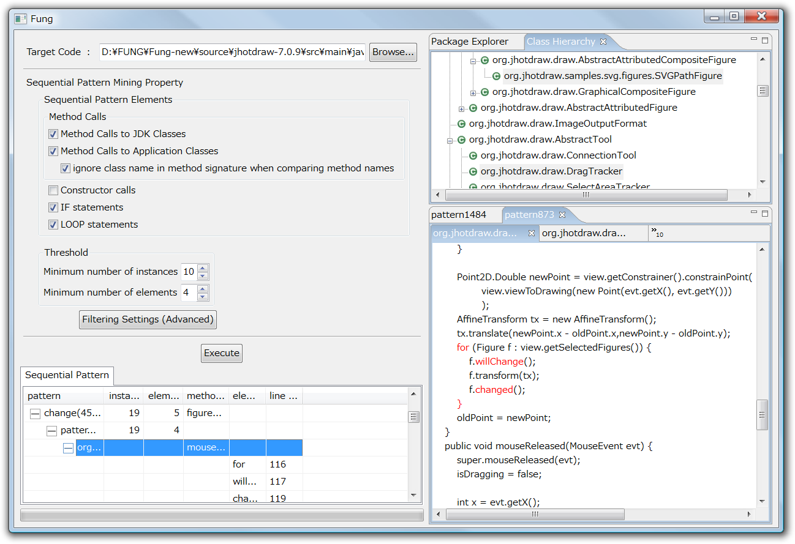
A screenshot of our tool
Class Hierarchy View
highlights classes involving a pattern.
Pattern Mining
Configuration
The resultant patterns
Source Code View
indicates elements of a pattern.
Notes:
We automated the pattern mining process as a tool.
This tool takes as input a source code directory and several parameters, and outputs a list of detected patterns with summary information, the number of instances and the number of elements in the pattern.
Selecting a pattern in the list highlights code fragments in the source code view and the class hierarchy view.

Slide 20
Case Study: 6 Java programs
Name | Version | Size(LOC) | #Pattern | #Group
JHotDraw | 7.0.9 | 90,166 | 747 | 37
jEdit | 4.3pre10 | 168,335 | 137 | 33
Azureus | 3.0.2.2 | 552,021 | 4682 | 128
Tomcat | 6.0.14 | 313,479 | 1415 | 85
ANTLR | 3.0.1 | 59,687 | 352 | 29
SableCC | 3.2 | 35,388 | 62 | 18
#instances ≧ 10, #elements ≧ 4
Notes:
Using the tool, we have investigated coding patterns in 6 Java programs as a case study.
We selected applications from different domains; two GUI tools JHotDraw and jEdit, two network systems Azureus and Tomcat, and two parser-generators ANTLR and SableCC.
We have extracted patterns that has at least 10 instances and each of patterns involves at least 4 elements.
The table shows version, size and the number of detected patterns in the programs.

Slide 21
Patterns in the programs
Manually analyzed 5 frequent pattern groups for each program.
  Excluded pattern groups comprising only JDK methods
    because most of them are well-known patterns for manipulating collections and strings.
17 groups (about 55%) are related to some functionality in applications
  Others are implementation-level patterns
    E.g. null-check if (getView() != null) getView().get…
Notes:
We have manually analyzed 5 frequent pattern groups for each program.
Before we choose 5 frequent patterns, we excluded patterns that comprises only JDK classes because most of them are well-known patterns for manipulating collections and strings.
We found that 17 pattern groups are related to some functionality in applications.
Others are implementation-level patterns such as null-check pattern that are not related to a particular function.

Slide 22
Pattern Categorization
17 pattern groups into five Categories
ID | Pattern Description | #pattern groups
1 | A boolean method to insert an additional action: <Boolean method>, <IF>, <action-method>, <END-IF> | 3
2 | A boolean method to change the behavior of multiple methods: <Boolean method>, <IF>, <action-method>, <END-IF> | 3
3 | A pair of set-up and clean-up: <set-up method>, <misc action>, … , <clean-up method> | 3
4 | Exception Handling: Every instance is included in a try-catch statement. | 3
5 | Other patterns | 5
Notes:
During the investigation, we recognized five categories of patterns.
Two categories are patterns related to a method call that returns a Boolean value followed by an IF statement using the value.
The third category is a pair of set-up and clean-up method calls.
The fourth category is exception handling; every instance of patterns is a part of a try-catch statement.
The final category is other patterns that are not covered by this categorization.
I show the example patterns for each category.

Slide 23
Category 1:
Boolean method inserting an action
Logging patterns in Tomcat and Azureus
[ isDebugEnabled(), IF, debug(String), END-IF ] (in Tomcat)
BasicAuthenticator.java
public boolean authenticate(…) … {
Principal principal = …
if (principal != null) {
if (log.isDebugEnabled())
log.debug("Already authenticated “ + …);
…
return (true);
}
…
}
304 instances in Tomcat
119 instances in Azureus
A well-known
crosscutting concern,
but
hard to modularize
various messages.
Notes:
The first category is a Boolean method followed by an IF statement that executes an additional action.
A typical pattern in this category is this logging pattern in Tomcat.
The return value of isDebugEnabled method controls a debug method call.
Logging is a typical crosscutting concern, we found many instances of this type of patterns in Tomcat and Azureus.
Modularizing them into aspects is difficult because each instance uses a different debug message.

Slide 24
Category 2: Boolean method to switch the behavior of multiple methods
jEdit has 34 instances of the pattern
  Preventing a user from editing a read-only buffer
[ isEditable, IF, beep, END-IF ]
JEditBuffer.java
public void undo(…) {
if (undoMgr == null)
return;
if (!isEditable()) {
Toolkit.getDefaultToolkit().beep();
return;
}
// undo an action
}
Around advice in AspectJ
may replace the pattern.
Notes:
The second category is a boolean method followed by an IF statement that switch the behavior of methods.
While the category 1 inserts an additional action such as logging, this category completely replace the original behavior.
This is an example in jEdit that prevents a user from editing a read-only buffer.
This pattern first calls isEditable method.
If a buffer is not editable, beep method is called and the action is skipped.
Patterns in this category might be modularized using around advice in AspectJ.

Slide 25
Category 3: set-up and clean-up
Synchronization in Azureus
[ enter, LOOP, END-LOOP, exit ]
151 instances use
AEMonitor.enter and
AEMonitor.exit
DHTControlImpl.java
try {
activity_mon.enter();
listeners.addListener( l );
for (int i=0;i<activities.size();i++){
listeners.dispatch(…);
}
} finally {
activity_mon.exit();
}
Template-Method or
before/after advices
might be applicable.
Notes:
The third category is a pair of method calls for set-up and clean-up.
An example is synchronization method calls in Azureus.
This pattern comprises a pair of Enter and Exit method calls for a monitor object.
Each instance executes method calls between Enter and Exit.
These patterns may be replaced with template-method or a pair of before and after advices in AspectJ.

Slide 26
Category 4: Exception Handling
“Report Error” pattern in ANTLR parser
[ LT, match, reportError, recover ]
ANTLRParser.java
void rewrite_block() throws … {
try {
lp = LT(1);
…
match(LPAREN);
…
} catch (RecognitionException ex) {
reportError(ex);
recover(ex,_tokenSet_34);
}
returnAST = rewrite_block_AST;
}
38 instances
in parser classes
Notes:
The fourth category is exception handling; every instance of patterns in this category is a part of a try-catch statement.
For example, this pattern is found in ANTLR parser classes.
The pattern calls LT and match methods to process tokens according to a grammar.
If a RecognitionException is thrown, reportError and recover methods are called in catch block.
To extract this kind of patterns automatically, we need to extend our normalization rules for try-catch statements.

Slide 27
Other Patterns
Duplicated code in ANTLR’s test cases
[ setErrorListener, newTool,
setCodeGenerator, genRecognizer ]
TestAttributes.java
public void testArguments() … {
…
ErrorManager.setErrorListener(equeue);
Grammar g = new Grammar(…);
Tool antlr = newTool();
CodeGenerator generator = new …
g.setCodeGenerator(generator);
generator.genRecognizer();
… // extract a string from AST
assertEquals(expecting, found);
}
107 instances
in ANTLR test cases
The pattern configures
parser for each test case.
Notes:
Other patterns are duplicated code fragments that are not covered by other four categories.
One example is duplicated code in ANTLR’s test cases.
The pattern configures parsers for test cases using different grammar objects.

Slide 28
Discussion
Coding patterns are “Consistent Behavior” crosscutting concern sort [Marin, 2007].
Maintenance support using coding patterns
  Refactoring the patterns (AO-Refactoring)
  Consistently edit the instances (Fluid AOP)
  Documenting the patterns (SoQueT)
Only frequent patterns are investigated.
Notes:
The coding patterns we have investigated are to implement “consistent behavior” that is a crosscutting concern sort.
The coding pattern information can be combined with several approaches to support software maintenance.
One approach is refactoring the patterns using AspectJ or other techniques.
If refactoring is hard to perform, coding pattern information is still effective to consistently maintain the pattern instances and to write documentation for crosscutting concerns.
Our case study has one limitation; we have investigated only frequent patterns.
Less frequent patterns are not investigated yet. Therefore, we need further investigation on coding patterns.

Slide 29
Conclusion
Sequential pattern mining
to detect Coding Patterns in Java programs.
  Applied PrefixSpan algorithm to normalized source code.
  Frequent coding patterns implements “Consistent Behavior” in programs.
Future Work
  Support try-catch and synchronized statements
  Analyze more patterns with software metrics
  Compare coding patterns with code clones
Notes:
In summary, we proposed a sequential pattern mining to detect coding patterns in Java programs.
We have applied PrefixSpan algorithm to normalized Java source code.
The resultant patterns we found in 6 Java programs include consistent behavior crosscutting concern sort.
In future work, we would like to support try-catch and synchronized statements in pattern mining process.
We are developing a new version of the tool to investigate more coding patterns with software metrics.
We are also interested in comparison between coding patterns and code clones because both approaches extract duplicated code fragments.
Thank you for your attention.

Slide 30
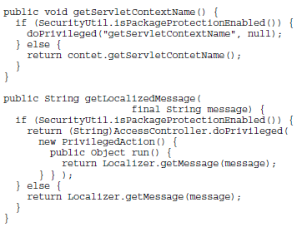
“Execute an action in privileged mode” pattern
[Ishio, LATE2008]
Tomcat has 46 instances of the pattern.
[ isPackageProtectionEnabled, IF, doPrivileged, ELSE, END-IF ]
Notes:
This is a pattern in Tomcat that switches the behavior if the package-protection is enabled.
If isPackageProtectionEnabled method returns true, these methods use doPrivileged method instead of regular method calls.
Developers might refactor this pattern using an interface and polymorphic method calls; one class implements the protected mode and the other implements the regular mode.

