Slide 1

Cage: A Keyword Search Tool Enhanced with
Semantic Property Extraction
grep
A tool for developers who do not (cannot?) modularize concerns
Takashi Ishio
ishio@ist.osaka-u.ac.jp
Osaka
University

Slide 2
Research Background
Code Clones: similar source code fragments created in a program
  Reused functions/algorithms/idioms
  Implementation of crosscutting concerns
bug
copy-and-modify
copy-and-modify
bug

Slide 3
A bug-fix process for code clones
A bug is reported by a user.
Developers identify the cause of the bug.
They inspect source code to find the same problem in other locations.
  Similar code fragments exist if modularization is not perfect.
They fix the bug and run a regression test.
They report the bug fix to the user.

Slide 4
How to find the same problem
A developer picks up keywords from the code fragment including the bug.
The developer executes grep with the search keywords.
The developer inspects all keyword occurrence and creates a list of “to-be-fixed” or “not-fix” for each occurrence.
The list is reviewed by another developer.

Slide 5
Why developers prefer grep
100% recall with low precision
A quantitative metric
to ensure accountability.
A recurrent bug makes users anger.
What if users find a similar problem
immediately after developers
reported a bug fix …?
There is no perfect system.

Slide 6
Towards Efficient Inspection
Developers’ requirement: 100% Recall
  (if keywords are correct)
  Don’t exclude any code fragments
Clustering the result of grep
  Enable developers to inspect a group of similar code fragments at once
Target: Java langauge

Slide 7
Example: When JEdit sounds beep?
A user tried to edit a read-only text. (34 methods)
A user tried to move a caret but failed. (22 methods)
Case 1 (class JEditBuffer)
public void undo(…) {
if(undoMgr == null) return;
if(!isEditable()) {
textArea.getToolkit().beep();
return;
}
… // undo the previous action
}
Case 2 (class TextPane)
public void goToNextMarker(…) {
java.util.List<Marker> markers = …
if(markers.isEmpty()) {
getToolkit().beep();
return;
}
Marker marker = …
textArea.moveCaretPosition(
marker.getPosition());
…
}
Can we find these groups
(semi-)automatically?

Slide 8
“Similarity” of code fragments
Similar code fragments have common “properties”.
  Behavioral Properties
    The code fragments call the same method.
      Variation: Exactly same, same signature, same name
    The code fragments directly access the same field.
  Structural Properties
    The code fragments are involved in the same class.
    The code fragments override the same method.

Slide 9
Property Extraction Process
  We define each property as a predicate:
  P(m: method) => boolean
Select Java methods
including the keywords
The result of grep
Evaluate the properties
B1(m) = m calls “isEditable”.
B2(m) = m calls “moveCaretPosition”.
B3(m) = …
…
S1(m) = m is defined in class “JEdit”.
S2(m) = m have the name “set*”.
S3(m) = …
…

Slide 10
Method-Property Table
Ananlyzed JEdit source code with a keyword “beep”
Methods found by grep (93 methods) | Call beep (85 methods) | Call isEditable (34 methods) | Call moveCaretPosition (21 methods) | Accesses undoMgr field (2 methods)
JEditBuffer.undo | X | X |  | X
EditPane. goToNextMarker | X |  | X
EditPane. goToPrevMarker | X |  | X
Abbrevs. expandAbbrev | X | X

Slide 11
Formal Concept Analysis
FCA extracts all concepts (clusters).
  Non-exclusive clustering
A concept is a pair [M, P]
  Every method in M
  satisfies all properties in P.
  Any other method cannot
  satisfy at least one of the properties P.
 | P1 | P2 | P3 | P4
M1 | X | X | X | X
M2 | X | X | X | X
M3 | X | X | X | X

Slide 12
Interactive analysis using FCA
A limitation of FCA is the number of concepts (clusters).
  too many concepts to show
Interactive Analysis
  Two basic tools:
    Find common properties among selected methods
    Find methods satisfying selected properties
  … instead of direct visualization of concepts

Slide 13
Tool Demonstration
Example Target: JEdit, a text editor
  Anallyze when JEdit calls beep method.
Command line arguments:
java -cp jedit-bin Main jedit-source beep
Analysis excludes JDK methods except for “beep” method.
[Bytecode of JEdit] [Source] [grep keyword]

Slide 14
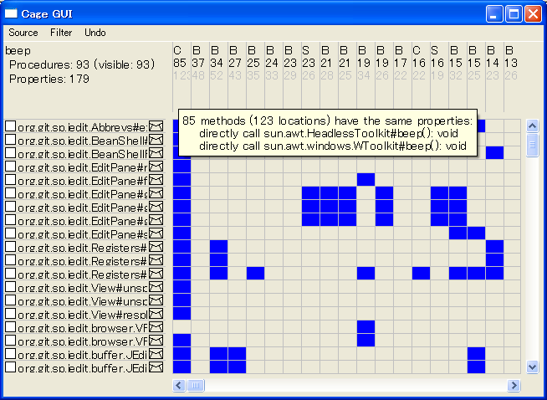
The Main Window: Method-Property Table
A column corresponds to a property
Sorted by #methods
satisfying the property
The detail of a column is shown as a tool-tip
Each row corresponds to a Java method
including a keyword
The method of the row satisfies the property of the column

Slide 15
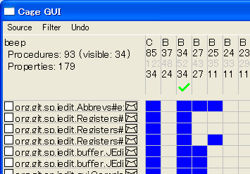
Filters
A right-click enables a filter.
Now the window shows only the methods calling “isEditable”.
An envelope icon indicates a method whose source code is not investigated yet.

Slide 16
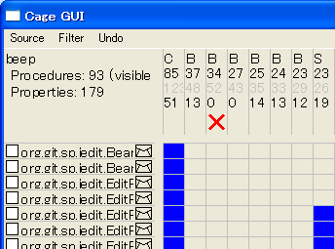
Excluding Inspected Methods
This filter hides methods that satisfy the property.

Slide 17
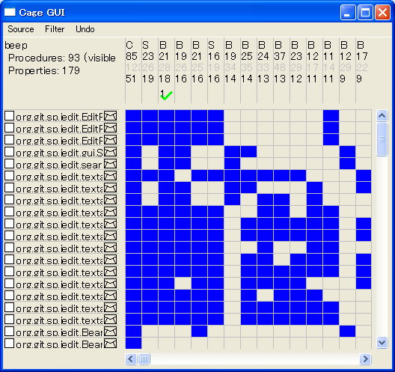
Properties can be sorted by #methods satisfying each property.
After the first property is inspected,
choose another property to inspect.

Slide 18
Is it effective?
In the case of beep method of JEdit, 52 of 93 methods are covered by “isEditable” and “moveCaretPosition” methods.

Slide 19
Conclusion and Future Work
Our tool extracts common properties among code fragments.
  Efficient code inspection with grep
Future Work
  Case study of the tool with an industrial team
  Advanced aspect mining: extract “why” the code fragments are not modularized
    Is there any special properties?

