Slide 1
Code Clone Analysis and Its Application
Katsuro Inoue
Osaka University

Slide 2
Clone Detection

Slide 3
What is Code Clone?
A code fragment which has identical or similar code fragments in source code
Introduced in source code because of various reasons
code reuse by `copy-and-paste’
stereotyped function
ex. file open, DB connect, …
intentional iteration
performance enhancement
It makes software maintenance more difficult
If we modify a code clone with many similar code fragments, it is necessary to consider whether or not we have to modify each of them
We easily overlook
code clone
copy-and-paste

Slide 4
Simple Example
AFG::AFG(JaObject* obj) {
objname = “afg";
object = obj;
}
AFG::~AFG() {
for(unsigned int i = 0; i < children.size(); i++)
if(children[i] != NULL)
delete children[i];
...
for(unsigned int i = 0;
i < nodes.size(); i++)
if(nodes[i] != NULL)
delete nodes[i];
}

Slide 5
Definition of Code Clone
No single or generic definition of code clone
Each researcher has own definition, but common understanding
Type 1 clone: syntactical equivalence
Type 2 clone: parameterized syntactical equivalence
Type 3 clone: others (semantic equivalence, deleted/added, …)
Various detection methods
Line-based comparison (type 1)
AST (Abstract Syntax Tree) based comparison (type 2, 3)
PDG (Program Dependency Graph) based comparison (type 3)
Metrics comparison (type 1, 2)
Token-based comparison (type 2)

Slide 6
Detection Method Token Based Comparison
Compare token sequences of source code, and identify the similar subsequence as code clones*
Before comparison, tokens of identifier (type name, variable name, method name, …) are replaced by the same special token (parameterization)
The Scalability is very high
M Loc / 5-20 min.
* T. Kamiya, S. Kusumoto, and K. Inoue, CCFinder: A multi-linguistic token-based code clone detection system for large scale source code, IEEE Transactions on Software Engineering, vol. 28, no. 7, pp. 654-670, Jul. 2002.

Slide 7
CCFinder and Associate Tools

Slide 8
Clone Pair and Clone Set
Clone Pair
A pair of identical or similar code fragments
Clone Set
A set of identical or similar fragments
Clone Pair | Clone Set
(C1, C2) | {C1, C2, C4}
(C1, C4) | {C3, C5}
(C2, C4)
(C3, C5)
C1
C4
C2
C5
C3

Slide 9
Our Code Clone Research
Develop tools
Detection tool: CCFinder
Visualization tool: Gemini
Refactoring support tool: Aries
Change support tool: Libra
CCFinderX
Deliver our tools to domestic or overseas organizations/individuals
More than 5000 organizations use our tools!
Promote academic-industrial collaboration
Organize code clone seminars
Manage mailing-lists

Slide 10
Detection tool: Development of CCFinder
Developed by industry requirement
Maintenance of a huge system
More than 10M LOC, more than 20 years old
Maintenance of code clones by hand had been performed, but ...
Token-base clone detection tool CCFinder
Normalization of name space
Parameterization of user-defined names
Removal of table initialization
Identification of module delimiter
Suffix-tree algorithm
CCFinder can analyze the system of millions line scale in 5-30 min.

Slide 11
Detection tool: CCFinder Detection Process
Source files
1. static void foo() throws RESyntaxException {
2. String a[] = new String [] { "123,400", "abc", "orange 100" };
3. org.apache.regexp.RE pat = new org.apache.regexp.RE("[0-9,]+");
4. int sum = 0;
5. for (int i = 0; i < a.length; ++i)
6. if (pat.match(a[i]))
7. sum += Sample.parseNumber(pat.getParen(0));
8. System.out.println("sum = " + sum);
9. }
10. static void goo(String [] a) throws RESyntaxException {
11. RE exp = new RE("[0-9,]+");
12. int sum = 0;
13. for (int i = 0; i < a.length; ++i)
14. if (exp.match(a[i]))
15. sum += parseNumber(exp.getParen(0));
16. System.out.println("sum = " + sum);
17. }
1. static void foo() throws RESyntaxException {
2. String a[] = new String [] { "123,400", "abc", "orange 100" };
3. org.apache.regexp.RE pat = new org.apache.regexp.RE("[0-9,]+");
4. int sum = 0;
5. for (int i = 0; i < a.length; ++i)
6. if (pat.match(a[i]))
7. sum += Sample.parseNumber(pat.getParen(0));
8. System.out.println("sum = " + sum);
9. }
10. static void goo(String [] a) throws RESyntaxException {
11. RE exp = new RE("[0-9,]+");
12. int sum = 0;
13. for (int i = 0; i < a.length; ++i)
14. if (exp.match(a[i]))
15. sum += parseNumber(exp.getParen(0));
16. System.out.println("sum = " + sum);
17. }
Lexical analysis
Lexical analysis
Lexical analysis
Lexical analysis
Token sequence
Token sequence
Token sequence
Token sequence
Transformation
Transformation
Transformation
Transformation
Transformed token sequence
Transformed token sequence
Transformed token sequence
Transformed token sequence
Match detection
Match detection
Match detection
Match detection
Clones on transformed sequence
Clones on transformed sequence
Clones on transformed sequence
Clones on transformed sequence
Formatting
Formatting
Formatting
Formatting
Clone pairs

Slide 12
Suffix-tree
Suffix tree is a tree that satisfies the following conditions.
A leaf node represents the starting position of sub-string.
A path from root node to a leaf node represents a sub-string.
First characters of labels of all the edges from one node are different from each other.
→ A common path means a clone

Slide 13
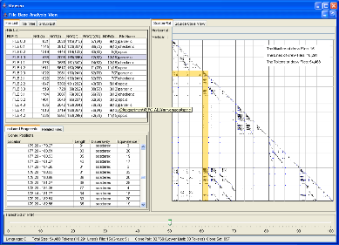
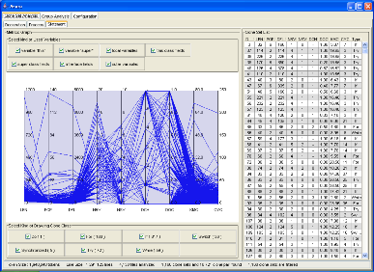
Visualization Tool: Gemini
Visualize code clones detected by CCFinder
CCFinder outputs the detection result as a text sequence
Provide interactive analyses of code clones
Scatter Plot
Clone metrics
File metrics
Filter out unimportant code clones

Slide 14
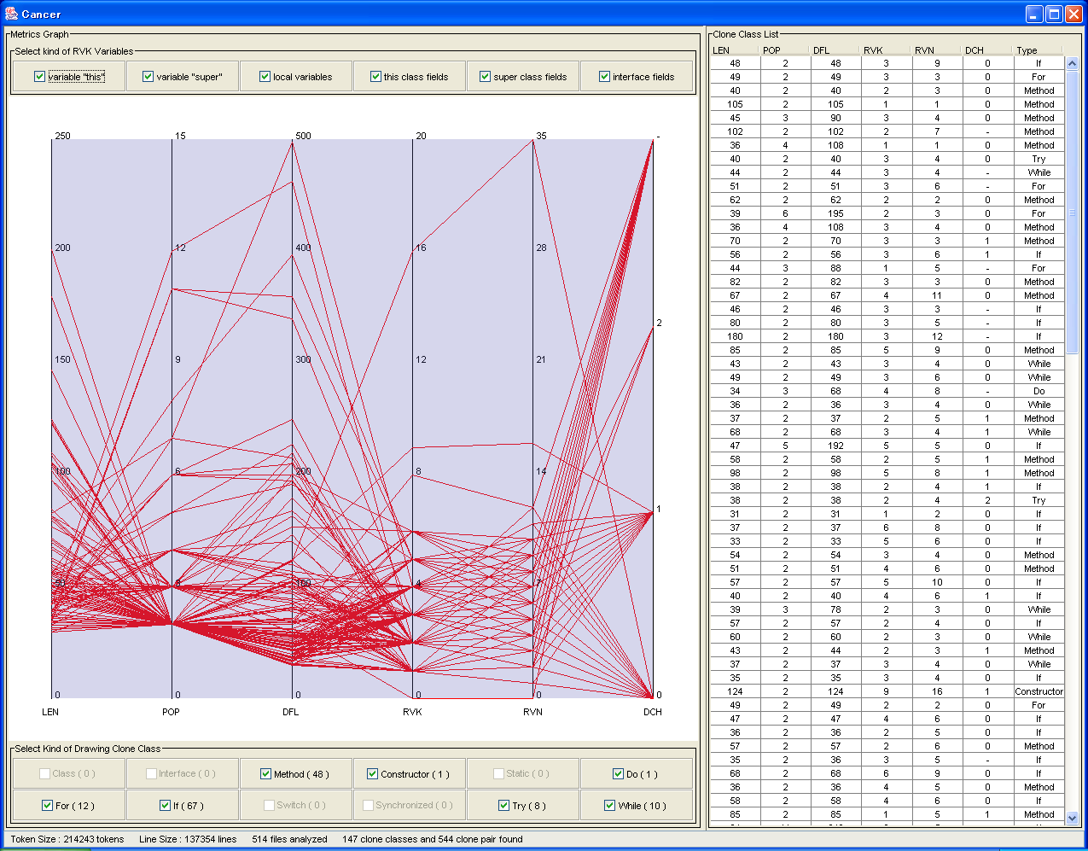

Slide 15
Applications

Slide 16
Case Studies
Open source software
FreeBSD, NetBSD, Linux(C, 7MLOC)
JDK Libraries(Java 1.8MLOC)
Qt(C++, 240KLOC)
Commercial software（more than 100 companies）
IPA/SEC, NTT Data Corp., Hitachi Ltd., Hitachi GP, Hitachi SAS, NEC soft Ltd., ASTEC Inc., SRA Inc., JAXA，Daiwa Computer, etc…
Students excise of Osaka University
Court evidence for software copyright suit
…

Slide 17
Case study 1: Similarity between FreeBSD, NetBSD, Linux
Result
There are many code clones between FreeBSD and NetBSD
There are a little code clones between Linux and FreeBSD/NetBSD
Their histories can explain the result
The ancestors of FreeBSD and NetBSD are the same
Linux was made from scratch

Slide 18
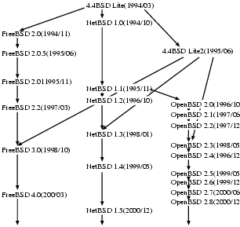
History of BSD Unix OS

Slide 19
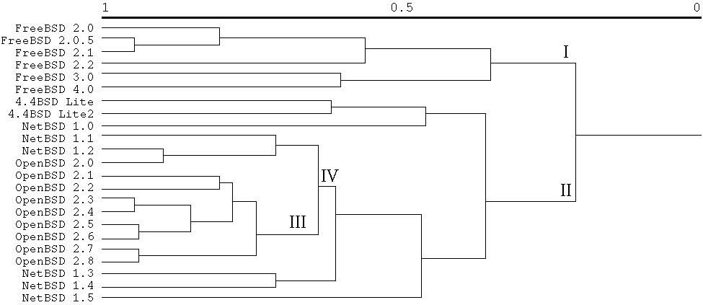
Cluster Analysis Using Clone Ratio as Similarity Measure

Slide 20
Case study 2: Students Excise
Target
Programs developed on a programming exercise in Osaka Univ.
Simple compiler for Pascal written in C language
This exercise consists of 3 steps
STEP1: develop a syntax checker
STEP2: develop a semantics checker by extending his/her syntax checker
STEP3: develop a total compiler by extending his/her semantic checker
Purpose
Check the stepwise development
Check plagiarisms

Slide 21
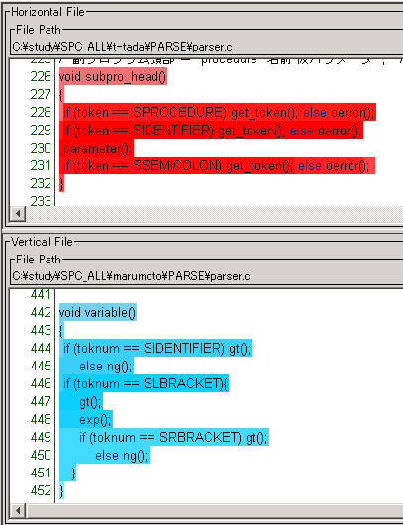
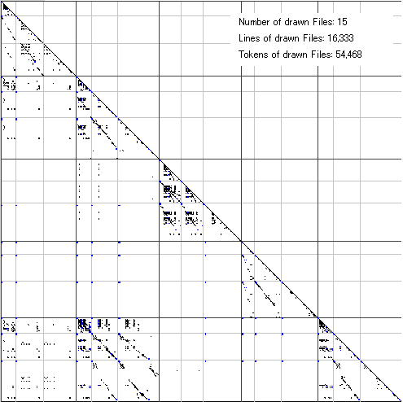
Result
There were a lot of code clones between S2 and S5
We did not use the detection result for evaluating their excises
S1
S2
S3
S4
S5
S1
S2
S2
S3
S4
S5
S5

Slide 22
Case Study 3: IPA/SEC Advanced Project
Target
A car-traffic information system using heterogeneous sensors, developed by 5 Japanese companies
The project manager had little knowledge of the source code since each company independently developed the components
Purpose
Grasp features of black-boxed source code
Approach
Analyzed twice, after the unit test (280,000LOC), and after the combined test (300,000LOC）
The minimum size of detected code clone is 30 tokens

Slide 23
Case Study 3: Scatter Plot Analysis
Scatter Plot of company X
In part A, there are many non-interesting code clones
output code for debug (consecutive printf-statements)
check data validity
consecutive if-statements
In part B, there are many code clones across directories
This part treats vehicle position information
Each directory include a single kind of vehicles, e.g., taxi, bus, or track
Logical structures are mostly the same
Notes:
A の部分にメトリクスRNR でフィルタリングされたコードクローンが多数存在している．
これらのソースコードを閲覧したところ，デバック用の情報出力コード（連続したprintf 文）やデータの妥当性チェック（連続したif 文）であり，うまくフィルタリングを行えていることが確認できた．
B の部分にも多くのコードクローンが存在した．
この部分のコードクローンは黒の格子をまたいで存在することからディレクトリ間クローンであることがわかる．
この部分は車両の位置情報を扱う処理部分であり，車両種別によりディレクトリが分かれていた．
ディレクトリ毎に扱う情報の種類は異なるものの，処理内容は非常に類似していた．

Slide 24
Handling Huge Targets

Slide 25
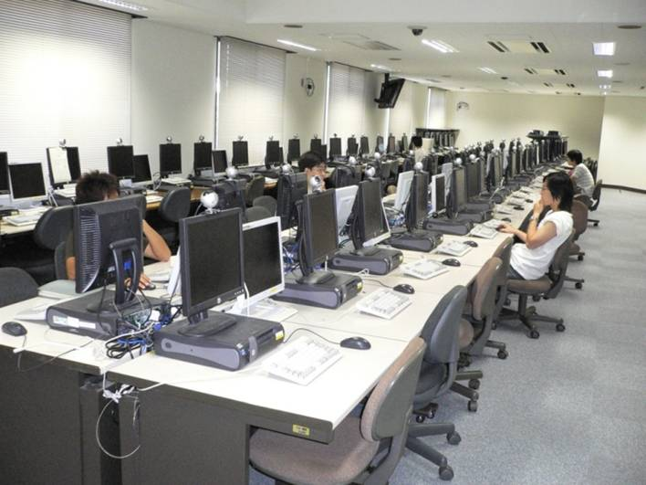
1.Distributed Code-Clone Analysis
Embarrassingly parallel problem
D-CCFinder (Distributed CCFinder)
Virtual PC cluster with 80 lab. machines
Each tile is a task with a single CCFinder

Slide 26
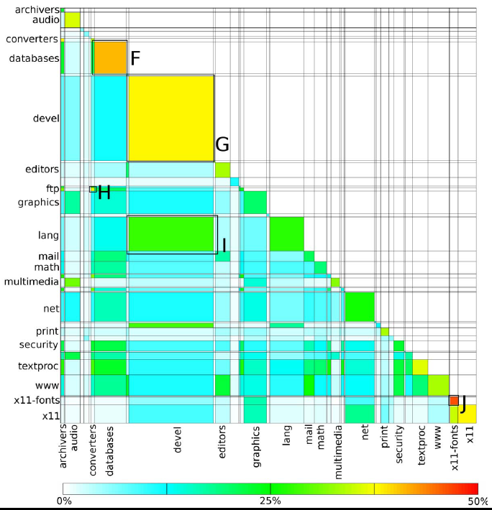
Result of FreeBSD Ports Collection
10.8GB/403M LOC in C
Livieri, S., Higo, Y., Matsushita, M., Inoue, K., “Very-Large Scale Code Clone Analysis and Visualization of Open Source Programs Using Distributed CCFinder: D-CCFinder“, International Conference on Software Engineering, Minneapolis, MN. (May 2007, to appear)

Slide 27
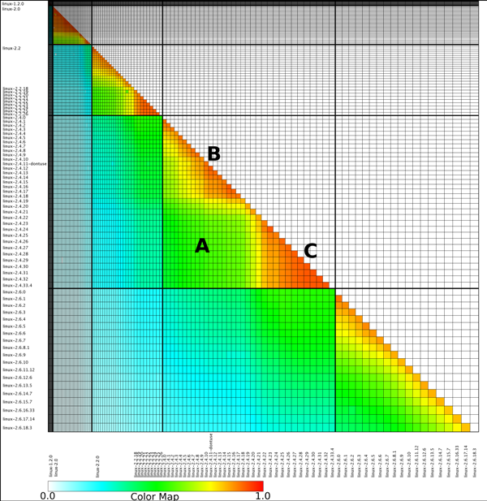
Result of 136 Linux Kernels
7.4GB
260M LOC in C

Slide 28
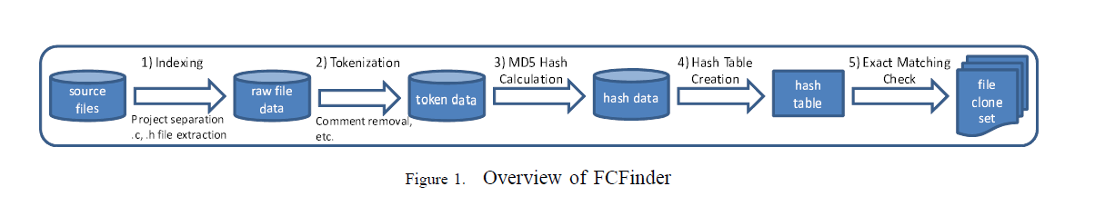
2. File Clone Finder FCFiner
Efficiently find only file copies
Except for comments and spacing
Tokenization and hashing technique

Slide 29
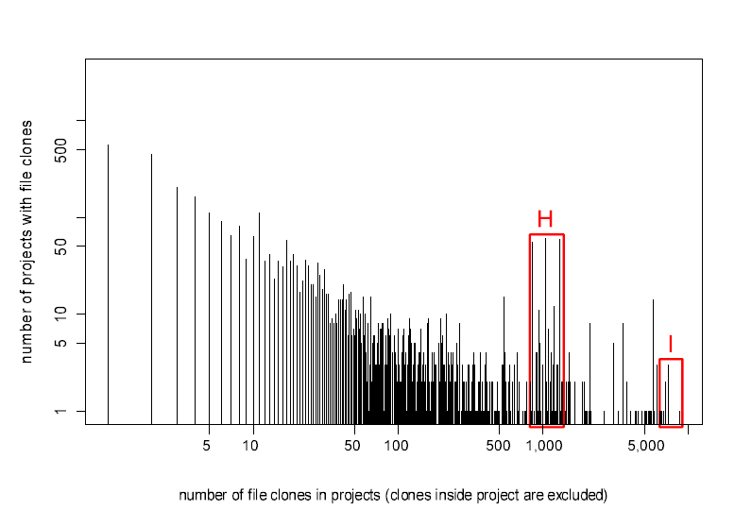
Analysis for FreeBSD Ports Collection
14.6 hours for 7GBytes target

Slide 30
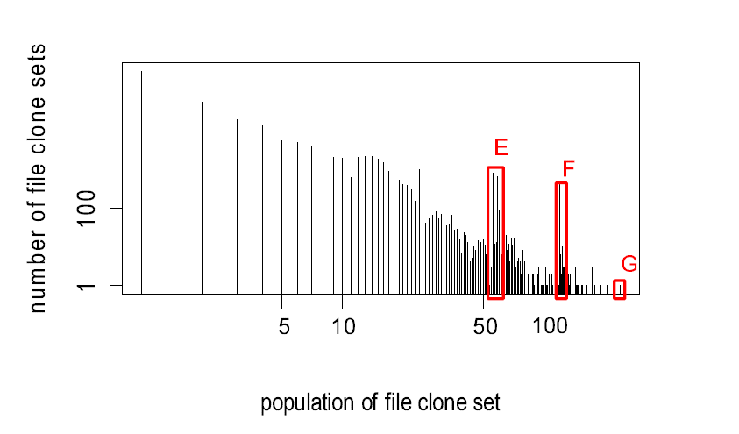
Analysis for FreeBSD Ports Collection (2)

Slide 31
Summary

Slide 32
Conclusion
We have developed Code clone analysis tools
CCFinder family
CCFinder, CCFinderX, Gemini, …
Scalable tools
D-CCFinder, Yocca, FCFinder
We have promoted academic-industrial collaboration
Applied to many industry practices

Slide 33
5th International Workshop on Software Clones IWSC2011
In conjunction with 33nd International Conference on Software Engineering ICSE2011
May 2011 @ Honolulu, Hawaii

