Slide 1
Reusing Open Source Software - Issues on Code Search and License Identification -
Katsuro Inoue
Osaka University

Slide 2
Motivation and Overview

Slide 3




Open Source Software
Key Driver of software engineering in researches and practices in there days
Essential resource for the software system development
Academia
Industry
Development environment provided as OSS
Notes:
SourceForge is a large ...
It provides version control, communication support, and many other features necessary for open source development.
It hosts more than 60,000 projects, and
registered users are more than 600,000.

Slide 4
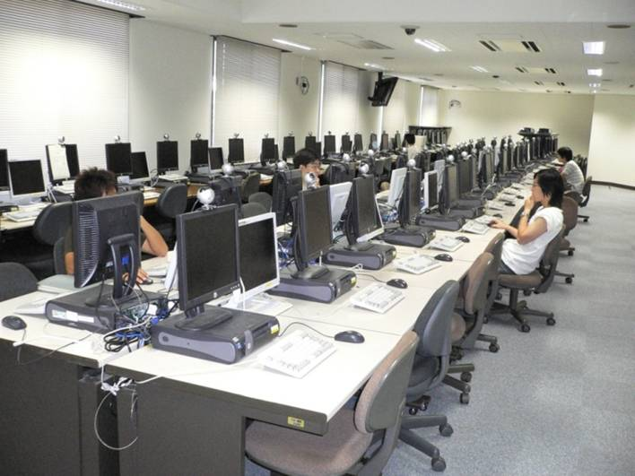
Code Clones in
FreeBSD Ports Collection
10.8GB 403M LOC in C
80 PC Workstations
2 days

Slide 5
Issues
How do we find appropriate software components in huge collection of OSS?
How can we identify the licenses of each component in the large OSS?

Slide 6
Software Space

Slide 7

SourceForge
Huge Open Source Software (OSS) development support site
Project repository, software search, ...
# Projects > 240,000
# Users > 2,600,000
This is only a small part of OSS space
Notes:
SourceForge is a large ...
It provides version control, communication support, and many other features necessary for open source development.
It hosts more than 60,000 projects, and
registered users are more than 600,000.

Slide 8
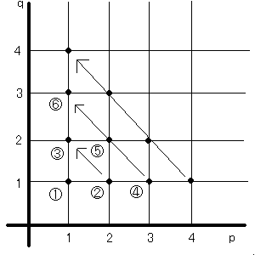
Software Space
The number of different software
Countably infinite
However, we feel very similar programs are repeatedly made by ourselves or others
I remember the similar code had been made before ...
I found a similar but better program on the net
...

Slide 9
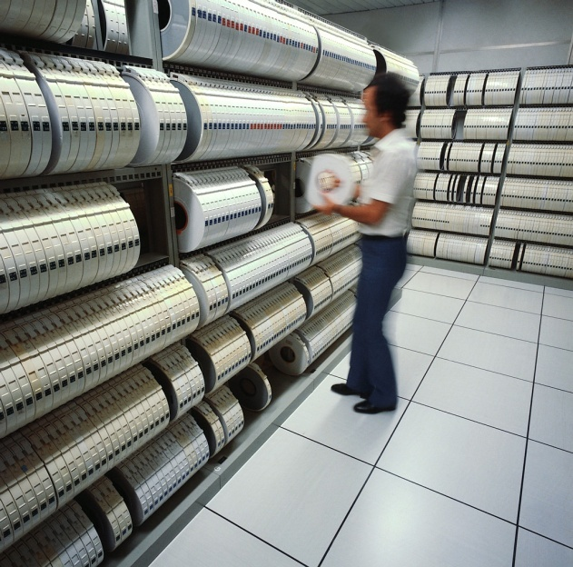
Managing Software Collection
Collection
Organizational assets in repository
Open source software projects
We can collect them relatively easily by simply keeping everything
Management
Categorize and register software components
Keep track of software evolution
Clustering/labeling/indexing software collection needs an extensive elaboration

Slide 10

Exploring Software Space
Browsing
Target must be well-organized
Feature
Name
Time
Kind
Not practical if the collection becomes huge
Search Find software from the mass collection
High quality answer → good ranking

Slide 11
Search Methods
Keyword
Function/Class names
Parameters
Variable/Identifiers
Comments
Program Snippets
Incomplete structures
Complete structures
Search keys can be automatically created through user activities
...
31 @author Ceki G&uuml;lc&uuml; */
32 public class SortAlgo {
33
34 final static String className = SortAlgo.class.getName();
35 final static Logger LOG = Logger.getLogger(className);
36 final static Logger OUTER = Logger.getLogger(className + ".OUTER");
37 final static Logger INNER = Logger.getLogger(className + ".INNER");
38 final static Logger DUMP = Logger.getLogger(className + ".DUMP");
39 final static Logger SWAP = Logger.getLogger(className + ".SWAP");
40
41 int[] intArray;
42
43 SortAlgo(int[] intArray) {
44 this.intArray = intArray;
45 }
46
...

Slide 12

Related Works (1) Software Search Engines
Google, Google Code Search (Google)
Koders (Black Duck)
3GB OSS, C/C++/C#/... 30 languages
Krugle (Krugle Enterprise)
OSS project support, search
SourceForge (Geeknet Inc.)
SPARS/J
Osaka-U, earlier than Google Code Search
CodeBroker, Sourcerer, Merobase, Exemplar, Strathcona, Assieme, XSnippet, ...

Slide 13
Related Works (2) Software Component Recommendation
Historical Approach Collect user activity and repository logs
Provide the raw data
Provide after processing such as collaborative filters
Social Approach Construct developers and users network
Ask experts the best solution
Developers values

Slide 14

Related Works (3) Program Analysis Approach
Software Component Ranking
Incoming references
Components with many incoming references have higher values
Component rank, page rank
Components with incoming reference from high-value components have higher values

Slide 15
Ranking Software Component for Code Search

Slide 16
Automated Component Library
Collect software components eagerly without preserving their inherent structures
Analyze relations among components by using various analysis techniques
Rank the components based on their significance
Answer user’s queries according to the rank
Component Rank Model
Notes:
Now we are planning to develop automated component library.
It collects ...

Slide 17
Component Graph
System X
System Y
A
B
F
C
G
D
E
H
I
component
use relation
Notes:
We are going to introduce component rank model.
First, we define a component graph.
This is a directed graph, whose nodes are software components,
and whose edges are use relations on component.

Slide 18
Weight of Nodes
System X
System Y
0.1
A
B
0.1
F
0.1
C
0.2
G
0.2
0.1
D
E
0.1
0.05
H
I
0.05
sum of all node weights = 1 ... (1)
weight of node represents significance of node
Notes:
We give non-negative weights to each node in the graph.
Node with higher weight means more important than lower-weighted node

Slide 19
Weights of Edges
0.05
0.2
d=1/4
d=1/4
0.05
A
0.05
B
0.2
d=1/4
0.4
0.05
d=1/4
0.15
0.05
d: distribution ratio
w(A) = sum of all outgoing edge weights ... (2)
sum of all incoming edge weights = w(B) ... (3)
Notes:
Not only the node, we give non-negative weights to edges.

Slide 20
Weight Equation
Under constraints (1)~(3), we have a simultaneous equation
.
=
W: node weight vector
D^{t}: transposed matrix of
distribution ratio

Slide 21
Propagating Weights
0.34
0.33
0.17
A
B
0.17
0.33
0.33
0.33
C

Slide 22
Propagating Weights
0.33
0.17
0.175
A
B
0.175
0.5
0.17
0.5
C

Slide 23
Propagating Weights
0.5
0.175
0.25
A
B
0.25
0.345
0.175
0.345
C

Slide 24
Propagating Weights
0.4
0.2
0.2
A
B
0.2
0.4
0.2
0.4
C
Stable weight assignment (eigenvector computation)
Component Rank : Order of nodes sorted by the weight

Slide 25
Markov Model
0.02
0.01
0.01
0.05
0.03
0.001
0.1
Component rank model can be considered as a Markov Chain of user's focus
User's focus moves from one component to another along a use relation at a fixed time period
Node weight represents the existence probability of the user's focus

Slide 26
Clustering Components
C
G
C
G
B
F
BF
A
D
E
AD
E
component graph
clustered component graph

Slide 27
Experiment 1 JDK1.3.0
575,000 lines, 1877 components
7 minutes on PC (Pentium IV, 2GHz, 2GB)
rank
class name
weight
1 java.lang.Object 0.16126 2 java.lang.Class 0.08712 3 java.lang.Throwable 0.05510 4 java.lang.Exception 0.03103 5 java.io.IOException 0.01343 6 java.lang.StringBuffer 0.01214 7 java.lang.SecurityManager 0.01169 8 java.io.InputStream 0.01027 9 java.lang.reflect.Field 0.00948 10 java.lang.reflect.Constructor 0.00936 ... ... 1256 sunw.util.EventListener 0.00011 ... ... 1256

Slide 28
Experiment 2: Application to Industry
Daiwa computer: a middle size software company in Osaka
A shared Java application framework for web-based data management
5 applications + framework
1538 components, 339 clustered nodes
Classes in the framework and definitions of data structure are highly ranked

Slide 29
Related Works
Markov models of documentation traversal
Influence Weight: impact of publication thought references
Page Rank: weight of HTML in the Internet through web links
Explicit use relation
No clustering (important for software products)
Reusability measurement
Various characteristic metrics of components or interfaces
Indirect inference of reusability (our approach directly reflects usage of components)

Slide 30
S P A R S-J
Software Product Archiving, Analyzing and Retrieving System for Java
Component
Collection
Classification/
Analysis
Internet / Corporate Component
Query
Creation
Component
Archive
Software Component Searcher
SPARS-J

Slide 31
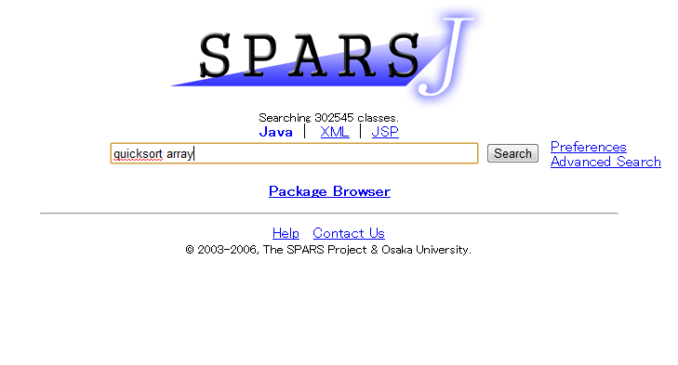
SPARS-J Portal

Slide 32
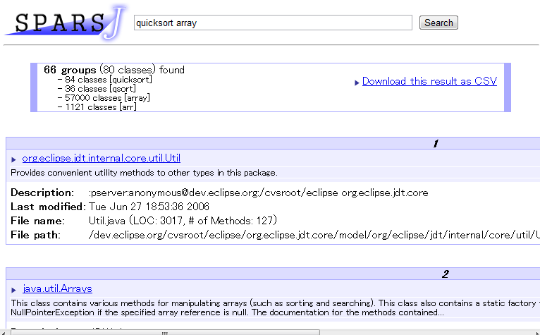
A Search Result

Slide 33
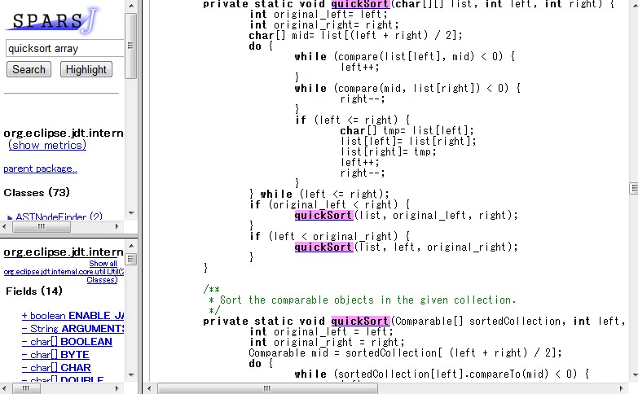
Displaying Source

Slide 34
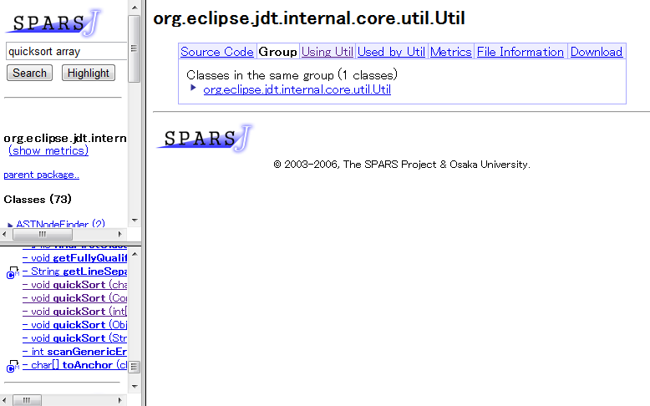
Similar Component Group

Slide 35
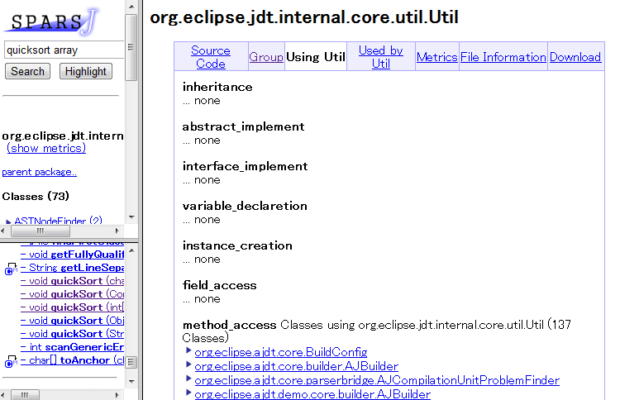
Callers

Slide 36
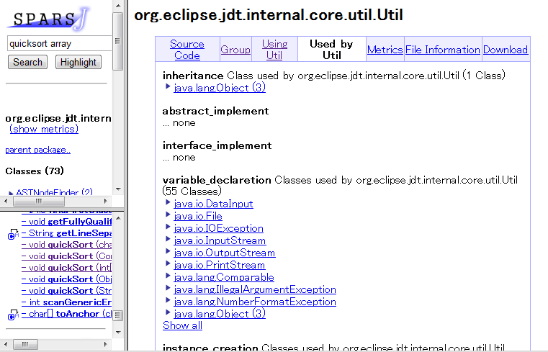
Callees

Slide 37
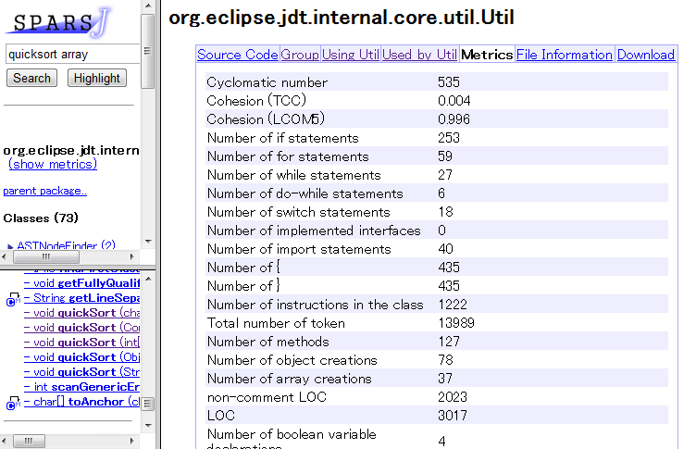
Metrics

Slide 38
Use Cases of SPARS-J
Source code management in a project
See code developed by others
See older versions
Source code management through related projects
Component dependency can be seen
Reusability and newly-developed code are identified
Source code management of overall organization
Components actually used and not used are identified
Overall asset in the organization can be seen

Slide 39
Applications
Asset management of Lab
OSS management (300,000 classes)
Java framework management of a software developer
The organizational Java class asset management of a Japanese food major company

Slide 40
Software License Identification

Slide 41
Software License
Permissions of use, and requirements and conditions to get such permission
Software license identification
Finding corresponding license statements from a known licenses database
Needed for reusing a component (class, method and so on)
If the license is not compatible with the license of the application, we cannot reuse it.
Notes:
(Importance of software identification)
One way to protect intellectual property of Free Open Source Software is software license
A software license grants permissions of use, and describes the requirements and conditions to get such permission.
Software license identification is the process of Finding corresponding license statements from a known licenses database.
This is needed, for example, to reuse a component.
If the license is not compatible with the license of the application, we cannot reuse it.

Slide 42
Challenges
Finding license statement
(F1) License statements are usually mixed with other text
(F2) Files might reference other file where the license is located
(F3) Files might contain multiple licenses
Language related
(L1) License statements contain spelling errors
(L2) A license is can be represented in different ways
(L3) Licensors change the spelling/grammar of the license statement
License customization
(C1) Several licenses must be customized when used
(C2) Licensors modify, add or remove conditions to well known licenses
(C3) Licensors modify licenses for various intents
Notes:
There are challenges for license identification.
To identify them, We have inspected some large scale FOSS and OSI approved licenses.
The result shows that challenges classified into three categories.
Finding license statement, Language related, License customization.
Each category has three challenges, so we identified 9 challenges.
In the following slides, we explain about these three categories.

Slide 43
Finding License Statement
The first comments of a file contain text that is not part of the license statement
/*
* This file includes utility functions
…
* Copyright (C) 2010 foo
*
* This program is free software: you can redistribute ...
…
* change log:
* v2.1 Bug fix
…
*/
Description of file
License statement
Change log
Notes:
One of the challenge in "finding license" is that license statements are usually mixed with other text.
Often the first comments in a source file contain text that is not part of the license statement, for example the description of the file contents, the change log, ... As you can see in this an example
Extracting only text relative to the license can be not trivial.

Slide 44
Language Related Issues
The licensors might change the spelling/grammar of the license statement
Example
"license" → "licence"
"it would be useful" → "it will be useful"
Notes:
One of the challenges in "language related" is that the licensors might change the spelling/grammar of the license statement, introduce typos, change punctuation, etc.
For example,
"license" is replaced with "licence",
"it would be useful" is replaced with "it will be useful“
And so on

Slide 45
License Customization
Licensors modify, add or remove conditions to well-known licenses to create a new license
Example
MIT/X11 license
"Permission to use, copy, modify, distribute and sell this software ..."
→ "Permission to use, copy, modify and distribute this software ..."
Notes:
One of the challenges in "license customization" is the licensors might also modify, add or remove conditions to well-known licenses and create a new license.
For example,
In the MIT/X11 license, the sentence "Permission to use, copy, modify, distribute and sell this software ...” are used.
However, someone omits the words “and sell".

Slide 46
Multi-Knowledgebase Approach for License Identification
Legend
source file
Knowledge Base
Process
Data
1. License Stmt. Extraction
equiv. phrases
(12)
2. Text Segmentation
3. Text normalization
filtering keywords
(82)
4. Sentence Filtering
5. Sentence Token Matching
sentence-token expressions
(427)
6. License Rule Matching
rules
(126 for 112 license)
license name
Notes:
(Structure of our approach)
We propose a sentence-based license identification approach.
This figure represent the structure of our approach.
Our approach use a source file as input and output a license corresponding to it.
This approach is composed of six steps and four knowledge bases.
These knowledge bases are: equivalent phrases, filtering keywords, sentence-token expressions, and rules.
They were created from a FOSS corpus of about 30000 files
I’ll proceed to illustrate each step.

Slide 47
1 License statement extraction
/*
* Copyright (c) 2001 foo foo@bar.org All rights reserved.
*
* Redistribution and use in source and binary forms, with or without
* modification, are permitted provided that the following conditions * are met: * 1. Redistributions of source code must retain the above copyright ...
* 2. Redistributions in binary form must reproduce the above copyright ... * * THIS SOFTWARE IS PROVIDED BY THE AUTHOR AND CONTRIBUTORS ...
* IN NO EVENT SHALL THE AUTHOR OR CONTRIBUTORS ...
*/
/*
* Copyright (c) 2001 foo foo@bar.org All rights reserved.
*
* Redistribution and use in source and binary forms, with or without
* modification, are permitted provided that the following conditions * are met: * 1. Redistributions of source code must retain the above copyright ...
* 2. Redistributions in binary form must reproduce the above copyright ... * * THIS SOFTWARE IS PROVIDED BY THE AUTHOR AND CONTRIBUTORS ...
* IN NO EVENT SHALL THE AUTHOR OR CONTRIBUTORS ...
*/
#include <sys/cdefs.h> #include <sys/types.h> #include <sys/types.h>
…
The comments at header
↓
License statement
Notes:
"License statement extraction" step extract license statement in a source file.
In our approach, we regard the comments at header as license statement.
For example. in this case, this comment are extracted.
(どのように各プロセスでデータが変化していくかを示しながら，各プロセスで何をするかを説明する）

Slide 48
2 Text segmentation
/*
* Copyright (c) 2001 foo foo@bar.org All rights reserved.
*
* Redistribution and use in source and binary forms, with or without
* modification, are permitted provided that the following conditions * are met: * 1. Redistributions of source code must retain the above copyright ...
* 2. Redistributions in binary form must reproduce the above copyright ... * * THIS SOFTWARE IS PROVIDED BY THE AUTHOR AND CONTRIBUTORS ...
* IN NO EVENT SHALL THE AUTHOR OR CONTRIBUTORS ...
*/
[Copyright (c) 2001 foo foo@bar.org All rights reserved. ]
[Redistribution and use in source and binary forms, with or without modification, are permitted provided that the following conditions are met:]
[1.]
[Redistributions of source code must retain the above copyright notice...]
[2.]
[Redistributions in binary form must reproduce the above copyright ...]
[THIS SOFTWARE IS PROVIDED BY THE AUTHOR AND CONTRIBUTORS
"AS IS"...]
[IN NO EVENT SHALL THE AUTHOR OR CONTRIBUTORS ...]
Split with an implementation based on [3] with some heuristics
[3] P. Claugh. A Perl program for sentence splitting using rules. http://ir.shef.ac.uk/cloughie/software.html, April 2001.
Notes:
“Text segmentation” splits the license statements into sentences.
In this step, Our approach split the license statement with an implementation based on [3] with some heuristics.
This implementation recognize sentences like this and split into sentences.
([3]を基にした．各行の先頭で使われるコメント

Slide 49
3 Text normalization
[Copyright (c) 2001 foo foo@bar.org All rights reserved. ]
[Redistribution and use in source and binary forms, with or without modification, are permitted provided that the following conditions are met:] [1.]
[Redistributions of source code must retain the above copyright notice...] [2.]
[Redistributions in binary form must reproduce the above copyright ...]
[THIS SOFTWARE IS PROVIDED BY THE AUTHOR AND CONTRIBUTORS
"AS IS"...]
[IN NO EVENT SHALL THE AUTHOR OR CONTRIBUTORS ...]
[Copyright (c) 2001 foo foo@bar.org All rights reserved. ]
[Redistribution and use in source and binary forms, with or without modification, are permitted provided that the following conditions are met<colon>] [1.]
[Redistributions of source code must retain the above copyright notice...] [2.]
[Redistributions in binary form must reproduce the above copyright ...]
[THIS SOFTWARE IS PROVIDED BY THE AUTHOR AND CONTRIBUTORS
<quotes>AS IS<quotes>...]
[IN NO EVENT SHALL THE AUTHOR OR CONTRIBUTORS ...]
Convert " to <quotes>
Equivalent Phrases
phrases which should be regarded as having the same meaning.
' , " ,` → <quotes>
: → <colon>
Notes:
(equivalent phraseの説明)
"Text normalization" convert any special symbol to a keyword with Equivalent Phrases.
Equivalent phrases are phrases which should be regarded as having the same meaning.
For example, the double quotation character is converted into <quotes>.

Slide 50
4 Sentence Filtering
[Copyright (c) 2001 foo foo@bar.org All rights reserved. ]
[Redistribution and use in source and binary forms, with or without modification, are permitted provided that the following conditions are met<colon>] [1.]
[Redistributions of source code must retain the above copyright notice...] [2.]
[Redistributions in binary form must reproduce the above copyright ...]
[THIS SOFTWARE IS PROVIDED BY THE AUTHOR AND CONTRIBUTORS
<quotes>AS IS<quotes>...]
[IN NO EVENT SHALL THE AUTHOR OR CONTRIBUTORS ...]
[Copyright (c) 2001 foo foo@bar.org All rights reserved. ]
[Redistribution and use in source and binary forms, with or without modification, are permitted provided that the following conditions are met<colon>] [1.]
[Redistributions of source code must retain the above copyright notice...] [2.]
[Redistributions in binary form must reproduce the above copyright ...]
[THIS SOFTWARE IS PROVIDED BY THE AUTHOR AND CONTRIBUTORS
<quotes>AS IS<quotes>...]
[IN NO EVENT SHALL THE AUTHOR OR CONTRIBUTORS ... DAMAGES ...]
[Copyright (c) 2001 foo foo@bar.org All rights reserved. ]
[Redistribution and use in source and binary forms, with or without modification, are permitted provided that the following conditions are met<colon>] [1.]
[Redistributions of source code must retain the above copyright notice...] [2.]
[Redistributions in binary form must reproduce the above copyright ...]
[THIS SOFTWARE IS PROVIDED BY THE AUTHOR AND CONTRIBUTORS
<quotes>AS IS<quotes>...]
[IN NO EVENT SHALL THE AUTHOR OR CONTRIBUTORS ...DAMAGES…]
Removing sentences not related to licenses
Filtering Keyword
If no sentences left → "NONE"
all rights, conditions, distributions, reproduce, damages, as is
License-related Keywords
Notes:
"Sentence filtering" removes sentences not related to a license
Sentences not containing any “Filtering keywords” are removed
The "Filtering keywords" are words often included in license’s sentences
For example, “all rights”, “conditions”, are filtering keywords.
These keywords are in these sentences.
Sentence "1." and "2." does not include any filtering keyword so they are removed.
After this step, if no sentence left, our approach reports "NONE“.
A1 License statements are usually mixed with other text
キーワードの説明
(この時点で文が残らなかったらNONE)
If no sentence exist after this process, Ninka report NONE.

Slide 51
5 Sentence Token Matching
[AllRights]
[BSDPre] [BSDcondSource] [BSDcondBinary]
[BSDasIs]
[BSDWarr]
[Copyright (c) 2001 foo foo@bar.org All rights reserved. ]
[Redistribution and use in source and binary forms, with or without modification, are permitted provided that the following conditions are met<colon>]
[Redistributions of source code must retain the above copyright notice...]
[Redistributions in binary form must reproduce the above copyright ...]
[THIS SOFTWARE IS PROVIDED BY THE AUTHOR AND CONTRIBUTORS
<quotes>AS IS<quotes>...]
[IN NO EVENT SHALL THE AUTHOR OR CONTRIBUTORS ...]
BSDcondSource
Matching
Sentence-token expressions
BSDcondSource:Redistributions? of source code must retain the (above )?copyright notice, this list of conditions(,)? and the following disclaimer(, without modification)?: …
Notes:
“Sentence token matching” converts a sentence to a tokens based on sentence-token expressions.
A sentence token expression consists of a sentence token and a regular expression pattern.
For example, the third sentence matches the "BSDcondSource" sentence-token expression, so, this sentence is converted to "BSDcondSource".
In the same way, these sentences is converted like this.
A2 Files might reference another file where might contain multiple
(テキストの
B1 Licensing statements contain spelling errors
B3 Licensors change the spelling / grammar of the license statement
C1 Several license must be customized when used
このステップと次のステップを通してmatchingが取れなかったらUNKNOWN

Slide 52
6 License Rule Matching
[AllRights][BSDPre][BSDcondSource][BSDcondBinary][BSDasIs][BSDWarr]
BSD2 (BSD 2-clauses license)
Matching
If no rule matches → "UNKNOWN"
Rule
BSD2：BSDPre, BSDcondSource, BSDcondBinary, BSDasIs, BSDWarr
Rules representing the relations between license name and a sequence of sentence tokens
Notes:
“License Rule matching” converts sentence-tokens into license name using license rules.
A license rule represents the relations between a license name and a sequence of sentence tokens.
Our approach matches a sequence of sentence tokens against rules and convert them into a license name corresponding to the rule can match it.
For example, this sequence of sentence tokens match BSD2 rule.
So, these sentence tokens is converted to "BSD2".
If no rule matches this sequence of sentence tokens, Our approach report "UNKNOWN".
A3 Files might contain multiple licenses
B2 A given license is referred in different ways
C2 Licensors modify, add or remove conditions
C3 Licensors modify licenses for various intents
If there is no rule matching with the seaquence of sentence tokens, Ninka report UNKNOWN.

Slide 53
Ninka
Automatically license identification tool
Reporting license name (112 licenses)
BSD4(BSD 4-clause license)
BSD3(BSD 3-clause license)
BSD2(BSD 3-clause license)
GPLv2+(GNU Public License version2 or later)
LibraryGPLv2+
...
Notes:
To identify a license of a source file automatically, we developed Ninka, an automatic license identification tool.
This tool use source files as input and report a license name corresponding to the license of the source file.
Ninka identify licenses of a source file from the comments of it using knowledge base.
Ninka recognizes 112 licenses.
For example, BSD3 license (BSD 3-caluse license), GPLv2 (GNU Public license Version2 or later)
This tool has 96.6% precision.
About the detail of Ninka, we will report on Friday in ASE 2010.

Slide 54
Analysis Result of Debian
 | Ninka | FOSSology | ohcount | OSLC
Recall [%] | 82.8 | 99.6 | 100 | 100
Precision [%] | 96.6 | 55.0 | 33.2 | 29.5
F-measure | 0.891 | 0.709 | 0.498 | 0.371
Execution Time [s] | 22 | 923 | 27 | 372
Ninka has the highest precision and faster execution time
Notes:
(Ninka has highest precision and does it efficiently)
This table shows the result.
Best score are in the bold typeface
The results show that ninka has the highest precision and faster execution time
(Recallの定義を回答率と同じにする）
(ohcount, OSLCのRecall 100%）

Slide 55
What Licenses Are Used in Debian?
NONE is the most popular
GPLv2+ is second most used license
License | Files | Percent
NONE | 210147 | 31.5%
GPLv2+ | 147535 | 22.1%
LesserGPLv2.1+ | 42692 | 6.4%
CDDLv1orGPLv2 | 37623 | 5.6%
SeeFile | 31685 | 4.7%
......
Notes:
(Result of sub question "What licenses are used in Debian?")
So, "What licenses are used in Debian?“
This table shows the number of files under each license.
This tables shows that NONE is most popular and GPLv2+ is second most used license.

Slide 56
Do Different Programming Languages Use Different Licenses?
Examine the number of files written in each programming language (Java, C, C++, Perl ) under each license
Java
License | Files | Percent | Apps
CDDLv1orGPLv2 | 37562 | 25.43% | 2
NONE | 25371 | 17.17% | 344
LesserGPLv2.1+ | 22834 | 15.46% | 61
Few application but many files
...
Perl
License | Files | Percent | Apps
NONE | 18227 | 31.63% | 999
GPLv2 | 3979 | 24.40% | 1171
SameAsPerl | 2651 | 8.10% | 15
SameAsPerl
Indirect license
Notes:
(Result of sub question "Do different programming languages use different licenses?")
To answer the question "Do different programming languages use different licenses?” we examined the number of files written in each programming language under each license.
due to time constraints, we show the results on only Java and Perl.
In case of Java, the Most frequent used license was CCDDLv1orGPLv2. This license is used in only few applications but these applications have many files.
Finally, In case of Perl, “SameAsPerl” is frequent used license.
"SameAsPerl" means the same license as Perl.
This license is different from other license in that this license is an indirect license.
(In case of C, GPLv2, Lesser GPLv2.1+ related to Free Software Foundation is most frequent used license.
In case of C++, GPLv2 or LGPLv2 or MPLv1.1 is most frequent used license because of Mozilla.)

Slide 57
When Present, What Types of Errors Do License Statements Have?
Observe several potential problems in the licensing of various applications that we analyzed
Found problems
Files without a license
Cutting & pasting the wrong license statement
Inconsistent license clauses
Incorrect name of the license
Notes:
(Research Question 2, We found some problem in some FOSS with Ninka.)
For addressing research question 2 "When present, what types of errors do license statements have? “
We observed several potential problems in the licensing of various applications that we analyzed.
As a result, we found the following problems, Files without a license, Cutting & pasting the wrong license statement, Inconsistent license clauses, Incorrect name of the license, license statements can only be edited by their copyright owners

Slide 58
Evolution of Licenses
Software licenses are adapted to environment
Software licenses evolves because of
author's requirement
user's demand
external pressure
No detail of the evolution characteristics was analyzed
Notes:
Software licenses are adapt to environment.
Software licenses evolves because of author's requirement, user's demand and external pressure.
This work only analyzed first and last versions. And no detail of evolution characteristics was analyzed

Slide 59
FreeBSD (all)
Decreased BSD4
Increased BSD2 and BSD3
Notes:
This graph shows the number of files under each license in each releases of FreeBSD (all).
The X-axis is the release version. The Y-axis is the number of files in the release version.
Each layer corresponds to each license.
Red means BSD4, BSD4-clauses license. BSD4 is original of BSD license.
Blue mean BSD3. BSD3 is BSD4 minus advertisement clause.
Green mean BSD2. BSD2 is BSD3 minus endorsement clause
Black mean Others. Others are the licenses except licenses under which the number of file reaches in top 5.
Gray mean NONE. NONE is files contain no license related sentences..
Pale Orange mean UNKNOWN. UNKNOWN is files which no rules match.
This graph shows that the number of files under the BSD4-clauses license decreased. On the other hand, the number of BSD2-clauses and BSD3-clauses licesned file increased.
This change relaxed the conditions of license because advertisement clause was deleted.
（下側にあるBSD４などがライセンスの名前を表しているということが説明されていない）
（Others，NONE，UNKNOWNの説明をここでやる）
Others は ファイル数上位５つのライセンス以外のライセンスをまとめたグループ
NONEは ライセンスに関連がある文が存在しなかった場合
UNKNOWNは ライセンスに関連がある文はあったが，マッチするルールがない場合
（ライセンスが緩くなるほうに変化した）
宣伝条項の削除
（下の層からライセンス名とどういうライセンスかを順に説明する）

Slide 60
FreeBSD (all)
v5.2.1 - v5.3
531 files under BSD4 were moved to other license BSD2 or BSD3.
Notes:
This graph shows the difference of the number of files under each license between nearby two versions of FreeBSD (all).
X-axis is the release version.
Y-axis is the the difference of the number of files between nearby two versions.
Each line corresponds to each license.
We can see from this graph that there are large shifts of license in some successive two release versions.
Especially, between 5.2.1 to 5.3, 531 files under BSD4 were moved to other license BSD2 or BSD3.
（グラフの説明が分かりにくい）

Slide 61
FreeBSD (kernel)
Decreased BSD4
Increased BSD2 and BSD3
Notes:
This is the analysis result of FreeBSD (kernel).
As well as FreeBSD (all), we can also see from this that the number of BSD4 files increased and the number of BSD2 and BSD3 file increased.
However, Only one of major changes detected in FreeBSD (all) is detected

Slide 62
OpenBSD (all)
Decreased BSD4
Increased BSD2 and BSD3
Notes:
This is the analysis result of OpenBSD (all).
We can see that OpenBSD (all) also decreased the number of BSD4 files and increased the number of BSD2 files and BSD3 files.

Slide 63
Eclipse
CPLv0.5→CPLv1.0
CPLv1.0→EPLv1.0
Notes:
This is the analysis result of Eclipse.
We can see from this graph that a few licenses cover almost all files.
Most commonly used license transited from CPLv0.5 to CPLv1.0, then to EPLv1.0.
In addition, the change is more drastically than that of BSD systems.
This change relaxed the condition of license because patent clause was deleted.
(少数のライセンスがほぼ全部を支配している）
（緩くなる変化）
特許条項の削除

Slide 64
ArgoUML
UNKNOWN(BSD-like license) →EPLv1.0
Notes:
This is the analysis result of ArgoUML.
In this case, Ninka can't identify most of files in the current knowledge base.
The reason is that Ninka have no rule corresponding to the license.
We examined these files manually and recognized that those are BSD-like license.
So, we conclude that most commonly used license transited drastically from BSD-like license to EPLv1.0.
This change tighten the condition of license because EPLv1.0 has constraints on a license of the source file created from a source file under EPLv1.0, on the other hand, BSD license doesn't have it.
（ライセンスが厳しくなるほうに変化した）

Slide 65
Findings
There are large shifts of license in FreeBSD (all) and OpenBSD (all)
ArgoUML and Eclipse also have similar large shifts
Sometimes those licenses are more drastically changed to others than FreeBSD (all) and OpenBSD (all)
A few licenses cover almost all files in those systems
The kernel of FreeBSD and OpenBSD also have large shifts
Notes:
Through these experiments we found these findings.
Firstly, There are large shifts of license in FreeBSD (all) and OpenBSD (all)
Secondly, ArgoUML and Eclipse also have similar large shifts.
However, sometimes those licenses are more drastically changed to others than FreeBSD (all) and OpenBSD (all)
and a few licenses cover almost all files in those systems
Finally, the kernel of FreeBSD and OpenBSD also have large shifts.

Slide 66
Conclusions

Slide 67
Summary
Searching software components
Component-Rank model
SPARS-J
Software license identification
Multi-knowledgebase approach
Ninka

Slide 68
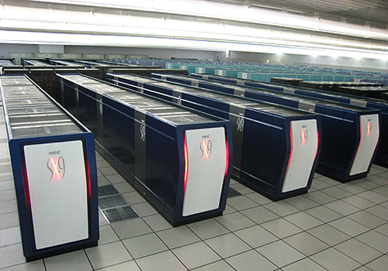
Computation Intensive Software Engineering
CISE
Methods and technologies which efficiently produce quality software using
High performance computation environment
Huge amount of empirical data collection
Comprehensive network with various data

Slide 69
Classifying Software Engineering
Main target of CISE
Ordinary SE tools and environment

Slide 70
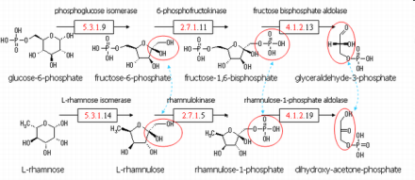
Idea behind CISE
Ordinary SE does not fully utilize cutting-edge computational power, network performance, data collection, ...
Success of computation intensive approaches in other fields, e.g., Web mining, bioinformatics, ...
Leading examples of CISE
Search-based software engineering
Mining software repositories
Large code-clone analysis
Internet-scale code search
License usage evolution

Slide 71
Conclusions
Use of Open Source Systems is still growing
Total management for the OSS assets using CISE concept is strongly expected
Our approach, SPARS-J and Ninka, would be initial steps for such total management

Slide 72
Resources
Papers
Katsuro Inoue, Reishi Yokomori, Tetsuo Yamamoto, Makoto Matsushita, Shinji Kusumoto: "Ranking Significance of Software Components Based on Use Relations", IEEE Transactions on Software Engineering, Vol.31, No.3, pp.213-225, 2005.
T. Kamiya, S. Kusumoto, and K. Inoue, CCFinder: A multi-linguistic token-based code clone detection system for large scale source code, IEEE Transactions on Software Engineering, vol. 28, no. 7, pp. 654-670, Jul. 2002.
Yuki Manabe, Yasuhiro Hayase, Katsuro Inoue: "Evolutional Analysis of Licenses in FOSS", Proceedings of the Joint ERCIM Workshop on Software Evolution (EVOL) and International Workshop on Principles of Software Evolution (IWPSE), 2010-9.
Daniel M. German, Yuki Manabe, Katsuro Inoue: "A Sentence-Matching Method for Automatic License Identification of Source Code Files", In Proceedings of the IEEE/ACM international Conference on Automated Software Engineering, 2010-9.
WEB
SPARS
http://www.spars.info/
CCFinderX http://www.ccfinder.net/ccfinderxos-j.html
CCFinder http://sel.ics.es.osaka-u.ac.jp/cdtools/index.html

Slide 73
Thank You!

Slide 76
Pseudo Use Relation
A
B
C
Add pseudo edges to get always convergence
Connect from each node to each non-connected node
Notes:
To adapt this model to practical software component environment, we do the following two adjustment.

Slide 77
Prototyping Component Rank System
inheritance
method call
attribute access
abstract class impl.
input
similarity measure
by SMMT
use relation
extraction
.java file =
component
similarity criterion t:
sharing 80% statements
clustering
clustered graph
construction
weight ratio p between real and pseudo edges : 0.85
output
de-clustering to
original graph
node weight
computation
component-rank pairs
equal distribution ratio d to outgoing edges
Notes:
Implementation of the model == Mapping to real world

Slide 78
Experiment 2: Collection of SE Tools and Libraries
CK metrics measurement tools, component rank system
ANTLR, JAMA, Caffe Cappuccino
582 components
rank
class name
weight
1 antlr.Token 0.10727
2 antlr.debug.Event 0.06189
2 antlr.debug.NewLineEvent 0.06189
4 antlr.collections.impl.Vector 0.05434
5 jp.gr.java_conf.keisuken.text.html.HtmlParameter 0.05246
6 jp.gr.java_conf.keisuken.net.server.ServerProperties 0.03699
7 Jama.Matrix 0.01564
8 jp.gr.java_conf.keisuken.util.IntegerArray 0.01390
8 jp.gr.java_conf.keisuken.util.LongArray 0.01390
10 jp.ac.osaka_u.es.ics.iip_lab.metrics.parser.IdentifierInfo 0.01365
... ...
418 cktool_new.examples.Main 0.00050

Slide 79
Experiment 4: Document Processing Tools and Libraries
JEDIT, jext, Enhydra, saxon, phex, JDK, etc. (7171 components)
Search getNodetype by grep
1(67) enhydra3.1 ... dom.Node 0.029110
2(169) saxon7_0 ... saxon.om.NodeInfo 0.000969
3(275) saxon7_0 ... saxon.pattern.NodeTest 0.000437
4(316) enhydra3.1 ... dom.DocumentImpl 0.000368
5(355) saxon7_0 ... saxon.pattern.Pattern 0.000324
6(382) saxon7_0 ... saxon.Controller 0.000296
7(437) enhydra3.1 ... xslt.XSLTEngineImpl 0.000241
8(446) enhydra3.1 ... dom.ElementImpl 0.000235
9(500) saxon7_0 ... saxon.style.StyleElement 0.000202
10(506) saxon7_0 ... saxon.tree.NodeImpl 0.000198
... ...
125(4441) enhydra3.1 ... FuncID 0.000029
... ...
125(4441)
Notes:
GetNodetype is a method to obtain the kind of node in the DOM tree.
The first two classes contain the definition of such method.
Highly ranked classes are for generic operations and data definitions.
Lower ranks are for more specific and non-general purposes.

Slide 80
Discussion 1: Weight Computation
Reference Count Model
Component Rank Model
0.2
B
0.31
B
0.6
A
0.33
A
E
D
C
E
D
C
0
0
0.2
0.03
0.03
0.30
Notes:
Now, we discuss on this component rank model.
Instead of using our model, we may want to use simpler model, such as
reference count model.
The weight is simply the number of incoming edges.

Slide 81
Discussion 2: Clustering Policy (1)
Simply duplicated components are eliminated
0.25
0.25
A
A
X
A
X
B
B
Y
Clustering
B
Y
original
copy
others
0.25
0.25

Slide 82
Discussion 2: Clustering Policy (2)
Reused components in different environments are counted
0.3
0.2
A
A
X
A
X
B
C
Y
Clustering
B
C
Y
original
modified
others
0.15
0.15
0.2

Slide 83
Discussion 3: Similarity Criterion and Pseudo Use Relation
Resulting ranks are fairly insensitive to the similarity criterion t
Some distinct components are in the same cluster if less than 0.8
Various pseudo use relation ratios p have been investigated
Resulting ranks are stable between
0.75 - 0.95

Slide 84
Features of SPARS-J (Registration)
One class file in Java (*.java)= Component
Dependence relations: Inheritance, interface, caller, refer, ...
Extraction of keywords in the class file
Indexing using Berkeley DB

Slide 85
Features of SPARS-J (Search)
Keyword search/ Package-tree browsing
Displaying source, caller/callee list (class/method), various metrics
Search with constraints
Display the top-ranked components by the component rank and TF-IDF rank
Clustering by source-code similarity
English/Japanese

Slide 86
Related Works
ASLA[21], OSLC, ohcount
Matching regular expression pattern corresponding to a license against license statements
FOSSology[11]
Matching simple string corresponding to a license against license statements with the bSAM argorithm
Not precise enough
Does not report whether any license exists or not when the tool can't identify the license
False positives
Slow execution time
Notes:
(Related work)
Existing license identification approach are classified into two groups.
ALSA, OSLC and ohcount match regular expression pattern corresponding to a license against license statements.
On the other hand, FOSSology match simple string corresponding to a license against license statements with the bSAM argorithm.
We think that these tools have 4 problem.
These tools are not precise enough
These tools don't report whether any license exists or not when the tool can't identify the license. These tools report false positives
Some tools are slow.

Slide 87
Evaluation of License Identification
Goal: To show if our approach is better than other methods
Tools
Ninka (implementation of proposed approach), FOSSology 1.0.0, ohcount version 3.90rc, OSLC 3.0
Target systems
Source files: 250 files in Debian 5.0.2
Randomly select 250 packages in Debian 5.0.2
For each selected packages, randomly select 1 file in each package in them
Notes:
We have conducted evaluation to show if our method is better than other methods.
We used Ninka, an implementation of our approach, FOSSology 1.0.0, ohcount version 3.90rc and OSLC3.0.
We analyzed 250 (two-fifty files) files in Debian 5.0.2 with these tools.
We randomly selected these 250 files by the following approach.
At first, we randomly selected 250 packages in Debian 5.0.2.
Then, for each selected packages, we randomly selected 1 file in each package in them

Slide 88
Method
Compare the results from each tool to the results obtained by manual inspection
Result category
C: Correct license name and version
I: Incorrect
U: Unknown
Measured values
Recall
Precision
F-measure
Execution Time
Notes:
(Explanation of terms used in this evaluation)
We Compare the results from each tool to the results obtained by manual inspection.
These results are classified into three category, Correct license name and version, Incorrect, and Unknown.
When the result by tool is "UNKNOWN", the result are classified into "UNKNOWN"
When the result by manual inspection "NONE", if the result by tool is "NONE", the result are classified into "C".
To evaluate performance of each tool, we use four values, Recall, Precision, F-measure, and Execution Time.

Slide 89
Research Questions
Goal: To demonstrate usefulness of Ninka
RQ1: What are the licenses used in FOSS?
RQ2: When present, what types of error do license statements have?
Notes:
(Empirical study for demonstrating usefulness of Ninka)
We had two research questions,
“What are the licenses used in FOSS?”
“When present, what types of error do license statements have?”

Slide 90
RQ1: What Are the Licenses Used in FOSS?
Sub questions
What licenses are used in Debian?
Do different programming languages use different licenses?
Does size matter?
Target: source code of Debian 5.0.2
794622 files from 11101 applications analyzed
Ninka could not identify license of 15.9% of source files (reported "UNKNOWN")
Notes:
(Research Question1. We split this question to three sub question)
We divided the first research question into three sub questions,
"What licenses are used in Debian?"
"Do different programming languages use different licenses?“ and "Does size matter?"
In this empirical study, we used the source code of Debian 5.0.2 as a target, and analyzed 794622 files (0.8 million files) from 11101 (eleven-thousand) applications.
In this analysis, Ninka could not identify the license of 15.9% of the source files.
In these cases Ninka reported "UNKNOWN".

Slide 91
Does Size Matter?
Examine median of the file size in case of with license and without license
Are smaller files more likely not to have a license?
→Are there difference in the size of files between with license and without license?
A Mann-Whitney test confirms that these difference are significant (p<0.0001)
 | overall | with license | without license | license statement
Median(bytes) | 4633 | 5488 | 2137 | 1005
Notes:
(Result of sub question "Does size matter?".)
For addressing the third sub question "Does size matter?” we examined median of the file size in case of with license, without license.
We were interested in "Are smaller files more likely not to have a license?” In other words, are there differences in the size of files with license and without license.
This table shows the median of file size , in case of overall, with license, without license and license statement.
A Mann-Whitney test confirms that these differences are significant.

Slide 92
Experiments
Examine the number of files under each license at each release version in FreeBSD (all), OpenBSD (all), Eclipse and ArgoUML
Analyze the difference of licensed file number across different versions in FreeBSD(all) and OpenBSD(all)
Examine the difference in evolution patterns of OS all and OS kernel
Notes:
In this study, we measured the following three values.
Firstly, we examined the number of files under each license at each release version in FreeBSD (all), OpenBSD (all), Eclipse and ArgoUML
Secondary, we measured the difference of the number of files under each license between each release version and the previous version between FreeBSD (all) and OpenBSD (all)
Finally, we examined the difference in evolution patterns of OS all and OS kernel
(何と何を比較しているか）

Slide 93
Analysis Targets
 | FreeBSD (all) | FreeBSD (kernel) | OpenBSD (all) | OpenBSD (kernel) | Eclipse | ArgoUML
Type | OS kernel, applications | OS kernel | OS kernel, applications | OS kernel | SDE platform | UML Design Tools
Release Version | 2.2-8.0 |  | 2.0-4.7 |  | 2.0- 3.5.2 | 0.8.1- 0.31.1
Release Date | 1994/11- 2009/11 |  | 1996/10- 2010/5 |  | 2002/6- 2009/9 | 2000/10- 2010/6
# release | 28 |  | 45 |  | 25 | 79
#Files (oldest-latest) | 4412- 21266 | 627- 3490 | 6245- 14181 | 987- 3314 | 11419-35880 | 686- 2208
Version Control System | CVS |  | CVS |  | CVS | Subversion
Notes:
This table shows the detail of analysis targets.
We used FreeBSD and OpenBSD, Eclipse and ArgoUML.
About FreeBSD and OpenBSD, We use two version (all) and (kernel).
For example, FreeBSD (all) include kernel and applications.
On the other hand, FreeBSD(kernel) include only kernel.
They have been developing for a long term.
For example, FreeBSD have been developing for over 15 years.
And, in development of them, Version control system is used.

